Slide 1
A College Student's Guide to Driving in Kentucky

Slide 2
401 College Heights Blvd.
Cherry Hall, Room 321 Bowling Green, Kentucky 42101
Phone: 270-745-4668
Email- wkusls@wku.edu

Slide 3
The information herein is not intended as a substitute for legal advice. If you have a specific question you are encouraged to seek assistance from the WKU SLEC Office or a licensed attorney.

Slide 4
How do I obtain a KY Driver's Permit?
First, you will need to schedule the written exam with Kentucky State Police. Visit their website for scheduling: http://kentuckystatepolice.org/driver-testing/
Go to the Regional Driver’s Licensing Office that services the county in which you live. You will need your Social Security Card, Birth Certificate, and Proof of Address confirming you reside within the county. If you are under 18 you will need a parent or guardian with you.
You must have the driving permit for a period of 180 days. During this time, you can drive only with a licensed driver who is 21 years and older.
You must pass a vision test and the written test about driving rules, regulations, procedures, and highway signs. (Tests are available in many languages). To study for this test review the KY driver’s manual: http://driving-tests.org/kentucky/kentucky-drivers-handbook-online/.

Slide 5
How do I get a KY Driver's License?
You must schedule your road test with Kentucky State Police. The road test date must be 180 days after you received your permit. Visit KSP's website for scheduling: http://kentuckystatepolice.org/driver-testing/
You must drive to the testing site with a licensed driver 21 and over.
You must provide the vehicle for the test and provide proof of insurance and registration for that vehicle.
After passing the road skills test, you will get in line with the Regional office to apply for your license credential. You will be issued a temporary permit printed on paper to use until the credential arrives in the mail. *If your current address differs from what is listed on your permit, make sure to bring a valid proof of residency with you (2 for a REAL ID).

Slide 6
What if I Have a License from My Home State or Country?
Full-time students enrolled in school or college with a valid license from another state DO NOT need to obtain a KY Driver’s License.
International students who have a driver’s license from their native country are permitted to drive for one year from their date of entry to the US. After one year they must obtain a Kentucky Driver’s License and begin at the permit phase.

Slide 7
What is a traffic stop?
A traffic stop, or more commonly known as "being pulled over" is when a law enforcement officer stops a vehicle for a possible traffic violation. The officer will turn on their sirens and lights while behind you on the road. This indicates they are stopping you, and you must pull over to the side of the road as soon as safely possible. Here are some reasons an officer may pull you over:
Reckless driving
Speeding
Officer suspects you may be under the influence
Headlights/brake lights are not properly functioning
Lack of a license plate/plate is not visible
Using a cell phone while operating the vehicle
Failure to wear seatbelt

Slide 8
What does a traffic stop look like?
Once you have safely pulled over onto the side of the road, the officer will approach the vehicle. You should roll down your window to speak to them. They will inform you of why they pulled you over, and ask to see your license, registration for the vehicle, and insurance policy for the vehicle. They will take that information back to their vehicle where they will run it on their computer to check for any possible warrants or stolen vehicles. After this the officer will return, give you your documents back, and either inform you that this is a warning and to not commit the violation again or they will issue you a citation, also known as a ticket.

Slide 9
What kind of citations could I receive during a traffic stop?
Distracted driving example texting while driving
Ignoring a red light signal
Speeding
Failure to yield the right-of-way
Improper parking
Tailgating
Going with an expired license
Driving in the wrong lane
Changing drivers in a moving vehicle
Driving without an insurance
Reckless driving
Assault at another vehicle user
Refusing to stop at the scene of an accident (Hit and Run)
The presence of an open container of alcohol in the vehicle.
Driving with a revoked license
Leaving the scene of an accident
Driving while intoxicated

Slide 10
What happens if I get a ticket?
The citation will list what violation/s you have been accused of, as well as the fines associated with that violation if there are any and a court date if necessary. Depending on the type of violation you may have to attend a court date, but it is most common for traffic violations that you can pay the fine ahead of time and not have to attend court. Some types of violence will require you to fix something and then prove you did so, such as issues with headlights/brake lights/broken windshields or failure to have insurance.

Slide 11
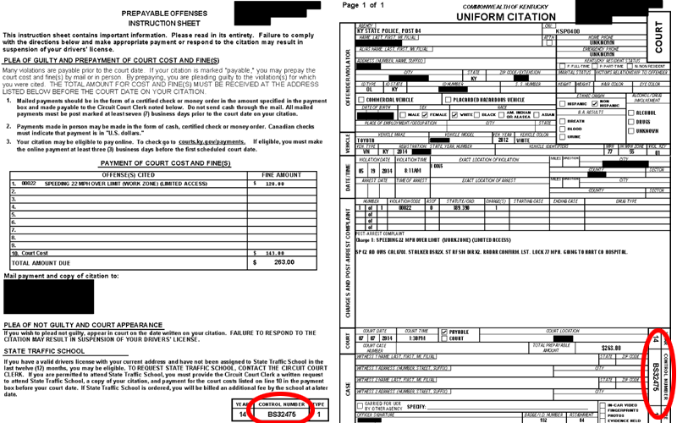
Reading a citation
Violation
Fine Amount
Court Date

Slide 12
The Point System in Kentucky
The Kentucky Point System identifies persons that may be habitually negligent drivers. Under the Point System, a driver starts with no points but accumulates points for various offenses. Upon the accumulation of 12 points (7 points if under age eighteen) within a two-year period, a driver's privilege to operate a motor vehicle may be suspended. Individuals are given an opportunity to meet with a hearing officer prior to any possible suspension.
Points assessed under the Kentucky Point System expire two (2) years from the date of conviction. However, the conviction entry remains part of the driver's record for a period of five (5) years from the conviction date.
Upon the accumulation of twelve (12) or more points against a driver age eighteen (18) or older or 7 points against a driver under age 18, the Transportation Cabinet conducts a hearing concerning the driver's privileges to operate a motor vehicle. Failure to appear for the hearing results in a driving suspension for a period of six (6) months for the first such accumulation of twelve (12) points, one (1) year for the second such accumulation of twelve (12) points, and two (2) years for any subsequent accumulation of twelve (12) points within the two (2) year period.
After a hearing, the department may require the driver to be placed on "probation" in lieu of suspension and attend a driver improvement clinic (State Traffic School) approved by the Transportation Cabinet. Once a driver has been placed on "probation" by the department, he/she shall not be considered for probation again until a lapse of two (2) years from the ending date of any previous probation period granted, whether served or not.

Slide 13
Resources
Kentucky State Police Web Site: www.kentuckystatepolice.org
Kentucky Transportation Cabinet Web Site: www.transportation.ky.gov
Department of Motor Vehicle Web Site: http://www.dmv.org/ky-kentucky/
Department of Transportation (800) 928-2992
Find a Regional Driver's Licensing Office near you: https://drive.ky.gov/Pages/Find-an-Office.aspx

