Slide 1


Board of Regents Special Budget Approval Meeting June 2, 2023

Slide 2
FY24 Budget Summary
No changes since the May presentation

Slide 3
Budget Recommendations and Approvals
Evaluate fixed cost increase in real time over the budget year – monitor excess in expenses to pay with one-time funds
2% Salary Pool to be distributed in January 2024 at the guidance of the BEC and senior leadership
Commitment to consider funding BEC High Priority List with Strategic Initiative Fund

Slide 4
Revenue Highlights

Slide 5
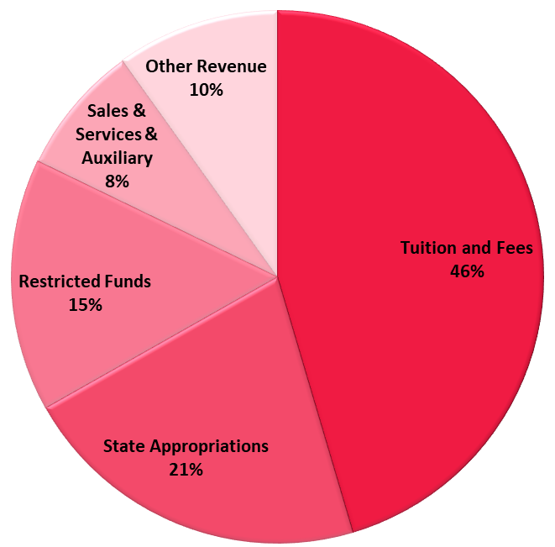
Revenue Highlights
46%
Tuition and Fees - $177.1M
State Appropriation - $83.4M
Restricted Funds - $59.8M
Sales & Services & Auxiliary - $31.0M
Other Revenue - $38.6M

Slide 6

Enrollment and Tuition Data
FY24 Budget Assumptions
Enrollment Projected FTE – 13,449
Total Headcount – 16,596
First time, First Year (FTFY) Projected –2,832
Projected increase over the current year
3% Tuition Increase for Fall 2023 (FY24)

Slide 7
Tuition and Fee Schedule
TIP - Students who are residents of other selected states across the US to strategically align with our student recruiting efforts

Slide 8
Tuition and Fee Schedule
Students that hold a current Educator License issued by the Departments of Education in KY, IL, IN, MO, OH, TN, VA, and/or WV

Slide 9
Tuition and Fee Schedule

Slide 10
Tuition and Fee Schedule

Slide 11
Tuition and Fee Schedule
On Demand - Online courses with schedules that do not necessarily align with the traditional terms.
Dual Credit - High school students

Slide 12

Short-Term Investment Strategy
The university adopted a cash management strategy & short-term investment policy in FY23
The policy achieves the following items with existing cash:
Principal protection
Liquidity
Investment earnings
An additional $3M will be generated to apply toward the FY24 operating budget

Slide 13
Expenditure Highlights

Slide 14
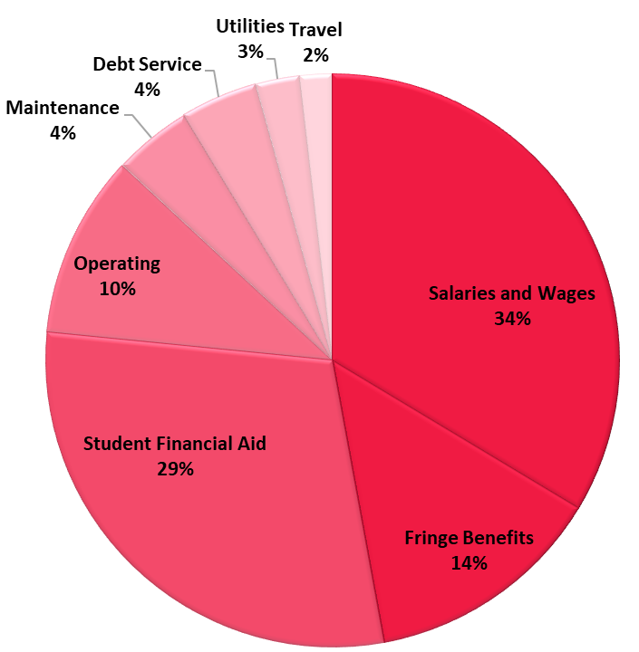
Expenditure Highlights
48%
Salaries and Wages - $131.1M
Fringe Benefits - $52.6M
Student Financial Aid - $114.8M
Operating - $40.4M
Maintenance - $17.1M
Debt Service - $17.0M
Utilities - $9.6M
Travel - $7.2M

Slide 15
Questions

Slide 16
Personnel Actions

Slide 17
Personnel Actions
Approved personnel actions 03/01/2023 – 04/30/2023
One-time compensation payments 03/01/2023 – 04/30/2023

Slide 18
Questions

