Slide 1
Welcome to the
FIRST ANNUAL WKU AASHE LUNCHEON!

Slide 2
ASSOCIATION FOR THE ADVANCEMENT OF SUSTAINABILITY IN
HIGHER EDUCATION
Creates a network of sustainability professionals & students in higher education
Provides sustainability resources for higher education in sustainability
Strengthens campus sustainability initiatives & curriculum through workshops & web-based trainings
Hosts the largest sustainability conference in North America
Facilitates the AASHE STARS program
WHAT IS AASHE?

Slide 3
SUSTAINABILITY TRACKING, ASSESSMENT & RATING SYSTEM
WHAT IS AASHE STARS?
An instrument for institutions to measure current sustainability performance and develop baselines for future progress.
Accomplished by gathering data from all sectors of campus
International recognition for sustainability efforts, commitments, and investments.

Slide 4
SUSTAINABILITY TRACKING, ASSESSMENT & RATING SYSTEM
WKU has submitted AASHE reports since 2011. Submissions are required every 3 years.
Ratings include Platinum, Gold, Silver, Bronze, and Reporter.
WKU is currently designated a Silver rated institution.
AASHE STARS
AT
WKU
2020 GOAL

Slide 5
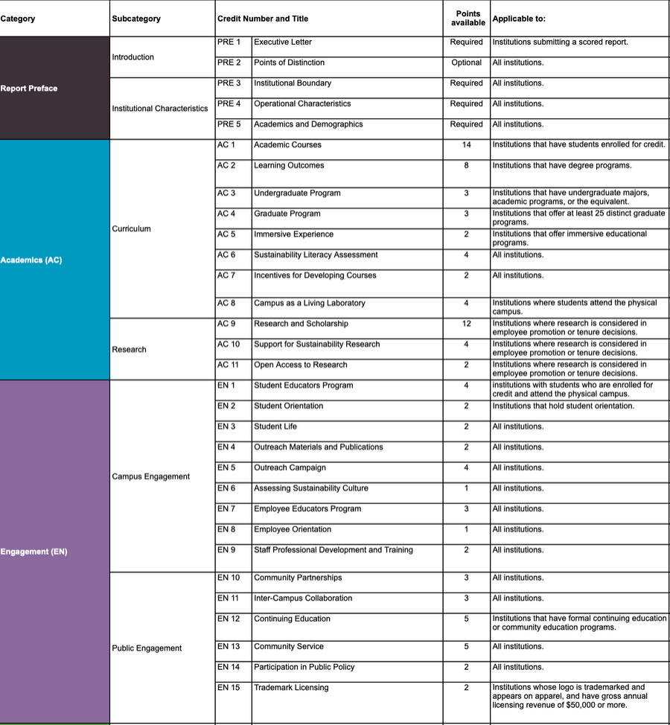
QUALITY REPORTING
AASHE STARS point system encourages institutions to provide as much detail as possible.
This increases the likelihood of earning the maximum number of points for each credit. The more information the better!
All data will require supporting evidence (spreadsheets, links to websites/news stories, etc).
Deadline for data submission is February 28th.

Slide 6
AASHE STARS Registration

Slide 7
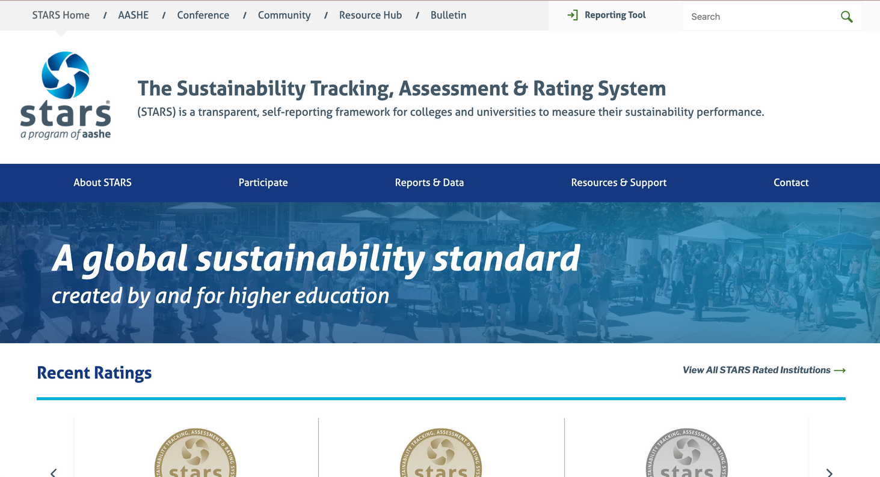
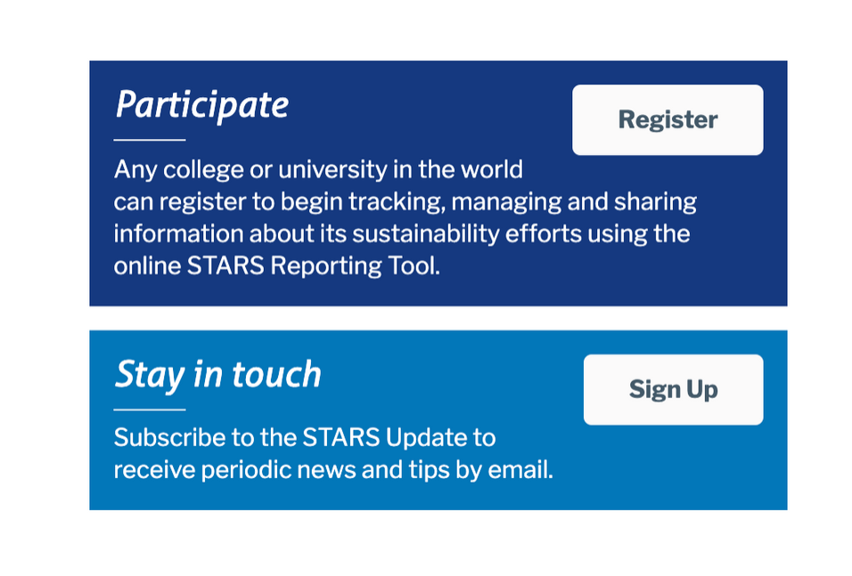
NAVIGATE TO STARS.AASHE.ORG
SCROLL DOWN TO 'PARTICIPATE'

Slide 8
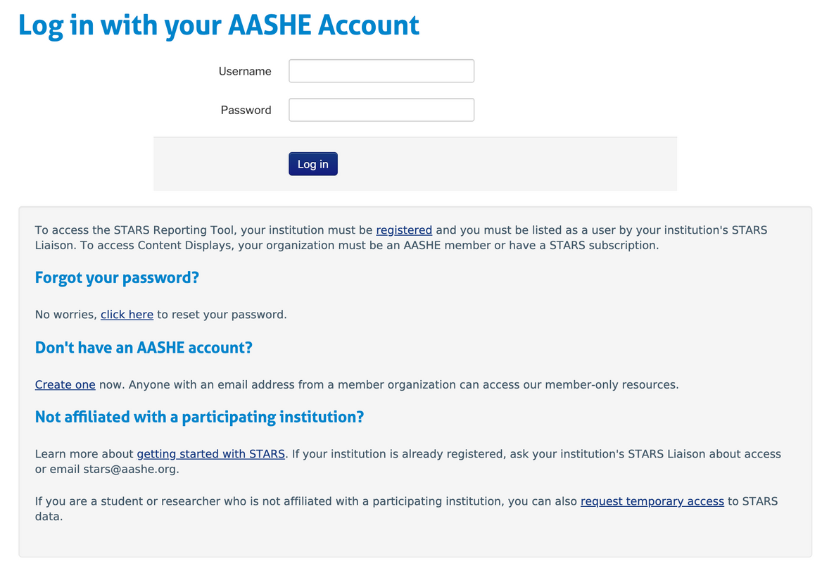
CLICK 'REGISTER'
BEGIN CREATING AN ACCOUNT

Slide 9
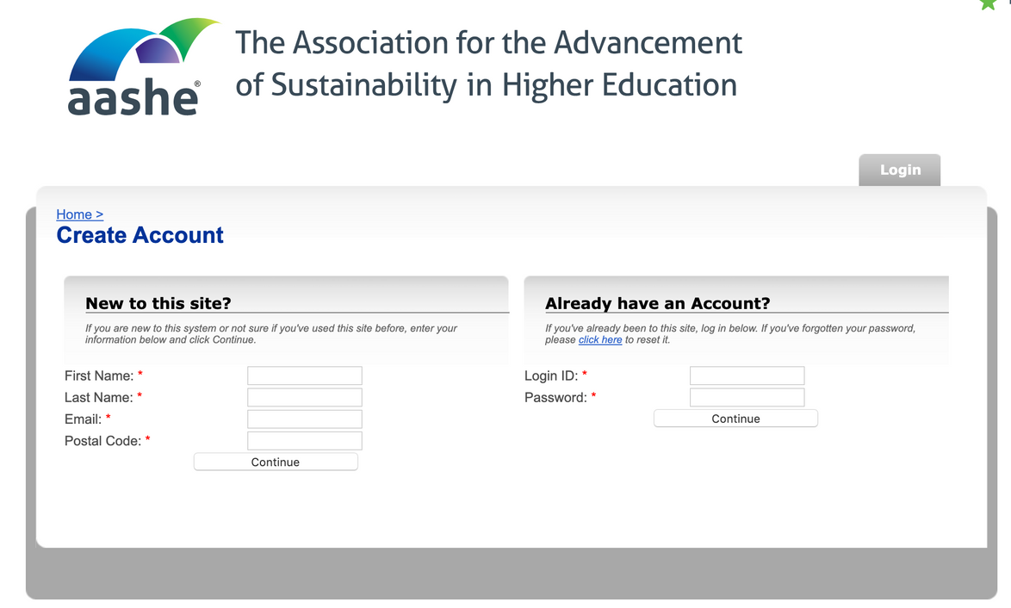
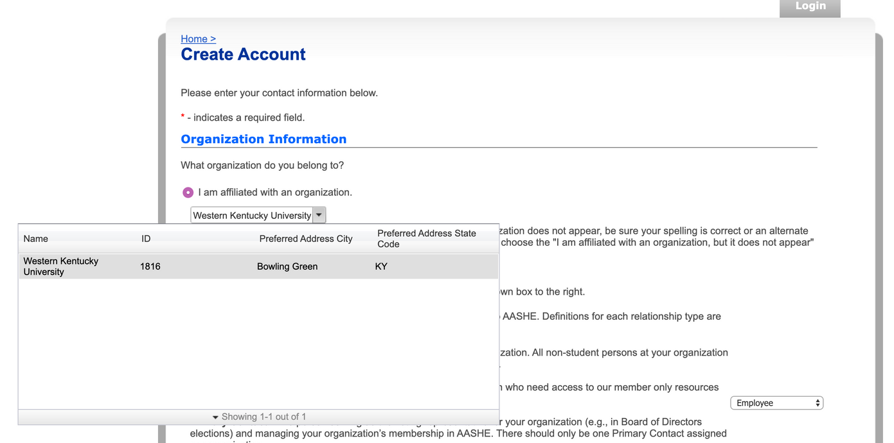
REGISTER USING YOUR WKU EMAIL
ADD WKU AS YOUR AFFILIATED ORGANIZATION

Slide 10
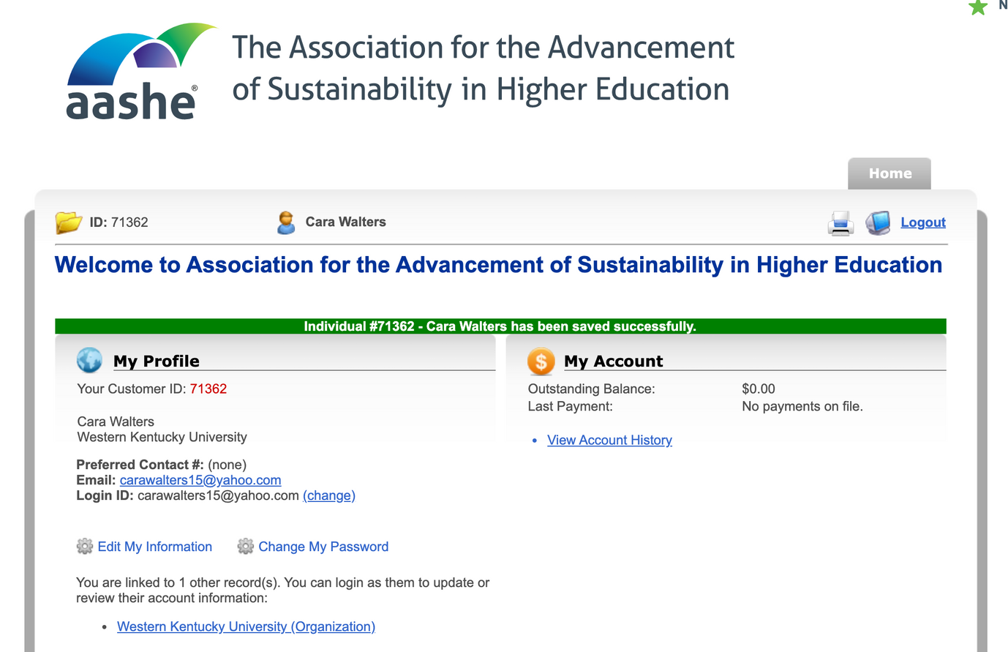
SUCCESS!
ONCE YOU HAVE REGISTERED, YOU WILL BE ADDED TO THE REPORT AND MAY BEGIN ENTERING DATA.
CHECK YOUR INBOX FOR A NOTIFICATION EMAIL

Slide 11
QUESTIONS?
Email
sustainability@wku.edu
leslie.north@wku.edu
Call
270-745-2508
270-745-5982
WKU Sustainability
wku_sustainability
sustainable_wku

