Slide 1

Becoming a Social Work Major at WKU
Dr. Dana Sullivan
BSW Program Director
270-745-5313
dana.sullivan@wku.edu

Slide 2

What do social workers do?
Foster care and adoptions
Counseling and therapy for individuals and families
Probation and parole services
Youth offender services
Victim assistance
Planning and developing community programs
Employee hiring, retention, and retirement or termination
Working with individuals who are developmentally disabled
Working with older adults
Improving conditions for people who are poor
Providing academic services in schools
Counseling people coping with an illness
Developing programs that promote health
Drug or alcohol addiction treatment
And much more!
WE HELP
Notes:
“All People Matter” image is hyperlinked to https://www.youtube.com/watch?v=DwldAMpsi1w

Slide 3
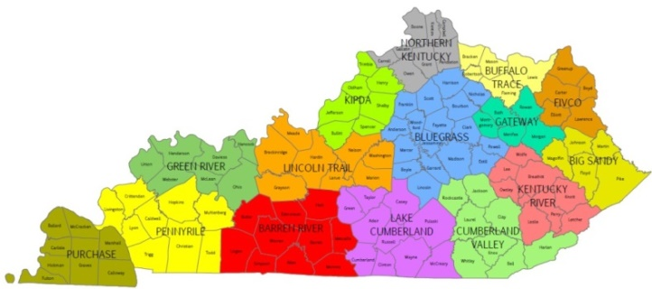

Occupational outlook
2010-2020
JOB OPENINGS!
CHILD, FAMILY, AND SCHOOL SOCIAL WORKERS provide assistance to improve the functioning of children & their families. May assist single parents, arrange adoptions, & find foster homes for abandoned or abused children. In schools, they address such problems as teenage pregnancy, misbehavior, & truancy. May also advise teachers.
Kentucky -- 336 openings/yr -- $17.45/hr; $36,290/yr
Barren River -- 19 openings/yr-- 17.52/hr; $36,442/yr
Lake Cumberland -- 16 openings/yr - $17.43/hr; $36,241/yr
* Among Top 50 occupations with the highest average number of annual openings in Kentucky; Requiring a Bachelor’s degree or higher; Job openings includes separations and new positions; Median wages are listed
Notes:
Source: Commonwealth of Kentucky, Office of Employment and Training, Workforce Intelligence Branch, Labor Market Information
Most annual job openings requiring a Bachelor’s degree or higher selected from the top 50 occupations in the areas with the most projected job openings between 2010 and 2020.
Fastest growing occupations requiring a bachelor’s degree or higher selected from the top 50 occupations in the areas with the greatest projected job growth between 2010 and 2020.
Barren River Area = Allen, Barren, Butler, Edmonson, Hart, Logan, Metcalfe, Monroe, Simpson, and Warren Counties
Lake Cumberland Area = Adair, Casey, Clinton, Cumberland, Green, McCreary, Pulaski, Russell, Taylor, and Wayne Counties
For more information about occupational profiles, see https://kylmi.ky.gov/admin/gsipub/htmlarea/uploads/Profiles.pdf
For information about fastest growing occupations in Kentucky, see https://kylmi.ky.gov/

Slide 4

Occupational outlook
2010-2020
GROWTH!
In Kentucky
SUBSTANCE ABUSE AND BEHAVIORAL DISORDER COUNSELORS ($17.34/hr; $36,070/yr)
MARRIAGE AND FAMILY THERAPISTS ($16.97/hr; $35,290/yr)
MENTAL HEALTH COUNSELORS ($16.56/hr; $34,440/yr)
In Barren River Area
REHABILITATION COUNSELORS ($15.75/hr; $32,806/yr)
MENTAL HEALTH COUNSELORS ($16.46/hr; $34,240/yr)
In Lake Cumberland Area
MARRIAGE AND FAMILY THERAPISTS (n/a; n/a)
MENTAL HEALTH AND SUBSTANCE ABUSE COUNSELORS ($13.81/hr; $28,718/yr)
* Among Top 50 fastest growing occupations In Kentucky; Requiring a Bachelor’s degree or higher; Job openings includes separations and new positions; Median wages are listed
Notes:
Source: Commonwealth of Kentucky, Office of Employment and Training, Workforce Intelligence Branch, Labor Market Information
Most annual job openings requiring a Bachelor’s degree or higher selected from the top 50 occupations in the areas with the most projected job openings between 2010 and 2020.
Fastest growing occupations requiring a bachelor’s degree or higher selected from the top 50 occupations in the areas with the greatest projected job growth between 2010 and 2020.
Barren River Area = Allen, Barren, Butler, Edmonson, Hart, Logan, Metcalfe, Monroe, Simpson, and Warren Counties
Lake Cumberland Area = Adair, Casey, Clinton, Cumberland, Green, McCreary, Pulaski, Russell, Taylor, and Wayne Counties
For more information about occupational profiles, see https://kylmi.ky.gov/admin/gsipub/htmlarea/uploads/Profiles.pdf
For information about fastest growing occupations in Kentucky, see https://kylmi.ky.gov/
Rehabilitation counselors help people with emotional and physical disabilities live independently. They work with clients to overcome or manage the personal, social, and professional effects of disabilities on employment or independent living. [Requires a Master’s degree] (Source: http://www.bls.gov/ooh/community-and-social-service/rehabilitation-counselors.htm)
Substance abuse and behavioral disorder counselors advise people who suffer from alcoholism, drug addiction, eating disorders, or other behavioral problems. They provide treatment and support to help the client recover from addiction or modify problem behaviors. (Source: http://www.bls.gov/ooh/community-and-social-service/substance-abuse-and-behavioral-disorder-counselors.htm)
Mental health counselors and marriage and family therapists help people manage and overcome mental and emotional disorders and problems with their family and relationships. They listen to clients and ask questions, to help the clients understand their problems and develop strategies to improve their lives. [Require a Master’s degree] (Source: http://www.bls.gov/ooh/community-and-social-service/mental-health-counselors-and-marriage-and-family-therapists.htm)

Slide 5
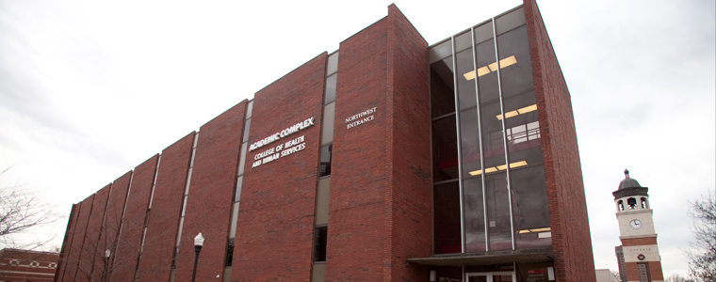
BSW since 1974, accredited 1978
Currently >200 social work majors/minors
BSW @ Bowling Green, E’town, Owensboro, Glasgow
MSW since 2004
MSW degree options
Full-time, part-time
Advanced standing
Online
The Academic Complex houses the Department of Social Work within the College of Health & Human Services

Slide 6
Prerequisites for SW Major 9 Classes
SWRK 101 and SWRK 205 (must pass with a “C”)
English 100
Math 116 (or eligible to enroll 1st semester)
Biology 113 or 120 or 131
PSY or PSYS 100/220 or SOCL100/AGRI 108 (one for admission; both are required no later than the end of the first semester following admission to the program)
PS110 or ECON 150/202/203 (one for admission; both are required no later than the end of the first semester following admission to the program)

Slide 7
Advising for the Major
Pre-majors are assigned an ACE advisor http://www.wku.edu/ace/
Becoming a SW major:
Complete change of major/minor/advisor form on Topnet
Indicate “yes” for change of advisor
Submit form on Topnet
Print form and deliver to the Office Associate for Dept. of SW, in Academic Complex 211; or fax form to 270-745-6841
Office Associate – Ms. Benita Langley
270-745-5312
benita.langley@wku.edu
The Program Director will be your SW advisor until you are admitted to the program at which time you will be assigned a SW advisor.

Slide 8
Admission Criteria and Process
Attain sophomore standing at time of admission
Completion of prerequisites (see previous slide)
GPA 2.5 or higher
Students enrolled at WKU fall 2009 or later
GPA 2.2 or higher - Students enrolled at WKU prior to fall 2009
Submit application, including an essay
essay: this is an introduction of yourself to the faculty and a sample of your best writing
you must include one paraphrase or directly quoted material, with APA (6th Edition) style documentation in your essay. Provide an APA style reference list for your source.
Sign off on NASW Code of Ethics agreement
Sign off on BSW Student Handbook agreement
The BSW Program Director will contact you to set up an interview

Slide 9
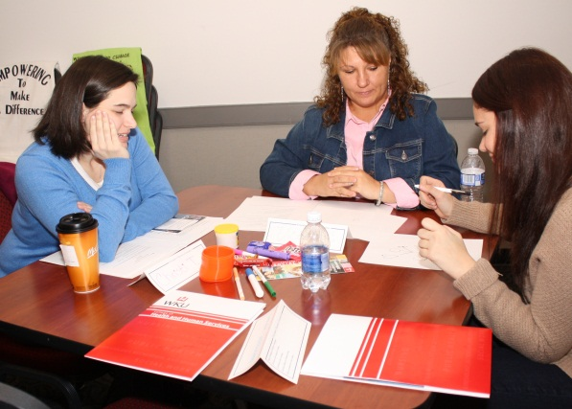
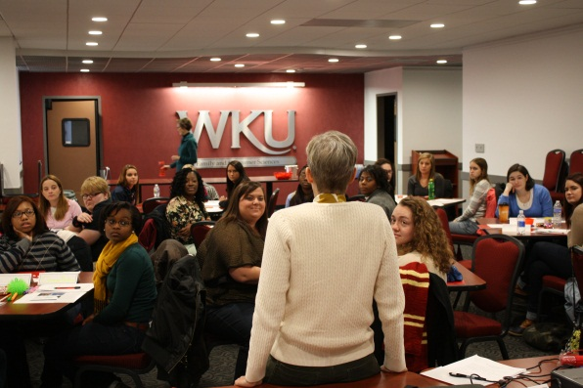
Application Deadlines
April 1/July 15 for students seeking admission for the following Fall semester at all campuses
November 1 for students seeking admission for the following Spring semester at WKU Bowling Green **
** The BSW enrolls cohorts at the regional campuses in Fall semester ONLY

Slide 10
Once you’re admitted. . .
Following admission to the major, a minimum of five semesters is required to complete the courses for the major, which will very likely include one summer session for your field placement. Regional campuses will have one summer semester of field.
Plan now for using your financial to account for summer field.

Slide 11
Course Sequence: SW Major
First Semester
SWRK 330:HBSE I
SWRK 344:Stats
SWRK 375: Generalist Practice I
ACE – Advisor Consent Elective
Second Semester
SWRK 331:HBSE II
SWRK 345:
Research
SWRK 379: Skills
ACE – Advisor Consent Elective

Slide 12
Course Sequence (cont.)
Third Semester
SWRK 381: Generalist Practice III
SWRK 378: Gen. Practice II
SWRK 395: Policy
SWRK elective
Fourth Semester
SWRK 480/481 (field placement and seminar)
Fifth Semester
SWRK 482/483 (field placement and seminar
During the five semesters students must complete all Gen Ed’s. and electives to fulfill 120 hrs. for graduation

Slide 13
Waiting for the decision . . .
Turn in your application by the deadline
The BSW Faculty will review all applications and make admissions decisions
The Program Director will inform the applicants of the decision.
Please note, this typically occurs after grades post each semester (ex. around May 15 and Aug 15 for fall admissions and around Jan 15 for spring admissions)
If accepted, student takes SWRK 330, 344, 375, BUT applicants cannot enroll in these classes until acceptance is verified . . . but some must be enrolled as full time student. So . . .
This is the time to work closely with your SW advisor (typically the BSW Program Director at this point) so you will know how to plan for the next semester.

Slide 14
Tuition Rates https://www.wku.edu/bursar/tuition_fees_1617.php
2016-2017 estimates (in-state rate)
Fall semester/spring semester: $4,956 per semester or $9,912 for the academic year (AY)
Summer tuition is calculated differently:
Summer: tuition is assessed per credit hour at the rate of $413 per credit hour for summer 2017.
$413 x six credit hours for SWRK field & seminar = $2,478
All of this information is available on WKU’s web site @ Financial Aid. Rates will likely change with each AY.

Slide 15
Public Child Welfare Certification Program (PCWCP)
Eligibility
Cumulative GPA of 2.5
SW cumulative GPA of 3.0 or “B” average in all SW classes
At least 3, and not more than 4 semesters of undergraduate SWRK courses to complete
Completed one SWRK practice course, typically SWRK 375, prior to enrolling in second of two PCWCP specialization courses, SWRK 450 and SWRK 451

Slide 16
Public Child Welfare Certification Program (PCWCP)
Benefits
Up to four semesters of tuition (instate rate)
Stipend for four semesters
Employment with DCBS upon completion of the BSW and PCWCP (consistent with state personnel requirements)
Dr. Dean May is WKU site coordinator for PCWCP
https://www.wku.edu/socialwork/pcwcp.php

Slide 17
Public Child Welfare Certification Program (PCWCP)
Obligations
Enter into a contractual agreement with the Cabinet for Health & Family Services
Apply for employment within specified time frame
Failure to complete the above may lead to forfeiture of funds and reimbursement to Cabinet in one lump sum

Slide 18
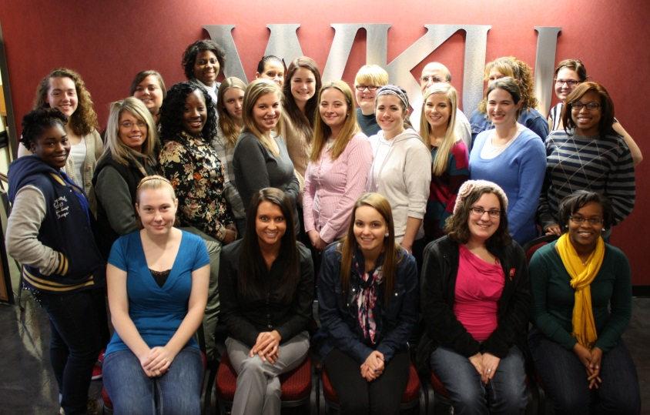
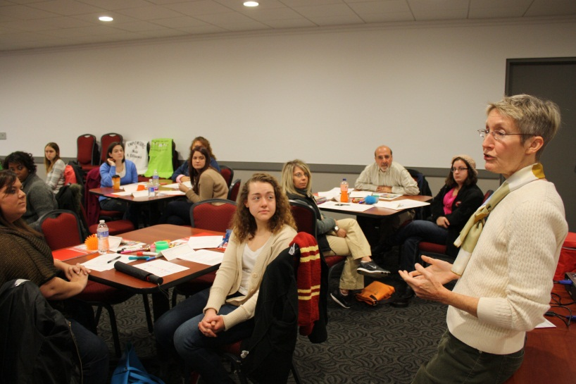
Social Work Minor
21 hours
SWRK 101
SWRK 205
SWRK 330: HBSE I
SWRK 331: HBSE II
SWRK 395: Policy
SWRK elective (3-hour)
SWRK elective (3-hour)
Notes:
Required core courses for the BS in Health Sciences:
FACS 111 PSY 199 BIOL 120/121 BIOL 131 CHEM 304 AH 190 AH 290 PHYS 231/232 PE 311 PH 381 or SOCL 300 PH 447 or PHIL 322 HCA 340 HCA 446/447 or CIS 243

Slide 19

BSW Scholarship Program
Applications are available on the departmental web site at www.wku.edu/socialwork/bsw

Slide 20
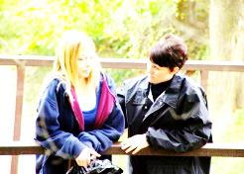
You’ll need a social worker when ...
You come into the world too soon
You are bullied
You get poor grades
Your friends pressure you to get high
You didn't want this baby
You feel like running away
You can’t forget the assault
You want to adopt
You wonder if you are drinking too much
You lose your baby
Your child with a disability needs friends
Your spouse wants a divorce
Your neighborhood needs a community center
You want to be a foster parent
You struggle to readjust after military service
Your best friend has panic attacks
You find drugs in your son’s room
Your mom gets Alzheimer's
You can't afford respite care
Your children ignore your medical decisions
Your retirement check won't pay the bills
You learn you have a terminal illness
You need a nursing home
Life's Challenges –
Social Workers Are There For You!
Notes:
© 2001 Darlene Lynch and Robert Vernon. For free distribution permission information visit: http://hsmedia.biz

Slide 21

Thank you!
QUESTIONS?
Dr. Dana Sullivan –
dana.sullivan@wku.edu
Ms. Benita Langley
benita.langley@wku.edu

