Slide 1
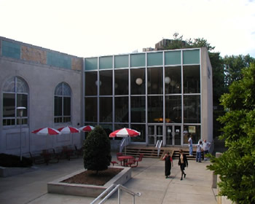
Social Work Library Resources
Carol Watwood
Health Sciences Librarian
Notes:
I’m Carol Watwood, the Health Sciences Librarian, and I’d like to show you some library resources to help you with Social Work research in the library.

Slide 2
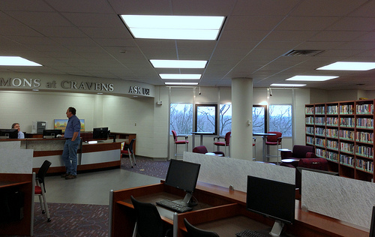
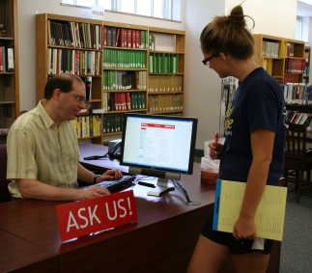
Helm-Cravens Library
“Ask Us!” Commons at Cravens, 4th floor
Email, IM, or call 1(270)745-6125.
Home page: https://www.wku.edu/library/
Notes:
This is the main information desk in the Helm-Cravens Library at the top of the hill. You can stop by, call, IM, or email us. You can check out a book, get help writing your paper, get computer assistance, and print no cost to yourself in one of our three computer labs. You can also reserve a group study room and find a quiet place to study. At our Java City coffee shop, you can get a drink or a snack.

Slide 3
Library Locations
Notes:
E’town: anthony.paganelli@wku.edu; Glasgow: Glasgow: Email:audrey.robinson-nkongola@wku.edu; O’boro: Email:jennifer.joe@wku.edu

Slide 4
NASW Code of Ethics

Slide 5
Borrowing Library Books
Check out books for 4 weeks.
WKU’s e-journals download or copy free. Scan or copy older print journals.
Document Services and
Interlibrary Loan serves
distance learners and
gets stuff we don’t have.
Notes:
You can borrow books and audiovisuals in the Cravens building at the top of the hill or in the ERC library. Print journals have to be used in the library or photocopied.

Slide 6
WKU Libraries
Notes:
This is the front page of the WKU Libraries website – a good place to start library research at wku. You can do much of your research from remote locations. If you log in with your WKU NetID/password, you can follow Internet links even if you’re off campus. You can read most of our journal articles and many of our books online.

Slide 7
One-Search
Notes:
One-Search (white search box) gives a quick overview of what library has. It has our book catalog. It also displays videos, print journal titles, online journal titles, and many articles that the library has. Databases, rather than One-Search, are the best way to search for individual journal articles on a topic. Log in with your WKU NetID/password to follow Internet links.

Slide 8
Encyclopedia of Social Work

Slide 9
Encyclopedia of Social Work cont’d

Slide 10
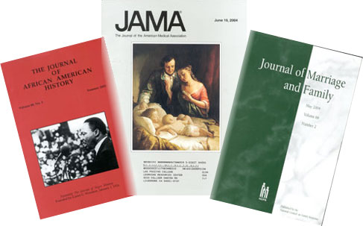
Scholarly Journals
Also called “Peer-Reviewed” or “Refereed” journals.
Articles written by scholars in the field using technical language.
Little or no advertising.
Articles contain charts, graphs, and references (bibliographies) citing the authors' sources.
Articles reviewed before publication for quality and accuracy by several scholars in the same field.
Notes:
Scholarly journals use different types of review processes to ensure quality and accuracy. Journal websites and online databases such as EBSCOhost will often tell you if a journal is considered scholarly or is peer reviewed. If in doubt, ask the professor teaching your class.

Slide 11
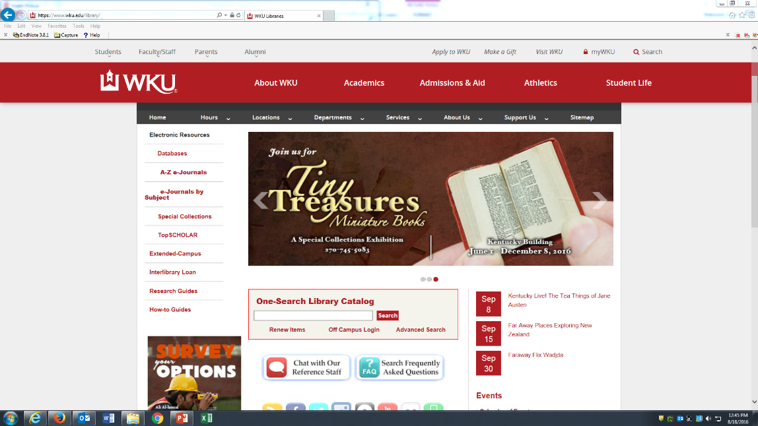
Search Databases: find articles by subject
Notes:
A common classroom assignment is to find magazine or journal articles on a topic, such as “mandatory reporting of child abuse.” To look for articles on a topic, click the “Databases” link on the WKU Libraries home page. If you’re off campus, log in with WKU NetID/password.

Slide 12
EBSCOhost
Notes:
EBSCOhost is the “family” of databases we use most often to search for articles on a topic. You can search them separately or together.

Slide 13
EBSCOhost (cont’d)
Notes:
Press [continue] to do a general search You can scroll down and add specialized databases if you wish.

Slide 14
EBSCOhost (cont’d)
Notes:
I’m searching for “mandatory reporting of child abuse.” EBSCOhost works best if you break your subject into 1-3 short chunks and put one in each box. Then click [Search]. If you have problems, contact the Information Desk at (270)745-6125 or the Health Sciences Librarian.

Slide 15
Open Full Text
Attached full text – click to open
Notes:
Each blue link is an article title, followed by the reference and a summary. To get the full version, click the full-text link. If you don’t see one, click [check for full text at WKU Libraries]. If there is no full text, click the [request from interlibrary loan] to get a copy. You will be notified via your WKU email when we have obtained an electronic copy, often within 1-2 working days.

Slide 16
Put in APA format
Notes:
To put in APA format, click on title of article, then click [cite].

Slide 17
Print an online article
Click printer icon to open print dialog box and click “OK” to print
Notes:
You can easily print, download, or e-mail an online full-text article from EBSCOhost. Click the printer icon in the top left to open the print dialog box and click “ok” to print. Select the “disk” icon to download and the “e-mail” icon to e-mail. Sometimes you must move cursor to bottom center of page to display print/save icons.

Slide 18
Print a list of articles
Click “add to folder” then click folder icon
-or-
Use browser “print” command
Notes:
There are two easy ways to print out this list of articles for later use: (1) Use your browser’s print command to print the whole page. (2) Click “add to folder” to select certain ones, then scroll to the top and click the “folder” icon. Follow on-screen directions to print. To save paper, select [email] instead of print.

Slide 19
Research Guides: LibGuides
Notes:
Research guides help you get started with research. They have shortcuts to key databases, important journal titles, and helpful websites for different kinds of nursing research.

Slide 20
Research Guides – Social Work
Notes:
Research guide for Social Work – pulls together key quick links to Social Work from WKU Libraries website.

Slide 21
Get article from another library
If we don’t have a book/article you need, request a copy free from another library.
Articles sent electronically – notification by email.
Taking an online course? Get books/articles from Document Services and Interlibrary Loan.

Slide 22
Thank You!
Information Desk (270)745-6125 Email: web.reference@wku.edu

