Slide 1
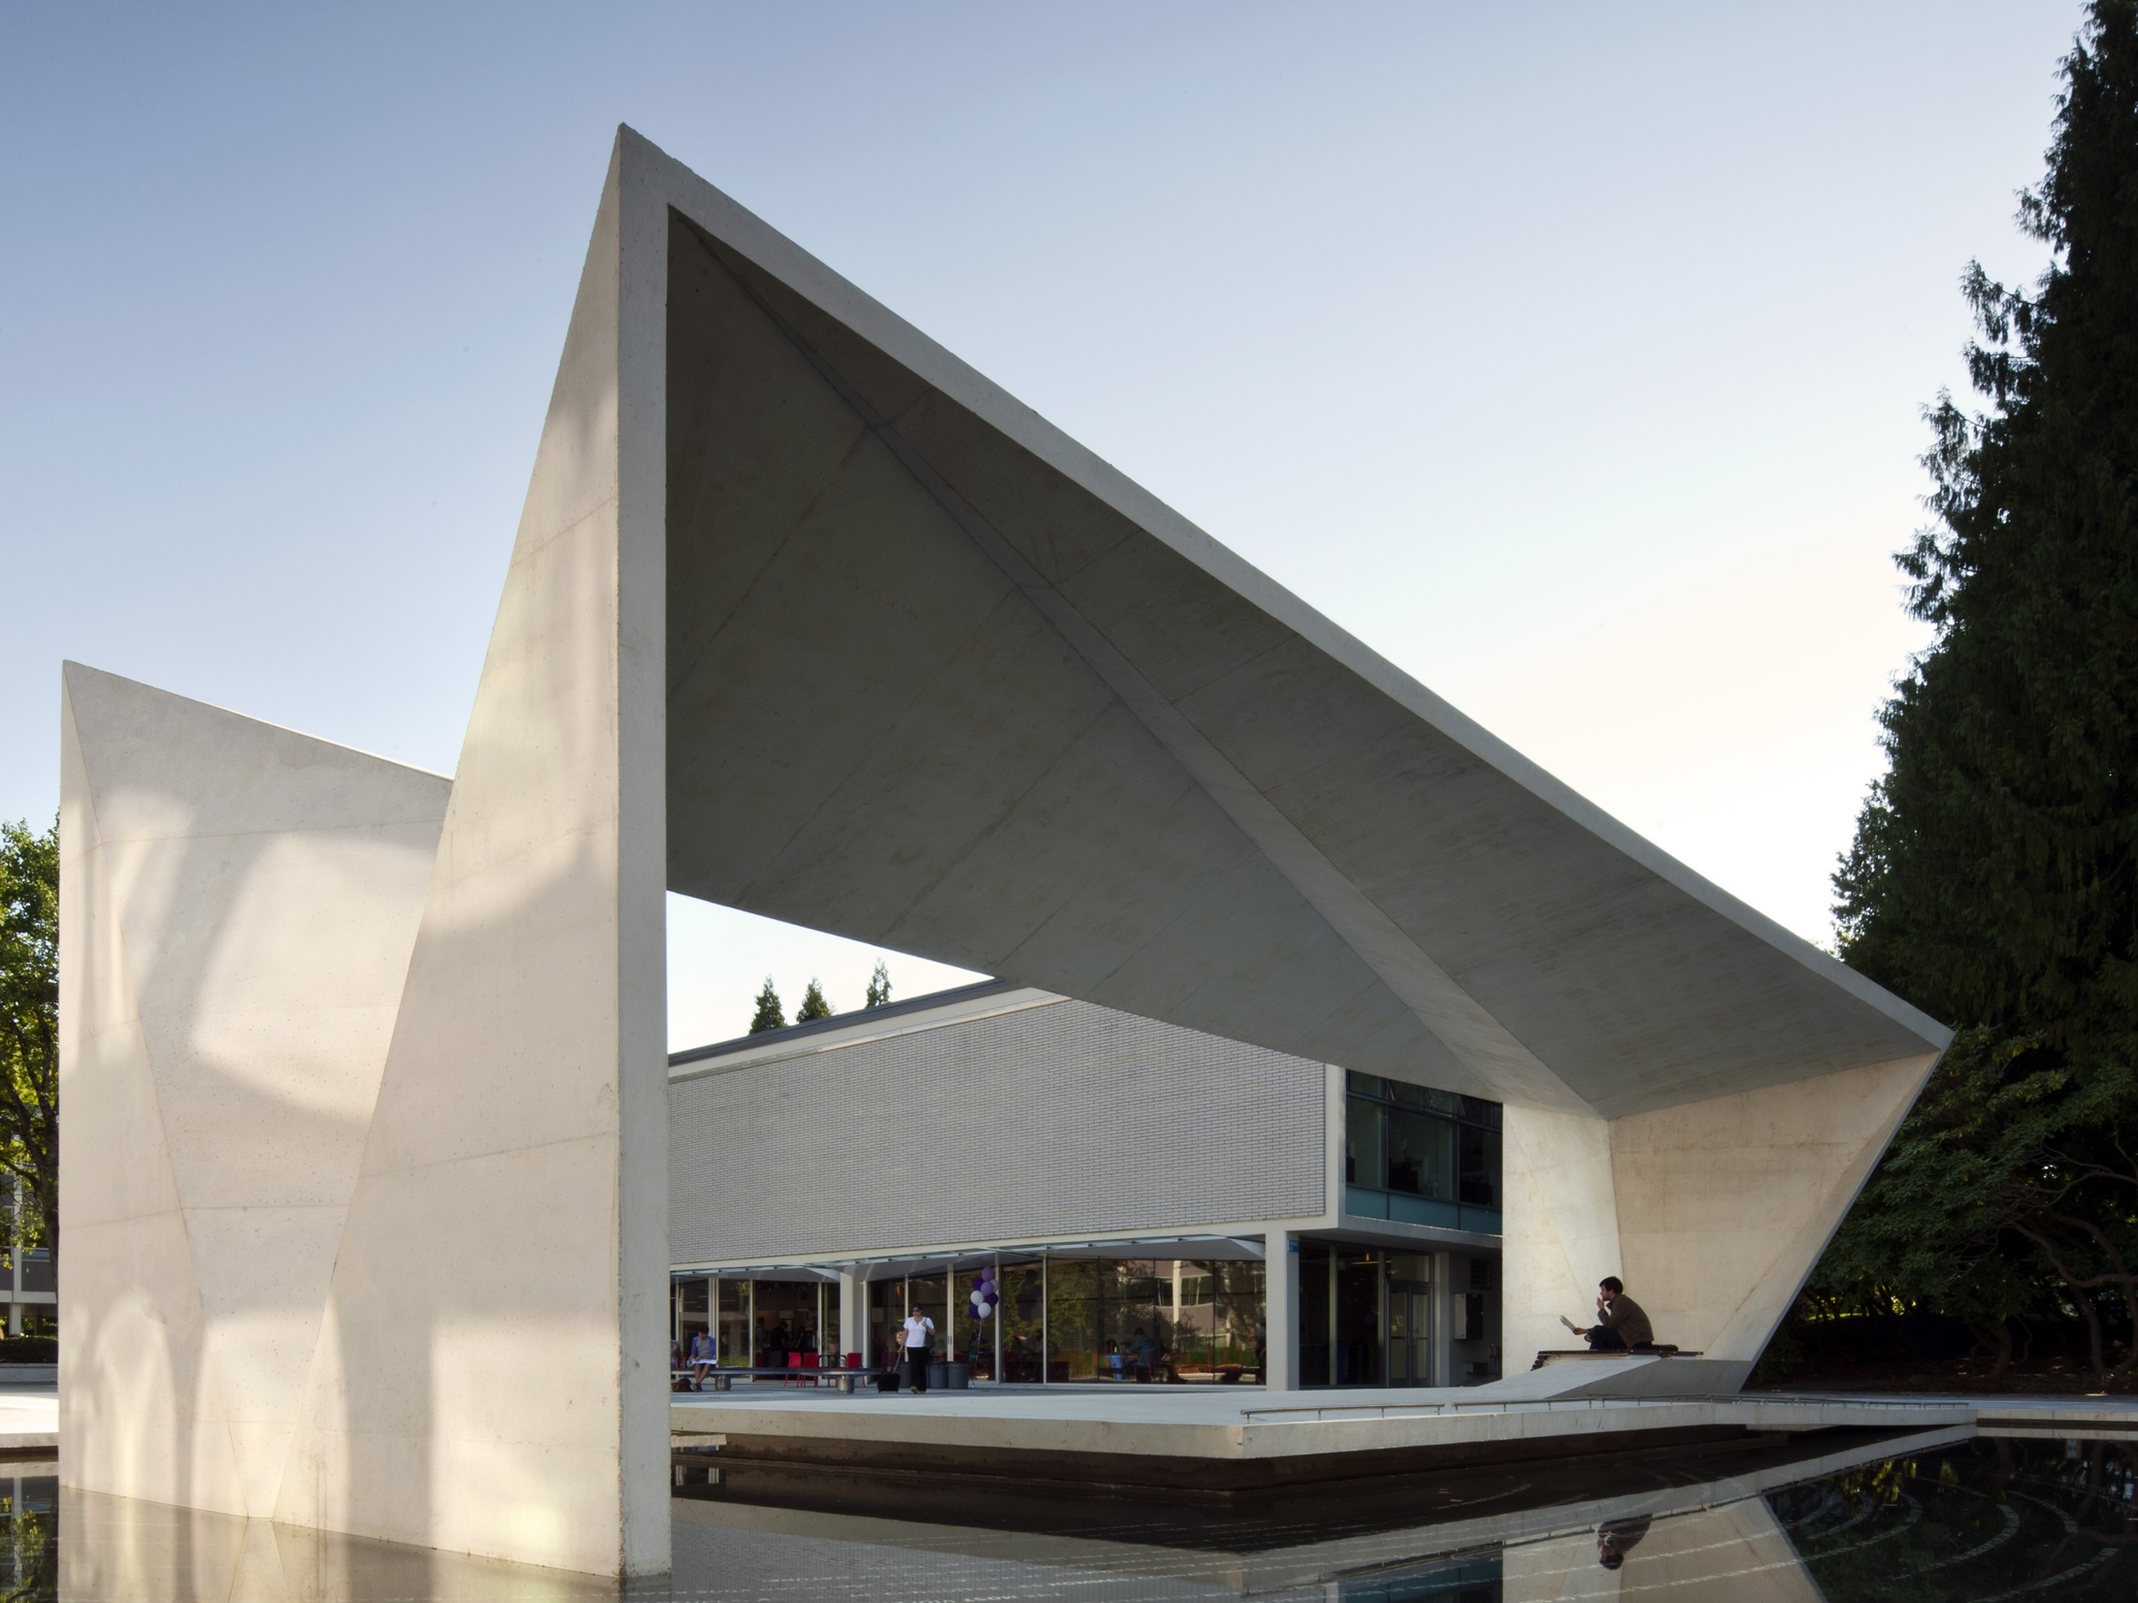


Resource Allocation, Management, and Planning
Open Forum
November 28, 2018

Slide 2
Agenda
Huron is pleased to partner with WKU on this resource allocation, management, and planning (“RAMP”) initiative.
Our goals for today’s meeting includes:
Review project timeline and recent efforts
Discuss model development and using the model as a catalyst for success
Overview new governance structures and annual budget processes
Outline next steps

Slide 3
RAMP Redesign Timeline
Since the initiative started in January, Huron has met with 75+ stakeholders to ensure the RAMP model meets campus needs.
2018 |  |  |  |  |  |  |  |  |  |  |  | 2019
Jan | Feb | Mar | Apr | May | Jun | Jul | Aug | Sep | Oct | Nov | Dec | Jan | Feb | Mar | Apr | May | Jun | Jul | Aug | Sep | Oct | Nov | Dev
Visioning
Financial Modeling
Stakeholder Engagement
Infrastructure Development
Parallel Process
RAMP Model Active
Phase | Overview
1. Due Diligence and Visioning | Develop a clear understanding and vision through an assessment of current resource allocation practices.
2. Financial Modeling | Build-out a “pro-forma” model to provide a platform for testing different model alternatives.
3. Stakeholder Engagement | Address change management through methodical, data-driven stakeholder engagement.
4. Infrastructure Development | Develop supporting tools, processes, and governance to carry out budget development.
5. Parallel Process | Test a new model to understand outcomes if the new model were implemented.

Slide 4
Recent Efforts
Since the last open forum event at the end of May, Huron has completed several tasks described in the project plan; these are as follows:​
Conducted the Dean's Capstone Retreat to establish a framework for the new incentive-based budget model ​
Presented project updates to the President’s Cabinet, the Board of Regents, and the Faculty Senate
Met with the auxiliary and support units on multiple occasions to provide an overview of the RAMP initiative, share the FY17 actuals model, and answer questions
Held four additional Steering Committee meetings to discuss model progress and make key decisions surrounding the operationalization of the new RAMP model
Facilitated a second round of Department Chair meetings with each of the Colleges to present the FY17 actuals model and answer questions​
Conducted model training sessions with the Budget Office to explain the functionality of the budget model tool​

Slide 5
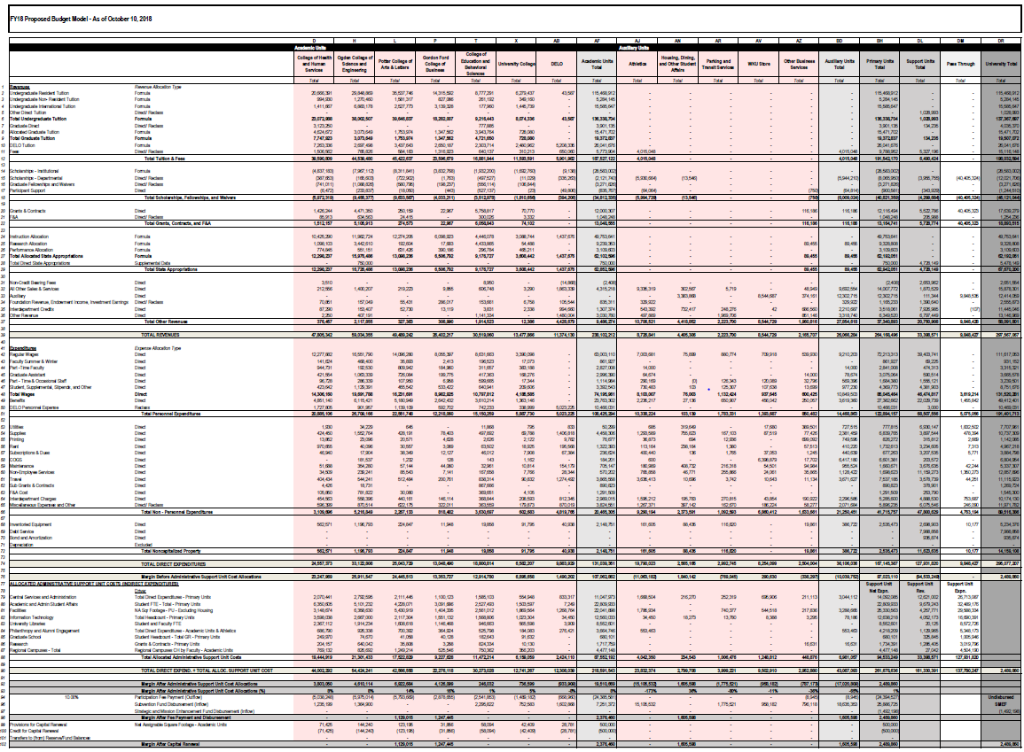
Model Development
While partnering with WKU, Huron has developed two models relying on actuals data (FY17, FY18) and a model relying on budget information (FY19) in the new model format.
FY19 Budget Model
FY18 Actuals Model
FY17 Actuals Model
Operating Units
Revenues and Direct Costs
Admin & Support Units Allocated to Primary Units
Central Funding Mechanism
Developing multiple years of model data will allow stakeholders to examine the impact
that strategic decisions have on the financial sustainability of the University.

Slide 6




The Budget Model as a Catalyst for Success
While the new incentive-based model is only a management tool, it is intended to be leveraged to support academic excellence and resource optimization.
New Program Development
Space Management
Administrative Service Delivery
Academic Portfolio Management
Research Collaboration
Key Model Benefits
Developing innovative market-relevant programs will differentiate the University and can attract an increasing number of high caliber students, growing both institutional prestige and the overall size of the tuition revenue pools Academic portfolio analysis highlights the balance between financially beneficial and mission critical programs By developing a greater understanding of the costs of University space, the new budget model will create incentives for optimizing the use of university space The new model governance structure provides a platform for feedback into the overall administrative cost setting process to control cost growth

Slide 7
Governance Structure and Considerations
WKU’s RAMP Steering Committee has approved a model governance structure which incorporates a number of new and existing committees that are designed to ensure broad-based feedback.
Decision Making Flow¹
Committee Participation
Executive Budget Committee – 2 Faculty Rep., President’s Cabinet Rep., Budget Director, AVP – Academic Budgets and Admin., Staff Rep., SGA Rep., and Strategic Plan Implementation Committee Rep. (nonvoting) Auxiliary/Support Unit Allocation Committee – 2 Faculty Rep., all Academic Deans, CFO, Dean of Libraries, and Staff Rep. Space Allocation Committee – Designees from five colleges, which may include faculty members, Chief Facilities Officer, VP Enroll. & Student Experience, Ass. Provost for Research, Provost Office Rep., Athletics Rep., and Libraries Rep.
Note 1: In addition to the depicted governance committees, additional operational support teams are recommended to enhance the budget development process

Slide 8
Executive Budget Committee
The Executive Budget Committee will review academic, auxiliary, and support unit budgets and provide recommendations to the President.
Roles and Charges
Review recommendations from the Provost regarding Academic Unit budget requests Review recommendations from the Auxiliary/Support Unit Allocations Committee Recommend Central Fund distribution Recommend comprehensive budget Review and provide policy/guidance on budget model management Conduct outreach across university on resource allocation priorities
Positions
Position | Nominating Body
AVP – Academic Budgets and Admin. | None
President’s Cabinet Rep. | None
Budget Director | None
Staff Rep. | Staff Council
SGA Rep. | SGA
Faculty Rep #1 | University Senate
Faculty Rep #2 | University Senate
Strategic Plan Implementation Committee Rep (nonvoting) | None

Slide 9
Auxiliary/Support Unit Allocation Committee
The Auxiliary/Support Unit Allocation Committee would review each unit’s budget proposal to promote discussions about service effectiveness and efficiency.
Roles and Charges
Reviews the auxiliary and support unit’s budget proposals, including strategic objectives, service level demands, and workforce plans Examines benchmark data and performance metrics to evaluate service level effectiveness and efficiency Offers suggestions for performance improvement for support units; promotes development of service level agreements Submits an executive summary of the unified auxiliary and support unit budget recommendations to the Executive Budget Committee
Positions
Position | Nominating Body
CFO (nonvoting) | None
AVP Business Services (nonvoting) | None
Dean of Libraries (nonvoting) | None
CEBS Dean | None
OCSE Dean | None
CHHS Dean | None
GFCB Dean | None
PCAL Dean | None
Staff Rep. | Staff Council
Faculty Rep. #1 | University Senate
Faculty Rep. #2 | University Senate

Slide 10
Space Advisory Committee
The Space Advisory Committee develops policies and procedures for space management and acts as a broker for space across campus.
Roles and Charges
Reviews requests, identifies possible solutions and makes recommendations for the use of space on campus Develop policies and procedures for space management Govern the allocation and brokerage of space across campus Ensure that facilities management distributes accurate and timely space utilization data to operating units for budget planning Support development of service level agreements between facilities management and revenue-generating units
Positions
Position | Nominating Body
Chief Facilities Officer | None
VP Enroll. & Student Exp. | None
Ass. Provost Research | None
Provost’s Office Rep. | Provost
Athletics Rep. | Athletics
Libraries Rep. | Dean of Libraries
OCSE Rep. | Dean of OCSE
CHHS Rep. | Dean of CHHS
PCAL Rep. | Dean of PCAL
GFCB Rep. | Dean of GFCB
CEBS Rep. | Dean of CEBS

Slide 11
Model Development Process Overview
The table below outlines milestones in the proposed budget development process, along with the groups with primary accountability and responsibility for their completion.
Model Development
A
B
C
D
E
Collect Data & Develop Assumptions | Develop Cost Allocations | Develop Budget Requests | Finalize Funding Decisions | Update Throughout Fiscal Year
Forecast University revenues and allocate in model using data variables | Review Central Support Unit budgets and allocate in model using data variables | Develop financial plan requests based on assumptions, cost allocations and local priorities | Review funding requests and make central fund allocation decisions. | Revise budget as needed based on updated forecasts.
Operational Support Teams, Budget Office | Support Units, Auxiliary/Support Unit Allocation Committee | Deans, Auxiliary Unit Leaders, Business Officers | Deans, Auxiliary Unit Leaders, Advisory Committees, Executive Budget Committee | Executive Budget Committee, Budget Office, Primary Units
Oct. – Nov. | Dec. – Jan. | Feb. – Mar. | Apr. – May | Jul. – Jun.
Milestone
Goal
Primary Participants
Timeframe
(Jul. 1 FY)

Slide 12
Notable Budget Process Changes
The notable proposed changes to the current budget development process can be categorized into four main areas.
Academic Planning
Academic units will need to take into consideration additional funds, revenues, expenses, and activity-level metrics when developing budget forecasts and academic plans
Template Creation & Distribution
New templates will need to be developed and distributed that reflect all the necessary data inputs for building the budget in the RAMP model format
Budget Proposal Cycle
Timelines and content for budget proposals, particularly for administrative support units, will vary from current timelines under the new process
Data Consolidation
The Budget Office will take on a new role in collecting templates and creating the necessary reports based on model information to support budget development

Slide 13
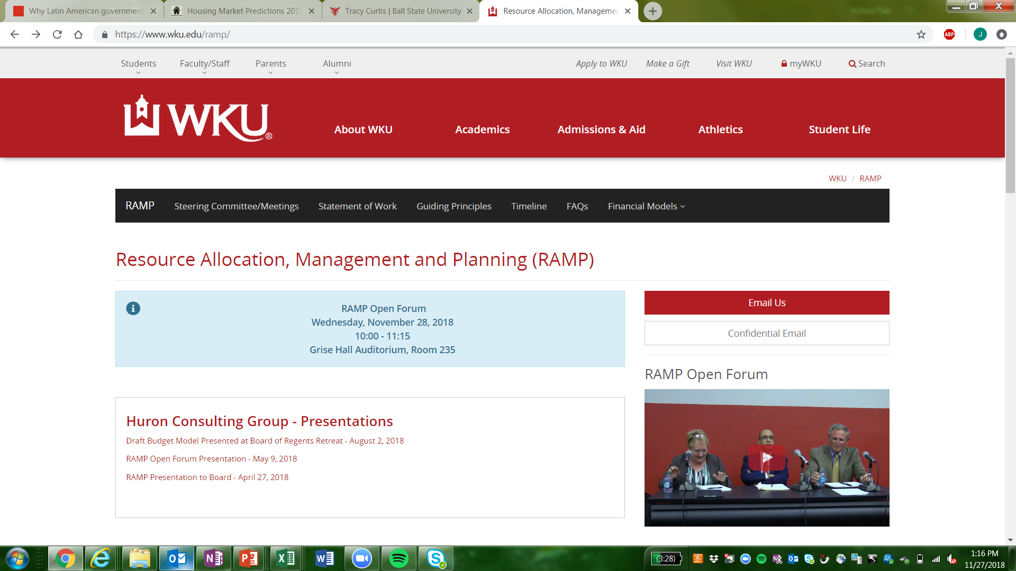
RAMP Website
The University has developed a website to track the RAMP progress and provide a platform for the broader campus community to view key aspects of the initiative.
Website Components
Overview of the RAMP initiative including the timeline and FAQs
Content from the Steering Committee meetings that have been used as the basis for decisions regarding the new RAMP model
Financial models that have been developed to date
For more information, please visit the WKU RAMP website: https://www.wku.edu/ramp/

Slide 14



550 W Van Buren St #1700, Chicago IL, 60607
(312) 583-8700
www.huronconsultinggroup.com

