Slide 1

PHUGAS
Public Health Graduate and Undergraduate Associated Students
Notes:
For the first PHUGAS meeting, I was originally going to record. However, given the nature of some things discussed, I rethought this plan. So click thru the Powerpoint I showed and read my extra notes to see what you missed.

Slide 2
Agenda, PHUGAS Meeting, September 3, 6pm CST
Introduction
What is PHUGAS?
  Facebook Group
  Blackboard Discussion Boards
Elected Positions
  Graduate President
  Undergraduate President
  Vice President
  Secretary
    PHUGAS Webpage
Committee Representation
Open Floor: Questions and Nominations
Open Floor: Program Suggestions/Feedback/Recommendations

Slide 3


What is PHUGAS?
Student governing body within the MPH and BSPH programs
Get student concerns, ideas, suggestions, feedback, etc. on the programs and on any proposed changes
Every BSPH and MPH student at WKU is already a member of PHUGAS, but it’s up to you to be an active member
Presidents of PHUGAS vote in the Joint MPH-BSPH meetings to represent the vote of the student body
Notes:
PHUGAS is the programs’ most organized way of listening to you.

Slide 4
2 “Meeting” Types
PHUGAS
Joint MPH-BSPH Meetings
MPH and BSPH students
Advisor – me
Led by Presidents
Once a month
Meetings to be set by elected positions
Makes recommendations, gives feedback, shares ideas, etc. for the programs
Flexible in meeting topics
MPH and BSPH Faculty and Instructors
MPH staff – me
Led by Dr. Gardner, Dr. Lartey
Once a month
Meetings already set for the semester
Makes the decisions within the programs
Each faculty/instructor/staff gets a vote; both PHUGAS President’s get votes
Notes:
There are two types of meetings you will see discussed in this PPT, so I just wanted to clarify what each are. The Presidents of PHUGAS are the only PHUGAS members who should really be worried about the dates of the Joint MPH-BSPH meetings.

Slide 5

How to be an “active” member
Give feedback & stay connected
  Facebook Group
  Blackboard Discussion Boards
  PHUGAS Zoom Meetings
  Talking to the PHUGAS President
Run for an elected position
Serve as a committee representative
Notes:
Be active in the way the works best for you! The Facebook Group is yours to post whatever you want, even if it’s just an article you think other public health students would be interested in. You can also use the discussion boards on your Blackboard organizational site. There are screenshots of what that looks like in the following two slides. There is an option to post to these discussion boards anonymously, but I don’t recommend that if it’s something you want a quick answer about. If we know who asked something, it’s easier for us to answer with that student in mind. If there are other sensitive things you want to talk about but don’t want to post on the discussion boards, you can speak directly with your PHUGAS President.

Slide 6
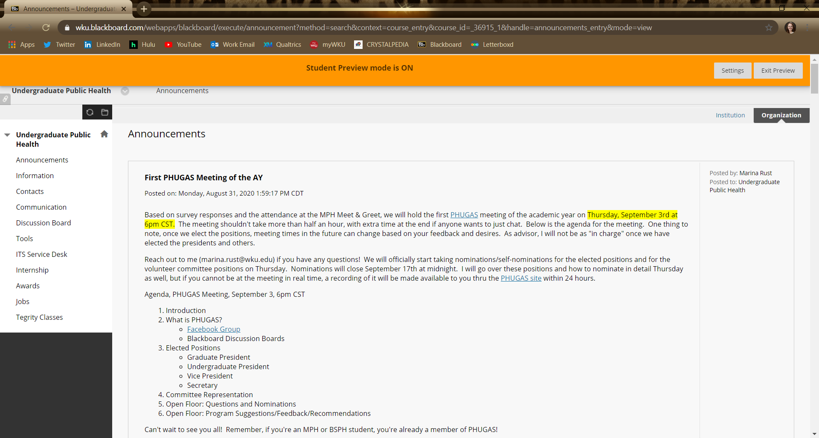
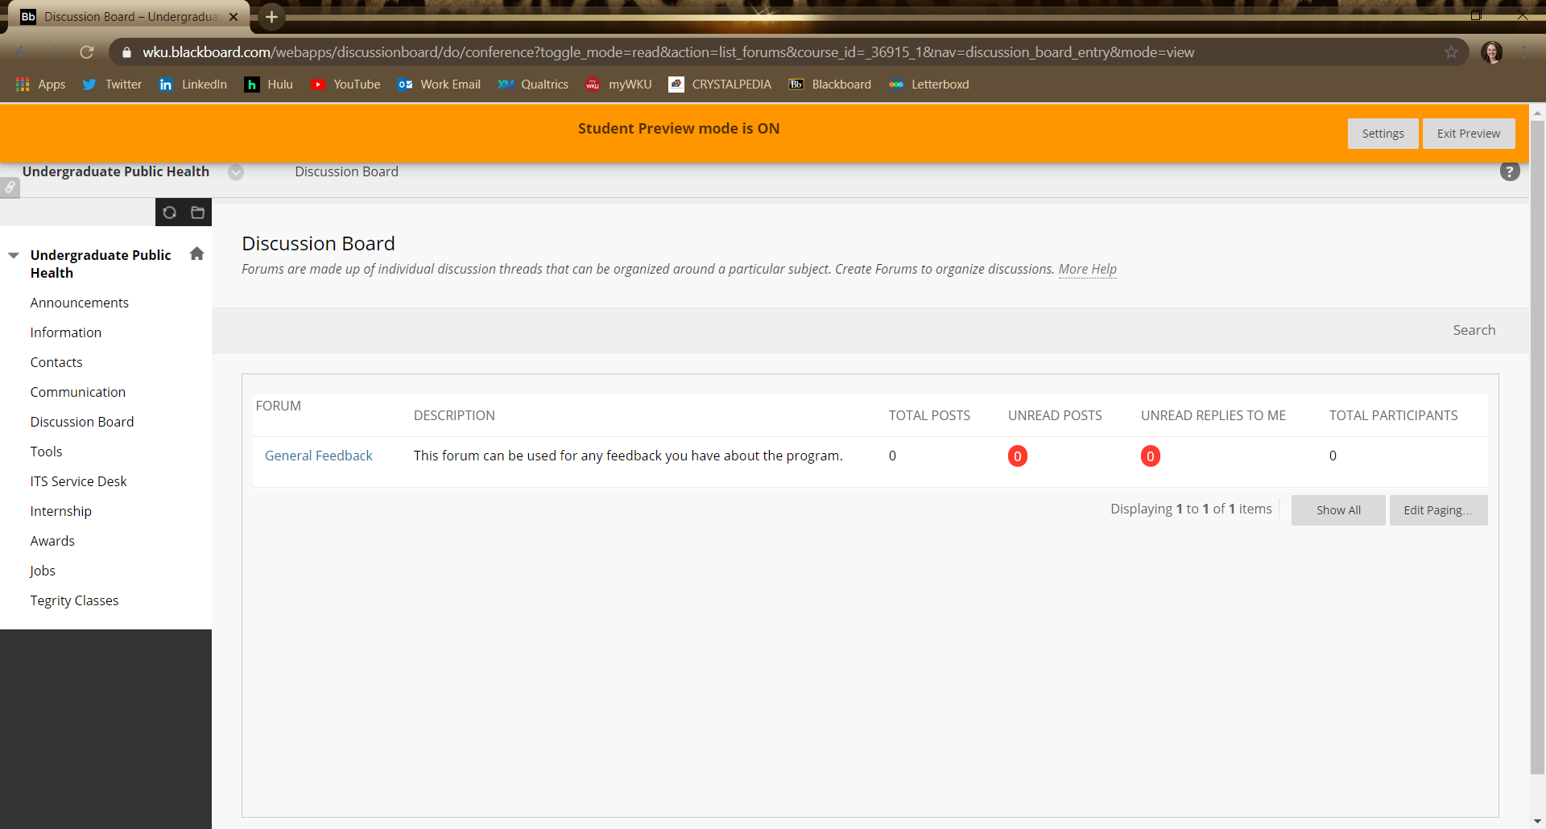
Notes:
If you view this in presentation mode, you will see the announcement screen of the BSPH organizational site. The screenshot shown now is what the discussion board tab opens up to. The screenshot shown now is what the discussion board tab opens up to. To post, you will open a forum and create or respond to a thread.

Slide 7
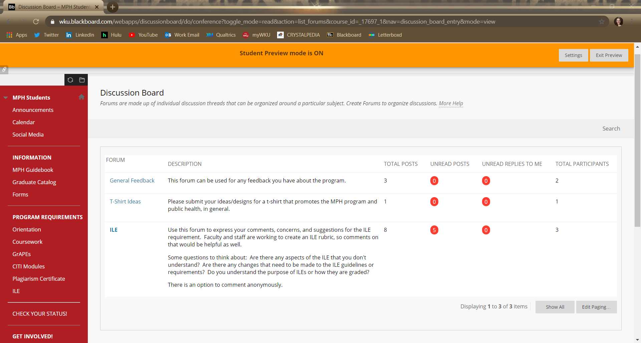
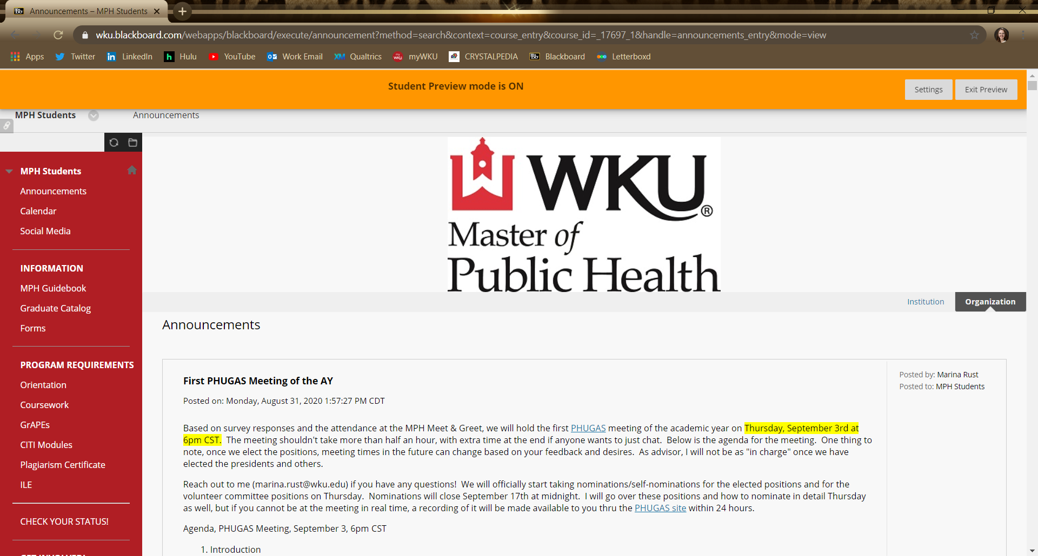
Notes:
If you view this in presentation mode, you will see the announcement screen of the MPH organizational site. The screenshot shown now is what the discussion board tab opens up to. To post, you will open a forum and create or respond to a thread.

Slide 8
Elected Positions
Undergraduate and Graduate Presidents
  Set, plan, and lead PHUGAS meetings
  Create agendas for the PHUGAS meetings
  Carry out any necessary RSO work
  Collect student feedback to present at Joint MPH-BSPH Meetings
  Attend the Joint MPH-BSPH Meetings
Vice President
  Collect discussion board and Facebook feedback to present at PHUGAS meetings
  Can be delegated other duties by the Presidents
  Can fill in for either President at the Joint MPH-BSPH Meetings
Secretary
  Make sure meeting recording and minutes are available ASAP after a PHUGAS meeting
  Announce meetings on the Facebook page and make sure all reports and agendas are available on the PHUGAS website
  Can be delegated other duties by the Presidents
*All elected positions are expected to be at as many PHUGAS meetings as possible.*
Notes:
There are a total of 4 elected positions, two Presidents (one graduate, one undergraduate), a Vice President, and a Secretary. All of these duties are negotiable between positions. This is simply my suggestion. The bylaws are fairly vague about duties, and we can update the bylaws if needed.

Slide 9

PHUGAS Webpage
Here, you can find the dates and times of the meetings
  Agendas
  Zoom Links (temp)
  Video Recordings
  Minutes
Link to the list of Joint MPH-BSPH Meetings (Presidents)
Vice President makes sure I keep this updated; won’t be able to get access to OU Campus
Notes:
This is the PHUGAS webpage, where you can find a list of previous meeting dates, meeting agendas, meeting presentations, meeting minutes, and a copy of the bylaws. You will also find links to the Joint MPH-BSPH meetings that the Presidents need to attend when possible and to the current committee structure. You can find this page by Googling “WKU PHUGAS,” by holding down CTRL and clicking the screenshot, or by going to wku.edu/publichealth/phugas.php

Slide 10
Timeline
September 3
First PHUGAS meeting of the AY
September 9
First Joint MPH-BSPH Meeting
September 17
Nominations Close at 11:59pm
September 18
Voting Begins
October 2
Voting Closes at 11:59pm
Notes:
This is a brief timeline of nominating and voting for elected positions.

Slide 11
Committee Representation
In the past, there have been 4 committees on which a student could represent the student body. Some of these committees may be consolidated in the future, so this list may change soon.
  Undergraduate Curriculum
  Graduate Curriculum
  Diversity, Inclusion, & Equity
  Assessment
These positions are volunteer, not elected. If this becomes a problem, we can change the Bylaws or vote on an exception.
Committee representative expectations:
  Attend the committee’s meetings (for most, 1/semester with emails between)
  Share student feedback or ideas as it relates in those committee meetings
  Write a report on what was discussed at the committee meeting
  Give the report at PHUGAS meetings and take feedback, questions, ideas, etc. to take back to the committee
Notes:
The committee structure may be consolidated soon, so this may update. I should find out more on September 9; therefore, I will start asking for volunteers for these committee representatives after that date.

Slide 12
Questions?
Email any nominations or other questions to marina.rust@wku.edu

Slide 13
Suggestions, Feedback, Recommendations

