Slide 1

Department of Public Health
Award & Hooding Ceremony
May 11, 2019

Slide 2
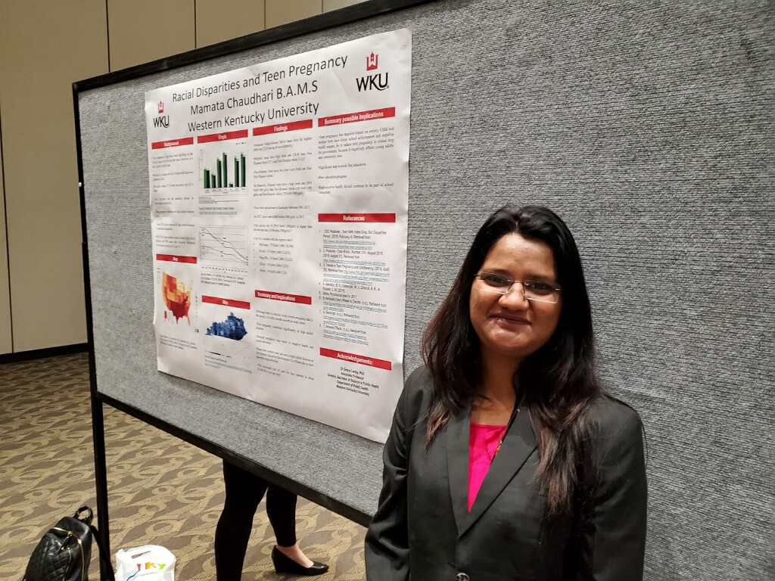
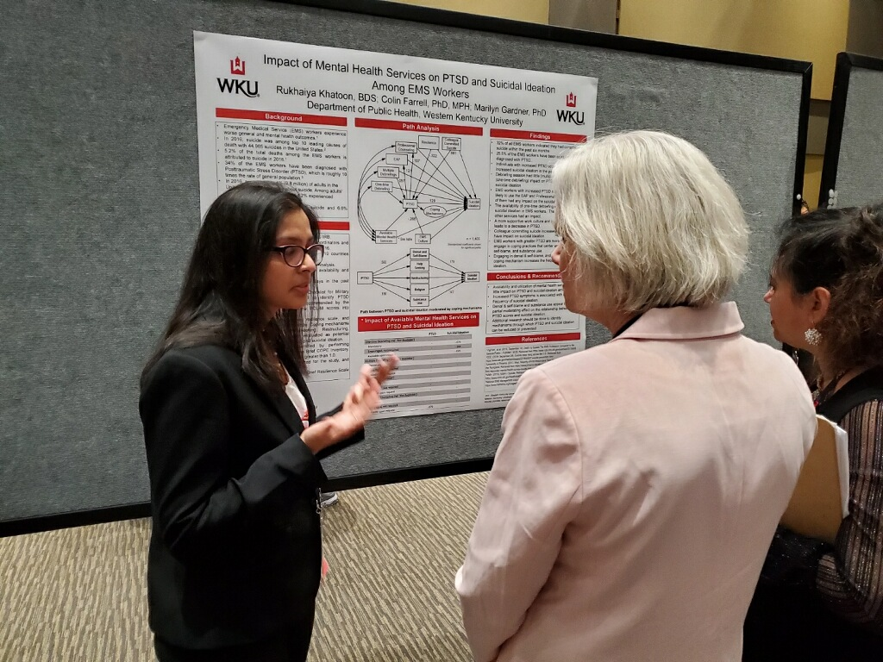
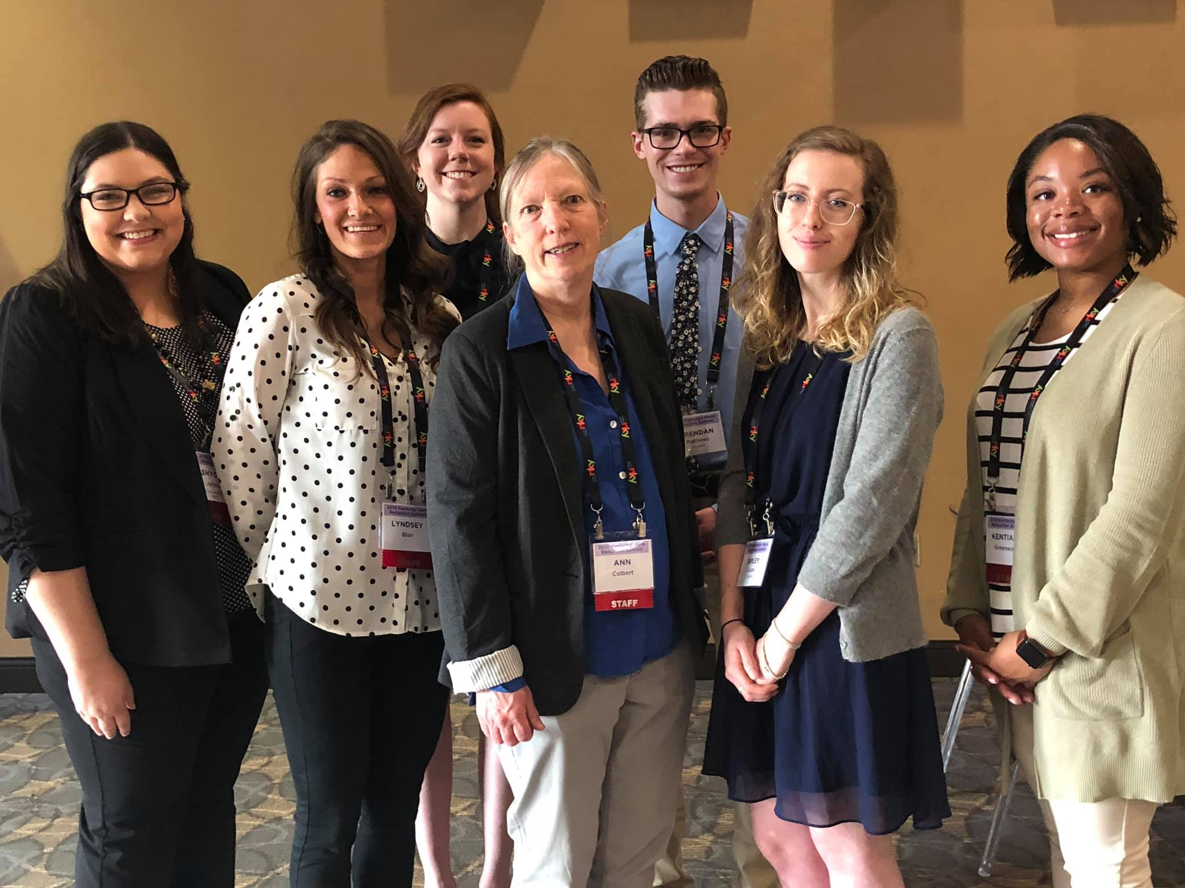
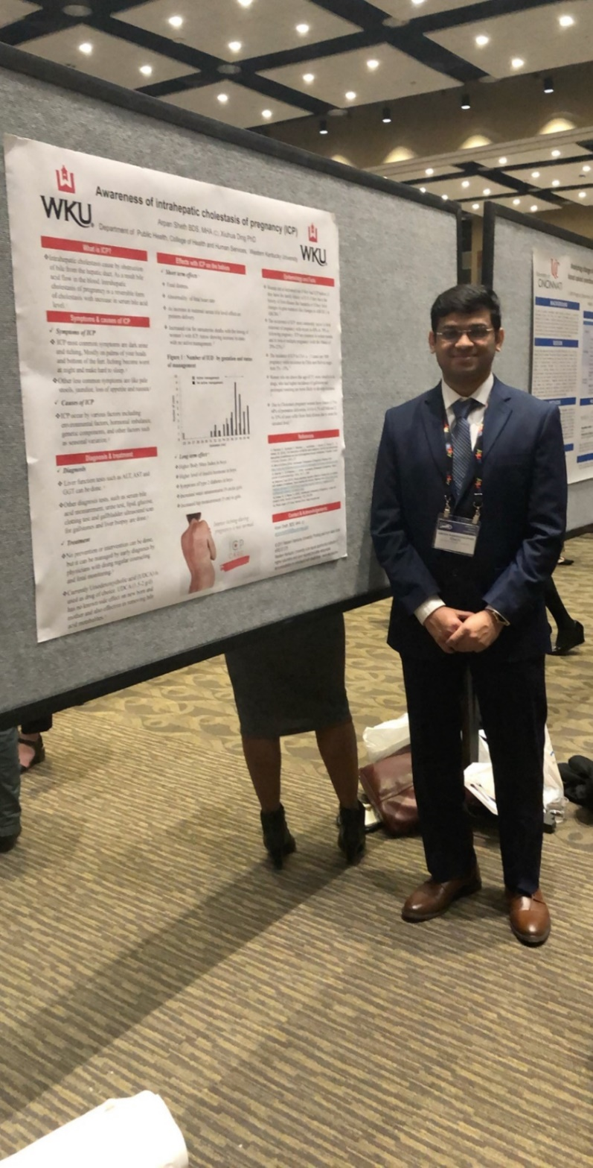
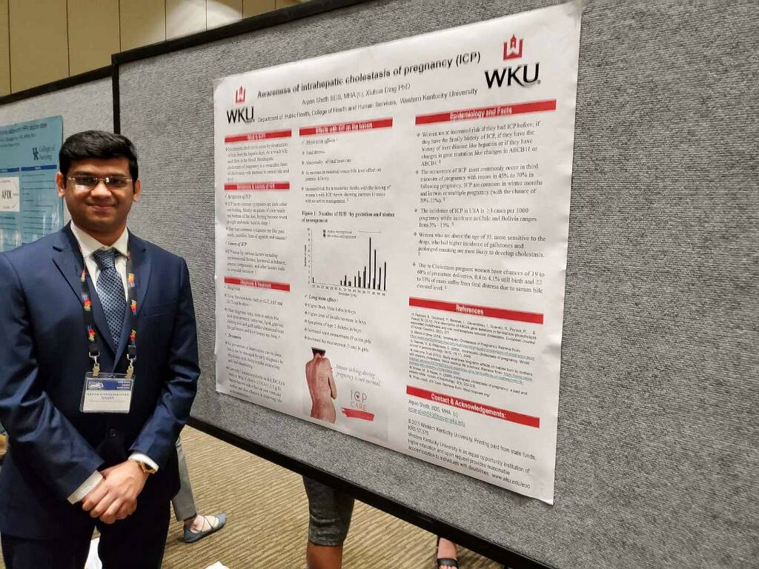

Slide 3
Master of Science
Environmental & Occupational Health Science Graduates

Slide 4
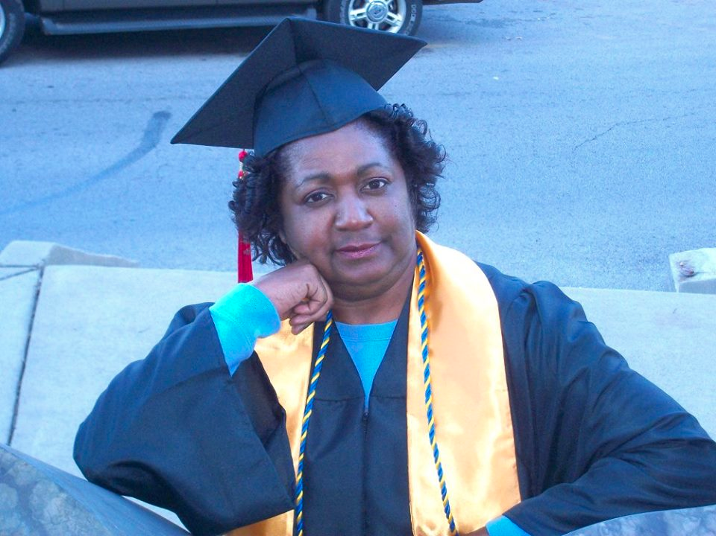
Jemitta Burroughs
Miami, Florida
Live Your Dream.

Slide 5
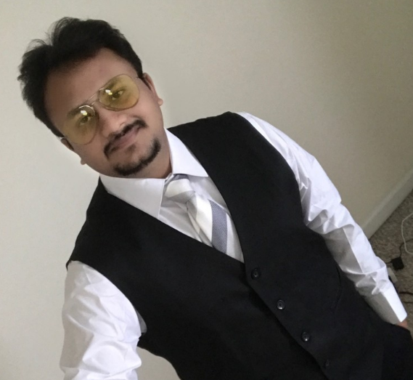
Viraj Christian
Vadodara, Gujarat, India
Education is the most powerful weapon which you can use to change the world.

Slide 6
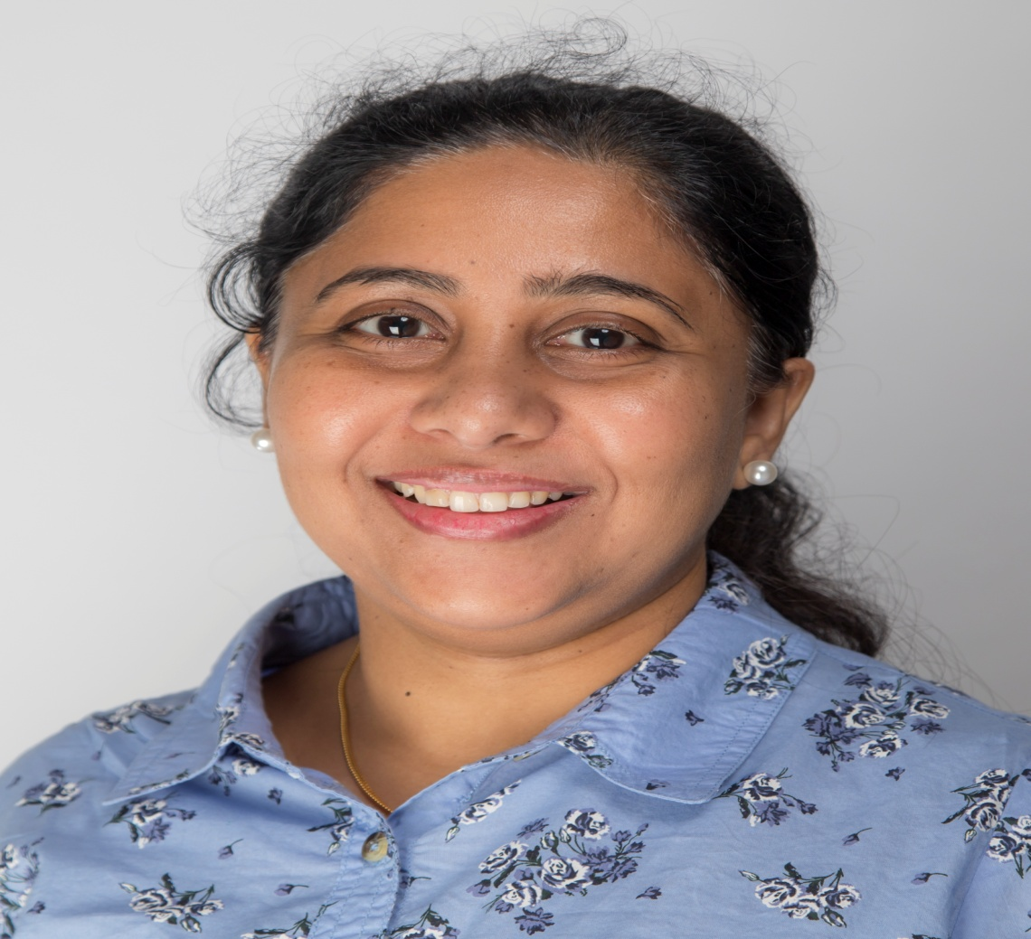
Preethi Dugyala
Hyderabad, Telangana, India
“The bad news is time flies. The good news is you’re the pilot.”
-Michael Altshuler

Slide 7
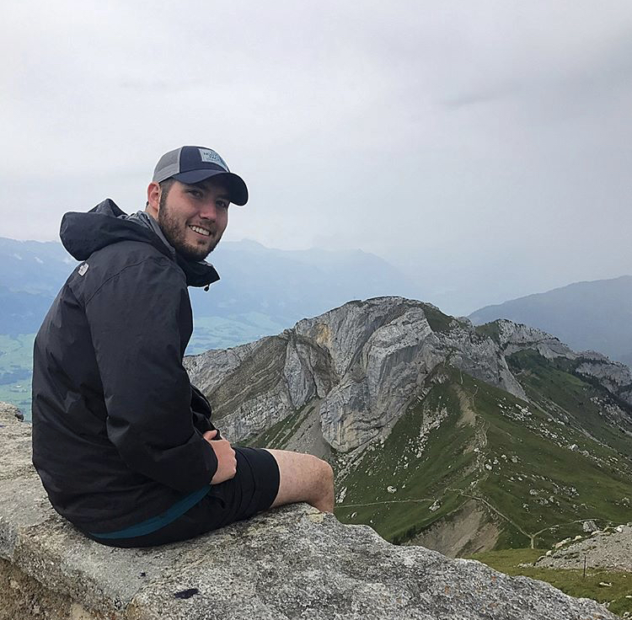
Braxton Johnson
Bowling Green, Kentucky
“It is hard to fail, but it is worse never to have tried to succeed.”
              -Theodore Roosevelt

Slide 8
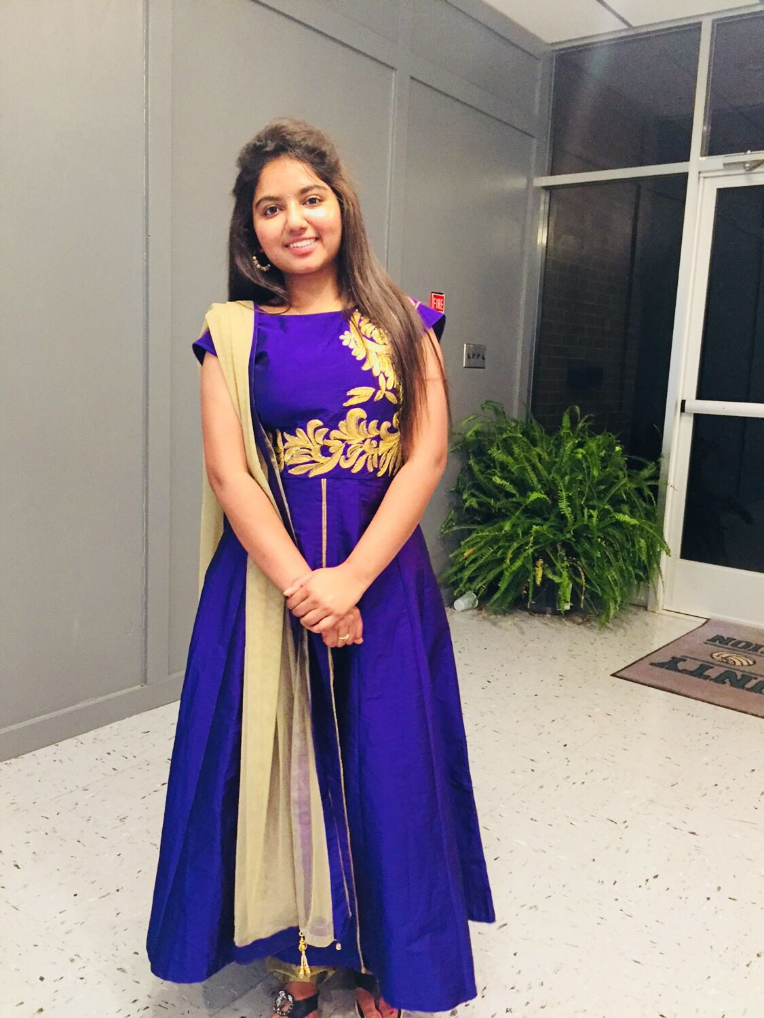
Sweety Seelam
Secunderabad, Telangana, India
WKU is a best place through which we can achieve our dreams.

Slide 9
Master of Health Administration Graduates

Slide 10
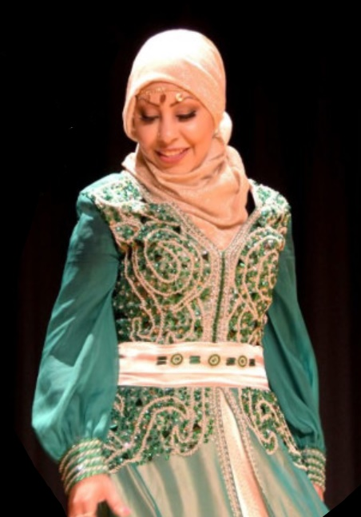
Sukainah Al Shahab

Slide 11
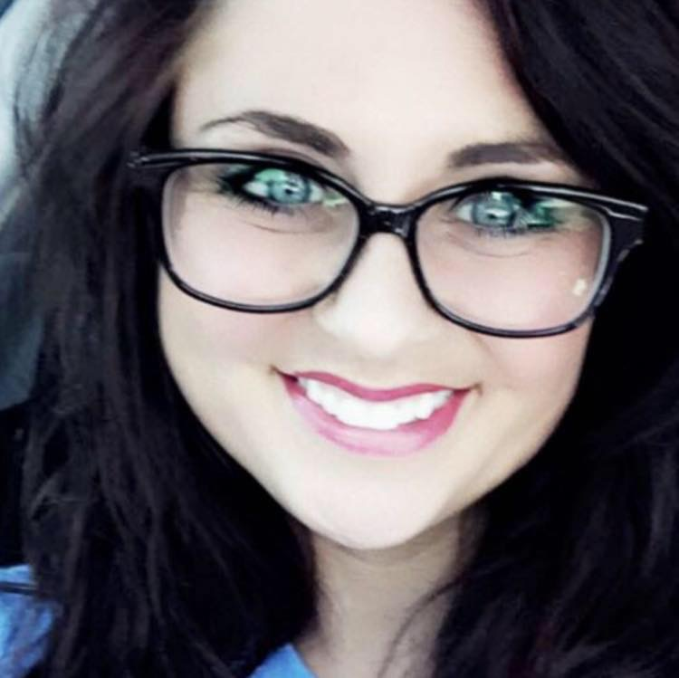
Megan Brown
Sebree, Kentucky
Thank you to WKU and all EMHA professors and instructors for making this accomplishment possible.

Slide 12
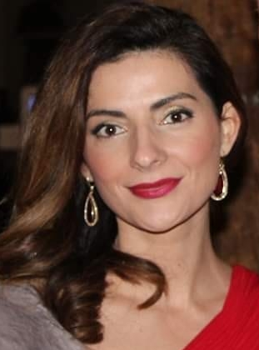
Brunilda Cross
Smiths Grove, Kentucky
Nothing is impossible;
The word itself says
I’m Possible!

Slide 13
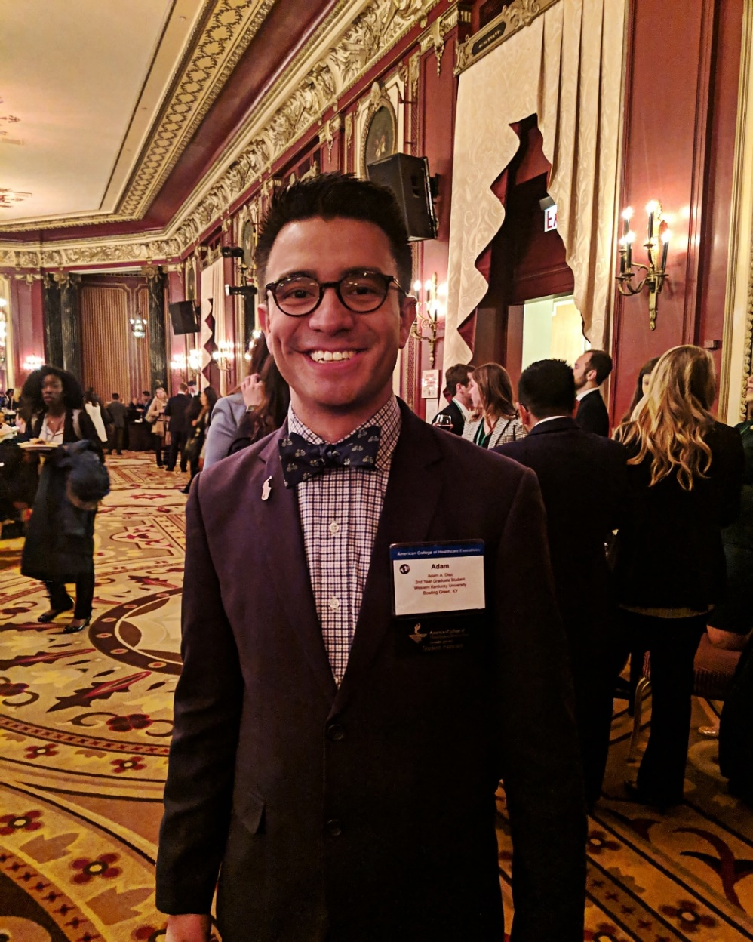
Adam A. Diaz
Clarksville, Tennessee
“Only those who will risk going too far can possibly find out how far one can go.”
                -T.S. Eliot

Slide 14

Tonia Haddow
Detroit, Michigan
“The future belongs to those who believe in the beauty of their dreams.”
        - Eleanor Roosevelt

Slide 15
Israel Moore
Bowling Green, Kentucky
“For I know the plans I have for you, plans to prosper you and not harm you, plans to give you hope and a future.”
    - Jeremiah 29:11

Slide 16
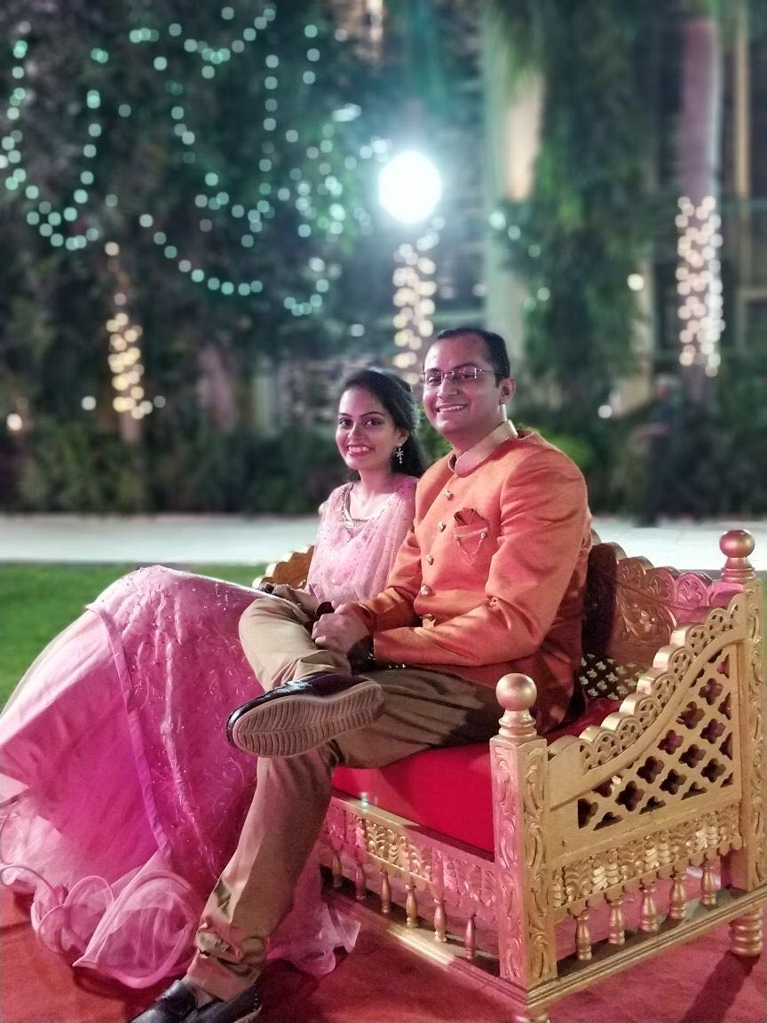
Rajvi Parikh
Ahmedabad, Gujarat, India

Slide 17
Krishna Patel
Ahmedabad, Gujarat, India
“The future belongs to those who believe in the beauty of their dreams.”
- Eleanor Roosevelt

Slide 18
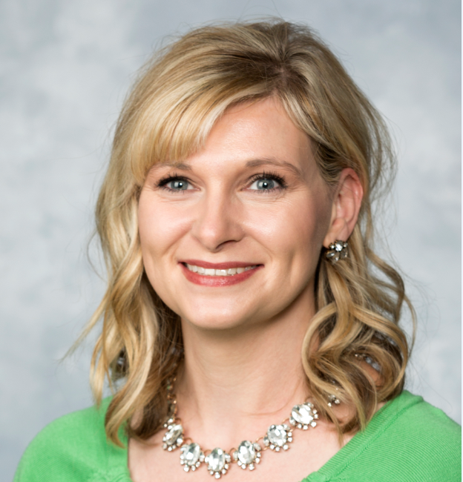
Jessica Lynne Smith
Stamping Ground, Kentucky
“Live like no one else now so later you CAN live like no one else.”
                – Dave Ramsey

Slide 19
Master of Public Health Graduates

Slide 20
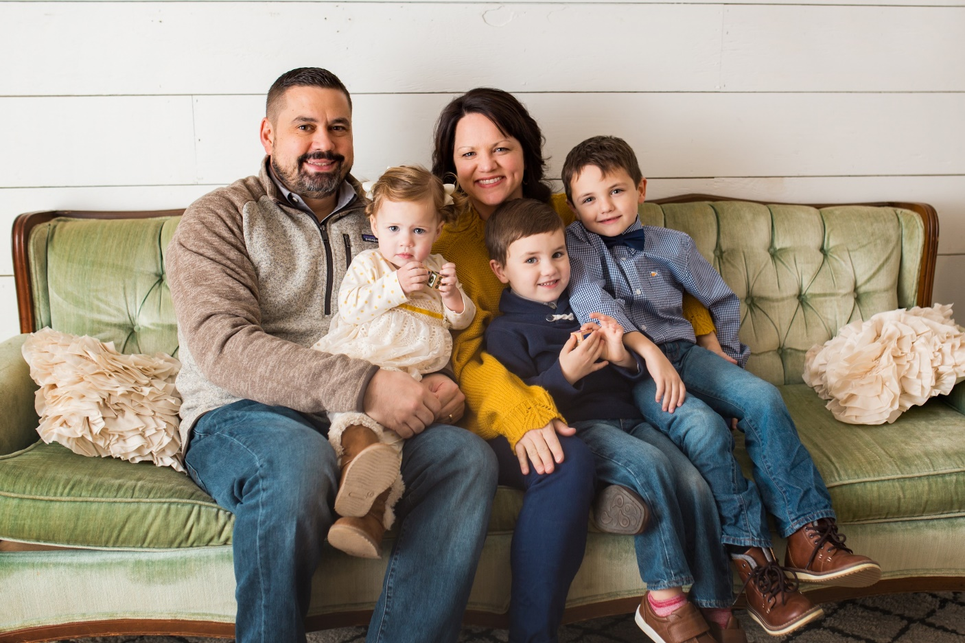
Brandi Breden
Bowling Green, Kentucky
A huge thank you to my amazing family for helping me get this far! XOXOXO

Slide 21
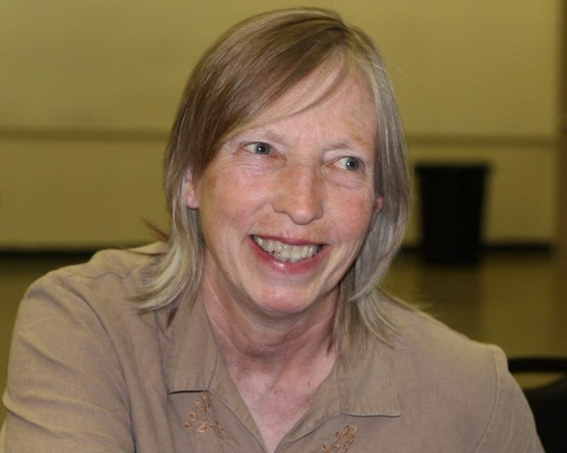
Ann Colbert, MD
Morehead, Kentucky
Learned to see medicine in a completely different way

Slide 22
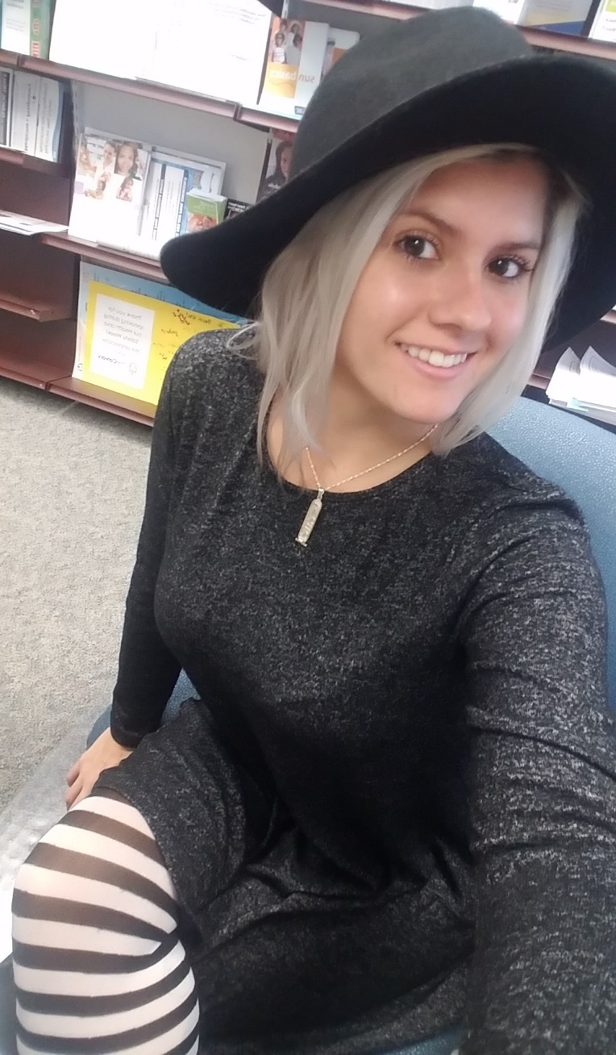
Deanna Couts
Born and raised in Nashville, Tennessee
Residing currently in Cincinnati, Ohio
“They laugh at me because I’m different. I laugh at them because they are all the same.”
              -The Joker, Heath Ledger

Slide 23
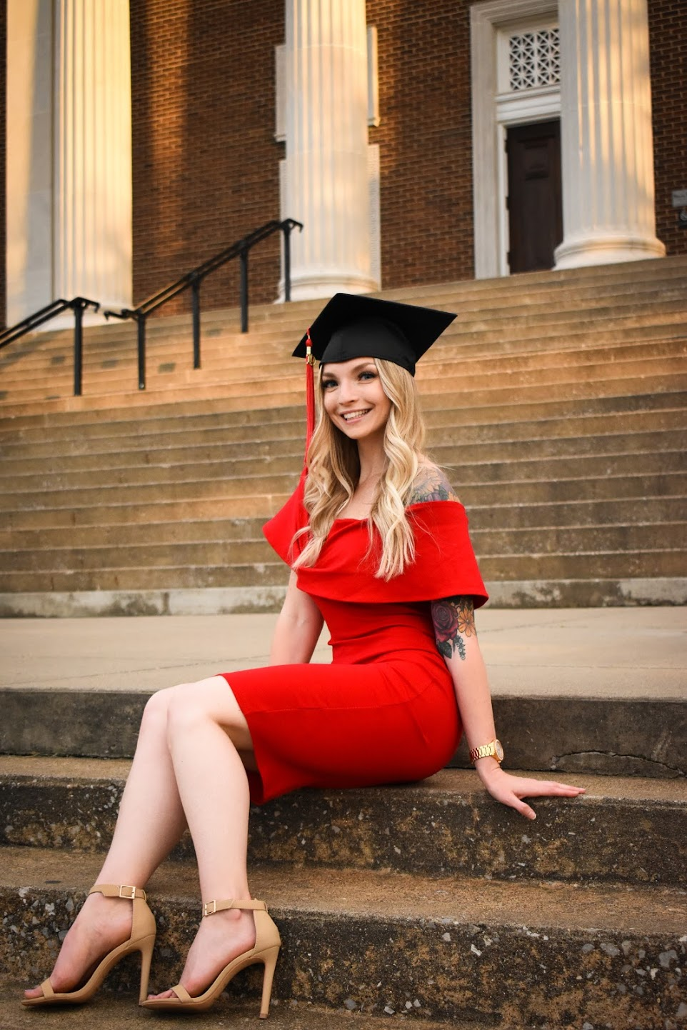
Keriann Granato
Dickson, Tennessee
“He who has health has hope; and he who has hope has everything.”
- Thomas Carlyle

Slide 24
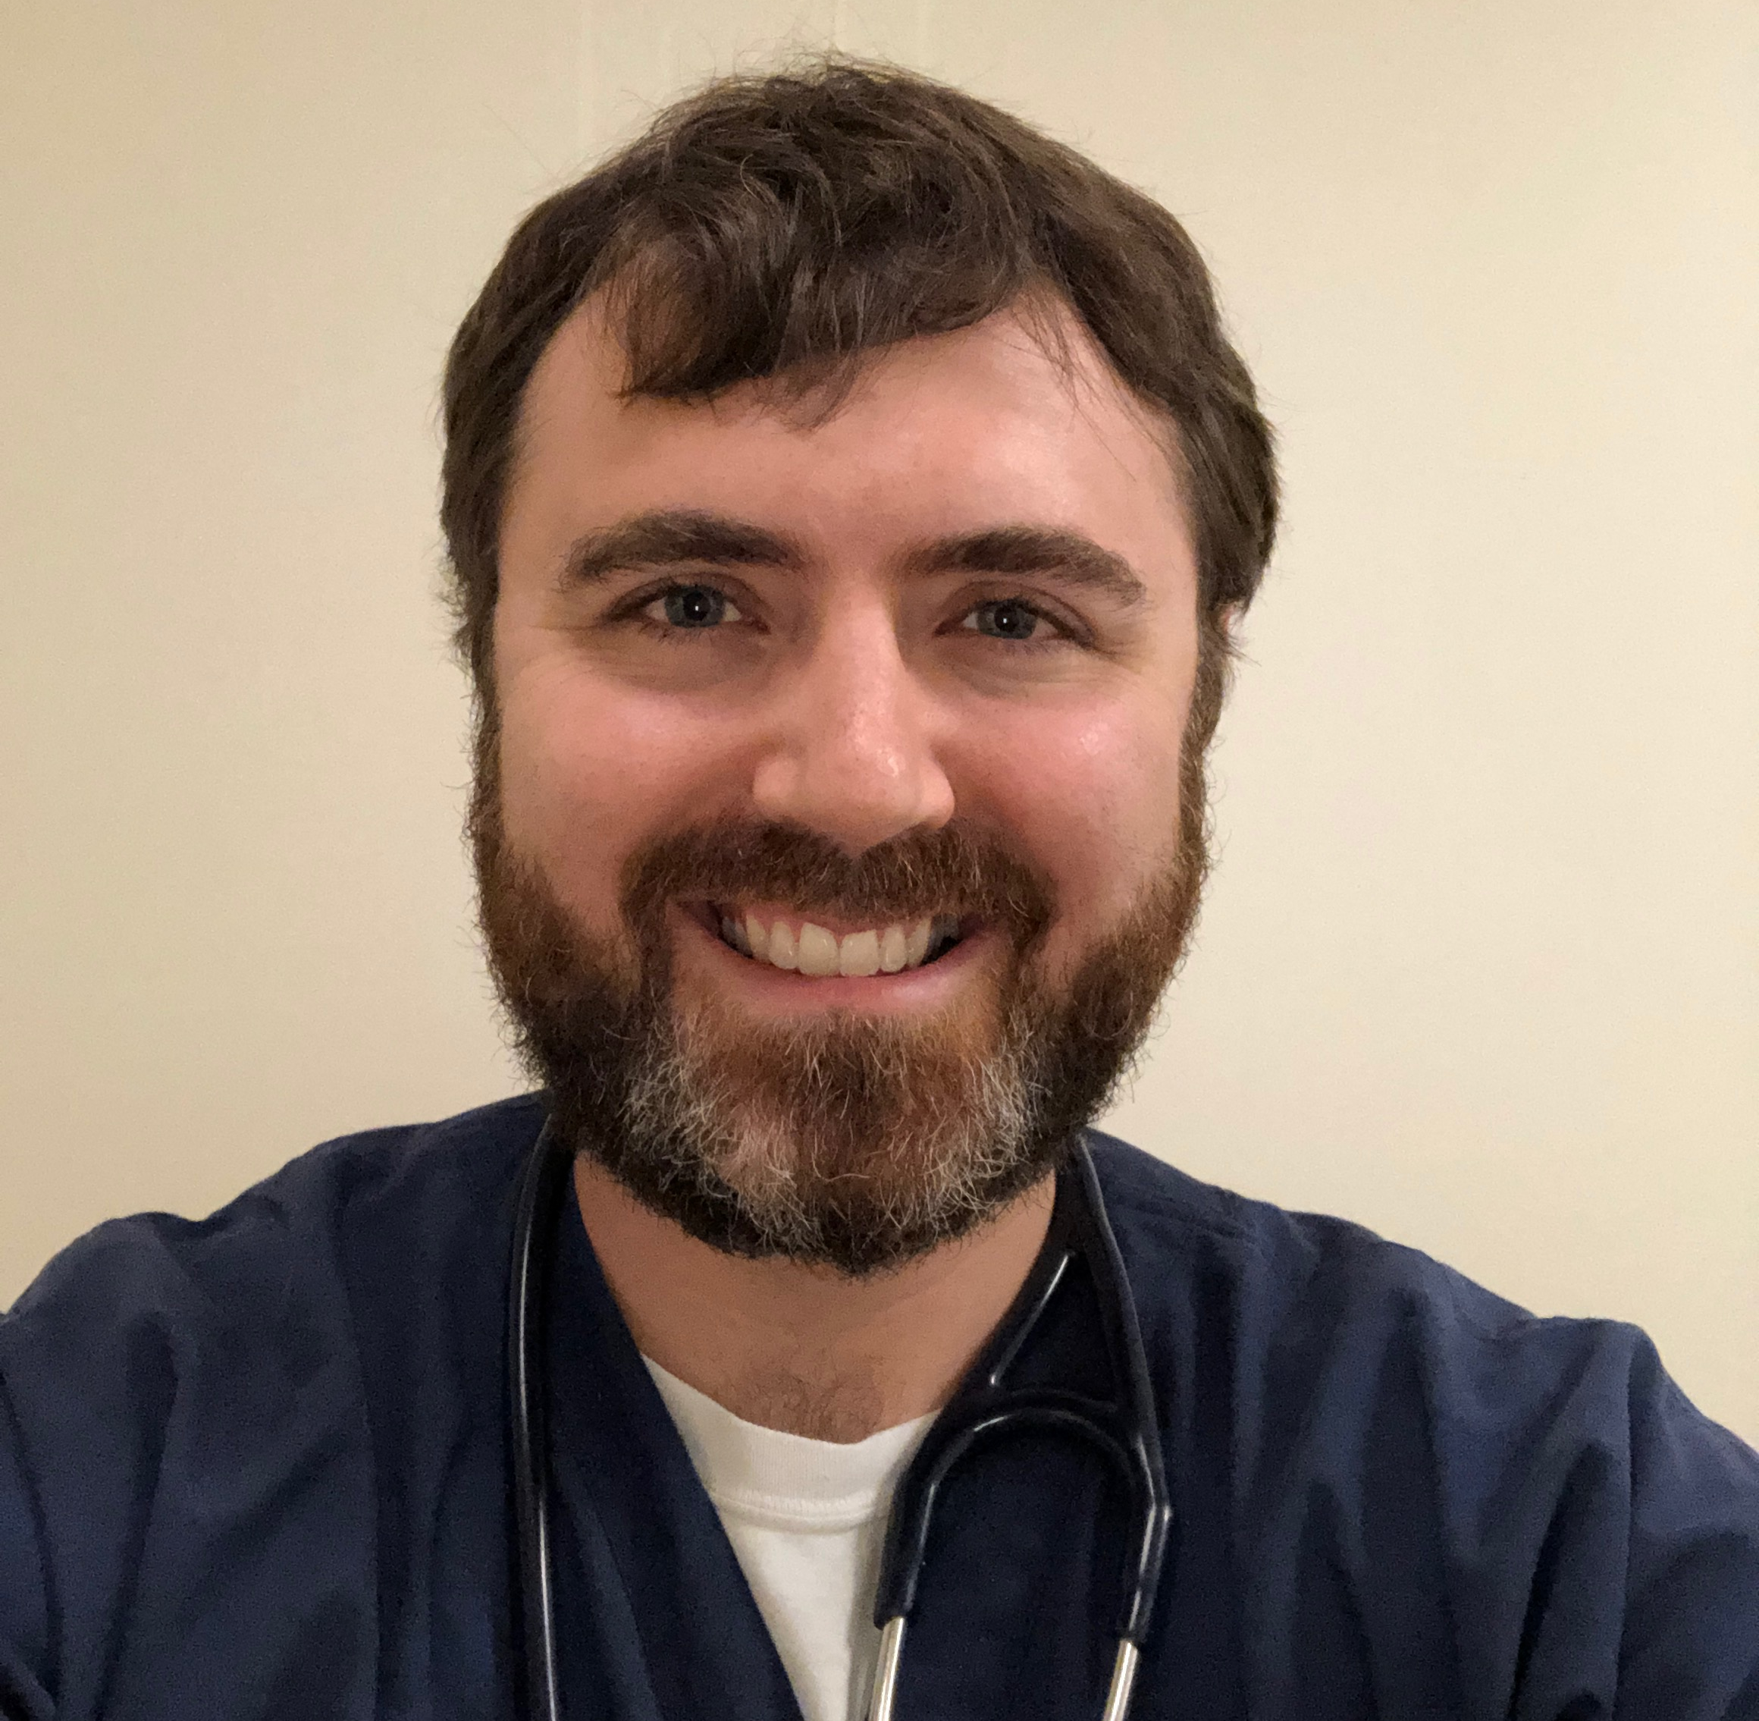
Joel Hamm, MD
Lexington, Kentucky
Soli Deo Gloria.

Slide 25
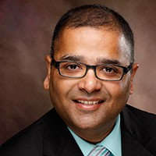
Dixitkumar N Modi, MD
Port Canaveral, Florida

Slide 26
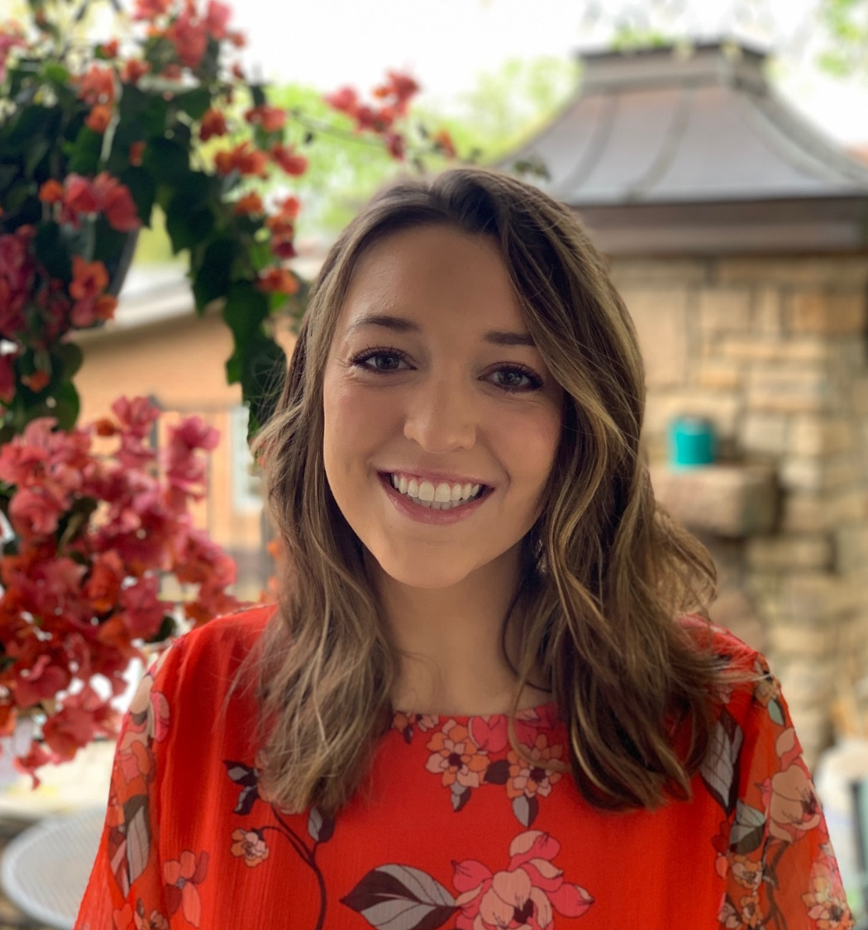
Sara Russo
Park Hills, Kentucky
“Opportunity does not knock, it presents itself when you beat down the door.”
                -Kyle Chandler

Slide 27
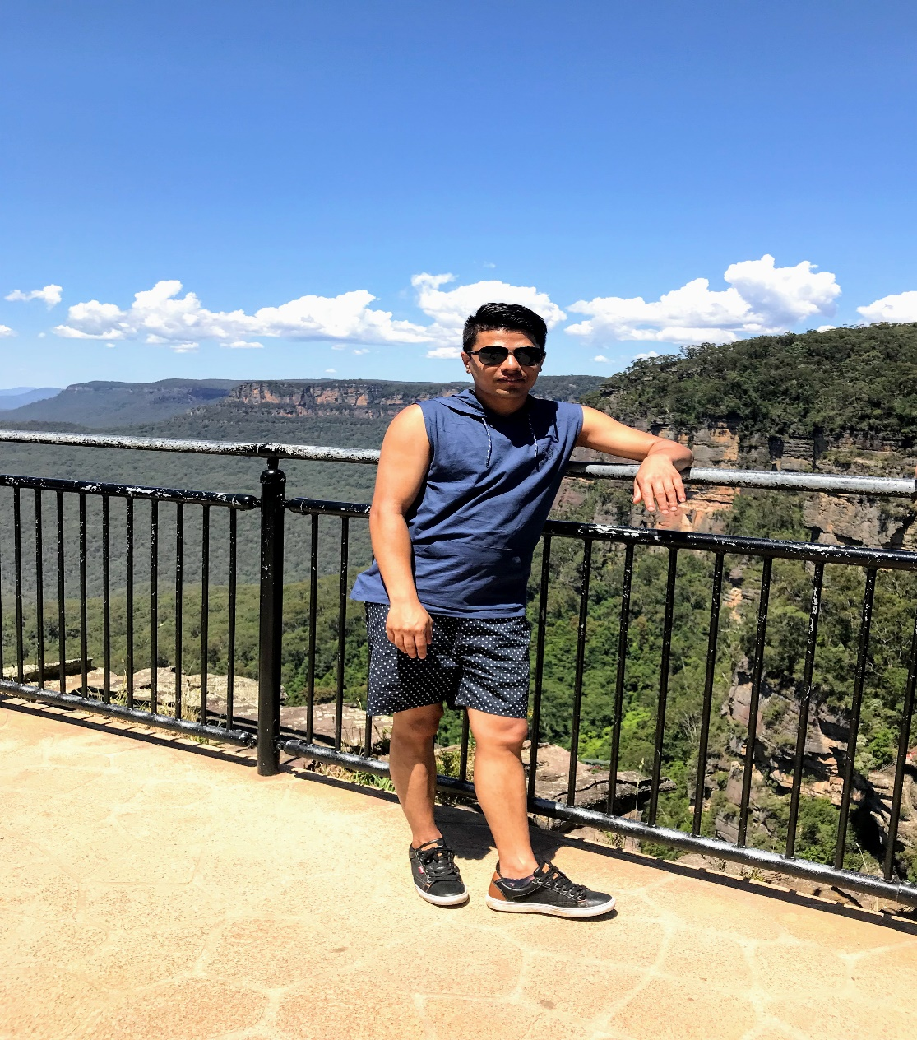
Ravi B Shrestha
Kirtipur, Kathmandu, Nepal
Dream big and make it come true.

Slide 28
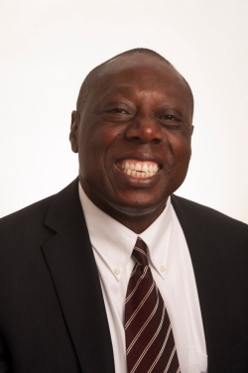
David Tataw, Ph.D.
Chino Hills, California

Slide 29
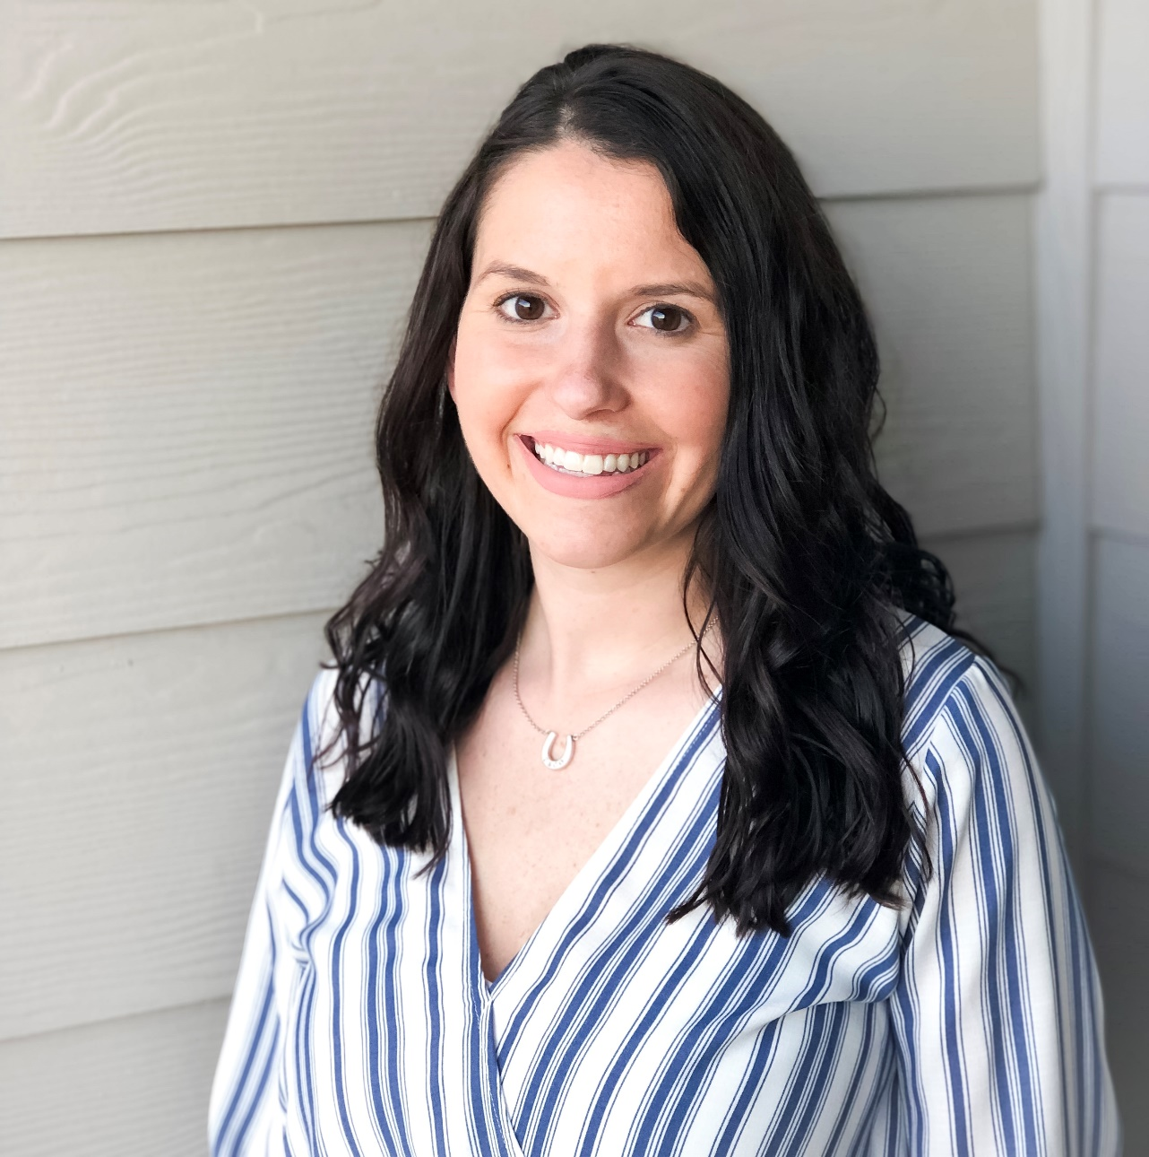
Sarah Tripp
North Lawrence, OH
“It’s not about what it is, it’s about what it can become.”
                - Dr. Seuss
Insert an appropriate picture of yourself here

Slide 30
