Slide 1
Department of Public Health

Slide 2
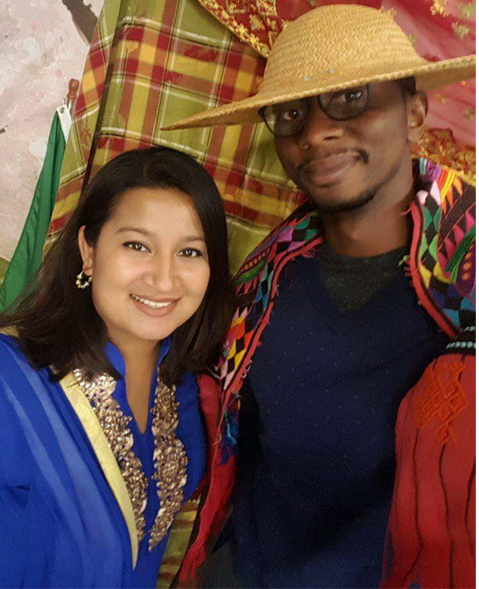
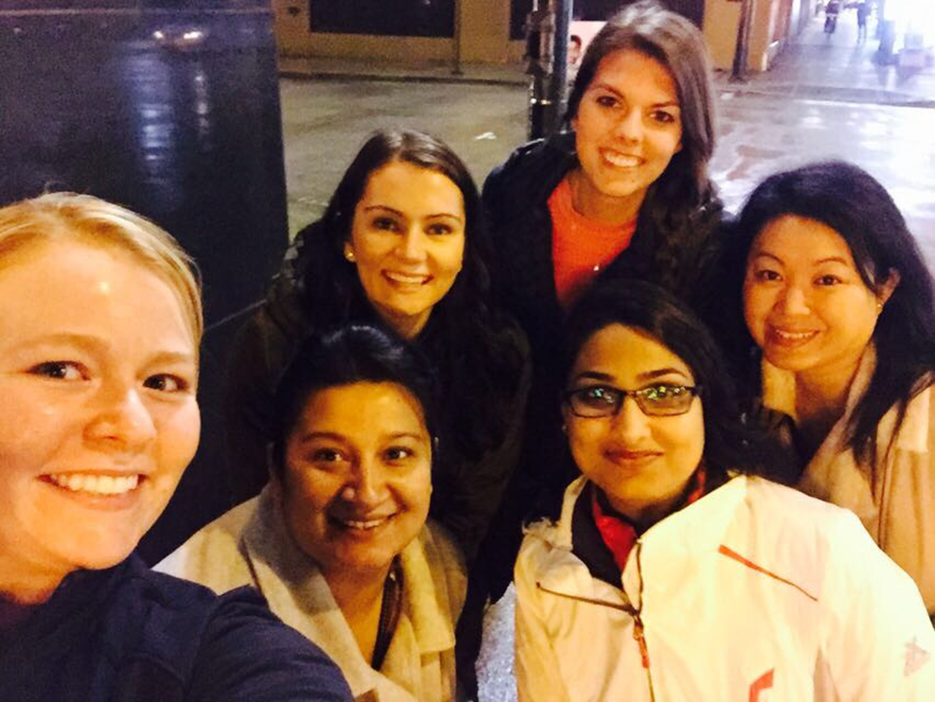
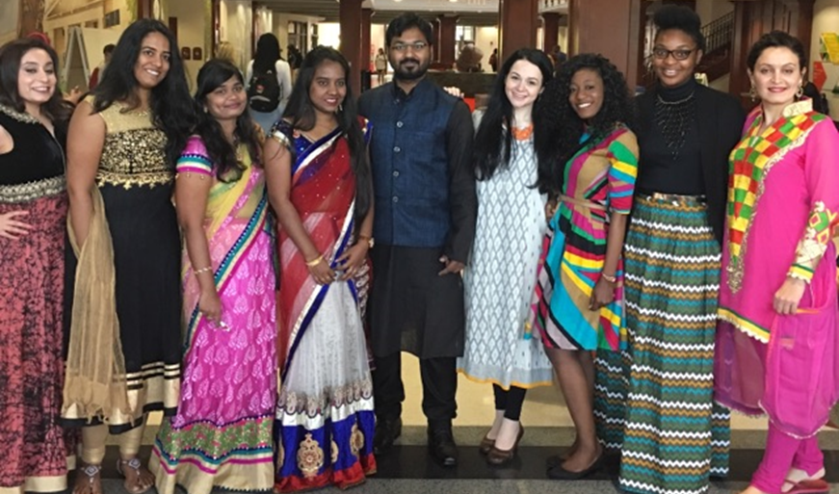
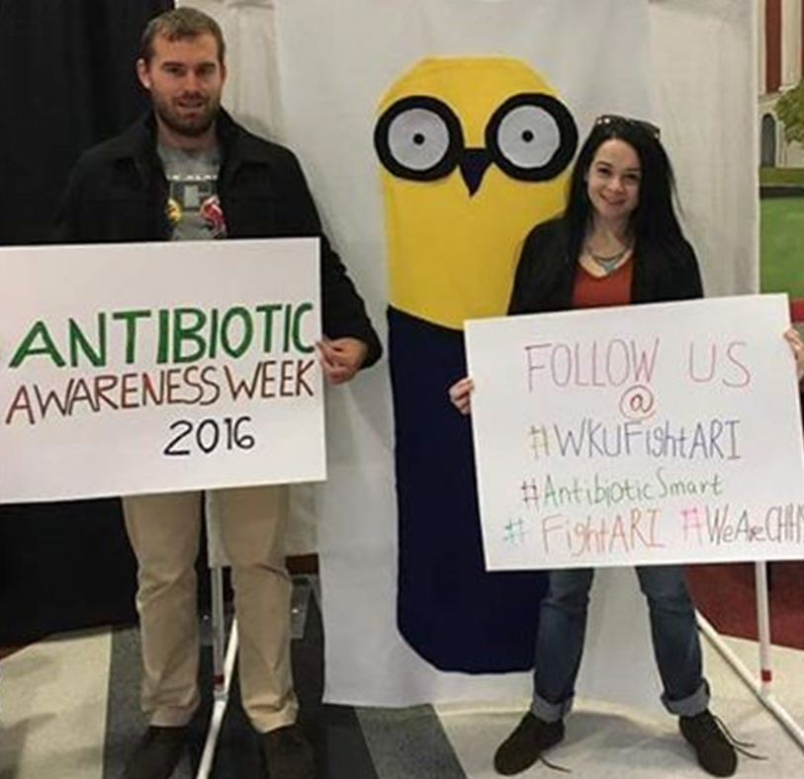
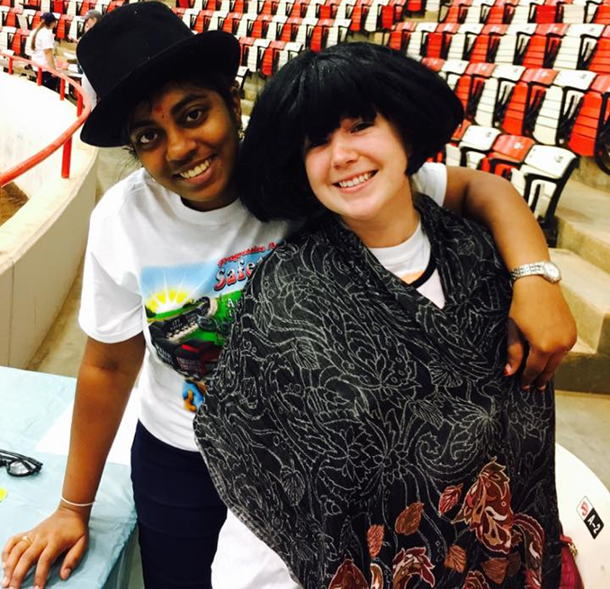
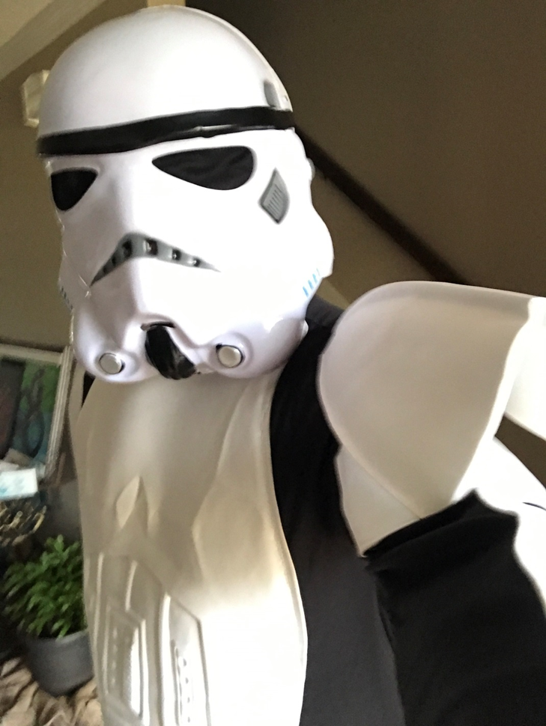
Department of Public Health

Slide 3
Masters of Public Health Graduates

Slide 4
Zona Josephine Ascensio, MPH
Bowling Green, Kentucky
I would like to express my gratitude to the faculty, staff and students of WKU’s Department of Public Health. The guidance, support, education, friendship and laughter they provided strengthened me as I worked through the MPH program. I am forever grateful to have had the opportunity to know and to work with such an excellent group of people. Thanks, guys!

Slide 5
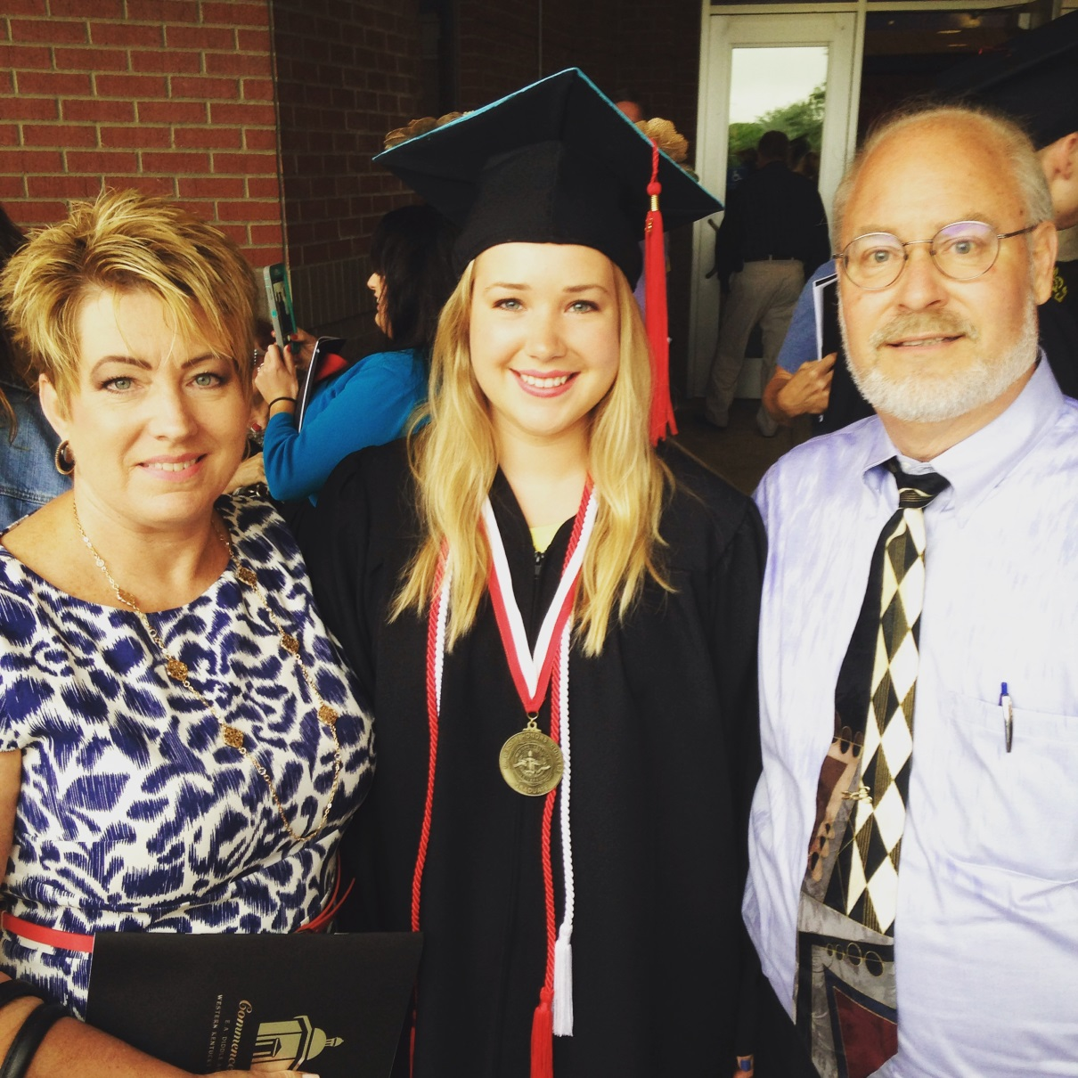
Mollie Berger, MPH
Louisville, Kentucky
“You cannot get through a single day without having an impact on the world around you. What you do makes a difference, and you have to decide what kind of difference you want to make.”
Jane Goodall
Insert an appropriate picture of yourself here

Slide 6
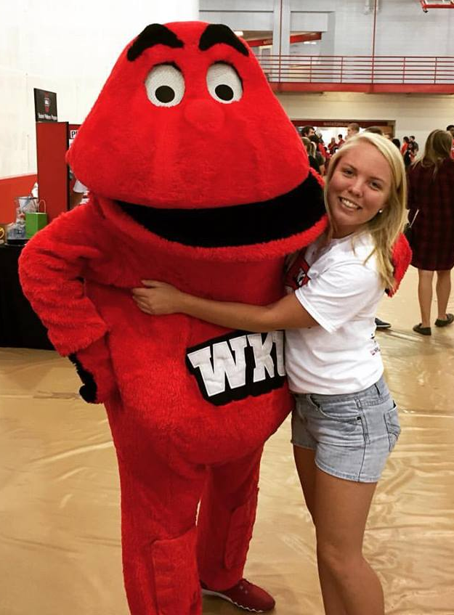
Casey Cahill, MPH
Copperas Cove, Texas
You can’t change the world, but if you help someone, you can change their world.
TOPS ON TOP!

Slide 7
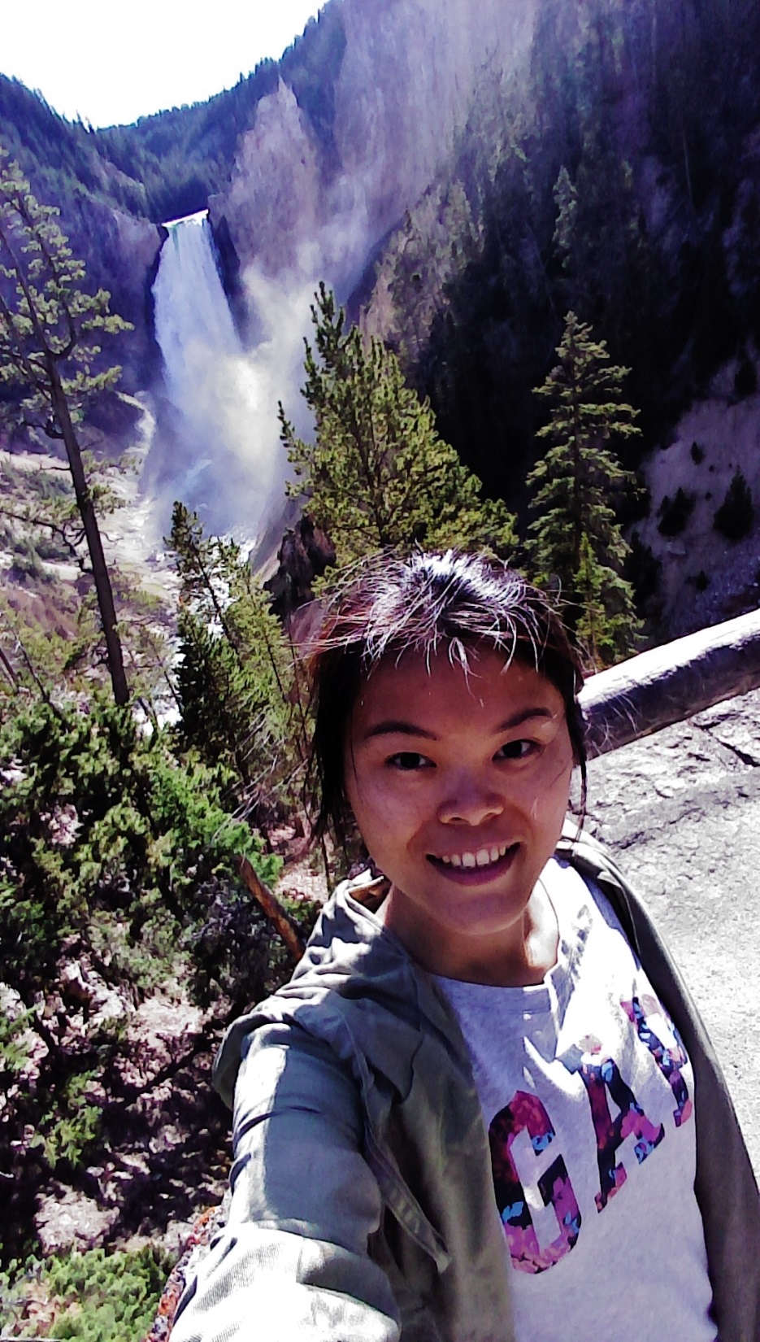
Yu-Hsuan Chen, MPH
Kaohsiung, Taiwan
I came, I saw, I conquered.

Slide 8
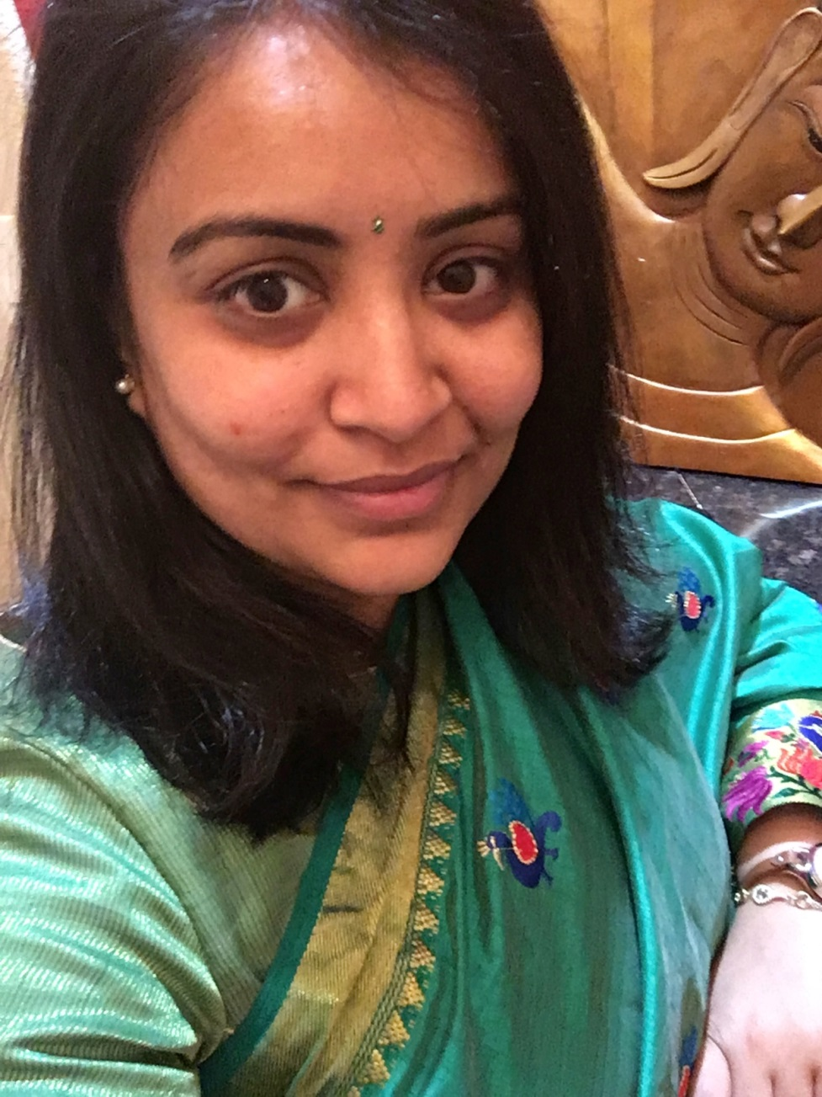
Jasmin Patel, MPH
Surat, Gujarat, India
WKU has positively impacted me by preparing me to follow my passion, helped me widen my perspectives, improve my skills, and search for better opportunities.

Slide 9
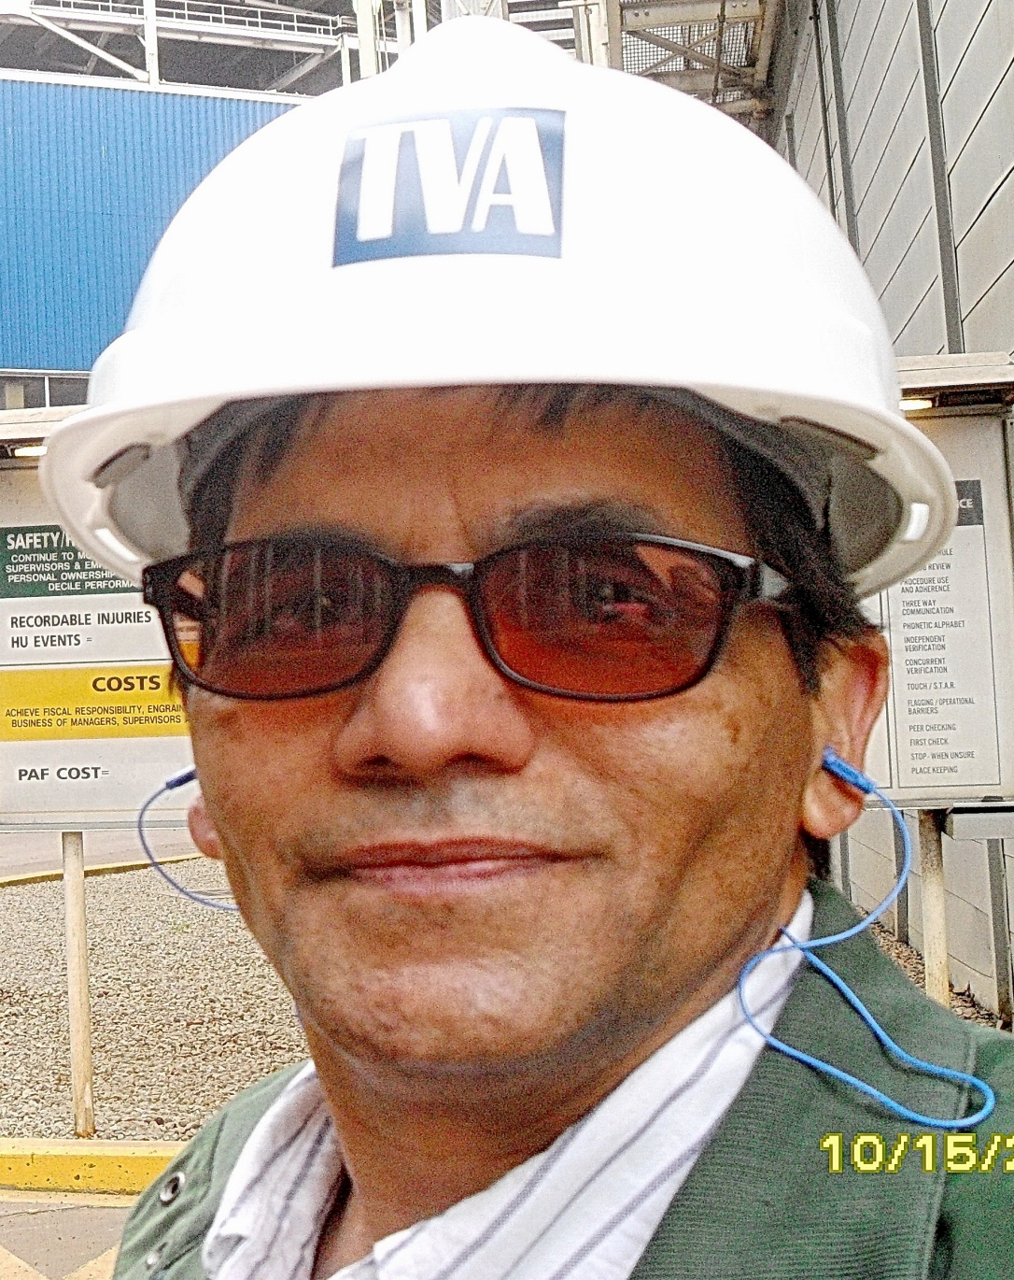
Gauher Saeed, MPH
Nashville, Tennessee
“One thing I know,
that I know nothing,
this is the source of
my wisdom.”
Socrates

Slide 10
Sujaya Thogaru-Rekala, MPH
Hyderabad, Telangana, India
I can do all things through Christ who gives me strength.
Philippians 4:13

Slide 11
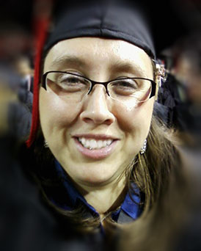
Amy Elizabeth Thomas-Hook, MPH
Park City, Kentucky
“It always seems impossible until it’s done”
Nelson Mandela

Slide 12
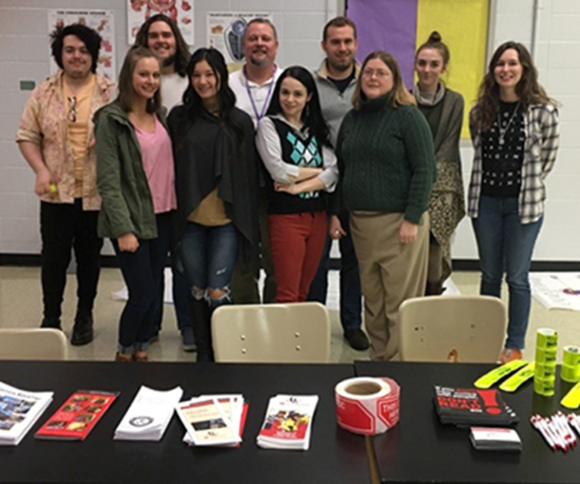
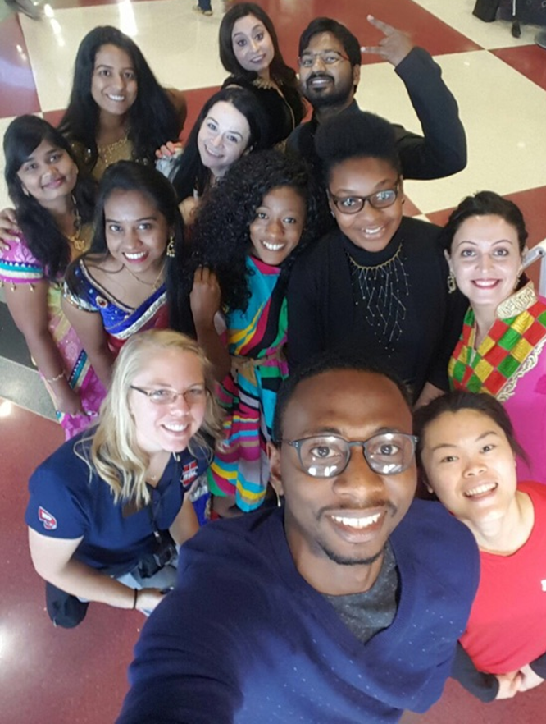
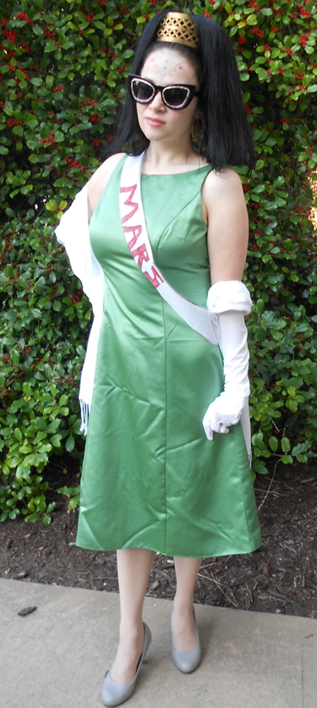
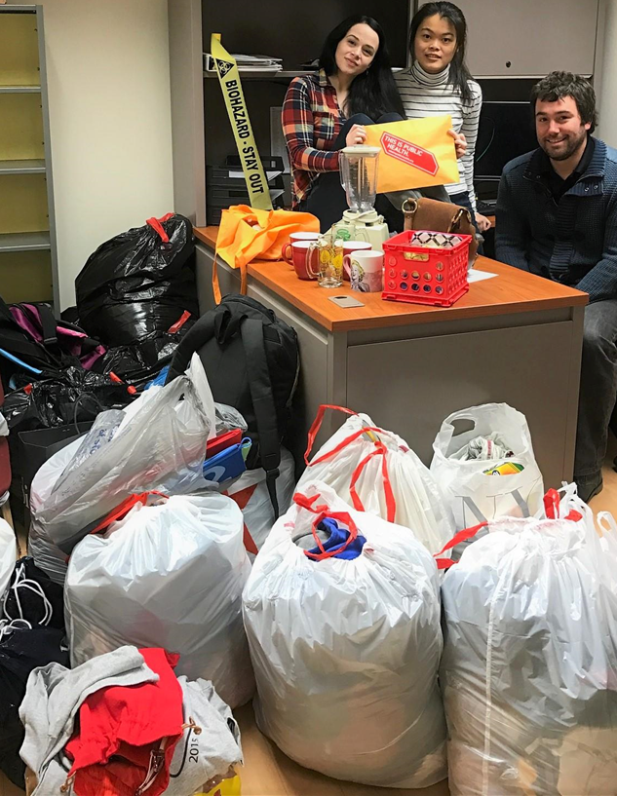

Slide 13
Masters of Science Environmental & Occupational Health & Safety Graduates

Slide 14
Bethany (Lusk) Bertram, MS-EOHS
Russell Springs, Kentucky
I have appreciated my 6 long years at WKU, and will miss everyone from my program! The professors have been so inspiring and helpful, and I cannot wait to take what I’ve learned and apply it. ☺

Slide 15
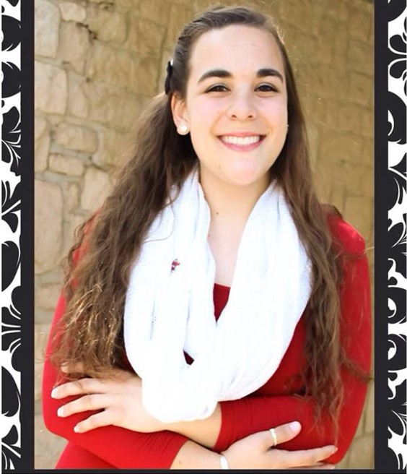
Rebecca Lauth, MS-EOHS
Bowling Green, Kentucky
“Difficult roads often lead to beautiful destinations.”
-Unknown
Graduate school was a challenging endeavor but I have grown exponentially throughout my time here at WKU. Now, with the help and support of my professors I have been able to successfully secure a job as an EHS Coordinator upon graduation!

Slide 16
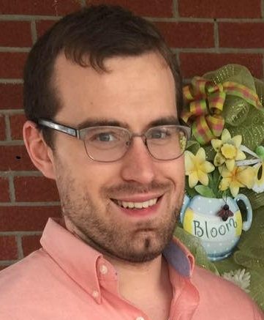
Joseph F. McCarty, MS-EOHS
Owensboro, Kentucky
Life is a garden, dig it.

Slide 17
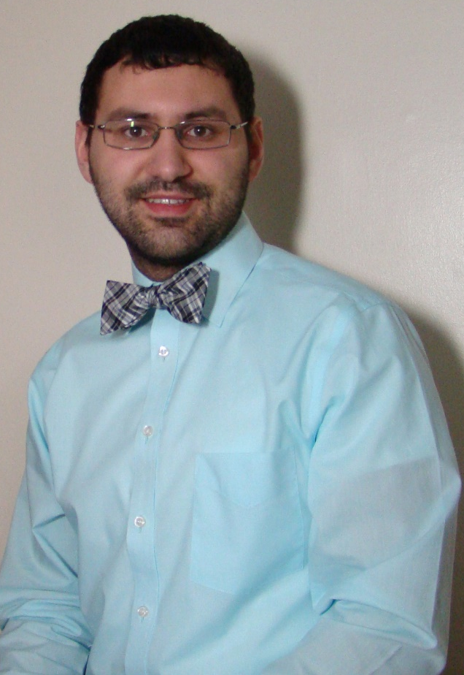
Matthew W. Shirley, MS-EOHS
Columbia, Kentucky
“I believe in Christianity as I believe that the sun has risen: not only because I see it, but because by it I see everything else.”
C.S. Lewis

Slide 18
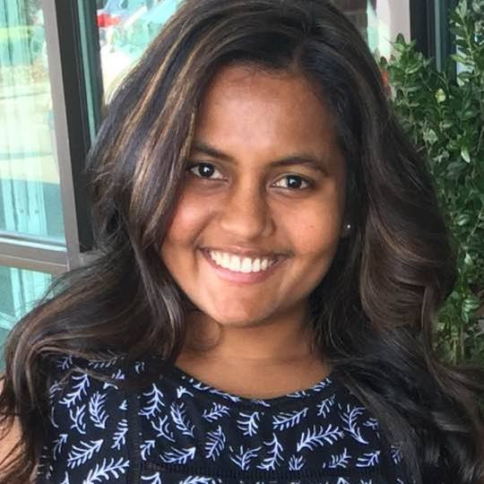
Ramya Thammineni, MS-EOHS
Insert an appropriate picture of yourself here
Visakhapatnam, Andhra Pradesh, India
It was a very rewarding, meaningful experience, which has prepared me for working in this field of expertise.

Slide 19
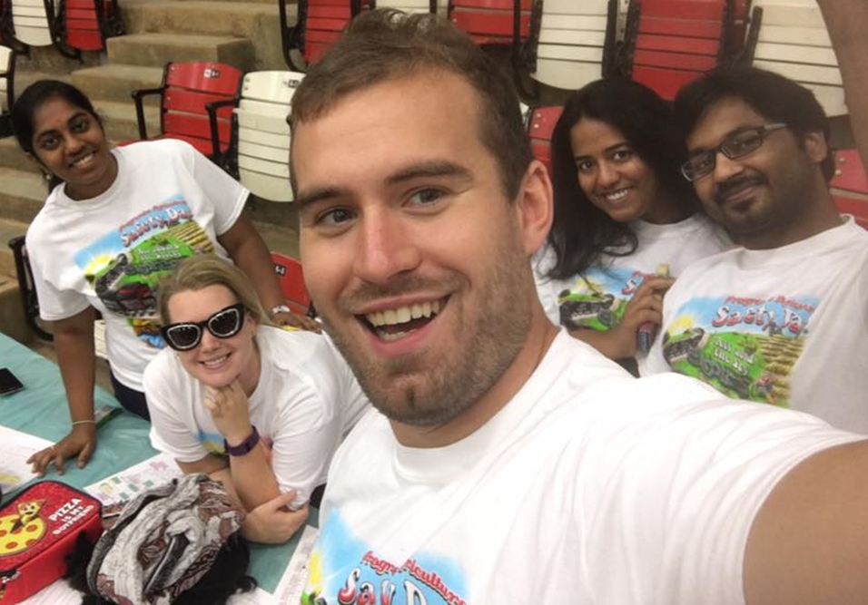
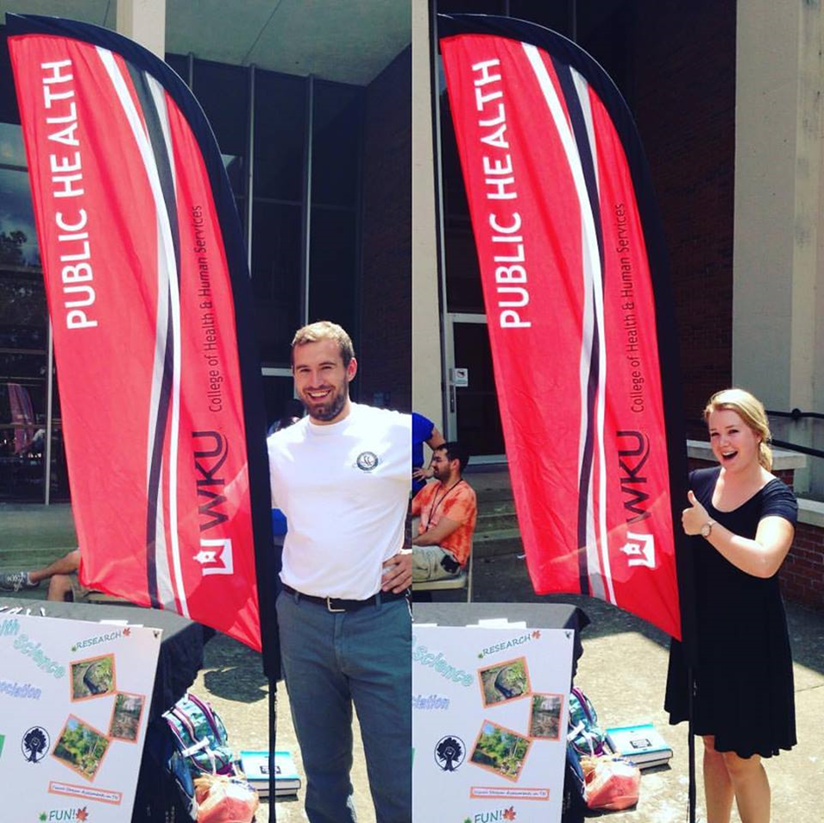
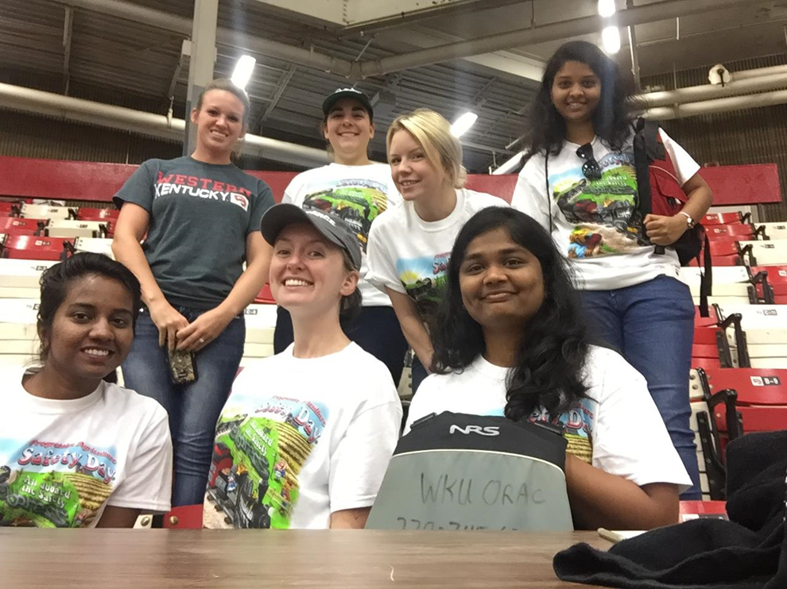
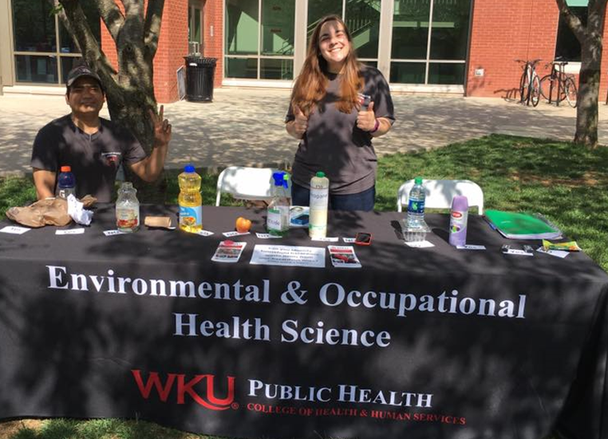

Slide 20
Masters of Healthcare Administration Graduates

Slide 21
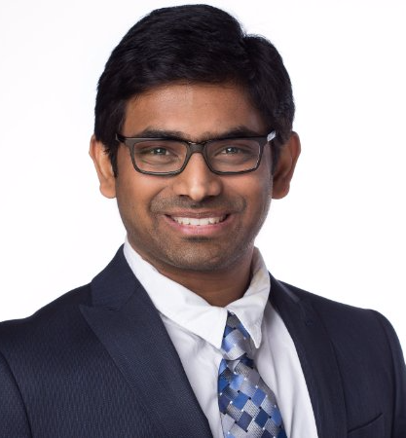
Sai Pavan Adigarla, MHA
Vijayawada, Andhra Pradesh,
India
I learnt many thing both academically and in life. I had an overall good experience at WKU.

Slide 22
Jamie Bittel, MHA
Owensboro, Kentucky
“Work hard in silence. Let your SUCCESS be the noise.”
Anonymous

Slide 23
Shannon Campbell Cales, MHA
Campbellsville, Kentucky
Always be the leader that you would want to work for.

Slide 24
Todd Chappell, MHA
Dawson Springs, Kentucky
After 13 years as a student and staff member, WKU will always feel like home. To all the co-workers, mentors, and friends, thank you for everything and I hope to see you on the hill. Go Tops!

Slide 25
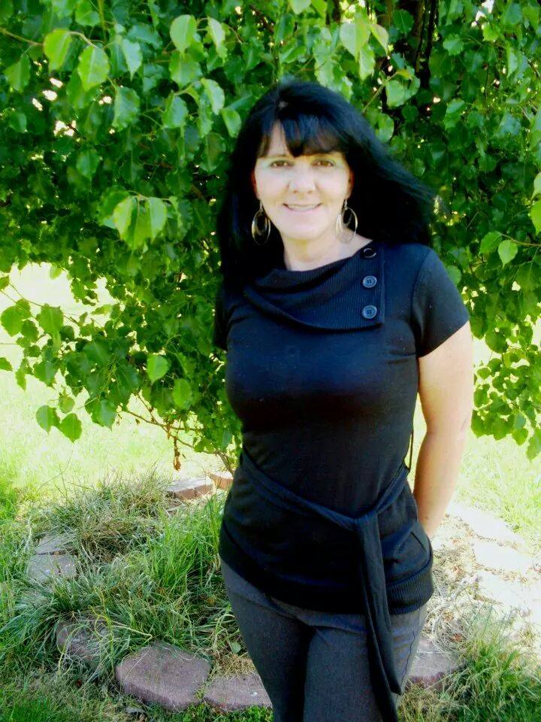
Sretta T. Clark, MHA
Insert an appropriate picture of yourself here
Frankfort, Kentucky
You can spend your time believing all those who say, “You can’t”…or you can spend your time silencing those voices. I chose the latter.

Slide 26
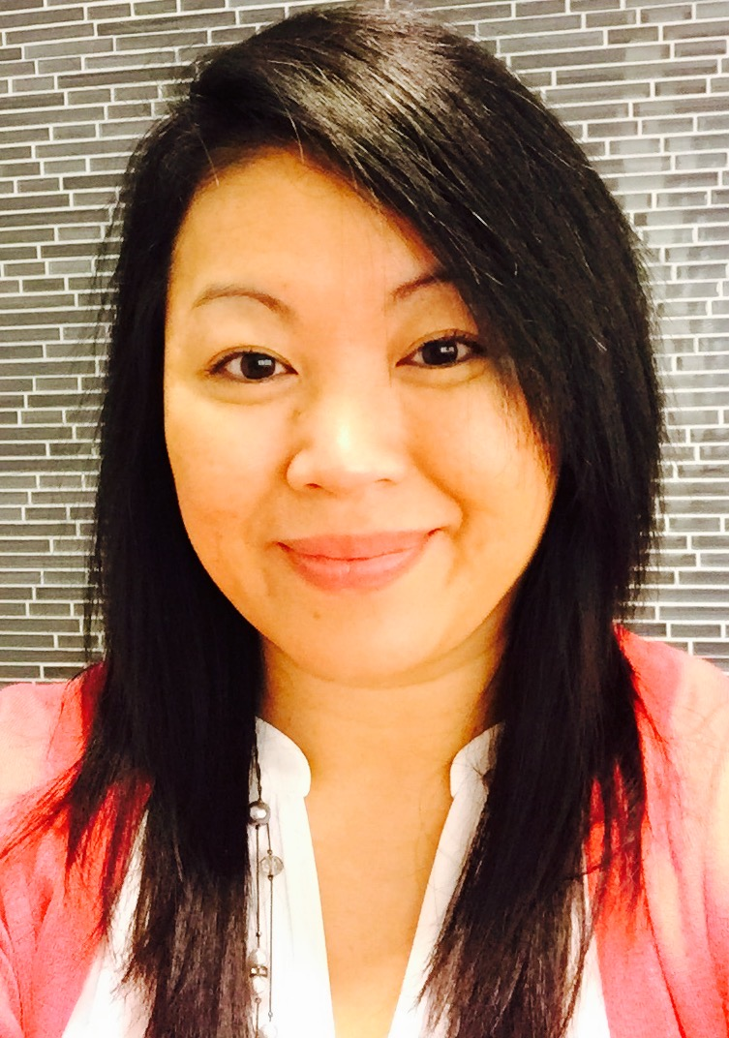
Phetsamone Om Dolby, MHA
Bowling Green, Kentucky
“Live as if you were to die tomorrow. Learn as if you were to live forever.”
Mahatma Gandhi

Slide 27
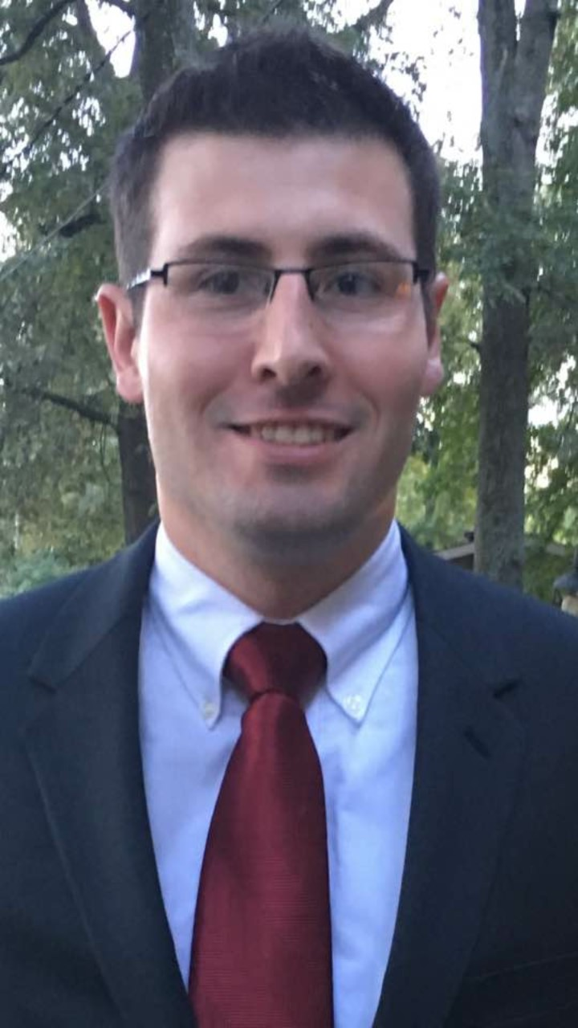
Austin Foreman, MHA
Owensboro, Kentucky
The capacity to learn is a gift; the ability to learn is a skill; the willingness to learn is a choice.

Slide 28
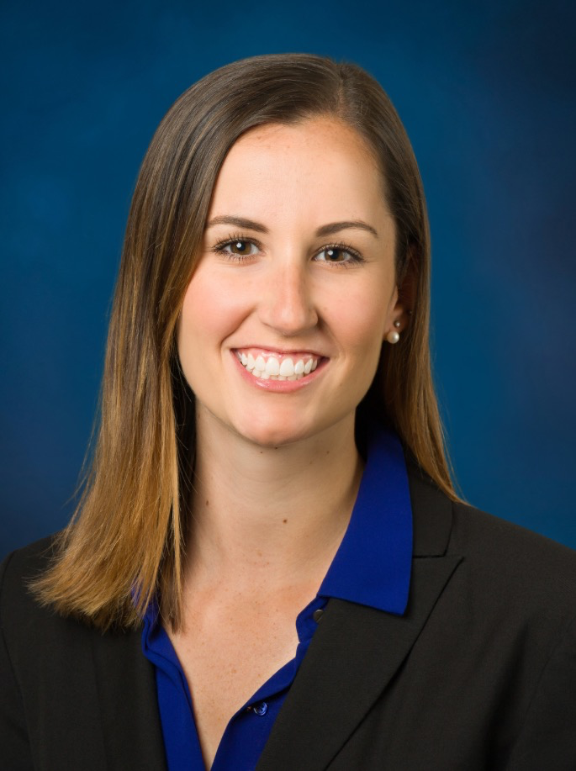
Julie Fussner, MHA
Cleveland, Ohio
Never stop learning and growing. The best investment you will ever make is in yourself.

Slide 29
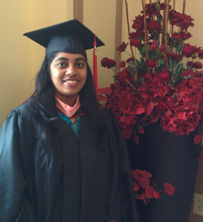
Keertana Reddy Gade, MHA
Vijayawada, Andhra Pradesh, India
Taught me how to lead my life independently.

Slide 30
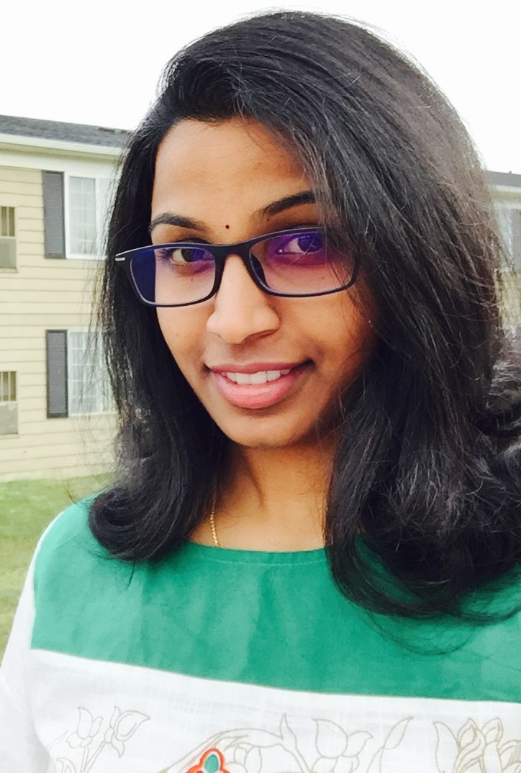
Yagna Roopa Kasaraneni, MHA
Vijayawada, Andhra Pradesh, India
I am very thankful to my family, professors, friends and colleagues for their support and guidance through all my time here. I wish each and every one here hearty congratulations for reaching this point in life… There is a long way to go though and I wish you all great success ahead.

Slide 31
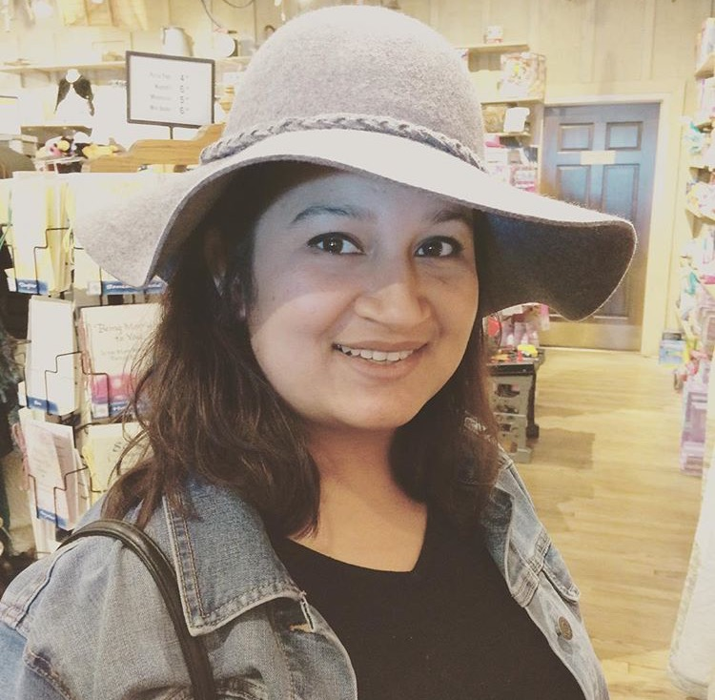
Nadia Farah Khan, MHA
Dhaka, Bangladesh
“I took the one less traveled by”
Robert Frost

Slide 32
Emily Lee, MHA
Insert an appropriate picture of yourself here
Versailles, Kentucky
“The best way to predict your future is to create it.”
Abraham Lincoln

Slide 33
Shirin Mahdavi, MHA
Tehran, Iran

Slide 34
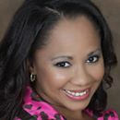
Lolita Miller, MHA
Lexington, Kentucky
I can do all things through Christ who strengthens me.
Philippians 4:13

Slide 35
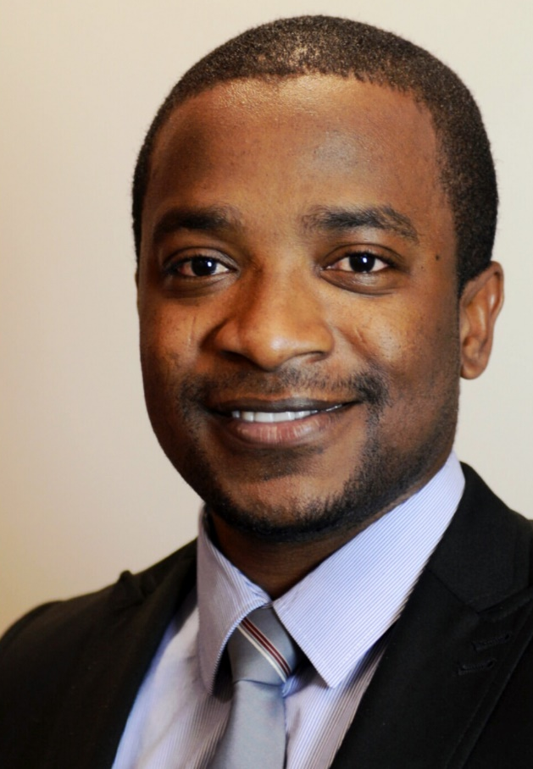
Ayodeji Joshua Omosule, MHA
Lagos, Nigeria
“The difference between school and life: In school, you’re taught a lesson and then given a test. In life, you’re given a test that teaches you a lesson.”
Tom Bodett

Slide 36
Mona Shirazi, MHA
Tehran, Iran

Slide 37
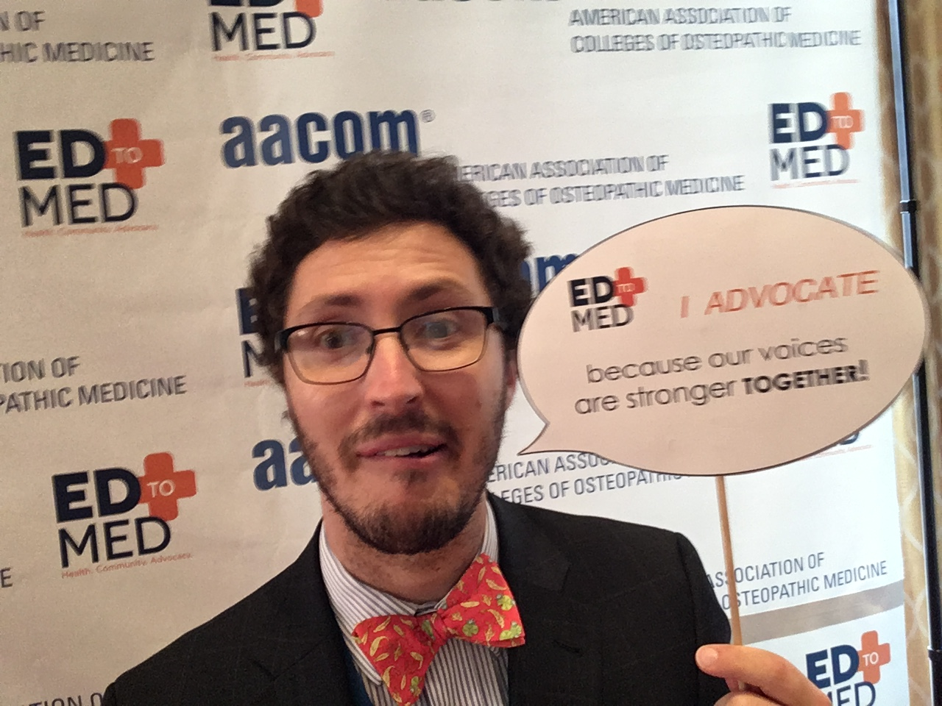
Frederick A. Stine, MHA
Fort Thomas, Kentucky
As a member of the next generation of physicians, I feel that WKU’s MHA program has empowered me to be a better provider and an agent for change in our health care system.

Slide 38
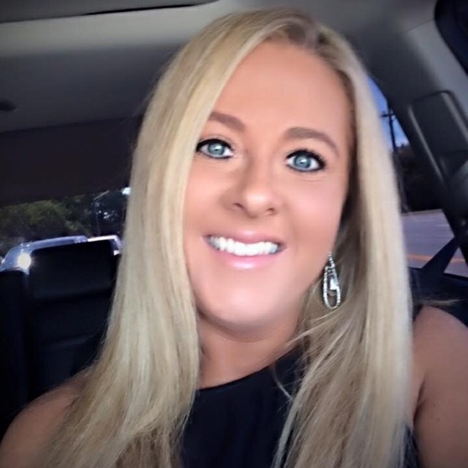
Tasha L. Tackett, MHA
Insert an appropriate picture of yourself here
Lexington, Kentucky
“The best way to predict your future is to create it.”
Abraham Lincoln

Slide 39
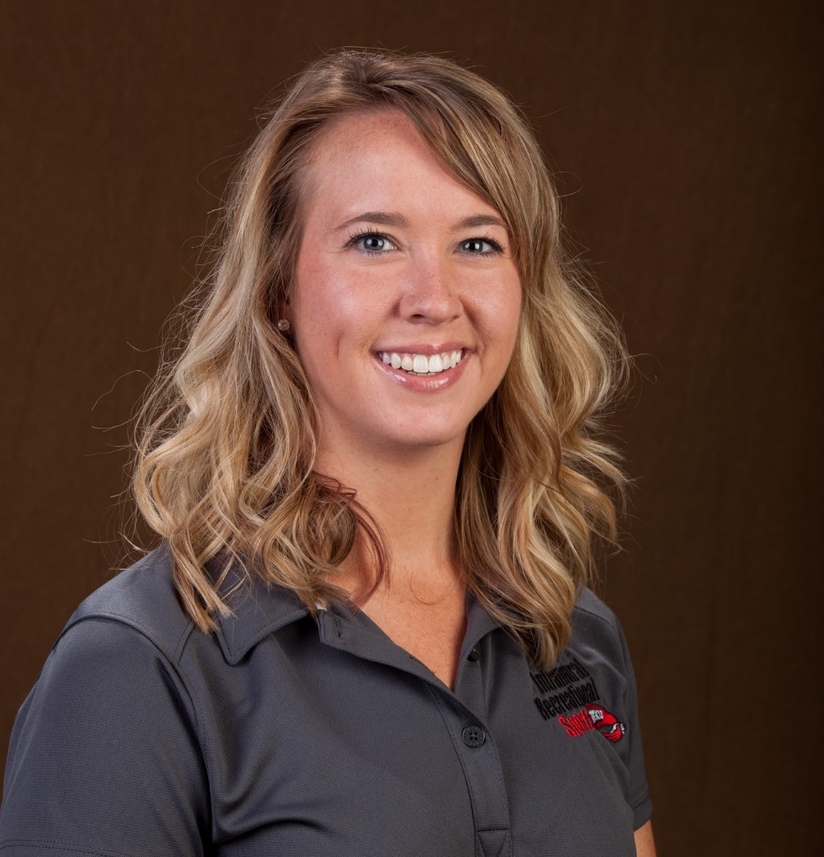
Lauren Tuttle, MHA
Fishers, Indiana
They certainly give very strange names to diseases…

Slide 40
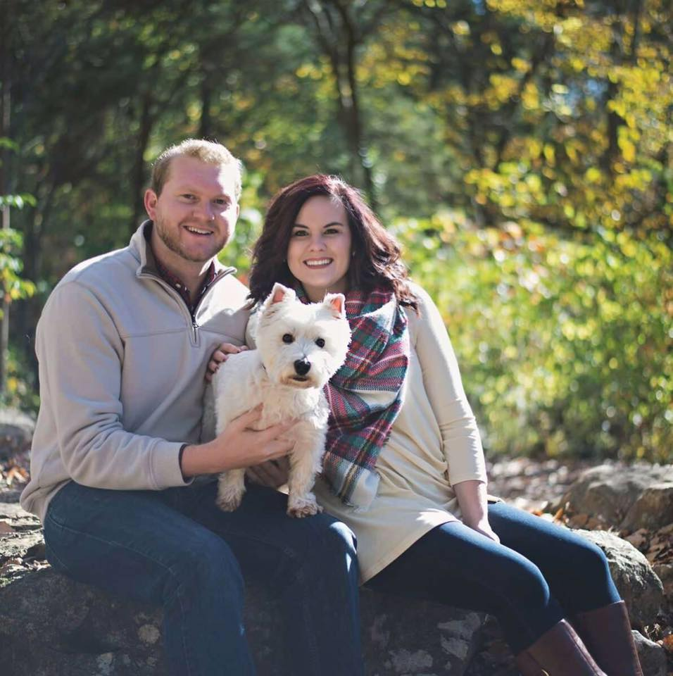
Coleman West, MHA
Morganfield, Kentucky
“Pursue whatever it is that you want to do with your life. It is the only secret to happiness that I know except for true love, that and maybe the amazing health insurance plan that our congressmen have.”
Lewis Black

Slide 41
Laura White, MHA
Bowling Green, Kentucky
Never stop learning because life never stops teaching.

Slide 42
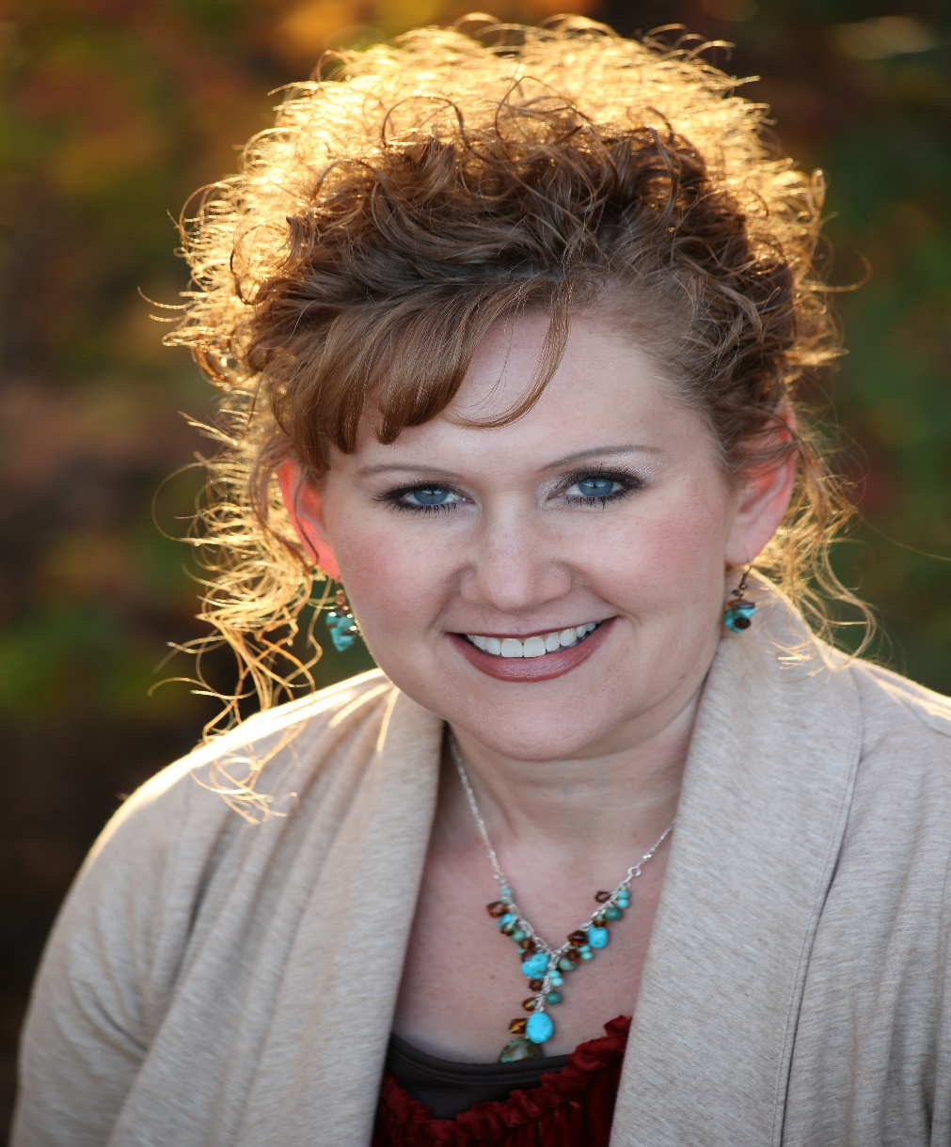
Shea Wilson, MHA
Smiths Grove, Kentucky
Nothing worth having comes easy!

Slide 43
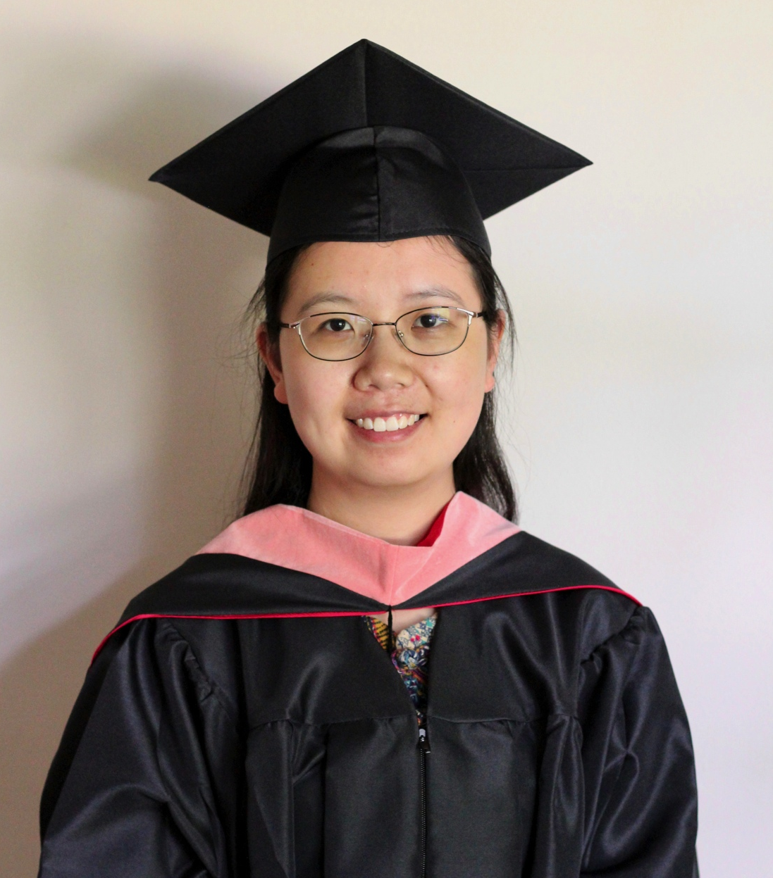
Haoran Xu, MHA
Kaifeng, Henan, China
The grand essentials of happiness are: something to do, something to love, and something to hope for.

Slide 44
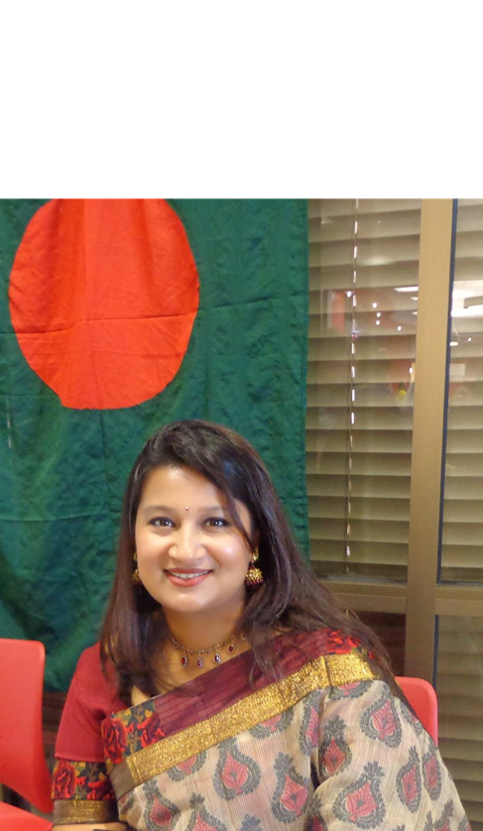
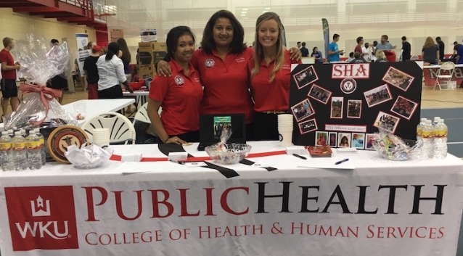
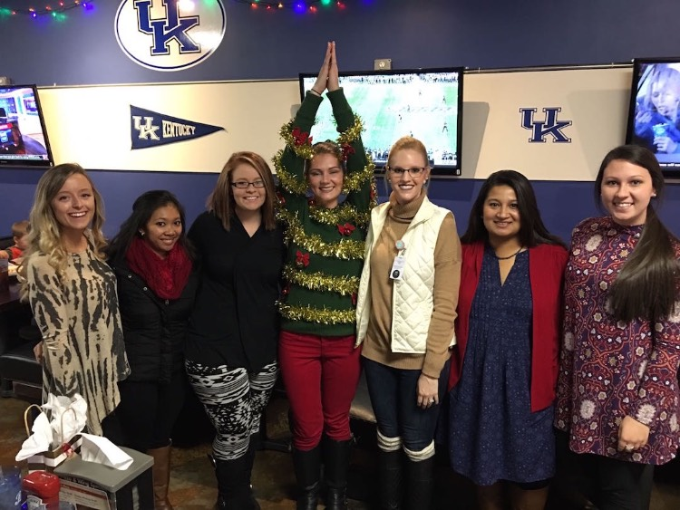

Slide 45
