Slide 1
Tips On Effectively Assessing Program- Level Student Learning

Slide 2
Assurance of Student Learning @ WKU

Slide 3
The Point of This Process…
….is not so much to demonstrate perfection but to establish a process toward continuous improvement.
We never really “close” the loop; rather, we continue to look for ways to improve the ways in which we serve the students in our program.

Slide 4
Definition of Program Assessment
An on-going process designed to monitor and improve student learning.
During this process faculty:
a) develop explicit statements of what students should learn (i.e., student learning outcomes);
b) verify that the program is designed to foster this learning (alignment);
c) collect data/evidence that indicate student attainment (assessment results);
d) use these data to improve student learning (“close” the loop).
(Allen, M., 2008)

Slide 6
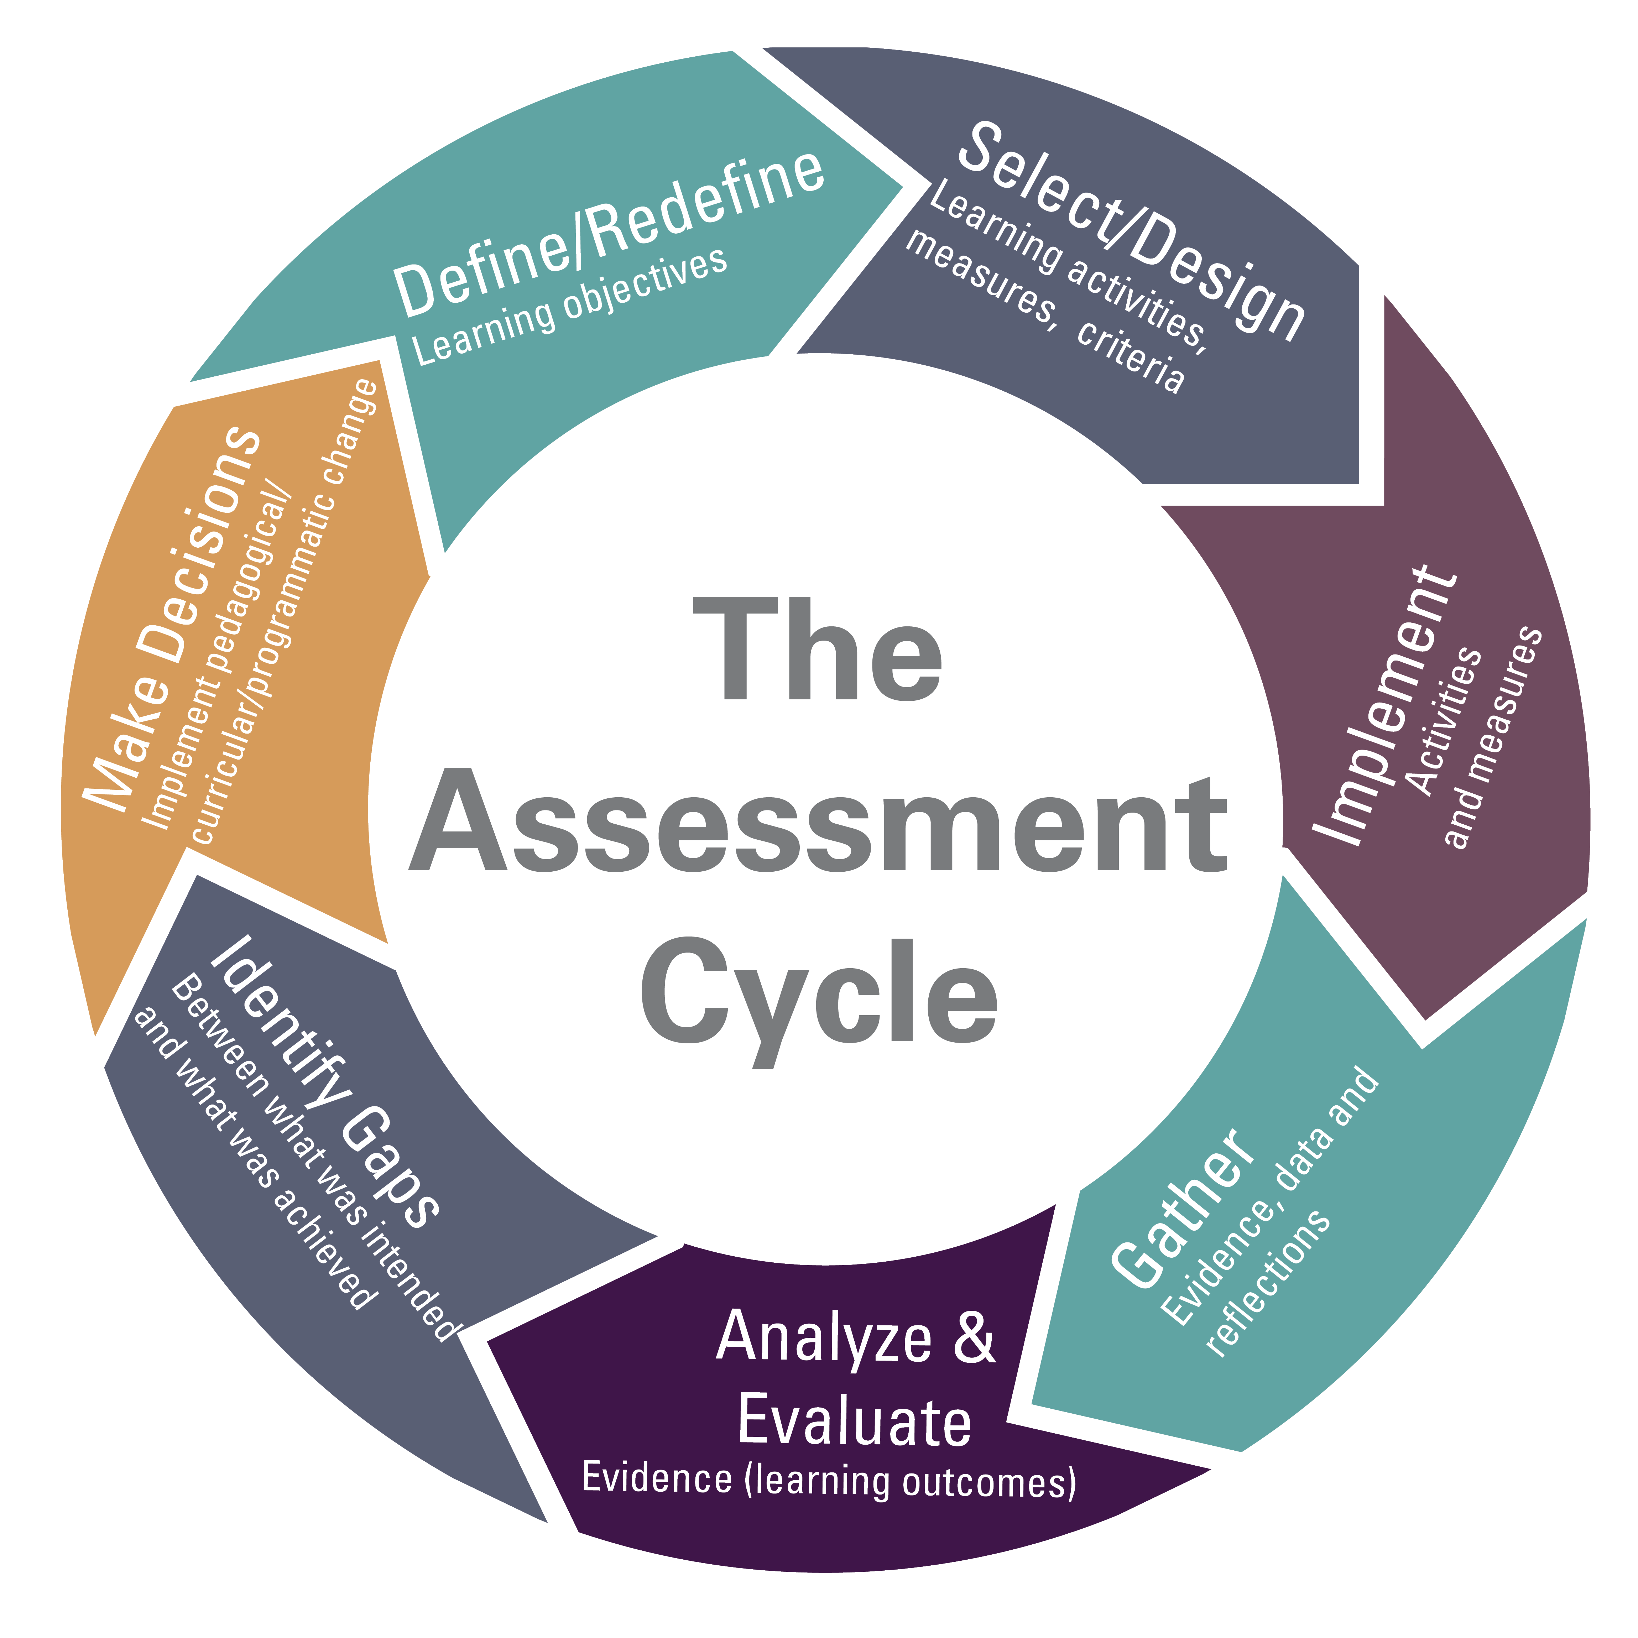

Slide 7
Creating Assessable Learning Outcomes

Slide 8
Sample Program Learning Outcomes
Students who successfully complete this major will be able to:
Analyze, interpret, and critically discuss a diverse variety of texts
Analyze argumentative and persuasive techniques in a variety of genres
Compose successfully in multiple genres, media, and formats
Demonstrate a strong understanding of the history and development of literature in the English language in a global context
Analyze a diverse variety of texts through multiple theories and histories
Conduct academic research and document it appropriately
Convey the core values and competencies of the discipline of English to wider audiences
Participate in extra-curricular activities and show awareness of educational and professional opportunities after graduation.

Slide 9
Writing an Effective Learning Outcome
Imprecisely stated outcome: Students will be able to understand the basics of psychology. (How would one know if a student “understands? What would the student understand? Should students know everything or things within a specific scope?)
Effectively stated outcome: Students will recognize and articulate the foundational assumptions, central ideas, and dominant criticisms of the psychoanalytic, Gestalt, behaviorist, humanistic, and cognitive approaches to psychology. (This one is better because the scope of the content is outlined and you can tell exactly how students will be assessed [recognition and articulation]).

Slide 10
Consider Creating a Curriculum Map

Slide 11
What Artifacts to Assess and How Many?
Outcomes describe what students are expected to know and be able to do by the time of graduation; therefore, focus collection of student work on senior level courses taken by all students (avoid elective courses).
Don’t double assess. If a particular set of exams completely assesses all of the performance criteria for an outcome, don’t collect two sets of exams simply for the sake of more data.
Target student work that can be used to assess multiple outcomes. For instance, a written lab report is very effective at assessing both outcome (1): performing an experiment, and outcome (2): written communication.

Slide 12
What To Assess Cont.
When assessing a paper or lab report, the entire document is assessed
With exams, you may not need to assess the entire exam. If one exam contains 3 or 4 conceptually similar problems, assessing only 1 question may be enough
Be sure to identify (rotating) assessment groups; about 3 faculty members who can assess the artifacts. Do *not* assess your own students’ work.

Slide 13
Ways of Assessing
Direct Assessment - Rubrics
Student Work – Exams, papers, presentations, portfolios
Indirect Assessment (Self-reporting)
Student Surveys – Exit Interviews
Focus Groups
Alumni Surveys

Slide 14
To Assess Effectively, You’ll Need a Rubric
In the assessment process, rubrics are the primary tool used in assessing student work
They’re best used to assess exams, projects, oral presentations, and written assignments.
Testing the rubric takes some time.
The rubric should be specific enough to properly assess the outcome, but broad enough that multiple faculty covering the same outcome in different classes can use the same rubric.

Slide 15
Learning Outcomes | 4 Exemplary | 3 Proficient | 2 Apprentice | 1 Novice | Score
Prepare Physical Model | Applies correct concepts to formulate a model with no errors affecting the problem solution. | Applies correct concepts to formulate a model with no conceptual and only one or two minor procedural errors. | Applies correct concepts to formulate a model; solution is conceptually correct but contains several procedural errors. | Applies incorrect concepts to formulate a model or solution contains conceptual or procedural errors affecting the problem solution.
Apply Mathematical Analysis | Applies correct mathematical concepts to formulate a model with no errors affecting the problem solution. | Applies correct mathematical concepts to formulate a model with no conceptual and only one or two minor procedural errors. | Applies correct mathematical concepts to formulate a model; solution is conceptually correct but contains several procedural errors. | Applies incorrect mathematical concepts to formulate a model or solution contains conceptual or procedural errors affecting the problem solution.
Present Final Result | Final result is correct and presented in the most appropriate format | Final result is correct, presentation of answer generally appropriate | Final result and/ or presentation reflect noticeable errors | Final result is incorrect, answer presented inappropriately
Apply Process | Solves problem using logical step-by-step and efficient procedure and obtains correct solution. | Solves problem using logical step-by-step procedure and obtains correct solution. | Solves problem using logical step-by-step procedure but makes minor procedural errors resulting in incorrect solution. | Solves problem without logical step-by-step procedure and makes procedural errors resulting in incorrect solution.

Slide 17
What Happens If A Program Is NOT Meeting Its Targets?
Consider revising:
Course changes
Program curriculum and policy
Resources and personnel
Student out-of-course experiences
Assessment tools and procedures

Slide 18
When discussing assessment results with colleagues, run through a set of questions.
Does the assignment explicitly align with the rubric?
Were classroom activities/pedagogy helpful in preparing students for the task?
Are the course standards aligned with the program’s exit standards?
Were students given sufficient opportunities to learn?
Were students motivated to do well on the assessment task?
Was our sample representative?
Are transfer and non‐transfer students performing at the same levels? What about other groups?

Slide 19
Example of Excellent Use of Assessment Results
Excellent use-of-results means that the actions taken are clearly aligned with the specific results and the judgment on the results.
It is not sufficient to say: “We changed the course content.” An effective report would say: “Because we found a deficiency in student writing, especially when it relates to summarizing primary sources, we added two writing assignments in course XYZ. In particular, we ask students to summarize three sources.”
A report that describes excellent use-of-result would demonstrate that the program used careful deliberation that led to the solution proposed and implemented.

Slide 20
Assessing student learning every semester is AWESOME because:
You will not have to re-learn the rubric
You will not forget to do it
You will not misplace data or student work
You will always know how your students are performing

Slide 21
If you assess each semester, it is fresh, regular, and surprisingly MUCH easier and faster
How?
Develop a list of items to be collected for each outcome
Collect approximately half of it each semester
Incorporate assessment into your grading
When grades are due each semester, assessment should be finished

Slide 22
A Model End Result That Underwent This Process
http://manoa.hawaii.edu/assessment/workshops/poster2016/2016Biology.pdf
https://manoa.hawaii.edu/assessment/workshops/poster2016/2016PacificIslandsStudies.pdf

