Slide 1
Department of Public Health
Award & Hooding Ceremony
May 11, 2018

Slide 2



University of Haifa Global Health Program

Slide 3
Undergraduate Awards

Slide 4

Kelly Coleman
Academic Excellence
in Health Information Management
Associate Degree
Health Information Management

Slide 5

Paul Miles
Academic Excellence
in Health Information Management
Baccalaureate Degree –
Health Information Management

Slide 6


Liza Brown
Academic Excellence
in Health Sciences
Bachelor of Science-Health Sciences

Slide 7
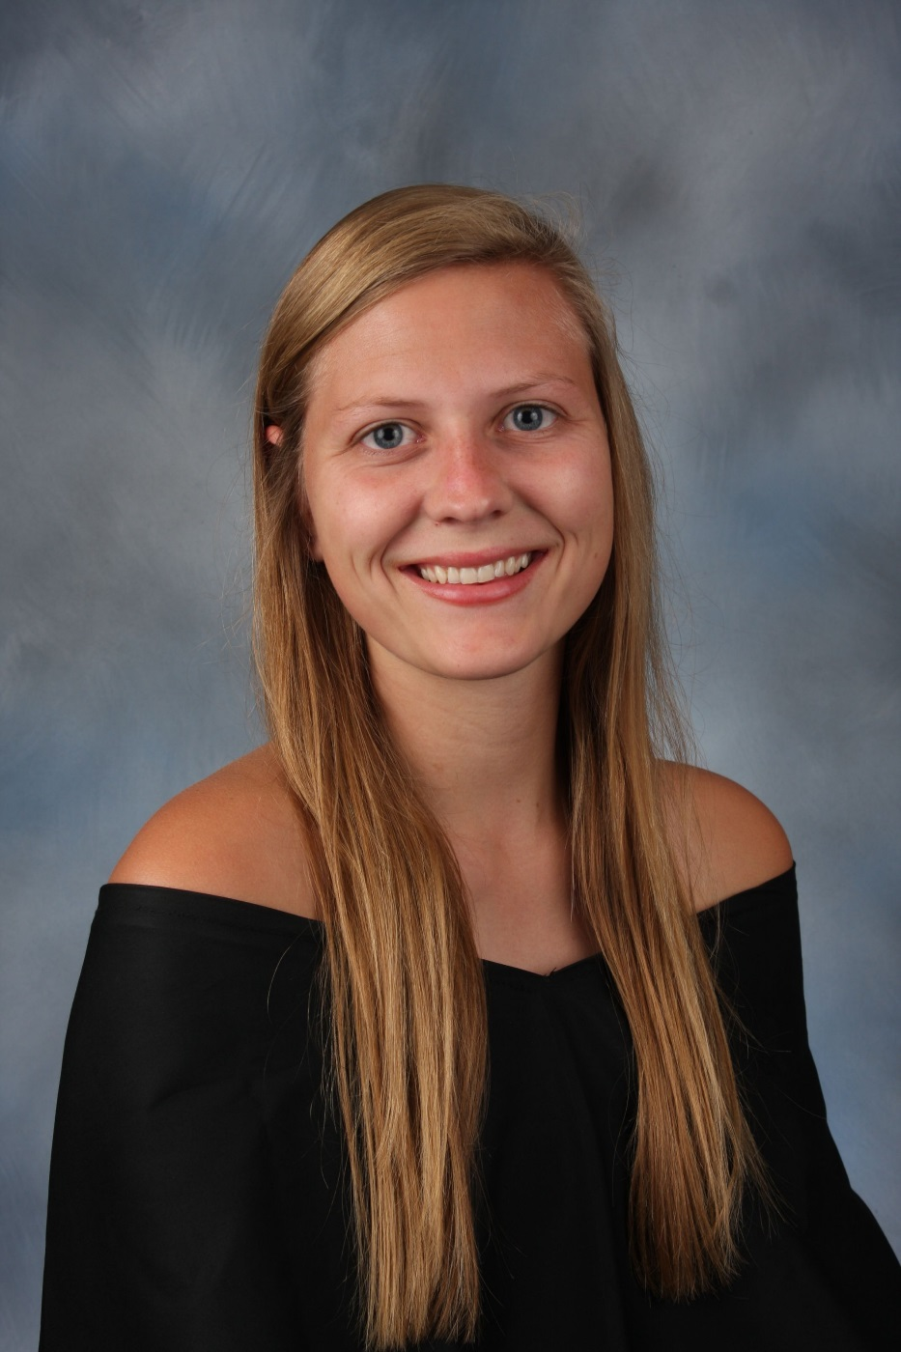
Hannah McMahan
Outstanding BSPH Student
Bachelor of Science - Public Health

Slide 8

Cody Brooks
Service & Professional Engagement
in Healthcare Administration
Bachelor of Science - Health Care Administration

Slide 9

Jennifer Franklin
Excellence & Leadership
in Healthcare Administration
Bachelor of Science - Health Care Administration

Slide 10
Graduate Awards

Slide 11

Harshitha Ponnala
Academic Excellence
in Environmental and Occupational Health Science
Master of Environment and Occupational Health Science

Slide 12
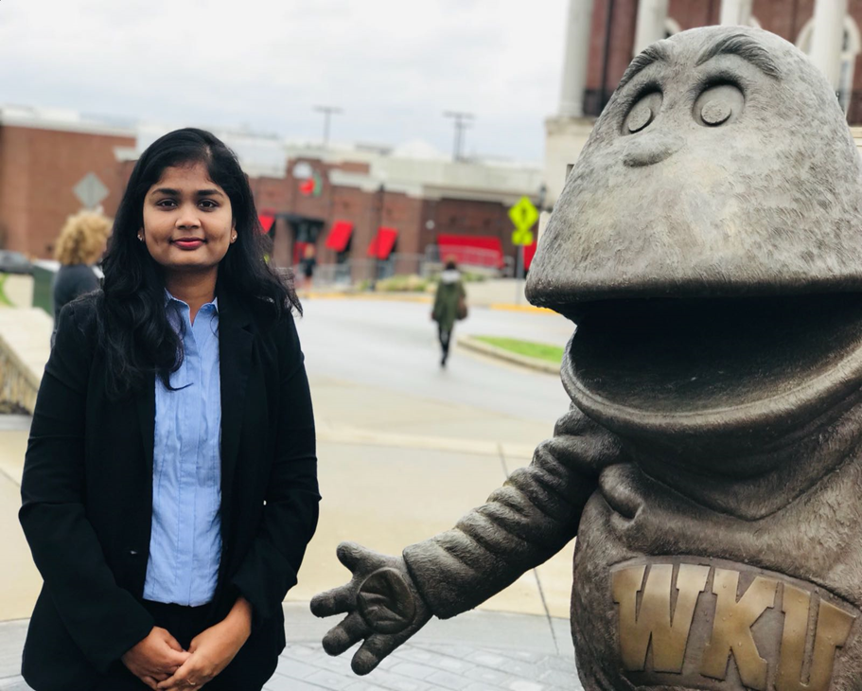
Divya Gadde
Research Excellence
in Environmental and Occupational Health Science
Master of Environment and Occupational Health Science

Slide 13

Zaiba Molena
Service & Professional Engagement in Healthcare Administration
Master of Health Administration

Slide 14

Brittney Gates
Academic Excellence & Service
in Healthcare Administration
Master of Health Administration

Slide 15

Aishwarya Potluri
Service & Professional Engagement in Healthcare Administration
Master of Health Administration

Slide 16
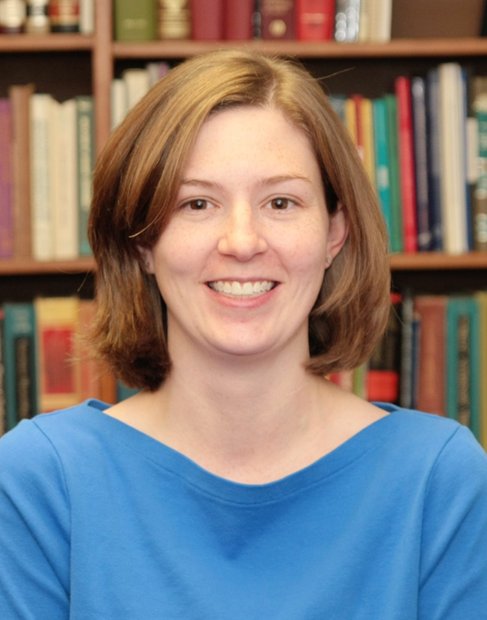
Rachel Hudson
Academic Excellence
In Public Health
Master of Public Health

Slide 17
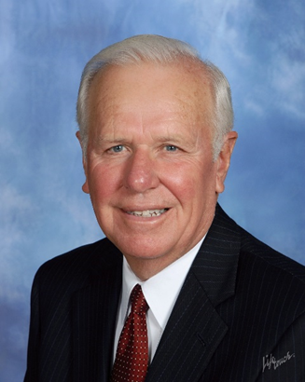
Dr. J. David Dunn
Professor Emeritus

Slide 18

Irma Kocer
Dr. J. David Dunn
Public Health Impact Award
Master of Public Health

Slide 19
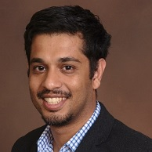
Dr. Soumitra Bhuyan
Distinguished Alumnus
Master of Public Health
WKU Class of 2010

