Slide 1
Teachers of Mathematics as Pedagogical Designers
Day 4
July 21, 2022
www.wku.edu/pdcmath
Sponsored by the Research & Creative Activities Program (RCAP) at
Western Kentucky University

Slide 2
Day 4 Agenda
Activity | Time
Q/A | 8:00-8:15
Parallel Math Tasks Activity | 8:15-9:15
Debriefing the Activity | 9:15-9:30
Revising Engage NY / Eureka Math | 9:30-10:00
Break | 10:00-10:15
Share Out | 10:15-10:45
Lesson Study Info for the Upcoming Year | 10:45-11:15
Working Lunch | 11:15-12:15
Going Forward | 12:15-12:45
Math Stuff! | 12:45-1:00
Day 4 Survey | 1:00-1:15
End of Summer Institute Survey | 1:15-1:30

Slide 3
Reminder
Don’t forget to add to the online resources document!

Slide 4
Mathler and Nerdle
Let’s do this together!

Slide 5
Let’s Do Math: Parallel Tasks
Get into groups with your grade band.
Your groups are going to be given parallel tasks (some will do Version A and some will do Version B), that is, they all cover the same content, they just are not identical tasks.
The goal of this activity is to tie Days 1-3 together, with Nick & Hope acting as the teachers
Task Identification
Task Improvement
Task Implementation
Meeting students where they are while still hitting content

Slide 6
Debriefing the Activity
Let’s look at the original task online.
Discuss with your groups:
What was changed? What are your thoughts on the changes?
What practices did you observed in the implementation?
Share out!
Notes:
Need to have pulled up on screen

Slide 7
Revisiting Engage NY / Eureka Task
In your grade band, you worked on improving a few Engage NY / Eureka tasks on Tuesday. Pull those back out and each pick one.
In your same groups, discuss any further improvements you can make to the task specifically regarding differentiation.
When doing this consider the following:
How will you implement the task?
What role does discussion play?
How can you create parallel tasks for the task?
To aid in this, we have created a structured handout to help guide your revision. We are giving you three copies and it will also be online. Please use this now, and we will collect them to scan them and give them back to you.
Take a Break ☺
Share out when we return

Slide 8
Lesson Study
You will be implementing a task in the Fall semester and another task in the Spring semester (they can be ones we have already started to work on, or another of your choosing, but make sure to pick lessons that will be done in August or September (more on this later)).
You will be grouped with the teachers in your school. You will be planning as a group, but the debrief will happen during the PD days.
While you may be in different grades, we do want you to discuss with your group your intended lesson plans. You can also reach out to other participants at other schools.

Slide 9
Lesson Study
We are collecting video data on the implemented lesson (if the intervention teachers can be included that is great, but we understand may not be possible).
One of the teachers will be the camera operator for another teacher, etc.
Should this not be possible, let us know and either Hope, Nick, or Sarah can come out and film.
The focus of the camera should be the teacher, but it is okay if students are captured (their data will NOT be transcribed).
We have a tripod for you.
We have 5 schools but only 4 cameras so we will have to coordinate moving one camera between two schools. We are hoping to get a 5th camera!
The SD cards on the camera should be able to hold all the data from all 3-4 lessons.

Slide 10
Lesson Study (continued)
We will meet in October after everyone has filmed their lesson (February in the Spring).
By then, we will have watched all your videos and we will be sharing clips (it’s a safe space ☺) and having discussion about the task implementation, our pedagogical design capacity, and more.
Each PD day will be a full day. Dates on next slide.
You will be sharing your lesson plan in the Fall/Spring PD days.

Slide 11
Timeline
 | July ’22 | Aug/Sept ’22 | Oct ’22 | Dec ’22 /Jan ’23 | Feb ’23
Summer Institute
Prep First Task/Lesson
Implement and Film First Task/Lesson
Fall PD |  |  | W 10/26/22
Prep Second Task/Lesson
Implement and Film Second Task/Lesson
Spring PD |  |  |  |  | W 2/8/23

Slide 12
Questions?
That was a lot of info! Phew! What questions do you have?

Slide 13
Working Lunch
Lunch is on us!
But it is also a working lunch where you will:
Plan with the teachers at your school (but also check in with you grade band partners),
Ask us any questions
Begin thinking about / prepping your lessons.

Slide 14
Day 4 Agenda
Activity | Time
Q/A | 8:00-8:10
Parallel Math Tasks Activity | 8:15-9:15
Debriefing the Activity | 9:15-9:30
Revising Engage NY / Eureka Math | 9:30-10:00
Break | 10:00-10:15
Share Out | 10:15-10:45
Lesson Study Info for the Upcoming Year | 10:45-11:15
Working Lunch | 11:15-12:15
Going Forward | 12:15-12:45
Math Stuff! | 12:45-1:00
Day 4 Survey | 1:00-1:15
End of Summer Institute Survey | 1:15-1:30

Slide 15
Going Forward
Important: You likely won’t be doing this PDC work for every lesson for this upcoming year (that would be too much). But our goal is for you to be intentionally thinking about task design and the level of cognitive demand, and also considering your implementation of lessons.
Discuss in groups then share out: What are the actions that you can take this year to improve on lessons that you implement?
Let’s summarize this week and how this going to impact your teaching for this year.

Slide 16
Math Stuff!
If you had $50 (per teacher) to spend for your classroom, related to mathematics instruction, what would you buy?
Think individually or collectively with the teachers at your school.
Examples:
Books
Manipulatives

Slide 17
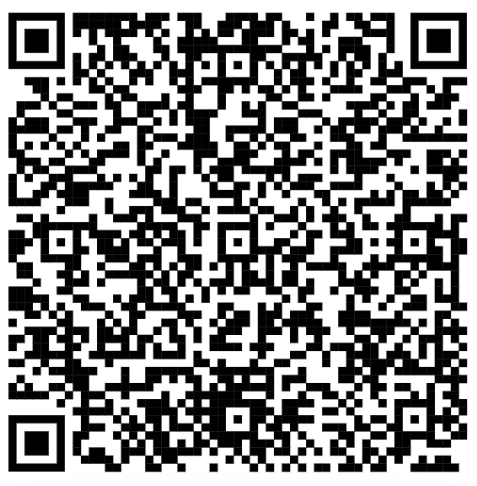
Day 4 Survey
Please fill out the end of day survey (this will be the same survey each day).
Q1: Identification Code
Q2: Select “Day 4 (Thursday)”
Use this QR code → or this link: https://tinyurl.com/pdcendofdaysurvey

Slide 18
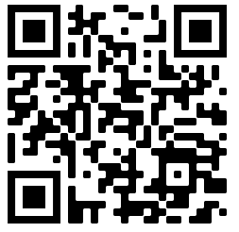
End of Summer Institute Survey
Please fill out this survey now.
Use this QR code → or this link: https://tinyurl.com/pdcmathendofweeksurvey

