Slide 1
Teachers of Mathematics as Pedagogical Designers
Day 3
July 20, 2022
www.wku.edu/pdcmath
Sponsored by the Research & Creative Activities Program (RCAP) at
Western Kentucky University

Slide 2
Day 3 Agenda
Activity | Time
Warm Up Activity | 8:00-8:30
Discussion on Discussion: Reading an Article | 8:30-9:00
More Discussion on Discussion | 9:00-10:15
Break | 10:15-10:30
My Favorite No and Building on Student Reasoning | 10:30-11:15
Lunch Break | 11:15-12:30
Building on Student Reasoning | 12:30-1:15
Break | 1:15-1:30
Student Misconceptions | 1:30-2:45
Day 3 Survey | 2:45-3:00

Slide 3
Warm Up Activity
Any questions from yesterday?
Magnetic Quotes
Around the room are 18 quotes about mathematics teaching (student and classroom discourse).
Do a gallery walk around the room and read every quote.
After you have read them all, stand next to the one that resonates with you the most.
If there are other people at the same quote, discuss why you all chose that quote.
We will have a few people share out at the end.

Slide 4
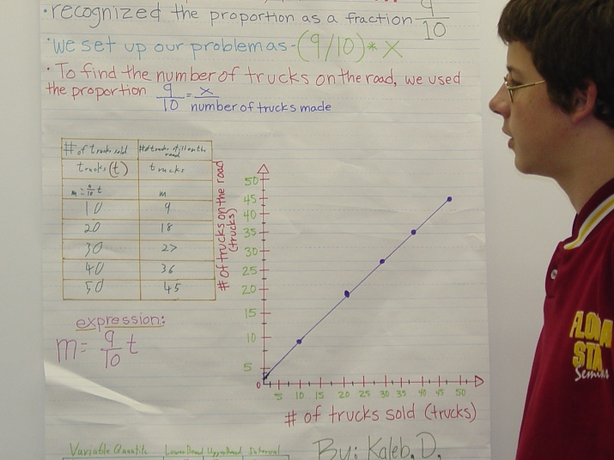
Communication
Communication is an essential part of mathematics and mathematics education. It is a way of sharing ideas and clarifying understanding. Through communication, ideas become objects of reflection, refinement, discussion, and amendment. The communication process also helps build meaning and permanence for ideas and makes them public. (NCTM, 2000, p. 60)

Slide 5
Component 3: Task Implementation Norm Setting in the Classroom
A major thing that leads to the success of a communicative classroom is setting those norms and expectations early.
What expectations and norms do you currently have related to classroom communication/discourse?
How do you communicate those expectations and norms?
How do you know if the communication/discourse is successful?
Let’s see what some students have to say about discussion:
Dropbox 1.1 and 3.1
Notes:
Videos

Slide 6
Component 3: Task Implementation Discussion on Discussion
Get into four groups (if there is someone you haven’t grouped with yet, get with them!).
Article 1: “Making the Right (Discourse) Moves”
Article 2: “Never Say Anything a Kid Can Say”
Article 3: “Launching a Discourse-Rich Mathematics Lesson”
Article 4: “Launching Complex Tasks”
Each group will be assigned one article to read.
Individually:
Read each article
Highlight 5 main take-aways
As a group:
Discuss the ideas that you came up and come to consensus on the top five take-aways they would like to share with the whole group.
Write these on chart paper.
Whole group share out!

Slide 7
Some Questions
How do you create a community of learners in your classroom?
What norms support this?
In what ways do your students engage in discussion?
What works? What challenges do you still have?
How do you manage wrong answers?

Slide 8
Break

Slide 9
Questions from Surveys
Participants contact info
How often do you allow students to explore misconceptions--does this ever confuse other learners?
Why isn't higher level considered harder? In my mind I can see that being the case most times.
What outside sources do you recommend for math activities?
How to make Engage into centers; How to differentiate questions for higher and lower level learners during centers.
Is there anything else you all would like to talk about/question?

Slide 10
“My Favorite No”
Notes:
https://www.youtube.com/watch?v=5VYyY_XkU1w

Slide 11
Reflection
Share out what you noticed during “My Favorite No”
We already discussed how do you manage wrong answers, but let’s think more on this. Reflect on a lesson where things maybe went wrong, or did not go according to plan. What did you do?
Share out!

Slide 12
Lunch Break
Be back by 12:50!

Slide 13
Day 3 Agenda
Activity | Time
Warm Up Activity | 8:00-8:30
Discussion on Discussion: Reading an Article | 8:30-9:00
More Discussion on Discussion | 9:00-10:15
Break | 10:15-10:30
My Favorite No | 10:30-11:30
Lunch Break | 11:30-12:50
Student Misconceptions & Rita | 12:50-1:30
Student Reasoning Levels | 1:30-2:00
Break | 2:00-2:15
Student Reasoning Levels | 2:15-2:45
Day 3 Survey | 2:45-3:00

Slide 14
Student Misconceptions
We are going to watch a video of a second grader, Rita, solving 70-53 in a variety of ways.

Slide 16
Rita
Discuss in groups
What does Rita know about subtraction?
What does Rita not know about subtraction?
Share out
Let’s read the follow up on Rita’s story in your notebook.
What did you learn about Rita’s story?

Slide 17
Building on Student Reasoning – Where to Start
Ways for a teacher to understand their students’ thinking
Individual interviews
Whole class discussion
Individual/small group work / centers
Importance of questioning
Identifying your students’ sophistication reasoning level
Then what do we do with that?

Slide 18
Identifying Student Sophistication Level
In your binder, there are two rubrics (on the same page). One is reasoning levels for place value and one is for addition and subtraction.
Read the rubrics and discuss with your groups what you notice?
Next work with your groups to use both rubrics to identify the student sophistication level for the two packets.
Under the Mat
Mental Math & Algorithms
We are not concerned on getting total agreement as there is large overlap between both the rubrics and the activities themselves, but we want to make sure we can identify our students to best support them and differentiate when needed.

Slide 19
What do we do?
Now that we know more about our students’ reasoning, what do we do this information?
What are you already doing?
Based on what we have learned so far, what could you do differently in the future?

Slide 20
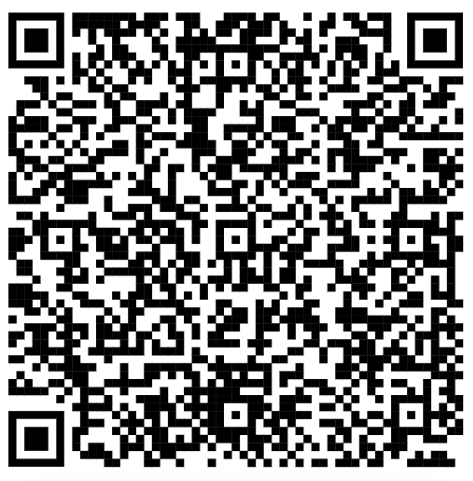
Day 3 Survey
Please fill out the end of day survey (this will be the same survey each day).
Q1: Identification Code
Q2: Select “Day 3 (Wednesday)”
Use this QR code → or this link: https://tinyurl.com/pdcendofdaysurvey

