Slide 1
Teachers of Mathematics as Pedagogical Designers
Day 2
July 19, 2022
www.wku.edu/pdcmath
Sponsored by the Research & Creative Activities Program (RCAP) at
Western Kentucky University

Slide 2
Day 2 Agenda
Activity | Time
Warm Up Activity | 8:00-8:15
What Makes an Engaging Task? | 8:15-8:30
Practice Standards & Video | 8:30-9:30
Break | 9:30-9:45
Engage NY / Eureka Math – Spill the Tea | 9:45-10:15
Engage NY / Eureka Math Task Identification/Critique | 10:15-11:30
Lunch Break | 11:30-12:30
Engage NY / Eureka Math Activity Part 1 | 12:30-1:30
Break | 1:30-1:45
Engage NY / Eureka Math Activity Part 2 | 1:45-2:45
Day 2 Survey | 2:45-3:00

Slide 3
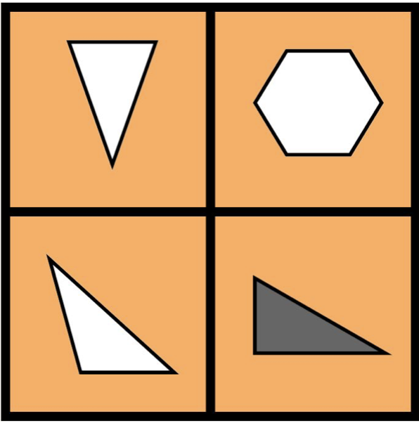
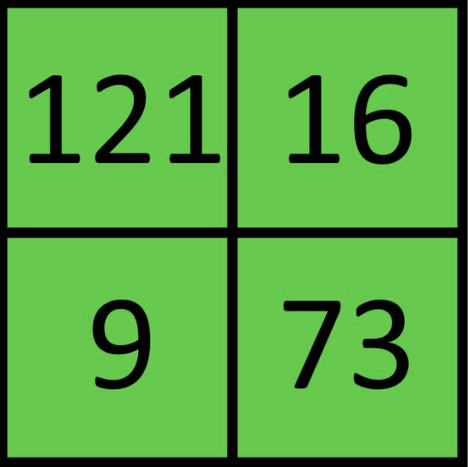
Warm Up Activity
Which one does not belong in each set? Justify your response. Set 1 Set 2 Set 3

Slide 4
What Makes an Engaging Task?
What questions/comments do you have from yesterday?
Get in groups of 4 (different ones from yesterday!). Answer the following questions on chart paper. Be detailed!
What makes an engaging mathematics task?
A student asked, is this correct?
81
-54
33
One possible response is to say no. What are other possible responses?
What are advantages and disadvantages to your different response?

Slide 5
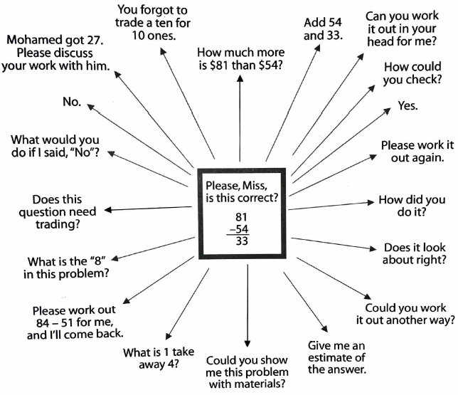

Slide 6
Component 3: Task Implementation Standards for Mathematical Practice
In your notebook is a handout with the 8 standards for mathematical practice (SMP)
Have you all seen these before?
What role do these play in our classroom?
Which ones do you see more often in your classroom?

Slide 7
More with SMP
We are going to watch two videos https://textbooks.rowman.com/lamberg
Video 1.1
Video 3.1
While watching the videos take notes on:
what SMPs you see or do not see,
what the goals of the lesson were, and
how the teacher accounts for student thinking.
Share out what you saw after each video!

Slide 8
Component 3: Task Implementation
Researchers (QUASAR project) found that a majority of the teachers were successful in identifying and setting up challenging instructional tasks.
However, simply selecting and beginning a lesson with a high-level task did not guarantee that students would actually think and reason in cognitively complex ways.
Only 40% of the tasks that started out (set up) at a high-level actually remained there as students engaged in the tasks (implementation).

Slide 9
Task Level → Student Learning
Task Set-Up
Task Implementation
Student Learning
High
High
High
Low
Low
Low
High
Low
Moderate

Slide 10
Break

Slide 11
EngageNY / Eureka Math – Spill the Tea
How do you currently use EngageNY / Eureka Math? Here are some guiding questions for the discussion:
Is this the only resource you use?
If yes, in what ways do you use it? Printed materials? PowerPoints? Chromebooks? Worksheets?
If no, what else do you use? How do you merge the resources?
How faithful are you to the materials?
Do you use it exactly as is and follow all the prompts? Or do you modify it? If you modify it, how?
What role does technology play in this curriculum?
What do you like about it? What do you not like about it?
Notes:
Whole group discussion

Slide 12
EngageNY / Eureka Task Analysis
Grade 1
Module 2
Topic A
Lesson 11
Get into groups by grade band. Discuss the following prompts and use poster paper to organize your thoughts.
Categorize each section (fluency, application, concept, debrief) of the above lesson, which you can find in your binder.
What about the task is low level?
What about the task is high level?
Would you implement all parts of this task?
What are areas for improvement?
What would you do to make these improvements?
Group Share Out!
In the afternoon, we will do this for other lessons, so the goal here is to make sure that we have an example of an improved task.
Notes:
Add notes to Day 2 Slide 9 (basically look at G1M2TAL11 and figure out what the areas for improvement are)
Page 130 asks about efficiency which sometimes is a very subjective construct in mathematics. Pros/Cons could be better
Page 131-132 errors are either one of two things. It might be better to have some variety in the misconceptions.
Problems 28-30 are great but it would be awesome if those same kind of number sentences had stories to go along with them in the later part.
Forcing students to solve a problem in two different ways has benefits but also can be problematic to force into thinking into one particular way.
It doesn’t seem that there is a lot of manipulative use.

Slide 13
Lunch Break

Slide 14
Day 2 Agenda
Activity | Time
Warm Up Activity | 8:00-8:15
What Makes an Engaging Task? | 8:15-8:30
Practice Standards & Video | 8:30-9:30
Break | 9:30-9:45
Engage NY / Eureka Math – Spill the Tea | 9:45-10:15
Engage NY / Eureka Math Task Identification/Critique | 10:15-11:30
Lunch Break | 11:30-12:30
Engage NY / Eureka Math Activity Part 1 | 12:30-1:30
Break | 1:30-1:45
Engage NY / Eureka Math Activity Part 2 | 1:45-2:45
Day 2 Survey | 2:45-3:00

Slide 15
EngageNY / Eureka Math Activity
Group by grade band.
Pick the number of lessons depending on how many people are in your group (e.g., a group of 3 people picks 3 lessons) that your group will make improvements on.
CHOICE: Your group can choose how to work together. You can each do one lesson and then share the outcome with others. Your group can work on all lessons together. In the end, regardless of how you work, your group of 3 will leave with 3 lessons to use.
http://www.nysed.gov/curriculum-instruction/engageny

Slide 16
EngageNY / Eureka Math Activity Tips
Level/demand of the task
Materials needed
Possible discussion questions
How students will engage with each other

Slide 17
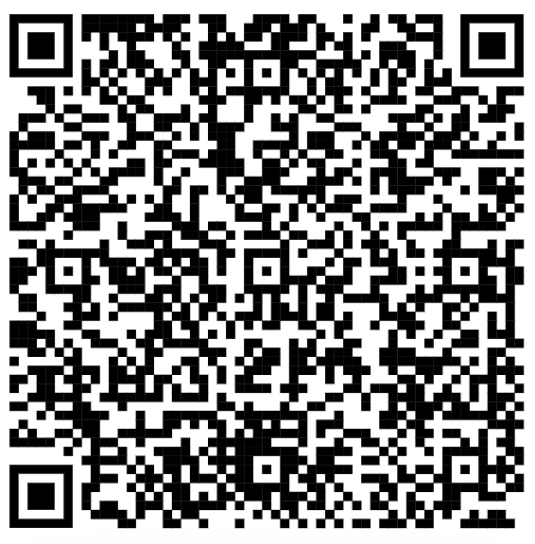
Day 2 Survey
Please fill out the end of day survey (this will be the same survey each day).
Q1: Identification Code
Q2: Select “Day 2 (Tuesday)”
Use this QR code → or this link: https://tinyurl.com/pdcendofdaysurvey

