Slide 1
Teachers of Mathematics as Pedagogical Designers
Day 1
July 18, 2022
www.wku.edu/pdcmath
Sponsored by the Research & Creative Activities Program (RCAP) at
Western Kentucky University

Slide 2
Day 1 Agenda
Activity | Time
Icebreaker Activity | 8:00-8:30
Purpose, Expectations, & Forms | 8:30-9:00
Project Pre-Survey | 9:00-9:15
Learning Mathematics for Teaching Survey | 9:15-10:00
Break | 10:00-10:15
Current Challenges | 10:15-10:45
Components of PDC & Math Activity | 10:45-11:30
Lunch Break | 11:30-12:30
Task Identification | 12:30-1:30
Break | 1:30-1:45
Pedagogical Design Capacity Video & Discussion | 1:45-2:45
Day 1 Survey | 2:45-3:00

Slide 3
Icebreaker Axes Activity
The Axes Activity
Groups of 4 (we will join a group if necessary). Make sure you don’t know at least one person in your group.
Determine two axes such that each person fits into one of the quadrants.
Example: One axis could be ‘Traveled Internationally’ and the other could be ‘Likes Seafood.’ But this only works if each person can uniquely fit into a quadrant.
Do two versions: One with personal characteristics and one with professional characteristics.
SHARE OUT via Chart Paper

Slide 4
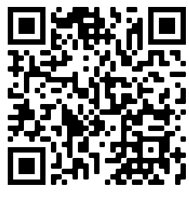
Purpose of Grant, Expectations, W9, & Consent Form
Purpose and overview of the grant
Fill out the Consent Form https://tinyurl.com/pdcconsentform
You will create a 6-character identifier to maintain anonymity
Everyone participates in the PD
Voluntary participation in the research
Everyone must fill out consent form
Only if getting stipend: Fill out W9 to be able to get paid.
$500 for summer PD
$200 for academic year PD
Participation expectation, engagement, and norms

Slide 5
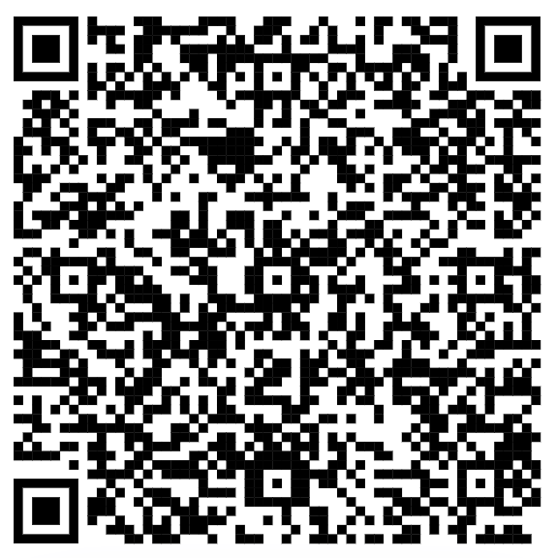
Project Pre-Survey
Please spend 10 minutes taking the project pre-survey.
You will be asked to write the identification code that you just created (details in survey).
QR Code →
Link: https://tinyurl.com/pdcpresurvey
We recommend a laptop or tablet for this survey.

Slide 6
Learning Mathematics for Teaching
LMT investigates the mathematical knowledge needed for teaching. These measures include items that reflect the real mathematics tasks teachers face in classrooms - for instance, assessing student work, representing numbers and operations, and explaining common mathematical rules or procedures.
Spend 1-2 minutes on each question (roughly 30 minutes in total)
Login Information
https://az1.qualtrics.com/apps/harvard-tkas/assessment
Program Code: 10000001307
Set up an account
Project Code: Use your 6-character identification code

Slide 7
Break
Be back in 15 minutes!

Slide 8
Current Challenges
Group up with other teachers from your school.
On poster paper respond to the following prompts before we share out.
What is your biggest challenge in designing a mathematics lesson?
Do you feel confident in your ability to find and/or create a high-level mathematics task? Why or why not?
What is your biggest challenge with implementing a mathematics lesson?
Do you feel confident in responding to your students’ mathematical thinking? Why or why not?
What other current teaching challenges do you have?

Slide 9
Components of Pedagogical Design Capacity (PDC)
Knowledge
Content – Pedagogy – Curricular
Pedagogical Content Knowledge (PCK)
Technological Pedagogical Content Knowledge (TPCK)
Technology, Pedagogy, and Content Knowledge (TPACK)
Task Design
Task Implementation

Slide 10
Component 2: Task Design
There is no perfect set of curricular materials, so what do we do?
We arm ourselves with knowledge and take what we have access to and adapt it for the goal in mind.
What makes a great task?

Slide 11
Component 2: Mathematical Tasks
Let’s consider a topic that we are all familiar with… area.
What is the importance of this topic?
Why do we want students to learn about area?
What do we want to students to learn about area?
Let’s Do Some Math!
Carpeting task versus Fencing task

Slide 12
Component 2: Mathematical Tasks
How are Martha’s Carpeting Task and the Fencing Task
the same and how are they different?

Slide 13
Component 2: Mathematical Tasks
“Not all tasks are created equal, and different tasks will provoke different levels and kinds of student thinking.”
Stein, Smith, Henningsen, & Silver, 2000
“The level and kind of thinking in which students engage determines what they will learn.”
Hieber et al., 1997

Slide 14
Component 2: Mathematical Tasks
Mathematical tasks - A set of problems or a single complex problem that are designed to focus students’ attention on a particular mathematical idea.
Tasks form the basis for students’ opportunities to learn what mathematics is and how one does it.
Tasks influence learners by directing their attention to particular aspects of content and by specifying ways to process information.
Tasks influence what and how students learn (level and kind of thinking required)

Slide 15
Lunch Break
Be back in 1 hour!

Slide 16
Characterizing Tasks
Goal:
Identify characteristics of high and low-level mathematical tasks.
Martha’s Carpet: Low-level
The Fencing Task: High-level

Slide 17
Characterizing Tasks
Task Sort
Sort Tasks A – P into two categories: high level and low level.
Develop a list of criteria that describe in general the characteristics of low level and high-level tasks.
Debrief

Slide 18
Characterizing Tasks
Are all high-level tasks the same?
[Is there an important difference between Tasks J and K?]
Are all low-level tasks the same?
[Is there an important difference between Tasks E and O?]
Notes:
Participants do not need to differentiate between the four levels – this is a guideline for what you are looking for. Keep in mind that “easy” and “hard” activities do not mean “low” or “high”. You will differentiate the four levels in a few slides.
Memorization – Procedures without connections –
Definitions to memorize Algorithmic
Not ambiguous Limited cognitive demand
No connection to concept or meaning Little ambiguity
No connection to concept or meaning
Focused on what and not why – no explanations or explanations that just describe procedures
Procedures With Connections –
Suggest pathways that are broad – explicitly or implicitly
Represented in multiple ways
Procedures can not be followed mindlessly
Requires the engagement of the conceptual ideas – connections!
Focus students’ attention on the use of procedures for the purpose of developing deeper levels of understanding of mathematical concepts and ideas
Doing Mathematics
Not predictable pathway
Requires students to explore and understand the nature of concepts
Requires students to access knowledge and experiences
Analyze, justify,
Requires considerable cognitive effort

Slide 19
Research says…
Low-Level Tasks
Memorization
Procedures without Connections (e.g., Martha’s Carpeting Task)
High-Level Tasks
Procedures with Connections
Doing Mathematics (e.g., The Fencing Task)
Notes:
Begin by asking teachers, “Would the Task Sort have been easier if you had more categories?” If teachers had a lot of “on the line” tasks, they will be glad to know that there are actually more options for sorting tasks.
Page 269 Stein and Smith -- example of task at each of the four levels.
May also want teachers to review the tasks they sorted and identify a task that fits in each category.

Slide 20
The Mathematical Tasks Framework
TASKS
as they appear in curricular/ instructional materials
TASKS
as set up by the teachers
TASKS
as
implemented
by students
Student Learning
Notes:
Tasks alone aren’t enough to impact student achievement. The entire implementation of a task impacts the cognitive demand – from the task in the curricular materials to set up by the teacher to implementation by the students. At any point, the demand of a task can be maintained or lowered.

Slide 21
The Mathematical Tasks Framework
TASKS
as they appear in curricular/ instructional materials
TASKS
as set up by the teachers
TASKS
as
implemented
by students
Student Learning
Notes:
The first important step is identifying tasks that have a high-level of cognitive demand. This is what we’ve discussed all morning.

Slide 22
The Mathematical Tasks Framework
TASKS
as they appear in curricular/ instructional materials
TASKS
as set up by the teachers
TASKS
as
implemented
by students
Student Learning
Notes:
This level addresses the set up by the teacher. What kind of information does the teacher share about the task with the students before letting them work on it?
Back to the Fencing Task –- if I would have started that task by saying “remember that squares are rectangles” or “everyone draw a picture of each rectangle” or any statement of this kind leads the learner down the pathway without allowing them to struggle and work on their own first, I would have lowered the cognitive demand of the task.

Slide 23
The Mathematical Tasks Framework
TASKS
as they appear in curricular/ instructional materials
TASKS
as set up by the teachers
TASKS
as
implemented
by students
Student Learning
Notes:
When students start working on the task, there’s an opportunity for the cognitive demand to be maintained or lowered. The important point here is that it is the teacher that lowers the demand at this level by how he/she responds to the students working on the task.
One example of a teacher move that lowers the demand at this stage would be – Facilitator says, “alright guys, no one knows how to do number 5! Let me set it up for you and see if you can do the calculations and get an answer.” Do we respond to student questions by providing answers or do we respond by providing more thoughtful questions?

Slide 24
The Mathematical Tasks Framework
TASKS
as they appear in curricular/ instructional materials
TASKS
as set up by the teachers
TASKS
as
implemented
by students
Student Learning
Notes:
All three stages of the Mathematical Tasks Framework impact student learning.

Slide 25
Task Potential
We are going to watch this video https://textbooks.rowman.com/lamberg (Video 7.1)
This is a second-grade classroom that was given the following task.
“Solve 28+47=? on your own and then we will discuss as a class.”
Before we watch the video, discuss with your group your thoughts on the level of this task.
After we watch the video, have your thoughts changed? If so, how?

Slide 26
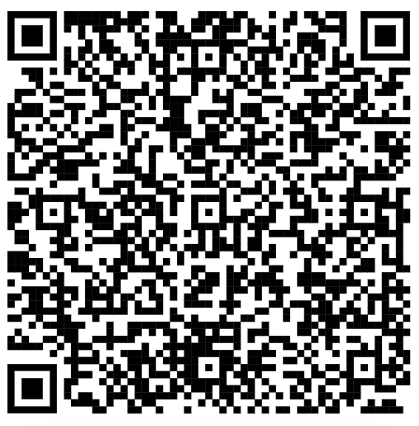
Day 1 Survey
Please fill out the end of day survey (this will be the same survey each day).
Q1: Identification Code
Q2: Select “Day 1 (Monday)”
Use this QR code → or this link: https://tinyurl.com/pdcendofdaysurvey

