Slide 1


Records Management Program
Records Management 101

Slide 2


Today’s Agenda
Records
Management
Program
Introductions
Public Records
Records Management
Retention
Kentucky State University Model Schedule
  Interpretation
  Implementation
Destruction of Records
Transferring Records to WKU Archives
WKU Archives

Slide 3
Public Records
Records
Management
Program
Public Records - defined in KRS 61.870 as all books, papers, tapes, disks, software or other documentation regardless of physical form, which are “prepared, owned, used, in the possession of or retained by a public agency.”
When is a public record not an open record? - KRS 17.150(2); KRS 61.878 (1)(a), (c)1, 1(f); KRS 160.705(1), KRS 164.283; KRS 422.330; FERPA; HIPAA; KRS 61.991;
KRS 171.720
Confidential information – social security numbers, grades, medical information, personnel records

Slide 4
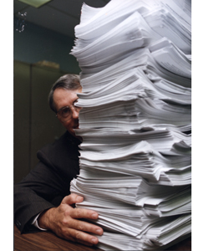
Records Management
Records
Management
Program
Creation – everyone on campus is creating records daily
Maintenance - being able to find what you need when you need it; varying levels of secure storage based on content of records; and
Preservation – identifying and transferring records with permanent value to WKU Archives in accordance with the records schedule
Destruction – destroying non-permanent records in accordance with the records schedule

Slide 5

Retention
Records
Management
Program
About 3% of the paper / e-records produced each year by WKU is worthy of permanent retention.
Much more than that is being kept in offices
  duplicates, triplicates, etc.
  file cabinets
  computer hard drives / shared drives
  fear factor, just in case

Slide 6

Kentucky State University Records Model Schedule
Records
Management
Program
Guidelines created for all universities in Kentucky by Kentucky Department of Library and Archives and the university records officers.
  Reviewed quarterly
  Multi-tiered
  Written generically
  More than you will need

Slide 7
Model Schedule - Sections
Records
Management
Program
Sections indicate “office of record” for most type of records.
U0100 – General Records
U0200 – Fiscal
U0300 – Awards
U0400 – Students/Courses
U0500 – Library/Archives/Museum
U0600 – Personnel
U0700 – Physical Plant
U0800 – Student Housing
U0900 – Athletics
U1100 – Food Service
U1200 – Bookstore
U1300 – Police
U1500 – Financial Aid
U1600 – Real Property
U1700 – Medical
U1800 – Sponsored Programs
U2000 – University Attorney
U2100 – Electronic Records
U2200 – Development
U2300 – Animal Diagnostic Laboratories
U2400 – Plant Disease Laboratories

Slide 8

Office of Record
Records
Management
Program
The office which has the most authority over a particular records series or type of record that may be found in multiple offices across campus.
Examples:
  Registrar – student records
  Accounts Payable – fiscal records
  Human Resources – personnel records
Your department is the office of record for items created nowhere else on campus.

Slide 9
Anatomy of a Records Series
Records
Management
Program
Series – U# - arbitrary number assigned by KDLA
Records Title & Description – brief descriptive title, may contain notes referring to another records series
Function & Use – brief generic description of why the records are created and how they are used
Access Restrictions – can be none or will list applicable statutes and sometimes notes
Contents – brief generic list of individual document types that may be found in the records series, is not exhaustive
Retention & Disposition – multi-tiered description of how long to keep a record and how to dispose of it; retention / disposition take effect at the end of the fiscal year or calendar year.

Slide 10

Records Destruction Reporting Form
Records
Management
Program
Report before you destroy
  Easy
  Fast
  Eliminates fear factor
  Collects statistics
  Paper trail for auditors and administrators
  Demonstrates routine compliance with records schedule
http://www.wku.edu/library/archive/recdestform.php

Slide 11
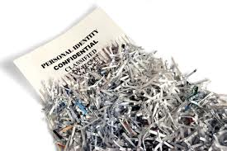
Destruction – When & How
Records
Management
Program
When – WKU runs on a fiscal year, so most of the records are destroyed at the end of the fiscal year. There are some departmental student records that are destroyed at the end of the next semester.
Exceptions – do not destroy records
  during an audit - wait until the audit is complete
  during litigation
  early
Recycle – non-permanent records that have no restrictions
Shred – non-permanent records that have restrictions, confidential information
Delete – don’t forget the electronic records on your computer and shared drives!

Slide 12
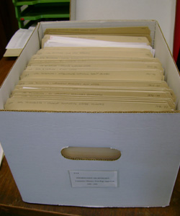
Transferring Records to WKU Archives
Records
Management
Program
Check schedule – permanent records with a disposition
“transfer to university archives.”
Box up records
  no oversized bankers boxes, please
  no hanging folders, please – reuse them!
  label boxes please – office, records series,
  dates of records
  your contact information
Make an appointment
  5-4793
  archives@wku.edu
Deliver records – to WKU Archives in the Kentucky Building
E-records – post on shared drive and we will copy onto the
WKU Archives server

Slide 13
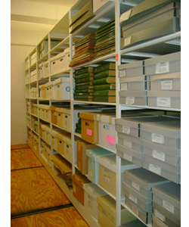
WKU Archives
Records
Management
Program
Historical WKU documents
  Departmental records
  Photographs
  Scrapbooks
  Maps
  Publications
  Film, Video, Audio
  Student organizations
  E-records
Inventories
  KenCat
  TopScholar
Available for Research by
  Students
  Faculty
  Staff
  General public

Slide 14
Questions? / Contact Information
Records
Management
Program
WKU Records Management Program
Suellyn Lathrop
Kentucky Building
Monday – Friday, 8-4:30
745-4793
archives@wku.edu
  http://www.wku.edu/library/archive/rm.php

