Slide 1

Tech Talk 2017

Slide 2

IT Services
Resources Include:
  WKU Email/TopperMail
  TopNet
  myWKU
  Blackboard
  Helpdesk Phone & Chat Support
  WKU myStuff (Network Storage)
  WKU Libraries Online Database
  More info at www.wku.edu/it/students

Slide 3
IT Services
TopperTech- Student IT Support
Location: 3rd Floor of Mass Media & Technology Hall (MMTH)
Hours
  Monday-Friday: 8 am - 4:30 pm
  Saturday and Sunday: Closed
  Web: www.wku.edu/it/toppertech
  Facebook: WKU TopperTech
  Twitter: @WKUTopperTech
IT Helpdesk
Hours
  Monday-Friday: 7 am – 8 pm
  Saturday: 11:30 am - 8 pm
  Sunday: 11:30 pm – 8 pm
  Phone: 270-745-7000
  Chat: www.wku.edu/it/chat
  Web: www.wku.edu/it/helpdesk

Slide 4
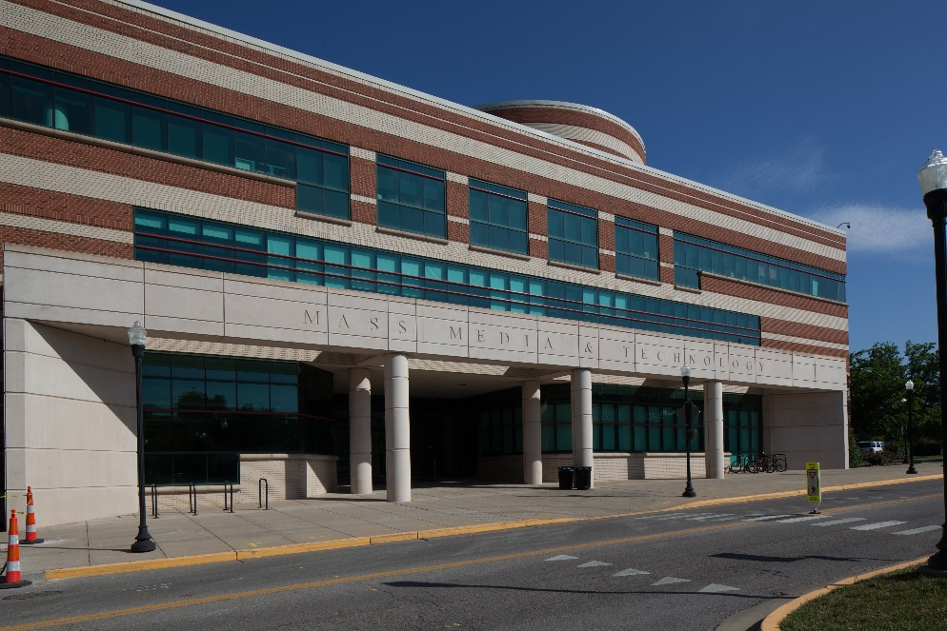
TopperTech 101
Drop Off Network and Computer Service
Available to all registered WKU students in Good Academic Standing
Contact Info
Phone: 270-745-7000
Online: www.wku.edu/it/chat
3rd Floor of MMTH

Slide 5
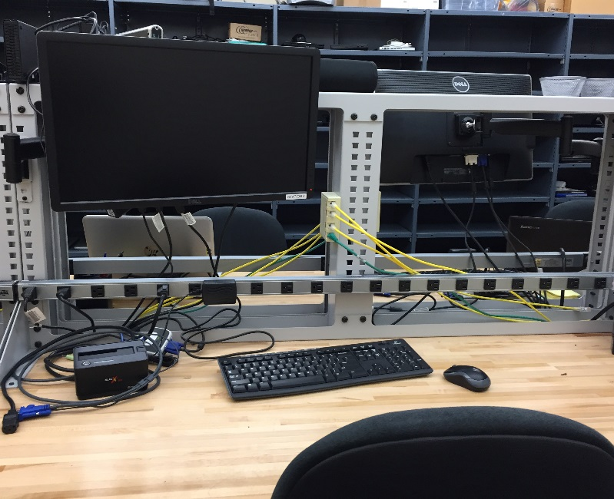
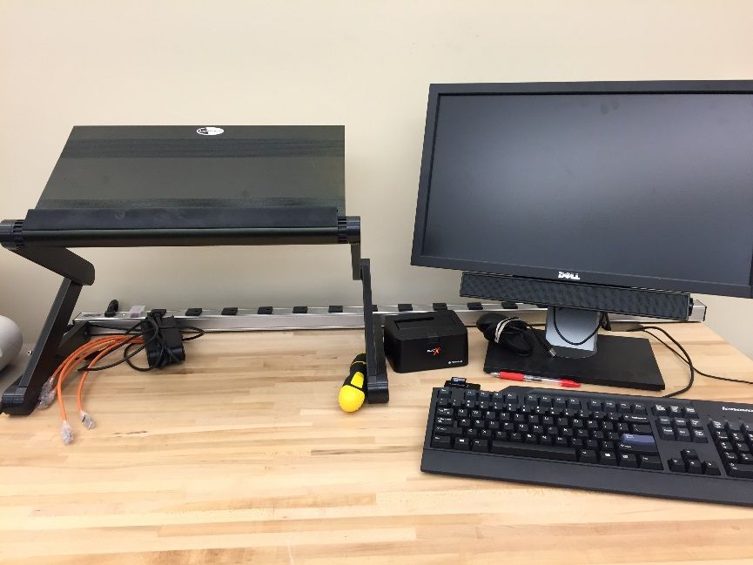
TopperTech Services
Windows and OS X Support
Virus and Spyware Removal
Hardware Diagnostics & Replacement
Operating System Refreshes
Game Console Registration
Data Backup & Recovery
Dell, Apple and Lenovo Warranty Service

Slide 6
Operating System Support
TopperTech’s computer repair division provides support for the following operating systems:
Windows Support
Windows 7 (Starter, Basic, Home Premium and Ultimate)
Windows 8.1 (Windows 8.1, Windows 8.1 RT, Professional and Enterprise)
Windows 10
Mac Support
Yosemite 10.10
El Capitan 10.11
macOS Sierra 10.12
Note: Any Apple MacBook checked in with OS X 10.8 (Mountain Lion) or 10.9 (Mavericks)
will be upgraded to at least OS X 10.10. Any OS lower than 10.8 will not be supported by
TopperTech.
Linux/Unbuntu
Note: No support options for devices running Linux/Unbuntu distributions.

Slide 7
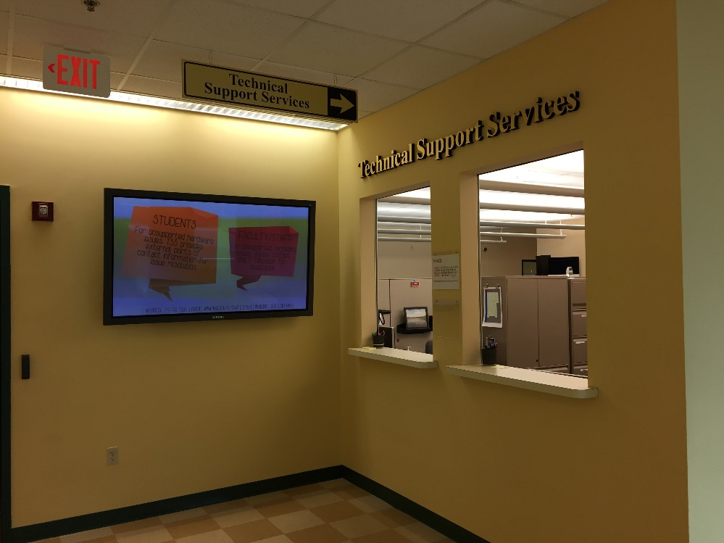
Costs
There are no charges for TopperTech’s current services.
Students are responsible for the costs associated with any hardware replacements.
  Example: TopperTech determines that the hard drive in your computer has gone bad. The technicians will provide a quote for a new hard drive, but it is the responsibility of the student to make this purchase.

Slide 8
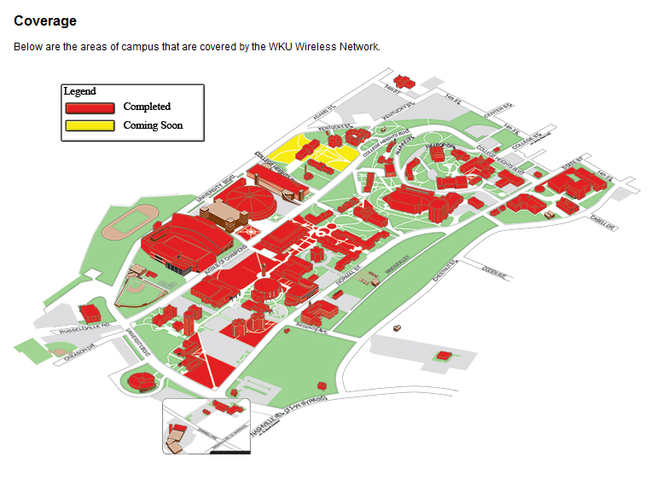
WKU
Wireless
Coverage

Slide 9
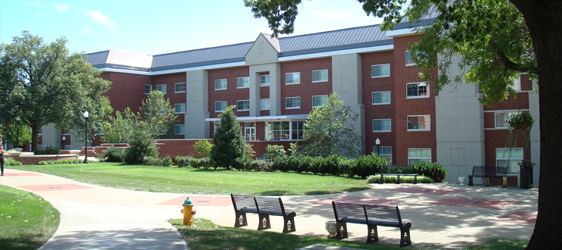
WKU Wireless
Wireless Access Points are not allowed in the residence halls.
  This includes, but is not limited to:
    Non-IT Sanctioned Hubs
    NAT routers
    Switches
    Wireless Access Points
  These devices are prohibited and can result in service termination.

Slide 10
Need Assistance?
Experiencing Technology Problems?
  Contact the IT Helpdesk at 270-745-7000 or chat in at www.wku.edu/it/chat
  Stop by the TopperTech Service Window in MMTH
Checking In at TopperTech
You must bring the following to check in your device with TopperTech for service:
  Your WKU ID
  Your Device Charger
  Your Device

Slide 11
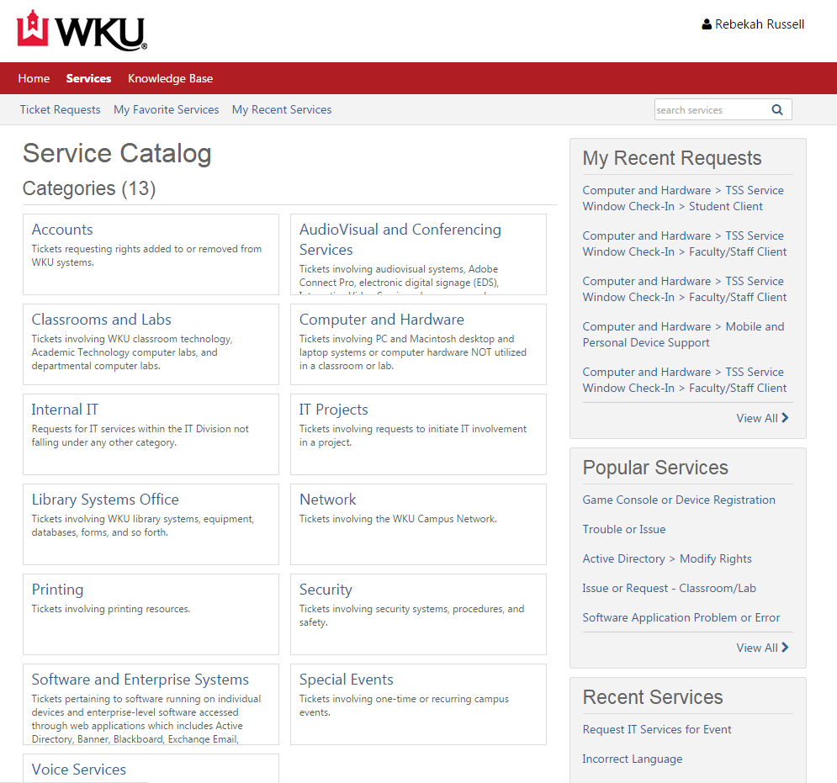
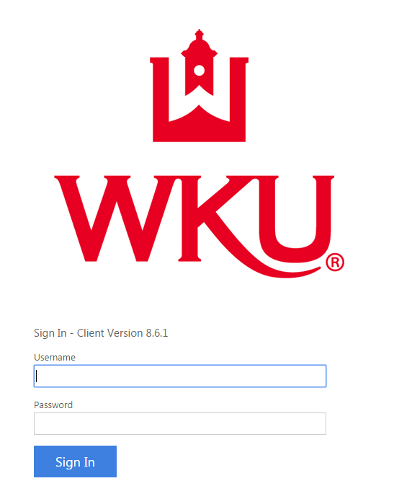
Service Catalog
Experiencing Technology Problems?
  Visit the IT Service Catalog at td.wku.edu/tdclient
  Log in via your NetID and password
  Search for your issue via the search bar
  Can’t find your issue? Contact the IT Helpdesk at 270-745-7000 or chat in at www.wku.edu/it/chat

Slide 12
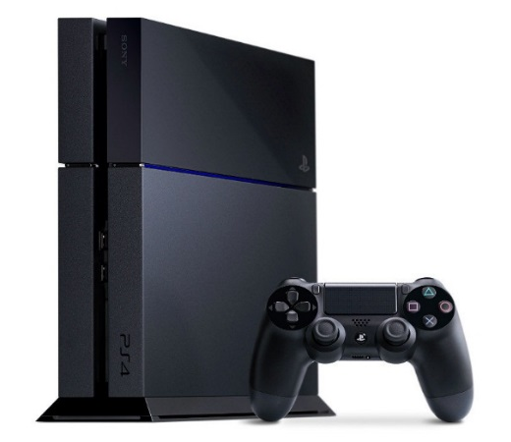
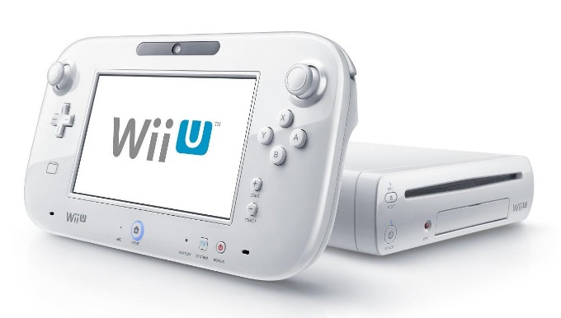
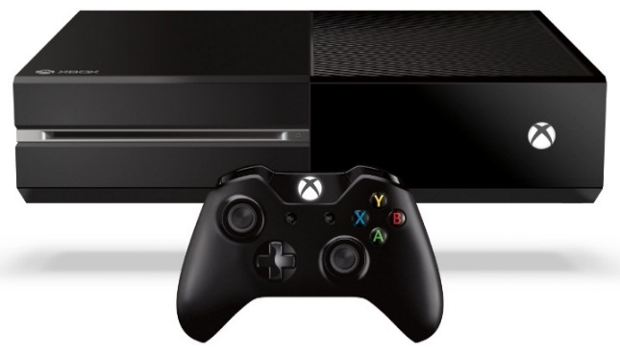
Gaming Consoles and Streaming Devices
You must register your game console* and/or streaming device for online capabilities.
Call the IT Helpdesk with the following info:
  Your WKU ID
  Username (ex. James.Smith or smithjc)
  Residence Hall & Room Number (ex. Barnes Campbell, Rm. 123)
  Contact Phone Number
  Console MAC Address (12 characters in this format: xx:xx:xx:xx:xx:xx)
    *Nintendo Wii systems can only connect to the network with an official Nintendo Wii Lan Adapter. For more information visit www.nintendo.com

Slide 13
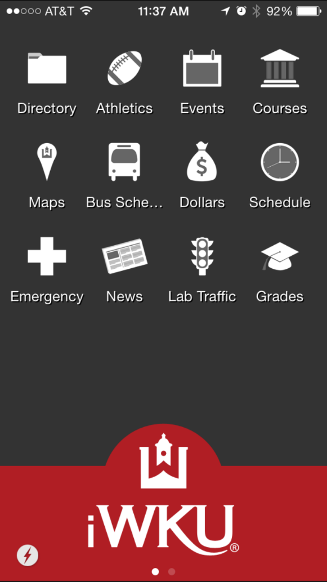
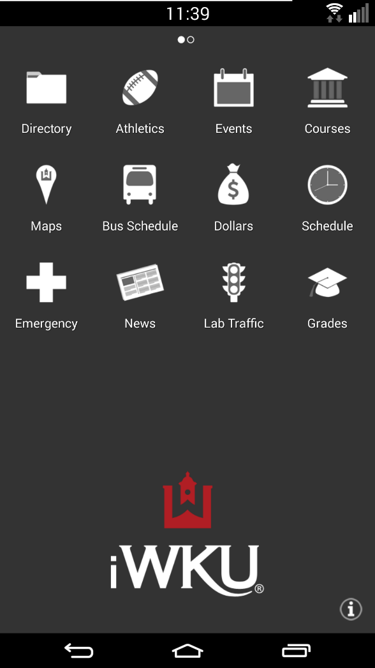
iWKU
iWKU is your easy mobile guide to information about WKU. iWKU is a suite of apps that gives you instant access to campus maps, contact information, the course catalog, libraries, news, events, grades, and more.
Search the Directory app
Store contacts, send email, or call directly
Search the course catalog for current and future semesters
Find your way with the Maps app
Search the WKU Libraries collection catalog
Get up-to-the-minute campus information
Check out campus photos and multimedia
Accessible from iTunes at:
http://itunes.apple.com/us/app/iwku/id365191342?mt=8
Accessible from Google Play at: https://play.google.com/store/apps/details?id=com.blackboard.android.central.WKU&hl=en
Other web-enabled mobile devices can visit http://i.wku.edu

Slide 14
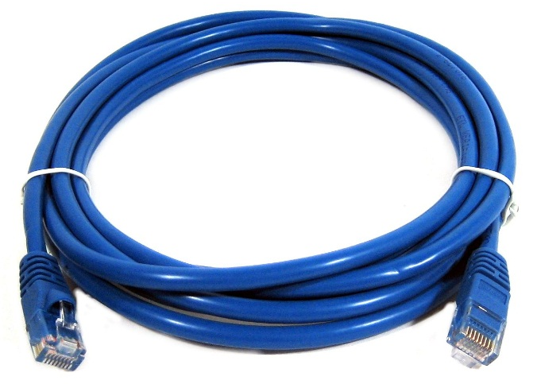

What Tech Should I Bring to Campus?
Every student’s needs are different!
Most computers will be supported on our network, including PCs and Macs.
You must provide your own Ethernet cable for a wired connection in your residence hall.

Slide 15
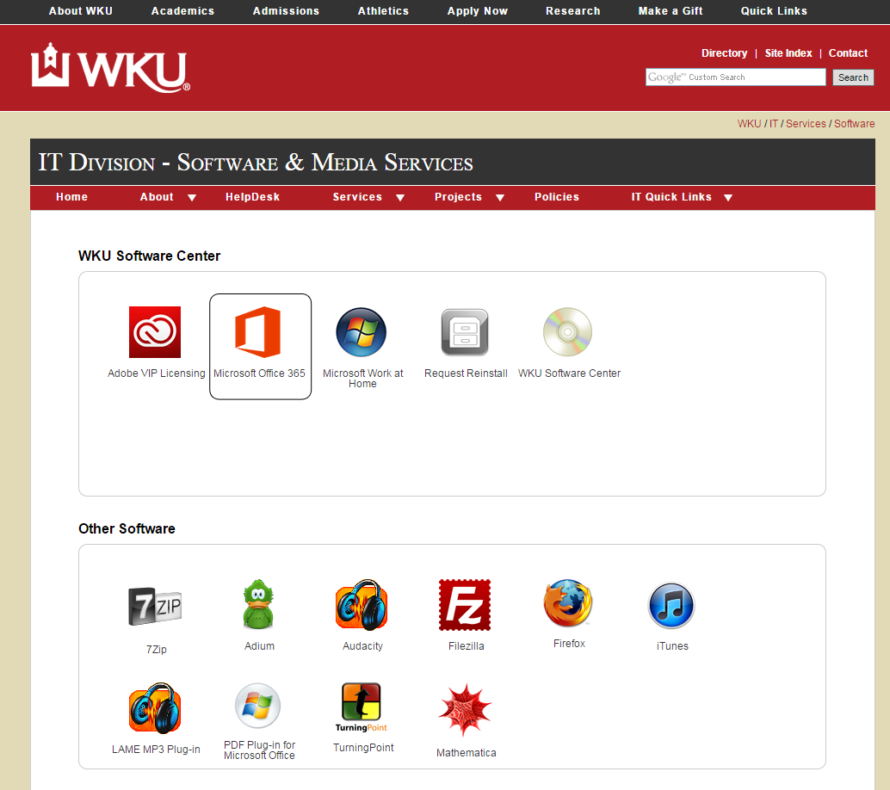
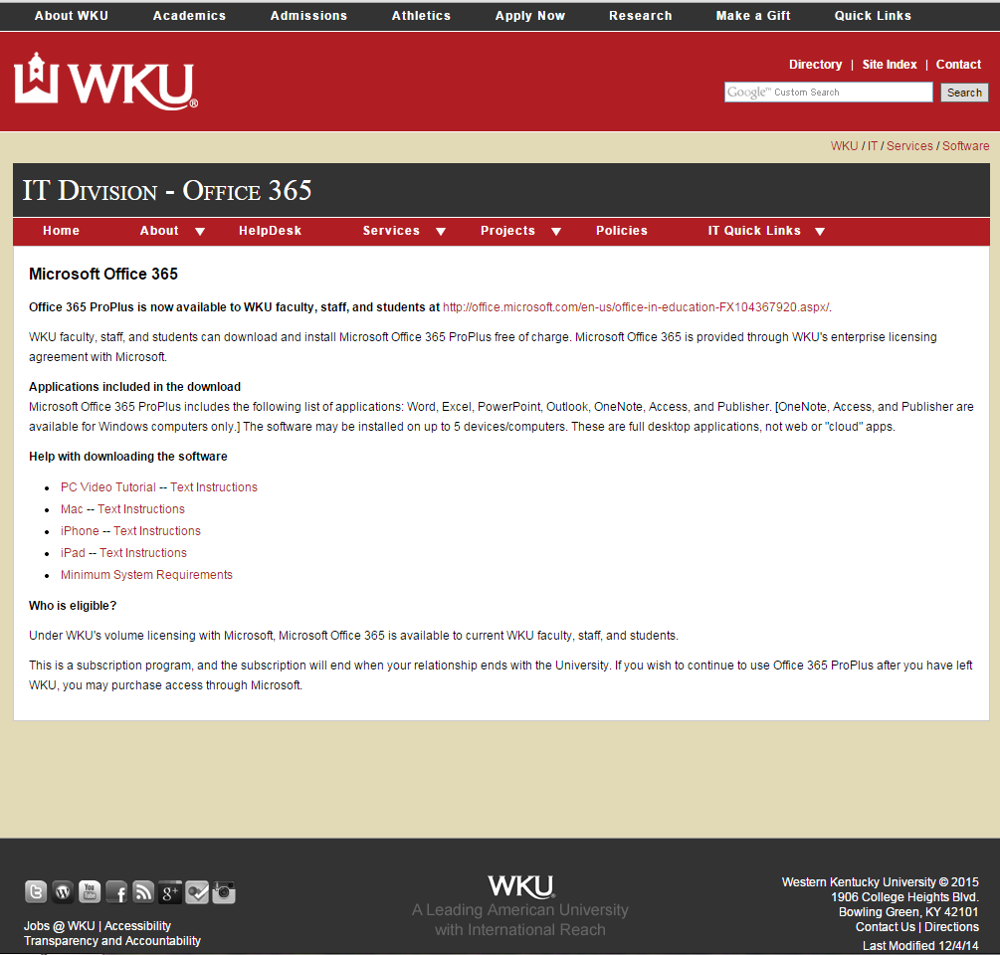
Microsoft Office 365
Microsoft Office is available to registered WKU students at no charge.
Students can download Office by visiting the Software Center at www.wku.edu/it/sms/
The download includes Microsoft Office 2016 applications:
  Word
  Excel
  PowerPoint
  OneNote

Slide 16
Purchasing Programs
Western Kentucky University has Educational Purchase Pricing with both Apple and Dell available for WKU faculty, staff, and students.
Special discounts and offers that are made available to an employee or student of Western Kentucky University are not available to the general public. More information can be found at www.wku.edu/it/discounts-purchasing

Slide 17
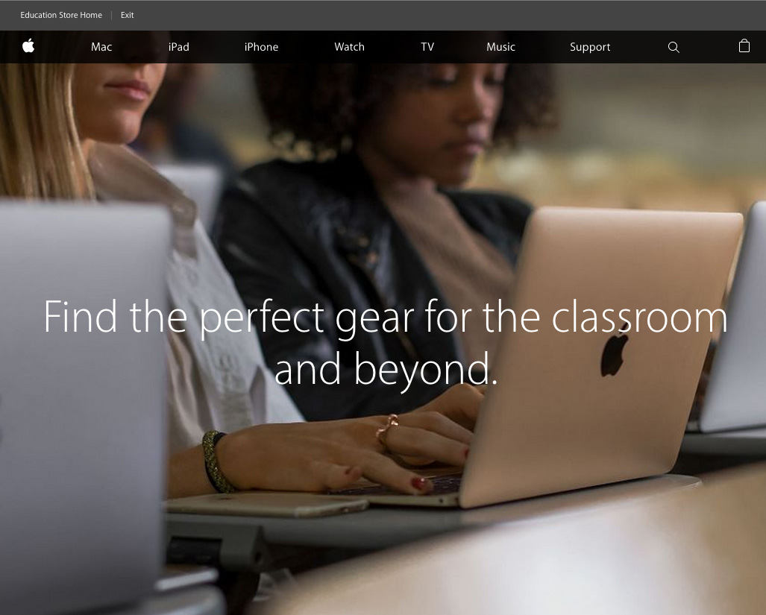
Apple Educational Purchase Program
WKU’s Apple Store
Western Kentucky University and Apple have teamed up to offer faculty, staff, and students the benefit of participating in the Apple Educational Purchase Program. In addition, the discounts are not limited to computers. Most Apple products are available at a discount, with the actual discount percentage averaging around 10%.
www.wku.edu/it/discounts-purchasing

Slide 18
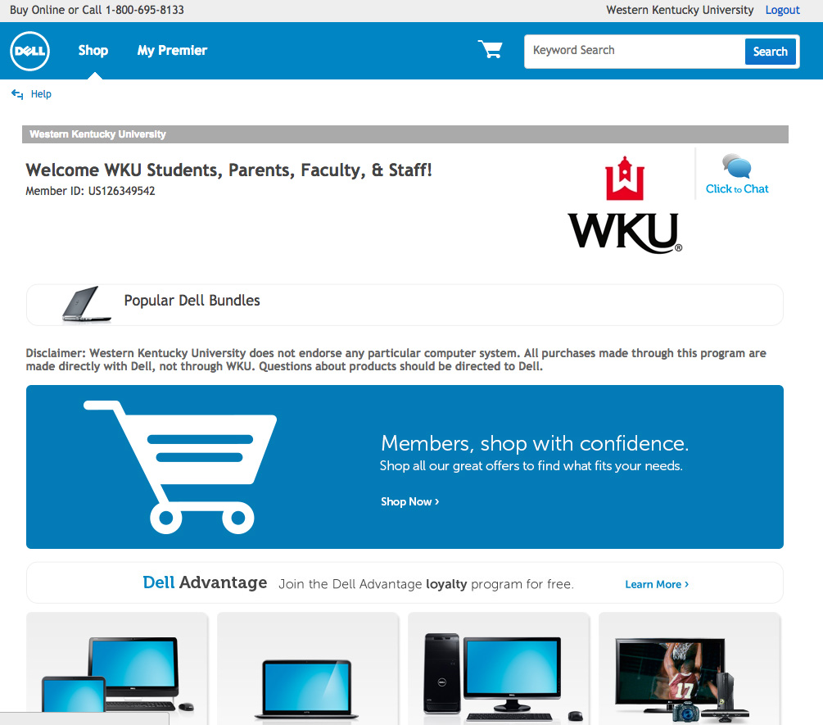
Dell Educational Purchase Program
Western Kentucky University and Dell have teamed up to offer faculty, staff, and students the benefit of participating in the Dell Educational Purchase Program. One can purchase LCD TVs, handheld devices, and printers as well as choose from over thousands of electronics and accessories at discount prices.
www.wku.edu/it/discounts-purchasing

Slide 19
Looking to Make a Purchase?
Looking to purchase a PC? Consider the following:
Your Major
  The requirement for the computer is different, depending on your major. Your advisor can discuss software you will be using in your courses to help you decide on the appropriate hardware.
  Portability
    Having a computer that can easily be transported is important when classes are heavily note dependent.
  Extended Warranty
    Consider extended warranty for duration of time in school. Extended warranties are highly advisable for any computer system.
  Anti-Virus Software
    Anti-virus protection is crucial. If you do not have an anti-virus software package installed on your device, WKU provides Symantec Endpoint Anti-Virus software for WKU students. It can be downloaded at www.wku.edu/it/sms

Slide 20
File Sharing
What is file sharing?
File sharing is the practice of making files available for other users to download over the Internet and smaller networks. Peer-to-peer (P2P) programs are often the preferred method of user that want to download and share files.
Is file sharing allowed at WKU?
While P2P programs have legitimate uses, using P2P, ftp, irc, or other applications to download or distribute copyrighted materials is against the law and against University Policy. WKU takes copyright violations very seriously and responds accordingly to each incident and violation.

Slide 21
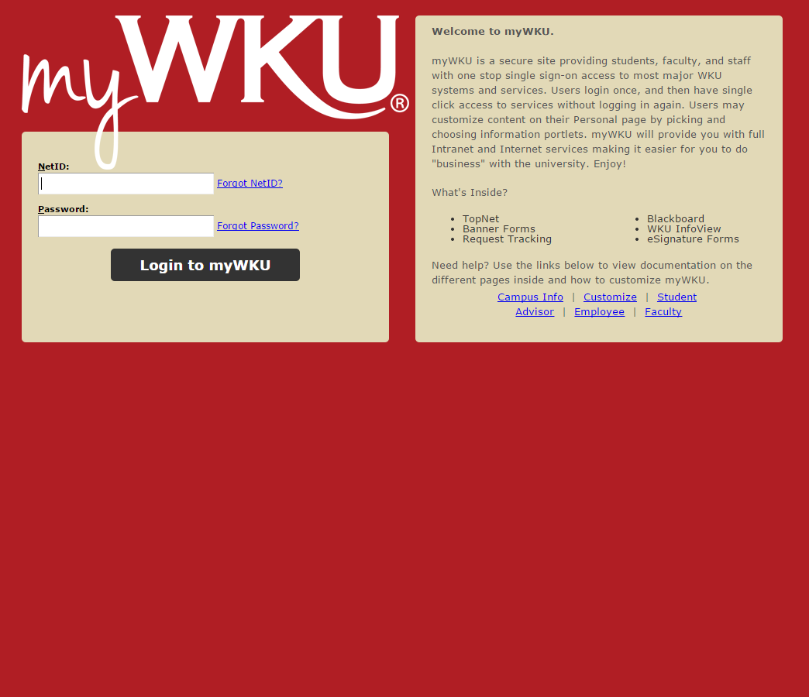
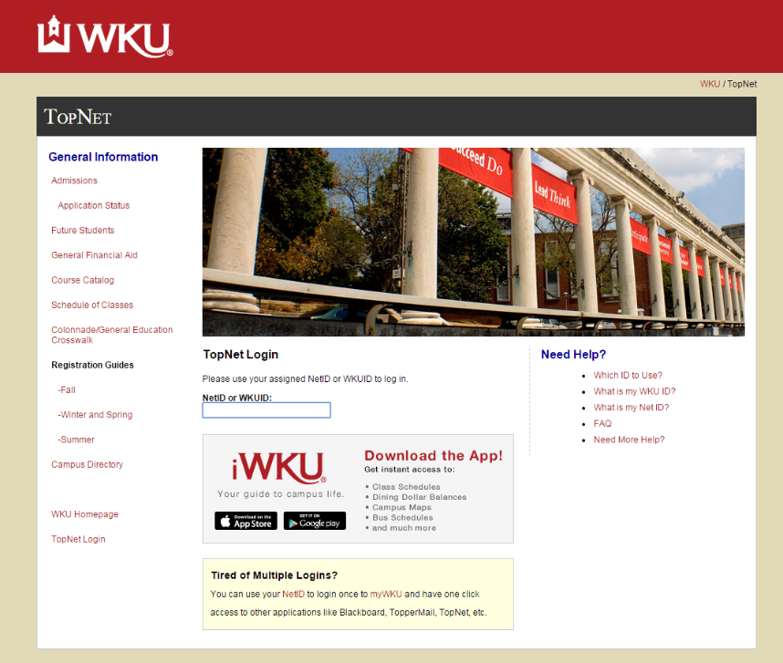
NetIDs
Once you have been admitted to WKU, your NetID will be created. This NetID and password will be your universal login to myWKU, TopNet, Blackboard, myStuff, computer labs, WKU wireless network and other IT services. You may look your NetID and set your password at www.wku.edu/it/accounts.

Slide 22
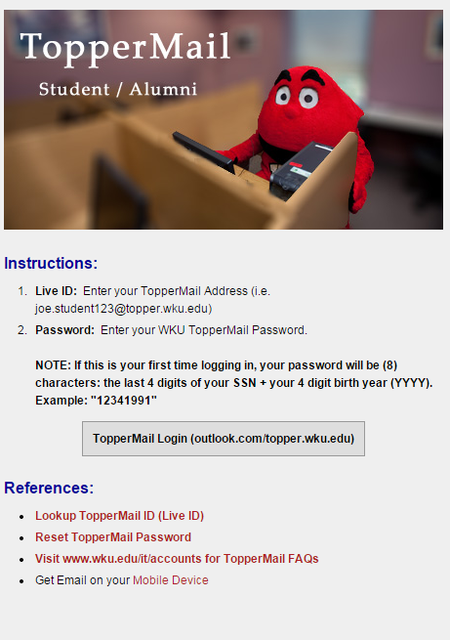
E-Mail Accounts
New WKU students will be issued a WKU e-mail account called TopperMail.
Your TopperMail account will be accessible 24-48 hours after you have registered for classes.
You will receive official WKU communications through your TopperMail account. Check this account regularly! Access your TopperMail at www.wku.edu/it/webmail.

Slide 23
Safe Computing
Create Strong Passwords
Choose passwords that are difficult to guess, using uppercase letters, numbers, and special characters. Try to pick phrases that are easy to remember, but hard for others to know.
Install Anti-Virus Software
Anytime you open an e-mail attachment or download a file from the Internet, you are in danger of getting a virus on your computer. Viruses could potentially send themselves to all your contacts, damage/delete files on your computer, or install hidden programs that allow your computer to be accessed remotely. Once you install anti-virus software, keep it up to date.
Back Up Your Critical Files
Saving your files on your hard drive, portable media (such as flash drives), AND external hard drives is encouraged to prevent data loss. Students also have access to 1 GB of online storage through myWKU.
Run Windows Updates
Use Windows Updates to keep your operating system software and hardware working smoothly.

Slide 24
Safe Computing
E-Mail
Never open an e-mail attachment from someone you do not know. Be sure your anti-virus scans your e-mails. Never forward letters, or virus warnings, as they may not be legitimate. Never use the “unsubscribe” feature of Spam e-mails or reply to Spam e-mails. Doing so confirms the validity of your address. This can allows the spammer to keep sending you e-mails. The proper way to deal with Spam is to delete it. You can also forward spam to your TopperMail account to spam@wku.edu.
Downloading Files
Be very careful about the software files that you download. Only download from trusted sources. Files from un-trusted sources may contain viruses or have adverse affects on your computer. Some downloaded software may also contain spyware. Spyware collects personal data about your web surfing and other habits, and then sends that info to other third parties. Do not download or share copyrighted files such as music or movies without permission from the copyright owners. Copyright infringement is against University Policy and federal law. The No Electronic Theft (NET) Act of 1997 allows for criminal prosecution of individuals who electronically copy and distribute copyrighted work, even if there is no commercial gain from doing so.

