Slide 1
Preparing Adult Learners for Success
Presenter: Amy Wayda, GED Testing Service
Date: March 13, 2013

Slide 2
What’s driving GED Testing Service?

Slide 3
GED® Testing Program
19M+ graduates
70 years experience
Only nationally recognized HSE test
Research-based
700,000+ Test-takers annually
72% pass rate
Accepted by colleges and employers

Slide 4
Why Test on Computer?
First – Test-taker access and convenience
One-stop registration and scheduling
Enhanced test security
Flexible testing experience
Instant score reports
Second – The 2014 test requires computer delivery to assess content and support advanced scoring and reporting

Slide 5
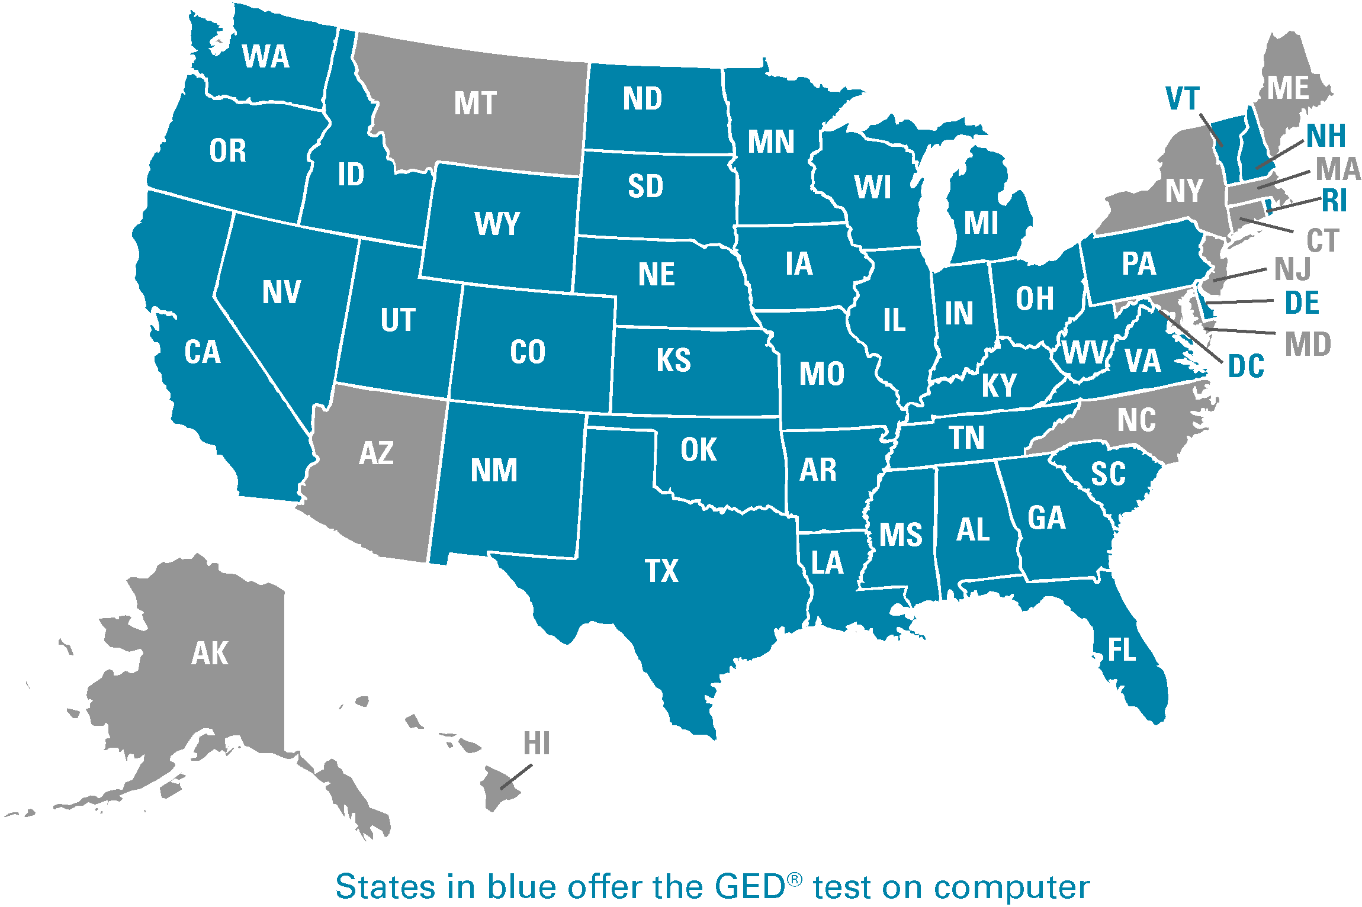
CBT is LIVE in 43 jurisdictions including the District of Columbia & American Samoa CBT is live in Corrections in 4 jurisdictions

Slide 6
The new GED® Test: Key facts
Launch
LAUNCH:
January 2, 2014
Delivered by computer in secure testing centers
CONTENT:
Aligned with career- and college-readiness content most closely linked to career and postsecondary success
Four content area sections rather than five
“Passing Standard” – represents high school equivalency, reflecting actual performance of 2013 graduating high school seniors
The 2014 GED Test will also provide more information about academic knowledge and skills deemed critical by employers and colleges – College and Career-Readiness targets
Platform
Content
Performance Standards
Notes:
Assessment Targets
Mathematics and Literacy are complete
Science and Social Studies to be complete by 11/30/11
Item Writing
Mathematics is in process
Literacy to begin after passages approved in November
Science and Social Studies to begin in December
Item review meetings begin in January, 2012

Slide 7
A New GED® Test in 2014: Why?
65% of jobs will require more than a high school diploma
Technology skills are a must
The GED® test credential must have value for adult learners, employers, and postsecondary institutions
Notes:
Add changing landscape
60% of HS grads require remediation
65% of jobs will require more than high school to earn a family-sustaining wage
Technology skills are a given in the eyes of employers (examples—job apps on line
Common Core—adults cannot be left behind

Slide 8
What will the 2014 GED® Test Look Like?
About 7 Hours of testing time
Reasoning through Language Arts: 150 minutes (including 10 minute break)
Mathematical reasoning: 90 minutes
Science: 90 minutes
Social Studies: 90 minutes
Plus field test items, directions and breaks
Standardized delivery on computer, in a testing center

Slide 9
The Big Picture: 2002 versus 2014
 | 2002 | 2014
Delivery mode | Paper only | Computer only
Test basis | Prevailing HS curriculum and performance standard | Content and Performance based on College and Career Readiness
Item type(s) | 100% multiple choice plus an essay based on personal experience or opinion | Multiple choice (more than 50%) plus technologically enhanced items and evidence-based writing
Guiding principle | Bloom’s Taxonomy | Webb’s Depth of Knowledge
Science & SS | Largely reading tests | Content knowledge required
Language Arts | Two tests: Reading and writing | RLA (an integrated approach to reading & writing about what is read)

Slide 10
2014 Item Types
Multiple-choice
Fill-in-the-blank
Drag-and-drop
Hot-spots
Drop-down
Short-answer
Extended-response
Notes:
MARTY
By way of review, you’ll probably recall from Chapter 1 that our new test will include a wider variety of item types than are on the current. IN OUR WEBINAR ON CHPATER 1, we mentioned that multiple choice items would continue to appear on the test as one of the key item types. Multiple choice items are a reliable method of measuring skills and knowledge at a range of cognitive levels in a standardized manner. But remember that the additional item types allow us to measure a wider range of skills and cognitive levels. Today we’ll be focusing on the constructed response items – ones in which test takers need to create their own written response to a test question. Those constructed response items come in two versions – one, we call short answer, and that type can be usually be answered in a few sentences, and the extended response, which requires a longer response – something like several paragraphs, most likely. You might think that there is another item type – fill-in the blank – that is a constructed response item. While Test-takers do need to provide their own response to fill-in-the-blank items, those items only require a number, word, or phrase, and so those items don’t require the more extensive scoring process of true constructed response items like the short answer and extended response. Although there are only six constructed response items on the test battery - four short-answers and 2 extended responses, they role these items play is critical in assessing the depth of a Test-taker’s understanding of the content, expressed in their own words. Even more importantly, these tasks also represent authentic, real-world skill application representative of competencies necessary for success in post-secondary education or a career.

Slide 11
The Results Are In
Computer based testing for the GED® test is faster, less stressful, and produces better results

Slide 12
Testing on Computer- First Year Results
Decreased failure rate
The failure rate of adults taking the test on computer is about half that of those taking the test on paper.
Higher likelihood of retesting
Adults testing on computer were 59% more likely to retake a failed test.
Faster finishing times than their paper-and-pencil counterparts
On average, adults who tested on the computer completed their exams an hour and a half faster.

Slide 13
The New Math Test
Math is by far the hardest subject with almost 30% of first time test-takers failing the subject test on paper
83% of test-takers passed the Math test on computer in their first try

Slide 14
What about Test-takers?

Slide 15
What Test-takers are Saying…
“It was easy to understand and easier to concentrate.”
“It was more independent than the booklets; I could work at my own pace and do the tests in the order that I chose.”
“Refreshing to get your scores right away.”
“Great to have everything in one place and no paper forms. I wish I could have taken my previous tests on computer.”
“The test was super easy and the computer option should have been available sooner. Scheduling was quick and simple. I can't wait to schedule the rest of the sections. I plan on attending CC and studying x-ray tech.”

Slide 16
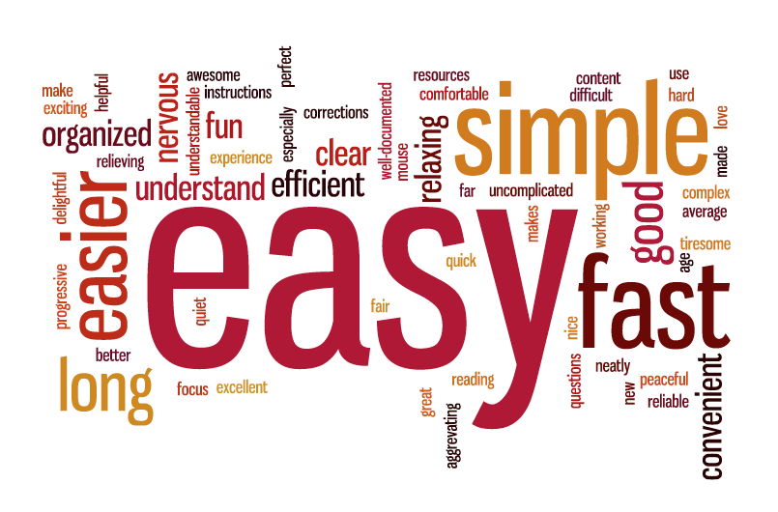
What do Test-takers Think?
Notes:
Here are some of the most common adjectives that the first group of Test-takers used to describe the testing on computer experience. The size of the word in the word cloud is indicative of the frequency that the term was used. So among the most common terms used to describe the experience were
EASY (EASIER)
FAST
SIMPLE
It all speaks to the goal we have of creating a more uniform Test-taker experience.

Slide 17
Second Shot Promotion

Slide 18
Second Shot Promotion
Gives first time test takers the ability to try the computer based test and if they fail they get one free retake
Promotion runs through the end of May
GED Testing Service is reaching out to CBT Test Centers to explain the promotion and how their candidates can take advantage of the promotion
http://www.gedtestingservice.com/secondshot/
http://www.gedtestingservice.com/educators/spreadtheword

Slide 19
How Do I Become a Computer Based Test Center?

Slide 20
What are the Criteria to Become a Test Center?
Any distraction-free location such as an enclosed area or classroom, equipped with at least 2 computers and access to the internet
• A separate check-in area with space for administrator check-in, lockable storage, seating area for candidates
A certified test administer to proctor the tests
• Meet technical requirements - http://www.pearsonvue.com/pvtc/technical_reqs.pdf
• Meet facilities requirements – http://www.pearsonvue.com/pvtc/facility_reqs.pdf

Slide 21
Benefits for Computer Based Test Centers
Pearson VUE software manages complete testing process, from test booking to test delivery
Testing center sets and manages schedule using software
Offer access to the GED® test, as well as other test programs that link to certifications/jobs in your community
Software is provided free to approved sites
On-going assistance and support from Pearson VUE teams
Test Centers are compensated for every GED test delivered
$5 per seat hour
Site is paid for candidates that schedule but do not show

Slide 22
The 5 Steps to Becoming a Test Center
Step 1 – Apply
Complete Part 1 of the Application Online
Complete Part 2 of the Application Online
Upload required photos of the site and a floor plan
http://www.pearsonvue.com/pvtc/academic/
Step 2 – Sign
Once Pearson VUE has received your application, they will send you a contract and additional forms that might apply.

Slide 23
The 5 Steps to Becoming a Test Center
Step 3- Approval
Pearson VUE will send a pre-activation pack (containing material for your test center), signed agreement, Pearson VUE Site ID.
The test center will then order the Enhanced Security Protocol (ESP) Kit.
Step 4- Install
The Pearson VUE Support Services (VSS) Team will assist you in doing all the installations needed to set- up your center for test delivery
*Site has 30 days to complete installation*

Slide 24
The 5 Steps to Becoming a Test Center
Step 5: Train
Pearson VUE will send the designated Test Administrator (TA) the Polices & Procedure Guide to be certified. Once your TA passes the test and installations are done, you will be activated to start test delivery.
Administrator/Proctor Training
Login to Pearson VUE Support Services web site
Train using the self-paced PowerPoint presentation and other administrator training materials
Take a no-cost, informal, open-book administrator/proctor test on a Pearson VUE test Delivery workstation at your test center

Slide 25
Pearson VUE Administrator/Proctor
General Responsibilities:
Ensure secure and appropriate testing environment
Proctor candidates during test delivery
Verify candidate identification
Capture photos and digital signatures, as required
Report incidents affecting candidates’ performance
Utilize Pearson VUE applications
Site Manager – manage site
Admissions Manager- admit candidates into the testing room
Delivery Manager – launch tests
Registration Manager – register candidates

Slide 26
Test Center Administrator/Proctor

Slide 27
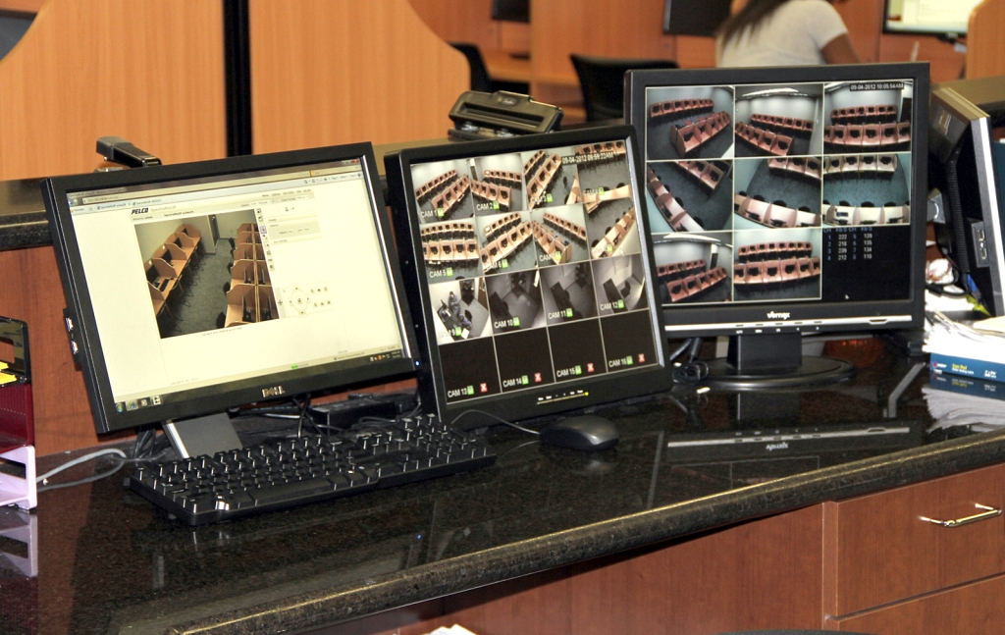
Video Surveillance

Slide 28
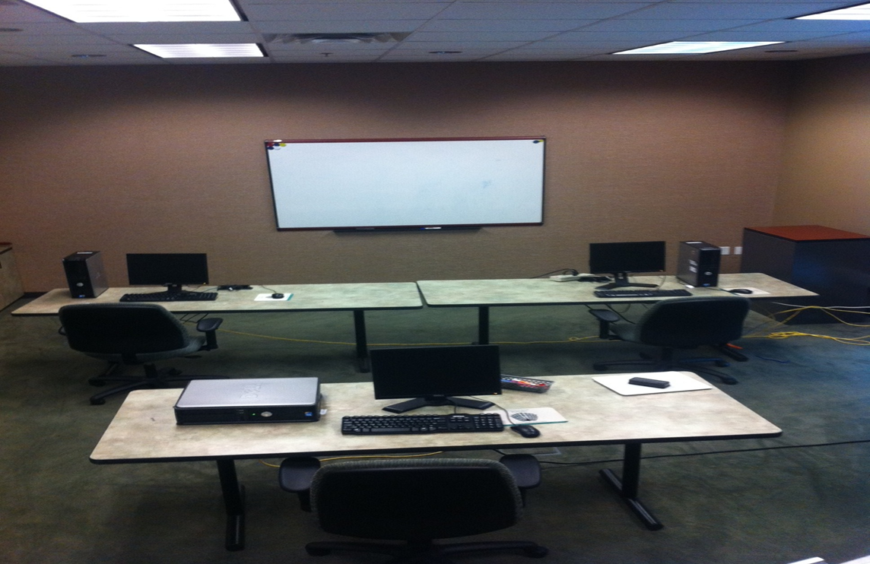
Proctor Inside of the Testing Room

Slide 29
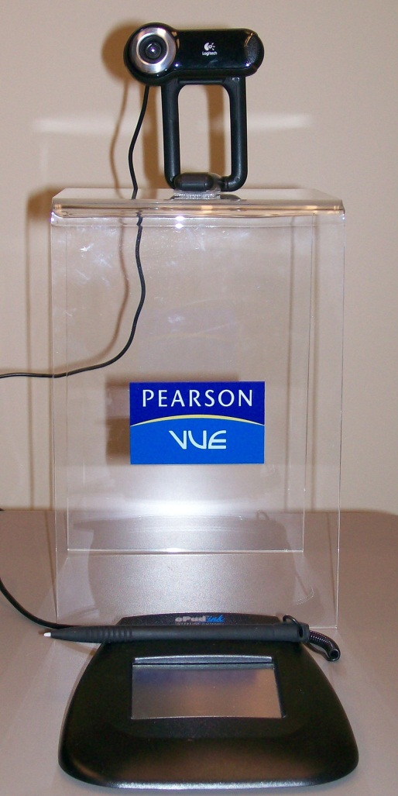
ESP Equipment
2 digital cameras (one for back-up)
1 digital signature pad
1 Pearson VUE branded camera stand
One-time fee of $450 to test centers)

Slide 30
Test Scheduling
Your test center will appear on www.Gedtestingservice.com as a computer-based testing center

Slide 31
Resources

Slide 32
www.GEDtestingservice.com

Slide 33
Additional Resources
Test-taker resources
Multimedia outreach
Video profiles of success
Online tutorials and training
Brand resources for local programs
Research on adult learners
One-stop shop for practice materials
Webinars

Slide 34
Thank you!
Amy Wayda: Amy.wayda@GEDtestingservice.com
Questions: GED2014@GEDtestingservice.com
Website: www.GEDtestingservice.com

