Slide 1
CEBS College Spotlight College of Education and Behavioral Sciences
#HeadForTheHill
Notes:
The cover slide is a required slide for all presentations

Slide 2
College of Education and Behavioral Sciences
Welcome!
#HeadForTheHill
Notes:
Duplicate this slide as necessary to make your key points.

Slide 3
Prepared To Lead And Serve
#HeadForTheHill
Notes:
Duplicate this slide as necessary to make your key points.

Slide 4
College of Education and Behavioral Sciences
We are home to:
Psychology
Teacher Education
Counseling
Military Sciences
ROTC
Interdisciplinary Education and Organizational Leadership Studies
#HeadForTheHill
Notes:
Duplicate this slide as necessary to make your key points.

Slide 5
College of Education and Behavioral Sciences
How is the job market for my area of interest?
#HeadForTheHill
Notes:
Duplicate this slide as necessary to make your key points.

Slide 6
Occupational Outlook
School Psychologist
#47 Top 100 Jobs
#1 Best Social Services Jobs
Psychologist
#30 Top 100 Jobs
Mental Health Counselor
#97 Top 100 Jobs
#8 Best Social Services Jobs
Substance Abuse and Behavioral Disorder Counselor
#74 Top 100 Jobs
#5 Best Social Services Jobs
Marriage and Family Therapist
#51 Top 100 Jobs
School Counselor
#11 Best Social Services Jobs
Elementary School Teacher
#2 Best Education Jobs
Middle School Teacher
#3 Best Education Jobs
High School Teacher
#72 of top 100
#1 Best Education Jobs
#HeadForTheHill
Notes:
Duplicate this slide as necessary to make your key points.

Slide 7
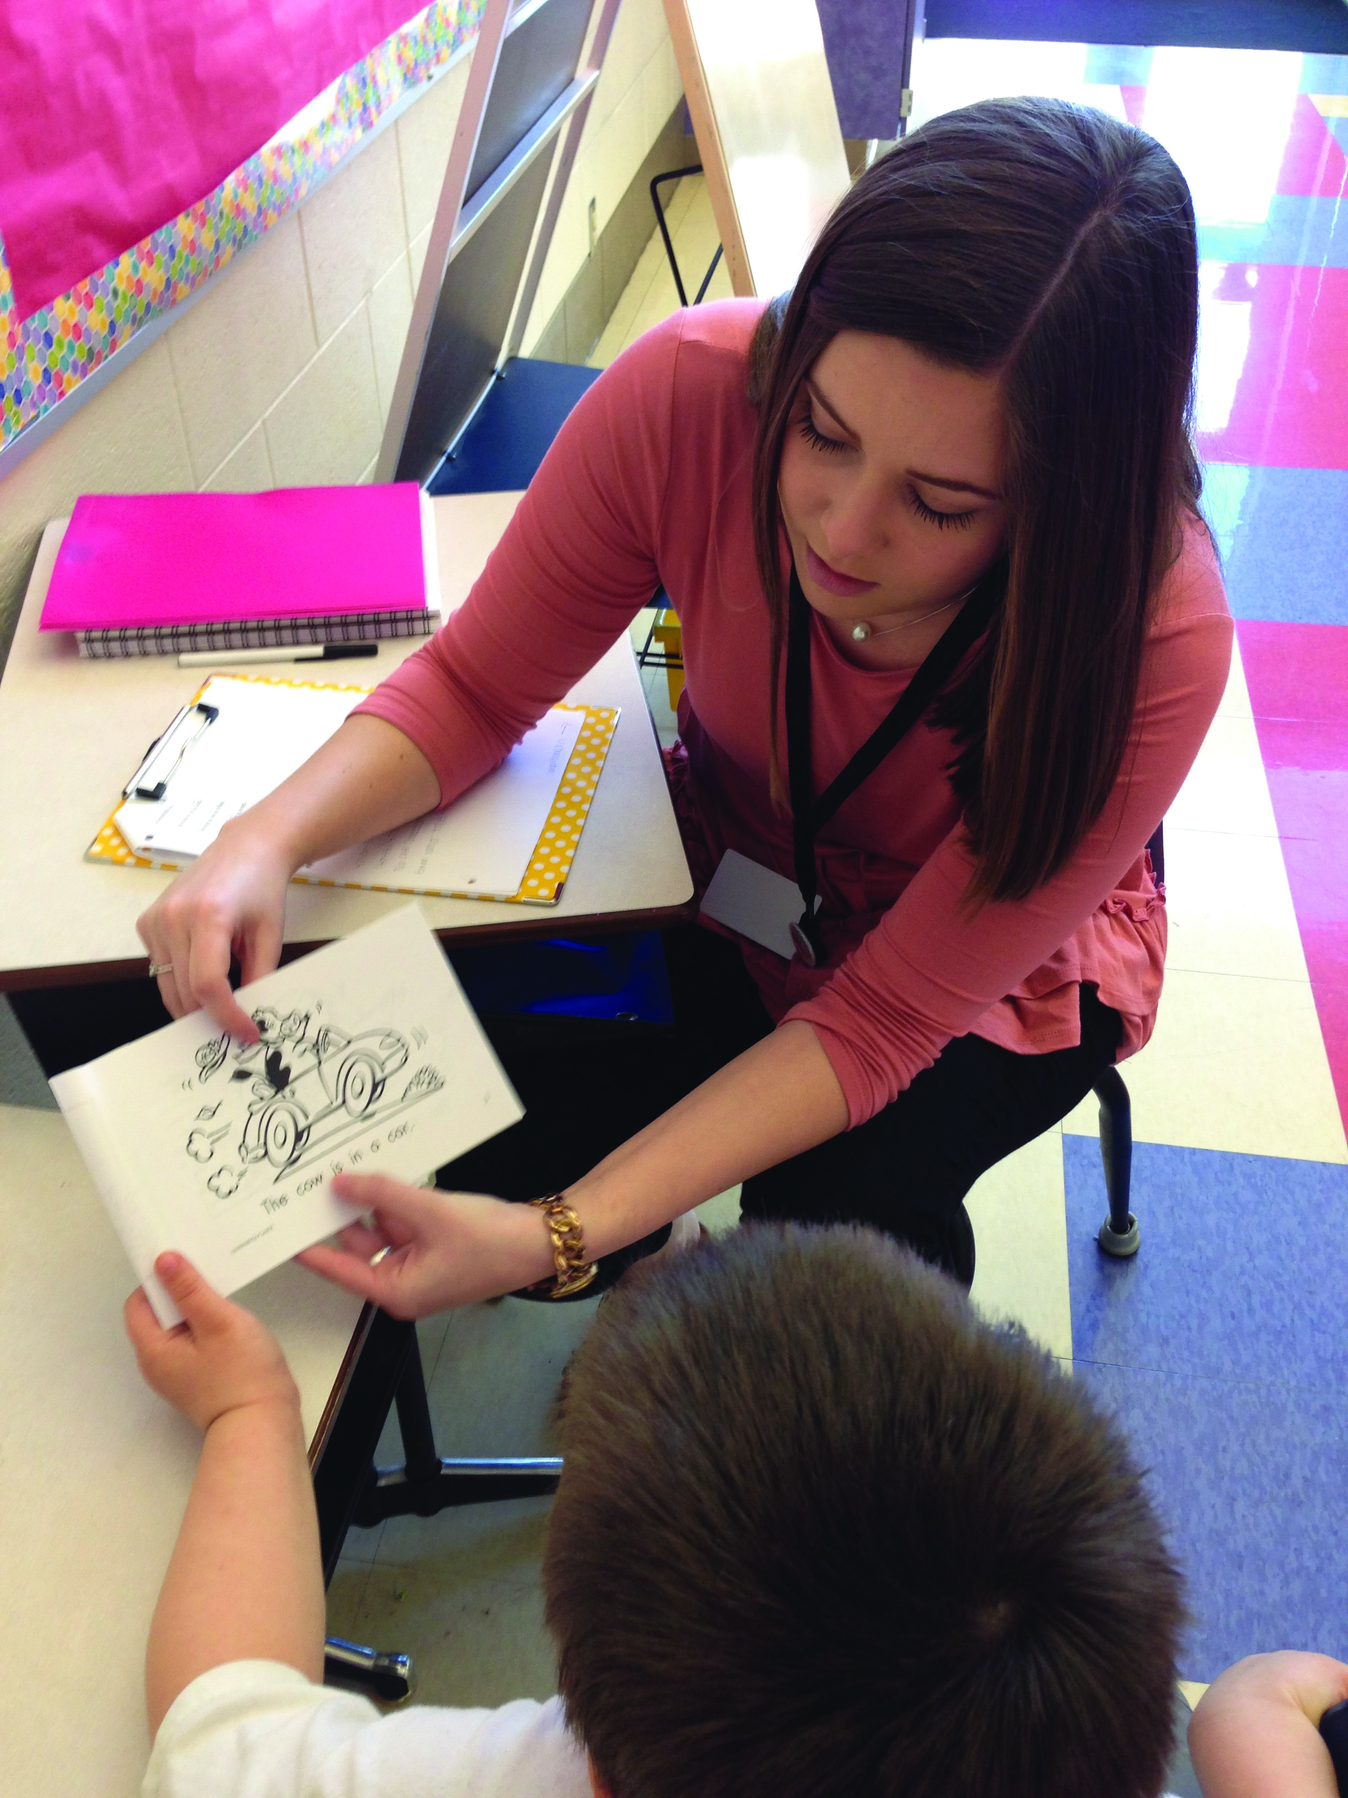
Clinical Experiences and Practicums
#HeadForTheHill
Notes:
Duplicate this slide as necessary to make your key points.

Slide 8
Student Engagement
#HeadForTheHill
Notes:
Duplicate this slide as necessary to make your key points.

Slide 9
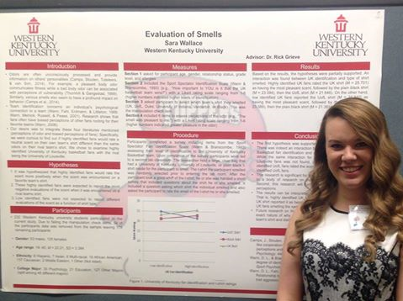
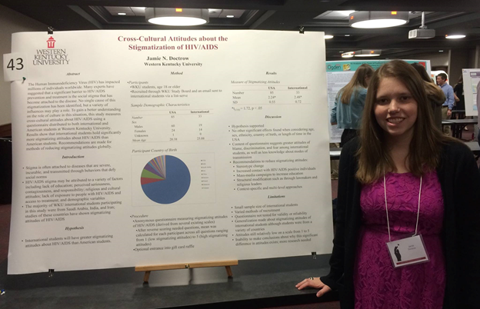
Student Research Opportunities
#HeadForTheHill
Notes:
Duplicate this slide as necessary to make your key points.

Slide 10
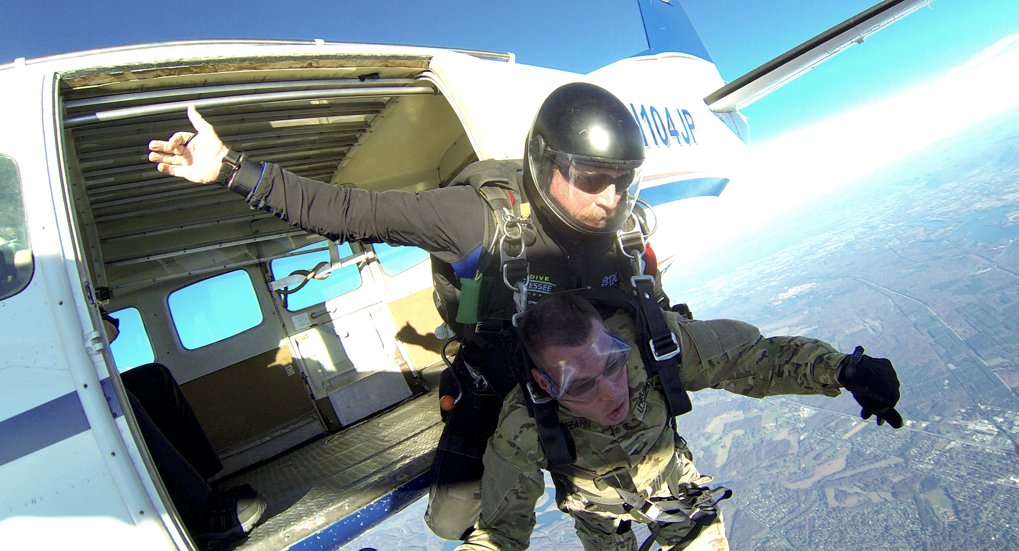
THE SKY’S THE LIMIT
#HeadForTheHill
Notes:
Duplicate this slide as necessary to make your key points.

Slide 11
College of Education and Behavioral Sciences
YOUR DECISION
#HeadForTheHill
Notes:
Duplicate this slide as necessary to make your key points.

Slide 12
College of Education and Behavioral Sciences
I invite you to be the next Hilltopper in CEBS!
#HeadForTheHill
Notes:
Duplicate this slide as necessary to make your key points.

Slide 13
QUESTIONS?
wku.edu/cebs/
#HeadForTheHill

