Slide 1
HRL: Your Home on the Hill Blair Jensen, Assistant Director Housing and Residence Life
#HeadForTheHill
Notes:
The cover slide is a required slide for all presentations

Slide 2
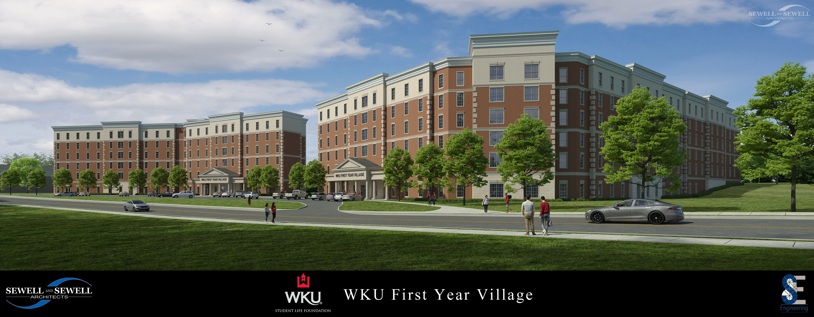
The Future of On-Campus Living at WKU
#HeadForTheHill
Notes:
Truly an exciting time to be a Hilltopper!
Demolition of Bemis Lawrence Hall began just yesterday to make way for two brand new residence halls.
These two new pod-style residence halls will house WKU’s Living Learning Communities, feature in-hall classrooms and specialized common areas, and serve as the gateway to WKU’s First Year Village on the south end of the campus.
-deep faculty and peer engagement
-living learning laboratory that integrates in and out-of-classroom learning
Each pod will house approximately 25 students and include a bathroom and lounge.
-lower bed to bath ratio
-lower student to RA ratio

Slide 3
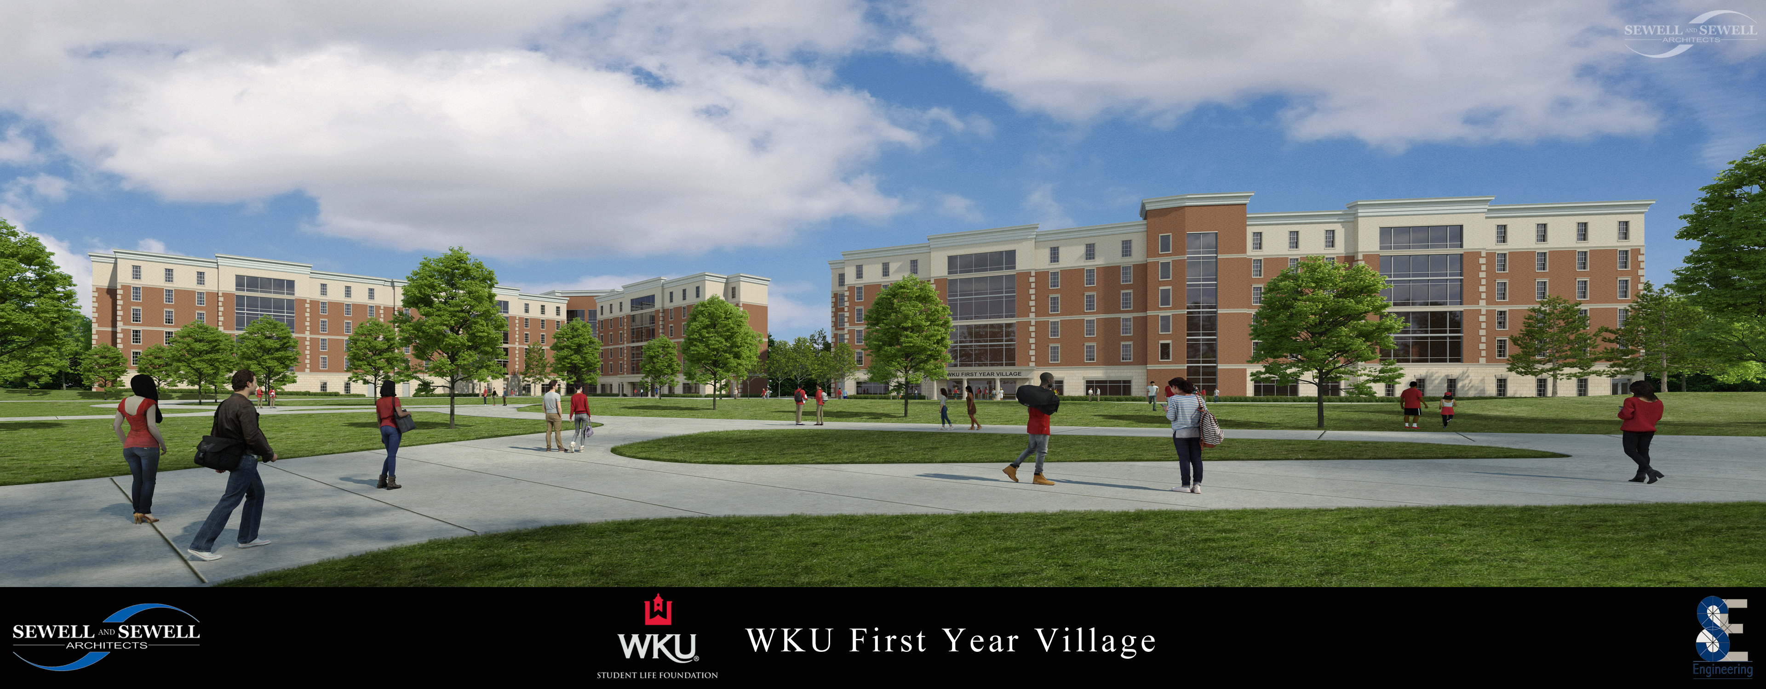
The Future of On-Campus Living at WKU
#HeadForTheHill
Notes:
What is currently the PFT parking lot will be transformed into green space, creating an idyllic park-like setting at the south end of campus.

Slide 4
Required Housing Policy
Living on-campus is an essential part of the educational experience at Western Kentucky University.
All full-time undergraduate students are required to live on campus for two years, unless otherwise exempted.
#HeadForTheHill
Notes:
Data shows that students who live on campus their first year are nearly 10% more likely to return for classes in the spring and almost 7% more likely to return the following fall than students who do not live on campus. Additionally, WKU students who live on campus for four semesters are over 25% more likely to graduate in six years than students who only live on campus for three semesters.
Required to live on campus for two years regardless of the number of credit hours earned.
Students who have not lived on campus for two years and choose to love off campus will be charged the lowest residence hall rate that HRL offers.

Slide 5
Required Housing Policy
Exemptions include students who are:
Veterans of military service (181 days or more)
Married
Primary caregiver for dependent child(ren)
21 years of age or older (prior to the first day of classes)
Commuting from their parent/guardian’s permanent home and primary residence (50 miles or less)
Special circumstances (unique and unusual)
#HeadForTheHill
Notes:
Duplicate this slide as necessary to make your key points.

Slide 6
Residence Halls
Hall amenities include:
High speed internet access, wired and wireless
Cable-ready
Moveable, stackable furniture
In-hall laundry (cost included in Housing fee), mail delivery, and vending
Recreation spaces
Study lounges
Kitchens
#HeadForTheHill
Notes:
Duplicate this slide as necessary to make your key points.

Slide 7
Residence Halls
Community-style residence halls
Single gender, all female
Single gender, all male
Co-ed
Honors
Living Learning Communities
Extended Living
#HeadForTheHill
Notes:
Community style residence halls are available to all students and provide a traditional residence hall experience. Students on each floor share a common bathroom. All bathrooms have private, locking stalls with changing areas.
Community style halls have many opportunities for students to interact with one another, producing highly engaged and connected students. These halls are the most economical option for students living on campus.

Slide 8
Residence Halls
Hotel-style residence hall:
Co-ed
Hiltopper Hall
#HeadForTheHill
Notes:
Hotel style residence halls provide rooms with private bathrooms.
Co-ed by room—room occupants are same gender but may live next to a room occupied by the opposite gender.

Slide 9
Residence Halls
Suite-style residence halls:
Single-gender, all female
Co-ed
#HeadForTheHill
Notes:
Suite style residence halls feature two rooms connected by a shared bathroom.
Suitemates are same gender, but may live next to suite occupied by opposite gender.

Slide 10
Safety and Security
Residence halls:
All halls are locked 24/7/365
24 hour desk operation in all halls
All halls feature Electronic Access Control, residents must use WKU ID to gain entry
Enforced visitation policies
#HeadForTheHill
Notes:
Duplicate this slide as necessary to make your key points.

Slide 11
Safety and Security
Residence halls:
Cameras on all entrances and exits
All halls are sprinkled, have fire extinguishers on every floor; fire drills conducted quarterly
Monthly safety checks
#HeadForTheHill
Notes:
Duplicate this slide as necessary to make your key points.

Slide 12
Staff
Professional, full-time, live-in staff members in all halls.
Student staff members on every floor and at front desks.
Housekeeping and maintenance staff:
Environmental Service Attendants
Zone Technicians
#HeadForTheHill
Notes:
Duplicate this slide as necessary to make your key points.

Slide 13
Residential Education
Residential Curriculum intentionally designed to develop competency in the areas of Civility, Identity Development, Academic Success, and Career Readiness.
Campus partnerships foster student learning, growth, and development in, and out, of the classroom.
Living Learning Communities house students by academic college, degree program, or interest.
#HeadForTheHill
Notes:
Duplicate this slide as necessary to make your key points.

Slide 14
Applying for Housing
Priority deadline: March 31st
2020-2021 Housing application will open late October
Apply online via WKU Housing Portal
www.wku.edu/housing/portal
Must be admitted to WKU in order to apply for Housing
Be prepared to pay $150 housing deposit
Students can list preferred hall amenities on housing application; most first-year students will reside in community-style residence halls
Students can add a specific person as a roommate, search for a potential roommate, or choose a random roommate
#HeadForTheHill
Notes:
Allow 48 hours for your admission status to be updated in the student housing system before applying.

Slide 15
Key Takeaways
All full-time students are required to live on-campus for two years, unless otherwise exempted.
Once admitted, apply for campus housing online through the WKU Housing Portal.
Submit $150 housing deposit.
Indicate preferred amenities on housing application.
#HeadforTheHill
Notes:
Key Takeaways is a required slide for every presentation.

Slide 16
QUESTIONS?
Blair Jensen | 270-745-5863 | blair.jensen@wku.edu
#HeadForTheHill

