Slide 1
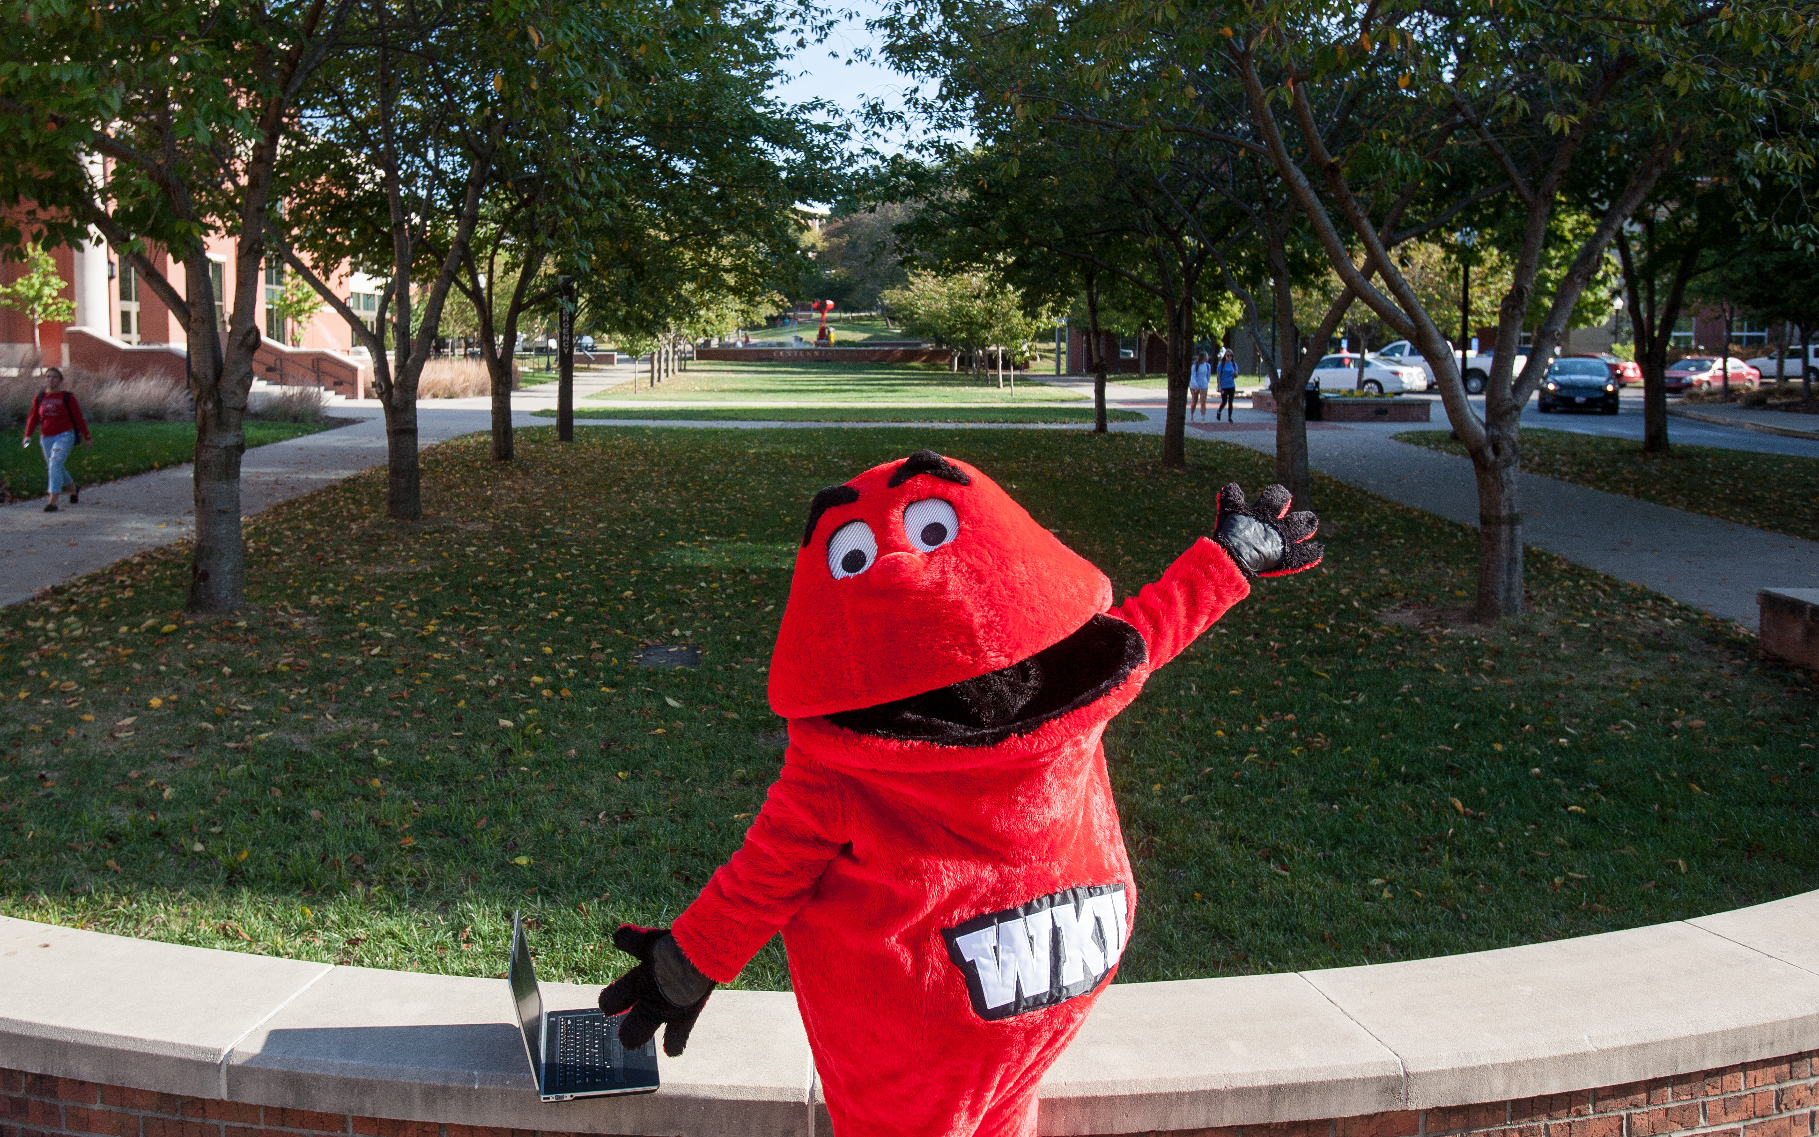
Exploring Majors at WKU Advising & Career Development Center
Exploratory Program | Downing Student Union 2141
(270) 745-5065
academic.advising@wku.edu
#HeadForTheHill
Notes:
The cover slide is a required slide for all presentations

Slide 2
Are you nervous about not having a major?
80% of students with a declared major are still unsure
On average, ACDC processes over 15,000 change of major a year
Most exploratory students only change their major once – and that’s the major they graduate with
#HeadForTheHill
Notes:
Duplicate this slide as necessary to make your key points.

Slide 3
How do we help students?
Advising and Career Development Center (ACDC)
Academic Advising
Career Development
Academic Support Programs
Tutoring and Study Space
Exploratory Program sponsored events
Living and Learning Community
#HeadForTheHill
Notes:
Duplicate this slide as necessary to make your key points.

Slide 4
The Exploratory Program
Mission: The Exploratory Program is an initiative of the Advising & Career Development Center (ACDC) created to lead Exploratory students on a path to self discovery. Students will explore the wide array of majors that WKU has to offer. The Exploratory Program will empower students to make well informed decisions regarding their major and career options. Students who utilize the Exploratory Program will build a foundation of success in order to persist to graduation.
#HeadForTheHill
Notes:
Duplicate this slide as necessary to make your key points.

Slide 5
Exploratory Advising
Advised in ACDC
Meet with assigned academic advisor at least twice a semester (recommend more frequent meetings)
Advisement on Colonnade Plan courses
A majority of Colonnade Plan courses will fulfill necessary requirements for any major
Students may also be encouraged to try out a course for a potential major
#HeadForTheHill
Notes:
Duplicate this slide as necessary to make your key points.

Slide 6
Exploratory Advising
You can select general Exploratory or Exploratory within a particular college:
Potter College of Arts & Letters
Gordon Ford College of Business
College of Education & Behavioral Sciences
College of Health and Human Services
Ogden College of Science and Engineering
#HeadForTheHill
Notes:
Duplicate this slide as necessary to make your key points.

Slide 7
WKU Colonnade Program Overview
Tiers | Credit Hours | Description, Code & Credit Hours
Foundations | 18 hours | College Composition (3) Writing in the Disciplines (3) Human Communication (3) Quantitative Reasoning (3) Literary Studies (3) World History (3)
Explorations | 12 hours | Arts & Humanities (3) Social & Behavioral Sciences (3) Natural & Physical Sciences (3) NS with lab (3)
Connections | 9 hours | Social and Cultural (3) Local to Global (3) Systems (3)
#HeadForTheHill
Notes:
Duplicate this slide as necessary to make your key points.

Slide 8
WKU Colonnade Program Course Examples
Foundations
ENG 100
Explorations
MUS 120
Connections
ENG 300
MATH 183
ENG 200
HIST 102
SOCL 100
BIOL 113
COMM 145
ASTR 104 (w/lab component)
PSY 350
FLK 388
HMD 211
#HeadForTheHill
Notes:
Duplicate this slide as necessary to make your key points.

Slide 9
Change of Major Policy
Exploratory students are required to declare their major at 59+ earned and in progress hours
The Colonnade Program requires 39 hours:
Colonnade allows the exploration you need to learn about major and careers in time to declare at the end of your second semester at WKU.
#HeadForTheHill
Notes:
Duplicate this slide as necessary to make your key points.

Slide 10
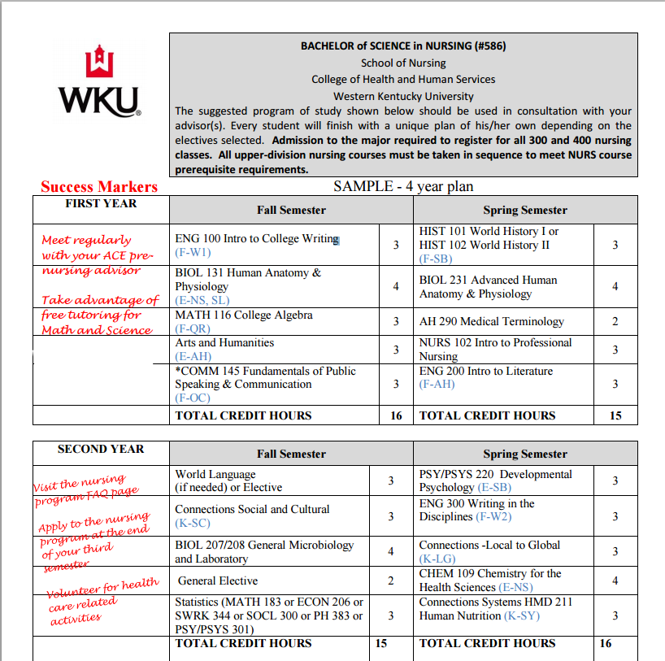
Four Year Pathways
Each major has a suggested four year pathway that assists students to see what classes would be required for a given major.
http://www.wku.edu/degreepaths/
#HeadForTheHill
Notes:
Duplicate this slide as necessary to make your key points.

Slide 11
Career Coaching
The Career Coaches serve all students in their career needs, all the way from exploration to the actual job search.
For Exploratory students, Career Coaches can help students consider career options for any major WKU offers.
Career Coaches also offer a career assessment called PathwayU which accounts for a student’s preferences, personality, skills, and interests.
Students can also use the What Can I Do With this Major? website.
#HeadForTheHill
Notes:
Duplicate this slide as necessary to make your key points.

Slide 12
Career Development
We can help with:
Choosing a Major & Career Exploration
Internship Preparation and Resources
Resume & Cover Letter Review
Practice Interviews
Full & Part-time Job Search Assistance
Career, Internship & Job Fairs
Handshake…and more!
#HeadForTheHill
Notes:
Duplicate this slide as necessary to make your key points.

Slide 13
Other Methods to Help with
Major Declaration
“What do you like? What don’t you like?”
(WKU Majors and Minors)
Summer job/volunteer experience
Job shadow/interviewing
#HeadforTheHill
Notes:
Key Takeaways is a required slide for every presentation.

Slide 14
QUESTIONS?
Advising & Career Development Center
Downing Student Union 2141
(270) 745-5065
academic.advising@wku.edu
#HeadForTheHill

