Slide 1

Project Reaching Academic Potential
Overview and Progress of the Project
Dr. Mary Evans, Program Developer, The Center for Gifted Studies, WKU
LaTonya Frazier-Goatley, Project Manager, Jefferson County Public Schools

Slide 2
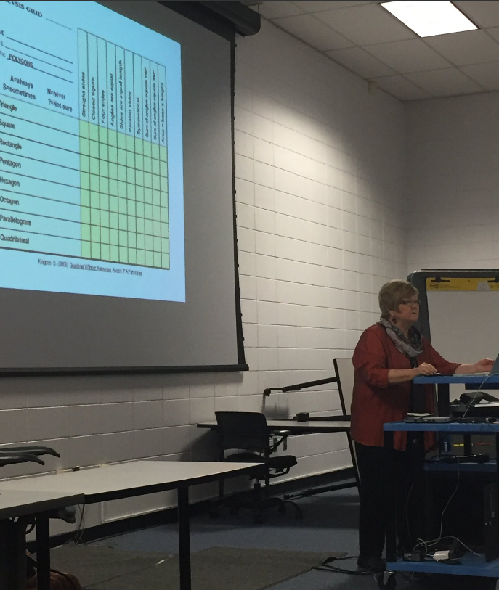
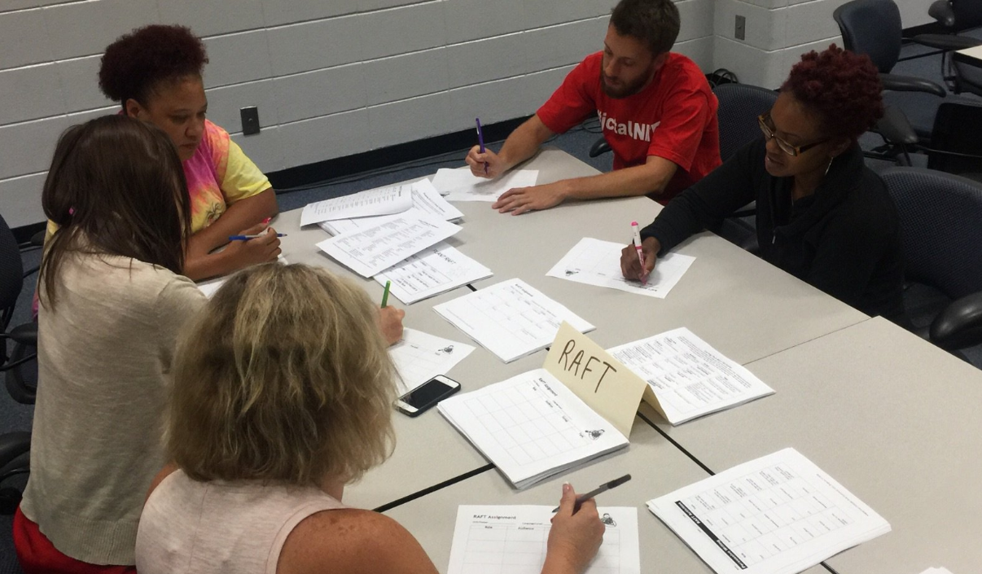
Purpose of Project “RAP”
Duplicate an existing project that demonstrated success with identification of students from under-represented backgrounds
Identify potential gifted students from non-traditional settings and backgrounds using non-traditional identification methods
Service these identified students in cluster group settings with trained cluster group teachers
Deliver high-quality professional development to cluster principals, teachers, and counselors

Slide 3

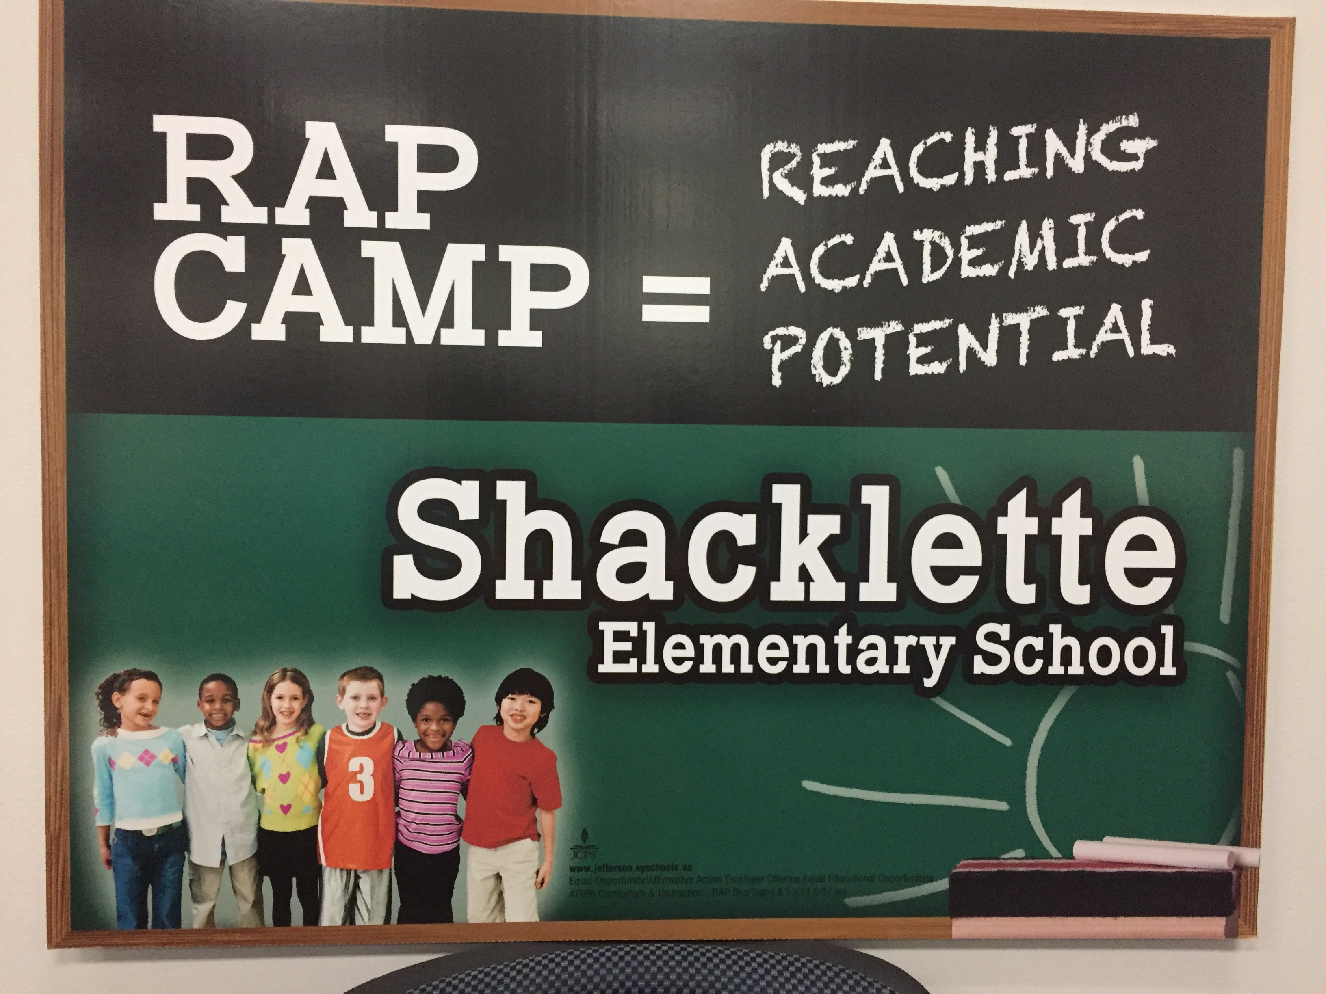
Purpose of Project “RAP”
Provide counseling services to students on a routine basis
Monitor student progress
Offer a summer enrichment experience to all identified RAP students
Inform parents of RAP students of ways to best nurture their child's talents
Educate stakeholders about the Excellence Gap and ways to reduce it.

Slide 4
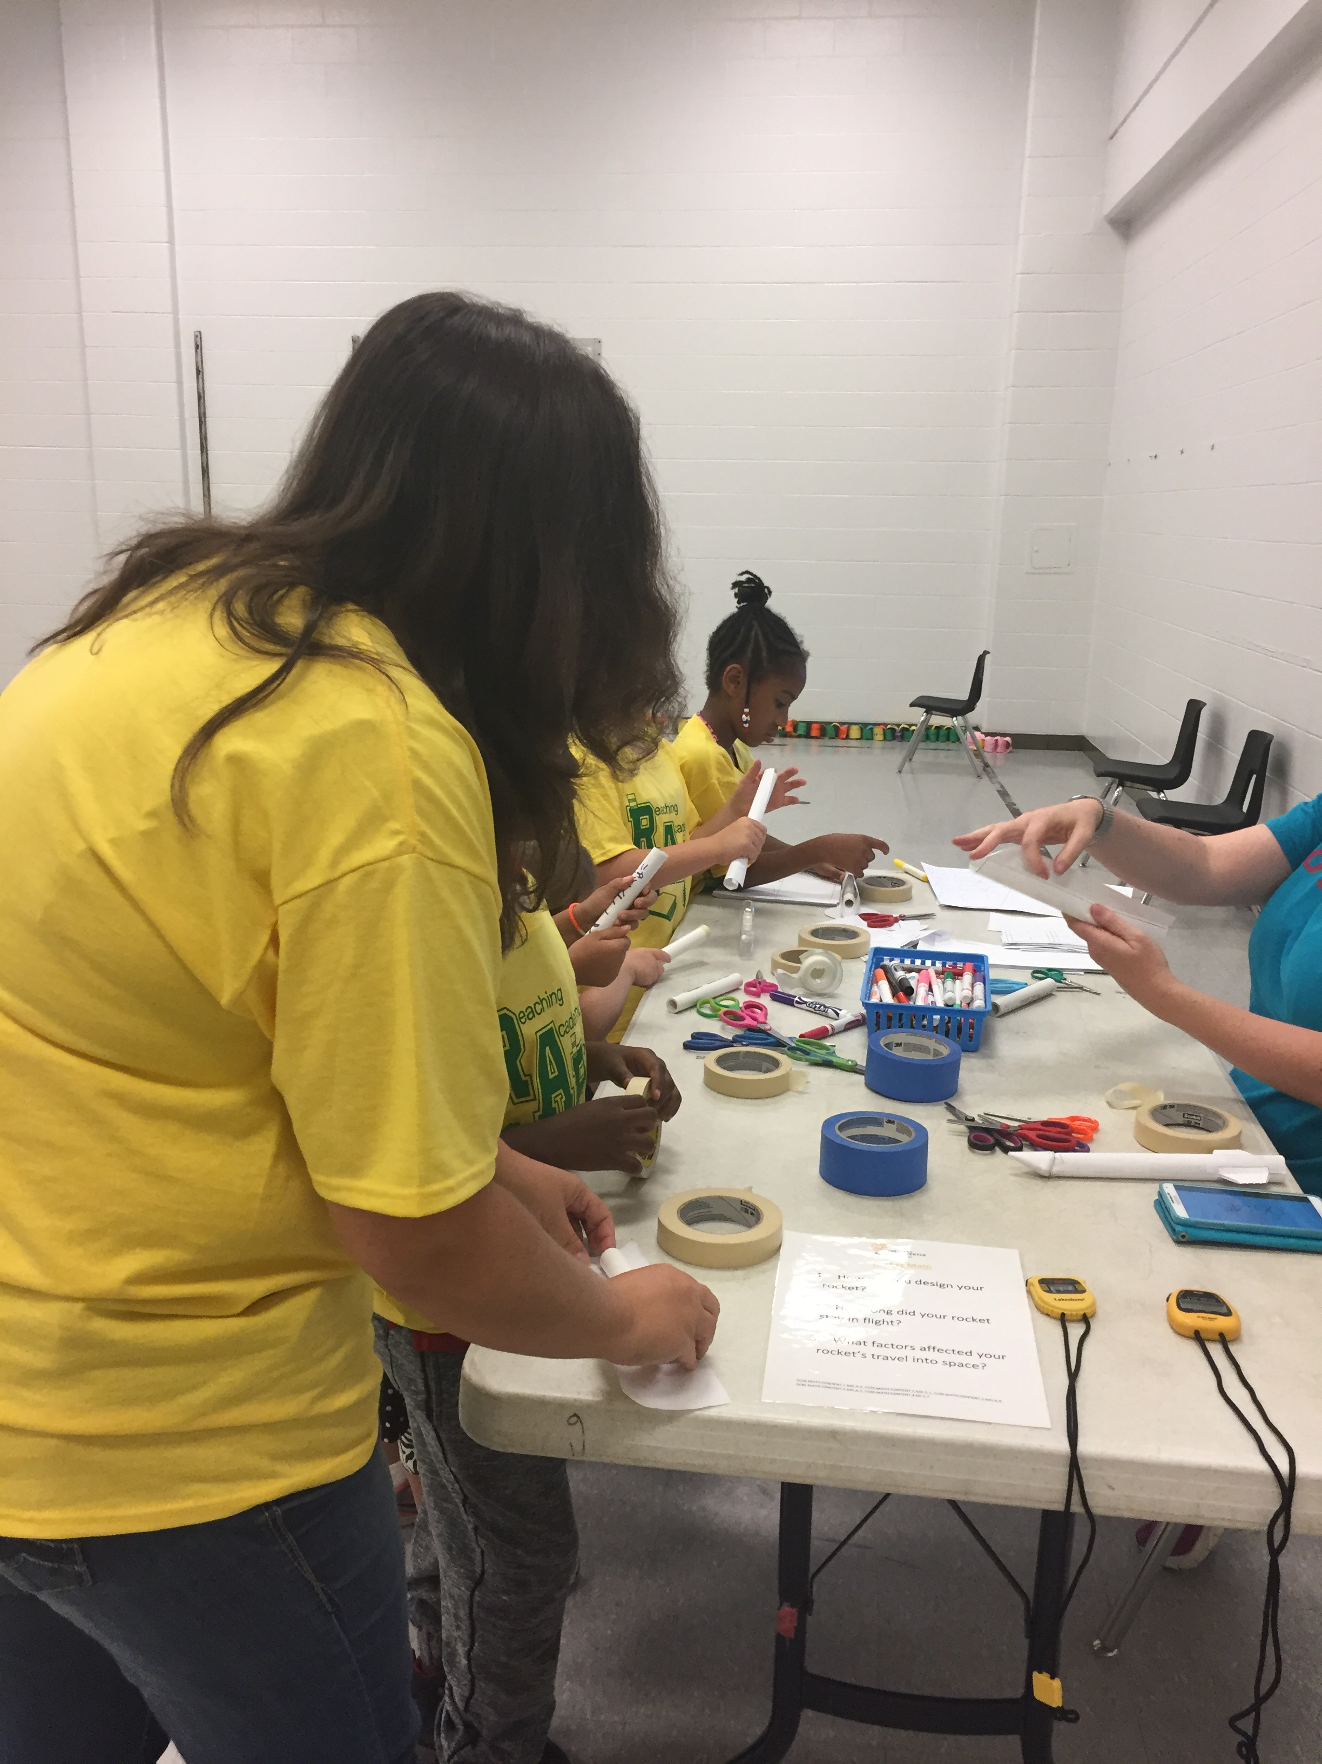
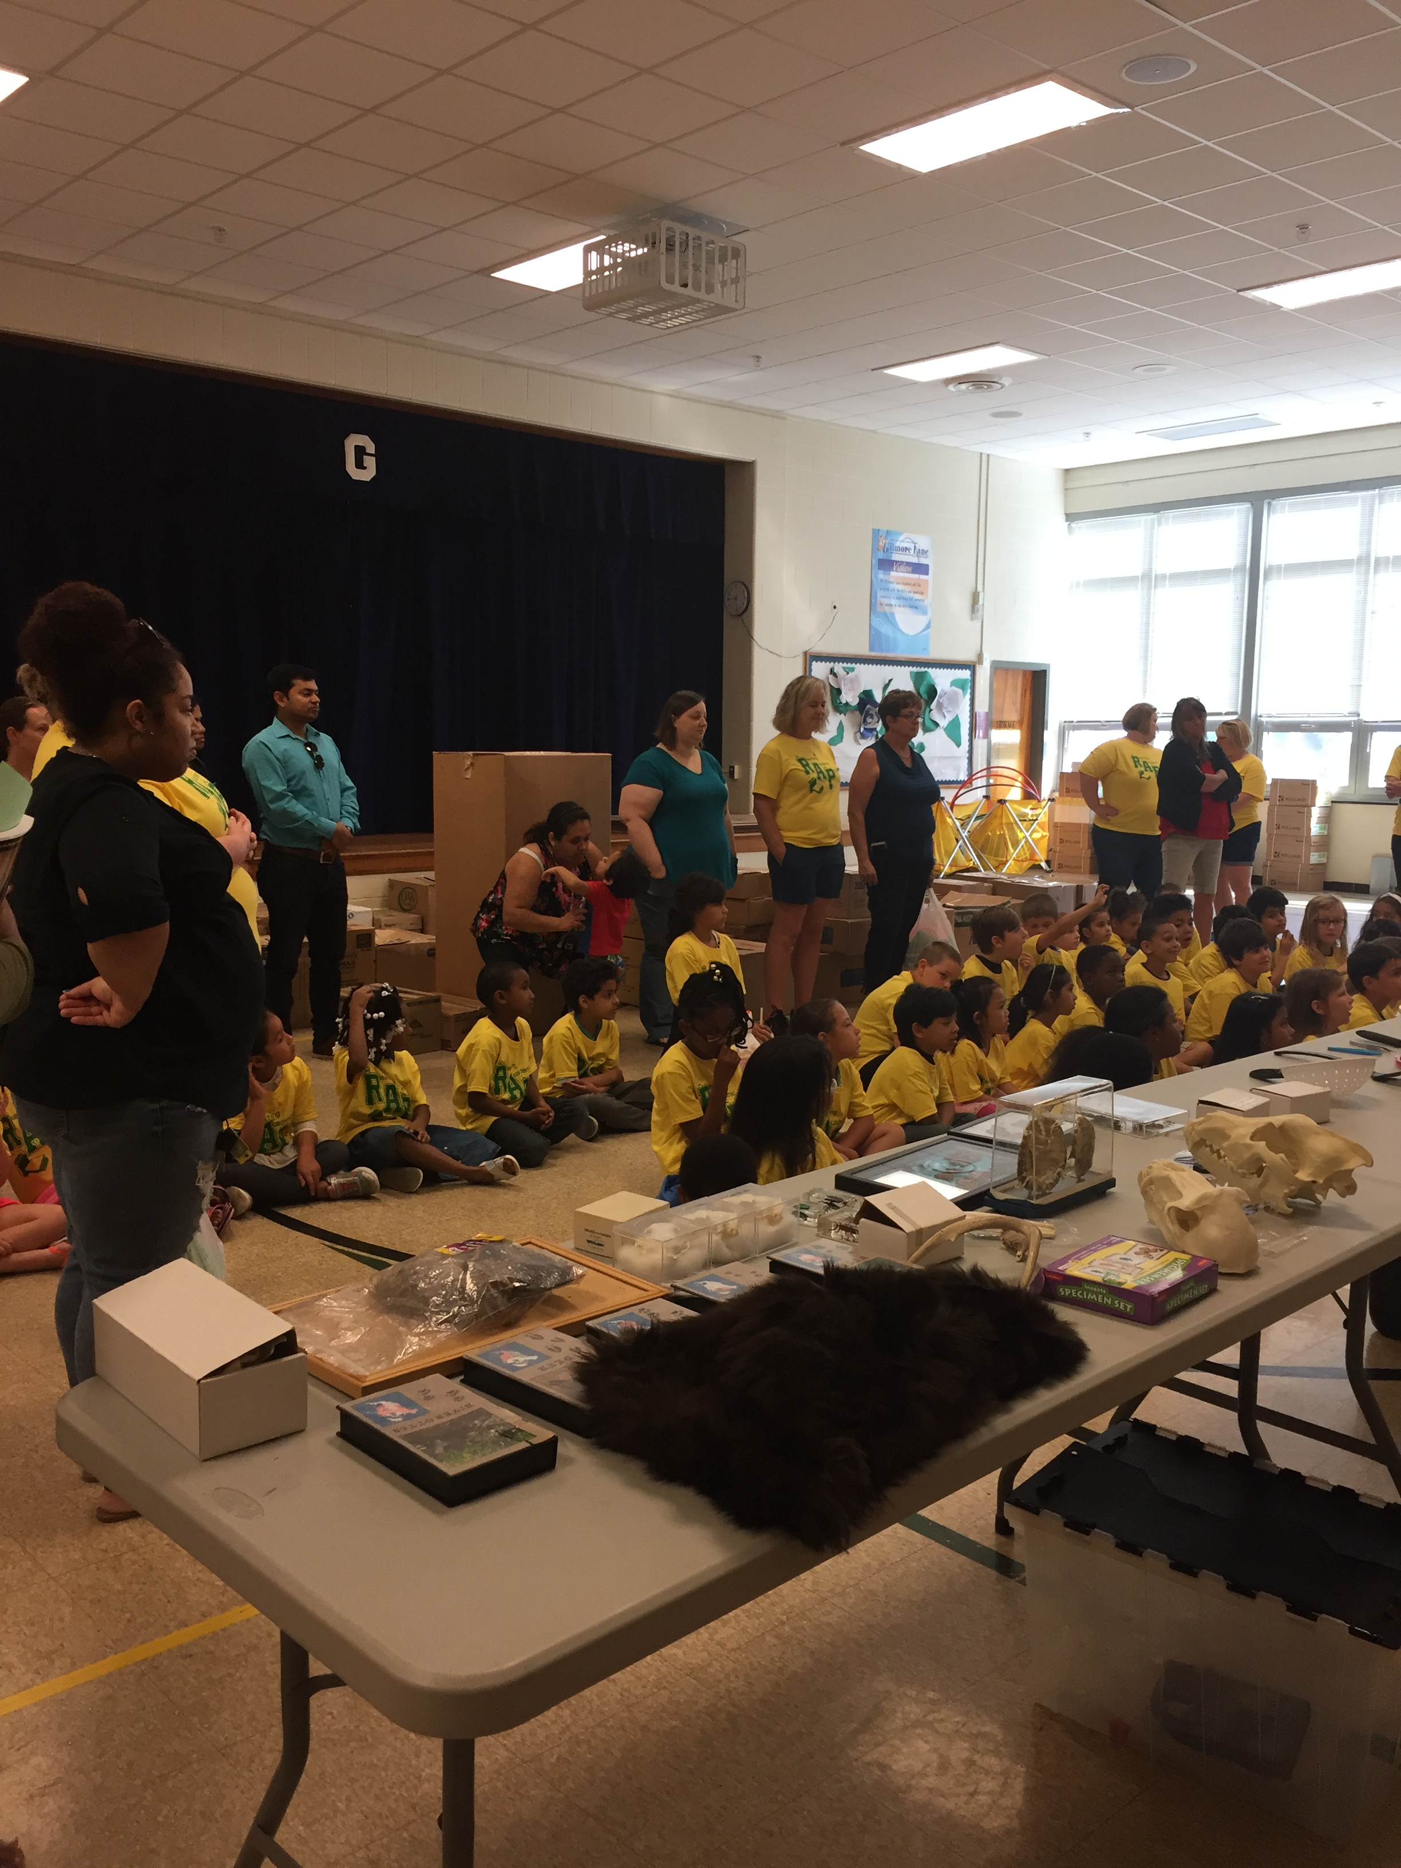
RAP Camp Culminating Event at Shacklette
RAP Camp Culminating Event at Gilmore Lane

Slide 5

Non-Traditional Identification Methods
Young Scholar Response Lessons
Gifted Behavior Rating Scale
Professional Learning Community Discussions
Naglieri-NNAT-3

Slide 6
Ten Black Dots by Donald Crew
https://video.search.yahoo.com/yhs/search?fr=yhs-adk-adk_sbnt&hsimp=yhs-adk_sbnt&hspart=adk&p=Ten+black+dots+You+tube - id=1&vid=5ca5514fca7afa48f9e085b643634597&action=click

Slide 7

Cluster Grouping in “RAP”
Primary Talent Pool grouping in each primary grade level in a mixed-ability classroom with a trained gifted-cluster teacher
Training Opportunities
  Gifted Lead at each school completed GT endorsement coursework in the summer of 2017 (Full Tuition paid through Javits Grant)
  Ongoing Professional Development for all cluster teachers on best practice strategies for cluster grouping

Slide 8
What is Total School Cluster Grouping?
A group of gifted students is placed (clustered) into a mixed-ability classroom. The teacher has received training in how to teach high ability students.

Slide 9
Why should gifted students be placed in cluster groups?
Teachers are better able to address needs.
Gifted students need time with other gifted students.
Needs of gifted students are addressed full time.

Slide 10
How are total school cluster groups formed?
All students grouped into clusters based on abilities.
All classrooms have either gifted or high-achieving students.
Clustering provides a learning range that is narrower than in a typical nonclustered classroom.
See Best Practices Handout

Slide 11
Total School Cluster Grouping for a Grade Level
 | TOTAL | Class 1 | Class 2 | Class 3 | Class 4 | Class 5
High achieving | 12 | 12 | 0 | 0 | 0 | 0
Above Average | 25 | 0 | 6 | 6 | 6 | 7
Average | 44 | 5 | 10 | 10 | 10 | 9
Low Average | 25 | 7 | 9 | 9 | 0 | 0
Low | 11 | 0 | 0 | 0 | 5 | 6
Special Education | 8 | 1* | 0 | 0 | 4 | 3
TOTAL | 125 | 25 | 25 | 25 | 25 | 25

Slide 12
Responsibilities of Gifted Cluster Teachers
Differentiate curriculum.
Participate in monthly PLC Meetings.
Coordinate nomination, data gathering, and reporting of test results.
Participate in professional development.

Slide 13
Professional Development
Year I
The Nuts and Bolts of Differentiation
--Characteristics, Myths
-- Classroom Culture
--Preassessment
--Content, Process, Products
--Bloom’s Charts
--Think Tac Toes, Cubing

Slide 14
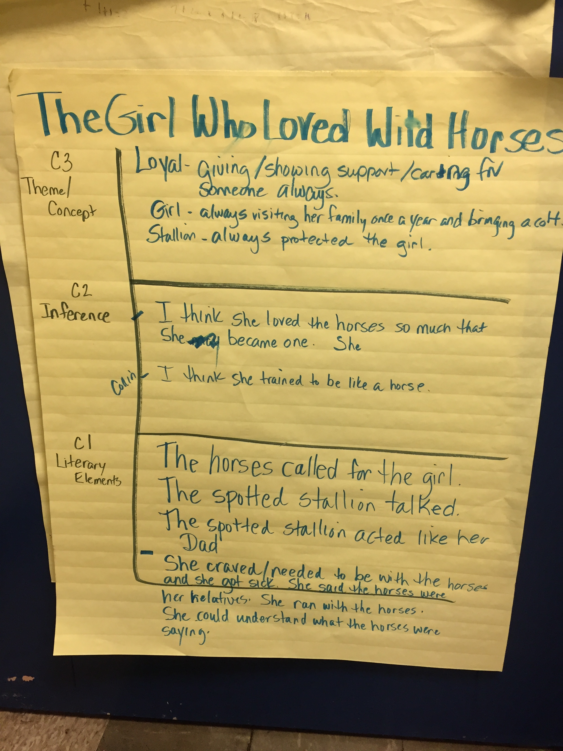
Differentiation in
Language Arts
Jacob’s Ladder

Slide 15
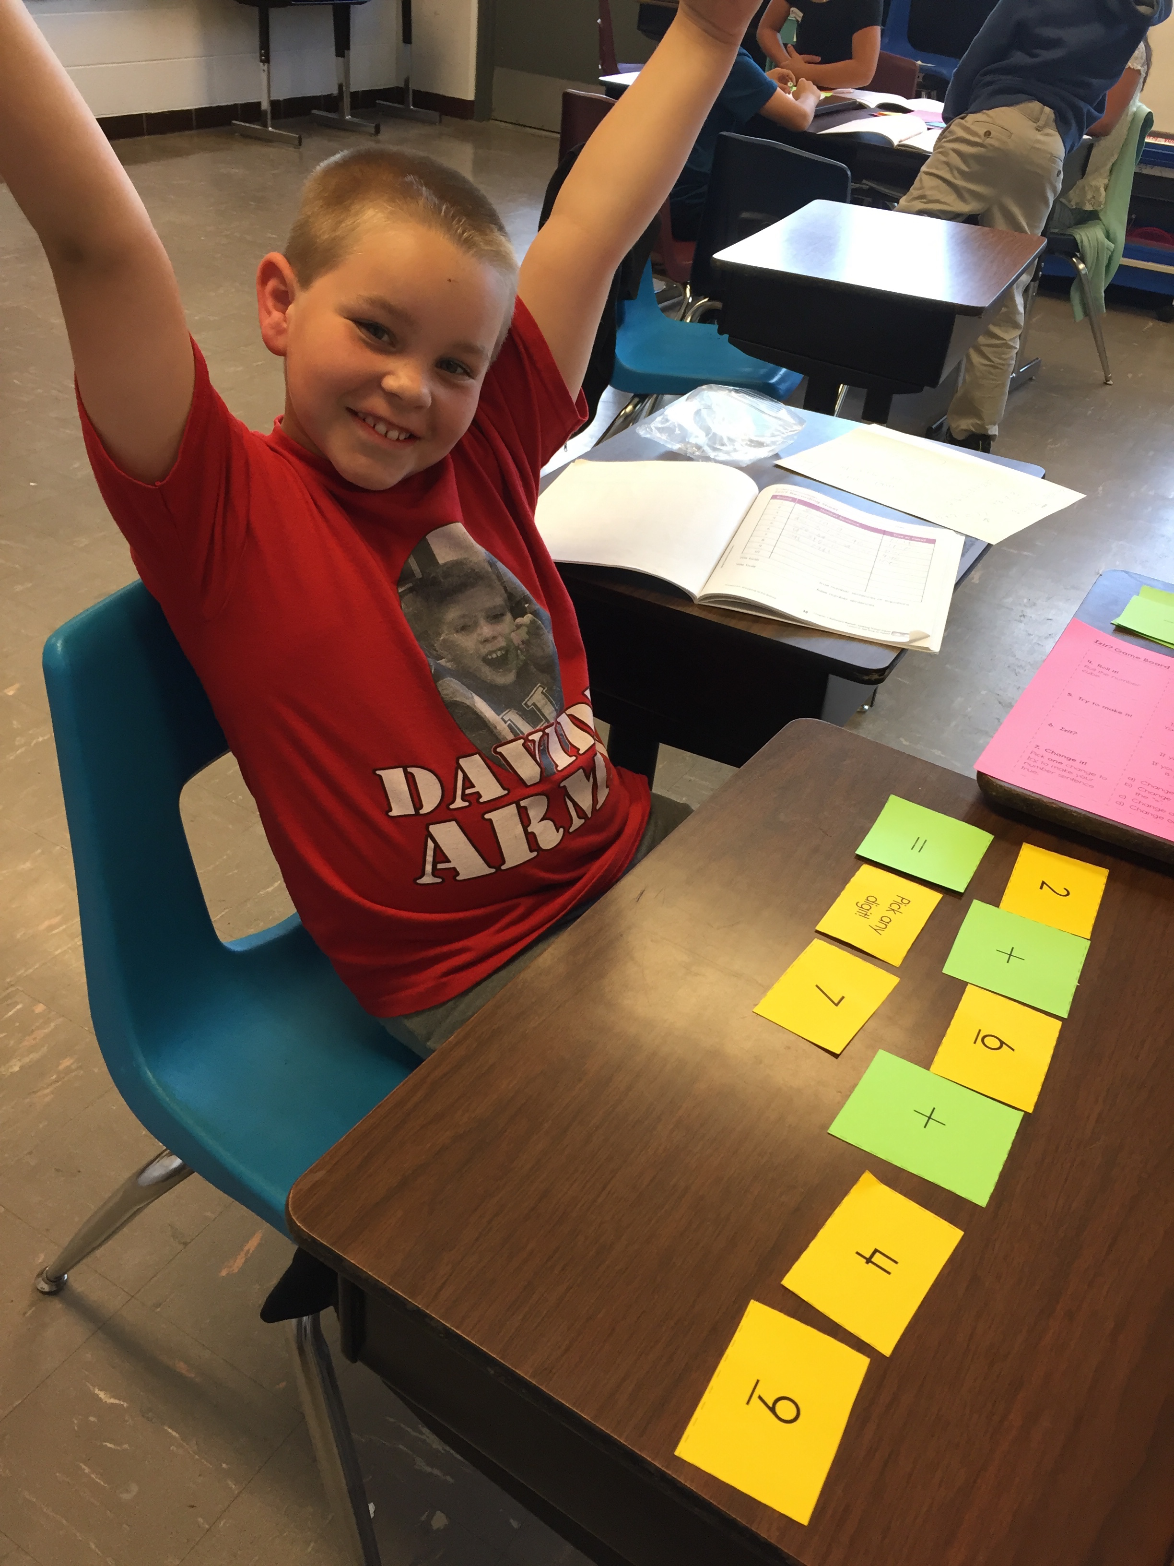
Differentiation
In
Mathematics
M2
Marilyn Burns Kits
Versatiles

Slide 16
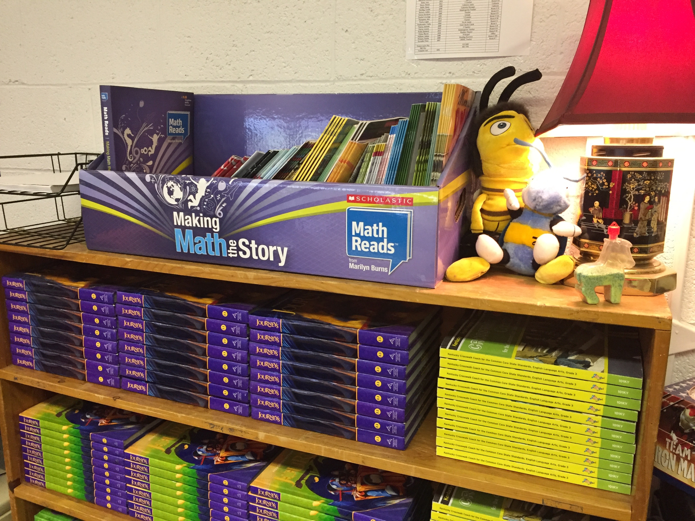
Math Reads

Slide 17
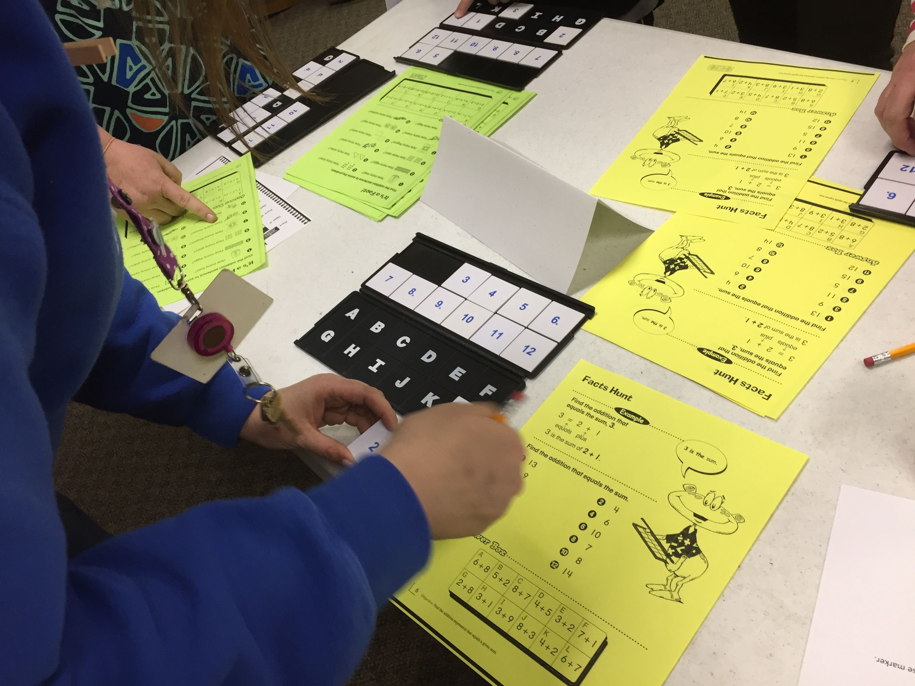
Versatiles

Slide 18
Professional Development
Year 2
Identifying and celebrating challenging learning experiences and differentiation occurring in Project RAP classrooms
Increasing Challenge Carousel (View a picture of an actual classroom activity and brainstorm ways to raise the level of learning.)
Adapting Jacob’s Ladder with basal reader stories and trade books
Classroom management

Slide 19

Raise the level of learning for this activity.

Slide 20
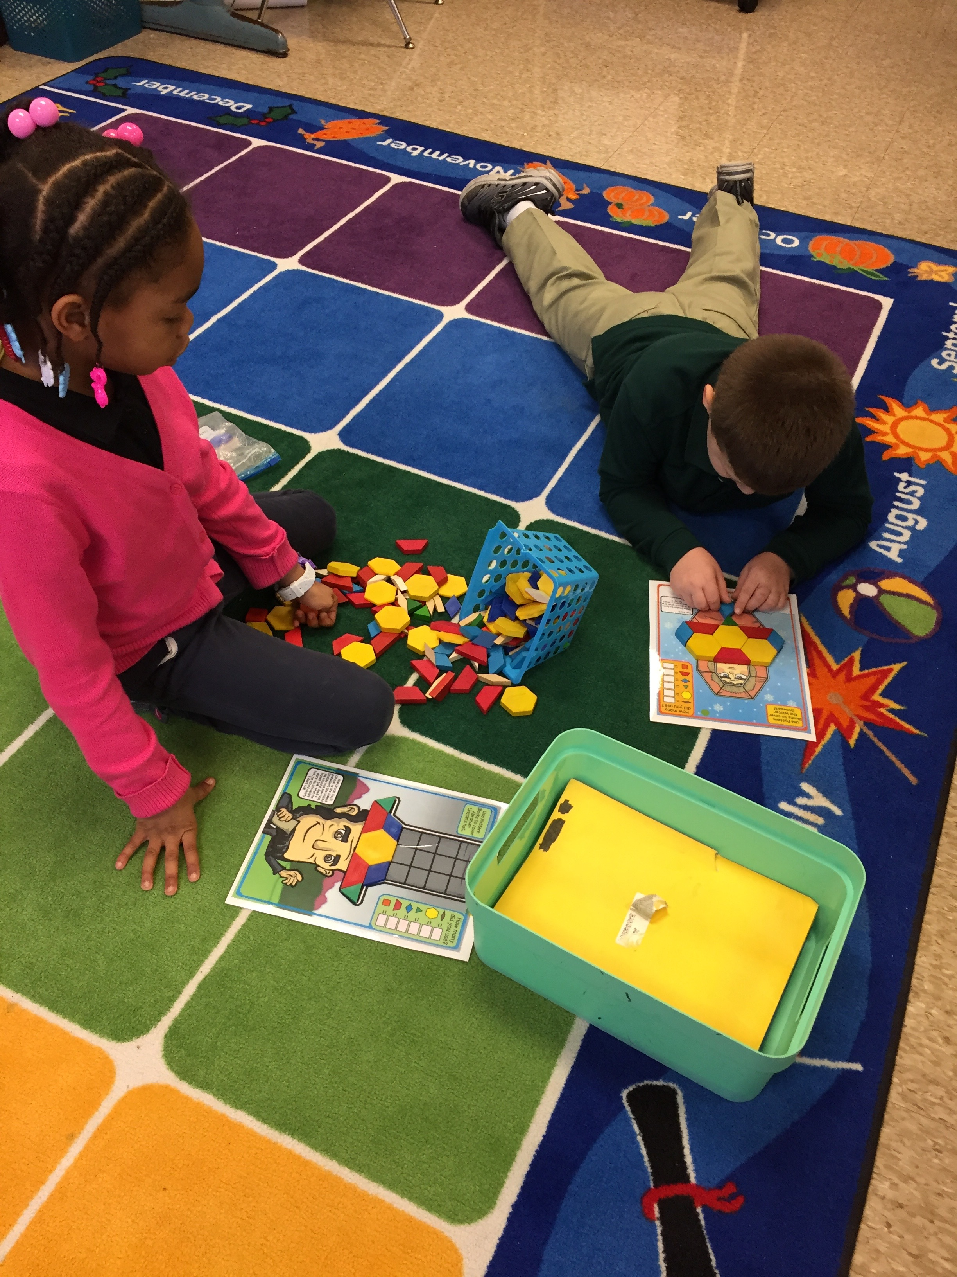

Slide 21
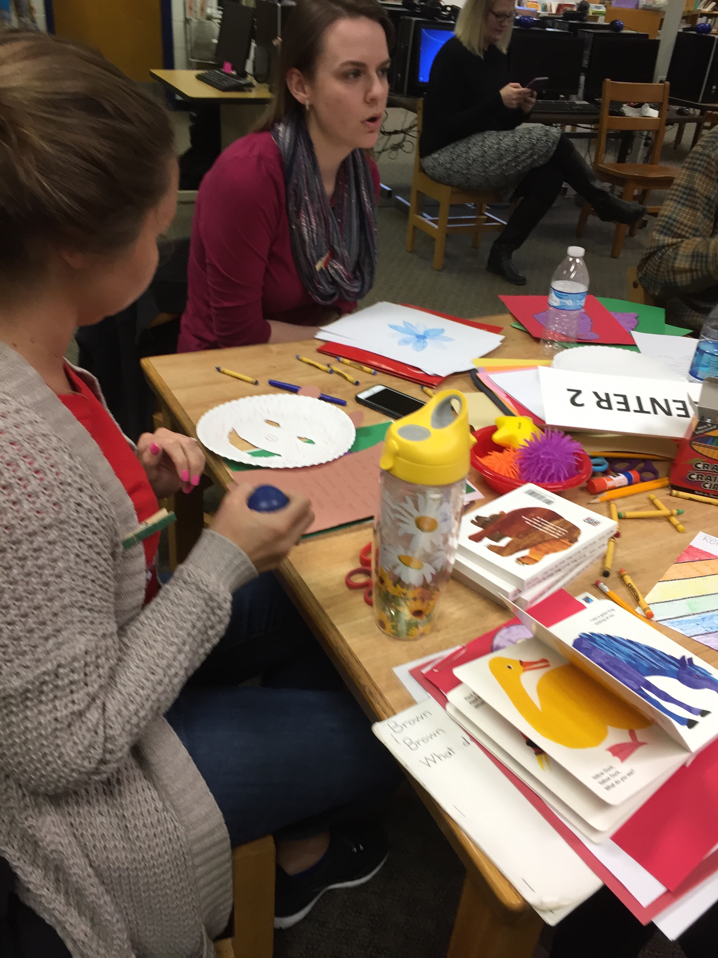
Professional Development
Year 2
Differentiating with
Learning Centers
--Grouping students for center work
--Tiered learning centers
--Accountability at centers
--Managing behavior at centers
--Use of Engine-uity Resources

Slide 22
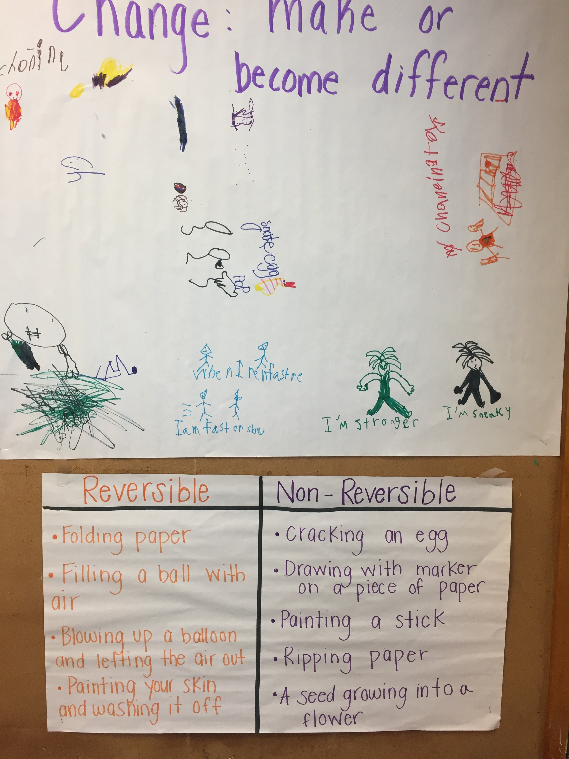
Language Arts Units
Using Broad Based Themes
Change
Power
Patterns

Slide 23
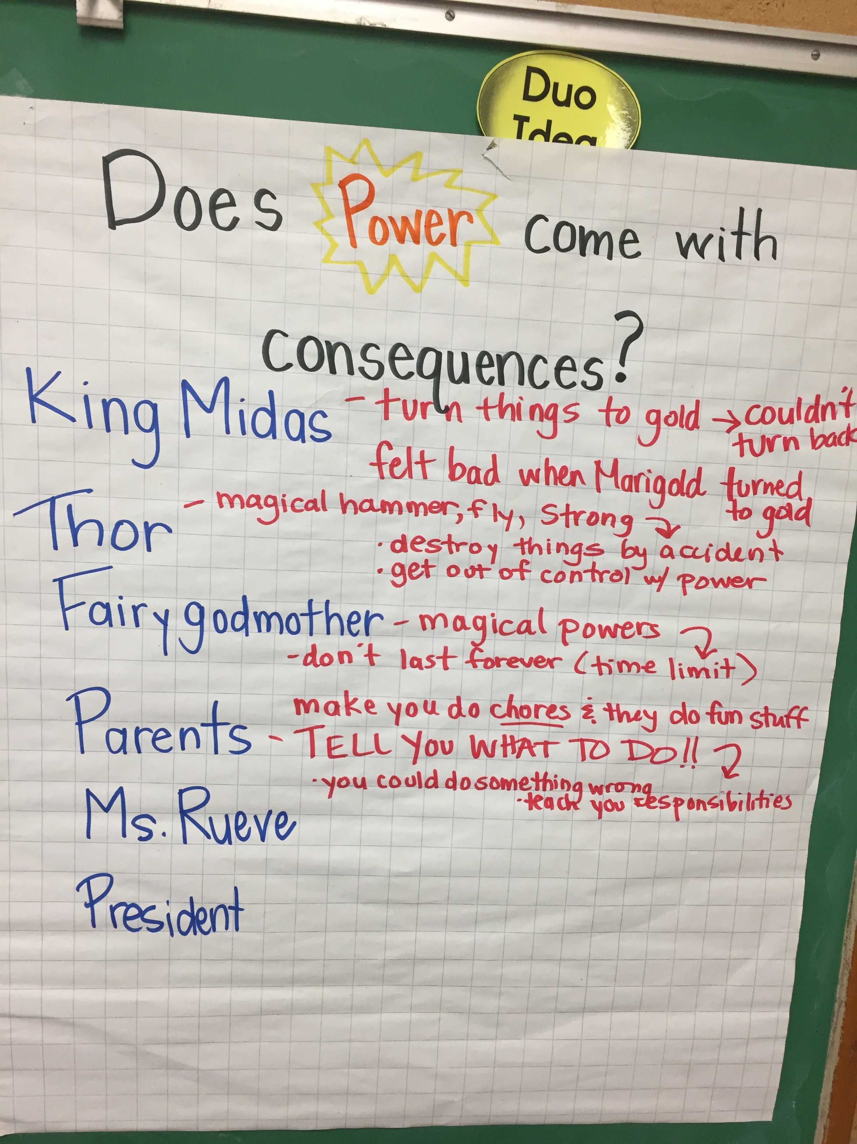
Power

Slide 24
Differentiated PD for Experienced
Cluster Teachers

Slide 25
Resources
Total School Cluster Grouping and Differentiation, Second Edition
By Marcia Gentry with Kristina Ayers Paul, Jason McIntosh, C. Matthew Fugate, & Enyi Jen, Prufrock Press, 2014
Jacob’s Ladder Reading Comprehension Program
Edited by Joyce L. VanTassel-Baska and Tamra Stambaugh, Prufrock Press, 2012
The Center for Gifted Studies website (Resources, Project RAP)
http://www.wku.edu/gifted/

Slide 26

Q&A
Notes:
All

