Slide 1
Project RAP: Jacob’s Ladder Reading Comprehension Program
Dr. Tracy Inman
June 2, 2016

Slide 2
“Jacob’s Ladder Primary 2 was written in response to teacher findings that students at the primary level who were already reading needed more rigorous materials and scaffolding to consistently work at higher levels of thinking in reading.”
VanTassel-Baska and Stambaugh, 2012, 1-2

Slide 3
Summer Camp Teachers
What did you think?

Slide 4
Overview
Six Skill Ladders, A-F
Students climb ladders moving from lower level to higher level questions
Each ladder stands alone, focusing on one critical thinking component in reading

Slide 5
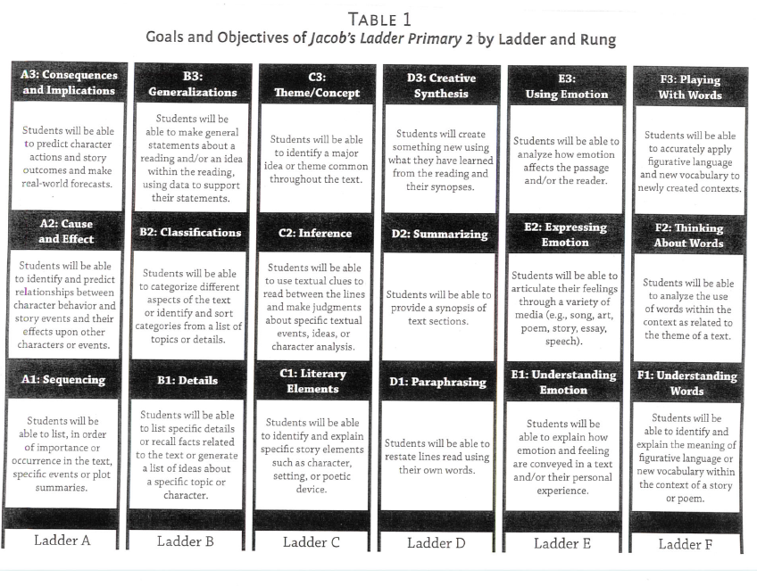

Slide 6
Six Ladders
Ladder A: Focus on Implications and Complications
Rung 3: Consequences and Implications
Requires students to think about both short- and long-term events that may happen as a result of an effect they have identified
Rung 2: Cause and Effect
Requires students to think about relationships and identify what causes certain effects and/or what effects were brought about because of certain causes
Rung 1: Sequencing
Requires students to organize a set of information in order

Slide 7
Ladder B: Focus on Generalizations
Rung 3: Generalizations
Requires students to use the list and categories generated in rungs 1 and 2 to develop general statements that apply to all of their examples
Rung 2: Classifications
Requires students to categorize examples and details based on characteristics
Rung 1: Details
Requires students to list examples or details from what they have read and/or to list examples they know from the real world or have read about

Slide 8
Ladder C: Focus on Themes
Rung 3: Theme/Concept
Requires students to state the central idea or theme for the reading
Rung 2: Inference
Requires students to think through a situation in the text and come to a conclusion based on information and clues provided
Rung 1: Literary Elements
Requires students to identify and/or describe setting and to develop an understanding of characters by identifying qualities and comparing to other characters

Slide 9
Ladder D: Focus on Creative Synthesis
Rung 3: Creative Synthesis
Requires students to create something new using what they have learned from the reading and their synopses of it
Rung 2: Summarizing
Requires students to summarize larger sections of text by selecting the most important key points within a passage
Rung 1: Paraphrasing
Requires students to restate a short passage in their own words

Slide 10
Ladder E: Focus on Emotional Development
Rung 3: Using Emotion
Requires students to begin regulating emotion for specific purposes
Rung 2: Expressing Emotion
Requires students to express emotion in response to their reading of various selections
Rung 1: Understanding Emotion
Requires students to identify emotions in characters and relate them to their own lives

Slide 11
Ladder F: Focus on Word Study
Rung 3: Playing with Words
Requires students to reflect on key words or literary elements to apply them to new situations or contexts
Rung 2: Thinking About Words
Requires students to think about how the author uses key words or language elements studied in the first rung to enhance the meaning of the story
Rung 1: Understanding Words
Requires students to consider how words are used in the context of the story to promote meaning and to find new examples or uses of literary elements

Slide 12
Additional Goal
Promote learning through interaction and discussion of reading materials in the classroom

Slide 13
Bellarmine Literacy Project
Phonemic Awareness
Phonics
Fluency
Vocabulary
Comprehension Strategies

Slide 14
Overlap of JCPS Initiatives
Project RAP
Bellarmine Literacy Project
Phonemic Awareness
Phonics
Fluency
Vocabulary
Comprehension Strategies
Ladder F
Ladders A-E

Slide 15
Points to Consider
Many selections are intended to be read aloud
May not be at appropriate individual reading level
May not be able to read fluently
Intent: critical thinking
Most vocabulary is grade-level appropriate
Be sure to discuss new or unfamiliar words before reading the text
Jacob’s Ladder is not intended as a worksheet or individual task
Stimulus for facilitation of ongoing discussion and reasoning

Slide 16
Points to Consider
Review how to complete the ladders with the entire class at least once, outlining expectations and record-keeping tasks, as well as modeling the process prior to assigning small group or independent work
Allow more independent work as students progress coupled with small group or paired discussion, and then whole-group sharing with teacher feedback
Dyads and small groups encourage discussions that stress collaborative reasoning, thereby fostering greater engagement and higher level thinking (Parallels Math Talk)
Encourage students to write ideas independently then share with a partner then discuss the findings with a group

Slide 17
Process of Jacob’s Ladder
See page 13 for questions and prompts

Slide 18
Time Allotment Estimate
15-30 minutes to read selection (aloud with teacher or partner or solo)
20-30 minutes to complete one ladder individually
10-20 minutes for dyad and whole group discussion

Slide 19
Assessments Provided
Pretest
The Crow and the Serpent (pp. 134-135)
Discussion checklist
A Guide for Monitoring Student Talk (p. 139)
Classroom Diagnostic Forms
Appendix B (p. 141+)
Posttest
The Peacock and Juno (pp. 136-137)

Slide 20
Pretest: The Crow and The Serpent
Setup pretest
Explain reasoning behind doing preassessment
Administer pretest
Handout with synonyms used for complex vocabulary
Score
Rubric for Scoring Aesop’s Fables
Record

Slide 21
Posttest: The Peacock and Juno
Setup posttest
Explain reasoning
Administer posttest
Handout with synonyms used for complex vocabulary
Score
Rubric for Scoring Aesop’s Fables
Record
Look for growth from pretest

Slide 22
Activity: Jacob’s Ladder

Slide 23
Plan
Teacher reads The Caterpiller (p.83) aloud defining potentially problematic words
Students break into small groups
Group 1: Ladder A
Group 2: Ladder A
Group 3: Ladder A
Group 4: Ladder D
Group 5: Ladder D
Group 6: Ladder D
Teacher uses Discussion Checklist while circulating
Students share with class; Teacher uses questioning on page 13
Teacher uses Classroom Diagnostic Form
Debrief

Slide 24
Resources
Each school has multiple grade-level Jacob’s Ladder books
Each school has a complete library for all books explored in Jacob’s Ladder
Work within your school to decide how to best utilize the curriculum

Slide 25
How to Use Jacob’s Ladder
Cluster class
Differentiate via cluster using Jacob’s Ladder materials and others use another curriculum
Whole class
Differentiate via ladders
Differentiate via rungs of ladders
Other ideas?

