Slide 1
The Role of School Board Members in Reducing Excellence Gaps

Slide 2
Six Myths of Gifted Education That Lead to Overlooking Talented Minority Students
Audrey D. Breen
Notes:
While approximately 49 percent of public school students are minority students, they make up only a small percent of those in programs for gifted students. There are exceptionally talented students in all demographic groups – African American, Hispanic, English Learners, and students who qualify for free/reduced lunches. There are several common myths that are often at play when these students are overlooked.

Slide 3
True or False
Gifted kids are the smartest kids in class.
All gifted kids show up to school gifted.
Giftedness is not something that can be developed. A student is either gifted or not.
Gifted students exhibit varying characteristics.
Gifted students need different classroom experiences from other students and from other gifted students.
Most gifted students are being identified.
Notes:
Reflect on these statements. Mark each one as either true or false.

Slide 4
false
Gifted kids are the smartest kids in class.
Notes:
Gifted students do not always show themselves to be the smartest, most eager learners in the classroom. One reason is there could be a mismatch between the child and the available learning opportunities. Very bright children are often bored in traditional school settings if the emphasis is on rote learning of facts. Gifted students may exhibit off-task behaviors, spend their time daydreaming, and put forth minimal effort because they already know the material being presented.

Slide 5

All gifted kids show up to school gifted.
Notes:
Some students come to school with a rich background of prior experiences. They have been read thousands of books and visited museums and zoos and attended high quality preschool programs. They have a wide knowledge base and demonstrate an abundant vocabulary. While these behaviors can suggest the potential for giftedness, more often this is a reflection of the environment the students experienced prior to entering kindergarten.
Children from impoverished backgrounds come to their first formal schooling having been exposed to 30 million fewer words than their more privileged peers. These students need intensive, literacy-focused experiences in pre-K through grade 2 to allow sufficient time to develop their potential.

Slide 6
Giftedness is not something that can be developed. A student is either gifted or not.
Notes:
Giftedness is very complex. There is much debate as to whether giftedness is innate (nature) or whether it can be developed (nurture). The current thinking is that one’s potential is most likely due to complex interactions from many systems, some systems innate and others nurturing, and that high levels of achievement in any area can be achieved through multiple developmental pathways.

Slide 7
Gifted students exhibit varying characteristics.
true
Notes:
No two gifted children are alike and they will vary among themselves as much as they do from typically developing peers.
Gifted students often exhibit unevenness in development. For example, a child might have an advanced vocabulary, but have difficulty with fine motor skills. He/She might have an in depth understanding of higher math concepts, but have difficulty following routine procedures for organizing belongings.

Slide 8
Gifted students need different classroom experiences from other students and from other gifted students.
true
Notes:
Gifted students learn at a faster rate and understand at a more in-depth level than their same age peers. It is important for teachers to preassess all their students so that they can determine what students already know and what they are ready to learn. Teachers can then differentiate the curriculum so that all students can learn at a pace and level that is most appropriate for them.

Slide 9
Most gifted students are being identified.
Notes:
Most gifted students who are being identified are white or Asian middle to upper class students. There continues to be heavy reliance on standardized IQ and achievement measures to identify gifted students and these measures do not find many African American, Hispanic, English Learners, or students living in poverty.

Slide 10
Why is it important for students to be learning at advanced levels?
Notes:
Audience discuss and share perceptions
All students deserve the opportunity to learn as much as they can. The business of schools should be providing learning opportunities that are matched with students’ abilities. We must find students with high potential and nurture their gifts and talents so that they can provide the leadership, ideas, creativity, and innovation that our country needs to be able to compete in a global society.

Slide 11
What is the Excellence Gap?
Notes:
Audience discuss and share perceptions
Most communities have groups of students who underperform relative to other demographic groups. These achievement gaps have been a focus in our K-12 education efforts for many years. Schools put lots of efforts toward getting students to a basic level of proficiency. These gaps also exist among the highest levels of achievement, a problem labeled excellence gaps. Excellence gaps are differences in scores at the advanced level among subgroups of students. We do not have nearly enough students performing at advanced levels and when we look at African American, Hispanic, English learners, and children qualifying for free lunches, the numbers are really small. This is a big concern because this is the fastest growing segment of our population.

Slide 12
Give Excellence a Chance - video

Slide 13
Discussion
Think-Pair-Share
Notes:
Share impressions of the video with a partner. Here are some points to consider:
Why is the excellence gap important to schools and districts?
What can you do to raise awareness of excellence gaps in your school or district?

Slide 14
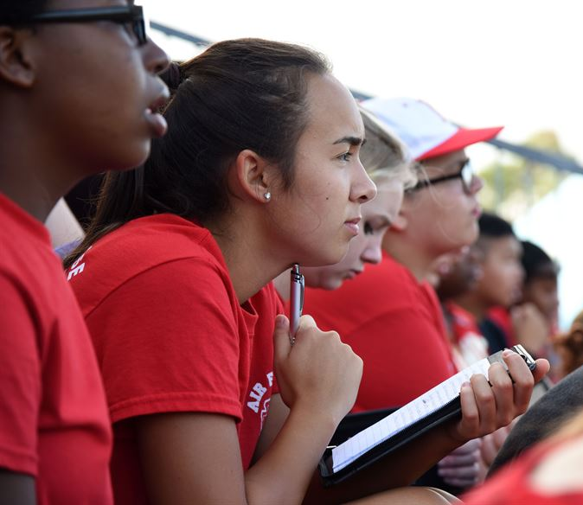
"We think that high-achieving, low income kids don't need our help.
Nothing could be further from the truth."
Harold O. Levy,
Executive Director,
Jack Kent Cooke Foundation

Slide 15
Discussion
Scenarios
Notes:
Divide audience into groups. Distribute one scenario to each group to read and discuss. Each group should select a recorder to take notes of the discussion and a reporter to share with the larger group.

Slide 16
Questions for Discussion
What would happen if this student were at your school?
What is in place to help this student continue learning?
What could be put in place to help this student continue learning at advanced levels?
Notes:
After reading the scenario, each group should focus on these questions.
Facilitator should summarize each scenario for the group, then ask each reporter to share answers to the these three questions.

Slide 17
What can you, as a school board member, do about the Excellence Gap?
Notes:
Audience discuss and share perceptions

Slide 18
Video
The Role of School Board Members in Reducing Excellence Gaps

Slide 19
Discussion
Intended and Unintended Consequences of Policies
Notes:
An important role that members of Boards of Education have is to set policies. Sometimes well intended policies have some unintended consequences for students with the ability to learn at advanced levels. Working in groups, discuss the six policies and jot down intended and unintended consequences of each.

Slide 20
Students are allowed to take a maximum of two on-line classes starting in 9th grade.
Intended Consequences
  Provides an opportunity for students to take classes they can’t fit into their schedules.
Unintended Consequences
  Advanced students may be ready for coursework available on-line earlier than 9th grade.
  Advanced students may benefit from taking more than two on-line courses.

Slide 21
Students are not allowed to take algebra until 9th grade.
Intended Consequences
  Students may not have the math background or understanding of math concepts to learn algebra before 9th grade.
  Students may skip over important math learnings in their basic math classes and have gaps in their math backgrounds if they take algebra in middle school.

Slide 22
Unintended Consequences
  Students who are ready to learn math at higher levels are not allowed the opportunity.
  If students aren’t allowed to take algebra until 9th grade, they will not have the opportunity to take more advanced math classes such as calculus or trigonometry during their high school years.

Slide 23
Students must be in 11th or 12th grade to take AP classes. (College Board doesn’t care what grade a student is in.)
Intended Consequences
  Students will be older and more capable of handling the rigor of AP classes.
Unintended Consequences
  Advanced students may be ready for the rigor of AP classes in 9th or 10th grade.
  Advanced students will not have the opportunity to take a full range of AP classes.

Slide 24
Students have to meet strict requirements to take AP classes.
Intended Consequences
  This will insure that only those students who have demonstrated through past academic success that they are capable of doing hard course work will be in AP classes.
Unintended Consequences
  High ability students who do not have good grades may be excluded from classes that would challenge them. Past circumstances such as family instability or boredom may have contributed to lower grades rather than lack of ability.

Slide 25
Students must be enrolled in high school to take high school classes for credit.
Intended Consequences
  This will insure that students who earn less than an A on a high school class they took as a middle school student will not have that lower grade on their high school transcript.
Unintended Consequences
  Students are not as motivated to do their best without the incentive of earning a grade that counts.
  Student may be required to retake the class in order to have a grade for it on their high school transcript.

Slide 26
Early Entrance to Kindergarten requirements are so strict that no child qualifies.
Intended Consequences
  Strict requirements will insure that children do not enter kindergarten before they are ready.
Unintended Consequences
  Young children with advanced abilities (particularly those from disadvantaged homes) will not have the opportunity to go to school even though they are ready to do kindergarten or higher work.

Slide 27
What can you do in your role to reduce Excellence Gaps?
Notes:
Become familiar with your local district data – What do your excellence gaps look like?
Review Board policies to examine their impact on advanced students and ask the two policy questions:
--How will this policy impact advanced students?
--How will this policy help more students perform at advanced levels?

Slide 28
Complete the follow-up module.
Examine your local districts’ and schools’ Excellence Gaps.
Gather information about what policies are in place and what needs to be done to remove the learning ceiling and accelerate learning.
Notes:
Distribute copies of the follow-up module.

Slide 29
School Board Members as
Charter School Authorizers
Information presented and discussed in this training session is also applicable in your role as a charter school authorizer.
Notes:
Say something like…Please keep in mind that as School Board Members, you are also now Charter School Authorizers.
Information presented and discussed in this training session is also applicable in your role as a charter school authorizer.
NOTE TO TRAINERS:
In case someone tries to contest their role as an authorizer or tries to diminish it by saying there is no funding, they won’t see a charter application, etc. here are a couple of possible responses….
Charter schools became a reality in Kentucky when House Bill 520 went into effect on June 29, 2017. That bill designates all school boards in Kentucky as charter school authorizers and requires boards to, among other tasks, “solicit, invite, and evaluate applications from applicants.”
School boards are automatically charter school authorizers and have to be prepared to act accordingly while mayors in Lexington and Louisville have the option to authorize charter schools.
KSBA legal staff member, Amy Peabody, will be happy to discuss this in greater detail if you wish to contact her or attend one of her training sessions.
IMPORTANT NOTE FOR FINANCE COURSES: Please be sure to let participants know that charter schools cannot offer bonds.

Slide 30
Dr. Mary Evans
Javits Grant Program Developer
The Center for Gifted Studies at WKU
mary.evans@wku.edu
Dr. Tracy Inman
Associate Director
The Center for Gifted Studies at WKU
tracy.inman@wku.edu
Dr. Julia Roberts
Director
The Center for Gifted Studies at WKU
julia.roberts@wku.edu

