Slide 1


WKU English Department
2021 Award and Scholarship Winners

Slide 2
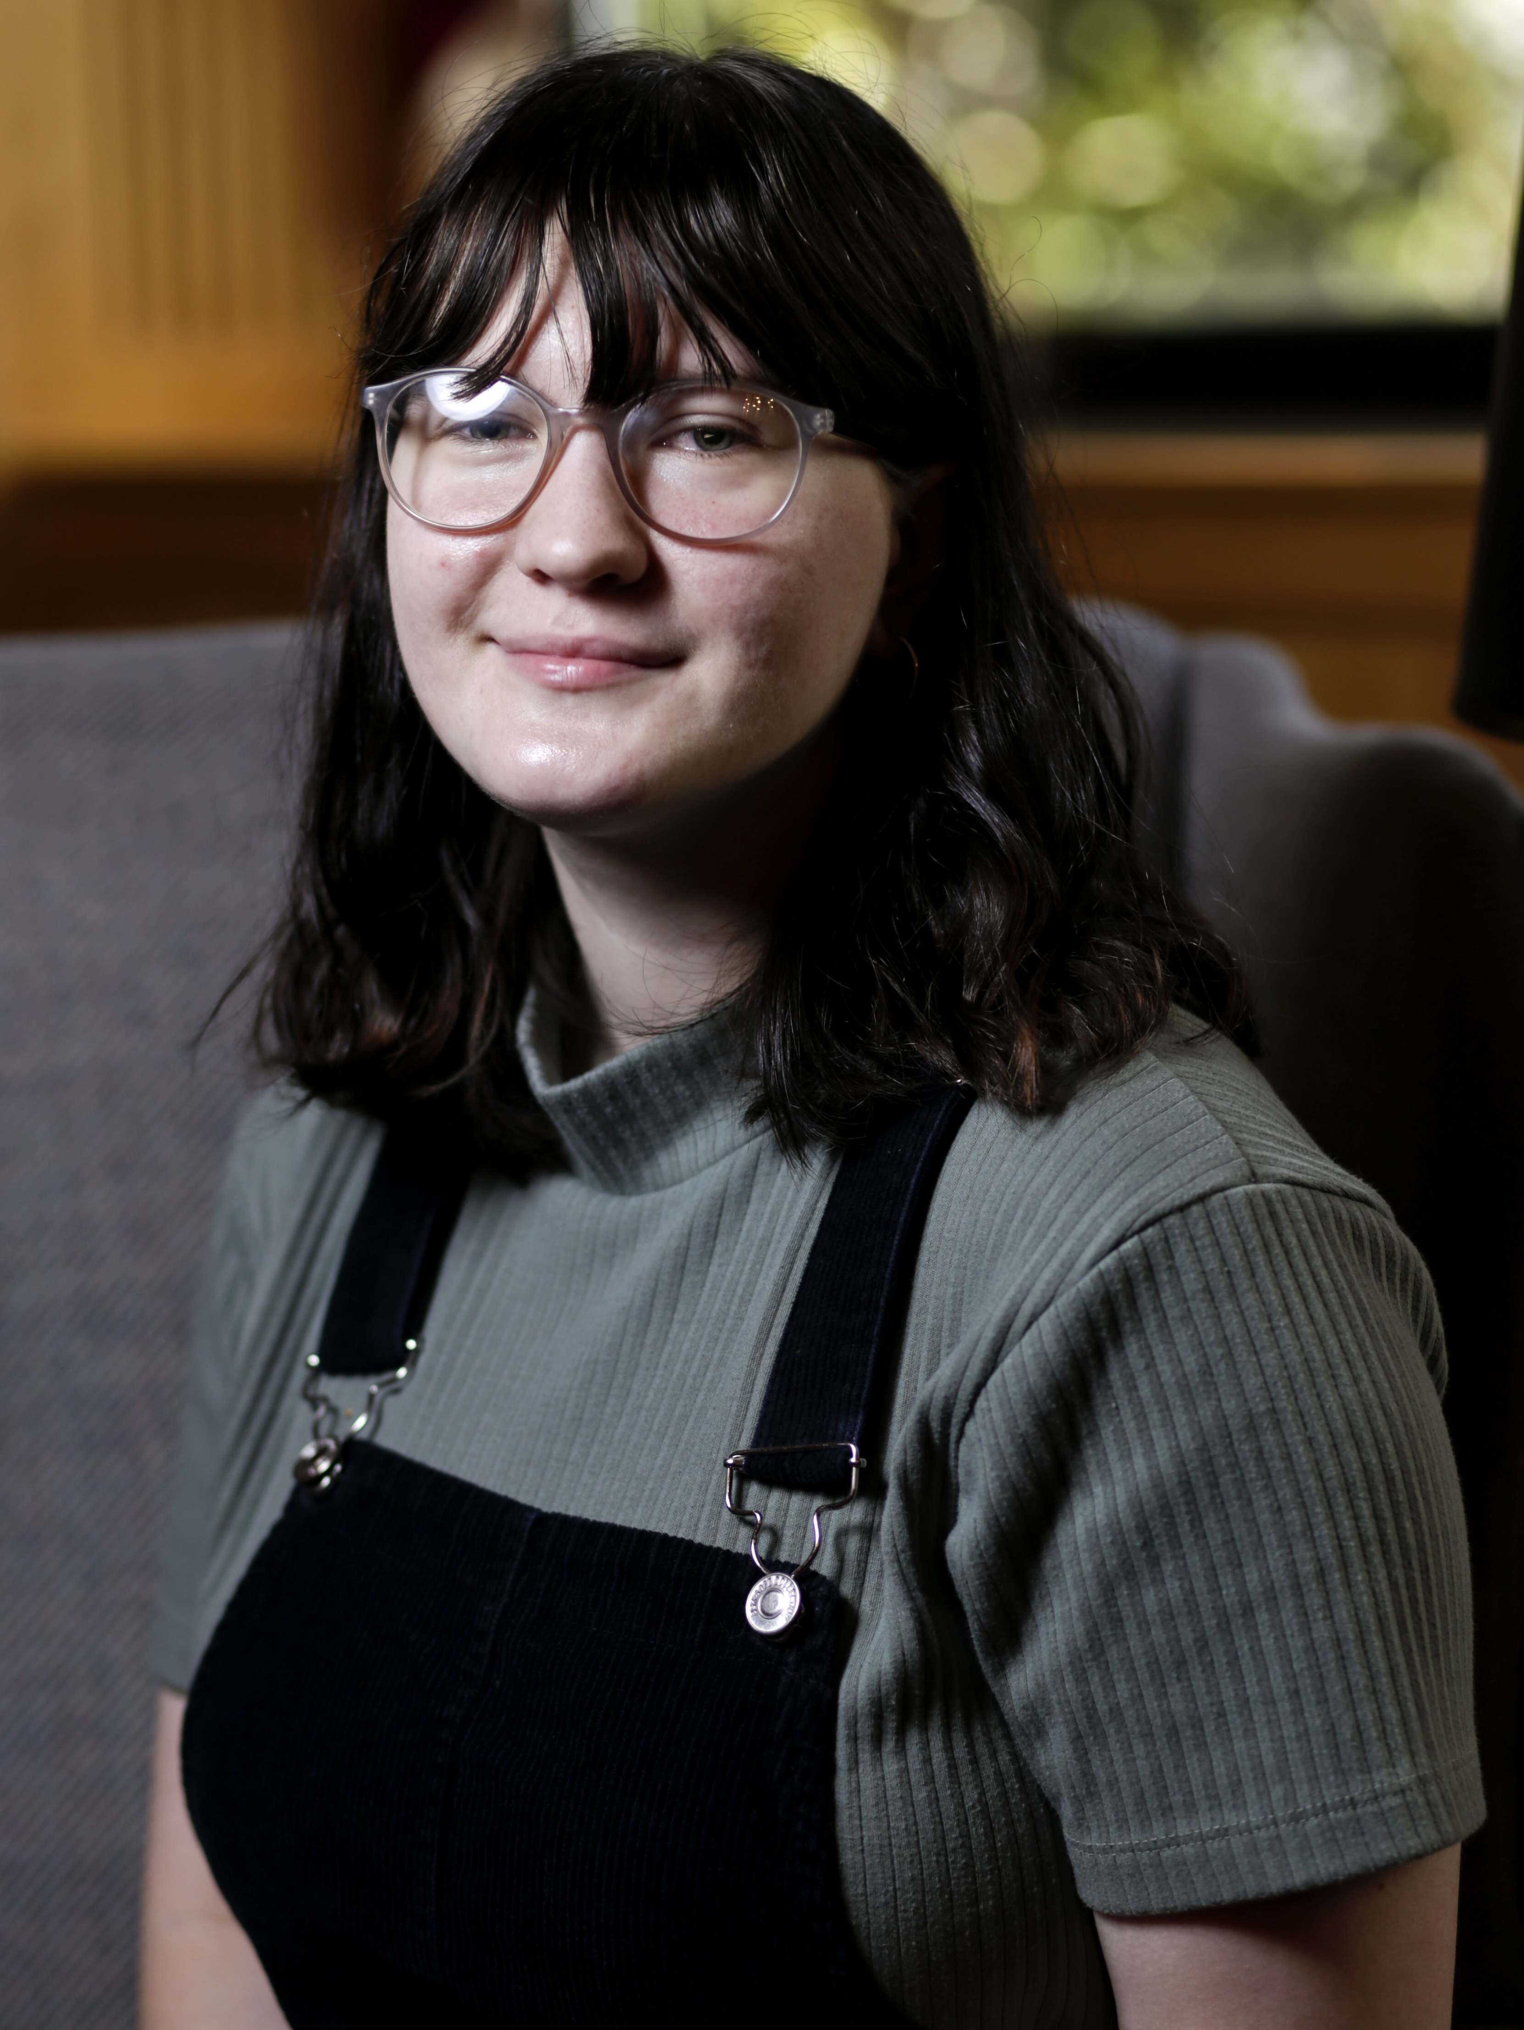
Emra Mehmedovic
Jim Wayne Miller Scholarship Fund

Slide 3
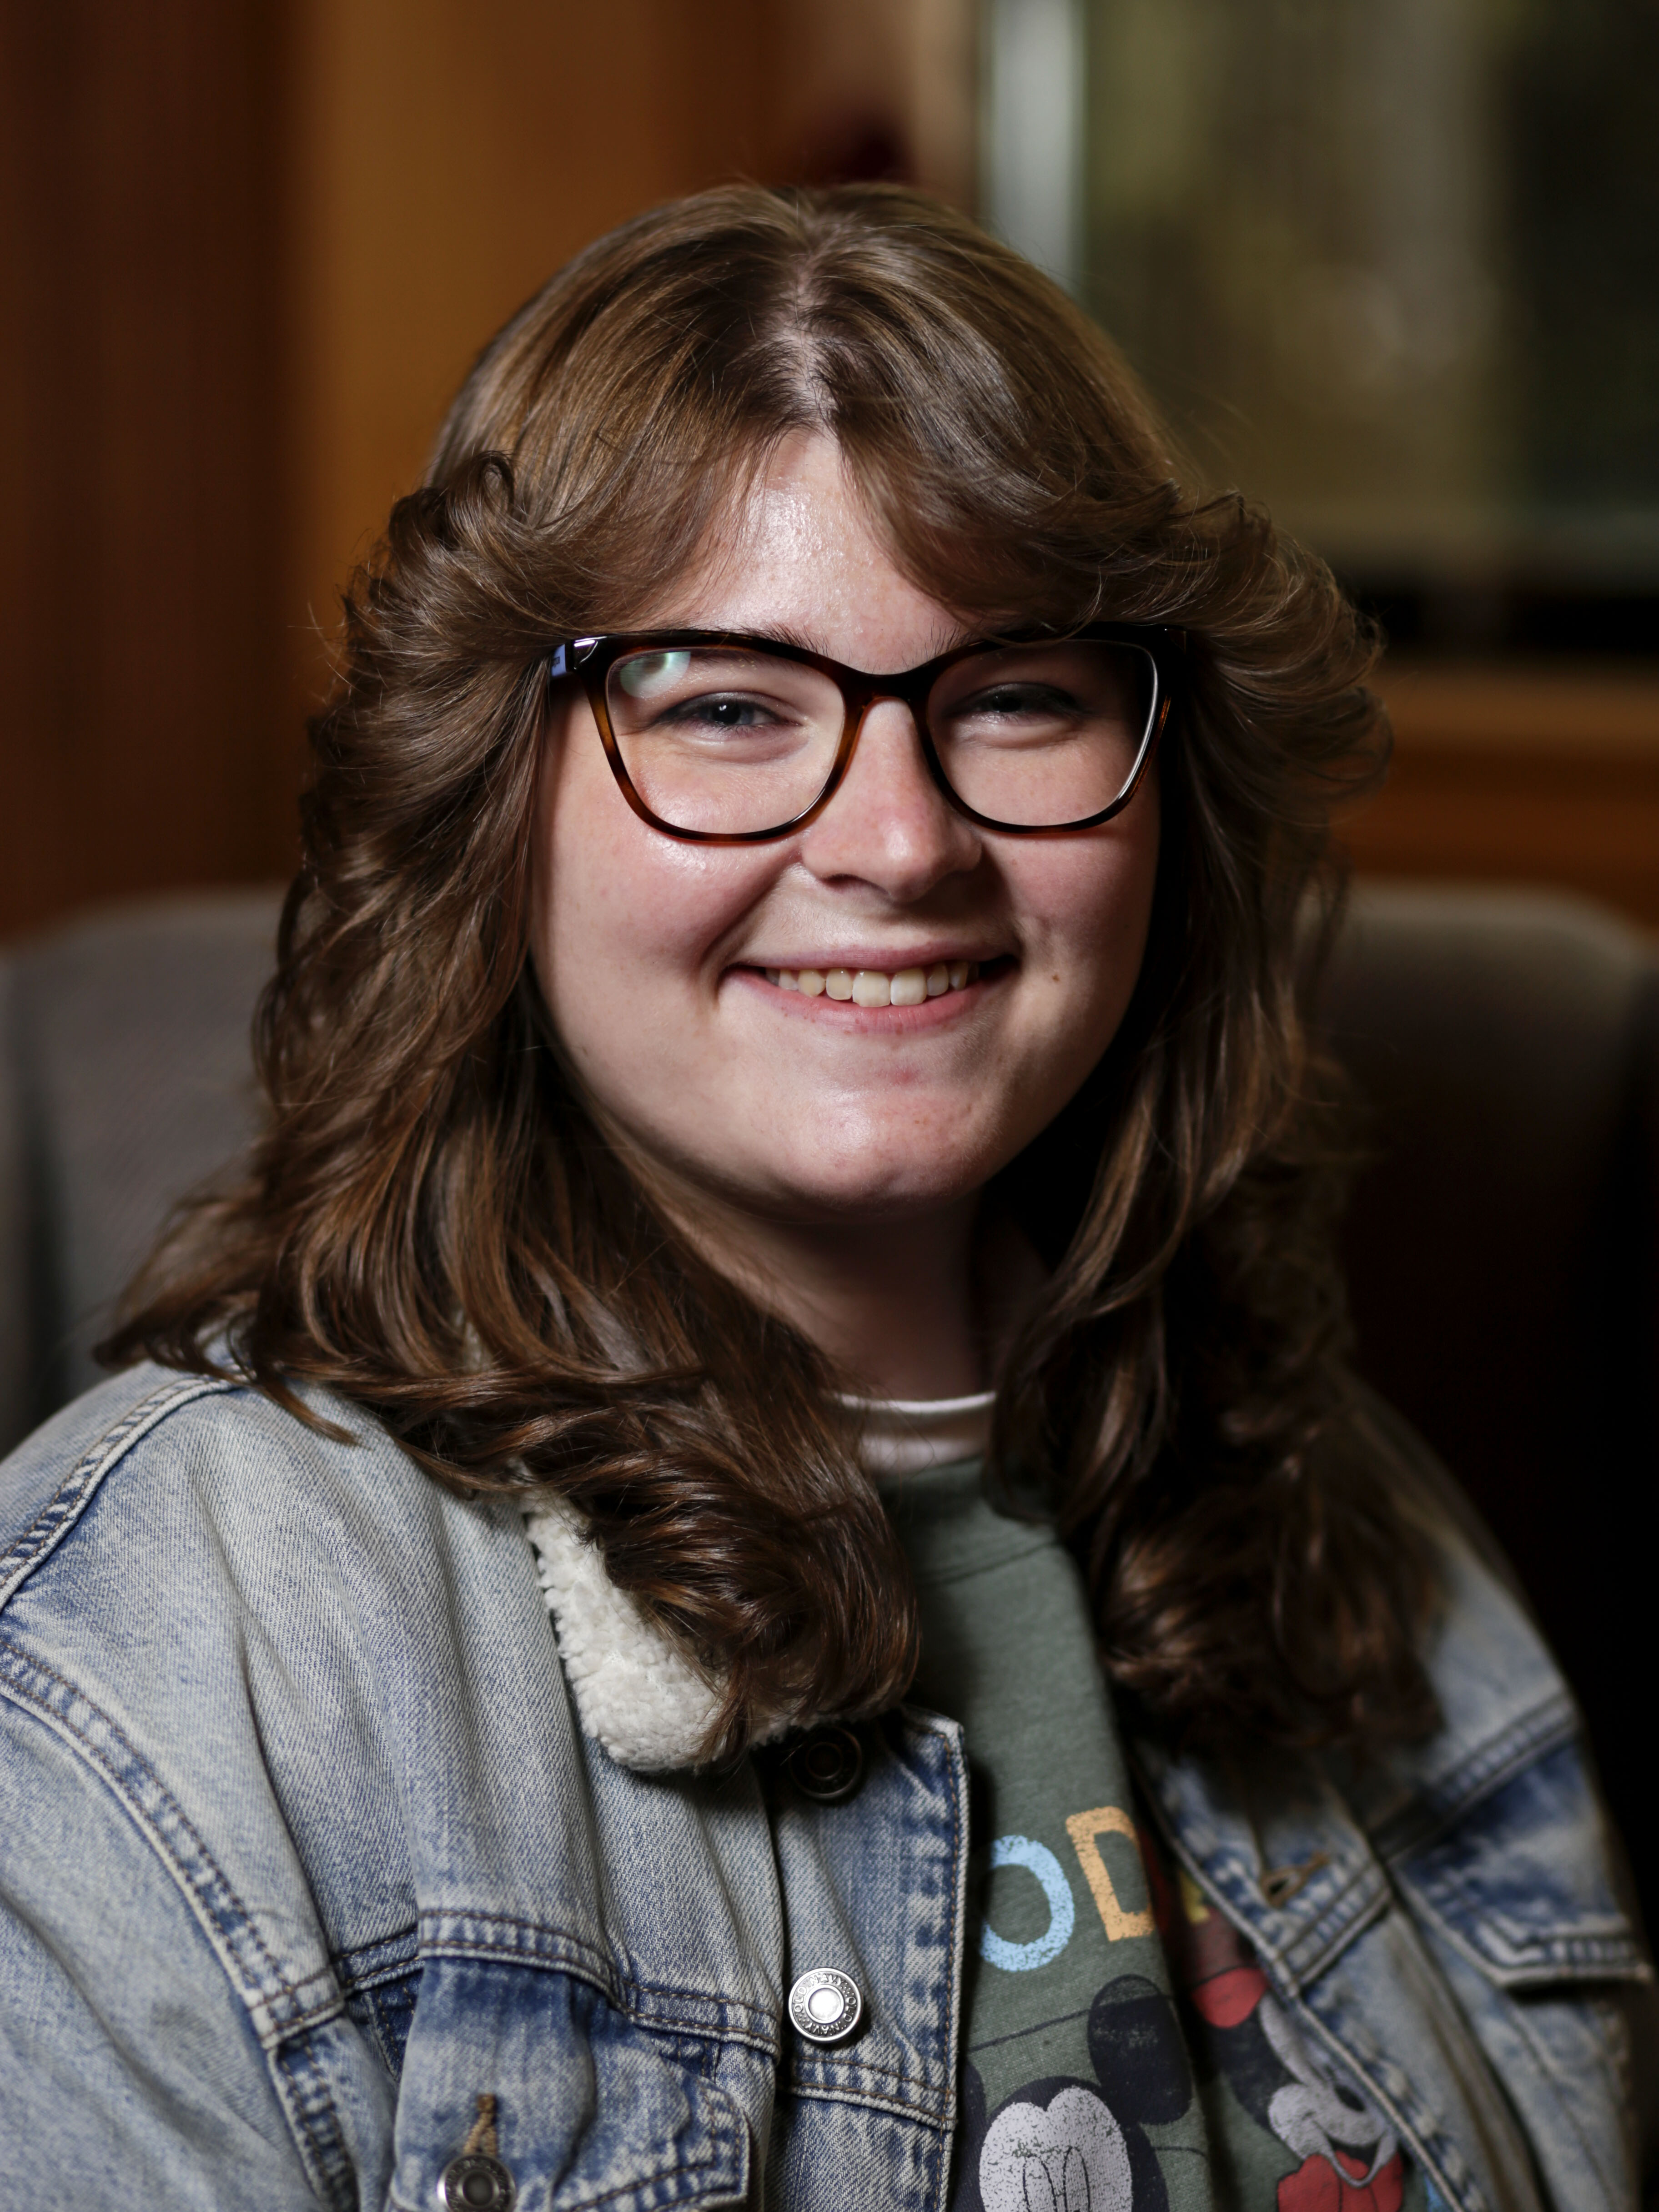
Catherine Sheffield
Noma Dunn Scholarship Fund
Seneca Falls Personal Empowerment Award

Slide 4
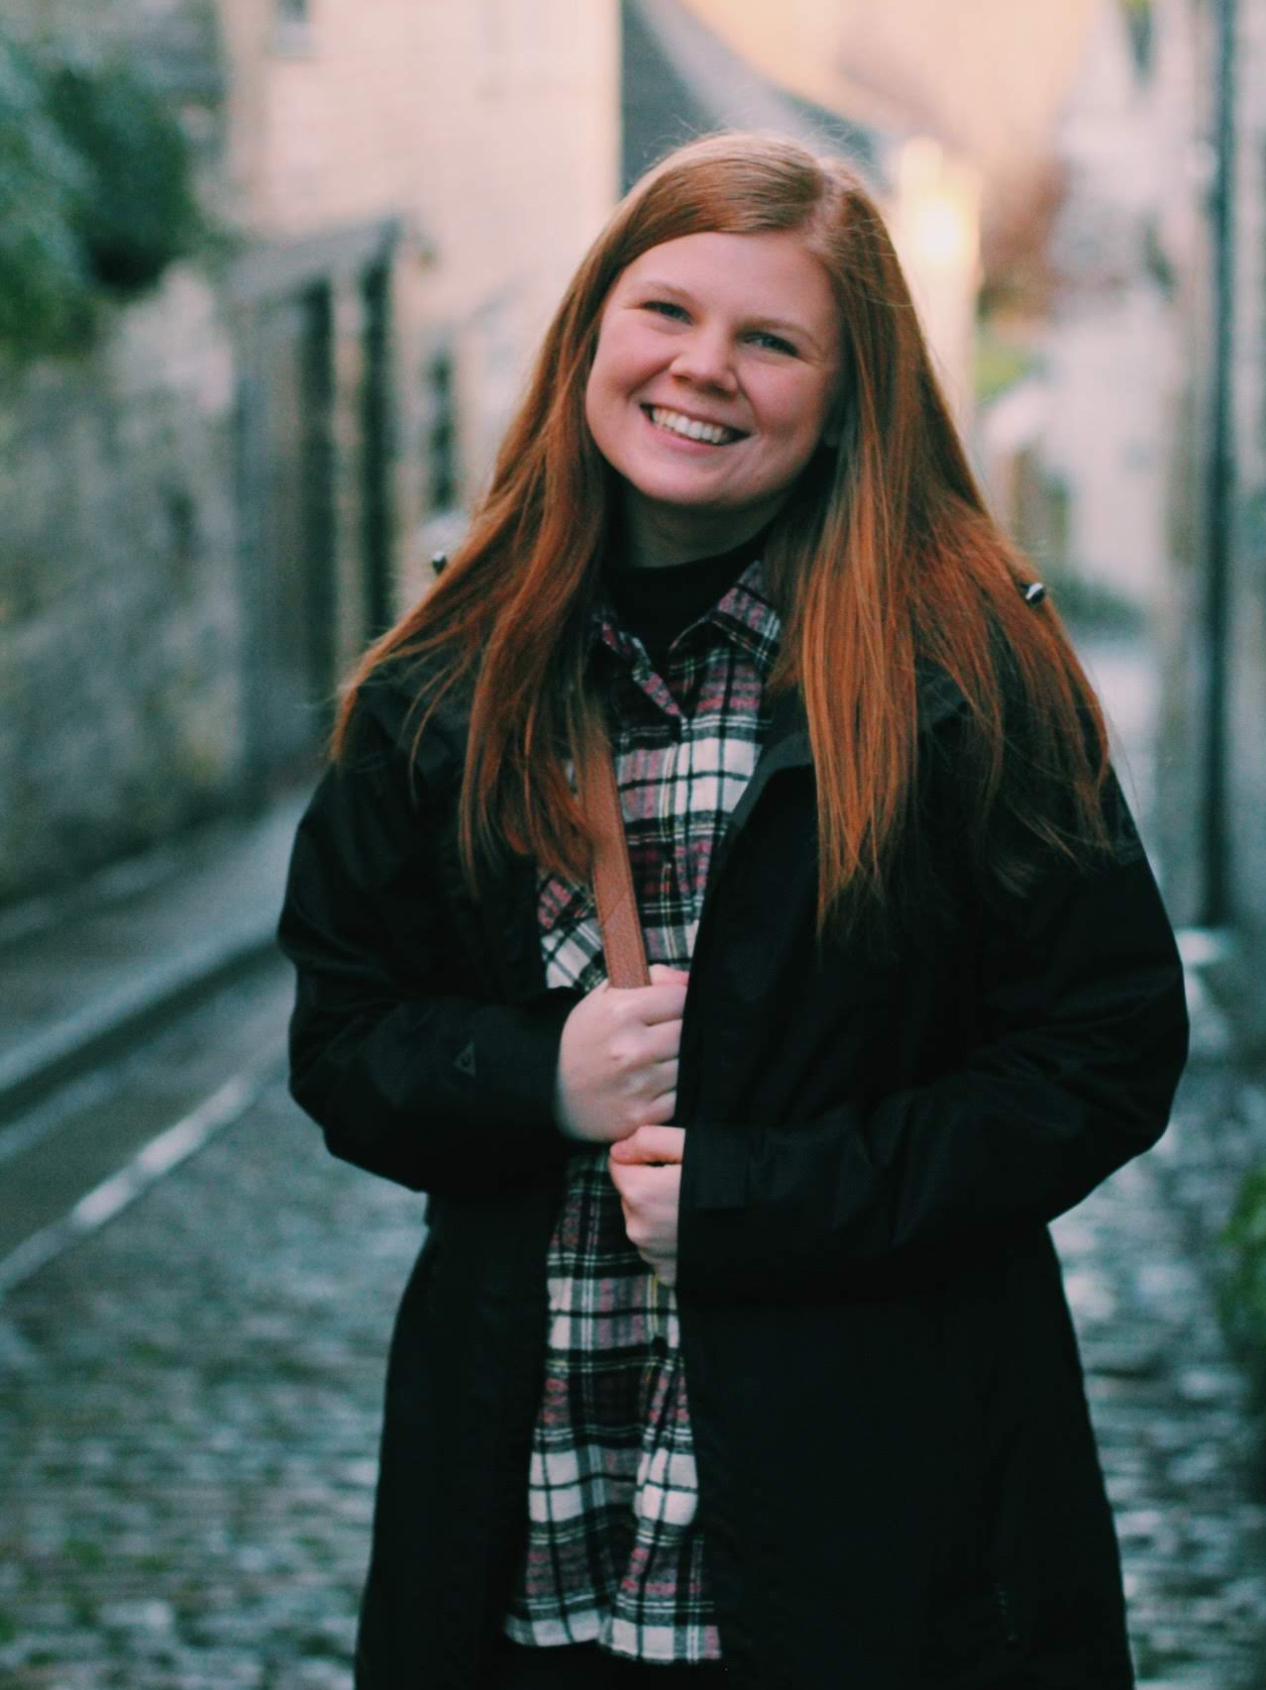
Bailey Alexander
Eva Rush Lee Scholarship

Slide 5
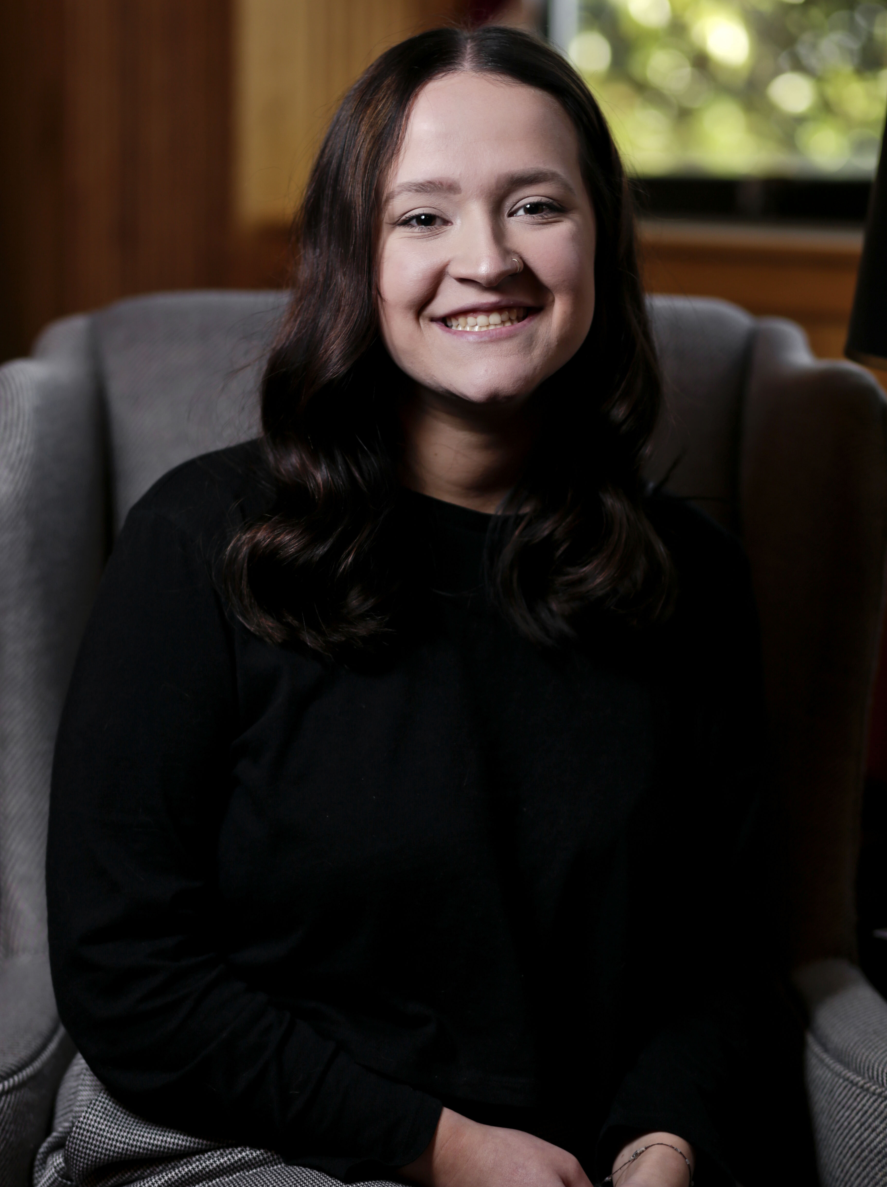
Sheridan Rosser
Eva Rush Lee Scholarship

Slide 6
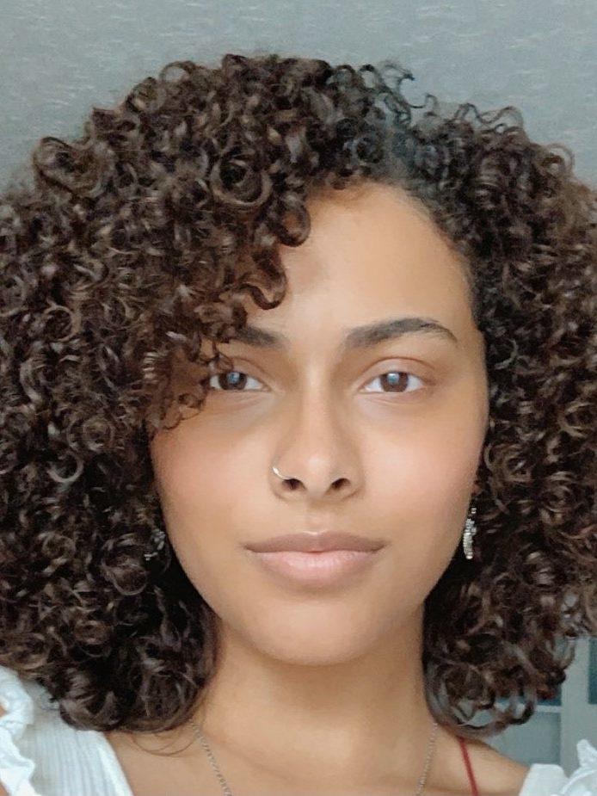
Summer Gary
Thomas G. Jones Scholarship Fund
2nd place, GWS Writing Contest

Slide 7
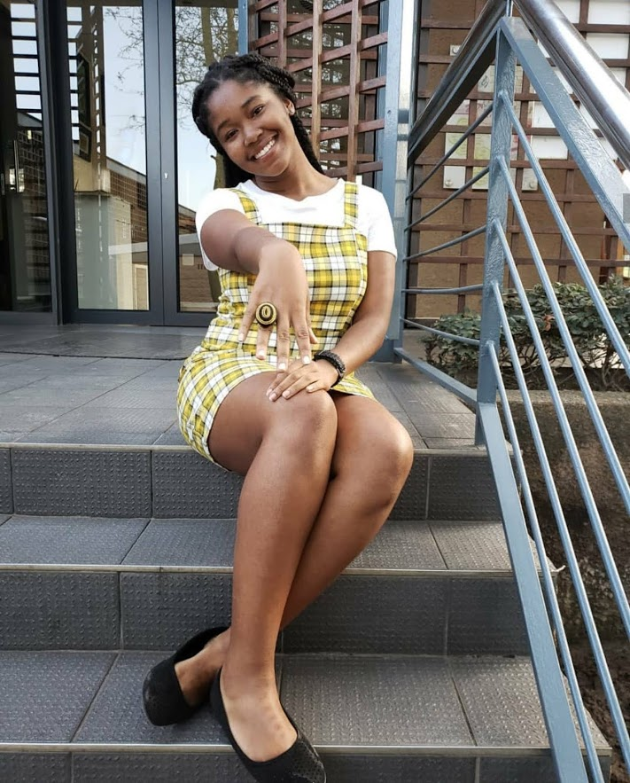
Nia Douglas
Department of English Scholarship for Racial Equity
3rd place, Mary Ellen and Jim Wayne Miller Writing Contest

Slide 8
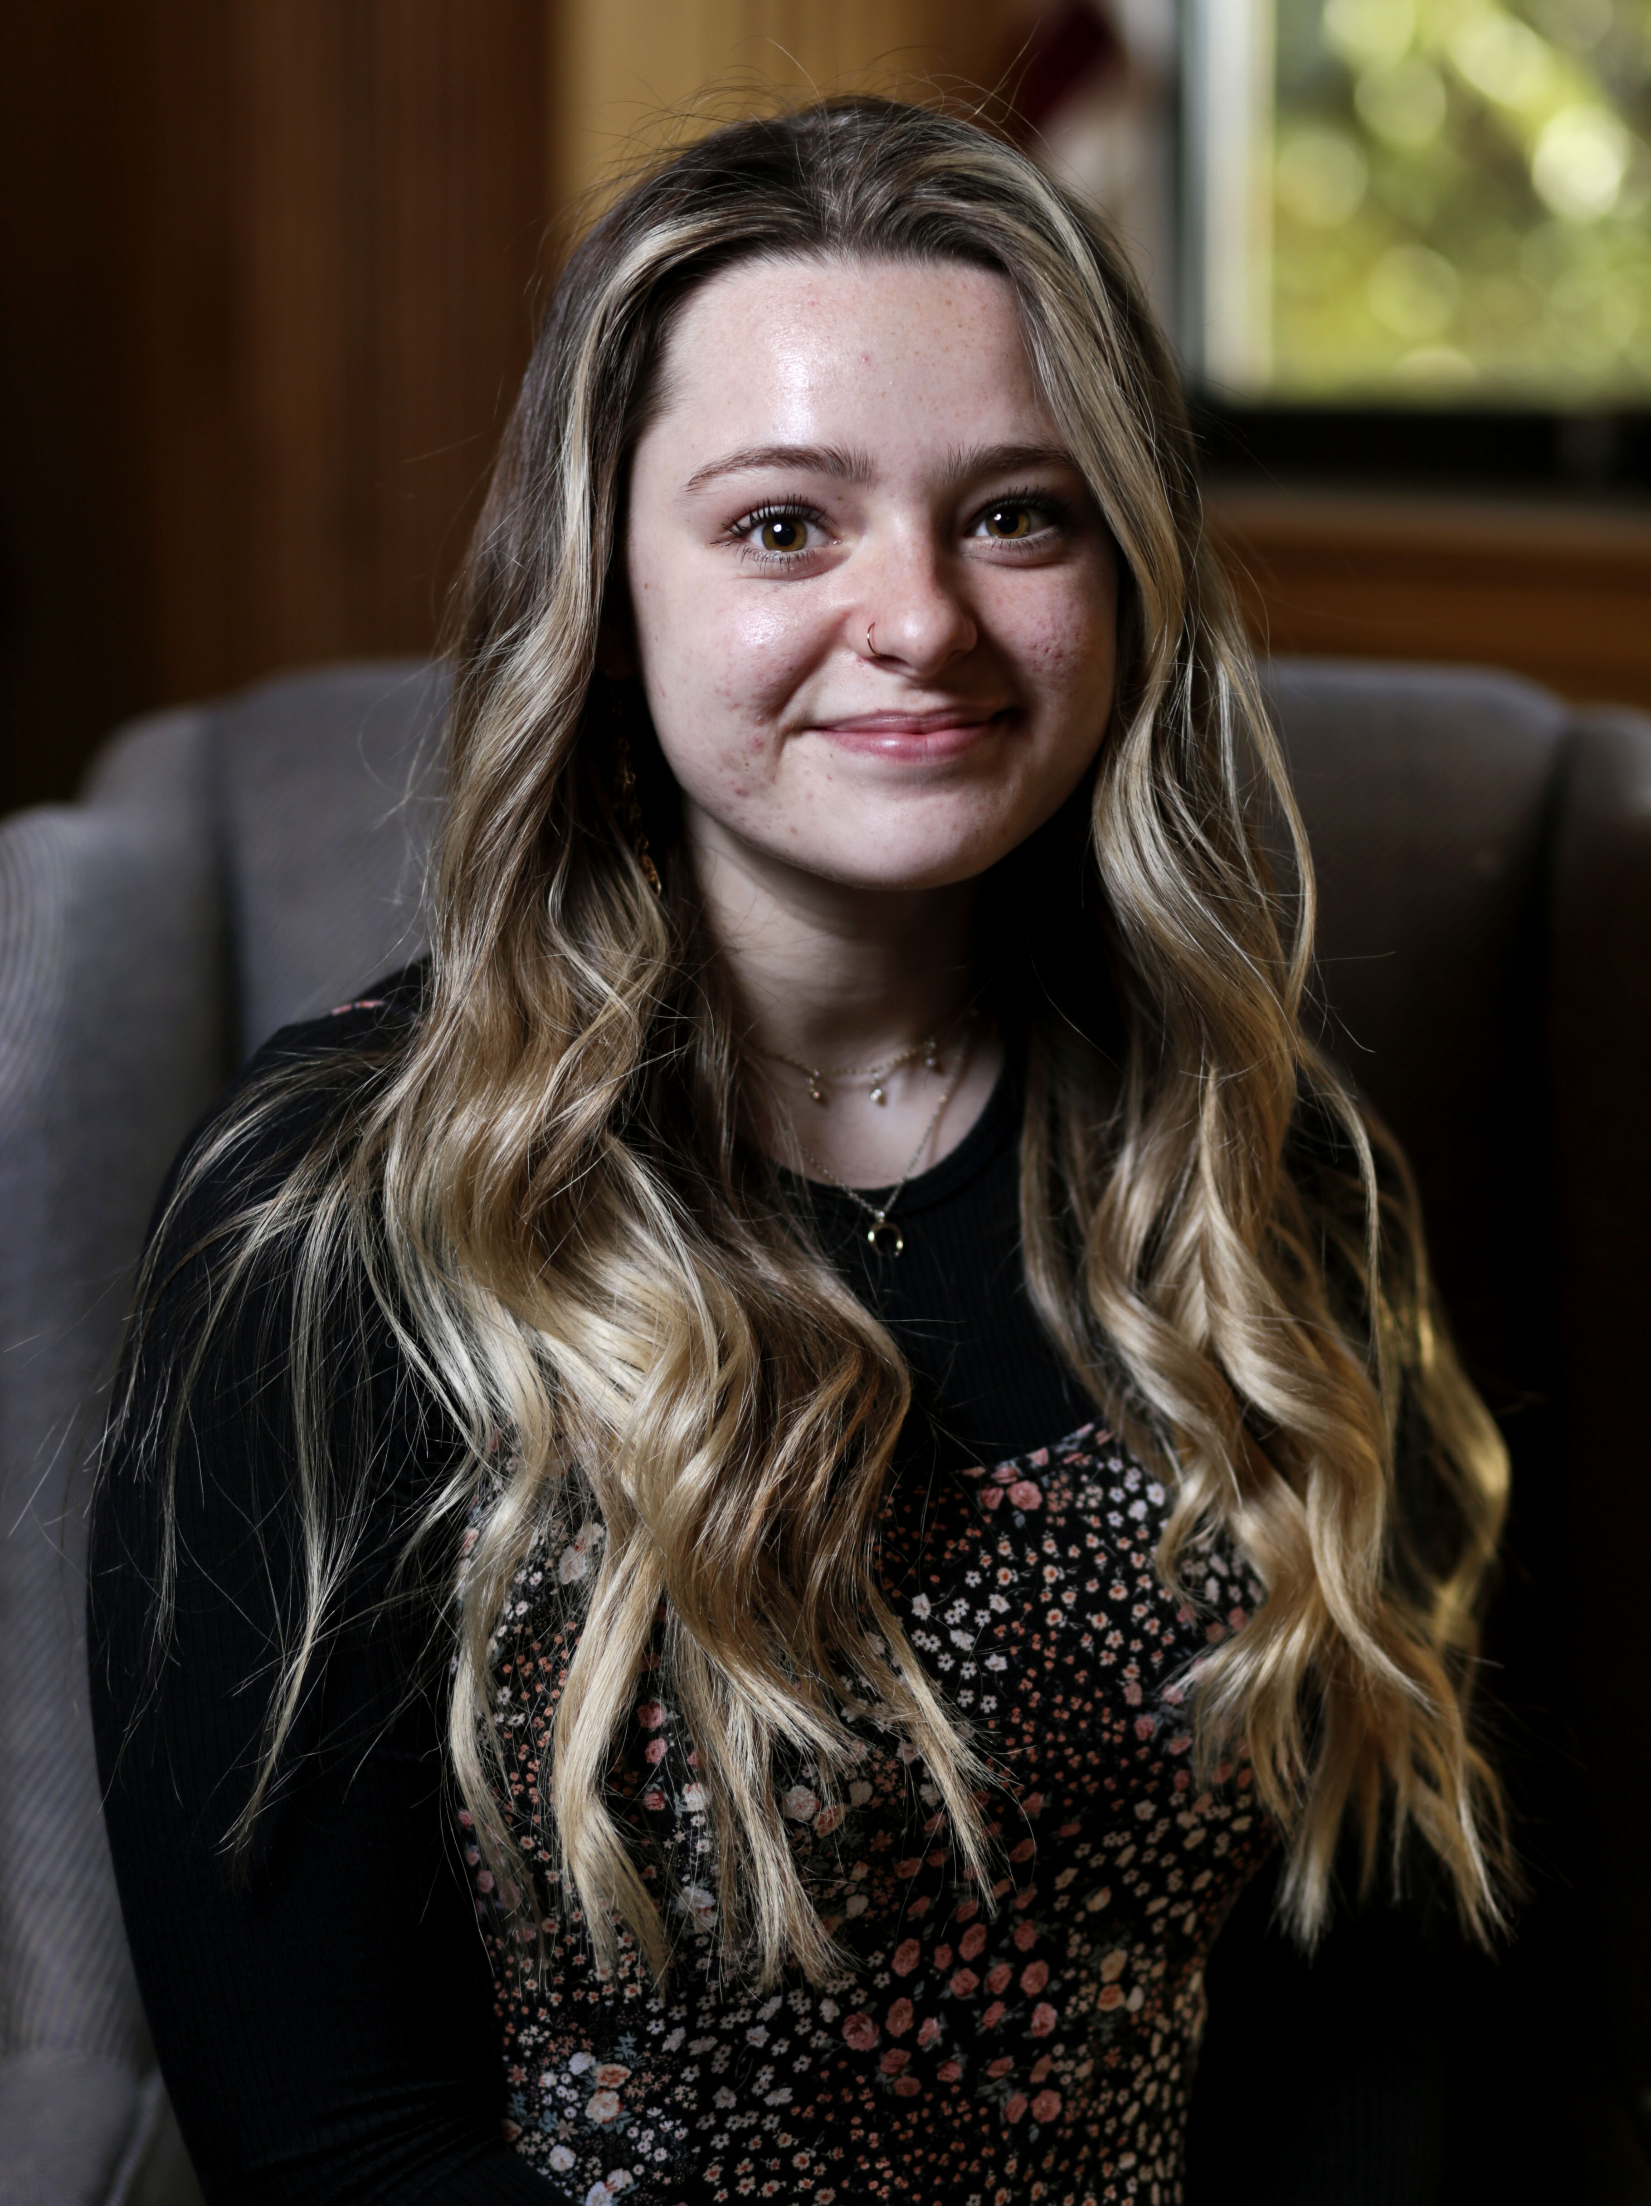
Julianna Lowe
Colonel Edgar Bryant and Edith R. Stansbury Scholarship Fund

Slide 9
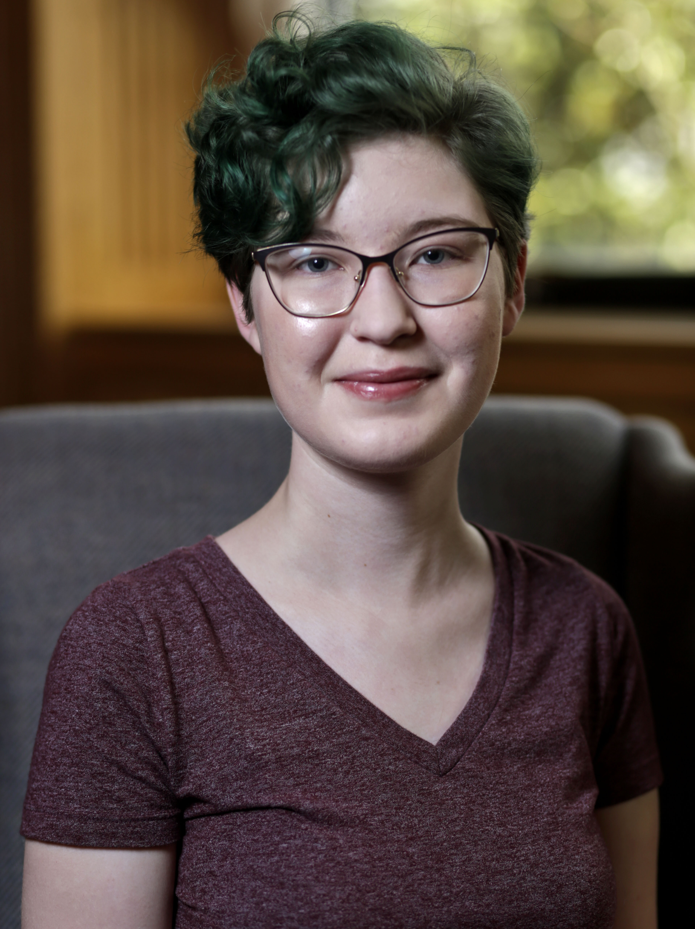
Sarah Stevens
Colonel Edgar Bryant and Edith R. Stansbury Scholarship Fund

Slide 10
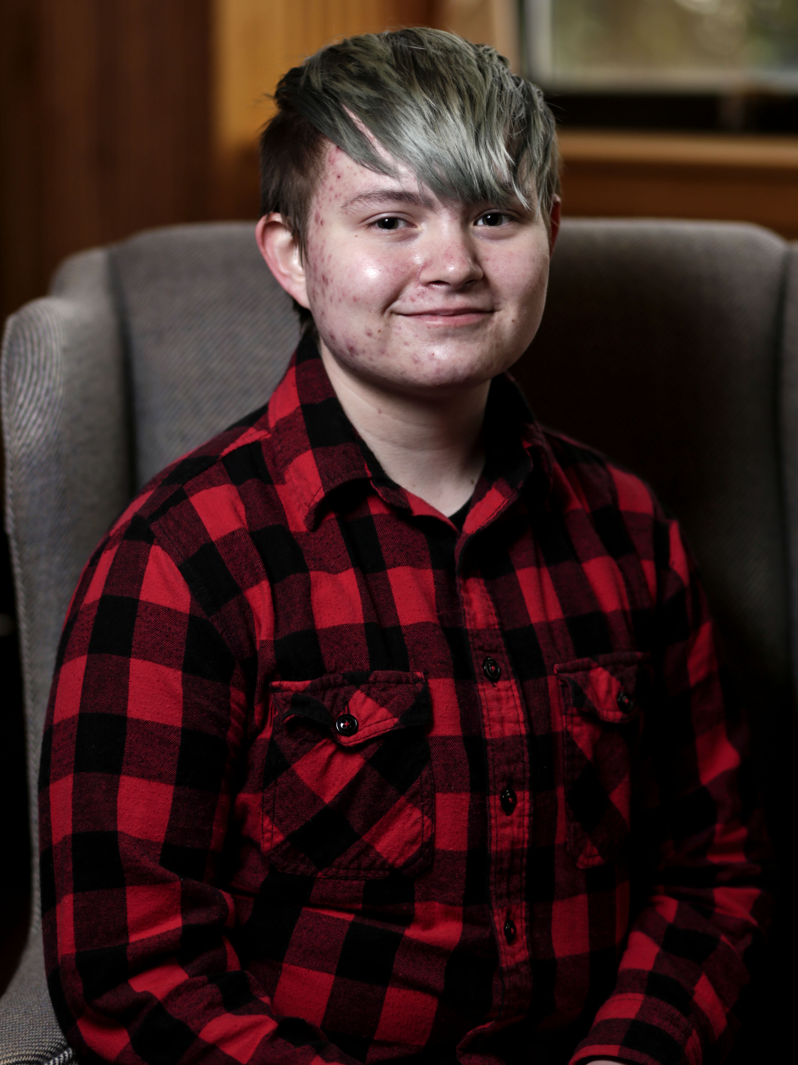
Joseph Shoulders
Patricia Minton Taylor English Literature Scholarship Fund

Slide 11
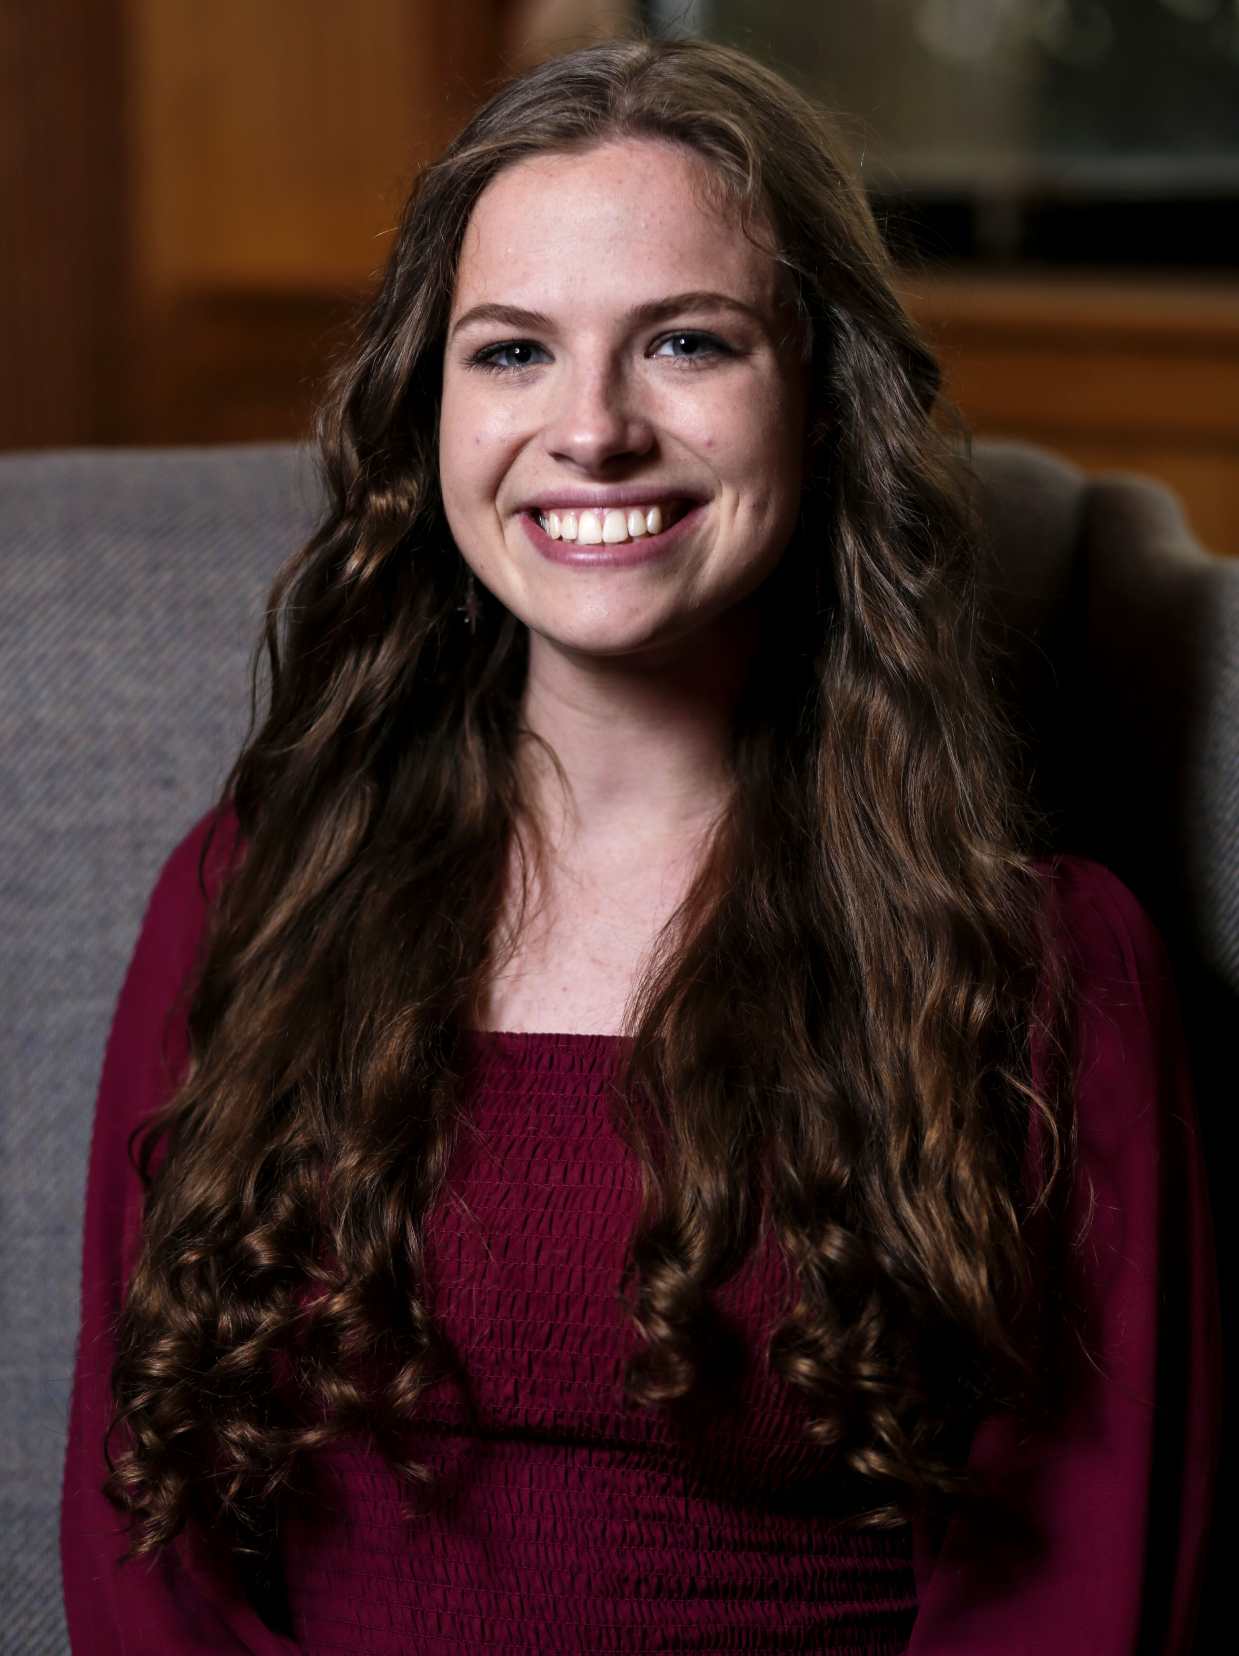
Abbie Booty
Dr. Karen Pelz Scholarship Fund

Slide 12
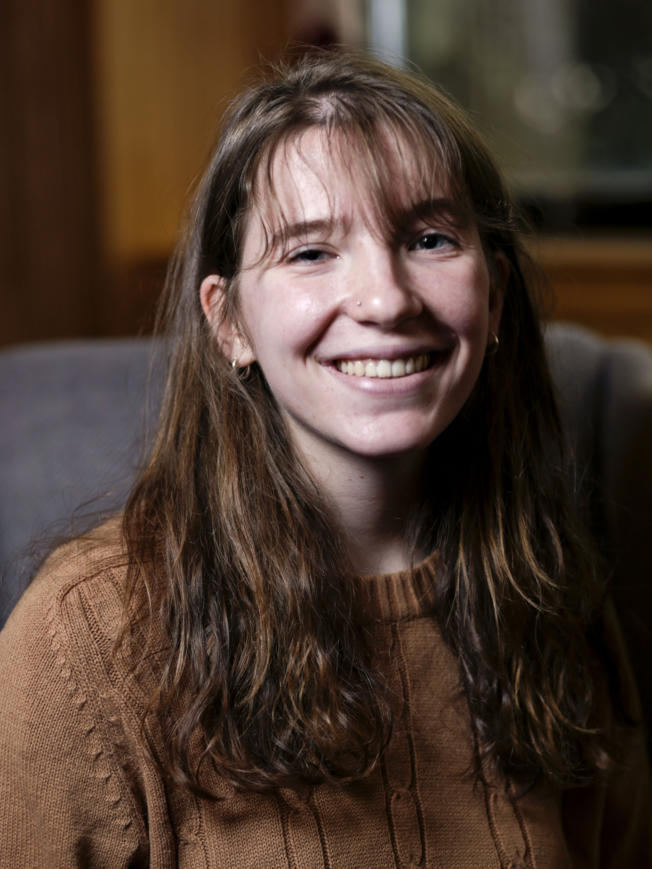
Kayla Spears
Jim and Lana Flynn
Study Abroad Scholarship
Wanda Essay Gatlin Award
1st Place, Goldenrod Poetry Festival

Slide 13
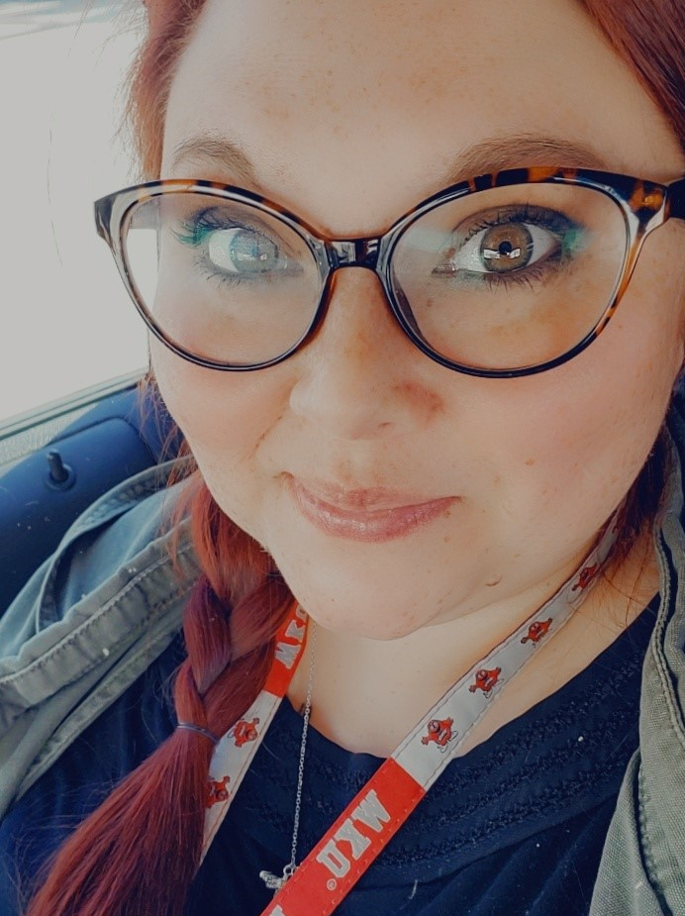
Jenna Woddard
Dr. Nancy Hightower
Davis Scholarship

Slide 14
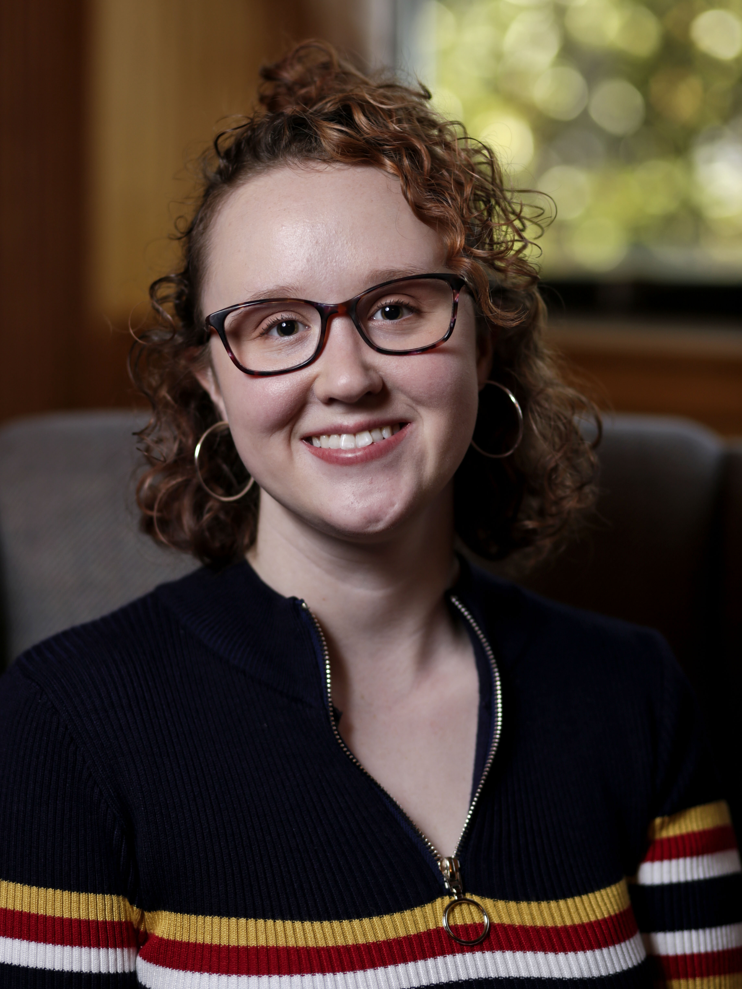
Sandie Merena
Earl A. and Cleo B. Moore— Terence E. and Sarah D. Kelsay Student Aid Fund

Slide 15
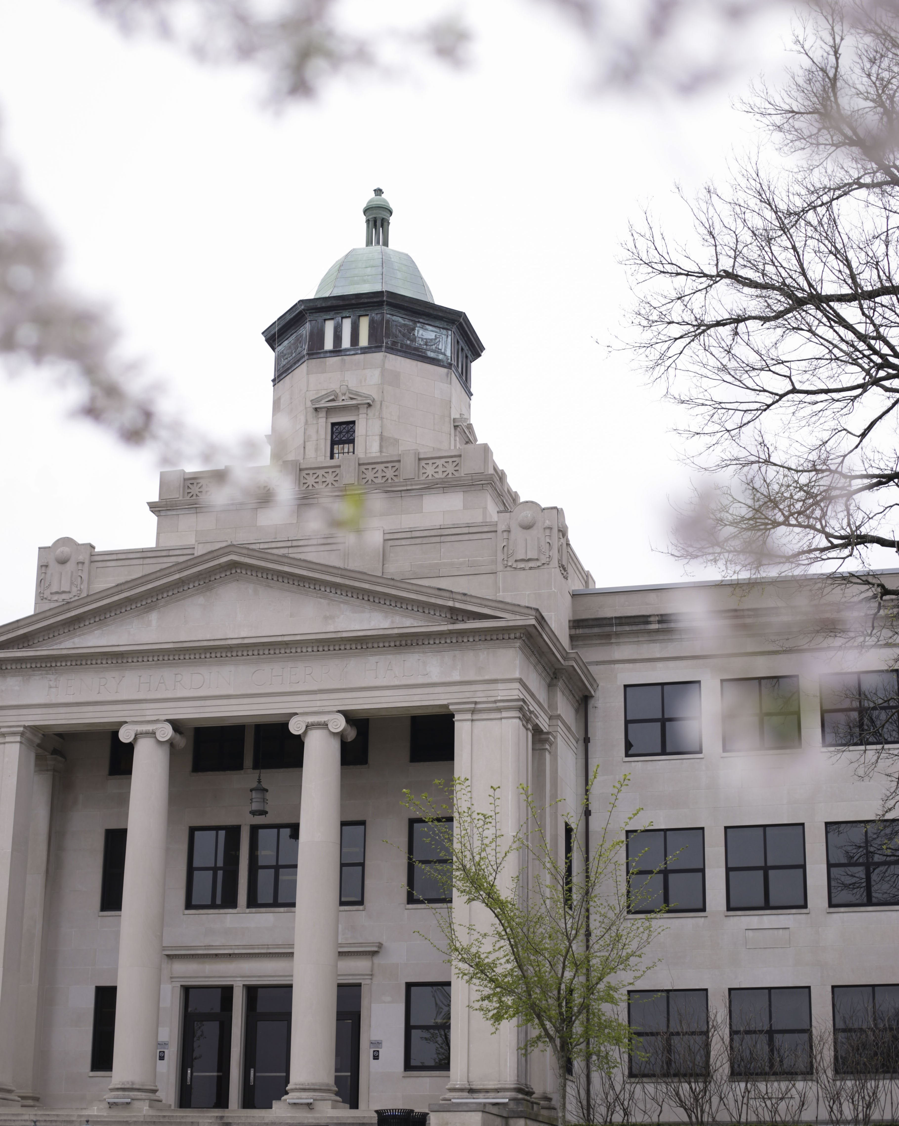
Aimee Scott
Mary Lucille Scott Scholarship Fund

Slide 16
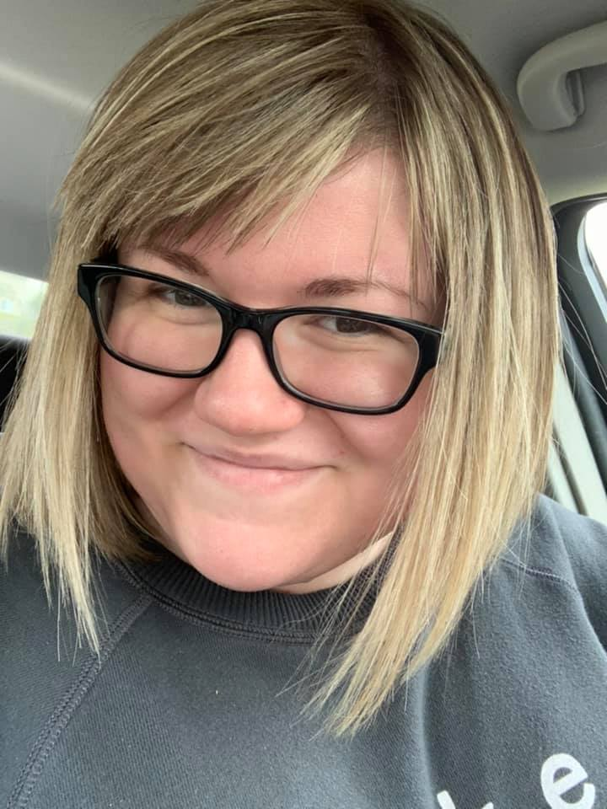
Delaney Holt
Gladly Graduate Award

Slide 17
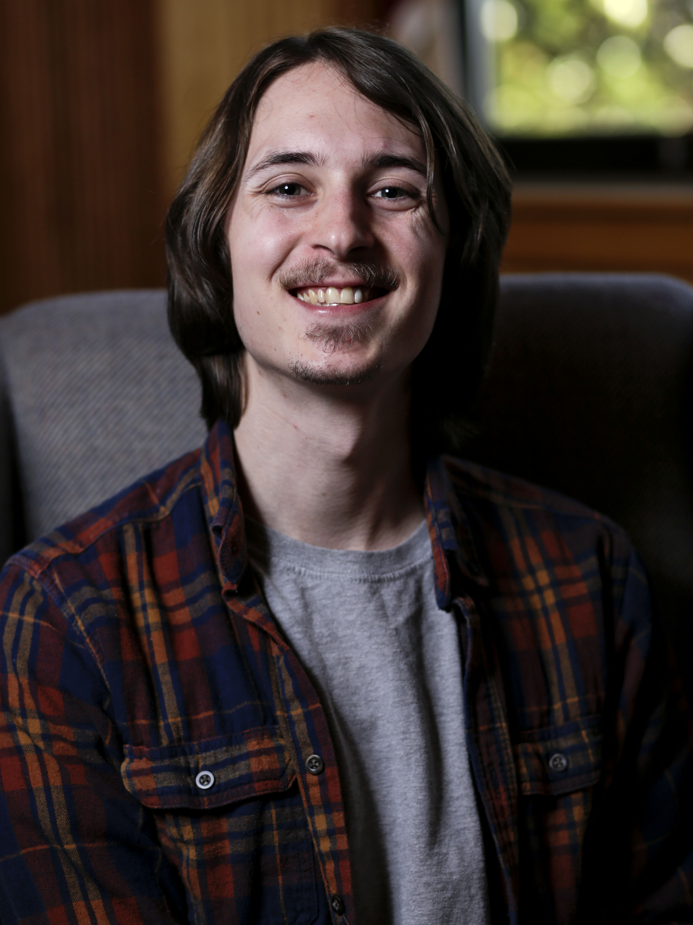
Mo Stevens
Wood Graduate Award

Slide 18
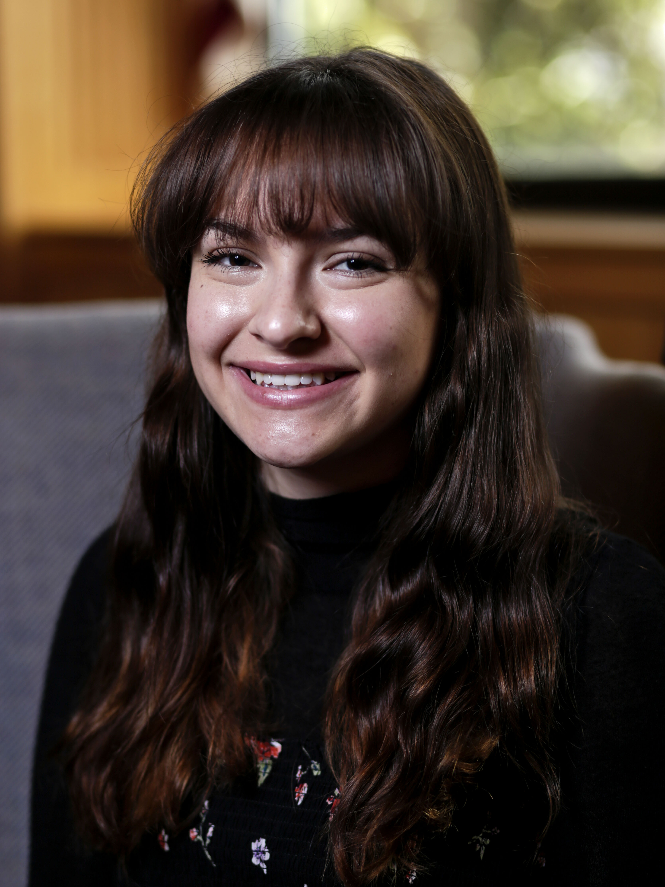
Jolie Finley
Pat and Wallace Nave
Student Aid Fund

Slide 19
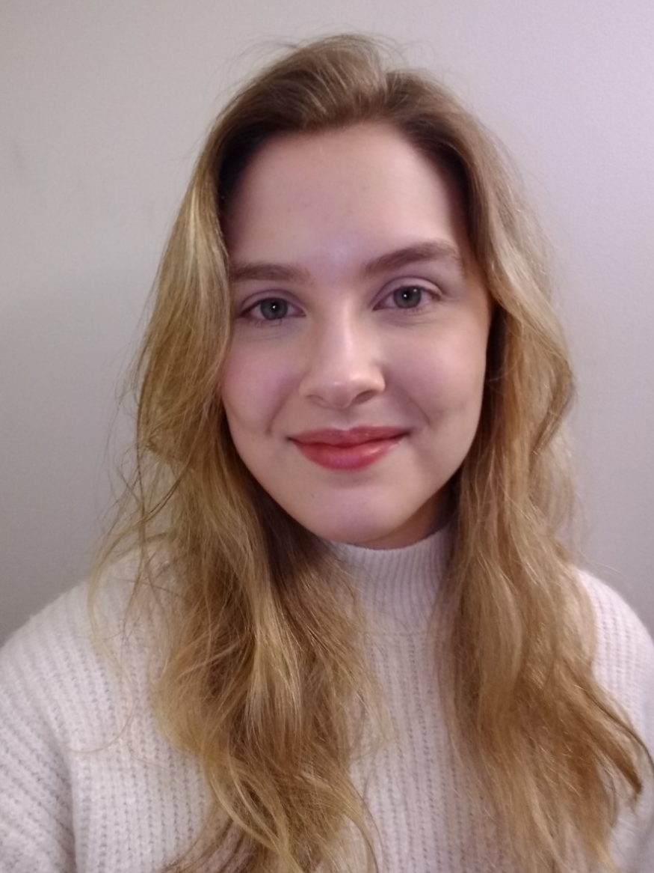
Brianna Hamilton
Frank L. Atkinson Scholarship

Slide 20
Marshall Dees
Earl A. Moore Scholarship

Slide 21
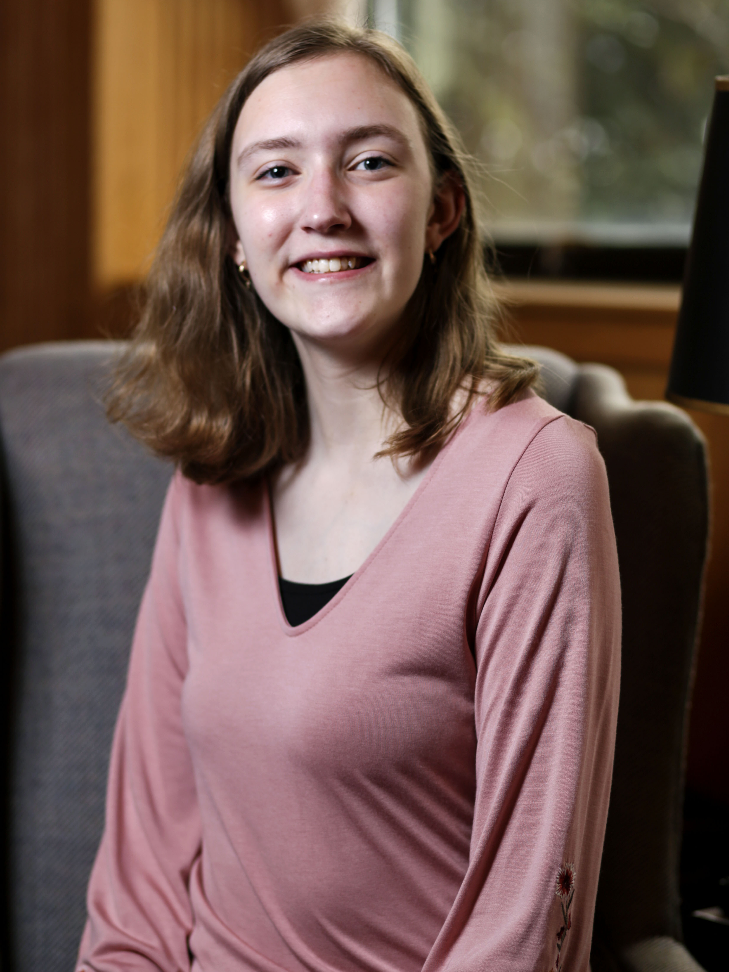
Elizabeth Roth
Addie Hochstrasser Estate Fund for the Jim Wayne Miller Scholarship in Creative Writing

Slide 22
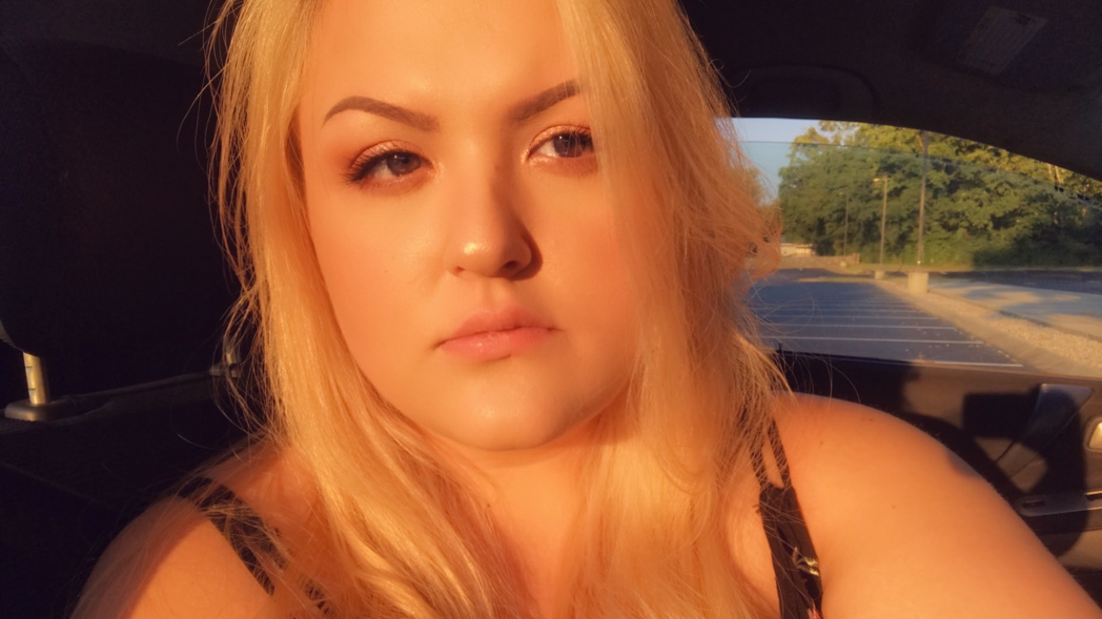
Stephanie Affield
Paul Bush Memorial Scholarship

Slide 23
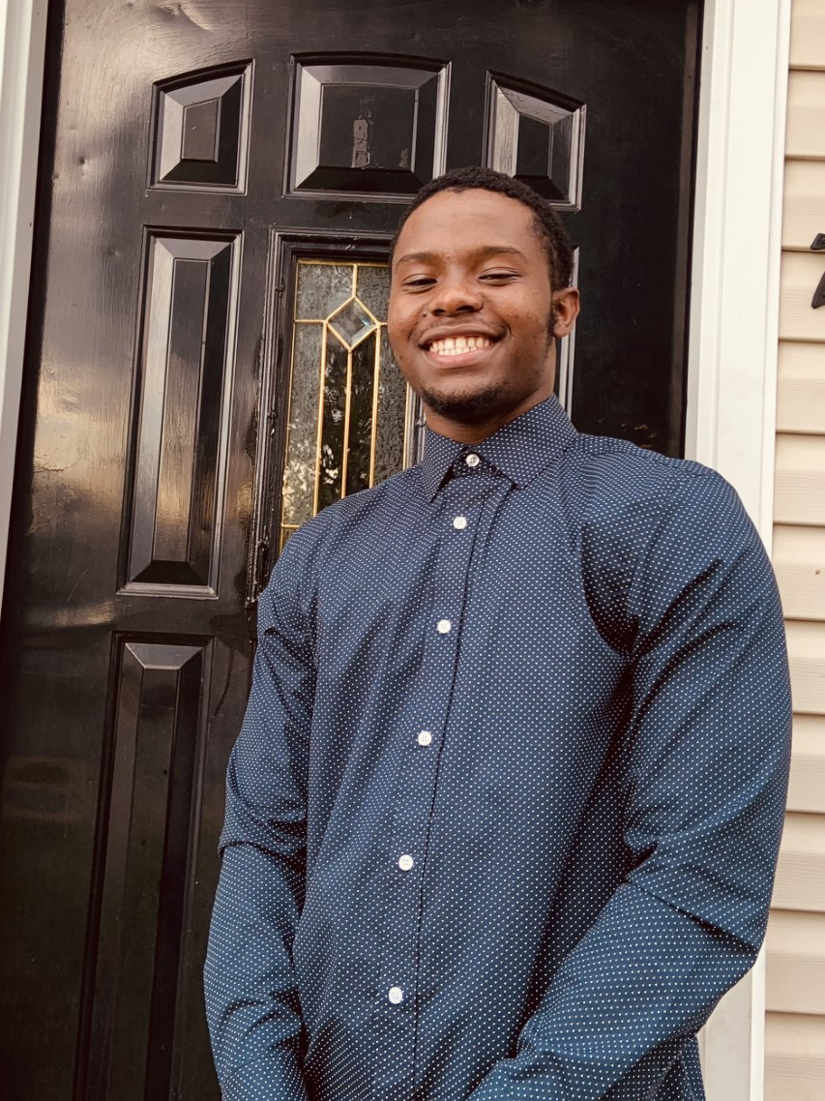
Bosco Tuyisenge
Paul Bush Memorial Scholarship

Slide 24
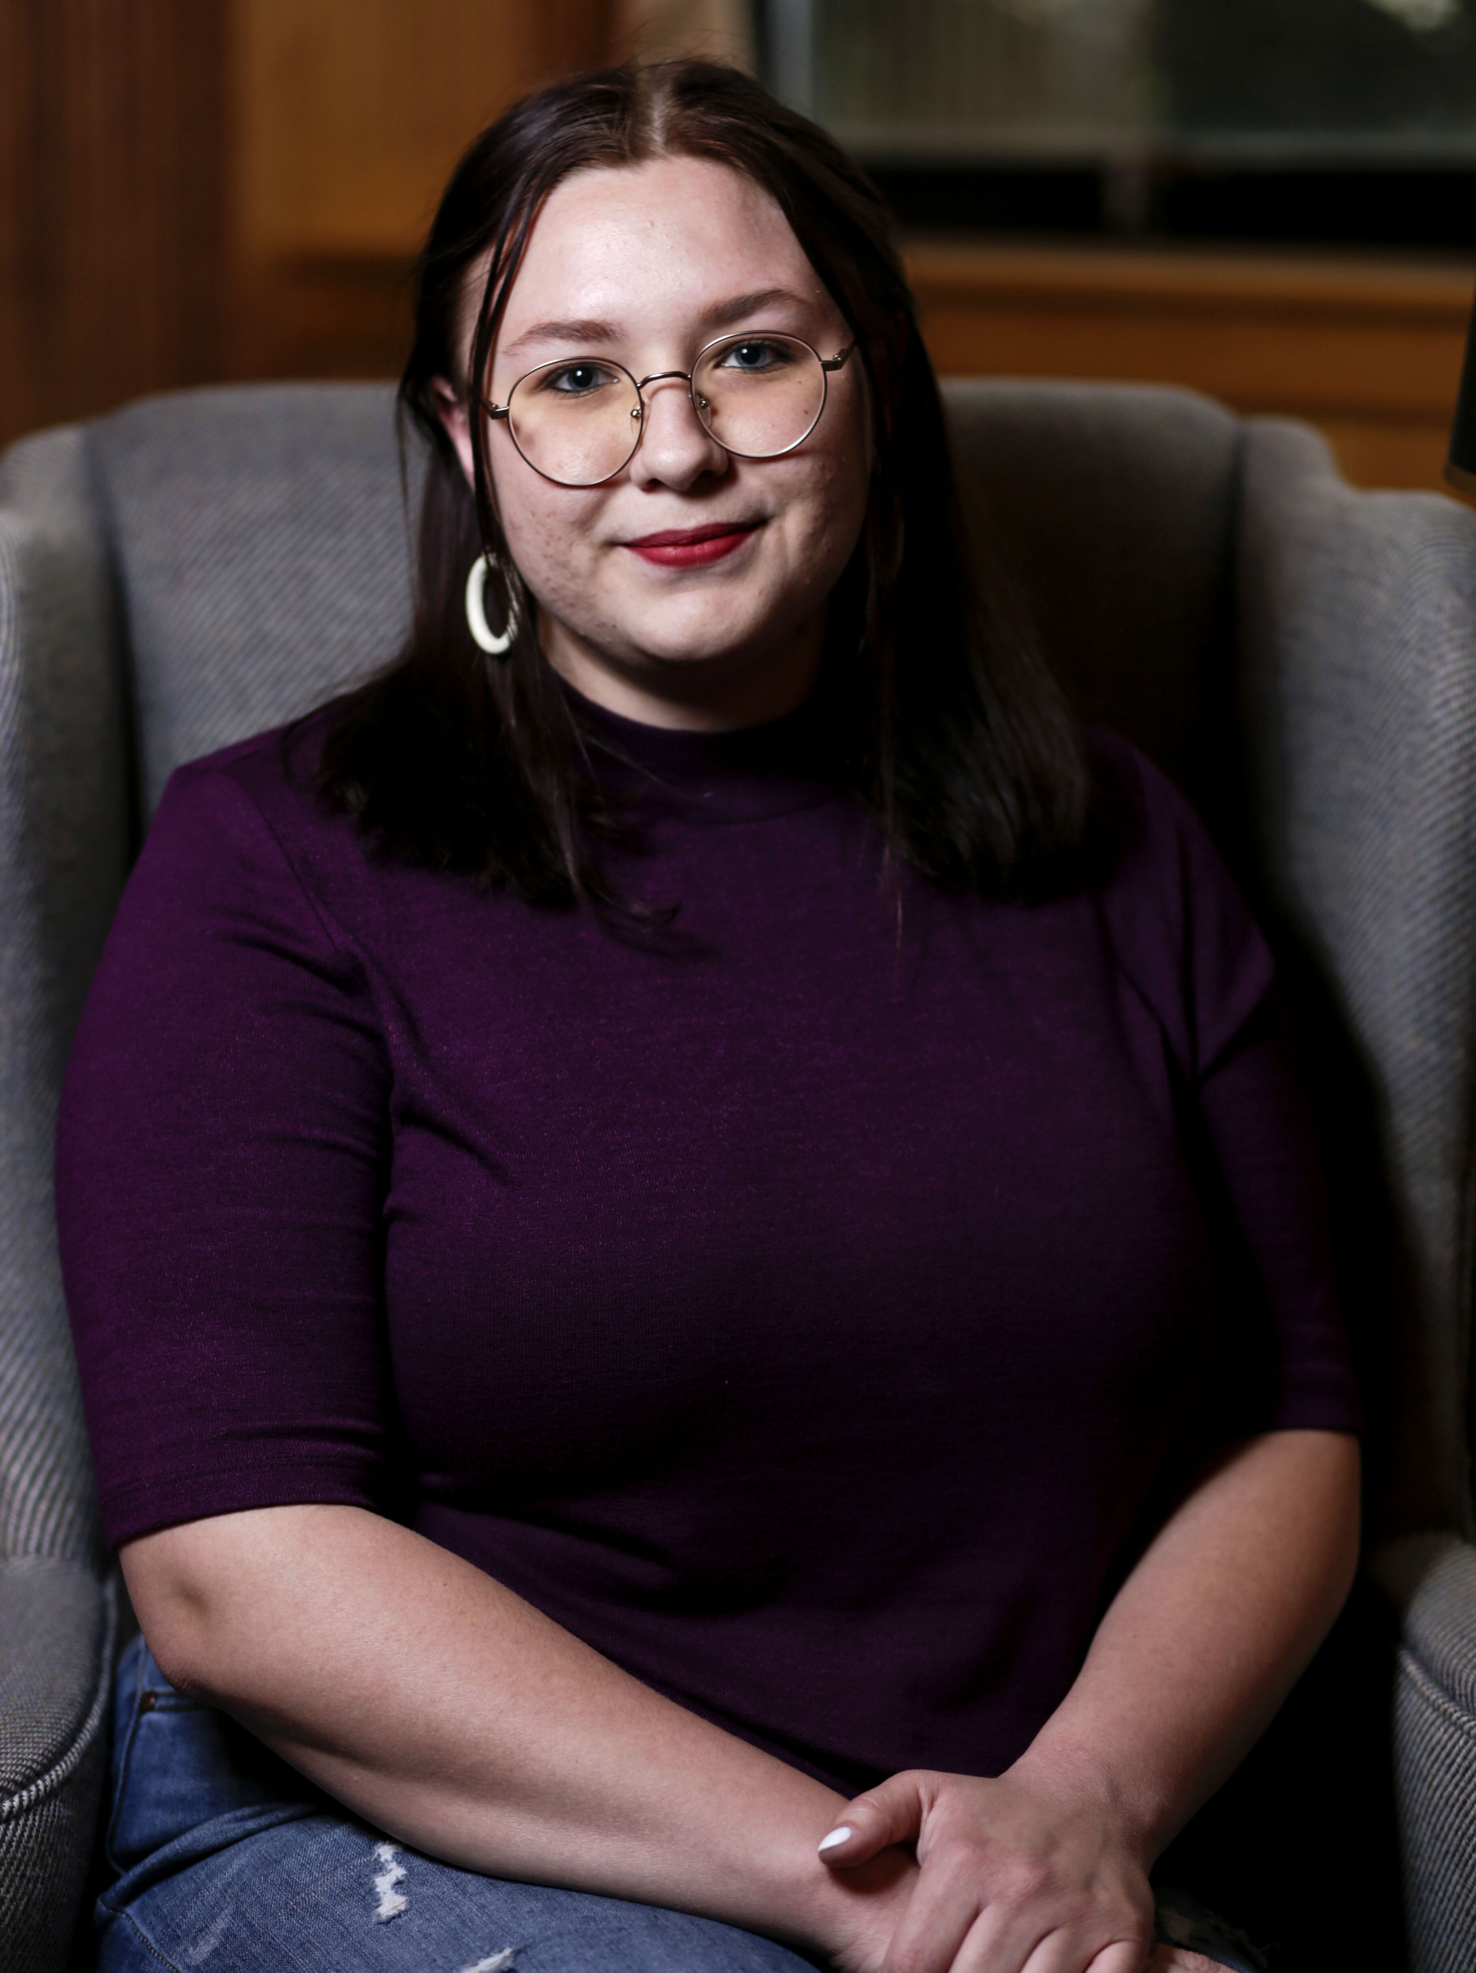
Olivia Alsup
Betty Jean and Doug Mosley Scholarship

Slide 25
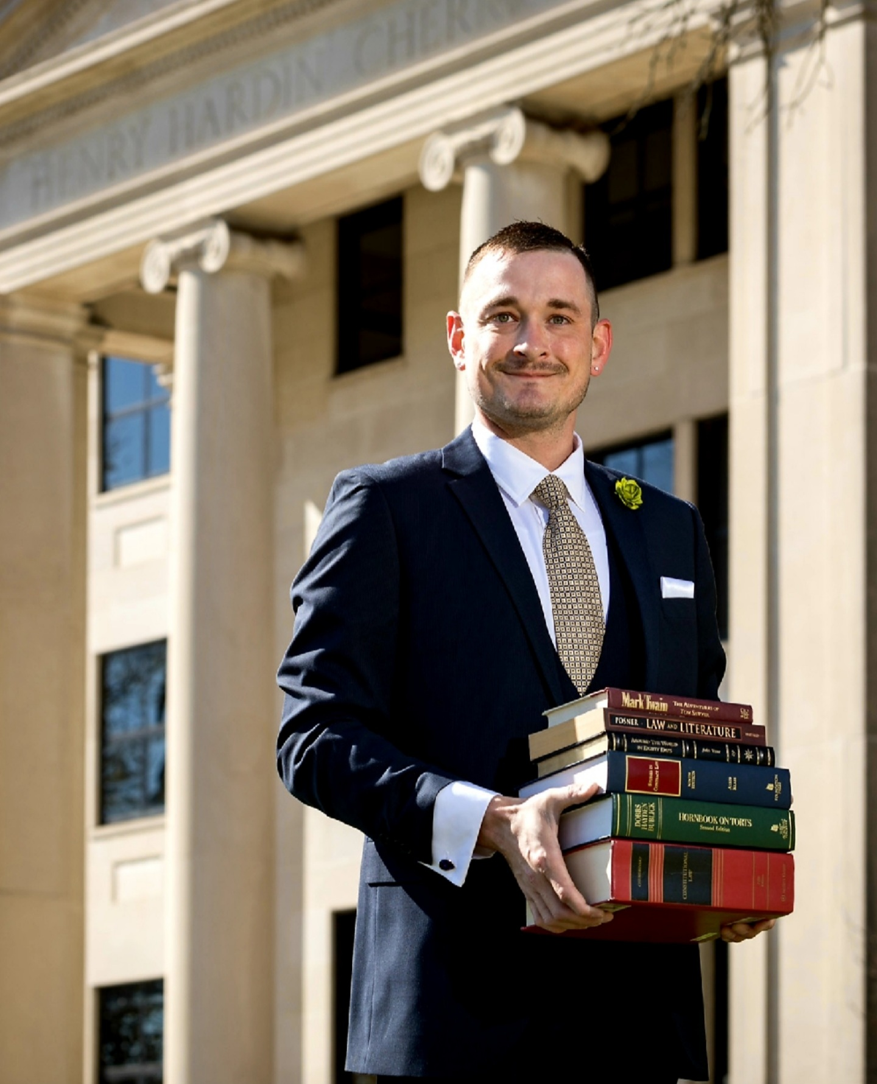
Will Williford
Outstanding Graduating
MA Student

Slide 26
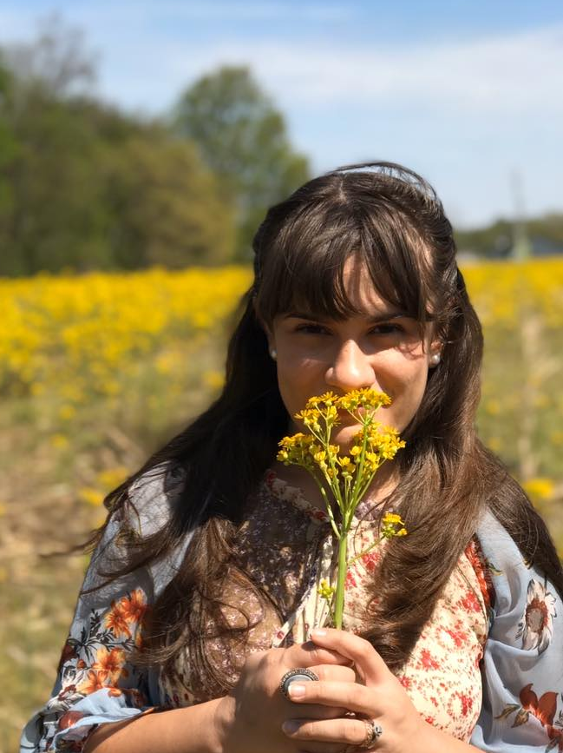
Megan Hutchinson
Outstanding Graduating
MFA Student

Slide 27
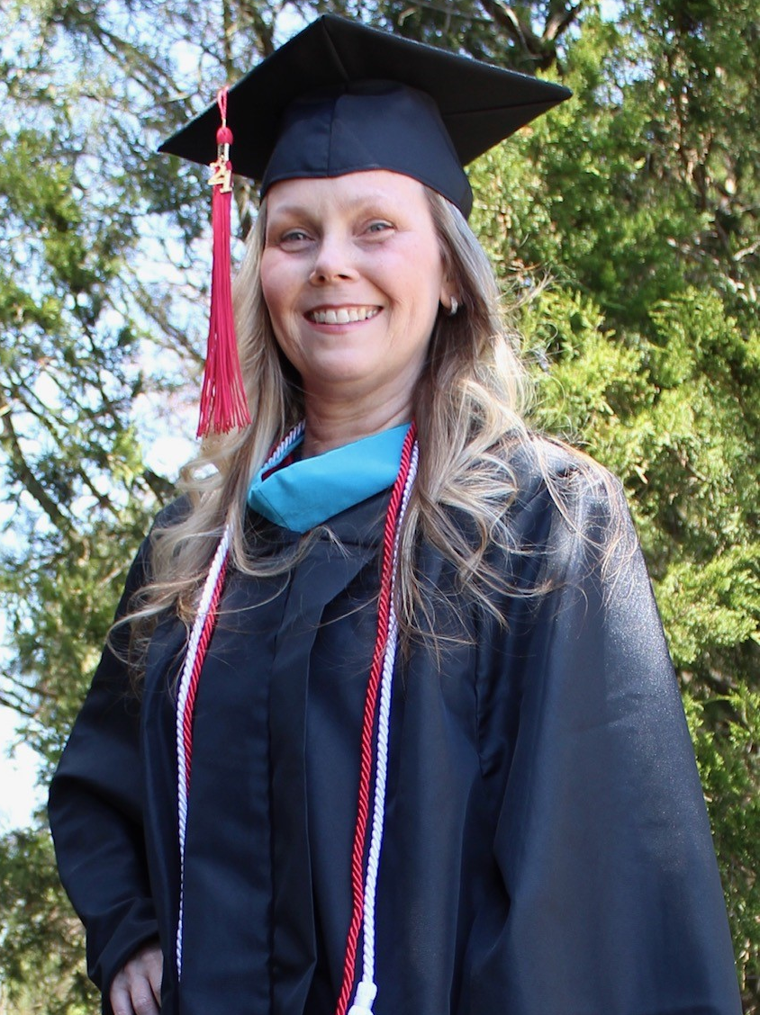
Renee Purdy
Outstanding Student pursuing the Social Responsibility and Sustainable Communities Master of Arts Award

Slide 28
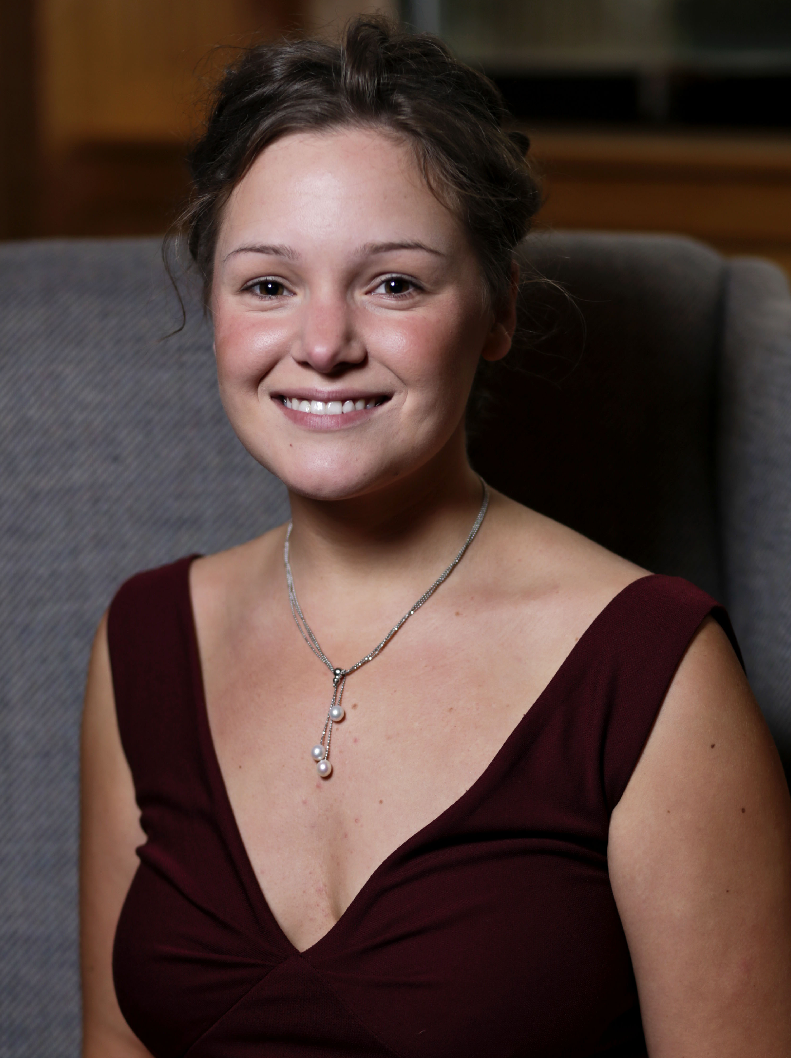
Ella Corder
Outstanding Graduating Student
in Creative Writing
1st place, Mary Ellen and Jim Wayne Miller Writing Contest
Sigma Tau Delta
Conference participant

Slide 29
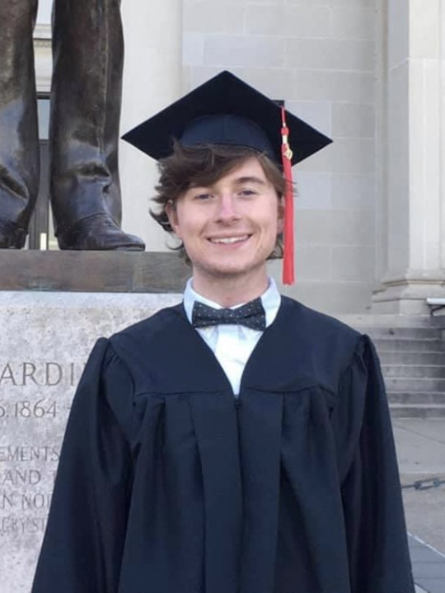
Carder Venable
Outstanding Graduating Student in English for Secondary Teachers

Slide 30
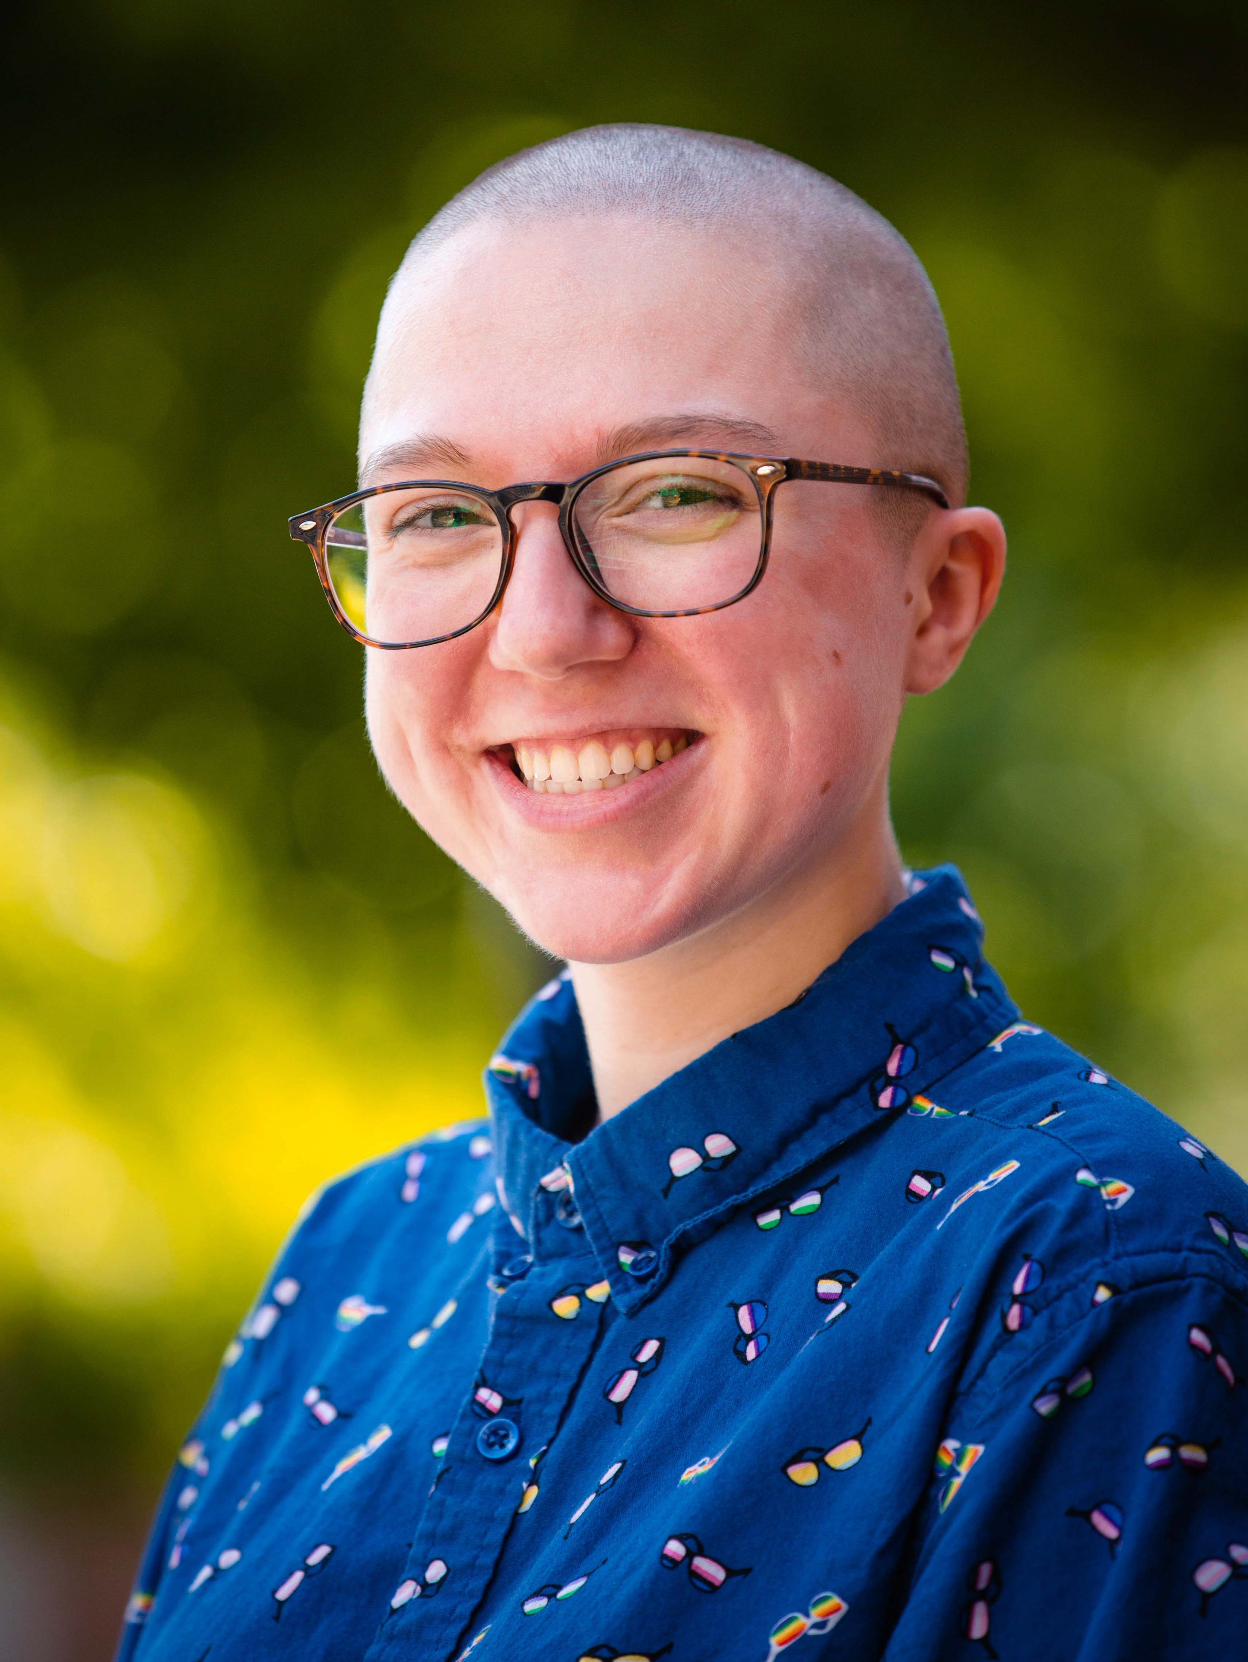
Max Chambers
Outstanding Graduating Student in Professional Writing

Slide 31
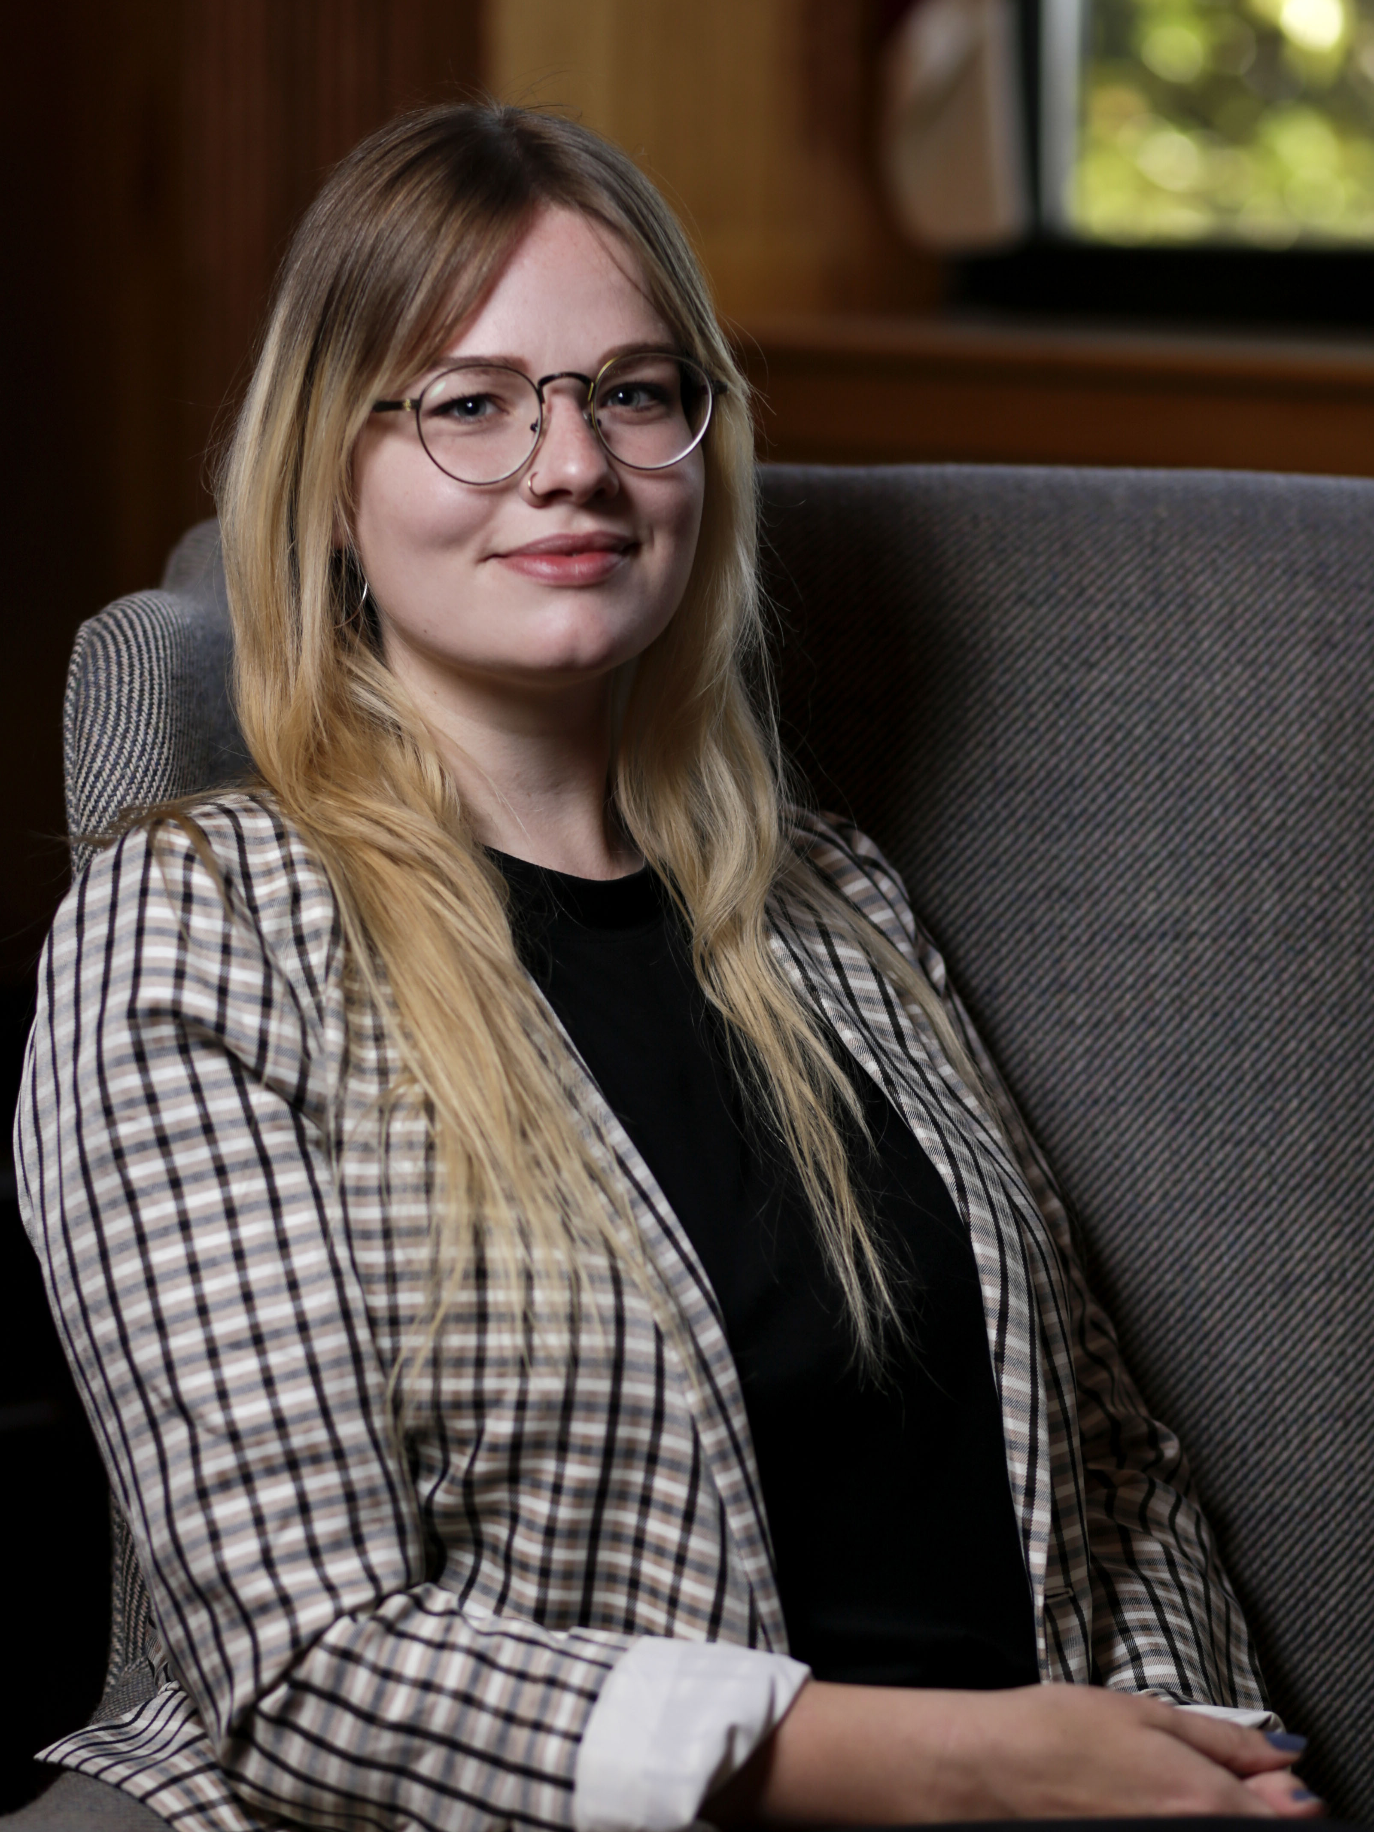
Emily Snyder
Outstanding Graduating Student
in Literature

Slide 32
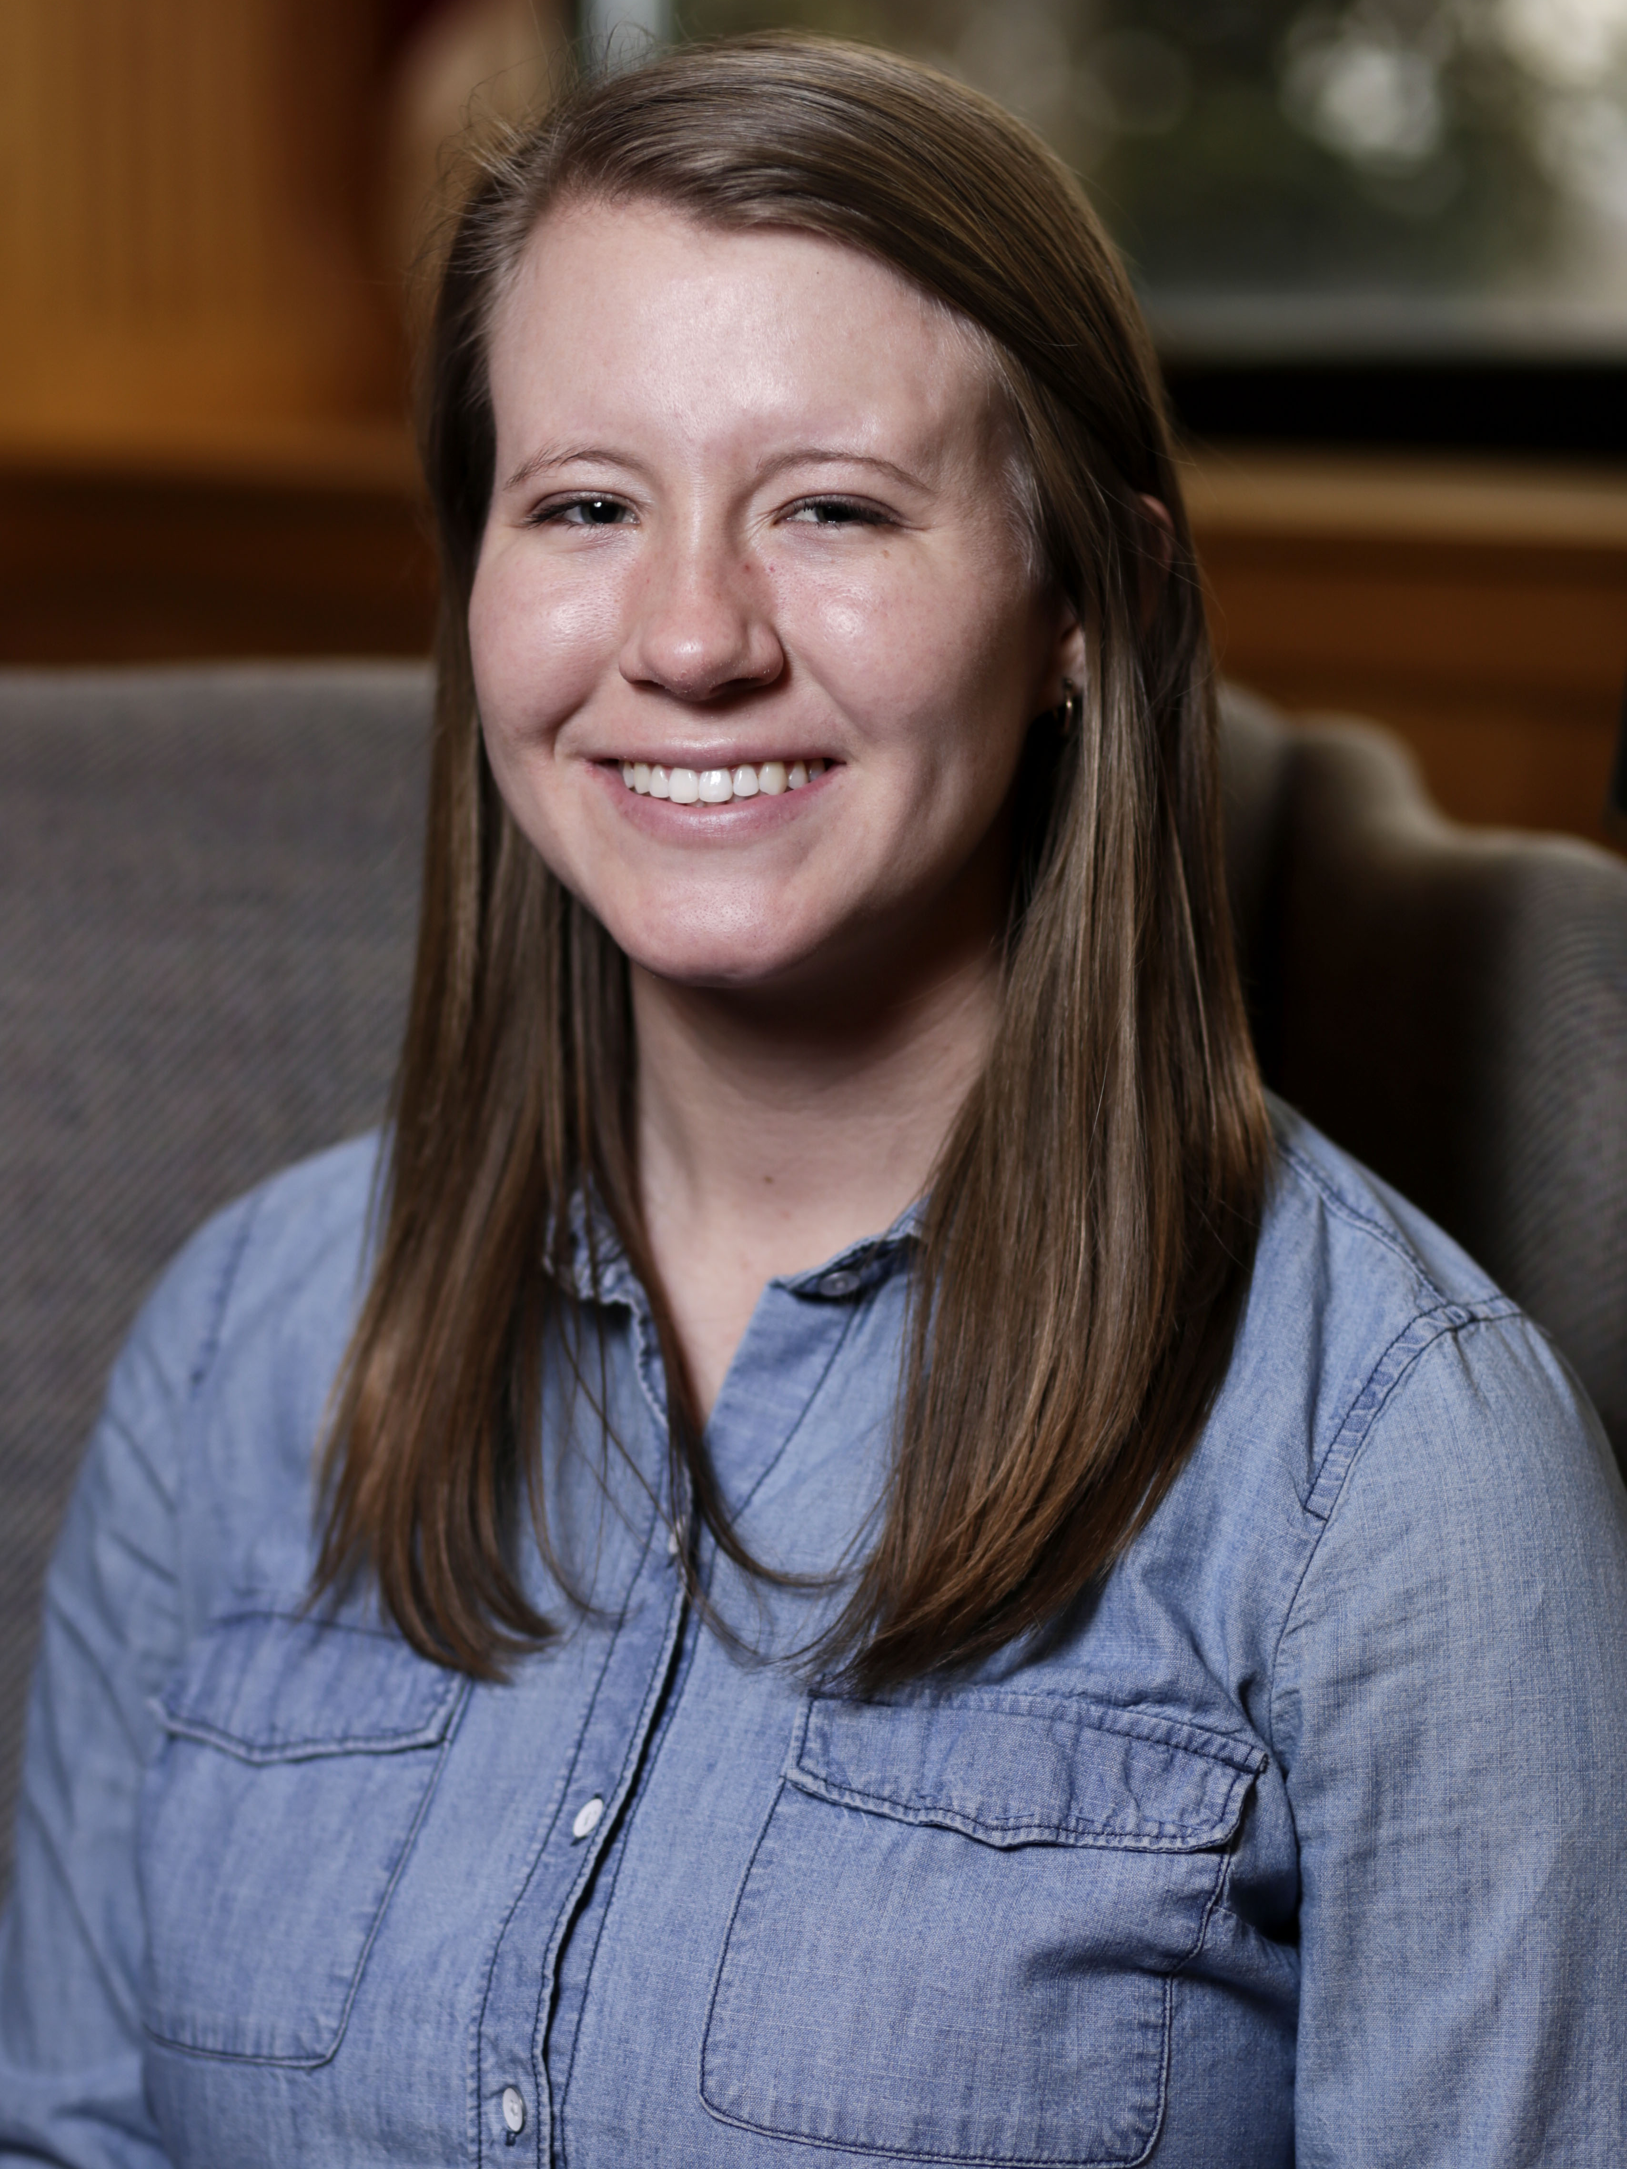
Lillian Golden
Outstanding Graduating Student with a minor in TESOL

Slide 33
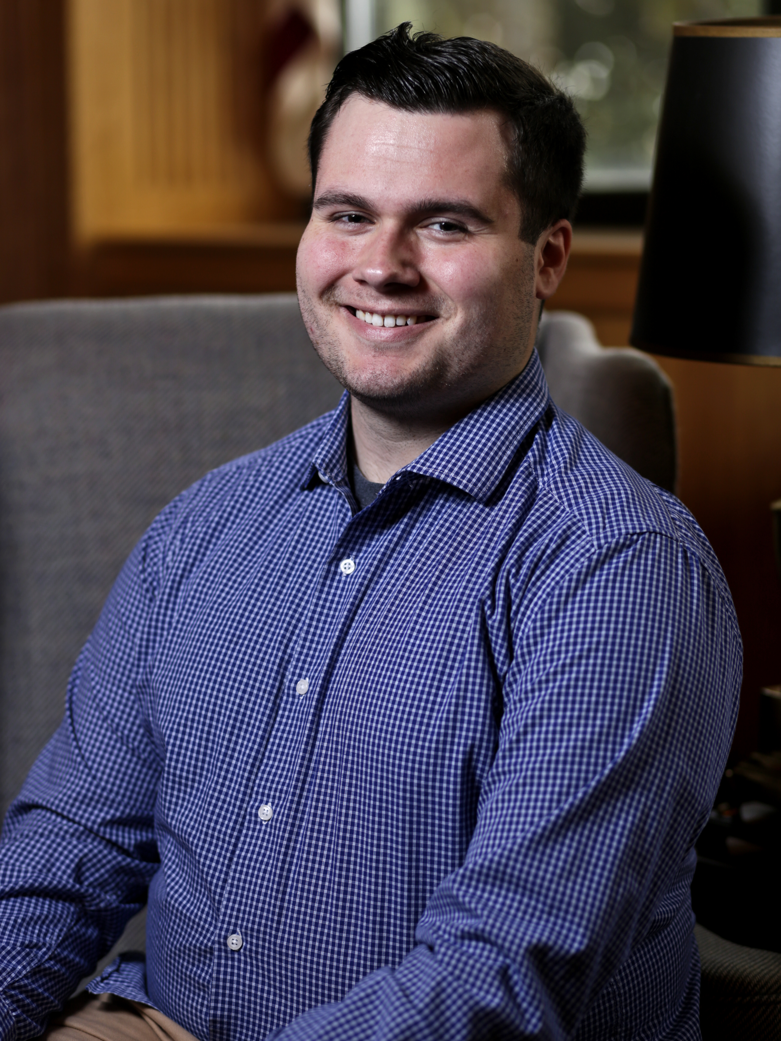
Cameron Fontes
Outstanding Graduating Student in the Film Studies Minor

Slide 34
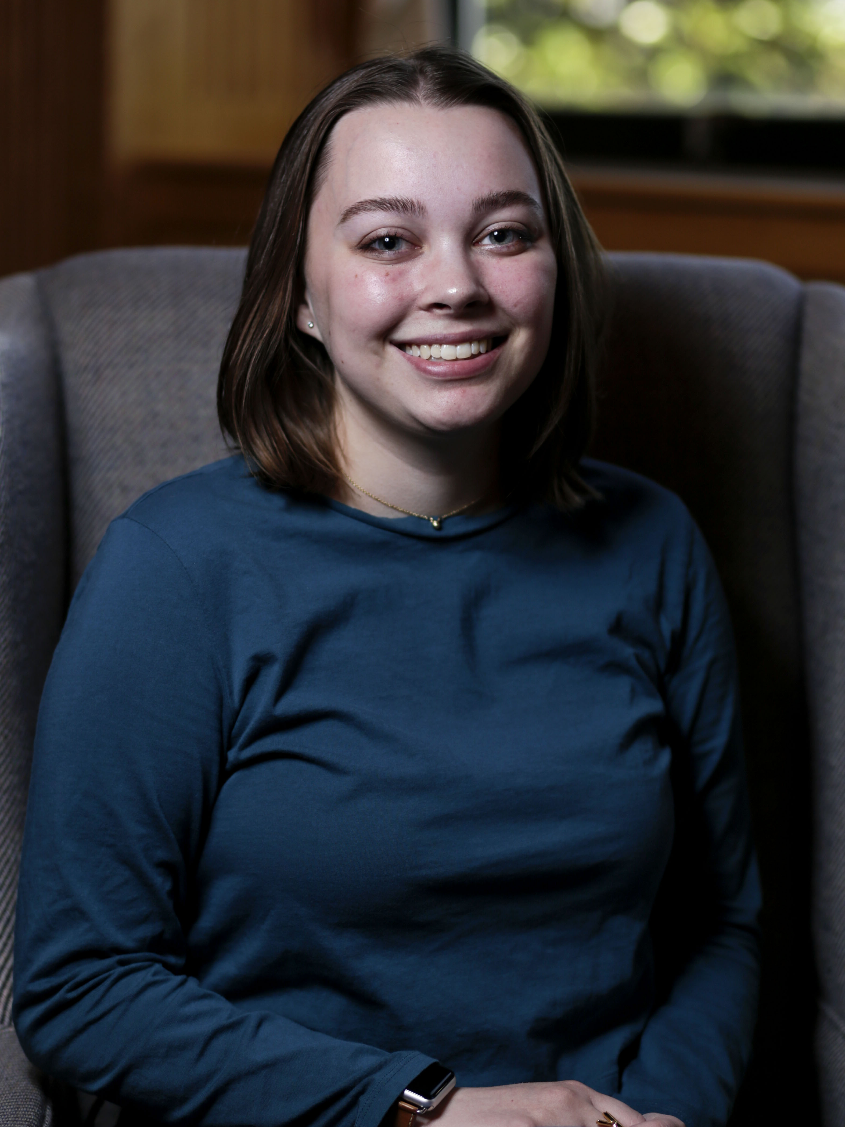
Katie Doll
Outstanding Graduating Student in the Film Studies Minor

Slide 35
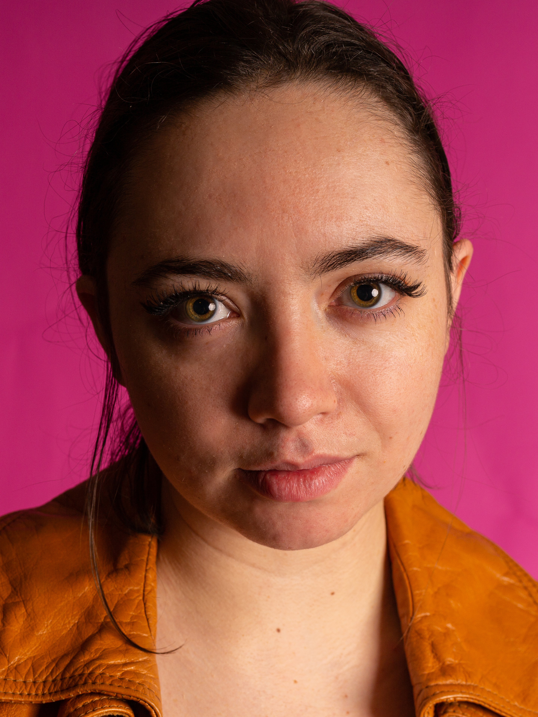
Abigail Raley
Outstanding Graduating Student in the Gender & Women’s Studies Minor
2nd place, Annual Conference on Literature, Language, and Culture
3rd place, GWS Writing Contest

Slide 36
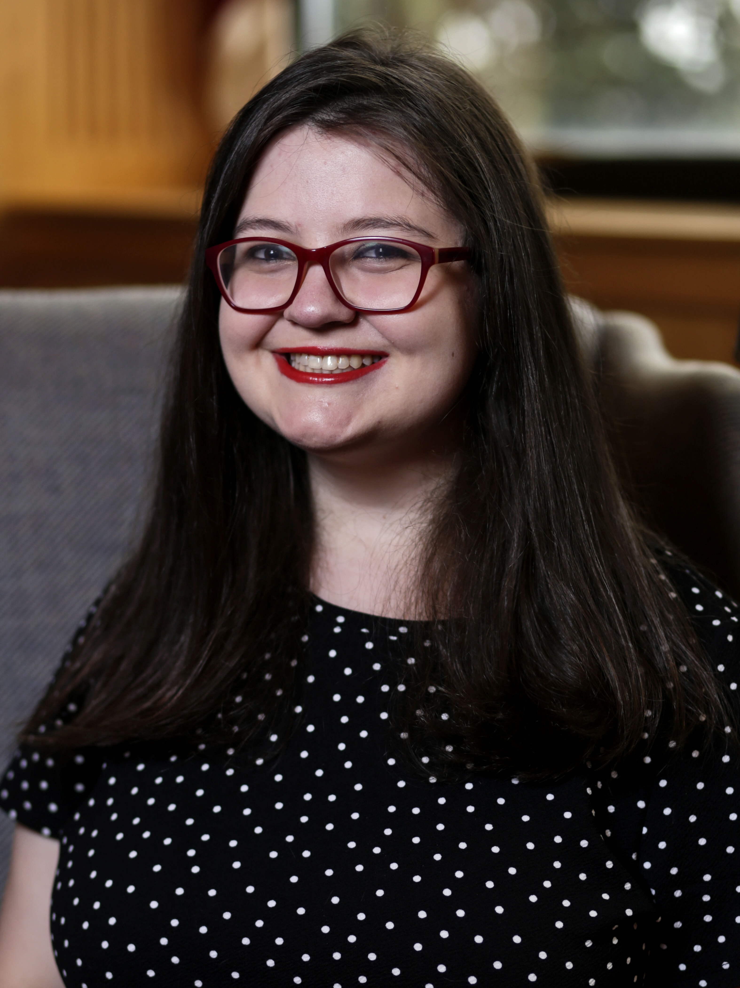
Adrianna Waters
Outstanding Graduating
English Major
Sigma Tau Delta
Conference participant

Slide 37
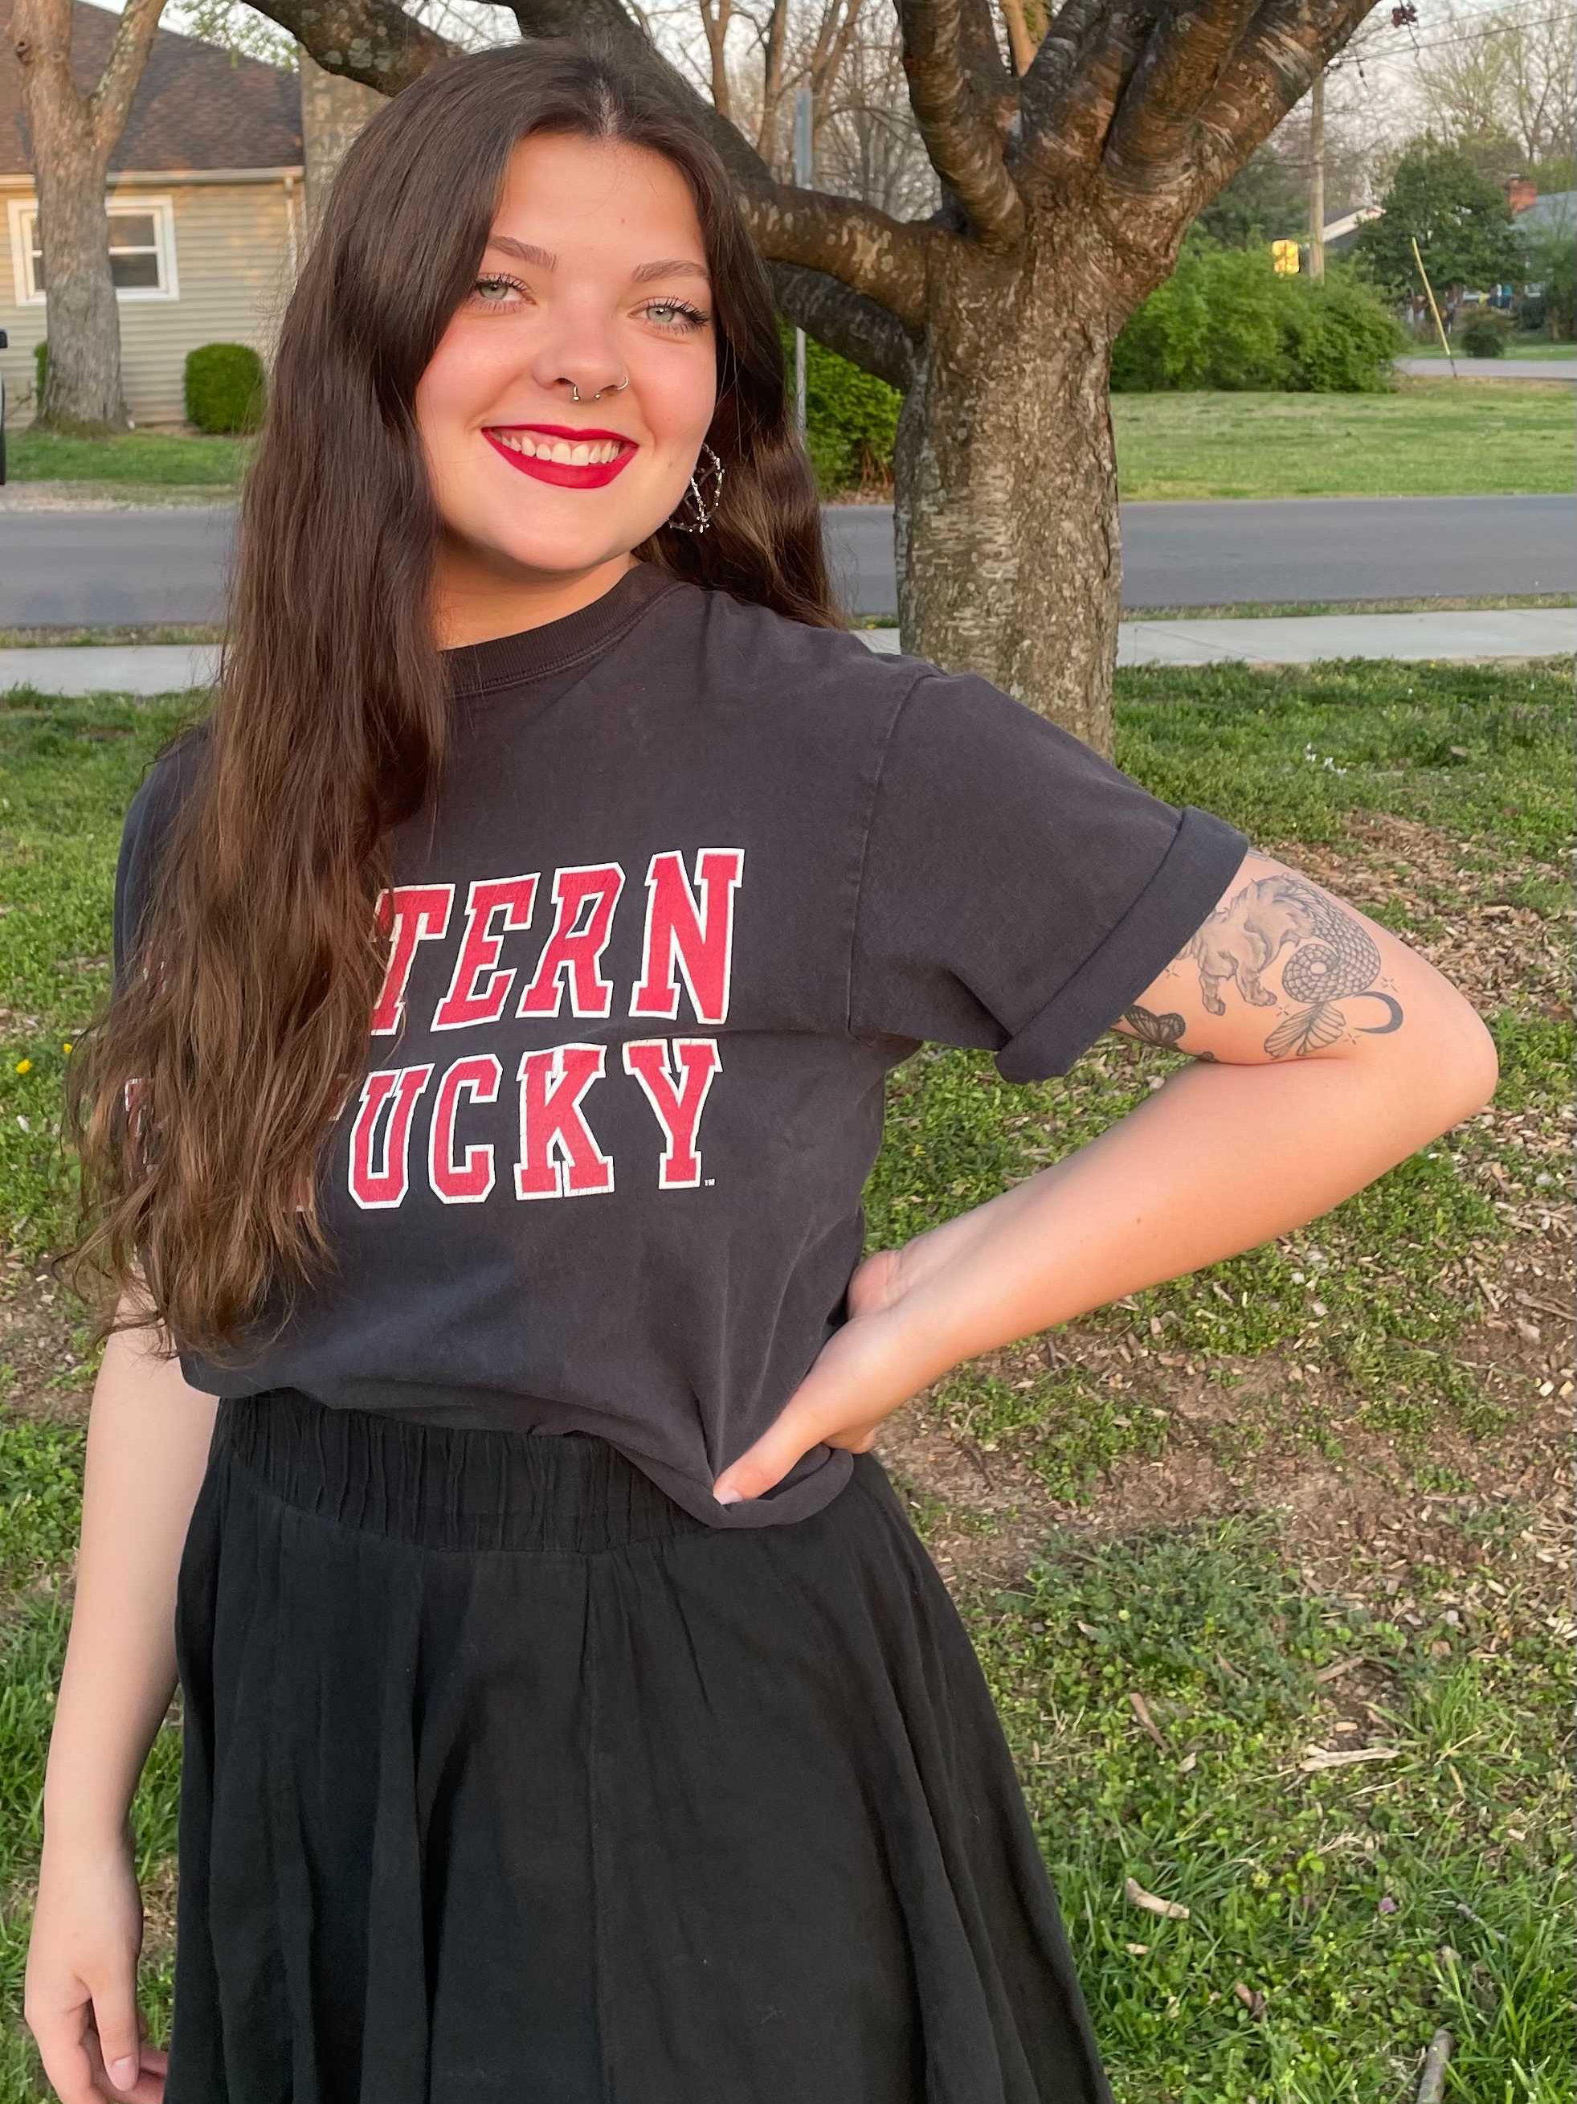
Bailey Cooke
Spirit of the Phoenix Award
The Gail and Amber Martin 2021 Learning Assistance Scholarship

Slide 38
Caitlyn Woitena
1st place, Annual Conference on Literature, Language, and Culture

Slide 39
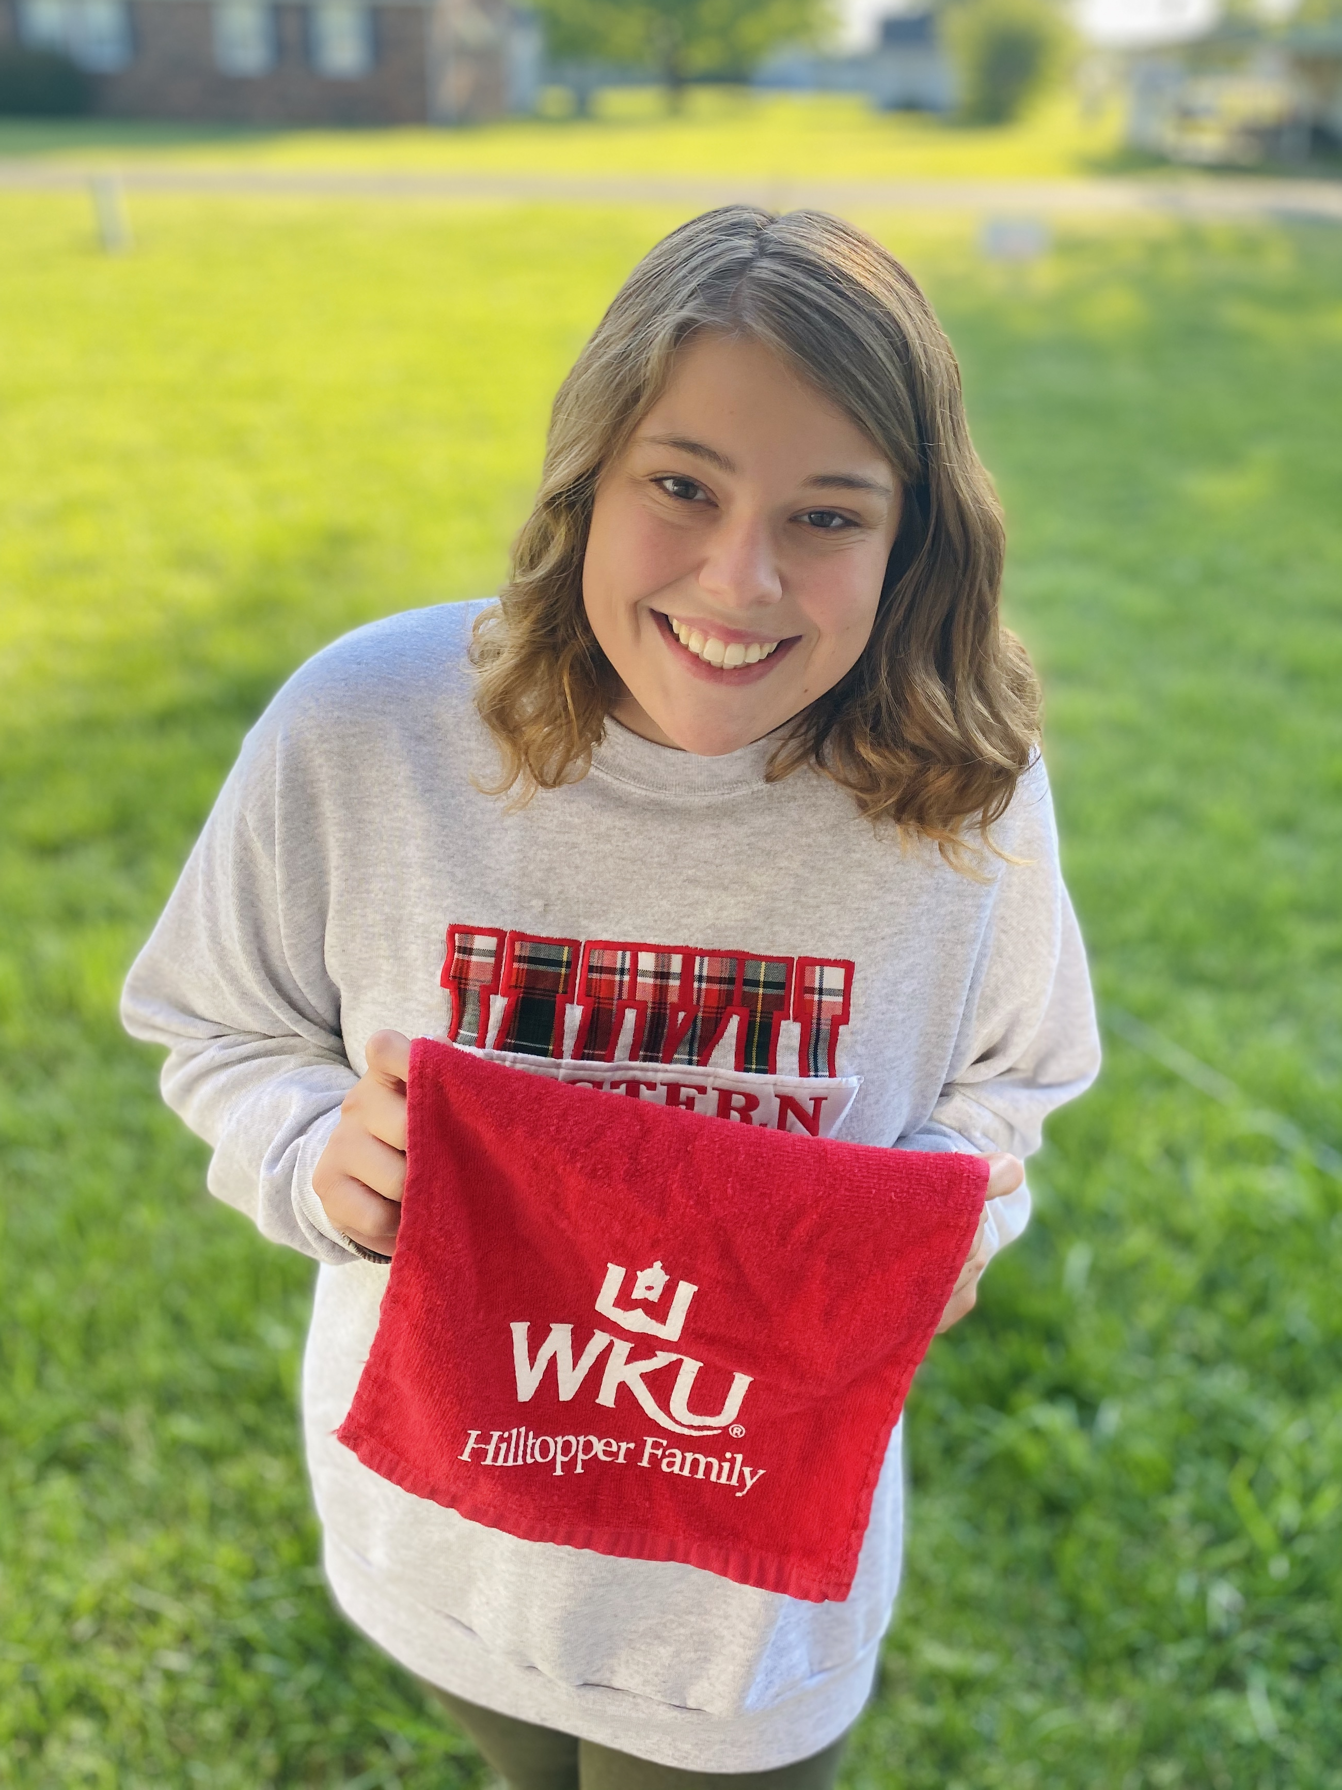
Hanna Van Winkle
3rd place, Annual Conference on Literature, Language, and Culture

Slide 40
Eli Edens
2nd place, Mary Ellen and Jim Wayne Miller Celebration of Writing

Slide 41
Maddie Grider
Allan Miller Memorial

Slide 42
Gender & Women’s Studies Department
Awards & Scholarships
Catherine C. Ward
Feminist Action Award
Lauren McClain
Seneca Falls Personal
Empowerment Award
Catherine Sheffield
Gale & Amber Martin Learning Assistance Scholarship
Emma Bell, Bailey Cooke, Ruby Chapdelaine,
Natalie Crane, Madysin Morris, Hope Wells
Esther Fund
Graduate Scholarship
Carol Clyde Gallagher
Valerie Scott
Undergraduate Scholarship
Sam Mallon
Catherine C. Ward Undergraduate Scholarship
Emma Bell

Slide 43
Gender & Women’s Studies Writing Contest
Undergraduate
1st place—Tonnie Marin
“untitled”
2nd place—Summer Gary
“It’s Just Politics”
3rd place—Abigail Raley
“The Fly”
Graduate
1st place—Larissa Haynes
“Triptych”
2nd place—Ian Haver
“Melancholy Nights”
3rd place—Sarah Olive
“Women’s History Month”

Slide 44
Goldenrod Poetry Festival Winners
1st place—Kayla Spears
“I See Myself in Everything”
2nd place—Noah Powers
“The Spaceman is All Alone on the Moon”
3rd place—Adam Woodward
“For Papa”
Honorable mention—Kaity Kot
“How Many Times Have People Used a Pen or Paintbrush Because They Couldn’t Pull the Trigger?”

Slide 45
Zephyrus Winners
Jim Wayne and Mary Ellen Miller Poetry Award
Abigail Raley, “Aberdeen”
Browning Literary Club Poetry Award
Gabby Wilson, “Afterlife”
Ann Travelstead Fiction Award of the Ladies Literary Club
Arivumani Srivastava, “Kumbh”
Wanda Gatlin Essay Award
Kayla Spears, “Good Sister Bad Sister Flickers Joy”
Zephyrus Art Award
Kendall Gott, untitled

Slide 46
Ashen Egg Contributors
Ella Corder
“Plot (V.)”
Katie Doll
“Power And Vulnerability In Fictional Languages: Linguistic Injury In Game Of Thrones”
Sarah Lyons
“The Dr. Jekyll And Mr. Hyde Annual Conference Of Duality Overview: Questions Of Value, Transformation, Mental Illness, And Origin”
Abigail Raley
“Absorbing The Blows: Embodied Racism In Ernest Gaines’s A Lesson Before Dying”
Joseph Shoulders
“The Gender Identity Defined By A Name In Silence”
Caitlyn Woitena
“Are We At War With Covid-19?”
Abigail Raley
“’Get The Tables’: A Metatheatrical Analysis Of Professional Wrestling”
Hanna Van Winkle
“Nonstandard Varieties Of English”

