Slide 1
Digitally Accessible Communication Strategies
A guide by the Office of Institutional Equity (OIE)
Notes:
Hi I am Chantel Wilson, Institutional Equity Specialist and ADA Coordinator. My role at WKU is to facilitate employee requests for workplace accommodations, ensure WKU complies with the Americans with Disabilities Act (ADA) by overseeing accessibility and resolving disability-related complaints, and provide training to employees on ADA requirements, like this one with the aim to make services and facilities accessible to individuals with disabilities.
Welcome to Digitally Accessible Communication Strategies. The ADA mandates that digital communications be accessible to individuals with disabilities. This session will help you ensure your digital content complies with ADA requirements. We will explore effective strategies for creating digitally accessible communications, engage in interactive discussions, and give you an opportunity to demonstrate your understanding of some of the key principles and tools for accessibility we cover.

Slide 2

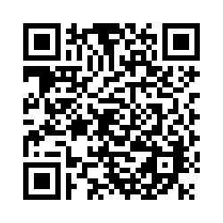
Record of Attendance.
Notes:
If you want to record your attendance for my records, you can take out your phone, open the camera, and scan the QR code to. By the end of this session, you should be able to enhance your digital communications, and help ensure they are accessible to all users, including those with disabilities.
I want to note that discussing disabilities is complex and ensuring content accessibility is an ongoing learning process. We will not be experts at the end of this session, but we will be able to be mindful of our communication and begin to think is this accessible based on what I know now? We will be more open to fixing our content when someone let’s us know it isn’t accessible. And if we can’t fix it, we will know to ask IT for help.

Slide 3
What is Electronic Communication?
The transfer of knowledge, ideas, data, or messages via digital means is referred to as electronic communication or digital communication. Electronic communication includes a broad range of methods, such as email, instant messaging, text messaging, online chat rooms and forums, social media platforms like X formerly Twitter, Facebook, SnapChat, and video conferencing tools like Zoom.
Notes:
Electronic communication refers to the exchange of information, messages, or data through electronic devices such as computers, smartphones, tablets, and other digital platforms. This form of communication allows individuals, businesses, and organizations to connect, share ideas, collaborate, and communicate effectively, regardless of geographical distances. Electronic communication has revolutionized the way we interact, making it faster and more convenient to connect with others.
Some common types of electronic communication include:
Email: Sending and receiving messages electronically.
Instant Messaging: Real-time text, voice, and video communication.
Video Conferencing: Face-to-face meetings through video and audio connections.
Social Media: Platforms like Facebook, Twitter, and LinkedIn for sharing updates and engaging in conversations

Slide 4
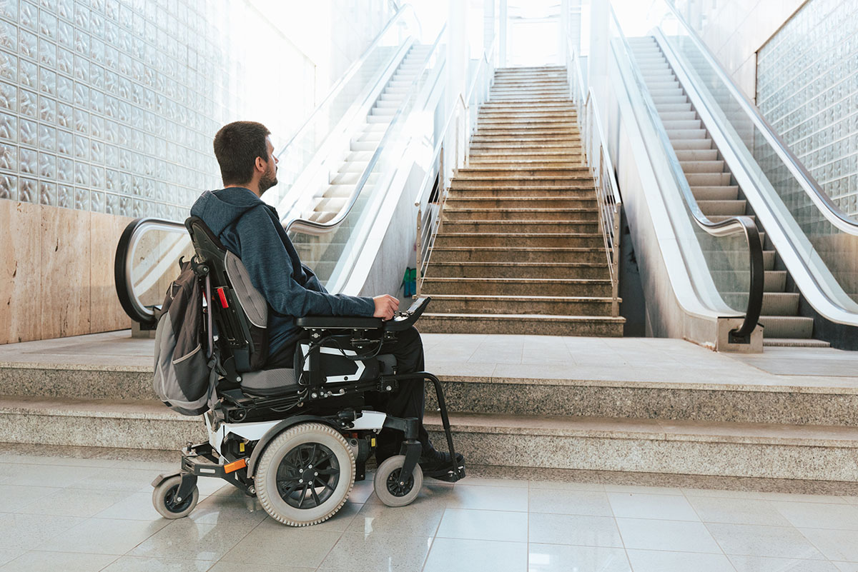
What is Electronic Accessibility?
Electronic accessibility is about reducing the barriers that exist in the electronic environment.
Notes:
Electronic accessibility, ensures that digital content, resources, and technologies are usable by everyone, including people with disabilities. The ADA defines a person with a disability as a person who has a physical or mental impairment that substantially limits one or more major life activity. Major life activities including, thinking, concentrating, walking, seeing, learning, sleeping, basically the functions most important to daily life.
Removing electronic barriers involves designing websites, tools, and technologies to be accessible through various assistive technologies, such as screen readers for the visually impaired or captioning for the hearing impaired.

Slide 5
Barriers to Accessibility:
Visual Impairments – Screen readers, read electronic content aloud for people who have low or no vision including alt text and audio descriptions.
Hearing Impairments – Need captioning and subtitles for sound
Physical Disabilities – Such as navigating via the keyboard without using a mouse
Cognitive Disabilities – Plain language that is easy to read and understand
Machine Impairments – Search Engine Optimization (SEO), Artificial Intelligence (AI) Ingesting
Notes:
Barriers to accessibility include:
Visual impairments such as individuals who are blind, color blind, or have low vison. These individuals would use screenreaders, and to address barriers for those with colorblindness, it is important to pay attention to color contrast and using color to convey meaning.
Hearing impairments for example those that are deaf or hard of hearing. They may require captions and subtitles for audio.
Physical disabilities that impact motor function and require the use of the keyboard to navigate instead of the mouse.
Cognitive disabilities also impact accessibility. Individuals with learning disabilities for example would need websites, emails, etc. to use plain language instead of jargon and complex terms and difficult sentence structure.
Machine Impairments-Here are some strategies to ensure your website is accessible to all users while also being SEO-friendly and AI-compatible:
1. Semantic HTML-Use Proper Tags: Use semantic HTML tags like <header>, <nav>, <main>, <article>, and <footer>. These tags improve SEO by making it easier for search engines to index your site.
2. Alt Text for Images-Provide descriptive alt text for all images. This helps improves your SEO by allowing search engines to index the images.
3. Keyboard Navigation
Ensure Full Keyboard Access: Make sure all interactive elements (like links, buttons, and forms) are accessible via keyboard also helps search engine crawlers navigate your site.
4. Responsive Design
Mobile-Friendly Layout: Use responsive design techniques to ensure your website works well on all devices, this boosts your SEO ranking, as search engines prioritize mobile-friendly sites..
5. Multimedia Accessibility
Provide Transcripts and Captions allows search engines to index the multimedia content.
By following these strategies, you can create a website that is accessible to all users, optimized for search engines, and compatible with AI technologies.

Slide 6
Web Content Accessibility Guidelines (WCAG) 2.1 Level AA
Four “P O U R” Principles
Perceivable
Operable
Understandable
Robust
Perceivable through senses regarding captioning for audio, color contrast, etc.
Operable with assistive technology using only the keyboard, no flashing or transitioning.
Understandable in terms of content and predictable on how to operate the site.
Robust, accessible using a variety of technologies and as technology improves.
The W3C Web Accessibility Initiative (WAI) develops standards and support materials to help you understand and implement accessibility; https://www.w3.org/wai
Notes:
The Web Content Accessibility Guidelines (WCAG) are a set of international standards developed by the World Wide Web Consortium (W3C) to make web content more accessible to people with disabilities. These guidelines cover a wide range of recommendations for making web content more perceivable, operable, understandable, and robust.
Perceivable means that information must be presentable to users in ways they can perceive. For example, text descriptions for images, so screen readers can describe the images to visually impaired users. Adding captions to videos and transcripts to audio content to make them accessible to users who are deaf or hard of hearing. Ensuring sufficient contrast between text and background colors to make content readable for users with visual impairments.
Operable: Information and navigation must be operable. This includes ensuring that all functionality is available from a keyboard. Next time you’re reading something electronic, try tabbing instead of using your mouse to navigate. Ensuring that content does not flash more than three times per second to prevent seizures in users with photosensitive epilepsy.
Understandable: Information and operation must be understandable. This means making text readable and predictable. Using simple and clear language, avoiding jargon, and providing explanations for complex terms.
Robust: Content must be robust enough to be interpreted reliably by a wide variety of technology, including assistive technologies like screenreaders. Essentially, it means the code is well-structured and free from errors to function properly across various platforms and accessibility tools.

Slide 7

Reasons to Care
It’s the LAW!
It’s a Civil Right!
Title II of The Americans with Disabilities Act (ADA): Requires Digital Accessibility to State and Local Government Organizations (Section 508).
Section 508 of the Rehabilitation Act (29 U.S.C. 794d), as amended in 1998, is a federal law that requires agencies to provide individuals with disabilities equal access to electronic information and data comparable to those who do not have disabilities.
U.S. Department of Justice (DOJ)
Guidance for Web Accessibility and ADA
Rule on Accessibility of Web Content and Mobile Apps Provided by State and Local Governments
Disability impacts ALL of us – (ex. Aging, Injury, etc.)
Saves money and time – Lawsuits are costly, and content still has to be made accessible!
Search Engine Optimization (SEO), Artificial Intelligence (AI)
Notes:
Why should you care about creating accessible electronic communication? Yes, it is the law, and it is a civil right, meaning people have a legal right to be able to access things electronically. Whether you care or not about following the law, avoiding lawsuits, or other people, the Americans with Disabilities Act (ADA) ensures equal access and opportunities for people with disabilities. Americans with Disabilities Act (ADA) is a civil rights law that prevents discrimination against people with disabilities. It is enforced by the US Department of Justice Civil Rights Division signed into law by President George H. W. Bush on July 26, 1990. The ADA focuses on promoting accessibility in public spaces, workplaces, and digital platforms, the ADA helps create an inclusive society where everyone can participate fully. Compliance enhances the user experience for everyone. At some point in time, barriers will impact us all, as we age and our eyesight suffers or our hearing, for example. We all benefit from accessible design.

Slide 8
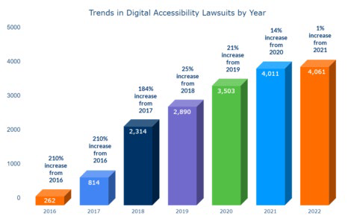
Notes:
Compliance with the ADA also avoids legal risks. Compliance saves money and time – Lawsuits are costly, and the electronic content still has to be made accessible!
There has been a 210% increase in digital accessibility lawsuits since 2016 that can be attributed to several key factors:
Increased awareness and advocacy about digital accessibility rights among people with disabilities and advocacy groups, leading to more individuals taking legal action.
Legal precedents: High-profile cases, such as Robles v. Domino's Pizza, have set important legal precedents, reinforcing that websites and digital platforms must comply with the ADA.
Growth of e-commerce: The rapid expansion of e-commerce has highlighted accessibility issues, as more people rely on online services for shopping and other activities.
Regulatory guidance: The U.S. Department of Justice has reiterated that the ADA applies to websites, even though specific guidelines for digital accessibility are still evolving.
These factors combined have driven the substantial increase in lawsuits, emphasizing the need for us to prioritize digital accessibility.

Slide 9
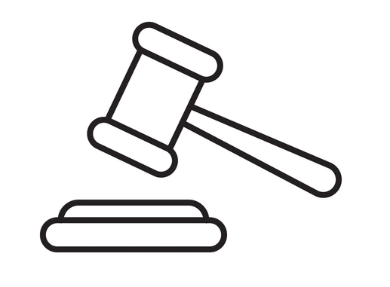
4, 605 digital accessibility lawsuits filed in 2023.
Notes:
In 2023, a record 4,605 digital accessibility lawsuits were filed, marking a 13% increase from the previous year. These lawsuits highlight the growing importance of ensuring websites and digital platforms are accessible to all users.
The main reason for the surge in digital accessibility lawsuits in 2023: Non-compliance with ADA standards: Many websites and digital platforms fail to meet the Web Content Accessibility Guidelines (WCAG), making them inaccessible to people with disabilities.
To avoid digital accessibility lawsuits, businesses can take several proactive steps:
Ensure ADA compliance: Make sure your website and digital platforms comply with the Americans with Disabilities Act (ADA) by following the Web Content Accessibility Guidelines (WCAG).
Conduct regular audits: Regularly audit your website for accessibility issues and address them promptly1
Integrate accessibility from the start: Incorporate accessibility into the design and development process from the beginning to avoid costly fixes later
Provide training: Offer accessibility training for your team to ensure everyone understands and can implement best practices

Slide 10
Basic Digital Access in Action: Checkpoints • Writing • Structure • Color • Media • Links
Notes:
Now that you understand electronic accessibility, let’s dive deeper into how you can put some basic digital accessibility checkpoints into action.

Slide 11
Writing: Content and Language
Keep it short and simple (K.I.S.S. Principle)
Use plain language that is easy to read
Acronyms and Abbreviations: spell out first use
Phone numbers: avoid periods – use dashes!
(A period is math and considered a decimal.)
Check spelling and readability (built-in, free tools) and a second set of eyes!
Be respectful and inclusive
Notes:
The first basic digital access point we will cover is writing, which includes content and language. The KISS principle suggests that systems and designs should be as straightforward as possible to ensure ease of use. The idea is that by avoiding unnecessary complexity, you can create more efficient, user-friendly electronic communication.
Inclusive language takes self-checking and education. But it’s important to start now and to make it a part of your everyday process.
Here are a few ways to start using more inclusive language:
Avoid bias in your writing. For example, using the word “normal” puts one group in “the norm.”
Use people-first language. For example, saying “a person with a disability” vs “a disabled person.”
Keep an eye out for offensive language. Language is ever-evolving. Keep an eye out for now-outdated phrases, sayings or references, and cultural appropriation in your language.
Keep learning. Language is constantly evolving, and we are constantly learning. Be curious about others and educate yourself on preferred terms.
When in doubt, ask. Preferred terms even differ within groups and over time. Rather than assuming things like pronouns or preferred terms, when in doubt, respectfully ask.

Slide 12
Writing: Font and Format
Limit: all caps “shouting”, italics, and scripts (decreases readability, and with a screen reader, all caps is read letter-by-letter.)
Size minimums:
Body Text: 12 pt
Footer: 9 pt
PowerPoint: 24 pt
Large Print: 18 pt
Line Spacing: 1.15 to 2
Font:
Serif: easily read on paper (Times New Roman)
Sans-serif: (easily read digitally ex. Helvetica)
Consider L I 1, in some fonts they all look the same!
Notes:
Continuing with the topic of writing, and its impact on accessibility. Ensuring font, size, and spacing are accessible is crucial for creating inclusive digital content. Here are some best practices:
Font Size: The recommended minimum font size is 12-14 points for body text to ensure readability. Users should also be able to resize or zoom in up to 200% without losing content or functionality.
Spacing:
Line spacing should be at least 1.5 times the font size to improve readability.
Paragraph Spacing at least 2 times the font size to separate blocks of text clearly.
Letter Spacing should be at least 0.12 times the font size and word spacing at least 0.16 times the font size to prevent text from appearing cramped.
Font Choice: Use sans-serif fonts like Arial or Helvetica that are generally easier to read on screens. Avoid decorative or script fonts that can be difficult for users with visual impairments.

Slide 13
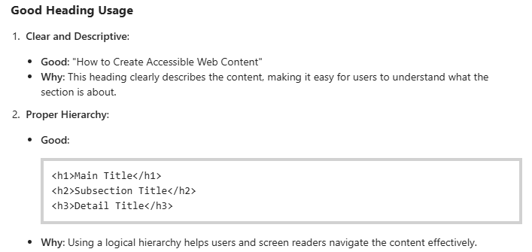
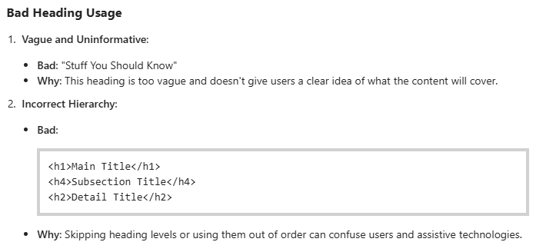
Structure: Headings
Required – Heading Level 1 to 6.
Use in order!
Length Maximum: 60-80 characters
Format in Styles pane
Use Lists – Don’t type dashes or astericksaple: Icons for Lists (numbered, bulleted) in toolbar of Microsoft Word.
Notes:
Headings play a crucial role in digital accessibility by providing structure and organization to content. They help all users, including those with disabilities, to navigate and understand the hierarchy of information on a webpage or document. Here are some key points about headings in accessibility:
Semantic Structure: Properly using heading tags (e.g., <h1> to <h6>) creates a clear, logical structure that assistive technologies, like screen readers, can interpret. This allows users to quickly jump between sections and understand the content's organization.
Descriptive Headings: Headings should be clear and descriptive, indicating the topic or purpose of the section they introduce. This helps users, especially those with cognitive or visual disabilities, to find and comprehend the information they need.
Consistent Use: Maintain a consistent heading structure throughout your content. For example, use <h1> for the main title, <h2> for major sections, and so on. Avoid skipping heading levels, as this can confuse users and assistive technologies.

Slide 14
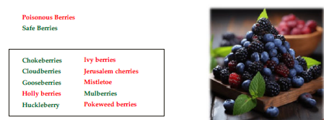
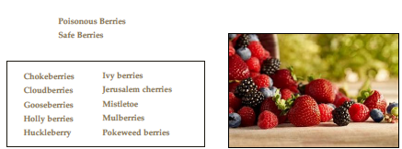
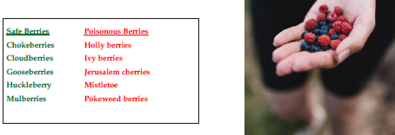
Color
Don’t rely on different colors to convey meaning.
This may exclude those who are colorblind and may be impacted by cultural differences.
Check that color alone is not required to understand.
Notes:
Next, let’s talk about color in relation to accessibility.
Relying solely on color to convey meaning can create accessibility issues for several reasons:
Due to Color Vision Deficiencies, people with color blindness or other vision impairments may not be able to distinguish between certain colors, making it difficult for them to understand the information.
Screen Readers do not interpret colors, so any information conveyed only through color will be missed.
As we see in the list of poisonous berries versus safe berries, we can use color to convey information, but it does not need to be the only way we convey the information. See how the last list uses color but by separating the lists communicates the information regardless of the ability to see red and green.
Taking into account Cultural Differences is also important. Colors can have different meanings in different cultures, potentially leading to misunderstandings. Perceptions of color are not universal. For example, in Western cultures, white often symbolizes purity and weddings, while in some Eastern cultures, it represents mourning and funerals. Similarly, red can signify love in many Western contexts, but it is associated with luck and prosperity in China. Where American brides are more apt to wear white gowns at their weddings, Chinese brides prefer red.
To ensure accessibility, it's important to use additional indicators like text labels, patterns, or shapes alongside color. This approach helps make content understandable for everyone, regardless of their visual abilities or cultural background.

Slide 15
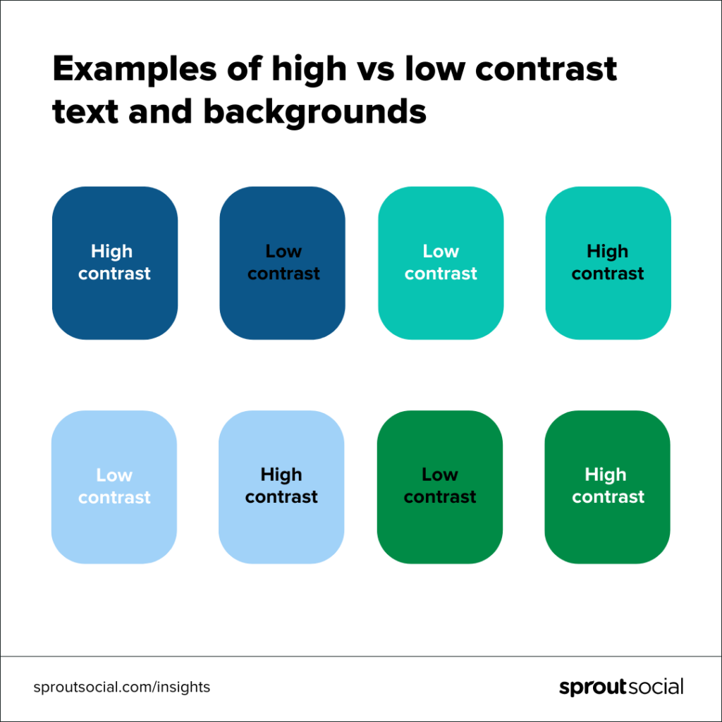
Color Contrast
Create visuals with high contrast
High contrast makes graphics easier to interpret
Ensuring the colors in your graphics have a 4.5:1 contrast will help make the text on your graphics visible to everyone.
Notes:
Still on the topic of color,
Color contrast plays a significant role in text readability, particularly for users with visual impairments or color blindness. Following the WCAG-recommended contrast ratios between text and background ensures that content is legible for everyone. For instance, a contrast ratio of at least 4.5:1 is required for normal text. Online tools can help verify whether your color schemes meet these contrast standards, which is essential for maintaining accessibility.
Note that black font on a dark blue background has a low contrast and is more difficult to see versus white font on a dark blue background that has a higher contrast and is easier to see.

Slide 16
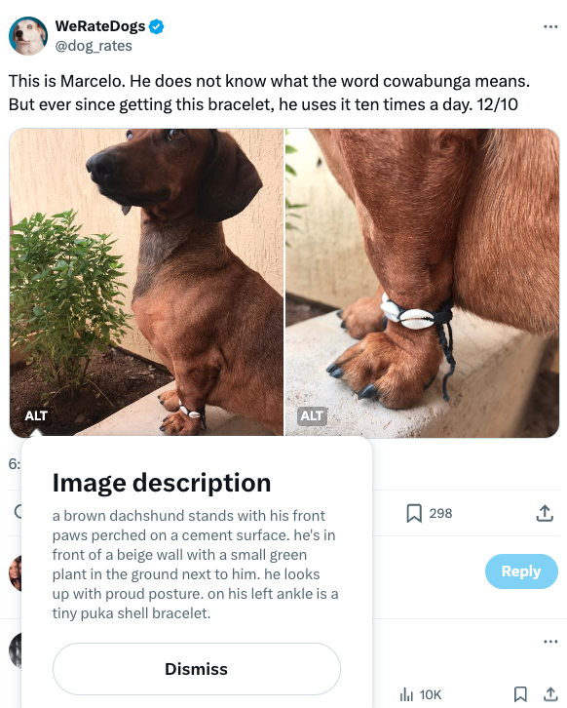
Media: Accessible Images
Alternative text, or “alt text,” is a short yet informative description of an image that screen readers use to describe that image.
When writing alt text, ask yourself, ‘What about my image is vital for someone to know?’
Don’t overthink it. Alt text is subjective. As Alexa put it, “As the content author, you have the power to decide what details are important in not only your image, but your entire post as well.”
Helps Search Engine Optimization (SEO) – Text is readily searched, and images are not.
Notes:
Moving into basic accessibility practices related to media, alt text is your best friend. The goal of alt text and image descriptions is to describe all relevant and important visual information to understand an image. While this information may not be relevant to every single type of image, here are examples of details I include when writing alt text or image descriptions.
The Type of image
Am I looking at a cartoon? A bar chart? A photo?
Who is in the image
If it’s a person with their own Wikipedia page, it’s okay to just write the person’s name at the beginning of the description and if not provide information such as race/ethnicity, gender, hair color, and an optional age/age range. When it comes to animals, write the species name or breed name don’t describe what animals look like because people likely have their own mental image of what a cow looks like, or can look up a description on their own.
Setting of the image
Where is this image being taken? Is it in a kitchen? A concert? Is the subject standing in front of something? Knowing the setting of an image can provide additional context for what is going on.
Color(s)
When describing colors, use shade names such as cobalt blue, periwinkle, burgundy, lime green, metallic gold, or similar names- there’s no need to describe what the color red looks like, but shade names provide more information. However, there’s no need to give shade names for every color in an image if color is not the main focus.
Expression and emotions
How does the subject (or subjects) look in the photo? Do they have a neutral expression? Are they smiling? Or are they looking at the camera in horror as they realized they just tossed a pile of leaves in the air that also had dog poop inside of it? That last description would definitely be relevant visual information to include!
Item locations and descriptions
When writing alt text and image descriptions, it helps to describe item locations from the top down and left to right in reference to the primary subject if there is one. If I took a picture of my computer while it was turned off, I would start by mentioning the monitor is in the center of my desk, along with a keyboard and a purple computer mouse to the right of the keyboard on the desk.
Interesting details
What makes an image unique or interesting to look at? What additional descriptive information can help a user understand what is going on?
Link to data or transcript
For charts, graphs, and data visualizations, as well as web articles, it is helpful to share a link to the original data or content so that readers can get further information. This should be included in the caption or image description do not paste links into alt text; they are not clickable.
Null alt text
For decorative images such as shapes or images that do not provide any meaningful information, you can write “null” instead of leaving alt text blank if an image is for decoration. Leaving alt text blank can make the user wonder if you forgot to write alt text for an image.

Slide 17
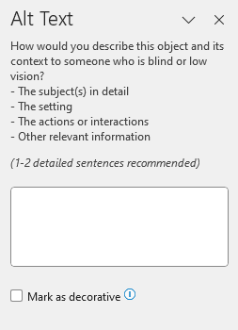
Alt Text: Recap
When describing a picture in English, follow these guidelines:
Start with a general overview, identifying the main subject.
Detail key elements like objects, colors, and people.
Describe the mood, atmosphere, and composition.
Use specific adjectives and, if relevant, similes or metaphors for vivid imagery.
Consider using captions, alt text, or image descriptions for different contexts.
Notes:
As far as Location; Alt text is typically added in the “alt text” box. Image descriptions may be in the image caption or post.
Alt text is usually only visible to screen readers, which read the alt text out loud or display it on a braille display. Image descriptions are “exposed” and can be read by anyone.
Length of text
A picture is worth a thousand words, but Alt text is typically limited to 100-250 characters (screenreaders break off at 125 characters). Image descriptions can be the same length or even longer, since they are included in the photo caption or post.
Level of detail
Image descriptions tend to go more in-depth about visual details than alt text due to the larger character limit. For example, alt text might tell a user there is a puddle on the floor, but an image description might go into further detail and say there is a puddle of orange juice on a white tiled kitchen floor.
Punctuation
Proper punctuation is important. It adds pause for screenreader. Put a period at the end of the alt text.
The goal of alt text and image descriptions is to describe all relevant and important visual information to understand an image.

Slide 18
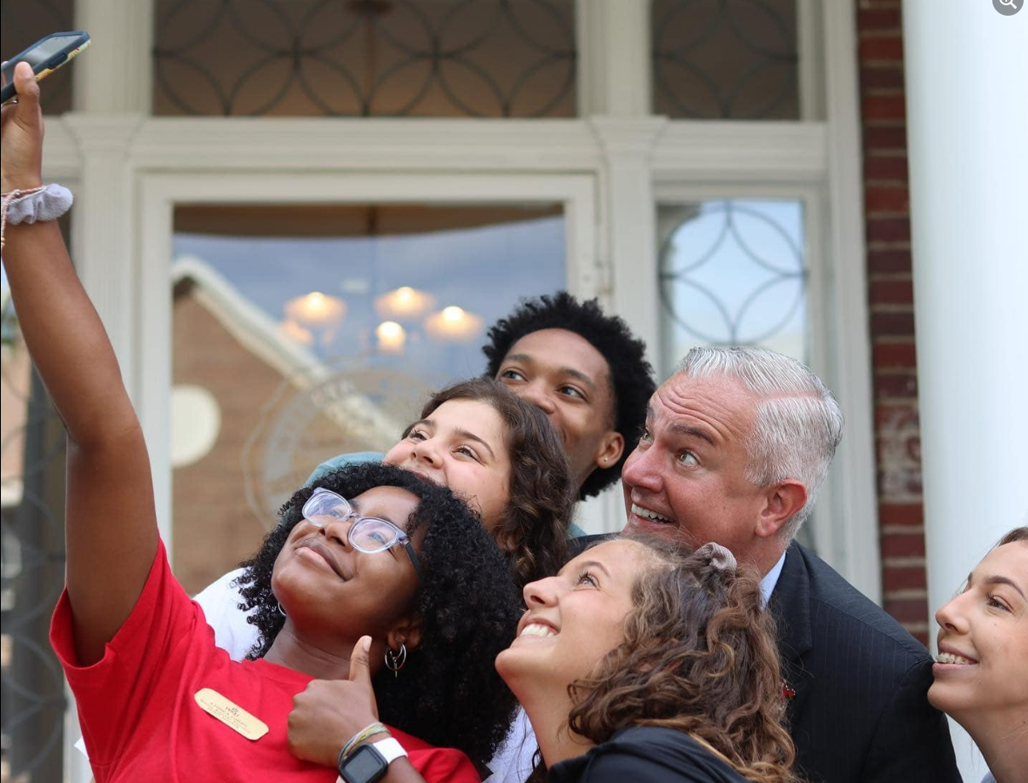
Example of Alt Text
President Timothy Caboni poses for a selfie with five WKU Spirit Masters in front of the Craig Administration Center.
Notes:
Keep it succinct, yet informative. 125 characters limit – 116 used
Doesn’t use “image of” or “picture of.” These are a given.
Includes keywords such as “WKU Spirit Masters” “Timothy Caboni.“ Alt text plays into SEO—include keywords, as long as they’re relevant.
Include context, too. - poses for a selfie, which also describes the mood
Includes key elements of location and people
Depending on why we were using this image, we could describe the diversity of those in the photo.

Slide 19
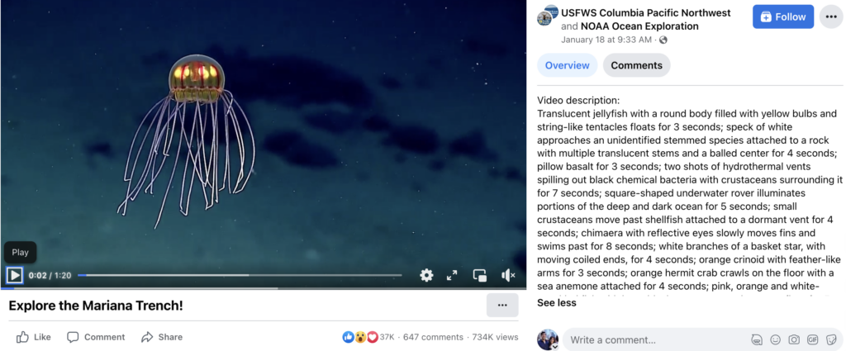
Alt Text: Pro Tip!
Add video descriptions, too.
Notes:
Audio Descriptions are Narrations that describe visual elements in videos to aid those who are blind or have low vision.
Videos may not have an alt text option, so remember to add descriptions to your captions or threads to describe your video content. Such as the video from US Fish and Wildlife Services that provides an in-depth and extremely informative description of their video.

Slide 20
Don’t Forget: Visual Content Warning
Include a warning for people with photosensitivity.
Notes:
Making your images and videos accessible goes beyond just using alt text. Don’t forget to include a warning for people with photosensitivity. If you post a video with strobe effects or flashing lights, include a warning and create a pause before your content plays. TikTok includes a warning for content that may trigger unpleasant or dangerous effects for some people.

Slide 21
Closed Captions and Subtitles
Captions: Text displays in the original language being spoken
Subtitles: Translated text displays of what’s being spoken
As Alexa put it, “Captions make videos accessible for a variety of users—from those with hearing loss or cognitive disabilities to those learning a new language to people who simply don’t want to wake their sleeping partners or babies.”
Here are a few common best practices:
Go beyond what’s being said. Subtitles write out what’s said, but closed captions add extra information for context like sounds in the background or music being played.
Ensure captions aren’t covered by platform content. Especially important in formats like Reels and TikTok.
Create high contrast captions. Make sure your captions are visible against your background, like white text against a black highlight, or vice versa.
Notes:
Captions and subtitles are essential tools for making multimedia content accessible to a wider audience, including those with hearing impairments and non-native speakers.
Captions provide a text representation of all audio content in a video, including dialogue, sound effects, and are synchronized with the video to appear on screen at the same time as the corresponding audio and crucial for viewers who are deaf or hard of hearing. Captions can be either closed (can be turned on or off by the viewer) or open (always visible).
Subtitles primarily display spoken dialogue as text and are often used for translating speech into different languages. Unlike captions, subtitles typically do not include sound effects or music cues. They are useful for viewers who do not understand the language spoken in the video or for those who prefer reading along with the audio like moms that don’t want to wake sleeping babies, for example.
Both captions and subtitles make content accessible to people with hearing impairments and those who speak different languages.
In regard to comprehension and cognitive disabilities, they help improve understanding and retention of information.
SEO: Adding captions and subtitles can enhance search engine optimization by making video content more searchable and indexable.

Slide 22
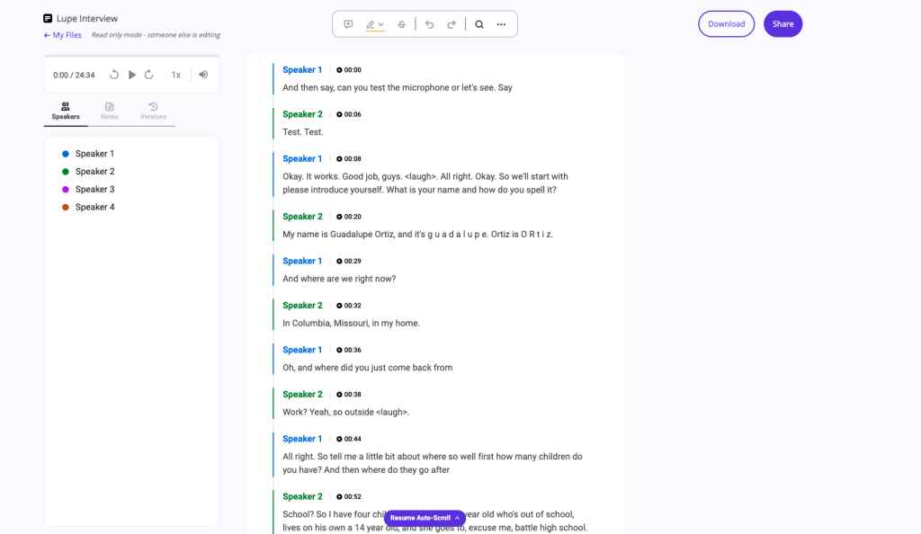
What about Transcripts?
Definition: A transcript is a written record of all spoken content in an audio or video file. It includes dialogue, but typically does not include non-speech elements like sound effects or music unless specified.
Usage: Transcripts are useful for making audio content accessible, such as podcasts or interviews. They can be read independently of the audio or video and are often used for reference, study, or SEO purposes.
Notes:
While both transcripts and captions aim to make content more accessible, transcripts provide a complete text version of the audio, whereas captions are time-coded to match the audio in videos and include additional non-speech information.
Transcripts make audio content accessible to people who are Deaf or hard of hearing. They also help those who have difficulty processing auditory information.
In some cases, providing transcripts is required by law to comply with accessibility standards, such as the Web Content Accessibility Guidelines (WCAG).
Americans with Disabilities Act (ADA): This law requires that public entities and places of public accommodation provide effective communication for individuals with disabilities. This includes providing transcripts for audio content to ensure accessibility.
Section 504 of the Rehabilitation Act: This mandates that any program receiving federal funding must provide equal access to individuals with disabilities, which includes offering transcripts for audio content.
Section 508 of the Rehabilitation Act: This requires federal agencies and organizations receiving federal funds to make their electronic and information technology accessible. This includes providing transcripts for audio content to comply with accessibility standards.
Transcripts also improve search engine optimization (SEO) by making the content searchable and indexable by search engines

Slide 23

Hyperlinks (Links)
Link text should:
Clearly and accurately convey the link's purpose
Indicate the destination or purpose of the link
Be the name of the linked page or document.
Clearly state in the link text if it is not a web page.
Not be ambiguous or reuse the same link text for links that lead to different destinations.
Notes:
Link text is the text you select for a link that describes what happens when a user clicks on the link. Link text needs to clearly and accurately convey the link's purpose. Commonly, link text is the name of the linked page or document. When a link leads to a document that's not a web page, such as a PDF or Word document, that should be clarified in the link text. Avoid ambiguous link text, and avoid reusing the same link text within a page for links that lead to different destinations.
Avoid generic terms and phrases such as “Click here,” “Learn more” and “Read more.”
Create link text that’s as specific as possible. For example, use “Download the FY24 annual report” instead of using “Click here.”
Create a hyperlink by using the most relevant word or phrase.
The link text should make sense out of context. Users navigating via screen readers often jump from link to link.
Avoid using URLs as link text as they can be confusing and difficult to read, especially for screen readers.

Slide 24
Links: Example 1
✗ Bad example
I think you should read this article about link text.
This link has text that does not indicate its purpose when read out of context: The screen reader would just announce "link: this." Screen readers also provide dialogs that list all the links in a page. If "this" was one of the links listed, it'd be impossible to tell where it might take you.
✓ Good example
I think you should read this article about link text.
After adjusting the link text, when the link is focused, screen readers will announce "link: article about link text." This link text is successful because its meaning is independent of its surrounding text.
Notes:
Link text should always be descriptive and clearly indicate the destination or purpose of the link. Vague phrases like “click here” or “read more” do not provide enough information for users who rely on screen readers. Instead, opt for descriptive link text that provides context and ensure that all users can easily understand the link’s purpose.

Slide 25


Creating Accessible Digital Content
Accessible Webpages: Ensures all users can access and navigate your content.
Accessible Emails: Ensure all recipients can read and understand your messages.
Accessible Documents: Ensure all recipients can read and understand your materials.
Accessible Social Media Content: Ensures all users can engage with your content
Notes:
So far, we have covered different aspects to incorporate when creating accessible digital content. At this point, we want to transition to application and how to incorporate the techniques we are learning into accessible webpages, emails, documents, and social media posts that are usable by everyone, including people with disabilities.

Slide 26
Accessible Websites
To ensure website accessibility:
All WKU CMS templates have been designed to be compliant and are always being updated for improvements in accessibility. For most things, you don’t need to worry about anything.
Accessibility Scan:
In addition to the using the WYSIWYG best practices, the Final Check feature scans the code on your page for any accessibility issues. Final checks also verify links and check spelling.
Publishing Webpages:
Pages containing any Critical Problems will be prevented from publishing.
If a page contains a Critical Problem, the publish button will be disabled until it is repaired.
Notes:
For most items you will not need to worry about anything. The CMS templates including the main navigation, footer, and surrounding content are already accessible and always receiving updates. Any web elements provided by WKU Web Development will be optimized for accessibility as well. That means using components, snippets, and other tools are also accessible.
When using the WYSIWYG to insert headings, images, icons, and links you may need to add some extra context.
Headings
Page structure is important when it comes to accessibility. Headings communicate the organization of the content on the page. Web browsers, plug-ins, and assistive technologies can use them to provide in-page navigation. See our Heading Best Practices to learn more about ordering and styling.
Images
When adding an image always remember to add a meaningful Alternative description. This is helpful for multiple reasons, it aids a non-sighted user in understanding the image and what it is displaying, as well as provides text if an image fails to load.
Be as descriptive as possible. Rather than a short description like "students walking", describe the entire scene. e.g. "Two WKU students walking through a shaded part of main campus on a sunny day."
Try to avoid using images with text in them. If you must use an image with text, be sure that all text contained in the image is typed out in the description.
Icons
When icons are purely decorative they need no extra context. When using an icon to represent something (e.g. using a car icon to represent "travel time by car" and a train for "travel time by train"), that context will need to be added using the Icon Meaning field of the Icons - Font Awesome Gadget.
Links
Use the Title attribute for your links when you can provide additional information about that link and/or the page it goes to. This text also displays in a tooltip when hovering over a link. A good title for a link with the text "Knowledge Base" would be "Step-by-Step Instructions". The title and link text should not match.
Do not use non-informative link text like Click Here, Learn More, Read More. In fact, the phrase "click here" is unnecessary, even if it precedes a more meaningful phrase. For example, a link that says "click here to access today's weather" can be shortened to "today's weather."
When working in the WYSIWYG editor each new line uses what is called a "block" item. Blocks are selected using the first dropdown in the WYSIWYG toolbar. The most common blocks are paragraph and headings 1-6.

Slide 27
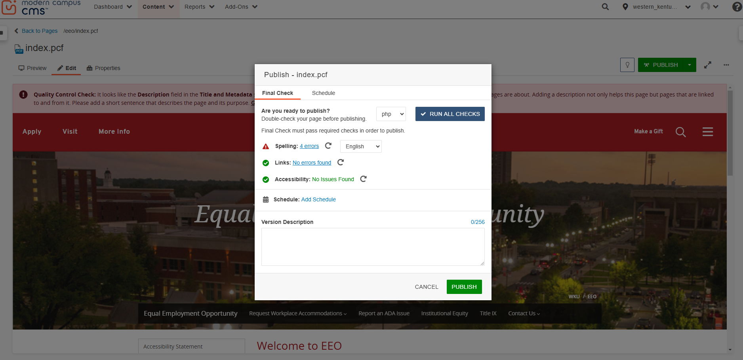
Accessible Websites
Notes:
Final Check reviews your page for spelling, link, and accessibility errors. Before publishing, it will provide a list of errors that may need addressed. Using Final Check to correct any issues will ensure that pages on the WKU website are accessible and provide the best experience for any user.
Accessibility check scans the page for issues as defined by WCAG 2.1 AA accessibility standards. It identifies four levels of problems:
Critical Problems: Result in blocked content for people with disabilities, preventing them from accessing fundamental features or content.
Serious Problems: May partially prevent people with disabilities from accessing fundamental features or content.
Moderate Problems: Will not prevent people with disabilities from accessing fundamental features or content.
Minor Problems: Considered to be annoyances for people with disabilities.
In the accessibility check results, each problem is listed with the location of the error in the source code, the name of the issue, an excerpt of the offending code, and a suggested repair. Visit the Knowledge Base Final Checks section for step by step instructions to fix common issues.

Slide 28
Accessible Emails
Subject lines: Use descriptive subject lines to tell users what the email is about.
Font: Use a font size of at least 14 points; Use sans serif fonts (like this one - Arial)
Links and buttons: Check that all links and buttons have the correct URL destination and are formatted properly with an underline or bold.
Video and Audio: Add captions for videos and transcripts for audio content.
Notes:
Accessible Emails are emails that use clear and simple language, proper headings, and alt text for ALL images. They also ensure that the subject line and links are descriptive and that the email is readable using larger font size and without relying on color alone to convey information.
Accessible email with audio or videos embedded need to have accurate captions added to all videos and transcripts for audio content.

Slide 29

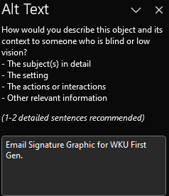

Digital Access: Emails!
Your email should NOT be made up of only images!
Don’t use images of text!
Add ALT TEXT or Image Descriptions to your Email Signature Graphics!
Or add a bracket underneath the image and describe!
[Email Signature Graphic for WKU First Gen.]
Notes:
By now, you notice we are talking about the same concepts of KISS, Alt Text, Attention to Color usage, and video/audio captions. Learning and applying these principles is going to impact all areas of making your electronic communication more accessible.
I am sure you realize NOW that your emails can’t be a flyer alone because not everyone can read it.
Also, when adding signatures, use actual text for name and contact information to ensure greater accessibility. Adding a logo, such as the WKU F1RST GEN graphic, is perfectly fine, just be mindful to add alt text for the image.

Slide 30
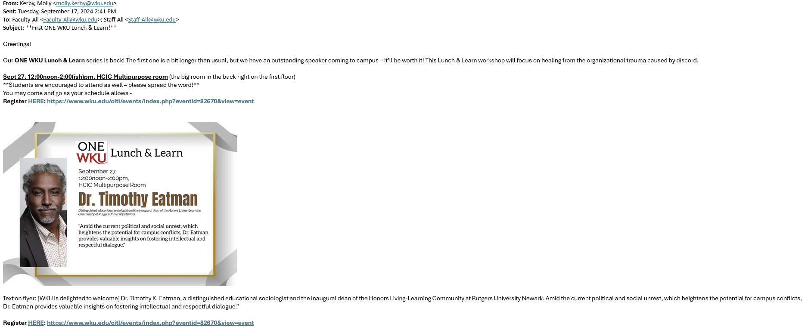
Event Emails
Notes:
At WKU, we get A LOT of emails about events with pretty flyers inviting us to different speakers and programs on campus.
Making your email images accessible goes beyond just using alt text.
If adding an event poster to an email, make sure that any text in the image is repeated either in the email body text or in the alt text. Important information like event details (date, time, location) should be included in the body text of the email.
Here, Molly Kerby has done a great job ensuring that what is on the flyer is also within the email message, so that anyone can read it!

Slide 31
Accessible Documents Turn on the accessibility checker for Word, PowerPoint, Excel, and Outlook! Microsoft support makes it easy with step-by-step instructions! Adobe also makes it easy to check PDF accessibility, too!
Notes:
It is understandable if like me, you leave here and may not recall all the topics we covered, that’s okay, just use the tools. That’s okay. Checks are built into the software! Turn on the accessibility checker in all your programs and if you need help, call IT!
Documents are often not accessible and can be difficult to remediate. For example, before you attach a document to an email, ask yourself if this is the best way to communicate the information, or could it instead be simply added to the body of the email?
If it’s necessary to attach a file to an email, make sure the document is accessible. Follow accessibility best practices such as tagging your document with headings to ensure screen readers can navigate them, writing helpful alternative text for images, and being mindful of color ensuring sufficient color contrast.

Slide 32
Basic Digital Access in Action: Social Media
Add alt text to images
Make your text accessible
Be mindful of emojis
Add closed captions and subtitles to videos
Make your visual content accessible
Use inclusive language
Prioritize inclusivity in your images
Make accessibility and inclusion part of your routine
Notes:
Accessible Social Media Posts that include images or videos and text cover the same concepts with the addition of hashtags and emojis
Of course, adding descriptive alt text to images on platforms like Facebook and Instagram helps screenreader users understand the content you post.
Captions for Videos: Including captions in videos on platforms like Facebook and TikTok ensures that users with hearing impairments can follow along. Like a cooking tutorial video with captions describing each step and ingredient.

Slide 33
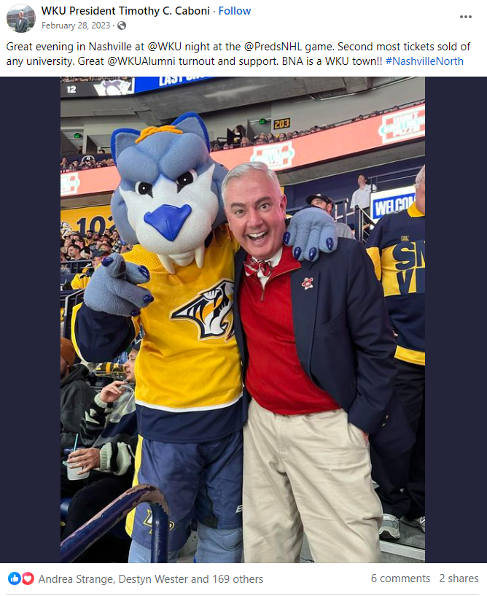
Make Your Text Accessible
Format your hashtags the right way
“CamelCase,”
So instead of #nashvillenorth, write #NashvilleNorth like President Caboni did!
Include @ mentions at the end of your posts
Avoid run-on sentences
Present the most important information first
Use special characters correctly, and in moderation
Notes:
Along with your images and videos, making the text in your post accessible is so important.
Format your hashtags the right way.
“CamelCase,”
So instead of #nashvillenorth, write #NashvilleNorth like President Caboni did!
Include @ mentions at the end of your posts. This helps the flow of your post, especially for screen readers.
Avoid run-on sentences. Instead, opt for clear, short sentences.
Present the most important information first. Helpful for accessibility, and to get your point across clearer, sooner.
Use special characters correctly, and in moderation. Screen readers know to not read all special characters aloud, like ampersands. But too many special characters in your text can result in a confusing experience for people using screen readers.
Avoid all caps. All caps make words harder to identify by their shape, and screen readers may read them as acronyms—not full words. For example: text vs TEXT.
Be mindful of font color. This is more relevant for pages or posts you link to. Ensure your font and hyperlink colors are accessible.
Spell out acronyms first. This helps screen readers and people unfamiliar with acronyms.
And again! Write in plain language. Avoid jargon and overly technical language to make your posts more accessible to everyone, including non-native speakers or people who experience cognitive impairments.
Avoid “creative” typography. Playing around with cute fonts has become popular in social bios and posts. But these don’t work well with assistive technologies.

Slide 34
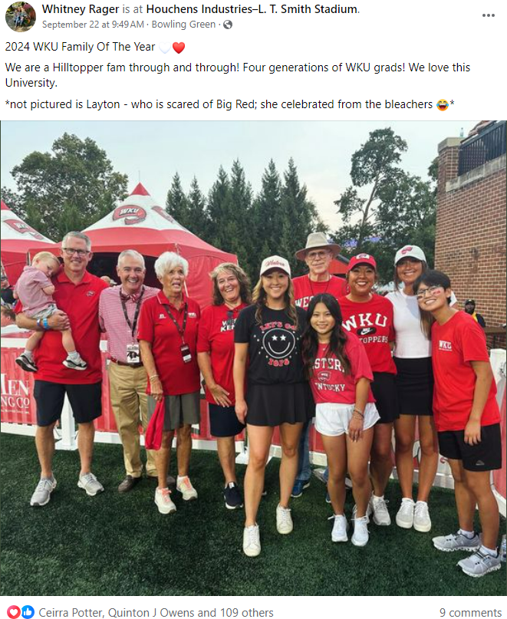
I Love Emojis!
Here are some tips:
Use emojis in moderation
Put them at the end of a social post
Custom emojis
Notes:
With emojis, we all love them, and you don’t need to stop using emojis, just be mindful of where and how much you use them.
Here are some tips:
Using emojis in moderation limits confusion in your posts.
Put them at the end of a social post. This will help you lead with your key information.
And keep in mind: custom emojis that represent different skin tones are fantastic and inclusive, but they have longer descriptions. If you use multiple in a row, you’ll add complexity for folks using a screen reader.

Slide 35
Your Turn
Notes:
Let’s review the accessibility concepts we’ve learned. In the next slides, it’s your turn to share accessibility issues you notice.

Slide 36
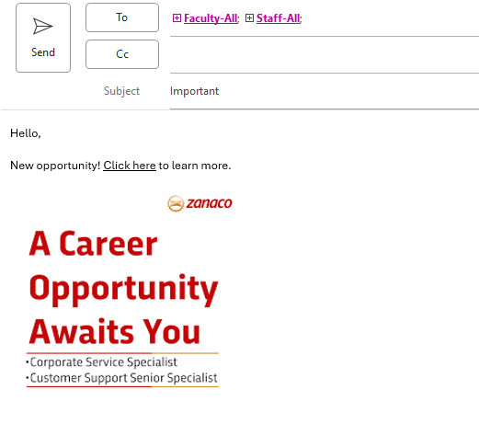
Email Check
Notes:
Let’s check for the concepts we have learned in this email. What accessibility issues do you see?
Missing alt text:
Including images without descriptive alternative text, leaving screen readers unable to explain the image content to users.
Unclear link text:
Using generic link descriptions like "click here" instead of descriptive text explaining where the link leads.
Small font size:
Using a very small font size that is hard to read, especially on smaller screens.
Image-only content:
Relying solely on images to convey important information without providing alternative text descriptions.
Subject line:
Avoid vague subject lines like “Important”; provides no information about the email’s content, leaving the recipient unsure of what the message is about, making it difficult for them to prioritize or understand the email, especially if they have accessibility needs

Slide 37
Email Check
You are a winner!
+ To learn more
+ Click here
+ Download
+ Form: www.register-pdf.com
Notes:
What about this email?
It looks like spam. No author, no subject, what did we win? A virus most likely?
The list is not formatted correctly and can’t be read as a list by screen readers.
PDF should be in brackets, so it is known that link opens a PDF.
Links are not descriptive.

Slide 38
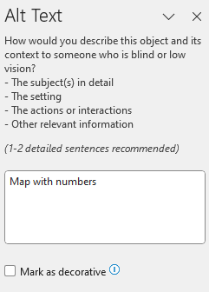
Image Check
Notes:
What accessibility issues do you notice in regards to this image?
Pixels are fuzzy, and the image is not even magnified. If someone needed to increase the size, it would be even more distorted. You can hardly read Virgin Islands and Pacific Basin.
No subject, no title, what is this map trying to show us?
Not enough color contrast with the Virgin Islands and the Pacific Basin
Alt Text: “map with numbers” is not enough! “US map with 10 regions of the US in different colors

Slide 39
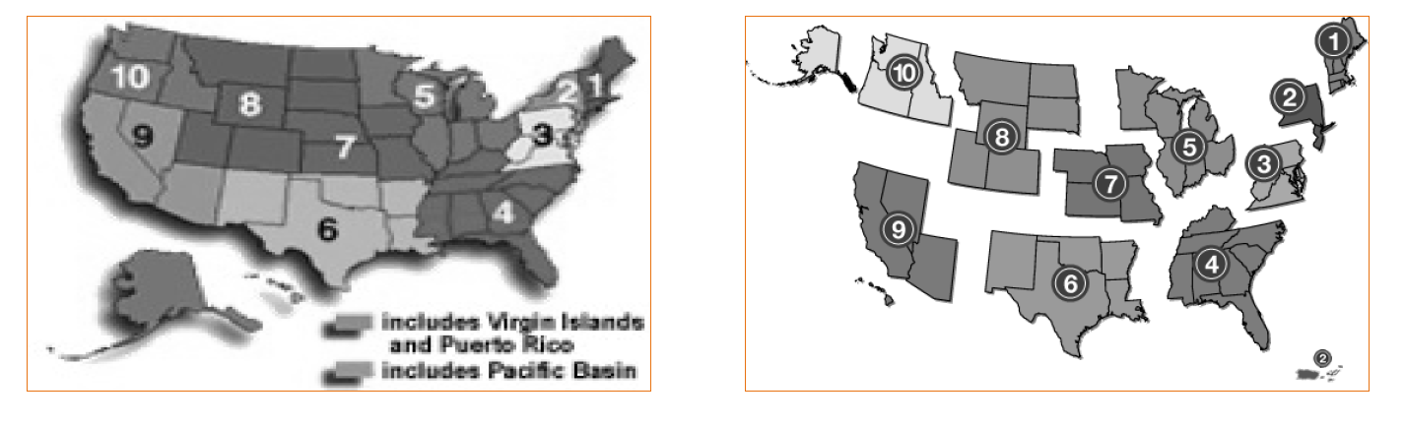
Color Check
Notes:
Same map but we’ve printed it out without color. Without the color, the regions are hard to discern due to the lack of color contrast in gray scale. Separating the regions with white space, gives definition and shows a different way to convey the information and not be locked into color as the only means.

Slide 40
Color Check
Notes:
Which is the correct way to note required information on a form that is accessible to everyone?
*Required fields…you can use green, but green does not need to be the only way for someone completing the form to know which fields are required. To use the asterisk, allows everyone to know regardless of ability to see the color green, which fields they have to complete.

Slide 41
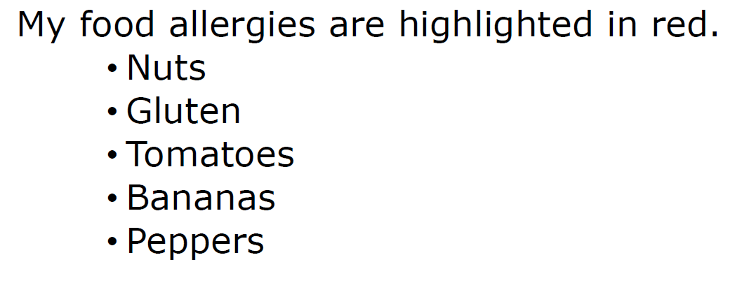
Color Review
Notes:
What issues do you see?
KISS – Keep it short and simple, just list your allergies
Maybe highlight in red AND underline that way color is not the only way to understand the information
No file ID and no author (who is this from and why are they telling us?) Remember information helps screen readers and other assistive technologies provide context to users.

Slide 42
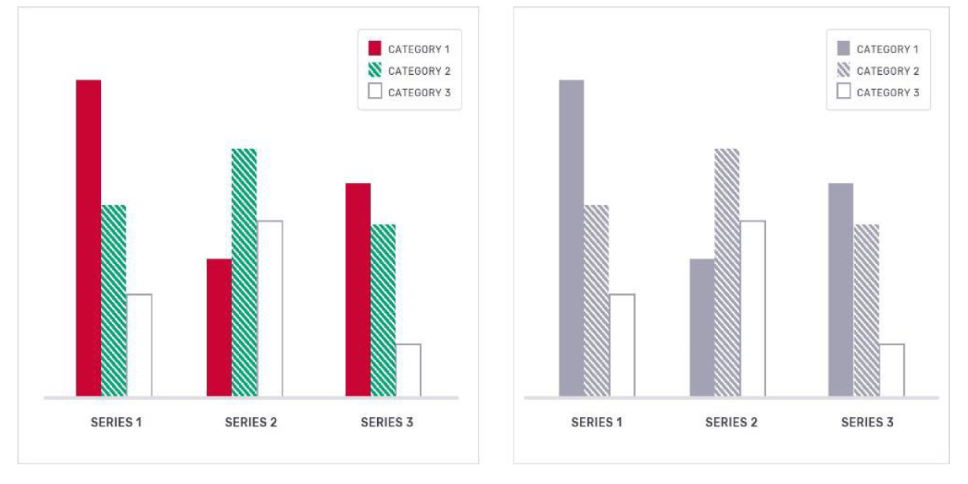
Color Review: Bar Graph with Fill Textures
Notes:
Can you still comprehend this graph without color?
Yes! This graph provides another example that you can use color, but texture gives more clarity in gray scale. Our goal is to convey information with or without color.

Slide 43

Alt Text Review
Notes:
Can anyone provide the alt text for this photo?
Avoid image or photo of, think about what is important for someone who is blind or has low vision.
“A cat is wearing black sunglasses. The cat’s face is angled to the right side looking up, cat is in black and white, and the black background is black. It has a patriotic feel like when someone is looking up to the American flag.” If this was a sunglass advertisement, our goal might be to mention the brand of sunglasses or be more specific of the lens shape.

Slide 44
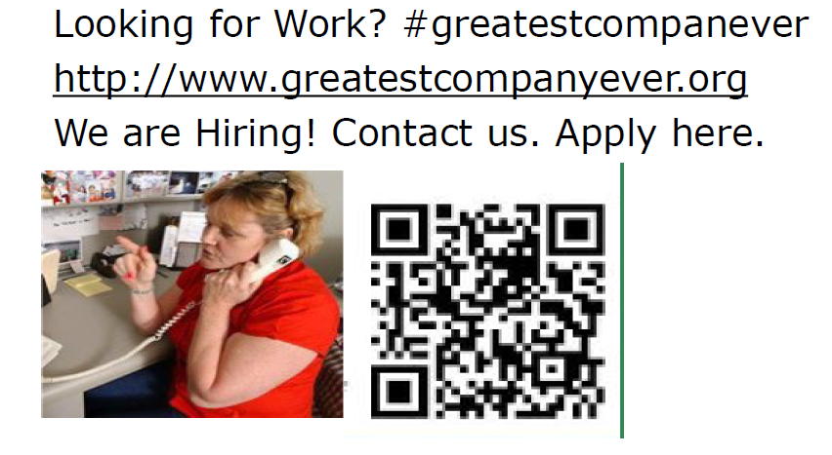
Social Media Review
Notes:
KISS-What’s the company? Information missing. Who are we contacting? Seems like a fake post.
Company is misspelled
Hashtag is not camel case, so screenreader can’t read it.
Hashtag should be at the end of the post.
Link of URL is too long, apply here should be linked instead of URL.
Links should be at the end of the post.
There is no visual description for the picture or QR code

Slide 45
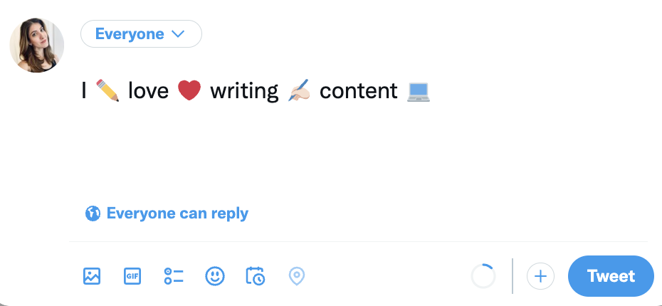
Emoji Check
Notes:
Remember: every emoji has a description assigned to it, like alt text to an image.
A screen reader would read the post below as, “I pencil love red heart writing writing hand: light skin tone content laptop.” Not so cute.
Use emojis in moderation.
Put them at the end of a social post.
This also helps you lead with your key information.
And keep in mind: custom emojis that represent different skin tones are fantastic and inclusive, but be aware that they have longer descriptions. If you use multiple in a row, you’ll add complexity for folks using a screen reader.

Slide 46
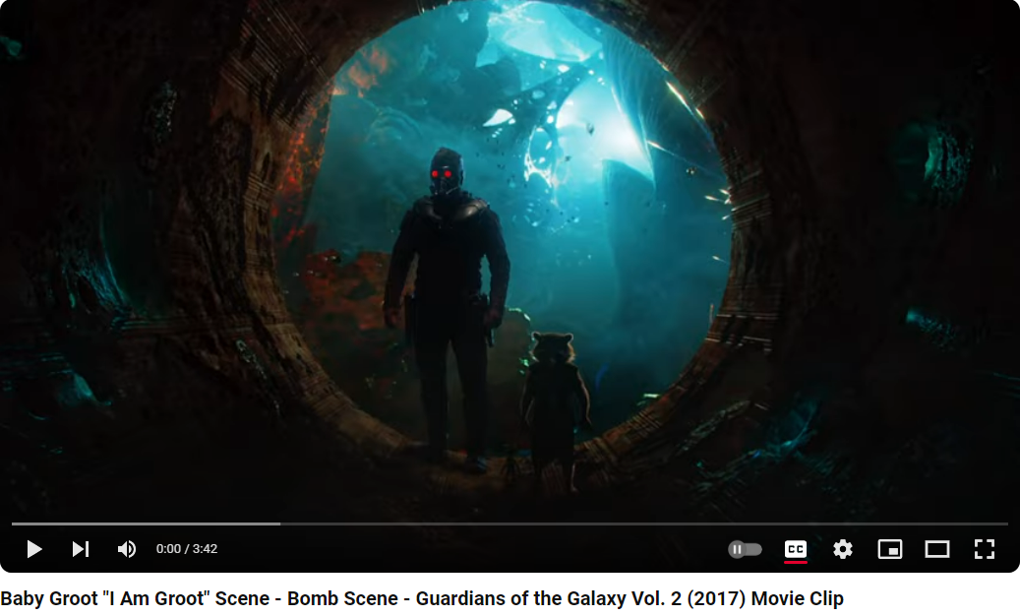
Video Review
Baby Groot "I Am Groot" Scene - Bomb Scene - Guardians of the Galaxy Vol. 2 (2017) Movie Clip
Notes:
No Photosensitivity warning for the strobing lights.
Captions are autogenerated and incorrect.
Disney does it better!

Slide 47
Digital Access: Points to Remember!
Equal Access is the Law.
Perceivable, Observable, Understandable, Robust (POUR Principles)
Access depends on Structure (i.e., use clear email subject lines and headings)
Keep It Short and Simple (KISS)
Alt Text
Color Contrast and Possible Alternatives
Link etiquette
Captions, visual descriptions, transcripts
Notes:
Here are the key digital accessibility points to remember:
It's the law: Compliance with the ADA is mandatory to ensure equal access for all users.
POUR principles: Ensure content is Perceivable, Operable, Understandable, and Robust.
KISS (Keep It Short and Simple): Simplify content and navigation for ease of use.
Structure: Organize content logically and consistently.
Headings: Use clear and descriptive headings to structure content.
Alt text: Provide alternative text for images to describe content.
Color contrast: Ensure sufficient contrast between text and background for readability. Do not use color alone to convey meaning. Remember not everyone can see color.
Include Captions, visual descriptions, and transcripts for multimedia content to make it accessible to all users.
By using these checkpoints, you can help create an inclusive digital environment that benefits everyone.

Slide 48
Accessibility Statement Western Kentucky University is committed to ensuring its electronic communication including websites, mobile applications, social media posts, etc. are accessible to all individuals, including those with disabilities. We are continually improving accessibility by following recommended guidelines outlined in Section 508 of the Rehabilitation Act Amendments of 1998. We strive to adhere to the guidelines and standards established by the World Wide Web Consortium's Web Content Accessibility Guidelines (WCAG) 2.1 at level AA conformance. These guidelines define how to make web content more accessible to people with disabilities, and conformance to them improves the web's usability for all people. Information Technology Services (ITS) provides training courses and assistance to all employees on accessibility best practices. When creating WKU websites, final accessibility checks are required before publishing. If you are experiencing difficulty accessing any element of this website or other means of electronic communication, please contact ITS at (270) 745-5000 and report the access issue to the ADA Coordinator, Chantel Wilson, at chantel.wilson@wku.edu or (270) 745-5121. Please describe the nature of the problem and where the difficulty was encountered. For main campus obstruction free walkways and accessible building entrances, here is a map. If you encounter a physical barrier or other physical obstruction on campus, please report the access issue, such as a push button for a door or an elevator not working, to the Department of Facilities Management at (270) 745-3253 and report the access issue to the ADA Coordinator, Chantel Wilson, at chantel.wilson@wku.edu or (270) 745-5121. For assistance after hours with physical access, contact the WKU Police Department at (270) 745-2548.
Notes:
Not only is it the law, as a federally funded University we are required to follow the guidelines and standards established by Section 508 of the Rehabilitation Act Amendments of 1998. This is the University’s Accessibility Statement that we are required to have and uphold. This solidifies our commitment to accessibility in our electronic communications including but not limited to our websites. This is also were we request that any accessibility issues be reported so that they can be remedied.
Ensuring digital accessibility at Western Kentucky University (WKU) has a profound impact on its faculty, staff, and community:
By integrating accessibility into their teaching materials and methods, faculty can reach a broader range of students, including those with disabilities. This fosters a more inclusive learning environment and enhances the overall educational experience.
Accessibility training and resources empower staff to create and maintain accessible digital content, ensuring that all university communications and services are inclusive.
An accessible digital environment at WKU benefits the wider community by promoting equal access to information and resources. This aligns with WKU's mission of inclusivity and social responsibility, helping to build a more equitable society.
Overall, prioritizing digital accessibility supports WKU's commitment to diversity, equity, and inclusion, benefiting everyone involved. Western Kentucky University's mission is to prepare students of all backgrounds to be productive, engaged, and socially responsible citizen-leaders of a global society. Ensuring digital accessibility aligns with this mission by promoting inclusivity and equal access to educational resources and opportunities for all students, including those with disabilities. By prioritizing accessibility, WKU fosters a more equitable learning environment, which is essential for developing socially responsible leaders

Slide 49
Resources
ADA National Network: Digital Access - Search Results
Office of Civil Rights (OCR) Video Series: Digital Access in Education
Digital Access Basics: Check. Test. Eval.
Notes:
Here are several links to resources that provide additional insight and guidance.

Slide 50

Any other Questions? Concerns? Thoughts?
Notes:
We have a few minutes for any comments, questions, or concerns you may have.

Slide 51

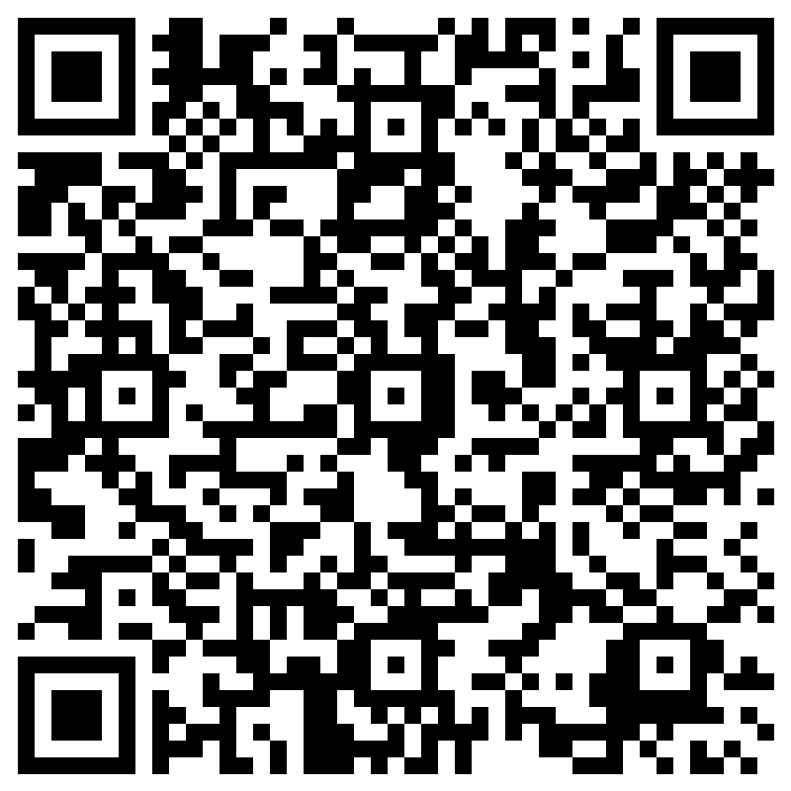
Survey/Feedback Please Tell us what you thought of this presentation.
Notes:
We welcome any feedback you may have. Here is a QR code to complete a survey for this presentation. Thank you.

Slide 52
Work Cited
Accessibility Best Practices | Western Kentucky University
Hill, C. August 8, 2024. “9 guidelines to make social media posts more accessible.”
https://sproutsocial.com/insights/social-media-accessibility/
Harvard University. “Technique: Writing link text.” https://accessibility.huit.harvard.edu/technique-writing-link-text
Williamson, P. and Marsha Schwanke. “Check! Basic Digital Access in Action.” PowerPoint.
Brunk, A. and Don Torrez. “Accessible Communications Strategy.” PowerPoint.
Khan, K. “7 Ways to Make Content Digitally Accessible.” PowerPoint.

