Slide 1
Employment Trends and Career Opportunities in the Digital Space
J. Sebastian Leguizamon and Dana Cosby
Western Kentucky University
March 17, 2023

Slide 2
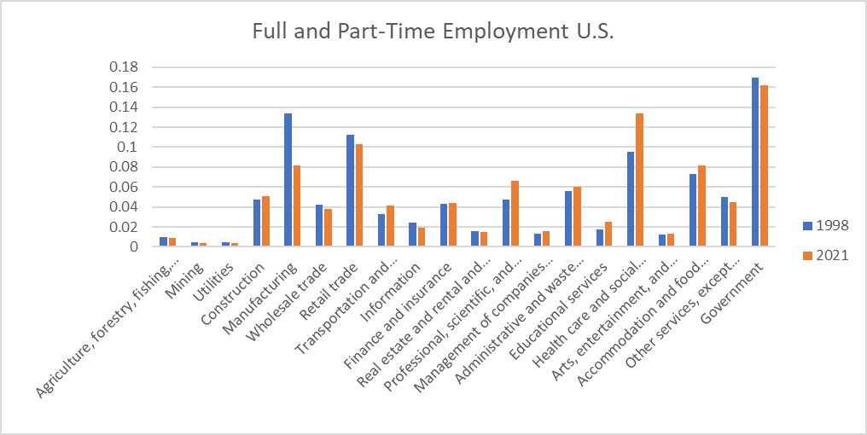

Slide 3
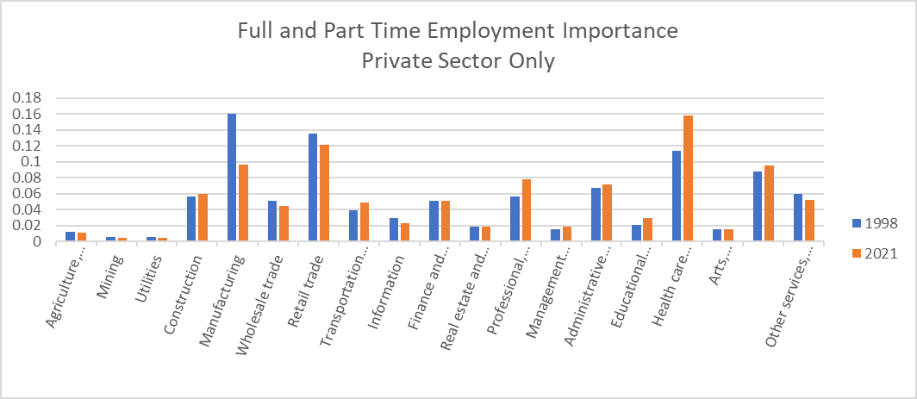

Slide 4
But…. Let’s be careful….
Hypothetically:
Total employment, 1998: 100 people
Manufacturing, 1998: 20 people
Share of Manufacturing, 1998: 20%.
Total Employment, 2021: 120 people
Manufacturing, 2021: 21 people
Share of Manufacturing, 2021: 17.5%
But Manufacturing grows by 1 individual: 1/20 is 5%.

Slide 5
Winners and Losers: 1998 vs 2021
Losers
Mining
Utilities
Manufacturing
Information
Biggest Winners
Professional, scientific, and technical services
Health Care and Social Assistance
Educational Services
Transportation and Warehousing

Slide 6
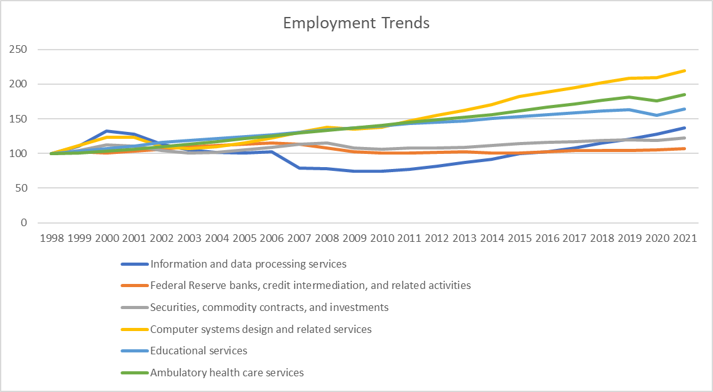
Winners: Subcategories

Slide 7
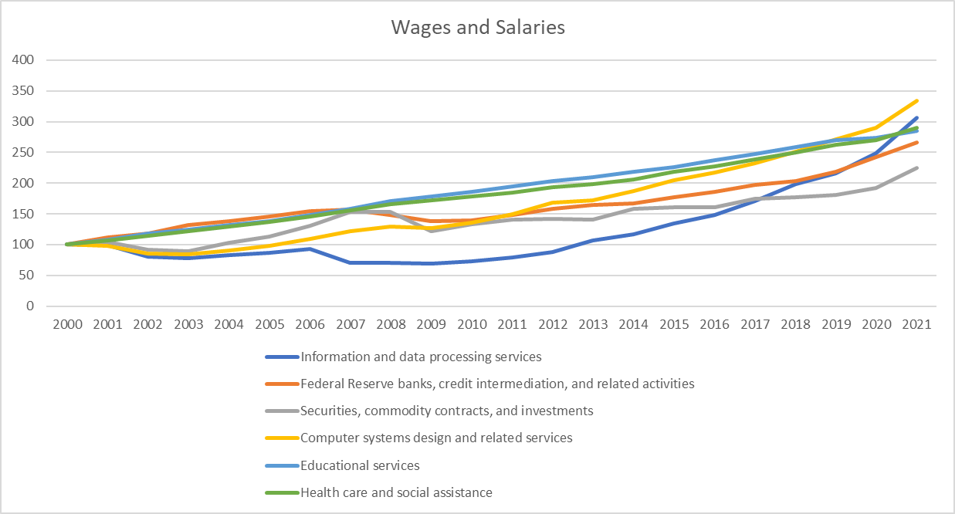
Salary Growth

Slide 8
Digital Space Trends

Slide 9
Digital Space Opportunities

Slide 10
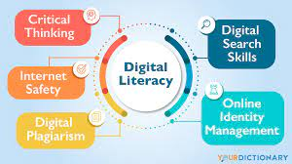
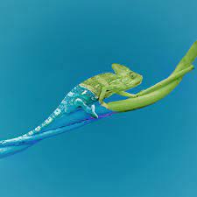
Skills

