Slide 1
Dr. J. Sebastian Leguizamon, Associate Professor of Economics Director, Center for Applied Economics
Economic trends
and the
Housing
Market

Slide 2
Overview
The U.S. Economy and Housing
The regional Economy
The local Economy
The Housing Market
Kentucky and similar States
Bowling Green and similar MSAs

Slide 3
Predictions are Hard CBER for 2022: “Slow Recovery”
U.S.:
3.7% Growth in GDP (lower than 2021)
Unemployment up to 3.7%
Inflation: 2.7%
Slow increase of interest rates
KY:
3.5% Growth in GSP
Unemployment: 3.9%
Employment Growth: 3.0%
Manufacturing Employment: 2.9%

Slide 4
Actual [Available] Data (Source: BEA)
 | Q1 | Q2 | Q3
Real GDP (US) Real GDP (KY) | -1.6% | -0.6% | …
Unemployment | 3.8% | 3.6% | 3.6%
Federal Funds Rate | 0.75% | 2.16% | …
Inflation (Annualized) | 8.3%

Slide 5
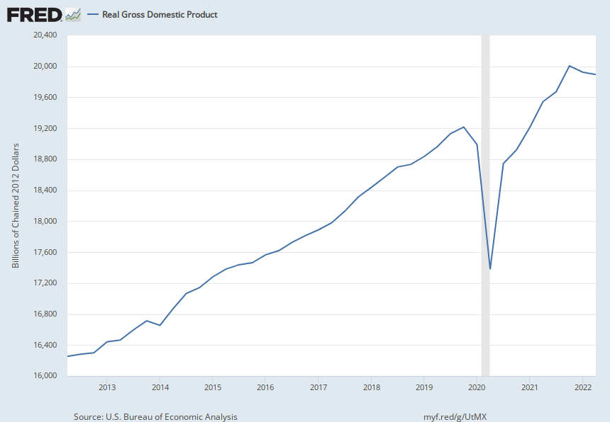
Trends- Economic Indicators RGDP

Slide 6
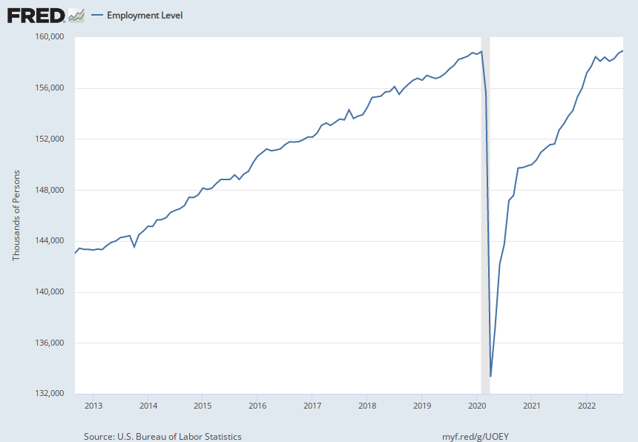
Employment

Slide 7
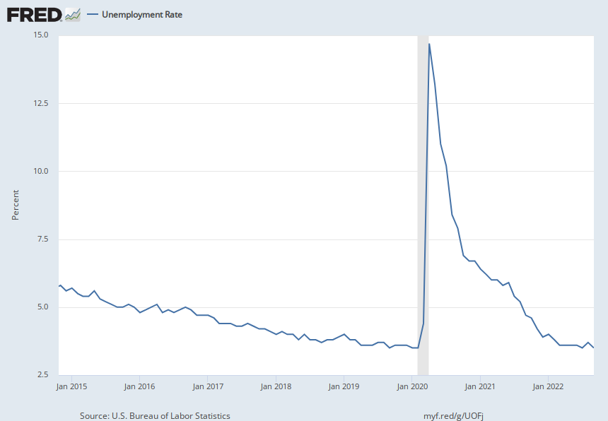
Unemployment Rate

Slide 8
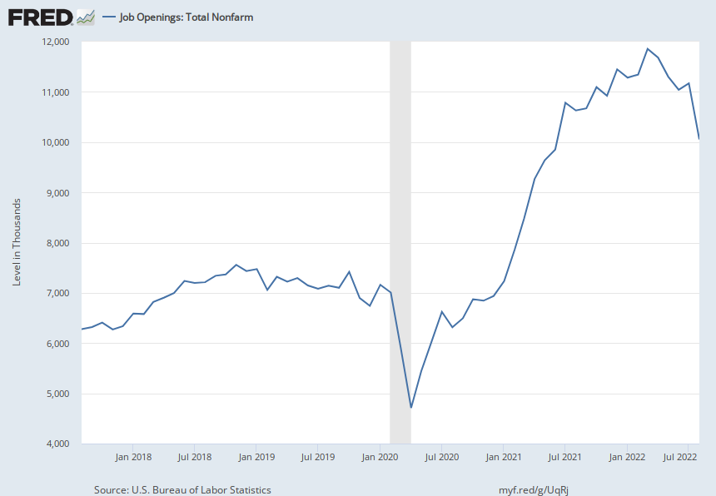
Job Openings

Slide 9
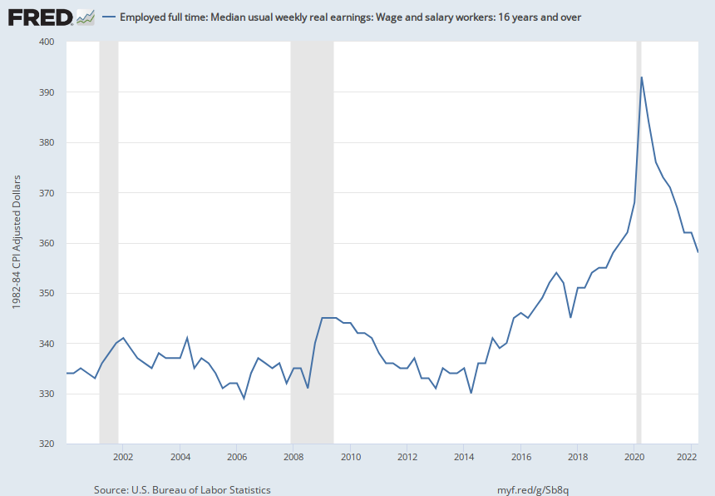
Weekly Earnings (Real)

Slide 10
Savings

Slide 11
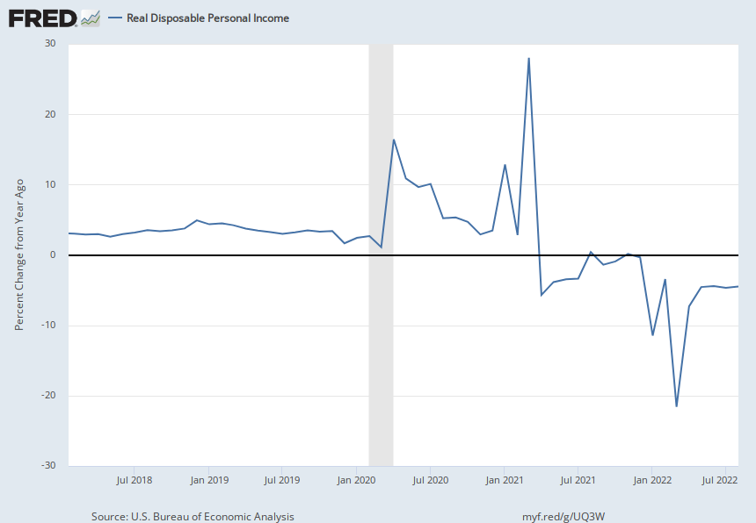
Disposable Income (Growth)

Slide 12
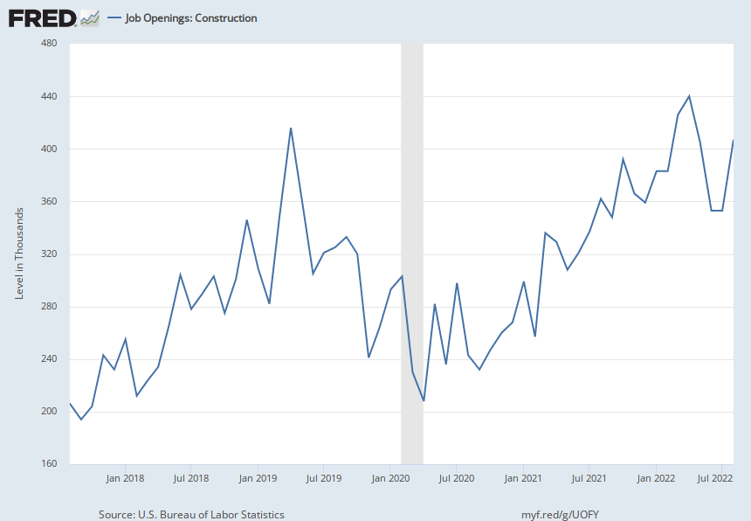
Job Openings: Construction

Slide 13
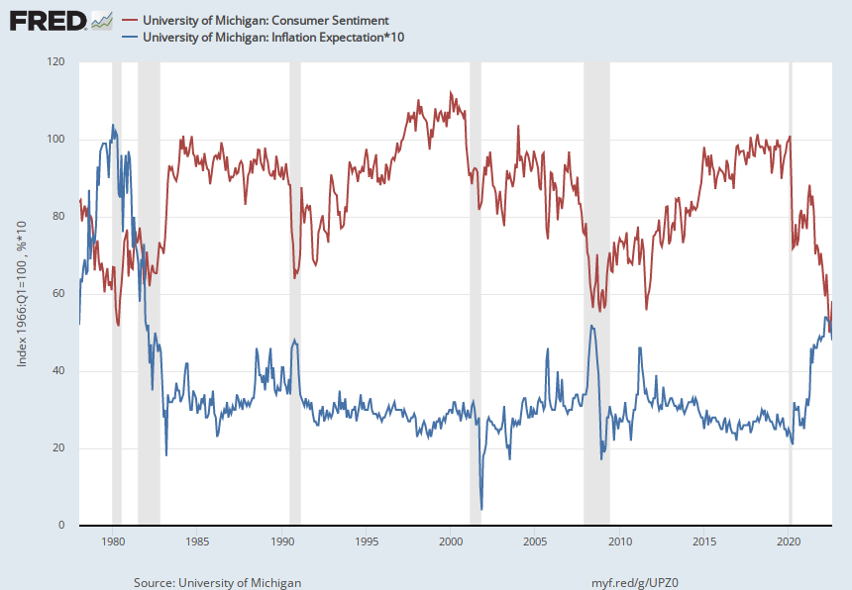
Consumer Expectation

Slide 14
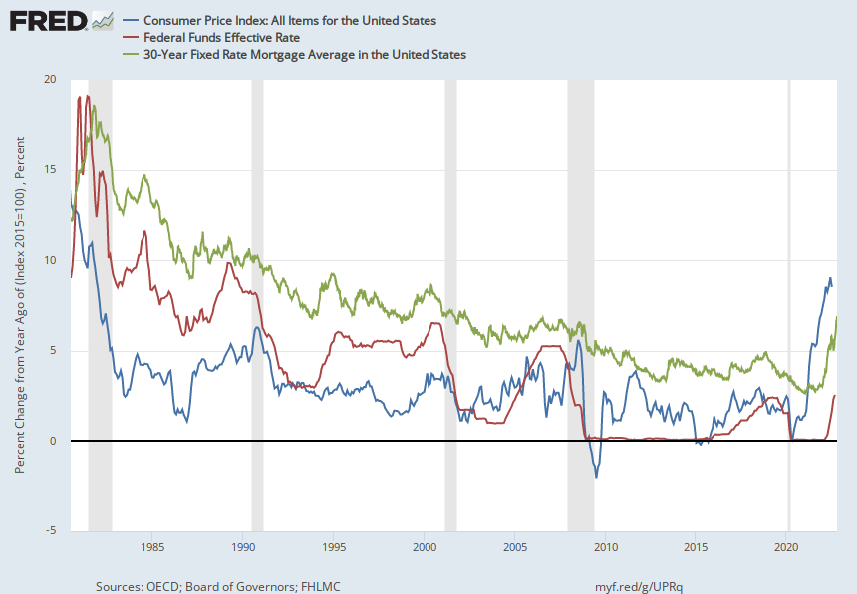
Inflation and Interest Rates

Slide 15
US Housing Market Trends Cost of Borrowing and New Inventory

Slide 16
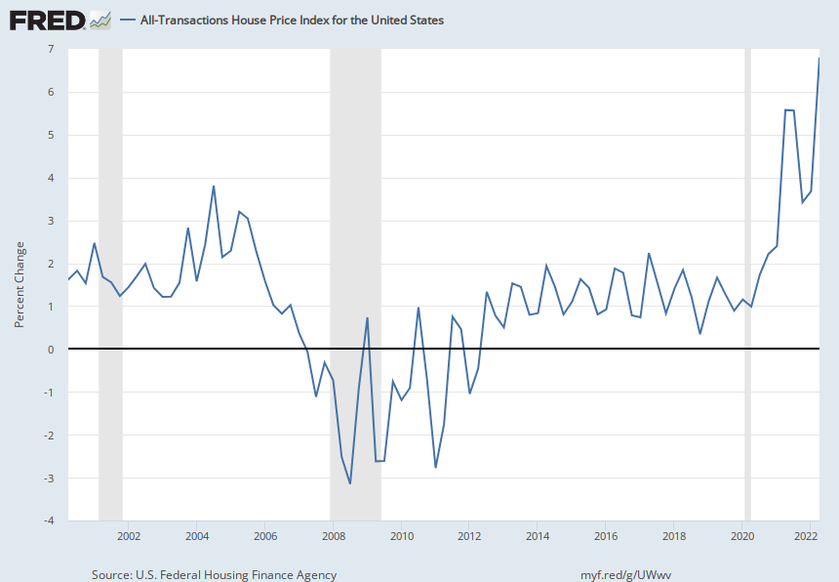
Cost of Owning

Slide 17
Cost of Renting

Slide 18
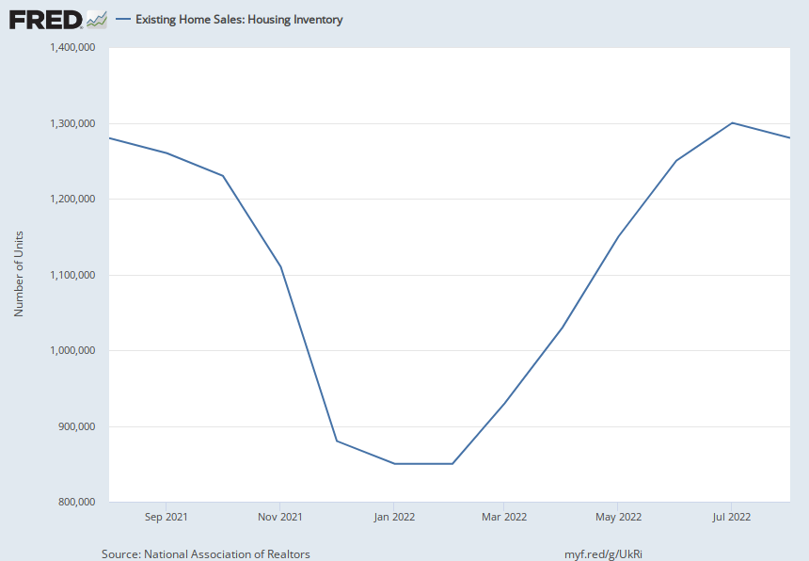
Inventory

Slide 19
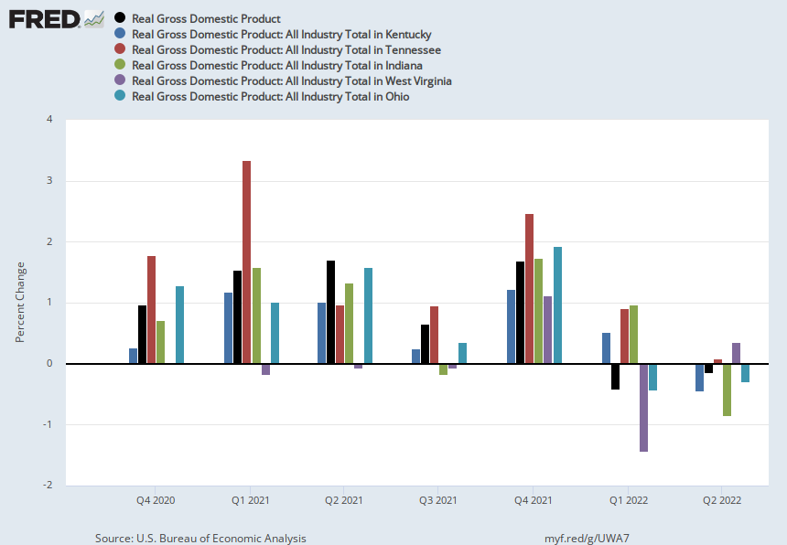
State Economy

Slide 20
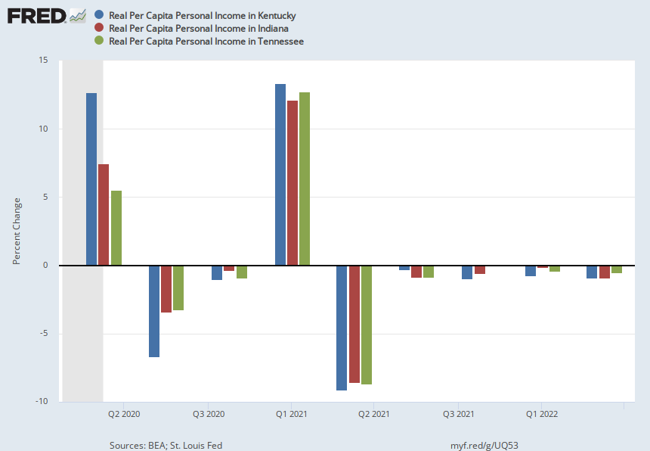
RPCPI (Selected States)

Slide 21
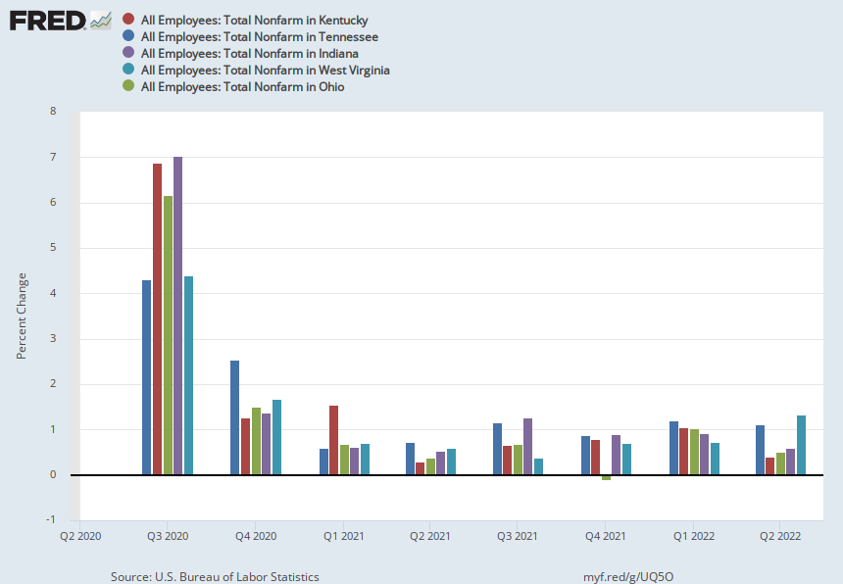
Employment Growth

Slide 22
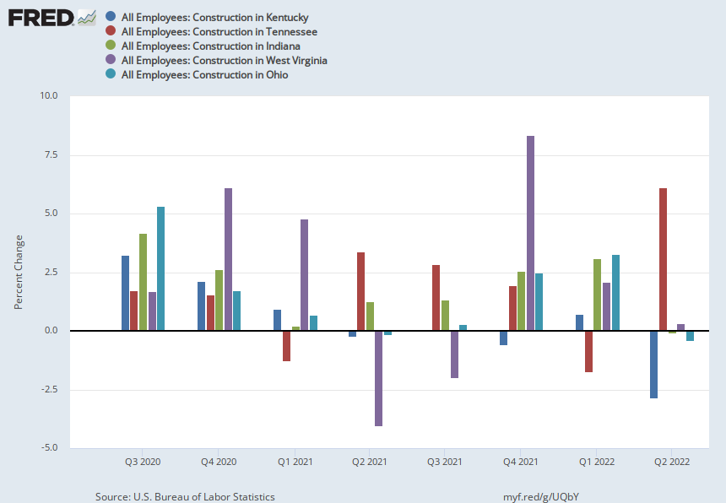
Employment Growth: Construction

Slide 23
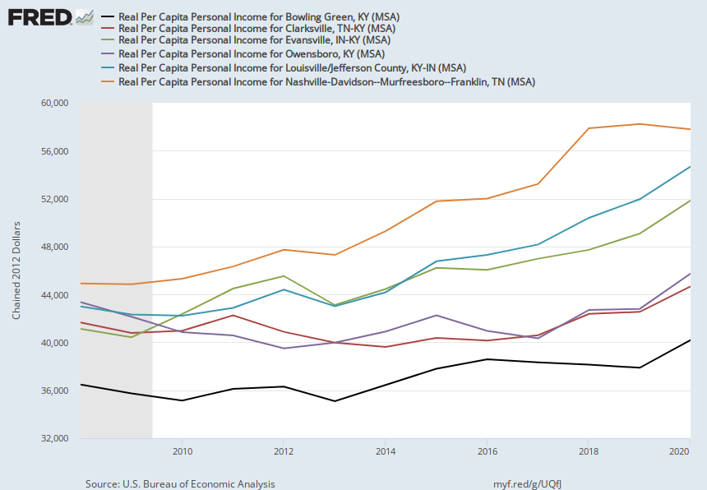
Local Economy Trends:

Slide 24
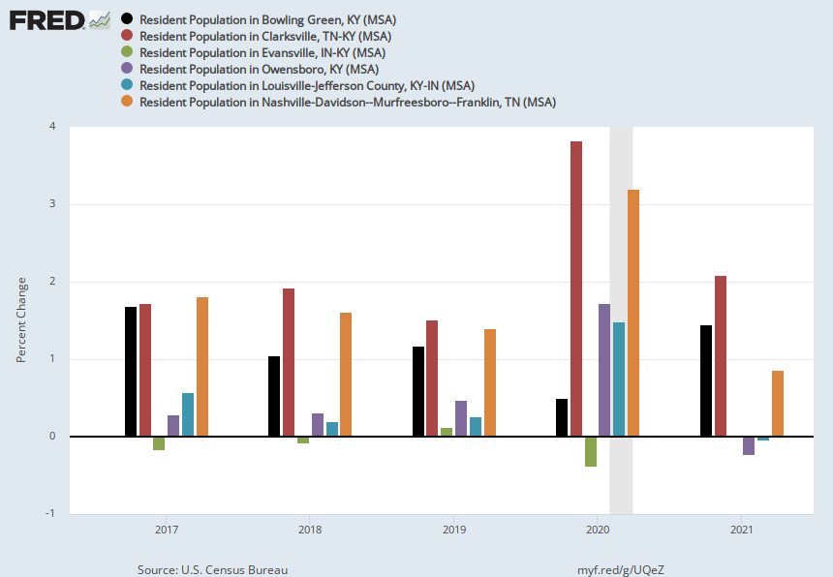
Population Growth

Slide 25
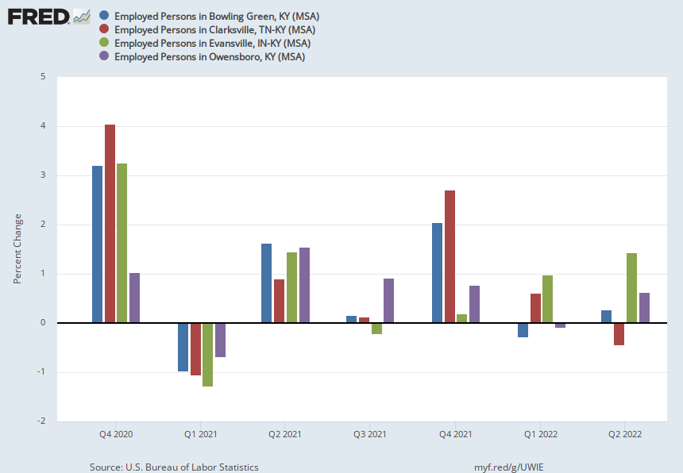
Employment Growth

Slide 26
Housing Market State and Local

Slide 27
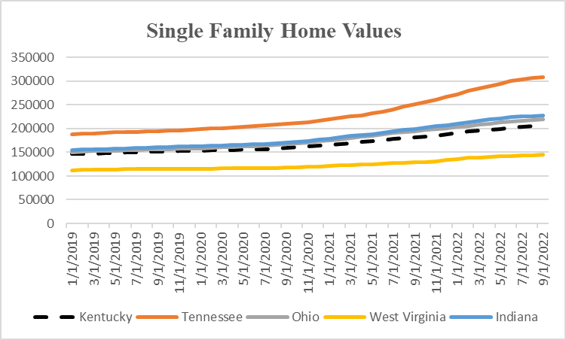
KY Still Affordable

Slide 28
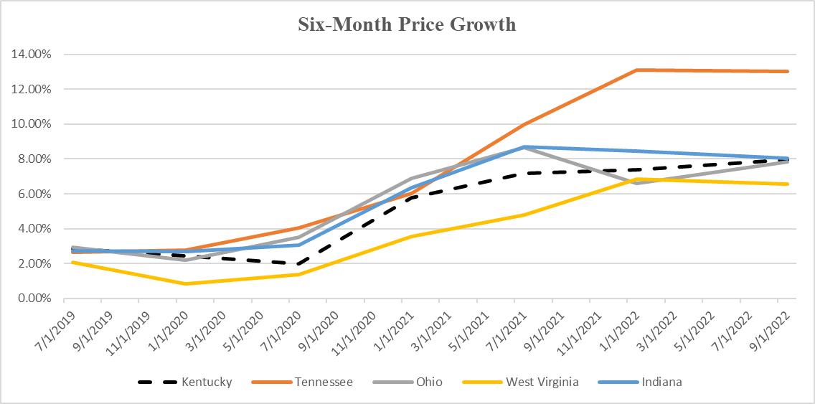
KY Growing Slower…

Slide 29
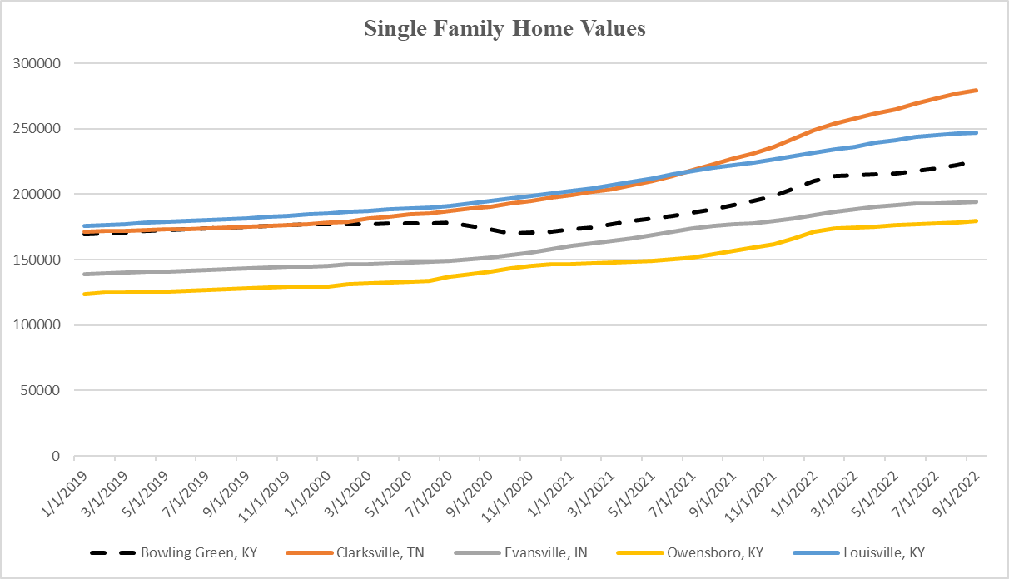
Home Values: Metro

Slide 30
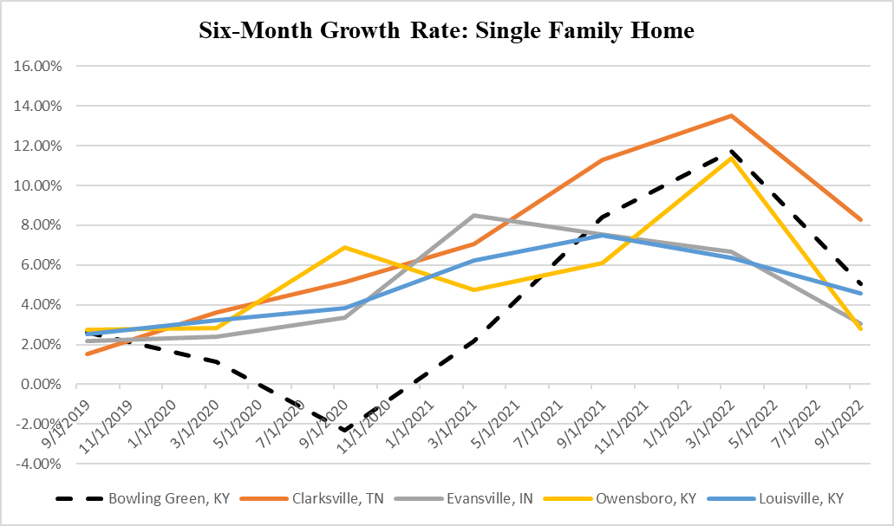
In Growth Terms: Metro

Slide 31
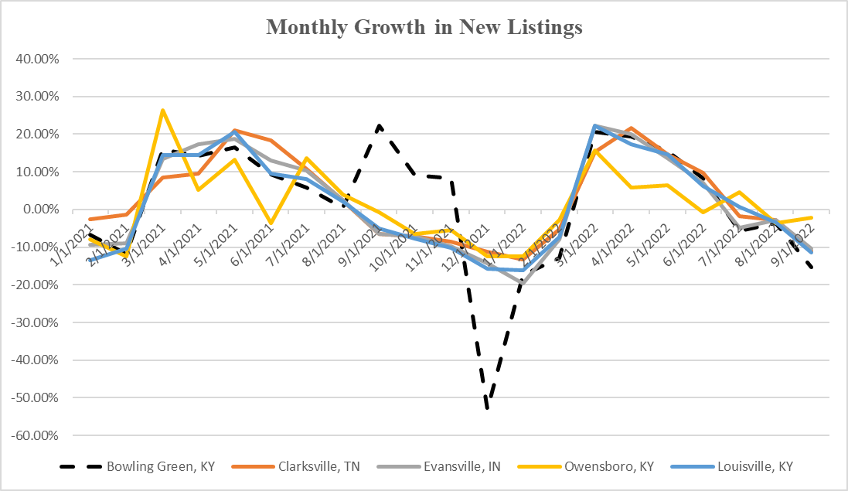
New Listings (Local)

Slide 32
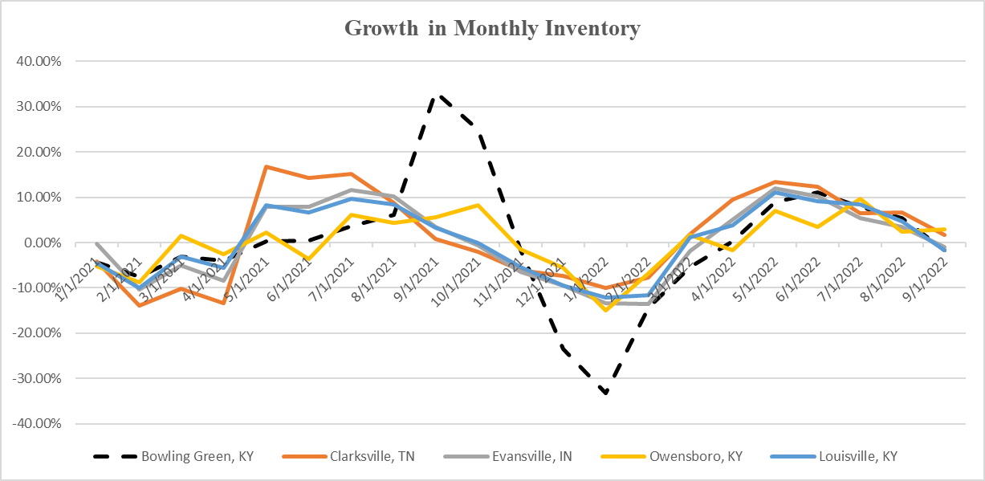
All Listings (LOCAL)

Slide 33
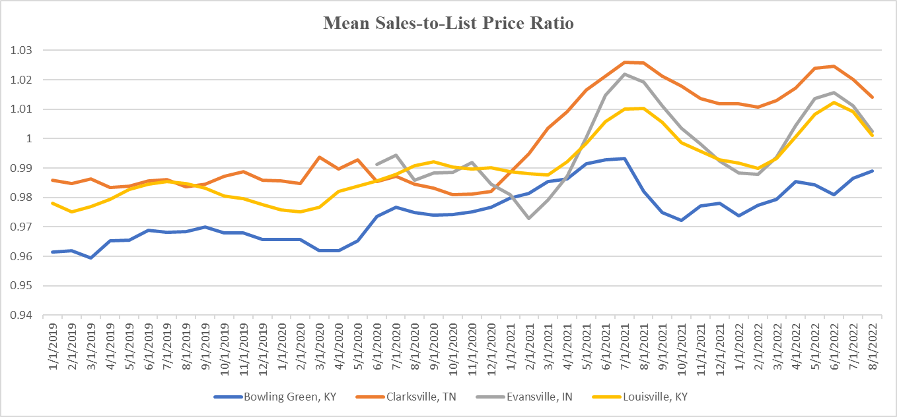
Discounts?

Slide 34
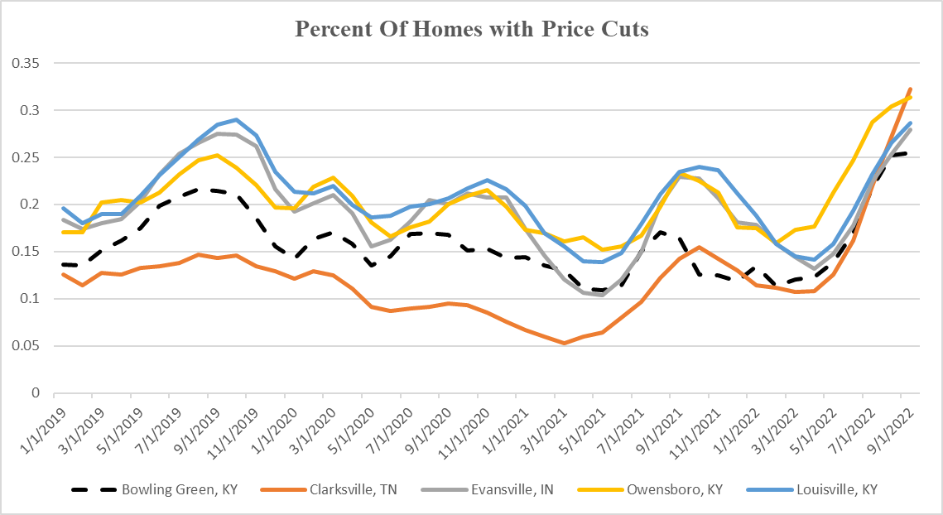
Current Price Reductions

Slide 35
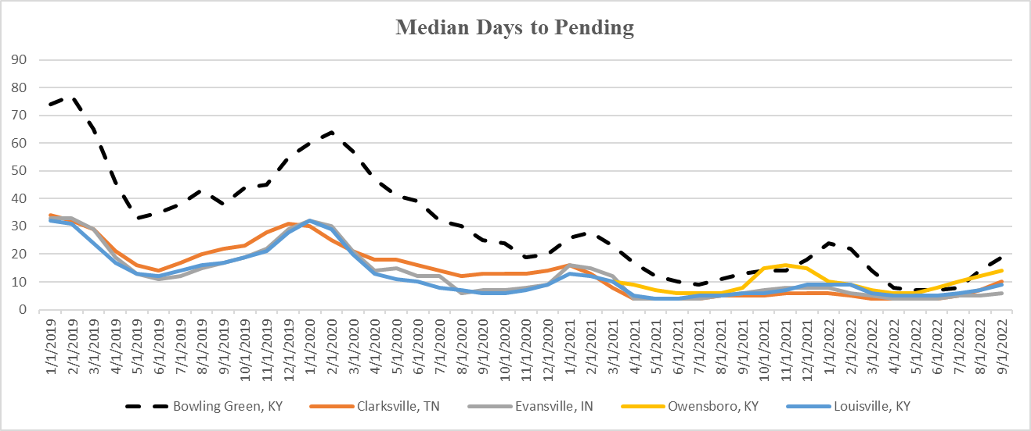
BG: Longer To Sell

Slide 36
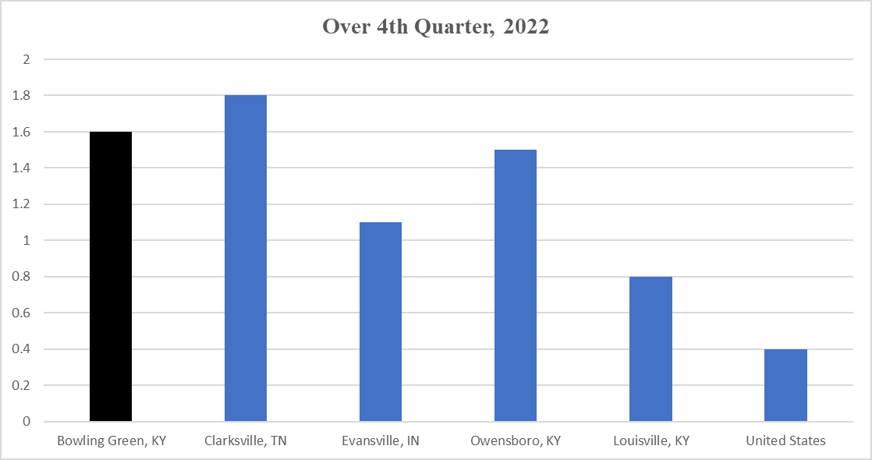
Home Value Growth: Forecast

Slide 37
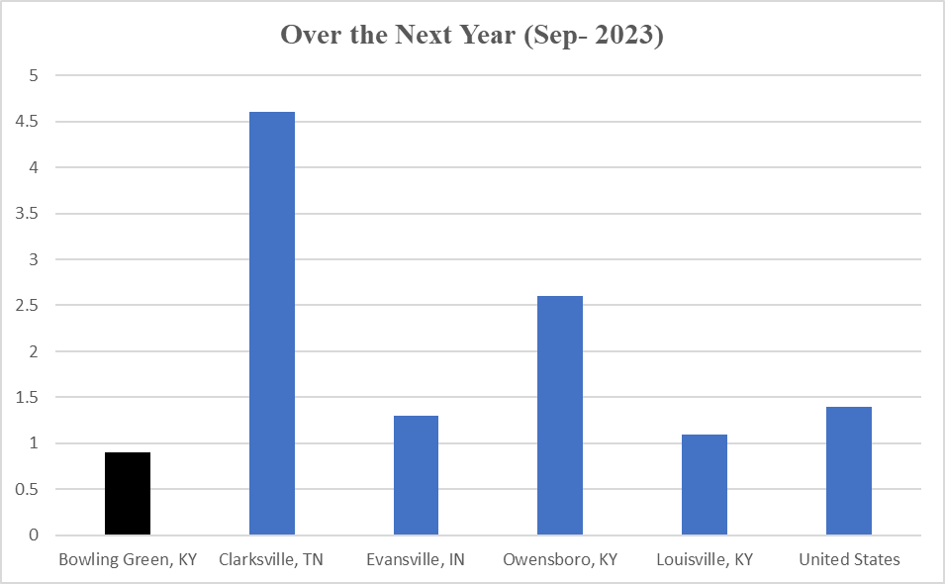
L-R Forecast

Slide 38
Conclusion
Inflation, Interest Rates, and the Economy affecting the KY and BG disproportionately
BG and KY – greater effect on the housing market
Trends suggest slowdown in growth
Prices may even start declining over the next year
Not very optimistic about selling quickly
Number of mortgages will probably be affected

