Slide 1
What’s Research Security Got To Do With It?
A Conflict of Interest & Research Security Training
Presented by The Office of Research Integrity

Slide 2
Why Disclosures Matter
Disclosures are not about preventing outside activities, income, or collaboration. It is about ensuring transparency so potential conflicts can be identified and managed.
Below are some reasons why we require disclosures:
Ensures compliance with sponsor, federal, and institutional requirements
Protects integrity and credibility of research
Maintains public trust
Allows conflicts to be reviewed and managed before a problem could occur
Protects researchers and the institution from noncompliance

Slide 3
What is a Conflict of Interest?
Conflict of Interest entail personal or financial considerations that could cause bias or create risks for research integrity or security. There are many areas of this that could be perceived as a conflict but not be an actual conflict, both need to be disclosed.
Disclosures ensure that we have documentation of potential risks and a way to manage them if there are significant conflicts.
Types of Conflicts of Interest:
Financial Conflicts
Personal Conflicts
Conflicts of Commitment
Foreign Affiliations
Disclosures are here to protect you and your research! Not to interfere with your relationships, finances, or your ability to complete research.

Slide 4


Financial Conflicts
Financial Conflicts can arise when a covered individual could gain or lose financial from research conducted. This is direct or indirect but often comes up with business ventures that could relate to the research being conducted.
Examples:
Advisory board roles
Ownership or equity in a company
Paid consulting
Stake in products/ services that relate to your research

Slide 5
Personal Conflicts
These conflicts arise when a covered individual has a personal relationship which could impact research integrity. This is typically seen when a personal relationship could impact your bias in research.
Examples:
Business that are owned by family or close friends
Personal gain from outcome of research involving friends or family members
Personal relationships that impact impartial bias on research

Slide 6
Conflicts of Commitment
These are situations in which activities interfere with a covered individuals professional obligations. In a research capacity this involves activities that could be required but the determination of effort is inconsistent.
Examples:
Working on one or more funded project (not a conflict but could become one)
Sitting on advisory boards (paid or unpaid)
Ensuring appropriate levels of effort on projects

Slide 7
Foreign Affiliations
This includes any foreign relationships or funding matters with countries outside of the United States. To comply with federal research security mandates such as the NSPM-33 Presidential Memorandum, foreign affiliations of any kind are to be disclosed.
Examples:
Formal affiliation with a foreign institution
Foreign research collaborations (resources, funding, appointments, and personnel)
Participation in a foreign talent recruitment program
Foreign-sponsored travel
Foreign personal relationships that could be related to research or disclosed to foreign personnel

Slide 8
Who Needs to Submit?
Conflict of Interest Disclosures and associated training need to be completed by any covered individual on a sponsored program/project, not just research.
Covered Individuals in Research:
Senior Personnel: Principal Investigators and Co-Investigators
Faculty and researchers named on federal proposals, grants, and contracts
Key personnel: consultants or anyone who must submit a biosketch
Students or postdoctoral researchers named on the budget
Anyone named in a RPPR or progress report
Staff supporting federally funded activities
Any individuals listed as investigators on a subaward
Covered Individuals involved in Non-Research Programs:
Senior Personnel: Principal Investigators and Co-Investigators
Faculty

Slide 9
Required Training
Training is important for maintaining research integrity and are required by certain funders and regulations regarding research. We check CITI Program Training when you Conflict of Interest Disclosure is submitted as well as the funding types you have. Below are required trainings for different funders and research:
Responsible Conduct of Research
All WKU employees or students conducting or assisting with research are required to complete this course
Good News: This course does not expire, but make sure to check that you have taken it!
Conflict of Interest Training
This is the title of the CITI Training
Those with Public Health Service Funded Research must take this
Those with Department of Energy Funded Research must take this before project submission
This course expires every four years
Research Security Training (Combined)
All Federal Funded Research or Project must take this course
This course expires every year
There is a new Refersher Course that can be taken after the initial course for yearly renewal- it is about 30 minutes long

Slide 10
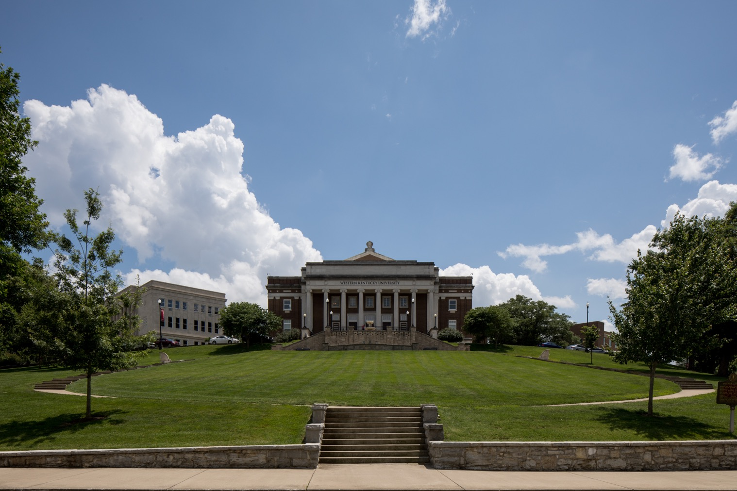
Research Security Training
This training was introduced last year due to the congressional mandates and executive orders of 2021 and 2022. CHIPS and Science Act of 2022 and the National Security Presidential Memorandum 33.
This ensures that all federally funded research activities are conducted with the highest standards of integrity, transparency, and protection from external threats.
Research Security Training must be completed every year you submit a proposal for federal funding. CITI Program now offers a Refresher Course for the yearly requirement.

Slide 11
Why Research Security Matters
Research Security is the policies and practices that are in place to protect United States Research and Development. This allows for collaborative research while protecting the people we serve, their data, and innovations. Research Security is not just the responsibility of one person or department, we all need to be aware of risks to research to protect ourselves, fellow researchers, the University, and United States Research as a whole.
Disclosures and Research Security
Accurate disclosures help us identify potential risks related to research security and manage these risk if needed.
Disclosures do not prevent international collaborations or outside work, but rather, help ensure that collaboration and outside activities are transparent, properly managed, and conducted in accordance with institutional, sponsor, and regulatory requirements.
Our goal is not to inhibit research collaborations but make them safe for all involved so that research is able to continue for generations to come.

Slide 12
When Is It Due?
Where Do I Submit?
This will need to be submitted into IRBNet.
We have in depth steps on our website under “How to Submit a COI Disclosure” as a guide.
Basic Steps:
Create a package in IRBNet
Attach your disclosure document to the package
Sign the package
Submit the package to Western Kentucky University (WKU) COI, Bowling Green, KY
If revisions are requested, you will receive an email notification outlining the revisions needed
Conflict of Interest Disclosures and associated training need to be completed each calendar year for covered individuals involved in a sponsored program at any point in the year or at the time of proposal submission.
Disclosures are to be submitted by 12/31 for the next calendar years coverage. Meaning that for 2027, disclosures will need to be submitted by 12/31/2026 for next years coverage or upon proposal submission within the 2027 calendar year.
Example:
If you are due to complete your sponsored research on 1/15/2027, you will still be required to submit your disclosure for the 2027 year as you had a sponsored project at some point in the year.

Slide 13

Raise the Red Towel
Now we will look at some scenarios and you have to decide if this is a potential risk that needs to be disclosed.

Slide 14

Right here! Make your own.
(With a little help from fellow Hilltoppers)
Raise The Red Towel
Does this require disclosure?
Dr. Security is a professor specializing in research on curriculum used in K-12 schools. Dr. Security picked up a paid consulting position for a curriculum development company whose materials will be evaluated in research that she is developing.
Does this need to be disclosed?

Slide 15
Right here! Make your own.
(With a little help from fellow Hilltoppers)
Raise The Red Towel
Does this require disclosure?
Dr. Security is a professor specializing in research on curriculum used in K-12 schools. Dr. Security picked up a paid consulting position for a curriculum development company whose materials will be evaluated in research that she is developing.
Does this need to be disclosed?
Yes, this is a conflict of interest and needs to be disclosed! If it is determined by the Conflict of Interest board that it requires a management plan, this will be developed with Dr. Security to allow for risk management in her consulting and research.

Slide 16
Right here! Make your own.
(With a little help from fellow Hilltoppers)
Raise The Red Towel
Does this require disclosure?
Dr. Integrity is conducting research college retention rates in other countries versus the United States. She is being invited to participate in a short-term teaching fellowship funded by a government-affiliated institution in Italy, this also includes a stipend.
Does this need to be disclosed?

Slide 17
Right here! Make your own.
(With a little help from fellow Hilltoppers)
Raise The Red Towel
Does this require disclosure?
Dr. Integrity is conducting research college retention rates in other countries versus the United States. She is being invited to participate in a short-term teaching fellowship funded by a government-affiliated institution in Italy, this also includes a stipend.
Note: A Malign Foreign Talent Recruitment Program is a program in which activity is compensated by a foreign country of concern. Foreign Countries of Concern are China, North Korea, Russia, and Iran
Does this need to be disclosed?
Yes, this is considered a Foreign Talent Recruitment Program and must be disclosed.

Slide 18
Right here! Make your own.
(With a little help from fellow Hilltoppers)
Raise The Red Towel
Does this require disclosure?
Dr. Research is conducting research on local business economics and is receiving travel funding from a German nonprofit to present his findings at a workshop there.
Does this need to be disclosed?

Slide 19
Right here! Make your own.
(With a little help from fellow Hilltoppers)
Raise The Red Towel
Does this require disclosure?
Dr. Research is conducting research on local business economics and is receiving travel funding from a German nonprofit to present his findings at a workshop there.
Does this need to be disclosed?
Yes, this is considered foreign affiliation and will need to be disclosed.

Slide 20

Questions?
Email: ori@wku.edu
Phone: 270-745-3360
Wetherby Administration Building
Suite 301
Website: https://www.wku.edu/compliance/

