Slide 1
Everything You Wanted to Know About IRB
Presented by The Office of Research Integrity

Slide 2
What is Human Subjects Research?
Examples
Interviews
Surveys
Focus groups
Secondary data analysis
Analyzing medical records
Testing interventions
Clinical Trials
A human subject is defined by the Code of Federal Regulations (CFR) as "a living individual about whom an investigator obtains (1) data through intervention or interaction with the individual or (2) identifiable private information.“
Research is defined in the Code of Federal Regulations (CFR) as "a systematic investigation designed to develop and contribute to generalizable knowledge."

Slide 3
Classroom Exemptions: these are related to any class project or assignment which involved human participants but for the purpose of teaching. These projects must not be presented, nor include minors or vulnerable populations, and have no video or audio recordings.
This is not considered Human Subjects Research but is required to be submitted to the IRB for review and exempt determination.
Secondary Data Analysis: these entail projects where previously collected data is analyzed and published. This includes but is not limited to medical chart data, publicly available data, databases, data from a previous work intended for different review, and course evaluations or instruction for the purpose of research.
Evaluations of an employee, course, program, or service where the evaluations are not designed to lead to generalizable knowledge. This includes surveys designed to enhance a program or course.
This is assumed that there will be no publication or presentation on the evaluation data outside of the original department.
Is It Human Subjects Research?
Not Human Subjects Research

Slide 4
Review Types
Exempt Review
This is for projects that are no more than minimal risk and are exempt from more detailed review.
Exempt research still needs IRB review.
Examples:
- surveys
- educational research in a classroom
- secondary data review
Expedited Review
This is for projects that are no more than minimal risk but are non-exempt. This also includes minor changes to approved projects.
Examples:
- collection of audio/visual recordings
- interviews
- clinical studies
- those determined non-exempt by IRB
- amendments to current protocols with no additional risk
Full Board Review
This is given to projects which could be more than minimal risk and may involve vulnerable populations. This also includes those that are determined by the IRB to not fit exempt or expedited categories.
Example:
- research with those under 18 or disabled groups
- sensitive research questions

Slide 5

Does It Require IRB Review?
Dr. Red is teaching a “History of WKU” class this Fall would like his students to conduct research on the community's perception of WKU in Bowling Green. This project will be conducted by the students, but the only presentation will be within the class. He wants each student to develop their own survey. Which of the following does Dr. Red need to do?
Submit a Continuing Review form for his other IRB application titled “Perceptions of WKU in age groups across Kentucky”
Nothing- this is not human subjects research and does not require an application
Submit a Classroom Exemption Form through IRBNet for IRB approval
Submit a Human Subjects Application though IRBNet

Slide 6
Does It Require IRB Review?
Dr. Red is teaching a “History of WKU” class this Fall would like his students to conduct research on the community's perception of WKU in Bowling Green. This project will be conducted by the students, but the only presentation will be within the class. He wants each student to develop their own survey. Which of the following does Dr. Red need to do?
Submit a Continuing Review form for his other IRB application titled “Perceptions of WKU in age groups across Kentucky”
Nothing- this is not human subjects research and does not require an application
Submit a Classroom Exemption Form through IRBNet for IRB approval
Submit a Human Subjects Application though IRBNet
Dr. Red must submit a Classroom Exemption Form as well as Student Code of Conduct Forms for each student participating in IRBNet. These projects will be given an exempt determination.

Slide 7


How Do I Complete an IRB Application?
Blank applications can be found on our Human Subjects Page or within IRBNet in Forms & Templates
Complete the first sections with your PI, Co-PI, and basic project information.
Be sure to complete all questions and add any key personnel.
Section A- Summary
This is a brief overview of your project. This should include hypothesis, research questions, and the proposed activities, no more than half a page.
Section B- Selection Criteria
We have developed specific targeted questions for this section on what we are looking for including how many participants you plan to recruit, where recruitment will occur, how it will occur, how you will contact participants, inclusion and exclusion criteria.

Slide 8
How Do I Complete an IRB Application?
Blank applications can be found on our Human Subjects Page or within IRBNet in Forms & Templates
Section C- Informed Consent
Describe your consent process. Where will it occur, how will consent be obtained, and what format (informed consent or implied consent) you will use. Do not include your consent document in this section.
Section D- Procedures
Step by step guide of how the research will be conducted from participant recruitment to study close.
Section E- Confidentiality
Describe how confidentiality is maintained, even if it you do not collect personal information. How incentive sign up will be maintained separate from responses should also be detailed here.

Slide 9
How Do I Complete an IRB Application?
Blank applications can be found on our Human Subjects Page or within IRBNet in Forms & Templates
Section F- Risks
Describe any potential risks. Even uncomfortable questions can be considered a risk. It is recommended to always mention this as a potential and that no participants have to answer any questions that make them uncomfortable.
Section G- Benefits
Incentives should be descriptive such as $25 online Amazon gift card. Indirect benefits should be outlined here as well.
Section H- References
Specific measurement tools or diagnostics are helpful to put here for review.

Slide 10

Now What??
Complete your Consent Form (not needed if the project is secondary data analysis)
Consent Templates can be found within IRBNet in Forms & Templates as well as on our Human Subjects Page.

Slide 11
Used when there is direct interaction with particpants, interventions, interviews, and audio/visual recording.
This includes the actual signature of the participant and a witness (the person obtaining consent.
Example: I am conducting interviews over Zoom for a research project and I plan on recording the interviews so I am able to trascribe the interaction for data analysis.
- This requires an infomed consent
These forms are used when there is only survey interaction with participants.
Consent is “implied” based on the continuation of the survey.
Example: I am sending out a survey for my research project to students on campus with a Qualtrics link. The consent document will show up first and the participants action of clicking next to the survey implies their consent.
- This requires an implied consent
VS
Informed Consent
Implied Consent

Slide 12
What Consent Do I Need?
Dr. Integrity is conducting a research project on how students, faculty, and staff feel about green spaces on campus. This will be composed of confidential surveys as well as a 60 minute follow up interview with willing participants. What kind of consent(s) does Dr. Integrity need?
Just an informed consent for the entire research study
Both an implied consent for the survey and an informed consent for the interview
An implied consent at the beginning of the survey that mentions the interview in the procedures
Just a recruitment script

Slide 13
What Consent Do I Need?
Dr. Integrity is conducting a research project on how students, faculty, and staff feel about green spaces on campus. This will be composed of confidential surveys as well as a 60 minute follow up interview with willing participants. What kind of consent(s) does Dr. Integrity need?
Just an informed consent for the entire research study
Both an implied consent for the survey and an informed consent for the interview
An implied consent at the beginning of the survey that mentions the interview in the procedures
Just a recruitment script
Dr. Integrity will need both consent types. An implied consent for the survey and then an informed consent for the interview. This is to ensure that participants are consenting to specific parts of the research as they are not required to complete all parts if unwanted.

Slide 14
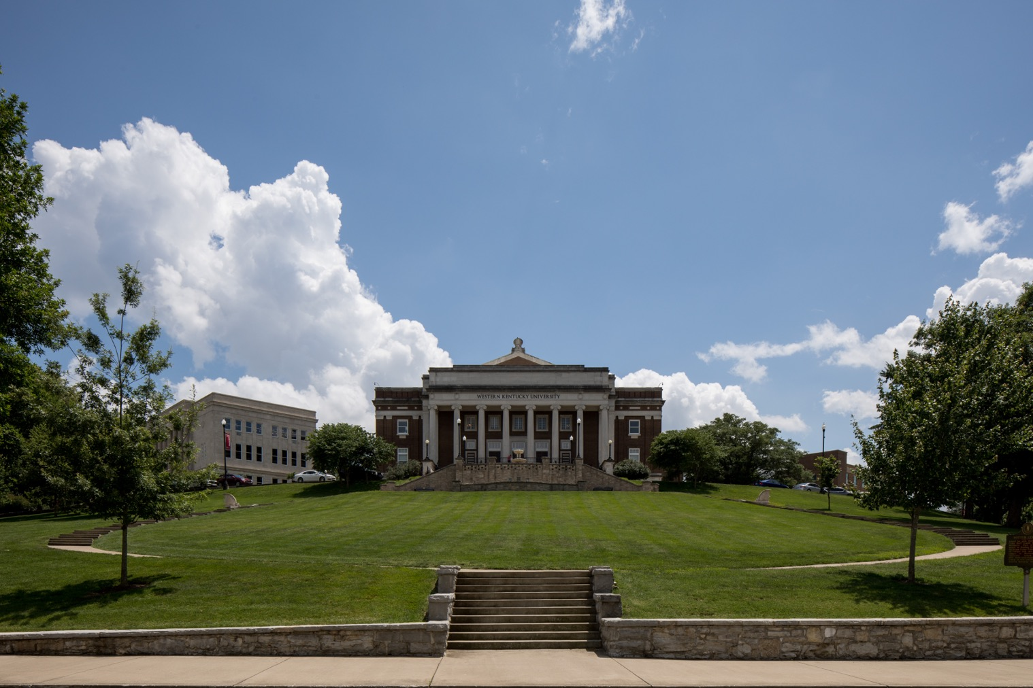
What Do I Even Put In A Consent?
Consent documents are the outline of the research for the participant so it should be easy to read and understand.
State that participants do not have to answer any questions they are uncomfortable with.
If there are no incentives explain that there are no direct benefits to the participants.

Slide 15
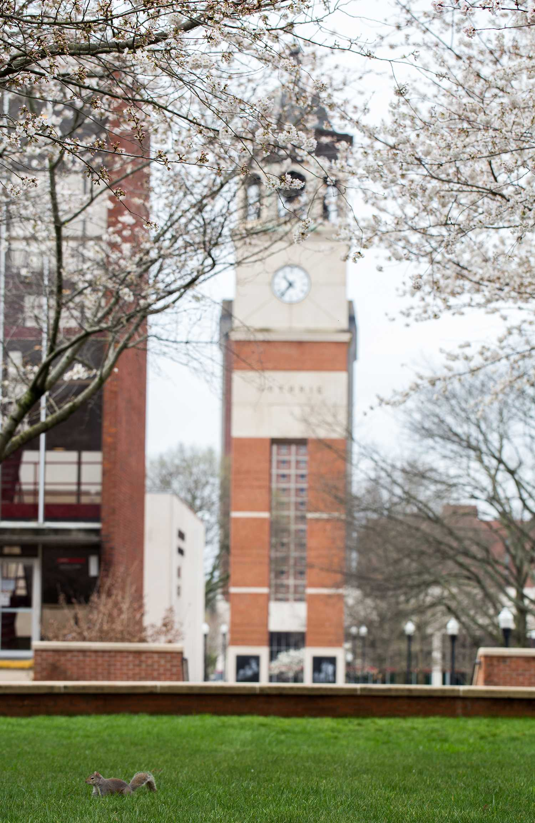
Where Do I Submit?
Now you will need to upload your required documents in IRBNet!

Slide 16
What Do I Upload?
Here are the documents you will need prepared before you submit in IRBNet. These are subject to change depending on the research you are conducting.
Based on Your Research
Surveys/ Interview Materials
Recruitment Scripts and Material
Letter of Permission/ Cooperation from the entity you are recruting from
                Example: I am recruting my participants from a pool of teachers at a high school, I will need to obtain a letter or email from the principal of their awarness and approval for me to conduct research there.
          Budget if you are receiving internal or external funding
At a Minimum
1. Human Subejcts Application
2. Informed/Implied Consent(s)

Slide 17
What Documents Do I Need?
Dr. Hilltop is conducting a research study with teachers at high schools in two counties in Kentucky. The research will include survey questions on what teaching resources are helpful for our community teachers. Recruitment will include an email with a QR code. What documents does Dr. Hilltop need to upload into IRBNet?
An application, an implied consent, recruitment email script, survey questions, and letters or emails from the superintendent of each county stating permission to recruit teachers in those counties.
An application, an implied consent, and survey questions.
An application, an informed consent, recruitment email script, survey questions, and a letter or email from the principle at one of the schools.
An application, and implied consent, and a letter or email from the superintendent of the two counties.

Slide 18
What Documents Do I Need?
Dr. Hilltop is conducting a research study with teachers at high schools in two counties in Kentucky. The research will include survey questions on what teaching resources are and could be helpful for our community teachers. Recruitment will include an email with a QR code. What documents does Dr. Hilltop need to upload into IRBNet?
An application, an implied consent, recruitment email script, survey questions, and letters or emails from the superintendent of each county stating permission to recruit teachers in those counties.
An application, an implied consent, and survey questions.
An application, an informed consent, recruitment email script, survey questions, and a letter or email from the principle at one of the schools.
An application, and implied consent, and a letter or email from the superintendent of the two counties.
Dr. Hilltop will need all of these for IRB review and approval. All materials should be uploaded into IRBNet upon submission or there could be delays in approval.

Slide 19
Uploading in IRBNet
Our website now has specific instructions for how to submit in IRBNet. This is under Preparing and Submitting an IRB Application
Create your Project and Upload Materials
Share Project with students, Co-PIs and others listed on the application
Sign the Package
Submit the Package
If Revisions are Requested, make sure to Lock the Package back for Review!

Slide 20
Who Needs to Sign?
Dr. Western is the faculty advisor for a graduate student. The student is conducting a research project which required IRB review. The student has submitted their project in IRBNet. Who needs to sign the package?
Just the student
Just Dr. Western
No one, the submission is enough
Both the student and Dr. Western

Slide 21
Who Needs to Sign?
Dr. Western is the faculty advisor for a graduate student. The student is conducting a research project which required IRB review. The student has submitted their project in IRBNet. Who needs to sign the package?
Dr. Western and the student need to sign. The student should share the package with their advisor for review and signature.
Reminder: Everyone listed on the project will need to sign the package.
Just the student
Just Dr. Western
No one, the submission is enough
Both the student and Dr. Western

Slide 22
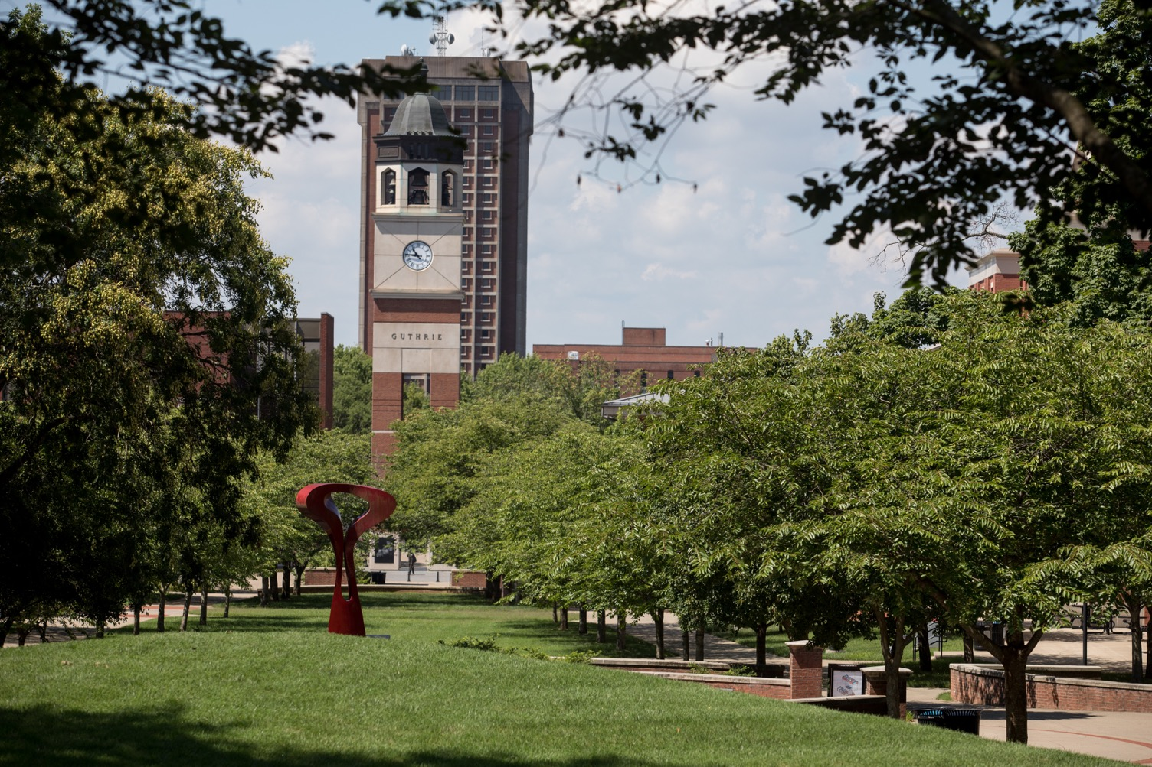
What Do I Do Now?
Once approved you may now begin research. Don’t forget these other important forms!
Continuing Review Form- Submit this to extend your study once it is about to expire. These should be completed within 30 days of expiration. If your project is expired no research activity, including data analysis may occur.
Amendment Form- Need to change something? Submit an Amendment Form to alter parts of the study that were not originally approved including but not limited to recruitment materials, adding personnel, changing survey questions, or altering participant incentives.
Closeout Form- All research completed? This includes data collection and data analysis. Once your project is completed please submit a Closeout Form to officially conclude the study and we will close your project out in IRBNet.
Please be sure to only complete forms directly downloaded from IRBNet or our Website as these are the most accurate and updated versions.

Slide 23
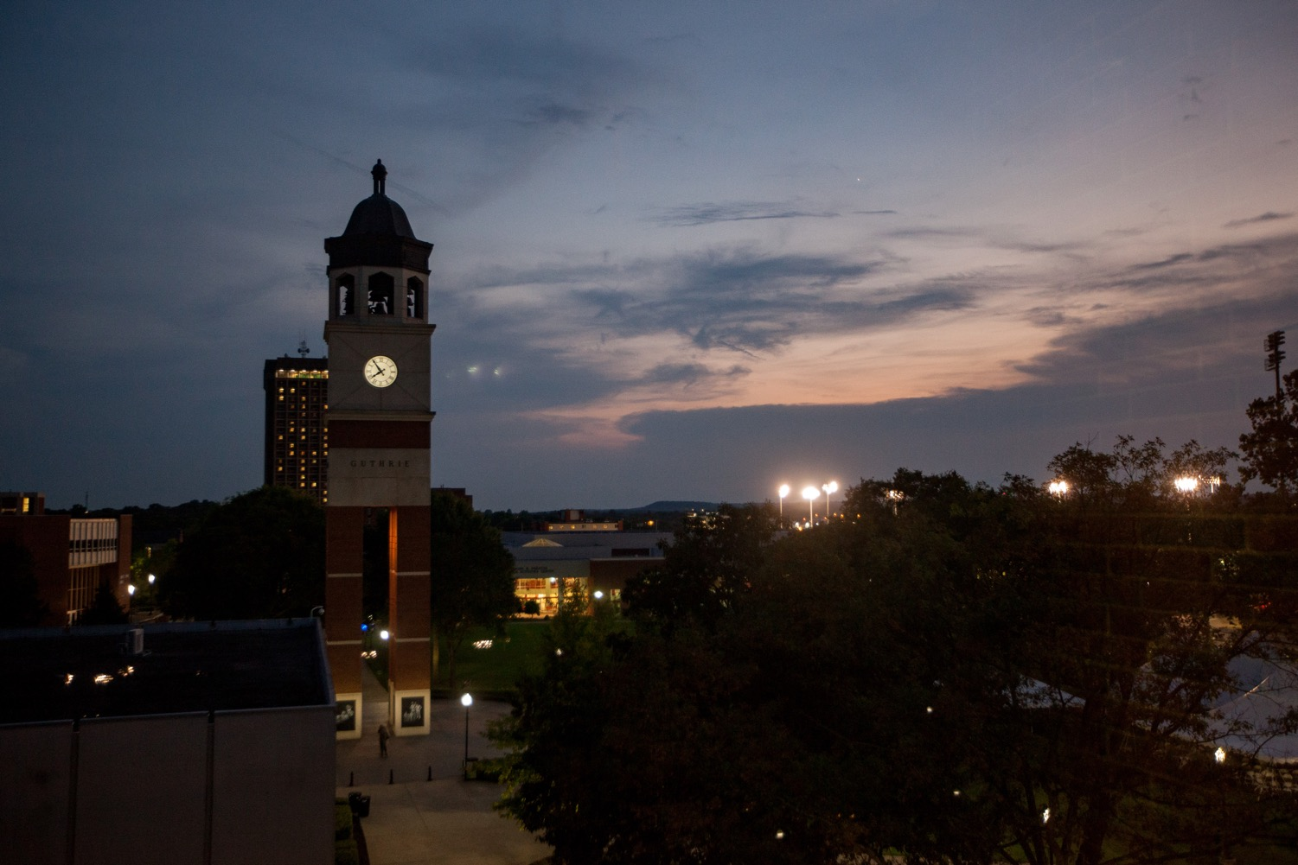
Questions?
Email: ori@wku.edu
Phone: 270-745-3360
Wetherby Administration Building
Suite 301
Website: https://www.wku.edu/compliance/

