Slide 1




Informed Consent VS Implied Consent
For Questions, please contact WKU Office of Research Integrity at ori@wku.edu

Slide 2
Informed Consent
In Human Subjects Research, consent is needed before performing any research with the subject.
Informed consents are used when there is direct interaction with the participant, intervention, interviews, and recording
Informed consents involve actual signature of the participant and the witness (the person obtaining consent)

Slide 3
Language in Informed Consent
At the top of the form
  “If you then decide to participate in the project, please sign this form in the presence of the person who explained the project to you. You should be given a copy of this form to keep.”
If you are working with another University include their name as well in the top portion next to Western Kentucky University
Signature Lines for participant and witness
If transcription or recording is happening, please keep the initial here section for audio/video recording

Slide 4
Implied Consent
Implied consent still requires a consent document like informed consent
Agreement is inferred based on the action of the participant
In WKU Human Subjects Research- these forms are used when there are only survey interaction with participants.
For example: If I am running a research study where I send out a mass email to all WKU students, the survey link would start with an implied consent and state “Your continued cooperation with this survey implies your consent” to which a “next” button would be shown. If the participant click next their consent is implied to be given

Slide 5
Language in Implied Consent
Use this at the top of the form
  “If you then decide to participant in the project, please click the button below to give consent to the survey. Please print this page if you would like to keep a copy of this form”.
No language about signing
At the end before the survey state
  “Your continued cooperation with the following research implies your consent”

Slide 6
What Language to Include in All Consents?
Clearly outline the nature and purpose of the project in easy-to-understand terms
If there are no risks, please state “This study will place participants at little to no risk.”
  Note that survey questions that could be uncomfortable can be risks. In this case, please include “participants are not required to answer any questions that may make them uncomfortable
If the research has no explicit benefits (like monetary or prizes) please include “While there is no direct benefit to the participant from this study”….(anything that could help the participant like knowledge or helping to a cause)
Under confidentiality, please include that data will be kept locked by a faculty member or PI for 3 years
If this is being completed in a class setting or on campus it is also important to note that participants grades, standing with the university, or otherwise will not be affected by their participation or non-participation in the study and they can withdraw at any time.

Slide 7
Frequently Asked
If I am conducting an interview AND a survey, do I need both consents?
  Yes, if you are conducting a survey online this will require an implied consent before the survey. Then if you conduct an interview (on zoom, over the phone, in-person) this will require informed consent where both parties will sign
Should I use the same information in my application as my consent document?
  You should explain the study in a way that participants can understand. This can be brief but informative. Do not copy and past everything from your application
Notes:
Since this research presentation is a result of your hard work and searching, you want to make sure you support the claims or points in your presentation with facts from your research findings. Make sure you give the author proper credit for helping you share your ideas. If one of your sources has a video that is relevant to your topic, you can add the video as added support. Keep in mind the length of the video and the amount of time you have for your presentation. For a 5 minute speech, the video should be no longer than 30 seconds.
Questions to consider:
How will you state the author of the source?
Will you need to cite the source on the slide?
What are some ways you can engage your audience so they feel like they are a part of the presentation? Some ideas to consider is by taking a quick poll like: by a show of hands, how many of you think school uniforms are a way to cut down on bullying? Another suggestion is to have them hold up a certain number of fingers to see if they agree or disagree. Finally, you can share a story that the audience can relate to that makes them laugh.
After all the applause, your audience may have some questions. Be prepared to answer some of their questions by making a list of questions you think they might ask. You may also want to share the presentation with them by providing the link to your presentation, if they want more information.

Slide 8
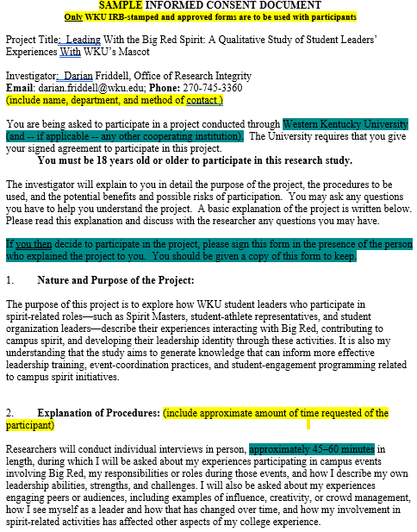
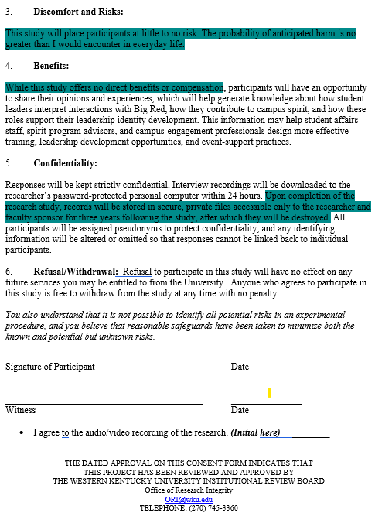

Slide 9
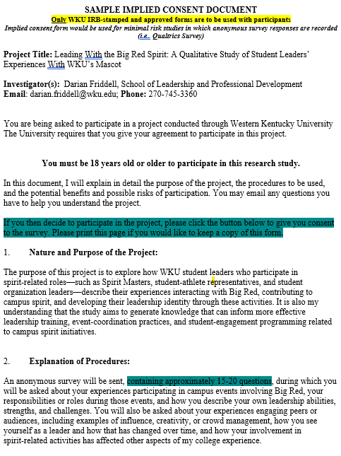
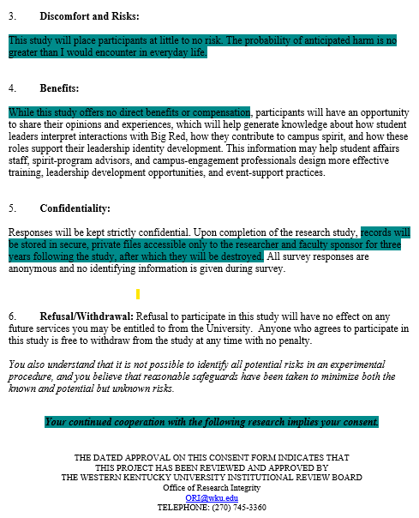

Slide 10
Questions?
If you have questions or concerns, please reach out to The Office of Research Integrity at ori@wku.edu

