Slide 1
Completing a Human Subjects Application
A guide by The Office of Research Integrity
ori@wku.edu

Slide 2
A human subject is defined by the Code of Federal Regulations (CFR) as "a living individual about whom an investigator obtains (1) data through intervention or interaction with the individual or (2) identifiable private information.“
Research is defined in the Code of Federal Regulations (CFR) as "a systematic investigation designed to develop and contribute to generalizable knowledge."
What is Human Subjects Research?
Human subjects research is systematic investigation designed to develop generalized knowledge about a living individual through data or interaction with that individual.
Examples:
Interviews
Surveys
Focus groups
Analyzing medical records
Testing interventions
Clinical Trials

Slide 3


Filling Out The IRB Application
Blank applications can be found within IRBNet in forms and templates as well as on our website at https://www.wku.edu/compliance/irbhumansubjects2021.php
Title of the Project
This should reflect the title within IRBNet and your consent documents.
Principal Investigator Information
Make sure to fill in the most recent CITI Training dates below. If they are close to expiring, make sure to take your refresher course!
Co-Investigator Information
Please leave blank if no Co-PI or if you are a student and have a faculty advisor.
List All Key Personnel
This is for any additional faculty, staff, or students on your project. If you need more spaces, please attach their information at the end of the application.

Slide 4
Filling Out The IRB Application
Blank applications can be found within IRBNet in forms and templates as well as on our website at https://www.wku.edu/compliance/irbhumansubjects2021.php
Student PI required questions
If you are a student please fill out this section of the application, otherwise please move to the next
Project Period
Add a future end date. This does not have to be exact but we do need an estimated project end.
Conflict of Interest Screening Question
Answer yes or no if you or any other key personnel have a potential conflict of interest, financial, personal, or otherwise.
External or Internal Funding
If “yes”, please fill in sections a-d below and attach your budget with the application

Slide 5
Filling Out The IRB Application
Blank applications can be found within IRBNet in forms and templates as well as on our website at https://www.wku.edu/compliance/irbhumansubjects2021.php
Participant Incentives
If you will be providing incentives in any form, describe below using sections a-c. You will be asked this question later but it is important to answer here as well for quick access to incentives in further approval processes.
Human Subjects
Answer question a-d concerning the level of human subjects research. If all four criteria are marked it may be required to review by a Biomedical IRB.
Existing Data
If you are only conducting research using a database please complete this question through section A. You are also required to add the databases if available or provide how they will be obtained
Plans to Publish
Publication includes: any presentation, publication, journal, paper, or outside sharing. If there is any potential you will use this data for any reason outside the University in the future this needs to be marked as “yes”.

Slide 6

Filling Out the IRB Application
Section A- Summary
This is a brief project summary of your research. It should include basic research design and hypothesis. Include any measurement tools you are using as well as define any acronyms clearly.
This is reviewed by many parties so using layman's terms or defining terms is helpful for us to read and understand
This does not need to include every single aspect of your project but should describe the main purpose and goal to establish working knowledge as the rest of the application is reviewed!
This section should be no more than half a page

Slide 7
Filling Out the IRB Application
Section B- Participant Information
Question 1 in this section is to determine if there are any vulnerable populations involved in the research.
If you are a student and any of the questions from Question 1 are answered yes, you will need to be listed as a Co-PI and your faculty advisor as the PI. Your faculty advisor will need to submit the application on your behalf.
Answer Questions 2-7 in enough detail for reviewers. This does not need to be super lengthy. A few sentences should suffice
Include any recruitment material or scripts in this application

Slide 8
Filling Out the IRB Application
Section C- Informed Consent
This section should include the process for how participants are consented.
State whether consent is implied or informed, how consent will be signed or given, and how consent will be reviewed with participants before research si conducted
If you are conducting multistage or multipopulational research you may have multiple different consents for groups of people or types of research being conducted in your project
Do Not include your consent documents in Section C. These should be uploaded separately in IRBNet.

Slide 9
Filling Out the IRB Application
Section D- Procedures
This should outline step by step instructions on how research is taking place
Include how long each step will take, how many questions in surveys/interviews, where it will take place, how and who will be conducting the step.
If applicable, explain how transcription audio recording or video recording will take place.
A sentence for each step is sufficient for this section.

Slide 10
Filling Out the IRB Application
Section E- Confidentiality
Confidentiality is a major section in the application. Even if a survey does not collect personal information, this must be described in this section.
Include how data will be stored during the retention phase after research in completed (WKU requires it to be maintained by a faculty member for 3 years).
If any contact information is collected for incentives or drawings please include how this information will be separate from survey or interview responses from participants
If you are using audio/visual recordings or transcriptions devices, please include how data will be de-identified or remain confidential

Slide 11
Filling Out the IRB Application
Section F- Risks
Describe any risks, discomforts, or side effects.
Please note that even uncomfortable questions could be considered a risk. In this case, please include this and outline that participants do not have to answer any question that makes them feel uncomfortable. This language is required in the consent document if potentially uncomfortable questions are present.
Describe any conflicts of interest or undue influence and how these will be mitigated
  Reminder that undue influence can arise from perceived positions of power. For example: a teacher handing out surveys to a class, students could feel pressured to participate because of the influence of the teacher

Slide 12
Filling Out the IRB Application
Section G- Benefits
Describe benefits or incentives
If participants do not receive any incentives, please include “there is no direct benefits for participants but may indirectly benefit from….”
Indirect benefits include but are not limited to sharing their opinion, reflecting on topics, education from the project, or contributions to research
Direct benefits or incentives include but are not limited to gift cards, cash, drawing for prizes, merch, etc.
When direct benefits are involved, please use specifical language such as $40 in cash, $30 amazon gift card, chance to win 1 out of 3 $10 Walmart gift cards,

Slide 13

Now What?
Ensure you have at a minimum: filled out an application and a consent document
Attach letters of support, survey/interview questions, supporting recruitment documents, and assents for minors if it applies
Submit through IRBNet
  Make sure all documents are uploaded and all PIs, students, and faculty advisors have signed the package.
Submit and the IRB will review and reach out with any revisions!!

Slide 14
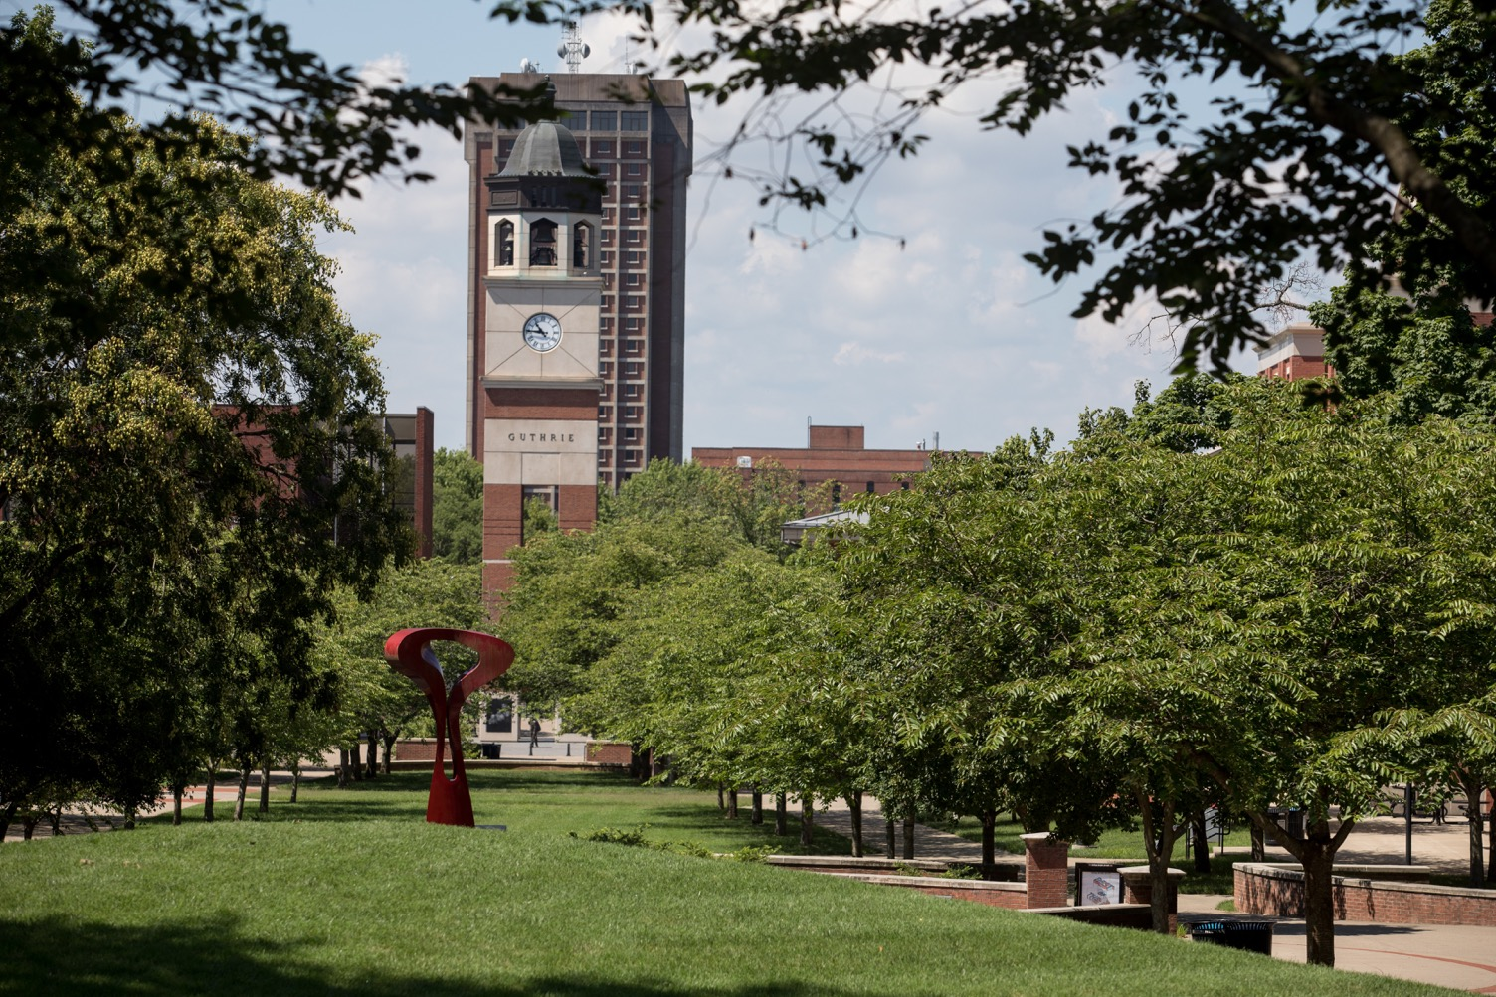
Further Questions?
Please contact The Office of Research Integrity
270-745-3360 ori@wku.edu
Wetherby Administration Building Suite 301

