Slide 1
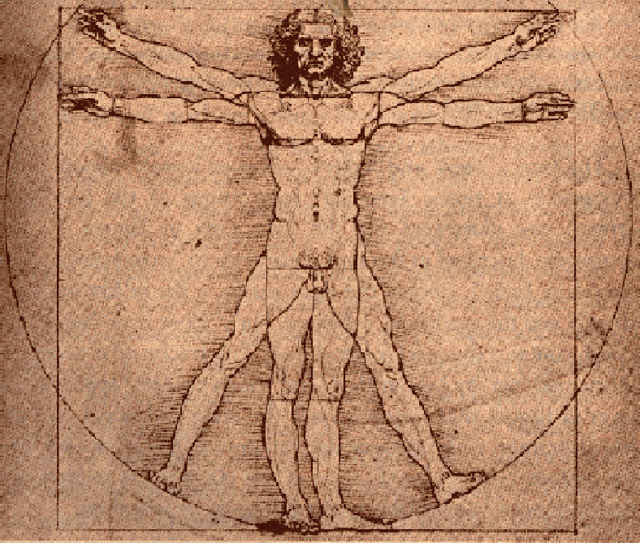
Biology Major
Academic Advising

Slide 2
Aims of this Session…
Familiarize Students with Requirements for Graduation
Familiarize Students with Requirements of the Biology Majors
Check Your Progress toward Graduation
Answer any Scheduling Questions for Next Semester
Release your Advisement Hold

Slide 3
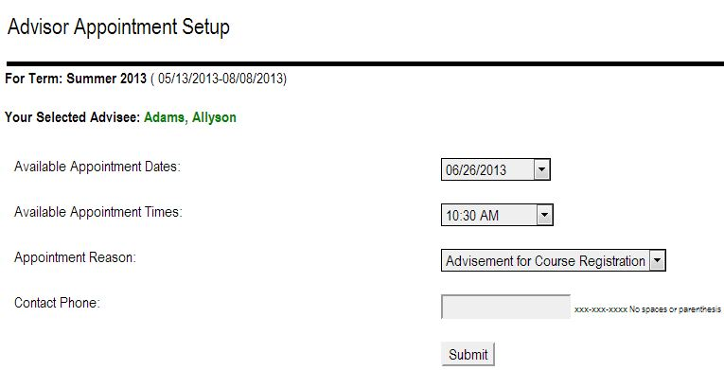
Advising
6
Who has to be advised?
What can an advisor do for me?
How do I find out who my advisor is?
Your name
TopNet, Student Services, Registration, View Advisor Information
Advisor Expectations
Colonnade Plan Requirements
Notes:
Every student needs to meet with their advisor each semester in order to register for classes for the next term. Exploratory students meet with advisors from the AARC while students with declared majors meet with an advisor relating to their major. You should expect to meet with your advisor in early to mid October. You can make an appointment with your advisor through TopNet.
Advisors can help make sure that you are taking the classes you need to be taking to keep on track toward graduation. They can help explore changes of majors. They can help you change your major. They are a listening ear to help you with academic related issues.
To find your advisor, you will log into TopNet. Advisor information is located in Student Services -> Registration -> View Advisor Information.
Your advisor may have certain expectations that they would like you to abide by.
Colonnade Plan Requirements:
There are 39 hours of general education that all students need to graduate from WKU with a Bachelors degree. These are spread out over three different categories (Foundation, Exploration, and Connections) and are designed to give more than just a particularly specialized degree.
Explain to students that there is some flexibility within the general education requirements.
Give examples as you go through the Colonnade Plan handout: Must take ENG 100 but can choose between HIST 101 and HIST 102.
This is where exploratory comes in

Slide 4
The ABCs of Grades
A, B, C, D, F… Fn, W?
Grade requirement for Biology majors
“C” or better
Academic Standing
Minimum 2.0 GPA for Biology Majors
Financial Aid and Grades
Notes:
Grades also differ in college. There are no “pluses” or “minuses” at WKU. Besides an A, B, C, D, or Fail grade, there also grades of “Fn” and “W”. A grade of “Fn” is failure due to non-attendance. It affects your GPA just like an “F” does. A grade of a “W” represents that you officially withdrew from the course. This can be done up through the midpoint of the semester and is done through TopNet. You cannot withdraw from a class simply by not going anymore. A “W” does not affect your GPA at all. For all but record purposes, it acts as if you never took the class at all.
While a “D” is technically passing a class, some classes require a better grade in order to continue taking similar classes. For example, if you are majoring in Biology, you need a C or better in Biology classes. Be sure to check with your major and advisor to ensure that you know and get the grades you need. Know also that certain majors require certain GPAs to be admitted into that program. Example: Biology majors require a cumulative GPA of 2.0 or better. And some programs, like nursing, are competitive meaning that even though they require a minimum of a 2.75 GPA, meeting that requirement does not ensure that you will be accepted.
To remain in good academic standing, you need to have a certain GPA. If you have less than 17 credits earned, you need to achieve higher than a 1.7 GPA. You need higher than a 1.8 if you have between 17 and 34 hours earned. Falling below once will put you on Academic Warning and a second time leads to Academic Probation. Academic probation will enroll you in the Best Expectations Program which will require monthly advising appointments, attendance at two academic workshops, and 6 monitored study hours/week among other things. This is designed to help those students achieve academic success.
It is important to note that financial aid requires certain academic progress. Grades of “F”s, “Fn”s, and “W”s can influence your ability to receive federal financial aid. In more ways than one, it is very important that you pass all of your classes.

Slide 5
Requirements for Graduation
120 Credit Hours; 42 must be 300 or 400 level
Major in Biology
36 Credit hrs. (#617) requires a minor (18 hours)
48 Credit hrs. (#525) no minor required
Major in Medical Technology (#582)
Major in Biochemistry (#519)
General Education; 44-45 credit hours
Really 36 Hours (double dip the Math and Science)
Notes:
WKU students require a minimum of 120 credit hours to graduate
Of the 120 credit hours, 42 of them must be Upper Division. Upper division are classes that are labeled at 300 or above.
There are two major options in Biology. One is with a Minor. The other option is without a minor. The Biology program that contains the minor is adjusted in credit hours to allot for the minor. A typical minor at WKU requires approximately 18-21 hours.
The department of Biology at WKU also offers degrees in Medical Technology and Biochemistry.
All majors at WKU requires 44-45 credit hours of General Education credit. However, one section of General Education is fulfilled through major’s classes therefore, leaving only 36 hours of General Education credit to be taken.

Slide 6
Requirements for the Biology Majors
Biol 120/121 and 122/123 (8)
Biol 222/223 or Biol 224/225 or Biol 226/227 (4)
Biol 319 or Biol 327 with lab of 322 or 337
Biol 315 or Biol 316 (3)
Laboratory experience (5): consult advisor
Electives to reach 36 or 48 hrs
Select electives in consultation with your advisor
Notes:
These classes are required for all Biology majors

Slide 7
Required Supporting Courses
Math 116 and 117, or higher
Phys 231/232 or 255/256
Chem 120/121, and
Two of the following: Agro 350, 452, 454, 455 & 456, 457 & 458, Biol 383, Chem 222/223, Chem 314 or Chem 340/341, Chem 330, CIS 343, CIS 226 or CS 226 or CS 230, Geog 316, Geog 317, Geog 415, Geog 417, Math 136, Math 137, Math 305, Math 307, Phys 332/233 or Phys 265/266, Socl 302.
Required for most health professions
Notes:
These are the supporting courses required for successful completion of a Biology Major

Slide 8
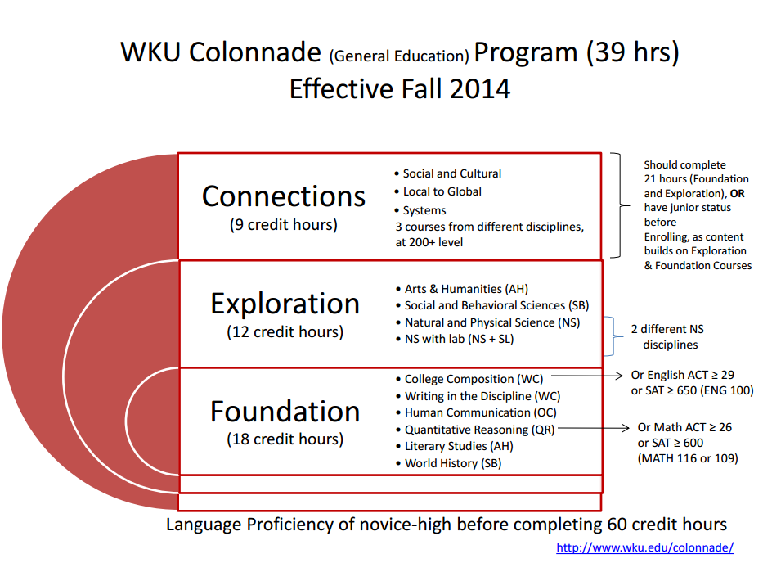
7
Notes:
When you meet with your advisor for your advising appointment, they are going to discuss your major course requirements as well as the Colonnade Plan requirements. The Colonnade Plan is a new set of general education requirements beginning in the Fall 2014 semester. All WKU students that attended prior to the fall 2014 semester fall under an old set of general education requirements. Be sure to listen to your advisor about these new requirements and not friends or family that started prior to Fall 2014 as they may not be familiar with the Colonnade Plan Requirements.
All WKU students are required to complete a total of 39 hours of Colonnade Plan Requirements. These requirements will apply to every WKU student no matter their major. The 39-hour WKU COLONNADE PROGRAM consists of the following required coursework:
Foundations: Practical and Intellectual Skills (18 hrs.)
Explorations: Knowledge of Human Cultures and the Physical and Natural World (12 hrs.)
Connections: Understanding Individual and Social Responsibility (9 hrs.)
Pull up a link to the Colonnade Plan approved courses and breakdown the requirements: http://www.wku.edu/colonnade/documents/approved_colonnade_courses_website.pdf
Foundations:
You will be required to take 18 hours from this section before you graduate. Courses include: ENG 100 (3 credit hours), COMM 145 (3 credit hours), ENG 300 or equivalent (junior/senior year) (3 credit hours), MATH (3 credit hours), ENG 200 (3 credit hours) and HIST 101 or HIST 102 (3 credit hours).
Explain the ACT/SAT scores –
English ACT score of 29 or higher or SAT score above 650 will give student credit for ENG 100
Math ACT score of 26 or higher or SAT score above 600 will give student credit for MATH 116
Explorations:
You will be required to take 12 credit hours from this section before you graduate.
Categories include Arts and Humanities, Social and Behavioral Sciences and Natural and Physical Science. You will be required to take one course from Arts and Humanities (3 credit hours) and Social and Behavioral Sciences (3 credit hours). You will be required to take two courses from Natural and Physical Science (6 credit hours), one of which will require a lab. The Natural and Physical Science will need to be different disciplines.
Connections:
You will be required to take 9 credit hours from this section before you graduate. You will not be eligible to take these courses until you have earned 21 hours from Foundations and Explorations or until you have reached Junior standing.
Categories include Social and Cultural, Local to Global and Systems.
You will be required to take one course from Social to Cultural (3 credit hours), Local to Global (3 credit hours) and Systems (3 credit hours).
Language Proficiency of Novice-High must be reached before 60 credit hours. This can be done by taking a language test at the Counseling and Testing Center or by completely a language at the 120 level or higher (Additional information can be found on the Modern Language Website, http://www.wku.edu/modernlanguages/placement/)

Slide 9
What should I have completed during…
Second Year
English 200
Math 117
Phys 231/232
Biol 222 or 224 or 226 (+lab)
Biol Supporting Course
Course in Minor or Additional Bio Course
Colonnade
Colonnade
Approx. 60 total credit hours
First Year
English 100
Comm 145
Hist 101 or 102
Math 116
Chem 120 & 121
Biol 120 & 121,
122 & 123
Colonnade
Approx. 30 total credit hours

Slide 10
Graduation Reality
9
Minimum of 120 hours needed
12 hour minimum to be full time
BUT… 12 hours X 8 semester = 96 hours
15 hrs/semester = 120 hours in 4 years
Or winter and summer hours can be taken to supplement spring and fall classes
Developmental courses
Failing a course
Notes:
You need 120 hours to graduate from WKU with a Bachelors degree. 39 of these will be general education requirements, the rest will come from your major and possibly electives.
To be a full time student, you need to take 12 credit hours. But everyone wants to graduate in four years, or eight semesters, right? Well four years of 12 credits/semester will only get you to 96 credits. 12 credits a semester will lead towards a degree in 5 years.
In order to graduate in four years, you need to average 15 credits a semester or 30 credits a year. Smaller course loads can be taken in the fall/spring and supplemented with winter and summer classed to keep you on track. Just remember that credits taken and credits earned also affect things like financial aid.
Also note that developmental courses, course designator of less than 100, do not count towards your graduation total or cumulative GPA.
English ACT of 16/17 – Students take 100E – one extra hour per week (counts as credit)
English ACT 15 and below – student takes English 055 – must pass with a “C” or better to take ENG 100
Reading ACT 18/19 – Student takes Literacy 199 (counts as credit) – must pass with a “C” or higher
Reading ACT 17 and below – student takes DRDG 080 – must pass with a “C” or better
Math is determined by ACT score and the Math Department Placement test according to a chart. DMA 055 and DMA 096 require a “C” or higher in order to move on to the next level.
Failing a course in most cases means getting an “F” although some classes require a “C” or better. If you fail, all is not lost! You can repeat courses.
Repeating courses – (Undergraduate Catalog page 30)
An undergraduate student is permitted to repeat a maximum of six courses. Only two courses in which a grade of “C” or above has been earned may be repeated.
Credit for a course in which a grade of “F” has been received can be earned only by repeating the course in residence unless prior approval is given by the head of the department in which the course was failed.
A course in which a grade of “D” has been received may be repeated at another accredited institution.

Slide 11
iCAP
Degree Audit for your major
“What if” Audit
TopNet
Student Services
iCAP (Interactive Degree Audit)
Notes:
iCAP is a students tool for success! The iCAP , which is a degree audit, can be found under the Student Services tab in Topnet. The iCAP will tell you what classes to take and which ones you have already taken. You can also run a “What If” Audit if you are considering changing a major but are not sure to what you want to change or if you are simply curious!

Slide 12
8
Notes:
Another tool to assist you in understanding your Colonnade Plan requirements is iCAP…
Ask for a M.A.S.T.E.R. plan volunteer before you start the session. Use their name or 800# so you can pull up their iCAP. You will need to use a new student as an example because any students that attended WKU before the fall 2014 semester will be listed under the old General Education Requirements.
Must have all green checkmarks to graduate.
Give examples of how the audit works (plus signs/minus signs)
Describe “What If” Audits

Slide 13
Tips for Academic Success
Attend class
Notify your instructor before missing a class if possible
Do the required reading
Complete assignments on-time/early
Keep coursework high on your priorities
Academic Dishonesty will earn you an F, or worse
Check your WKU email/Blackboard every morning
Notes:
No one will make you go to class. Attending class is your responsibility. Be aware of the attendance policy for each of your classes. Each instructor may keep track of attendance in different ways. Also be aware that WKU has an overall attendance policy and you can fail a class due to lack of attendance.
Notify your instructor as soon as you find out that you must miss a class. When needed, be prepared to provide documentation for the absence. Always offer to get the notes from a class mate and NEVER ask if you missed anything important. Instructors view every class as important and this will only hurt your image in their eyes. If you miss class unexpectedly, be sure to talk to a class mate for the notes and if something was handed out, ask the professor for that specific handout.
Do the required reading for class. The readings and lectures will supplement each other and provide detail at various levels in different areas. Some instructors will test you on information they never mention in class but expected you to have read from the text.
Do things early. You will often know about assignments from the beginning of the semester through the syllabus. Start them as soon as you have the information you need to complete the assignment. Because you have weeks to complete assignments, late work is often not accepted. Many instructors may even take a look at work completed early and guide you towards the highest possible grade, giving you suggestions to improve your work.
Set priorities. Make sure that your education is very high on your list beginning with going to class, studying, and completing all assignments.
Academic dishonesty (plagiarism, cheating, copying, etc.) will earn you an F. It is a violation of the student code of conduct and may also lead you to trouble with university disciplinary system.
Check your WKU e-mail and Blackboard every day, even multiple times a day. This is how instructors and university officials will communicate with you outside of class and not seeing a message is no excuse.

Slide 14
More Tips for Academic Success
Get to know your instructors
Get to know your academic advisor
Treat school as a full-time job (40 hours a week)
Make study time a regular part of your day
Make friends in class… the kind that will help you, not the kind that will distract you
Get tutoring/help when you need it
Get involved in your Major’s student organizations
Student Resources and Organizations
Notes:
Get to know your instructors. Doing so can help you in ways you may not realize. Borderline grades can shift due to class participation and an instructor’s acknowledgement of who you are. It can lead to networking within your major and future profession. And it could lead to opportunities that help you gain experience in your field. You never know what a good relationship with an instructor can do for you.
Get to know your academic advisor. You will need to communicate with him/her every semester in order to register for classes at the very least. He/she can be a very valuable resource in ensuring that you graduate in a timely manner.
Treat school as a full time job. If you spend 40 hours a week on school (including time you are actually in class), you should be extremely successful here. This should be spent reading for class, reviewing notes, completing assignments, and studying. The Learning Centers on campus offer a great quiet space to accomplish any of these things. Make it a regular part of your day and you shouldn’t have to worry about cramming and pulling all-nighters.
Make friends in class. These friends can help you study and offer a second set of eyes and ears that may pick up on different pieces of information. Learn from these friends and use each other to succeed, not to goof off.
As soon as you realize you are struggling in a course, seek out tutoring. They can’t help you the day before your final in December nearly as much as they can help you over the course of weeks starting in October. Tutors are provided in a number of courses and they have all received an A or B in the course they are tutoring.
Get involved in your Major’s student organization if there is one. This is a great way to meet the faculty of your major, other students in your major, and professionals working in your field. It will help provide you the experience and networking skills that will help lead you toward success after college.

Slide 15
In Conclusion:
Enjoy your time at WKU.
Make new friends.
Learn.
Participate in campus activities.
Get to know your advisors and instructors.
Prepare for an exciting future.
Notes:
Wrap-up of general tips:

Slide 16
Biology Advising Center
TCCW room 376
270-745-2638
Biology.advising@wku.edu

