Slide 1

WKU Biology
https://www.wku.edu/biology/
biology@wku.edu
270-745-3696
#becausescience
The Department of Biology at WKU strives to create a dynamic, experiential learning environment, and to be a destination department for competitive undergraduate and graduate students, involving them in the process of science and preparing them for success in a global society.

Slide 2
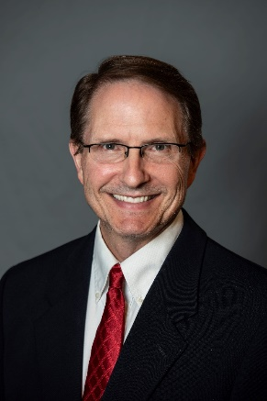
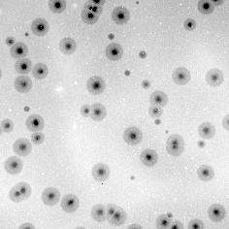
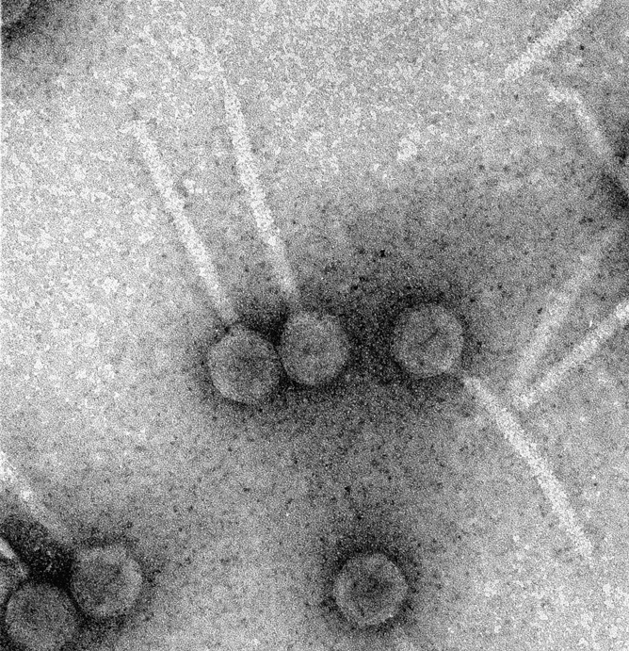
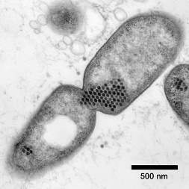
Dr. Rodney King
University Distinguished Professor
Ph.D. - Medical College of Virginia
B.S. - Virginia Tech
Interested in Graduate or Undergraduate Research with Dr. King?
Courses
BIOL 212 Genome Discovery and Exploration
BIOL 226/227 Microbial Biology & Diversity
BIOL 407/407H/407G Virology
BIOL 470/470H/470G Pathogenic Microbiology
Biol 450 Recombinant Gene Technology
BIOL 568 Advanced Microbiology
Identification and characterization of RNA based transcription antiterminators
Research​
Bacterial and Bacteriophage genetics
Bacteriophage biology
Control of transcription elongation and termination
Genomic analysis of Bacteriophages
Phage-host interactions
Clubs​
WKU Microbiology Club Advisor
rodney.king@wku.edu

Slide 3
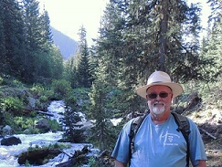
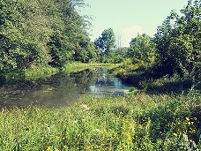
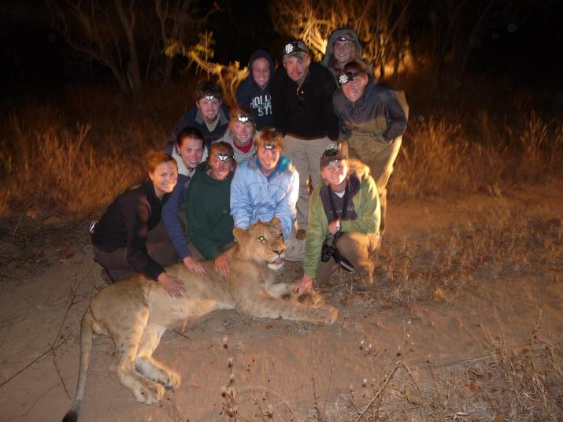
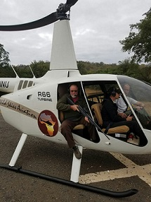
Dr. Michael Stokes
Professor
Ph.D. – University of Kansas
M.A. – University of Kansas
B.S. – University of Missouri Kansas City
Courses
BIOL131 Intro to Human A&P
BIOL332 Principles of Wildlife Ecology and Management
BIOL372 Human-Wildlife Conflict
BIOL459 Mammalogy
BIOL 485 Field Biology: Conservation and Management of African Wildlife (in South Africa)
BIOL518 Population Ecology
BIOL519 International Wildlife Management and Policy (online only)
Interested in Graduate or Undergraduate Research with Dr. Stokes?
Animal darting in Africa for conservation efforts
Mouse diet analysis
Rainwater collection and analysis
Drone fly overs for habitat analysis
Research
What role do rodents play in structuring their habitats in African savannas?
Can existing social-psychological models be applied to developing effective indigenous wildlife conservation efforts?
http://www.ecologyandsociety.org/vol18/iss4/art40/ES-2013-5837.pdf
michael.stokes@wku.edu

Slide 4
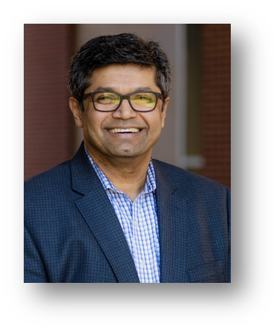
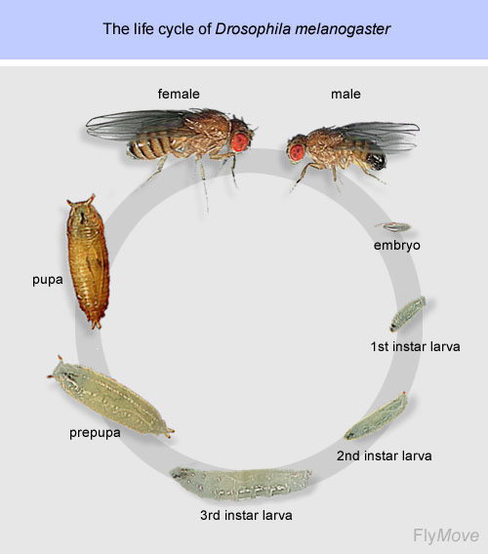
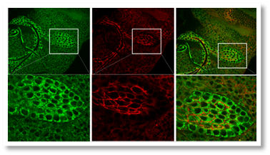
Dr. Ajay Srivastava
Professor
https://sites.google.com/view/srivastavalab-at-wku/welcome-to-srivastava-lab
Postdoctoral - Yale University
Ph.D. - University of Alberta
Courses
BIOL 120 Introductory Biology
BIOL 327 Genetics
BIOL 411 Cell Biology
BIOL 440 Developmental Genetics
Research
We use genetic tools available in the model organism Drosophila to better understand and dissect the underlying mechanisms of normal development and disease.
We are particularly interested in understanding the contributions of Extracellular Matrix to normal development and tumorigenesis.
Work done by the Srivastava lab has demonstrated the involvement of a Cathepsin L and JAK/STAT pathway in Air Sac Primordium development – specifically in invasive cellular behavior.
Development of Drosophila wing is another area of my labs’ interest as this is an excellent model for organogenesis where various events that give rise to an adult structure can be studied.
Several projects spanning the domain of our interest are available for motivated students.
Interested in Graduate or Undergraduate Research with Dr. Srivastava?
Understanding the underpinnings of tumor metastasis and normal development using Drosophila melanogaster as a model organism.
Understanding the contributions of Extracellular Matrix (ECM) and proteases to tumor progression and normal development.
We use Drosophila to address problems in development and disease
ajay.srivastava@wku.edu

Slide 5
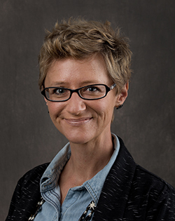

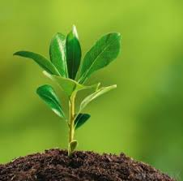
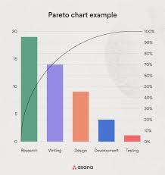
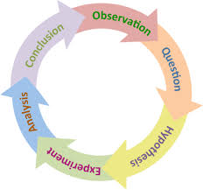
Dr. Natalie Mountjoy
Assistant Professor
Ph.D. -Southern Illinois University
Courses
Research
Interested in Graduate or Undergraduate Research with Dr. Mountjoy?
Measuring the impact of increased inquiry-based techniques in the biology curriculum
Assessing the effects of metacognitive interventions on BIOL-gateway course success
Learning Assistants in the General Biology Lecture Hall: How peer mentoring and small groups can transform the student experience in large lectures
Why they stay: Analyzing the persistence of at-risk students in the Ogden College of Science and Engineering to identify successful retention initiatives and programs
Patient Perspectives With Telehealth Visits in Cardiology During COVID-19: Online Patient Survey Study
Comparing COVID vaccine side effects in clinical vs. real-world applications, across brand types Moderna, Pfizer, and Johnson & Johnson
Development of Tsavo-Bushmeat database, populated by molecular data sourced by BIOL 121 students, can help identify poaching hotspots in the region.
BIOL 120
BIOL 121
BIOL 123
BIOL 369 BioCoaches
BIOL 369 Med Center Patient Coordinators
BIOL 397 Biomedical Research
Pedagogical Research
  Inquiry-based techniques, student retention and success
Ecological Research
  Community-based natural resource management and human wildlife conflict
Biomedical Research
  Research Consultant with Med Center
natalie.mountjoy@wku.edu

Slide 6
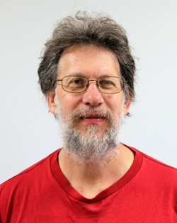
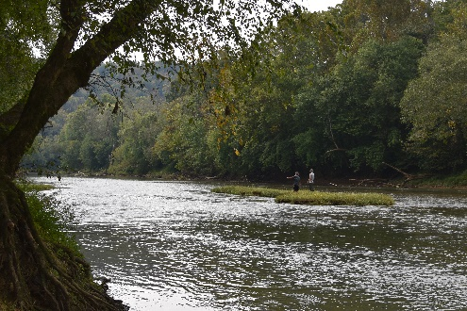
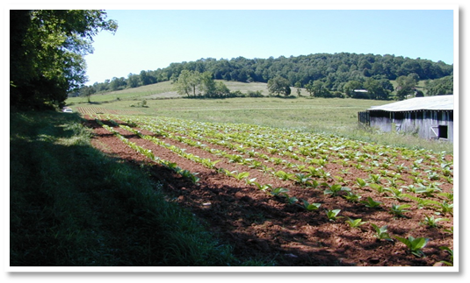
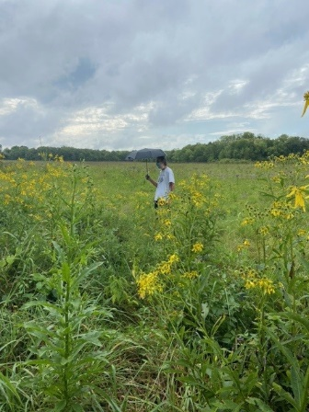
Dr. Albert Meier
Professor
Ph.D. – University of Georgia
Courses
BIOL 315 Ecology
BIOL 515 Advanced Ecology
BIOL 598 Graduate Seminar
BIOL 348 Plant Taxonomy
Interested in Graduate or Undergraduate Research with Dr. Meier?
Upper Green River Preserve Research and Management
Ecology, Biodiversity, and Conservation Biology.
Response of forest herbs to disturbance
Systems Ecology and Network Analysis
Eastern Old Growth
Research​
Ecology, Biodiversity, and Conservation Biology.
Eastern Old Growth
Response of forest herbs to disturbance
Upper Green River Research
Systems Ecology and Network Analysis
albert.meier@wku.edu

Slide 7
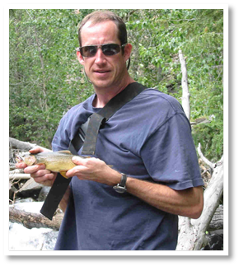
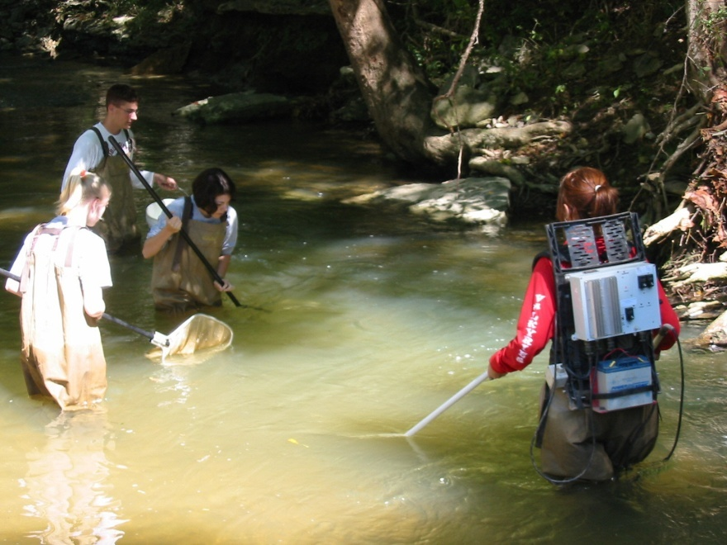
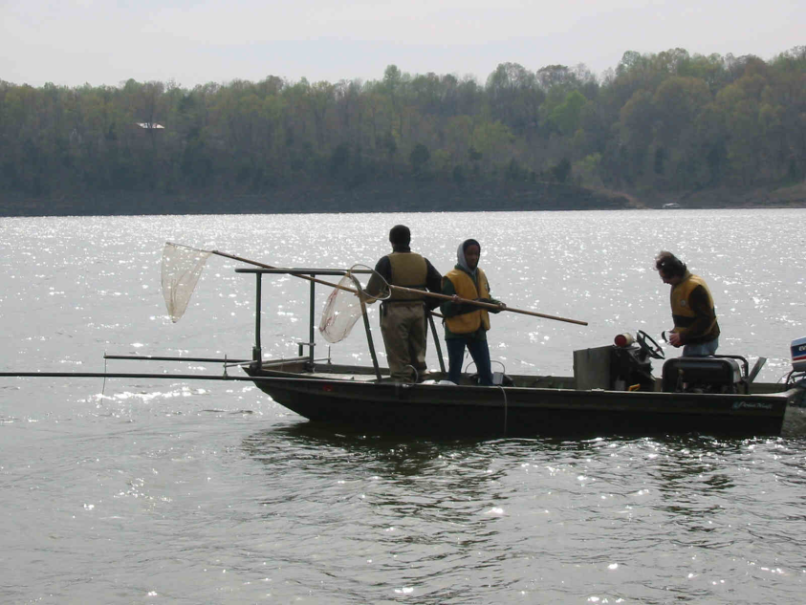
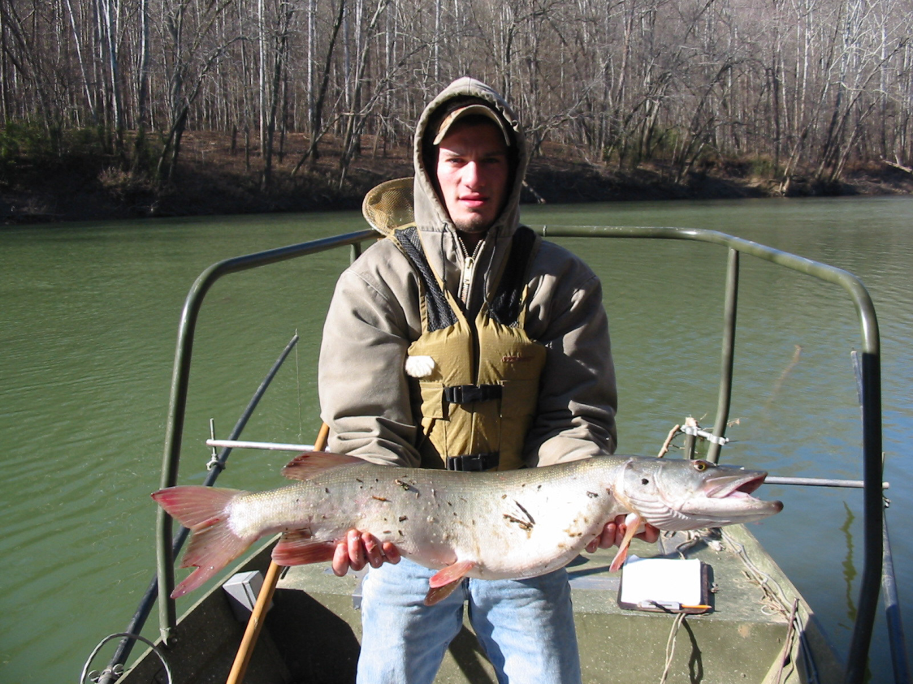
Dr. Philip Lienesch
Professor
Ph.D. - University of Oklahoma
Courses
BIOL 122 Biological Concepts – Evolution, Diversity & Ecology​
BIOL 224 Animal Biology & Diversity
BIOL 380 Challenges of a Changing Biosphere​
BIOL 456 Ichthyology ​
BIOL 458 Fisheries Management
Interested in Graduate or Undergraduate Research with Dr. Lienesch?
  Effects of introduced species on aquatic communities​
Effects of reservoirs on stream fishes distributions
Catfish Behavior
Research​
Basic aquatic ecology
Applied fisheries management.​
philip.lienesch@wku.edu

Slide 8
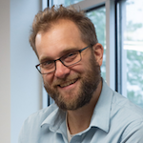
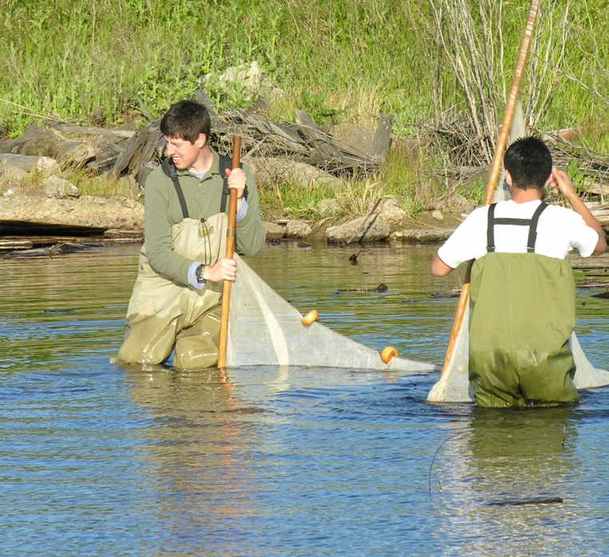
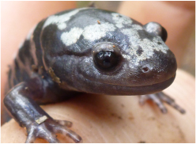
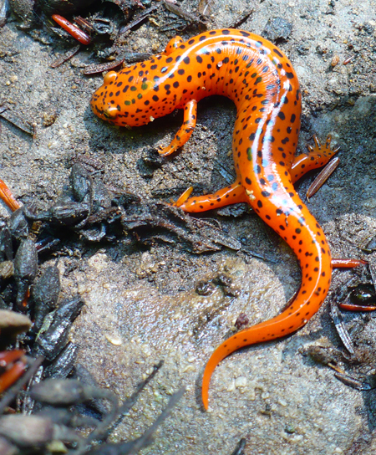
Dr. Jarrett Johnson
Associate Professor
https://people.wku.edu/jarrett.johnson/index.html
Ph.D. - University of Missouri
B.S. - University of Illinois
Courses
BIOL 327/337 Genetics & Genetics Lab
BIOL 457 Herpetology
BIOL 524 Ecological Genetics
BIOL 582 Biometry
Interested in Graduate or Undergraduate Research with Dr. Johnson?
Our goal is to provide empirical data that are relevant to the conservation and management of amphibian populations.
Using field and laboratory experimentation to understand local adaptation and speciation.
Molecular genetic tools to understand gene flow using amphibian species as models.
Improving our understanding of evolution and ecology.
Research​
Evolutionary Ecology and Population Genetics
Conservation of Amphibians
jarrett.johnson@wku.edu

Slide 9
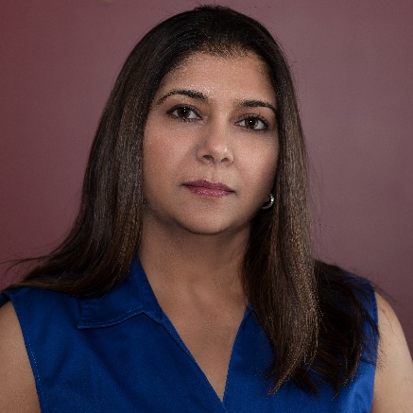
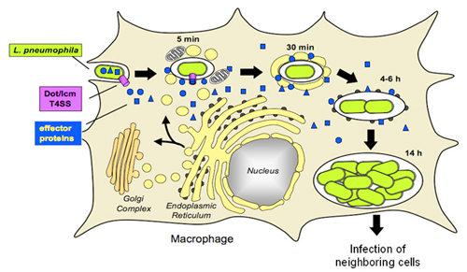
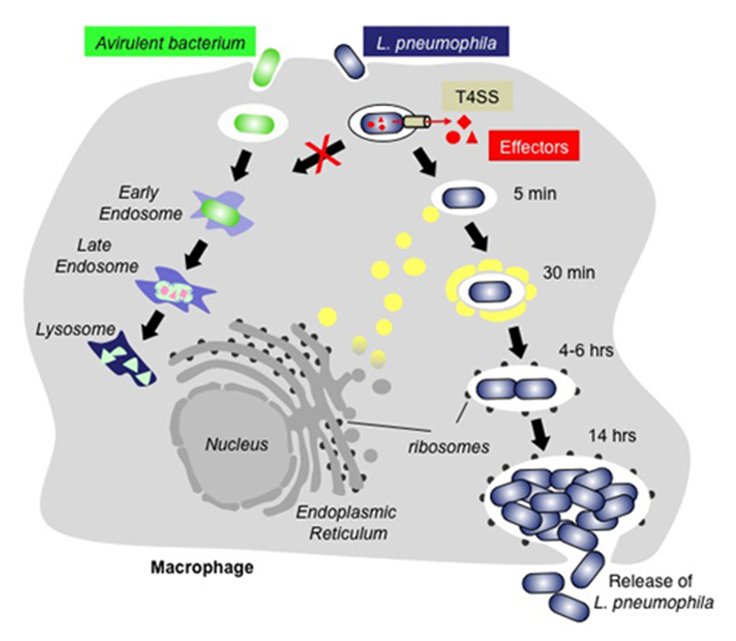
Simran Banga, Ph.D.
Assistant Professor
Ph.D. – Purdue University
M.S.- University of Mumbai
Courses
Interested in Graduate or Undergraduate Research with Dr. Banga?
BIOL 121 Biological Concepts Laboratory: Cells, Metabolism, and Genetics
BIOL 207 General Microbiology
BIOL 226 Microbial Biology & Diversity
BIOL 227 Microbial Biology & Diversity Lab
BIOL 328 Immunology
The lab research focus is on characterizing the functional role of bacterial proteins during an infection. The research in my lab is related to biomedical fields specifically microbiology, cell biology, immunology, biochemistry and molecular biology.
Research
Research involves microbiological, molecular and cell biology techniques to understand the mechanisms of bacterial pathogenesis.
Microbiology, Host-bacterial interactions, Bacterial infections
My research interest is understanding host-bacterial interactions during infections especially by pathogens that grow inside the cells. We use macrophages and Legionella pneumophila, the causative agent of Legionnaires disease, an infection model system. L. pneumophila releases an array of bacterial proteins upon infection to hijack multiple host cellular processes to survive and replicate.
Specially interested in understanding the function of different proteins released by Legionella pneumophila during an infection.
Collaborative project on effect of photodynamic treatment on bacteria.
simran.banga@wku.edu

Slide 10
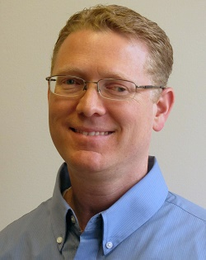
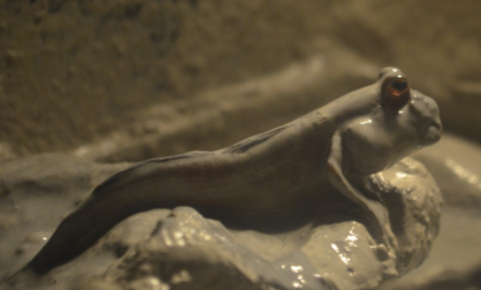
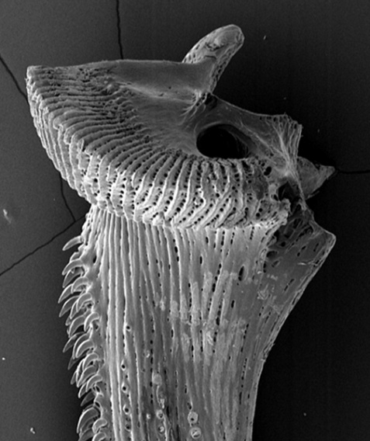
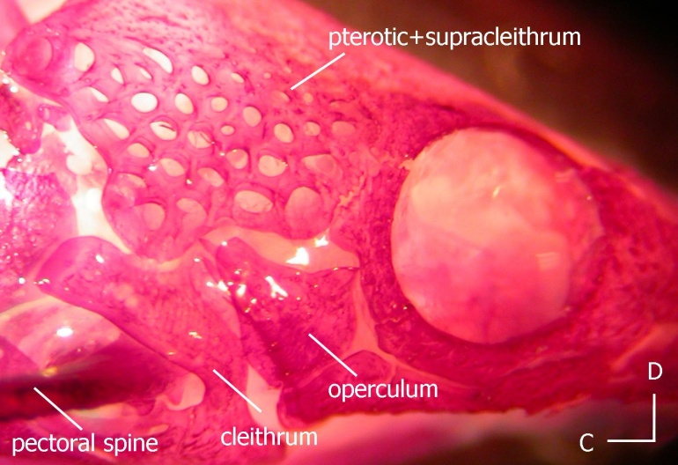
Dr. Michael Smith
Dept. Head - Professor
https://www.wku.edu/smithneurobiologylab/
Ph.D. - The University of Texas at Austin
B.S., M.S. -Brigham Young University
Courses
BIOL 120 Honors Introductory Biology
BIOL 335 Neurobiology
BIOL 545 Animal Communication
Interested in Graduate or Undergraduate Research with Dr. Smith?
Vibratory communication in mudskippers and chameleons
Ototoxic effects of platinum chemotherapies on hair cells
Sound production and hearing in suckermouth catfishes
Auditory hair cell regeneration in zebrafish
Effects of anthropogenic sounds on fishes
Research​
Auditory Neurobiology and Bioacoustics of Fishes
  Research in my lab uses electrophysiological, behavioral, molecular, and morphological analysis to understand processes related to hearing in teleost fishes.
Vibratory Communication
  Behavioral and morphological analysis of communication via substrate vibration in chameleons and mudskippers
michael.smith1@wku.edu

Slide 11
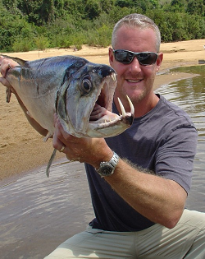
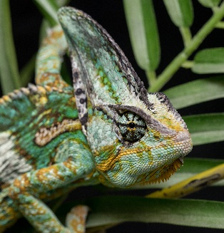
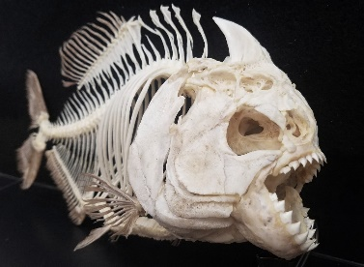
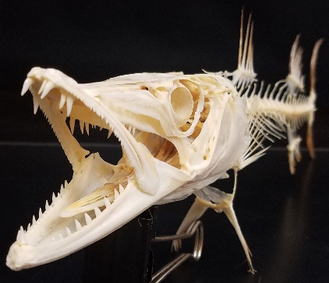
Dr. Steve Huskey
Professor
Post-doctoral - UC Davis
Ph.D. - Florida Tech
B.S. - Western Michigan University
Interested in Graduate or Undergraduate Research with Dr. Huskey?
Courses
BIOL 122H Introductory Biology
BIOL 377 Animal Form & Function
BIOL 477 Marine Biology
BIOL 527 Adv. Animal Form & Function
BIOL 577 Adv. Marine Biology
My lab focuses on understanding the mechanisms that underlie vertebrate performance, such as:
feeding
burrowing
climbing
swimming
running
flying
Research​
Feeding performance in fishes
Chameleon communication
Functional morphology of dynamic mechanisms
Skeletal reconstruction
steve.huskey@wku.edu

Slide 12
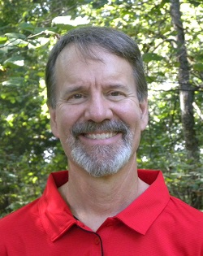
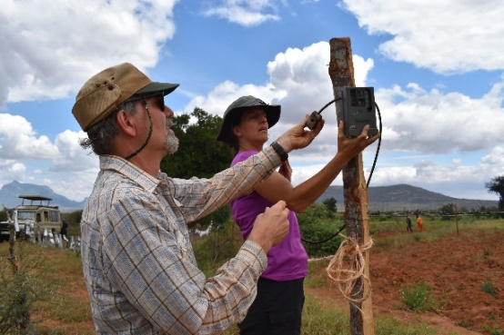
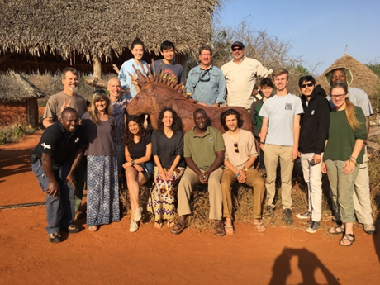
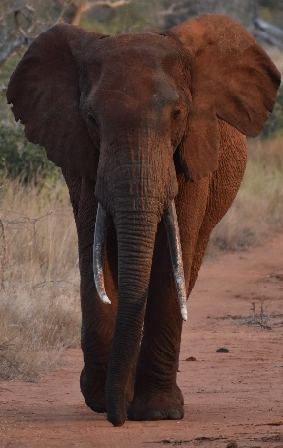
Dr. Bruce Schulte
Professor
https://www.wku.edu/schultebehaviorlab/
Doctorate of Philosophy - State University of New York
M.S. - University of Southern California
B.S. - College of William and Mary
Courses
BIOL 532 / 533 Behavioral Ecology / Lab
BIOL 534 Chemical Ecology
BIOL 543 Environmental Science Concept
Interested in Graduate or Undergraduate Research with Dr. Schulte?
We take a conservation behavior approach to reduce wildlife conflict by studying modes of communication, reproductive patterns, movements, and social system as well as the needs of people who share habitat with them.
We work with local peoples, government agencies, NGOs, and citizen scientists.
Research
Human-wildlife Interactions
Communication and social behavior of mammals such as elephants, beavers, cetaceans, otters, prairie dogs, and horses.
Africa, Alaska, western US, and more.
One project is ESAK, Elephants and Sustainable Agriculture in Kenya. Please see my Biology website, CV, and numerous videos, including a Ted-Ed talk with WKU Biology MS alum Chase LaDue on the incredible elephant trunk!
bruce.schulte@wku.edu

Slide 13
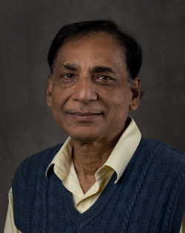
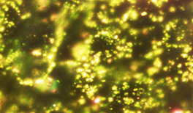
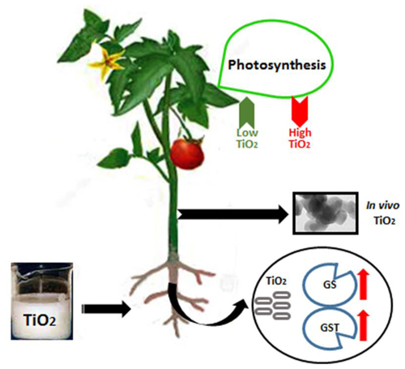
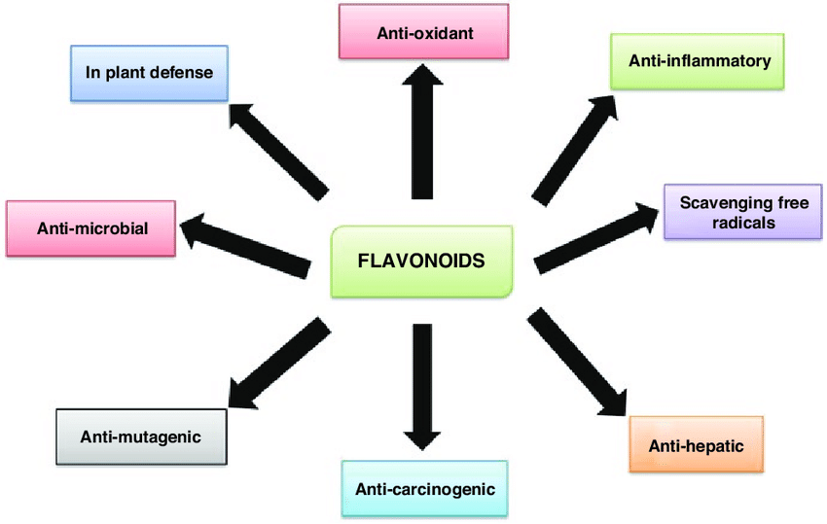
Dr. Nilesh Sharma
Instructor
Ph.D. – University of Bihar
M.S. - Patna University
B.S. - Patna University
Courses
BIOL 113 General Biology
BIOL 207/208 General Microbiology
BIOL 490 Plant Therapeutics
BIOL 516
Interested in Graduate or Undergraduate Research with Dr. Sharma?
In our phytotherapeutic approach we use phytochemicals (flavonoids) to examine their roles in disease (cancer, inflammation) and health (life span) in human cell lines or yeast.
Gold Nanoparticles
Wide applications of nanomaterials cause toxicity in living organisms and ecosystems. We investigate the effect of metal (Au/Ti) nanoparticles in vitro as well as in vivo using microbial or plant models
https://doi.org/10.3389/fpls.2017.00633
Research Interests
Applications of phytochemicals in therapeutics
Nanotoxicology
nilesh.sharma@wku.edu

Slide 14
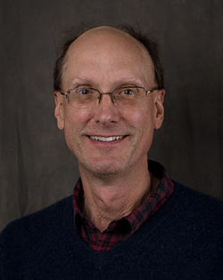
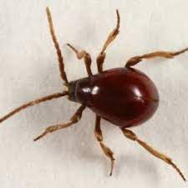
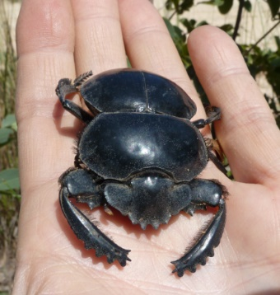
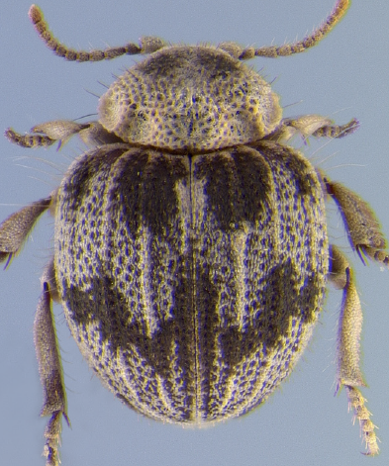

Dr. Keith Philips
Professor
Ph.D. – The Ohio State University
Courses
BIOL 122 Evolution, Diversity, and Ecology
BIOL 325 Insect Biodiversity
BIOL 285 Costa Rican Biodiversity
BIOL 522 Systematics + Evolution
BIOL 675 Coleoptera Evolution
BIOL 675 Insect Evolution
BIOL 675 Molecular Phylogenetics
Interested in Graduate or Undergraduate Research with Dr. Philips?
Global diversity and evolution of spider beetles
Diversity + ecological studies of dung beetles
The Ghana Insect Project
Evolution of cave beetles
Research
Evolution and Diversity of Insects, especially on beetles.
keith.philips@wku.edu

Slide 15



Dr. Chandra Emani
Associate Professor
B.S. - Chemistry, Nizam College
M.S. - University of Pune
Ph.D. - Osmania University
Courses
Biol 113 – Introductory biology
Bio 312 – Bioinformatics
Bio 350 – Introduction to Recombinant Gene Technology
Bio 399 – Research Methods in Biology
Bio 446/G – Biochemistry
Bio 495/G – Molecular Genetics
Interested in Graduate or Undergraduate Research with Dr. Emani? Opportunities exist both in-lab and online!
Engineering Basil to elevate Eugenol, an anti-cancerous phytopharmaceutical for cancer and polycystic kidney disease
Research
Phytopharmaceuticals – Basil and ginger extracts to treat cancer
Plant Genetic Engineering – Bamboo as a non-human model in medicine
Molecular Evolution – Tracing the evolution of Protein domains
Phytoremediation – pine and sorghum to clear oil field contaminants
Biology Education – Instilling scientific thought process in students and general public
Using Pine and sorghum for clearing salt water and oil contaminants near oil fields
Tracing the evolution of protein domains related to eugenol synthase, phaseolin and choline acetyl transferase in silico
Engineering sorghum with a cellulase gene from Acidothermus cellulyticus for biofuel usage
Using episodic history in science to instill the scientific thought process in classroom and educating the general public about scientific method and scientific thinking
chandrakanth.emani@wku.edu

Slide 16




Dr. Kerrie McDaniel
Associate Professor
Ph.D. - Southern Illinois University
M.S. - Western Kentucky University
B.S. - Western Kentucky University
Courses
BIOL 131 Human Anatomy and Physiology
BIOL 231 Advanced Human Anatomy and Physiology
BIOL 303 Life Science for Middle School Teachers
BIOL 420 Introduction to Toxicology
BIOL 579 Mechanistic Toxicology
BIOL 493 Internship in Medical Technology
Interested in Graduate or Undergraduate Research with Dr. McDaniel?
Understanding factors influencing student learning using E-texts (Student perceptions and frustration)
Study of Metacognition on Student Grades in Biology Courses
Impacts on the STEM Pipeline: Middle School Science Teachers
  Does Project-based Professional Development and Creation and Implementation of a Challenge Project affect creativity, collaboration, and pedagogy in the middle school science classroom?
kerrie.mcdaniel@wku.edu

Slide 17





Dr. Doug McElroy
University of Maine
Ph.D. – University of Maine
M.S. – University of Maine
B.S. – Southampton College
Interested in Undergraduate or Graduate Research with Dr. McElroy?
Courses
BIOL 113 General Biology
BIOL 382 Introductory Biostatistics
BIOL 397 Clinical Research
BIOL 489 Professional Aspects of Biology
My current research employs univariate and multivariate statistical tools to address a broad range of clinical research questions
I collaborate extensively with physicians at Med Center Health and the UK College of Medicine – Bowling Green Campus
I’m also interested in applying evolutionary principles and multivariate statistical methods to other topics of interest, including population genetics, speciation, conservation, and even teaching pedagogy
Research​
Evolutionary Biology and Genetics, Biostatistics
Impact of risk factors and treatment interventions on cardiovascular outcomes
Morphometrics and conservation of desert fishes
Genetics of morphology, coloration, and speciation in African cichlid fishes
doug.mcelroy@wku.edu

Slide 18




Dr. Noah Ashley
Associate Professor
Ph.D. - University of Washington
B.A. - Colby College
Courses
BIOL 131: Human Anatomy & Physiology I​
BIOL 224: Animal Biology & Diversity
BIOL 330: Animal Physiology
BIOL 326: Ornithology
BIOL 356: Ornithology Lab
BIOL 464: Endocrinology​
BIOL 503: Contemporary Research in Biology
Interested in Undergraduate or Graduate Research with Dr. Ashley?
Sleep-immune interactions in rodents​
Inflammation/Immune function & microglial activation​
Stress hormones​
Anxiety/memory
Research
Endocrine-Immune Interactions in Vertebrates​
Hormonal Regulation of Inflammation during Sleep Loss​
Comparative Evolution of Sickness Behavior and Inflammation​
Ecological Immunology​
Sleep/Wake Cycles and Chronobiology​
Non-Invasive Measures of Stress Hormones​
Regulation of Immune Function by Androgens​
​
Comparative biology of sleep and circadian rhythms​
Latitudinal studies (arctic vs. temperate comparisons)​
Determining responses to sleep deprivation​
Assessing seasonal and hormonal effects​
This project involves field work in Alaska!
noah.ashley@wku.edu

Slide 19




Dr. Carl Dick
Professor
Ph.D. - Texas Tech University​
M.S. - University of ​Central Arkansas​
B.A. - ​Tabor College​
Courses
BIOL 122 Introductory Biology​
BIOL 316 Evolution​
BIOL 489 Professional Aspects of Biology
BIOL 523 Evolution of Symbioses​ and Parasitism
BIOL 598 Graduate Seminar​
Interested in Graduate or Undergraduate Research with Dr. Carl Dick?
Research Questions
How and why do parasites specialize on host species?​
How do multiple parasite species coexist?​​
What host characteristics influence parasite distribution and abundance?​
How do parasites and hosts interact with viruses, microfungi, and other pathogens?​
Have parasites evolved in concert with their ​hosts?​
Research​
Evolution and ecology of parasite-host associations; taxonomy and systematics of bat flies; fungal hyperparasitism; biodiversity and faunal surveys
carl.dick@wku.edu

Slide 20




John M. Clauson M.S.
Microbiology Laboratory Coordinator/ Instructor
Clinical Microbiology
208 Microbiology
Laboratory Manual
Adams, A., Kumar, S., Clauson, J. and Sahi, S. (2011)
Anti-yeast activities of Origanum oil against human pathogenic yeasts.
Advances in Bioscience and Biotechnology, 2, 103-107.
Clauson, John M. “Microbiology Laboratory for the Health Science
Student; A Clinical Approach” 8th Ed.
Laboratory Manual for Introductory Microbiology
BIOL 208 Western Kentucky University. FALL 2004 - Present
Laboratory Manual for Introductory Microbiology
BIO 220 Northwest-Shoals Community College. SPRING 2012 - Present
Environmental Mycology
Clauson, John M. and Larry P. Elliott. 1996. Comparison of
Cryptococcus neoformans isolates from clinical and environmental
collections in south central Kentucky and surrounding areas.
Trans. KY. Acad. Sci., 57 (2), 1996,106-111
Clauson, John M. and Larry P. Elliott. 1987. Hydrocarbon degradation
in a waste-water pond by enriched indigenous microorganisms.
Trans. KY. Acad. Sci., 48 (3-4), 1987, 76-83.
Biology Department Safety Seminar
Online Course Development

Slide 21






Naomi S. Rowland, M.S.
Biology Lab Instructor &
Biotechnology Center Coordinator
M.S. 2005 University of Tennessee
B.S. 2003 Western Kentucky University
Courses
BIOL 212 Genome Discovery and Exploration
BIOL 319 Introductory Cell and Molecular Biology
BIOL 322 Introductory Cell and Molecular Biology Labs
Interested in working in the Biotechnology Center as a student worker?
Maintain the WKU Biotechnology Center equipment.
Assist students and faculty with general lab questions.
Help prepare materials for biology lab courses.
Represent the Dept of Biology in elementary school outreach programs.
Naomi.rowland@wku.edu

Slide 22








John Andersland
Coordinator, Ogden College Electron Microscopy Facility
Courses
BIO 404 Electron Microscopy
Ph.D. Cornell University
Scanning Electron Microscope (SEM)
Z-stepping Light
Microscope (LM)
Transmission Electron Microscope (TEM)
john.andersland@wku.edu

