Slide 1
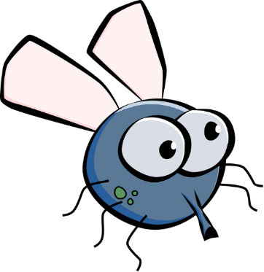








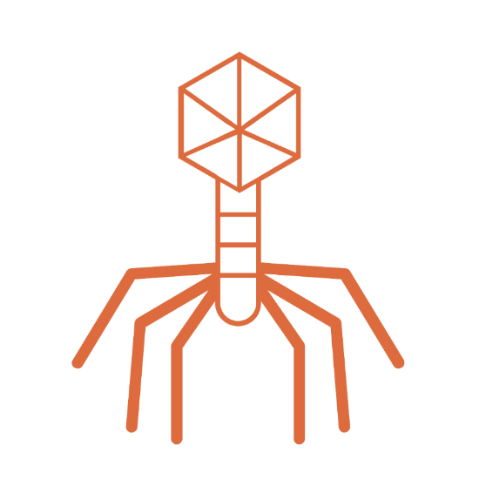
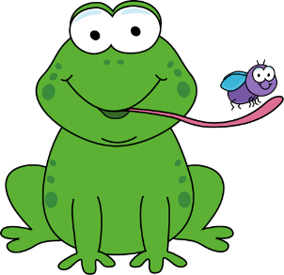
Meet the Biology
Faculty & Staff

Slide 2
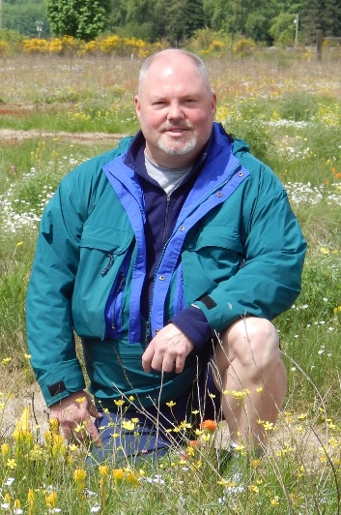

Dr. Lawrence Alice
University of Maine
Associate Professor
Courses
BIOL 122 - Biological Concepts: Evolution, Diversity & Ecology
BIOL 222/223 Plant Biology and Diversity
BIOL 348 Plant Taxonomy
Research
Systematics of Rubus
- Flora of North America
- Phylogenomics
- The Jepson Manual: Vascular Plants of California
Ph.D. - Plant Science, University of Maine 1997 ​
M.A. - Botany, Southern Illinois University at Carbondale 1989 ​
B.A. - Botany, Southern Illinois University at Carbondale 1986​
​
​

Slide 3
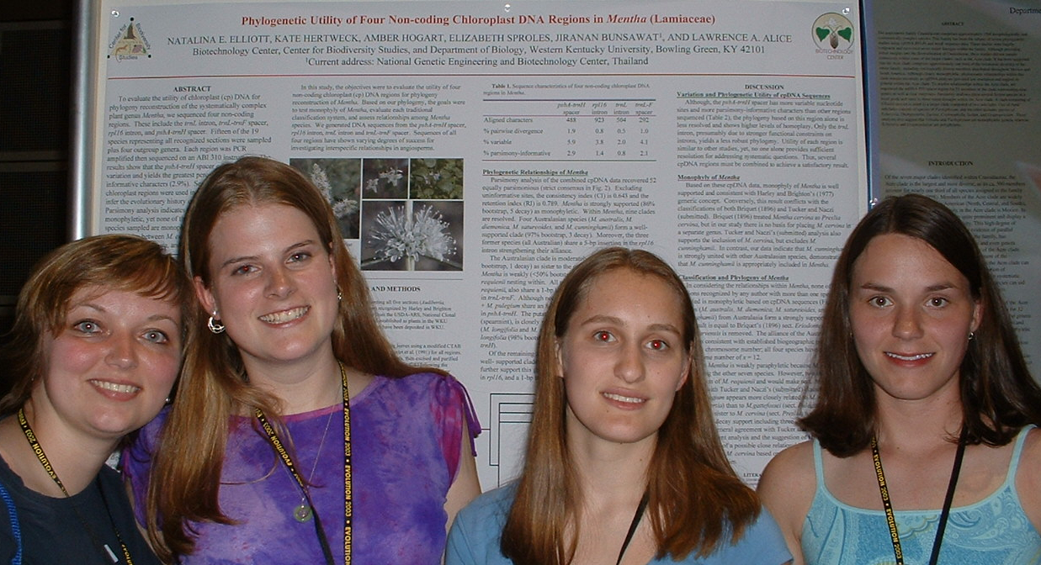
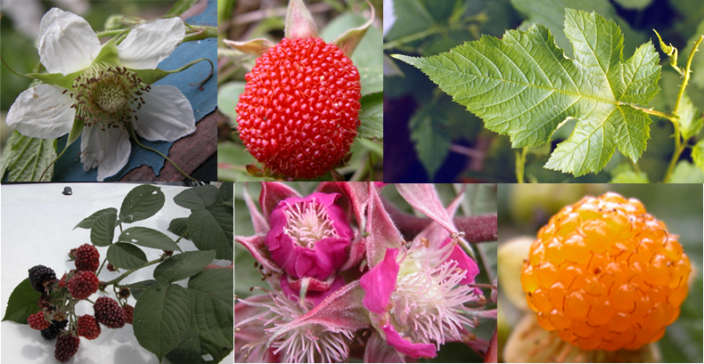
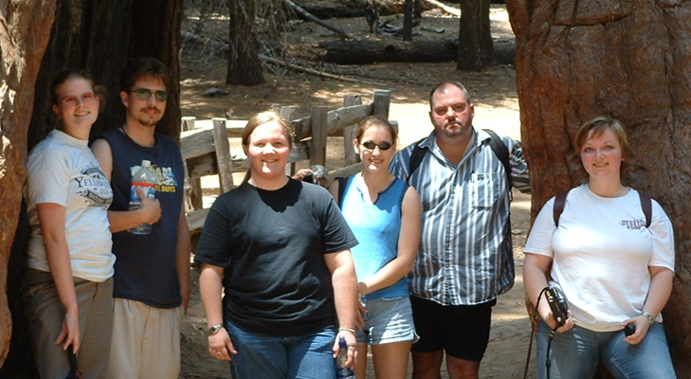
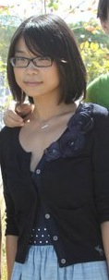
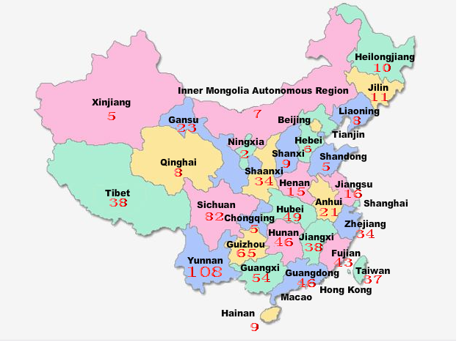
Research by Dr. Alice
Undergraduate Research
Current Research
Infer evolutionary relationships (phylogeny reconstruction) of the genus Rubus (Rosaceae) which includes blackberries and raspberries
Test hypotheses of hybridization
Examine biogeographic patterns
Assess origins of polyploid taxa
Genetics of invasive species
Poster presentation at the Evolution Conference – Chico, CA
Enter label here
Enter label here
Botanical tourism in Yosemite NP, CA
Graduate Research with Dr. Alice
Phylogeny of Rubus species in traditional Chinese medicine

Slide 4
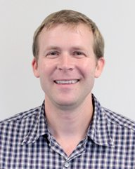
Dr. Noah Ashley
University of Washington
Associate Professor
Courses
BIOL 131: Human Anatomy & Physiology I​
BIOL 464: Endocrinology​
BIOL 326: Ornithology​
Research
Endocrine-Immune Interactions in Vertebrates​
Hormonal Regulation of Inflammation during Sleep Loss​
Comparative Evolution of Sickness Behavior and Inflammation​
Ecological Immunology​
Sleep/Wake Cycles and Chronobiology​
Non-Invasive Measures of Stress Hormones​
Regulation of Immune Function by Androgens​
Biography
Ph.D. Zoology,
University of Washington,
Seattle. WA​
B.A. Biology,
Colby College,
Waterville, ME​

Slide 5
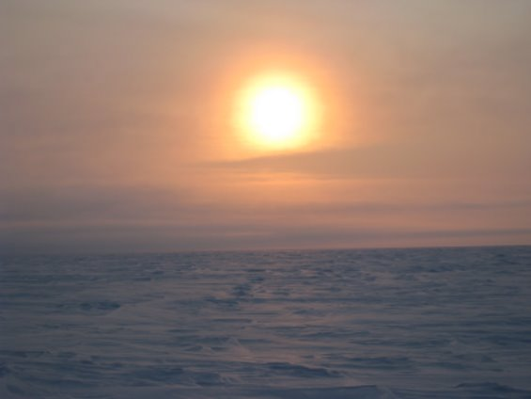
Research by Dr. Ashley
Graduate Students
Sleep-immune interactions in rodents​
Inflammation/Immune function & microglial activation​
Stress hormones​
Anxiety/memory​
​
Comparative biology of sleep and circadian rhythms​
Latitudinal studies (arctic vs. temperate comparisons)​
Determining responses to sleep deprivation​
Assessing seasonal and hormonal effects​
This project involves field work in Alaska!
Brett Hodinka
Wesley Payette
Nick Wheeler
Post-Doctoral Researcher
Dr. Melanie Richter
Enter label here
Enter label here
Land of the Midnight Sun, Barrow, Alaska​

Slide 6
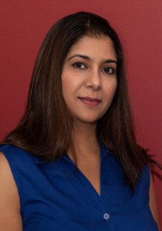

Dr. Simran Banga
Purdue University
Assistant Professor
Courses
BIOL 121 Biological Concepts Laboratory: Cells, Metabolism, and Genetics
BIOL 207 General Microbiology
BIOL 226 Microbial Biology & Diversity
BIOL 227 Microbial Biology & Diversity Lab
BIOL 328 Immunology
Research
Microbiology, Host-bacterial interactions, Bacterial infections
Biography
Ph.D. – Molecular Biology and Microbiology, Purdue University, West Lafayette, IN
M.S.- Microbiology, University of Mumbai, Mumbai, India

Slide 7
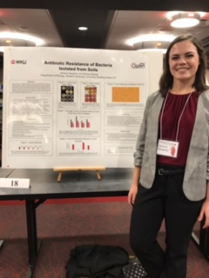
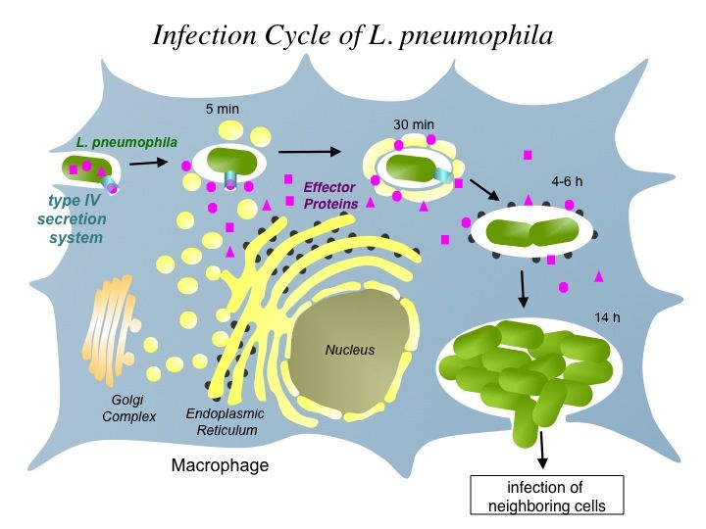
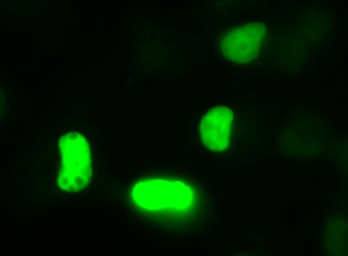
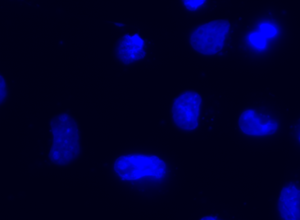
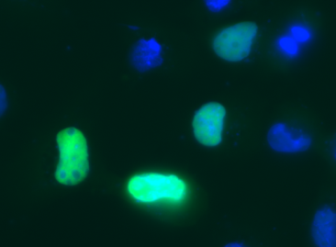
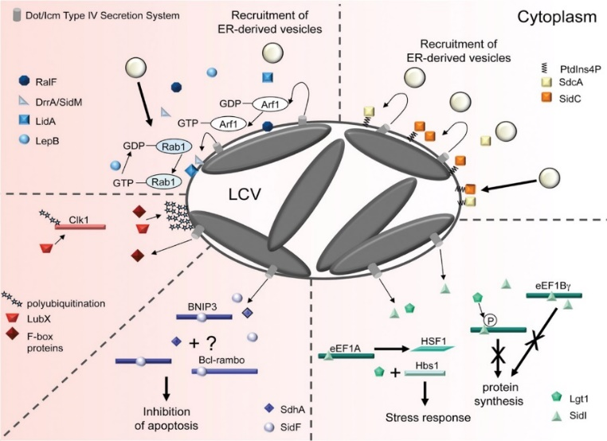
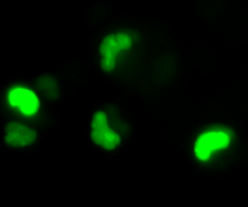
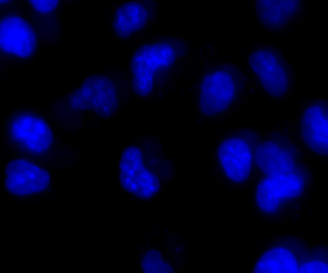
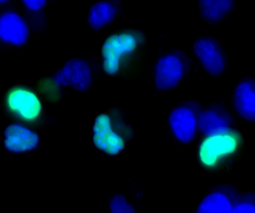
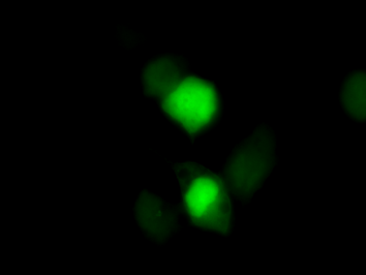
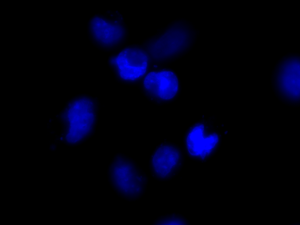
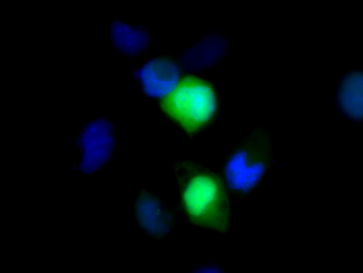
Research by Dr. Banga
Graduate Research
Understanding Mechanisms of Bacterial Pathogenesis through functional analysis of different proteins released by Legionella pneumophila during an infection.
The research involves techniques in:
  microbiology
  molecular biology
  cell biology
  biochemistry
Current Research
Host-bacterial interactions
Legionella pneumophila, the causative agent of Legionnaires disease.
Lab research focus characterizing the functional role of bacterial effector proteins during an infection
Enter label here
Enter label here
Interested in Graduate or Undergraduate Research with Dr. Banga? Send her an email at simran.banga@wku.edu

Slide 8
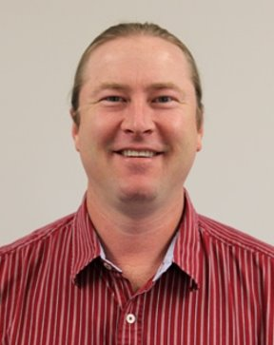
Dr. Carl Dick
Texas Tech University
Associate Professor
Courses
BIOL 122 Introductory Biology​
BIOL 316 Evolution​
BIOL 523 Evolution of Symbioses​
BIOL 598 Graduate Seminar​
Research​
Evolution and ecology of parasite-host associations; taxonomy and systematics of bat flies; biodiversity and faunal surveys
Biography
PhD, Zoology (2005), Texas Tech University​
MS, Biology (1998), University of ​Central Arkansas​
BA, Biology/Env. Science (1992), ​
Tabor College​

Slide 9
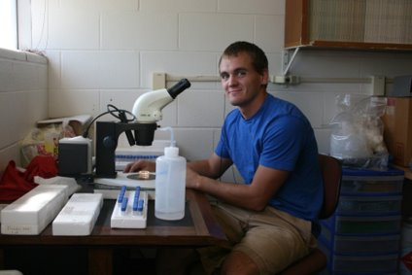
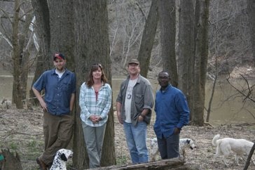
Research by Dr. Dick
Research Questions
How and why do parasites specialize on host species?​
How do multiple parasite species coexist?​​
What host characteristics influence parasite distribution and abundance?​
How do parasites and hosts interact with viruses​ and other pathogens?​
Have parasites evolved in concert with their ​hosts?​
Interested in Graduate or Undergraduate Research with Dr. Dick? Send him an email at carl.dick@wku.edu
Enter label here
Enter label here
Installing experimental bat houses at WKU’s Upper Green River Biological Preserve, Hart County, Kentucky​

Slide 10
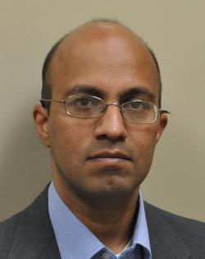
Dr. Chandra Emani
Osmonia University
Associate Professor
Courses
Research​
Plant Genetic Engineering
Phytopharmaceuticals
Molecular Evolution
Biology Education
Bio 312 – Bioinformatics
Bio 319 – Cell and Molecular Biology
Bio 337 – Genetics Lab
Bio 350 – Introduction to Recombinant Gene Technology
Bio 399 – Research Methods in Biology
Bio 446/G – Biochemistry
Bio 447 – Laboratory Biochemistry
Bio 450 – Recombinant Gene Technology
Bio 495/G – Molecular Genetics
Bio 496 – Plant Biotechnology
Biography
B.Sc. - Genetics, Zoology, Chemistry, Nizam College, India, 1989
M.Sc. - Biochemistry, University of Pune, India 1991
Ph.D. - Plant Molecular Genetics, Osmania University, India, 1997

Slide 11
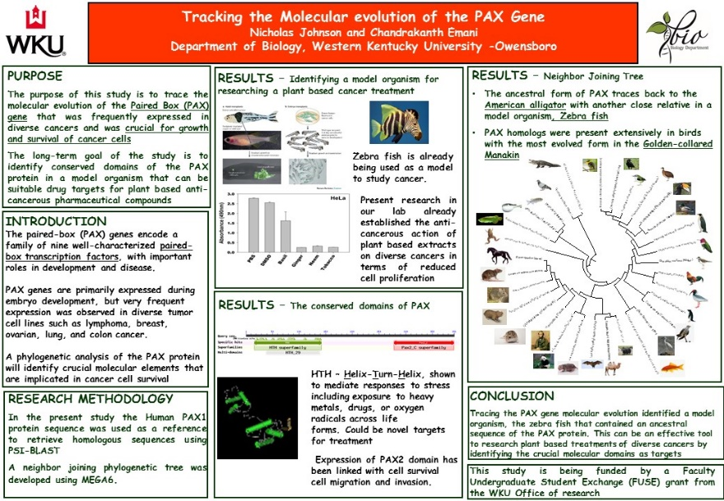

Research by Dr. Emani
Engineering sorghum with a cellulase gene from Acidothermus cellulyticus for biofuel usage
Using Pine and sorghum for clearing salt water and oil contaminants near oil fields
Interested in Graduate or Undergraduate Research with Dr. Emani? Opportunities exist both in-lab and online!
Engineering Basil to elevate Eugenol, an anti-cancerous phytopharmacetical for cancer and polycystic kidney disease
Tracing the evolution of protein domains related to eugenol synthase, phaseolin and choline acetyl transferase in silico to examine structural and functional features
Using episodic history in science to instill the scientific thought process in classroom and educating the general public about scientific method and scientific thinking

Slide 12
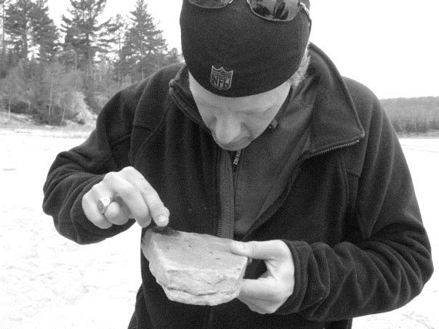
Dr. Scott Grubbs
University of Pittsburgh
Associate Professor
Courses
BIOL 122 - Biological Concepts: Evolution, Diversity & Ecology
BIOL 224 - Animal Biology & Diversity
BIOL 316 - Evolution
BIOL 405 - Aquatic Insect Diversity
BIOL 497 - Aquatic Field Ecology
Research​
Biogeography, Conservation, Diversity & Systematics of Stonefly (Plecoptera) ​
Biography
Ph.D. – 1998, Biological Sciences, University of Pittsburgh​
B.S. – 1990, Biology, Central Michigan University​

Slide 13
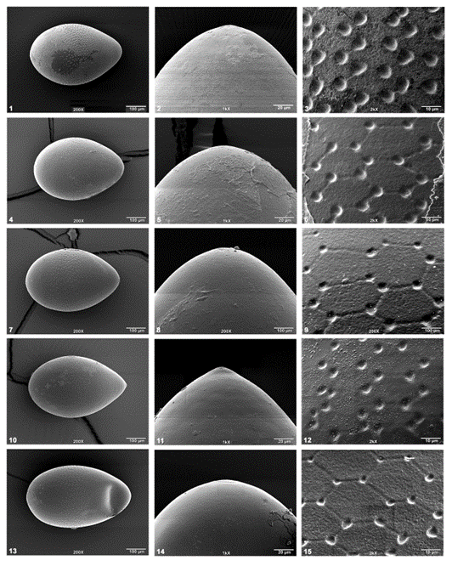
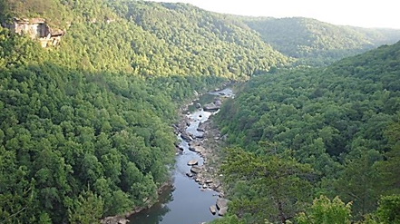
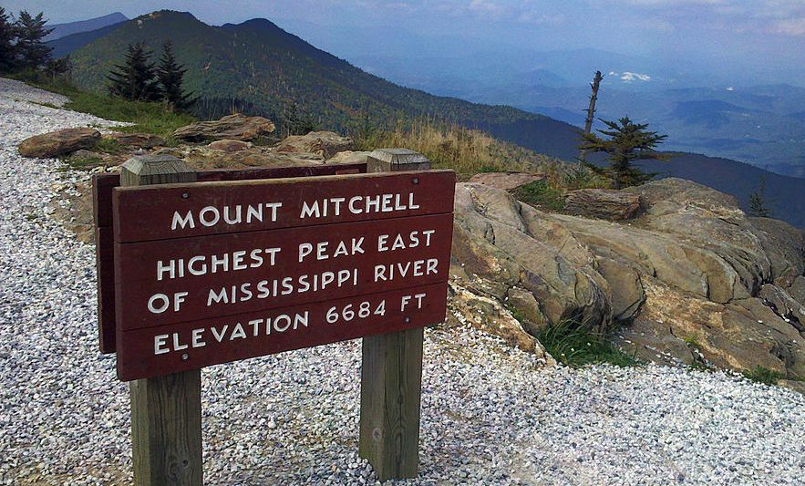
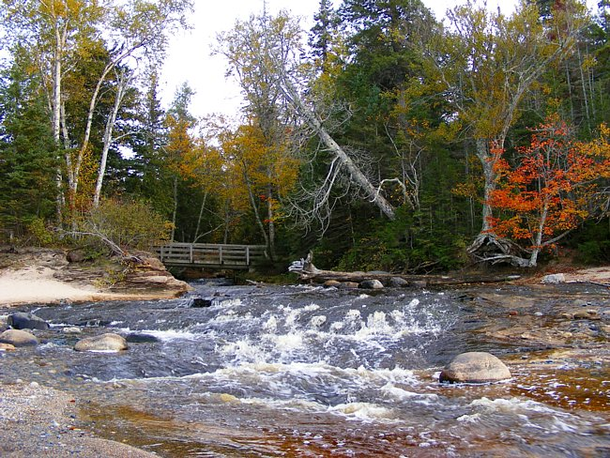
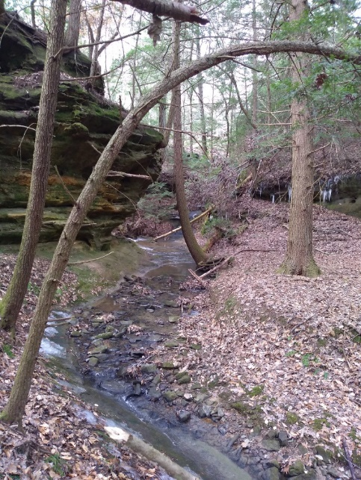
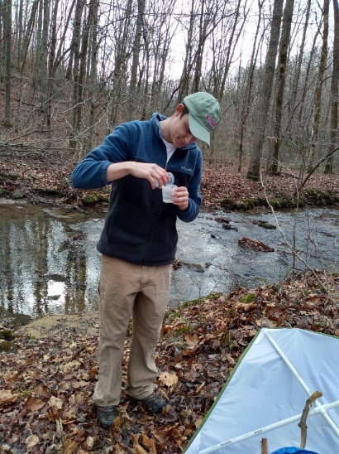
Research by Dr. Grubbs
Stonefly Biogeography, Conservation, & Diversity
Several species of stoneflies are now extirpated from Ohio.
I currently study Stoneflies in the Appalachian Mountains, including projects in:
Talladega Mountain region in Alabama
Kentucky, Maryland, and West Virginia
High peaks of North Carolina
Eggs of Perlesta teaysia
I emphasize the use of scanning electron microscopy as a tool to study fine scale morphology.
Current Graduate Students
Taylor McRoberts
Madeline Metzger
Enter label here
Enter label here

Slide 14
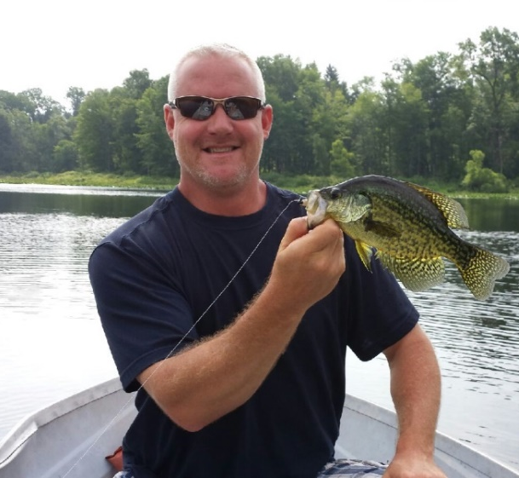
Dr. Steve Huskey
Florida Tech University
Associate Professor
Courses
BIOL 122H Introductory Biology
BIOL 377 Animal Form and Function
BIOL 477 Marine Biology
Research​
Feeding performance in fishes
Chameleon communication
Stone crab claw pressures
Predator-prey interactions
Skeletal reconstruction
Biography
Post-doctoral 2003 - UC Davis
Ph.D. 2003 - Florida Tech
B.S. 1996 - Western Michigan University

Slide 15
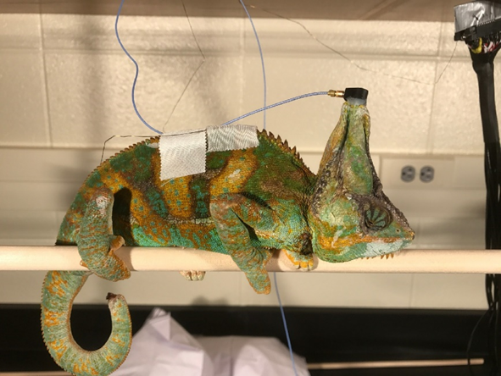
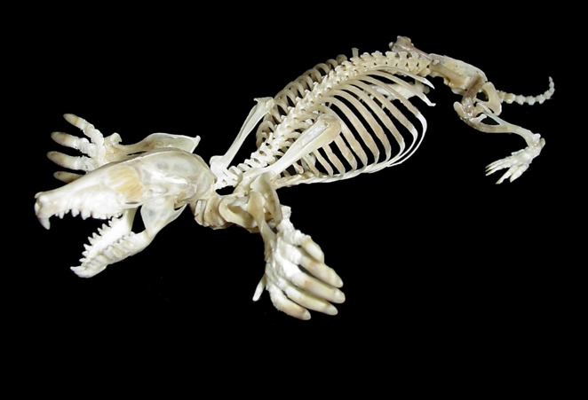
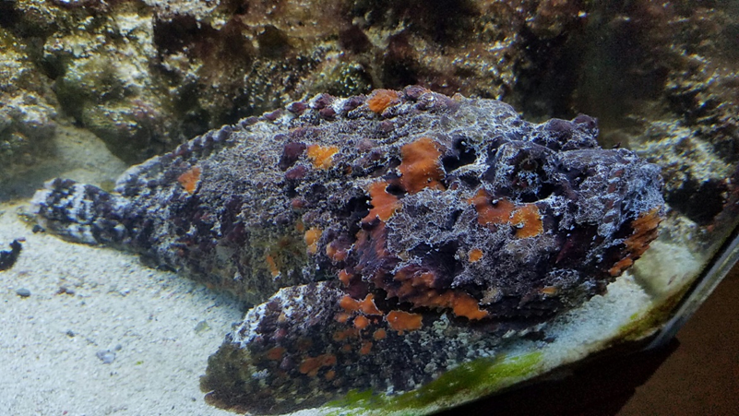
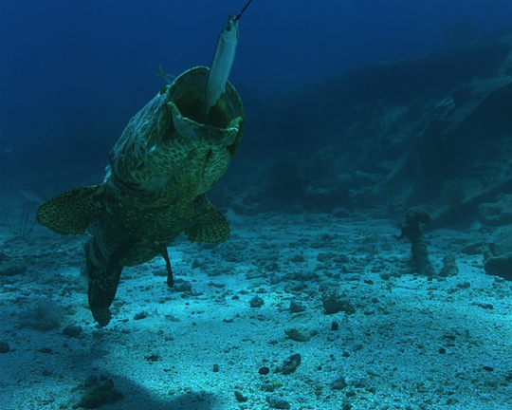
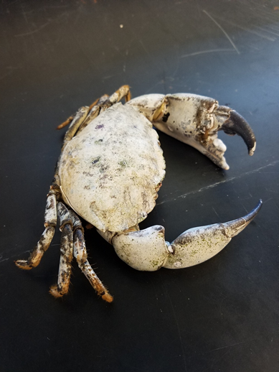
Research by Dr. Huskey
Research Topic
Undergraduate Researchers
My lab focuses on understanding the mechanisms that underlie vertebrate performance, such as:
feeding
burrowing
climbing
swimming
running
flying
  Tori Lawson is investigating stone crab claw forces.
  Amelia Winrich is studying stone crab claw pressure.
  Morgan Ballard is studying the mechanism of venom delivery by spotted scorpionfish.
Enter label here
Enter label here
Graduate Student
Lauren Kappel is studying vibrational communication between veiled chameleons.

Slide 16
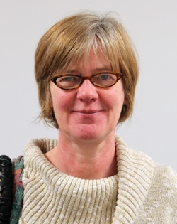

Dr. Sigrid Jacobshagen
Free University of Berlin
Professor
Courses
BIOL 400(G) Plant Physiology
BIOL/CHEM 446(G) Biochemistry I
BIOL/CHEM 446(G) on-line Biochemistry I
BIOL/CHEM 447(G) Biochemistry Laboratory
BIOL/CHEM 467(G) Biochemistry II
BIOL/CHEM 562 Advanced Biochemistry
Research​
Research in my lab is concerned with the circadian clock. We are using the unicellular green alga Chlamydomonas as a model organism to study the circadian clock, because we can measure its daily rhythm of swimming towards light in an automated fashion. The rhythm is very similar to the daily sleep/wake cycle in humans. Projects in the lab center on the photoreceptor proteins that are able to reset the circadian clock using physiological, molecular, biochemical and cell biological techniques. We are also interested in understanding how the circadian clock regulates genes so that they show a circadian rhythm in their expression. A third interest is the use of mathematical equations to model the circadian clock.
Biography
Ph.D. - 1988 Plant Biochemistry, Free University of Berlin, Germany
M.S. - 1985 Biology, Justus-Liebig-University of Giessen, Germany

Slide 17
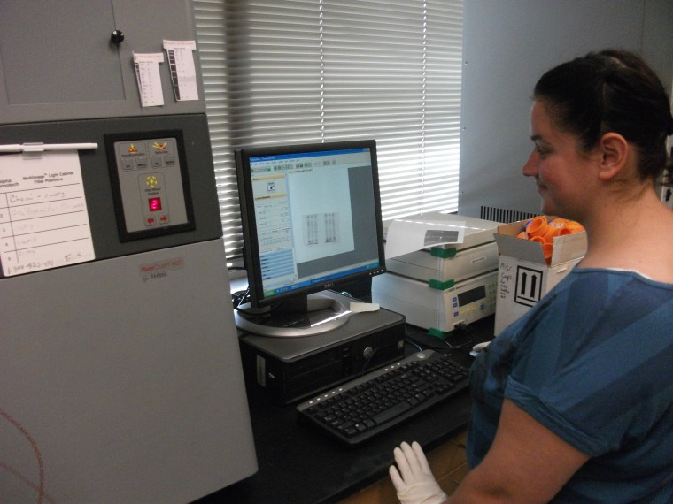
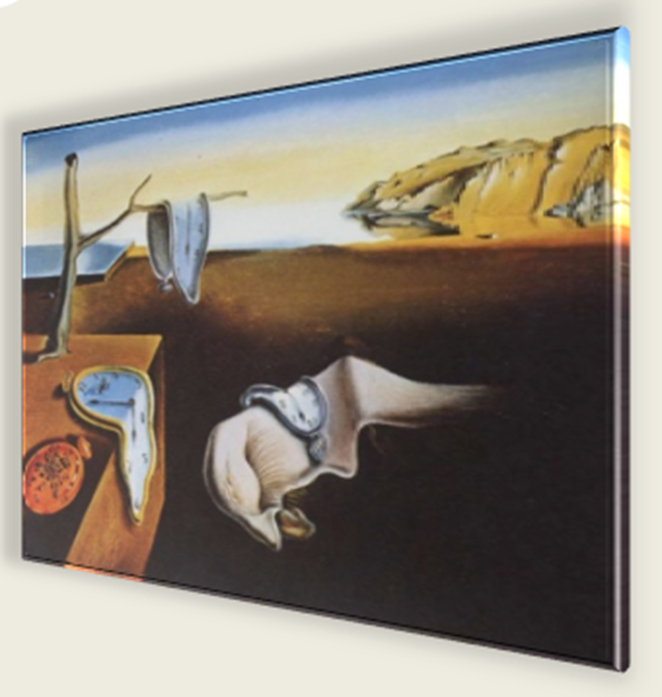
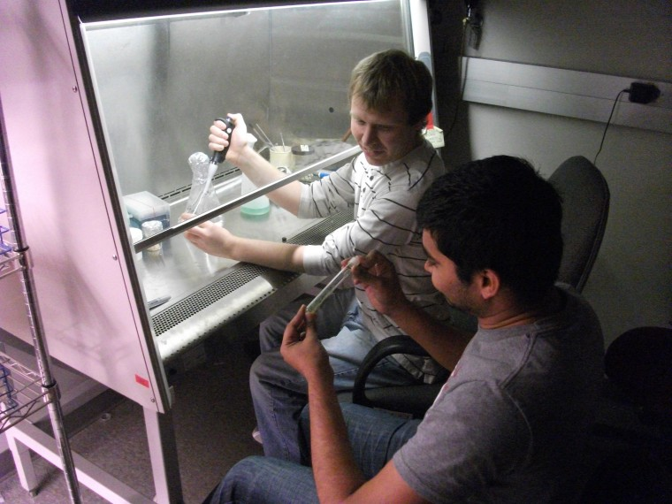
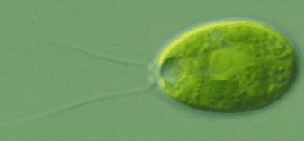

Research by Dr. Jacobshagen
Research Topic
How is the circadian clock reset after travel to a different time zone?
How does the circadian clock cause genes to be rhythmically expressed?
Can the circadian clock be modeled using mathematical equations?
Interested in Graduate or Undergraduate Research with Dr. Jacobshagen? Email her at:
sigrid.jacobshagen@wku.edu
Enter label here
Enter label here

Slide 18
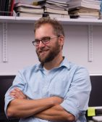
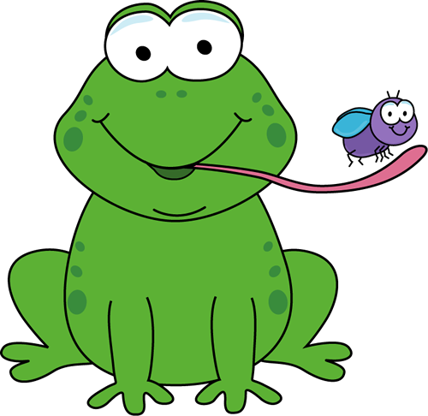
Dr. Jarrett Johnson
University of Missouri
Associate Professor
Courses
BIOL 122 Introductory Biology
BIOL 327 Genetics
BIOL 457 Herpetology
BIOL 524 Ecological Genetics
Research​
Evolutionary Ecology, Population Genetics, and Conservation of Amphibians
Biography
Ph.D. - 2005 Evolution and Ecology, University of Missouri
B.S. - 1999 Ecology, Ethology, and Evolution, University of Illinois

Slide 19
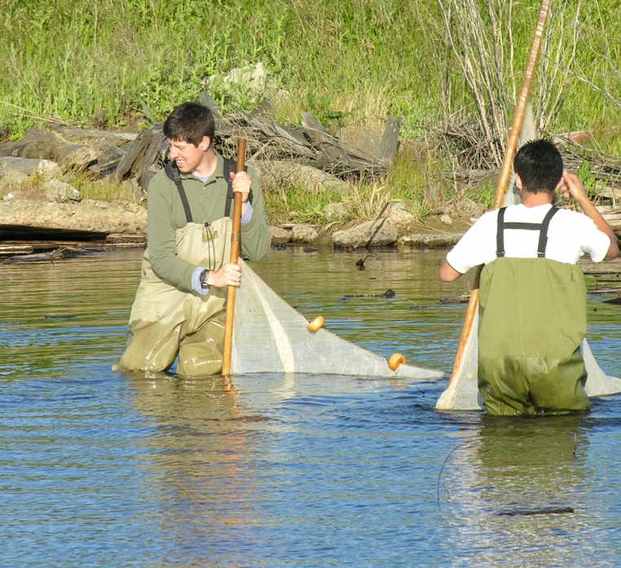





Research by Dr. Johnson
Research in my lab uses field and laboratory experimentation in conjunction with molecular genetic tools to understand local adaptation, speciation, and gene flow using amphibian species as models.
Our goal is to provide empirical data that are relevant to the conservation and management of amphibian populations while simultaneously improving our understanding of evolution and ecology.
Interested in Graduate or Undergraduate Research with Dr. Johnson? Email him at jarrett.johnson@wku.edu!
Enter label here
Enter label here

Slide 20


Dr. Rodney King
Medical College of Virginia
Professor
Courses
BIOL 226/227 Microbial Biology & Diversity
BIOL 407 Virology
BIOL 470 Pathogenic Microbiology
BIOL 568 Advanced Microbiology
Research​
Bacteriophage Biology
Regulation of Transcription
Biography
Ph.D. Med. Coll. of VA, VCU
B.S. Virginia Tech

Slide 21







Research by Dr. King
Undergraduate Research
Research Interests:
Bacterial and Bacteriophage genetics
Bacteriophage biology
Control of transcription elongation and termination
Current Projects:
Identification and characterization of RNA based transcription antiterminators
Genomic analysis of Bacteriophages
Phage-host interactions
Genome Discovery and Exploration
Graduate Research
Enter label here
Enter label here
Amanda Staples
Bacteriophages that infect Paenibacillus larvae, the causative agent of American Foulbrood Disease

Slide 22



Dr. Philip Lienesch
University of Oklahoma
Associate Professor
Courses
BIOL 122 Biological Concepts – Evolution, Diversity & Ecology​
BIOL 224 Animal Biology & Diversity​
BIOL 456 Ichthyology ​
BIOL 458 Fisheries Management
Research​
My research interests range from basic aquatic ecology to more applied fisheries management.​

Slide 23





Research by Dr. Lienesch
  ​
  Effects of reservoirs on stream fishes distributions.​
  Effects of introduced species on aquatic communities.​
  Catfish behavior​
Current Projects
Interested in Graduate or Undergraduate Research with Dr. Lienesch? Email him at philip.lienesch@wku.edu!
Enter label here
Enter label here

Slide 24

Dr. Kerrie McDaniel
Southern Illinois University
Associate Professor
Courses
BIOL 113/114 General Biology for non majors
BIOL 131 Human Anatomy and Physiology
BIOL 231 Advanced Human Anatomy and Physiology
BIOL 303 Life Science for Middle School Teachers
BIOL 420 Introduction to Toxicology
BIOL 579 Mechanistic Toxicology
BIOL 493 Internship in Medical Technology
Biography
Ph.D 1997 Southern Illinois University
M.S. 1990 Western Kentucky University
B.S. 1988 Western Kentucky University

Slide 25





Research by Dr. McDaniel
  ​
Assessing Efficacy of pedagogical change in university classroom.
Evaluating e-text effectiveness.
Improvement of STEM education.
Promote experiences in Medical Laboratory Science. (MLS)
Current Projects
Interested in Graduate or Undergraduate Research with Dr. McDaniel? Email her at kerrie.mcdaniel@wku.edu!
Enter label here
Enter label here

Slide 26

Dr. Albert Meier
University of Georgia
Professor
Courses
BIOL 315 Ecology
BIOL 515 Advanced Ecology
BIOL 598 Graduate Seminar
Research
Ecology, Biodiversity, and Conservation Biology.
Eastern Old Growth
Response of forest herbs to disturbance
Upper Green River Research
Systems Ecology and Network Analysis
Biography
Ph.D. – University of Georgia

Slide 27





Research by Dr. Meier
  ​
Ecology, Biodiversity, and Conservation Biology.
Eastern Old Growth
Response of forest herbs to disturbance
Upper Green River Research
Systems Ecology and Network Analysis
Current Projects
Interested in Graduate or Undergraduate Research with Dr. Meier? Email him at albert.meier@wku.edu!
Enter label here
Enter label here

Slide 28


Dr. Natalie Mountjoy
University of Georgia
Professor
Courses
BIOL 120
BIOL 121
BIOL 123
Research
Pedagogical Research
  Inquiry-based techniques, student retention and success
Ecological Research
  Community-based natural resource management and human wildlife conflict
Biography
  Center for Ecology, Southern Illinois University, 2014 Ph.D.
  Biology, Western Kentucky University, 2007 M.S.

Slide 29



Research by Dr. Mountjoy
  ​
Pedagogical Research
- Measuring the impact of increased inquiry-based techniques in the biology curriculum
- Assessing the effects of differing 5th week interventions on the success and retention of general biology students
- Determining the factors that cause at-risk students to persist in STEM fields at WKU: Broadening and strengthening what works
Other Research
- Development of Tsavo-Bushmeat database, populated by molecular data sourced by BIOL 121 students, can help identify poaching hotspots in the region.
Interested in Graduate or Undergraduate Research with Dr. Mountjoy? Email her at: natalie.mountjoy@wku.edu
Enter label here

Slide 30

Dr. Keith Philips
The Ohio State University
Professor
Courses
BIOL 122 Introductory Biology
BIOL 325 Insect Biodiversity
BIOL 285 Costa Rican Biodiversity
BIOL 522 Systematics + Evolution
BIOL 675 Coleoptera Evolution
BIOL 675 Insect Evolution
Research
Evolution and Diversity of the Insects, especially on beetles.
Biography
Ph.D. – The Ohio State University

Slide 31





Research by Dr. Philips
  ​
The Ghana and West Africa Insect Project
Evolution of cave beetles
Diversity + ecological studies of African dung beetles
Global diversity of spider beetles
Current Projects
Interested in Graduate or Undergraduate Research with Dr. Philips? Email him at keith.philips@wku.edu!
Enter label here
Enter label here

Slide 32

Dr. Claire Rinehart
University of Georgia
Professor
Courses
BIOL 312 Bioinformatics
BIOL 350 Introduction to Recombinant Genetics
BIOL 450 Recombinant Gene Technology
BIOL 495 Molecular Genetics
BIOL 566 Advanced Molecular Genetics
BIOL 275 co-teach Genome Discovery and Exploration with Rodney King
Research
Bioinformatics
Application of genome analysis to discover genes that are differentially expressed and the metabolic and regulatory pathways to which they belong.
Genome sequencing and annotation.
Comparison of bacteriophage families to discover the functional design of their genomes.
In silico prediction of protein structure as an aid in discovering the protein's function.
Biography
Ph.D. - Botany/Biochemistry, University of Georgia, Athens, GA, 1984
M.S. - Botany/Plant Physiology, Brigham Young University, Provo, UT, 1979
B.S. - Microbiology, Brigham Young University, Provo, UT, 1977

Slide 33





Research by Dr. Rinehart
  ​
Assembly and annotation of functions on newly sequenced viral and bacterial genomes.
Developing and applying bioinformatics tools.
Correlating protein structure and amino acid properties with protein function.
Current Projects
HHMI Genome Discovery & Exploration
Interested in Graduate or Undergraduate Research with Dr. Rinehart? Email him at claire.rinehart@wku.edu!
Enter label here
Enter label here
Students at the HHMI SEA PHAGES Symposium, 2017

Slide 34

Dr. Bruce Schulte
State University of New York - ESF
Department Head of Biology
Courses
BIOL 380 Challenges of a Changing Biosphere
BIOL 334 Animal Behavior
BIOL 489 Professional Aspects of Biology
BIOL 532 / 533 Behavioral Ecology / Lab
BIOL 534 Chemical Ecology
BIOL 543 Environmental Science Concept
Research
Communication and social behavior of mammals such as elephants, beavers, cetaceans, and horses.
Biography
Doctorate of Philosophy - Biology (1993). State University of New York
M.S. - Biology. University of Southern California, Los Angeles
B.S. - Biology. College of William and Mary

Slide 35






Research by Dr. Schulte
Current Projects
  ​
Our research group examines the development of social and reproductive behaviors as well as the mechanisms, especially chemical that mediate these interactions.
In recent years, we have taken more of a conservation behavior approach, as we work primarily to reduce wildlife conflict by studying the behavioral ecology of such species, specifically their modes of communication, reproductive patterns, movements, and social system as well as the needs of people who share habitat with them.
Interested in Graduate or Undergraduate Research with Dr. Schulte? Email him at bruce.schulte@wku.edu!
Enter label here
Enter label here

Slide 36


Dr. Nilesh Sharma
University of Bihar
Instructor
Courses
BIOL 113 General Biology
BIOL 207/208 General Microbiology
BIOL 490 Plant Therapeutics
BIOL 516
Research
Plant biotechnology
Nanotoxicology
Biography
Ph.D. – University of Bihar
MS - Patna University
BS Honors - Patna University

Slide 37




Research by Dr. Sharma
Current Projects
  ​
My research interests include biosynthesis of nanomaterials such as gold/silver nanoparticles using plants and bacteria.
Wide applications of nanomaterials cause concern for toxicity in living organisms. We investigate the effect of titanium and gold nanoparticles on the inflammatory response in mice model. The effect of Ti-nanoparticles on the growth and physiology of crop plants is also under investigation.
Interested in Graduate or Undergraduate Research with Dr. Sharma? Email him at: nilesh.sharma@wku.edu!
Enter label here
Enter label here
Au

Slide 38


Dr. Michael Smith
University of Texas
Professor
Courses
BIOL 120 Introductory Biology
BIOL 335 Neurobiology
BIOL 545 Animal Communication
Research
Auditory Neurobiology and Bioacoustics of Fishes
  Research in my lab uses electrophysiological, behavioral, molecular, and morphological analysis to understand processes related to hearing in teleost fishes.
Biography
Ph.D. 2001 Marine Science, The University of Texas at Austin
B.S., M.S. 1994, 1996 Zoology, Brigham Young University

Slide 39







Research by Dr. Smith
Current Projects
  ​
Auditory hair cell regeneration in zebrafish
Tonotopic organization of the fish ear
Electrophysiology to examine fish hearing loss
Sound production and hearing in suckermouth catfishes
Interested in Graduate or Undergraduate Research with Dr. Smith? Email him at: michael.smith1@wku.edu!
Enter label here
Enter label here

Slide 40


Dr. Ajay Srivastava
University of Alberta
Associate Professor
Courses
BIOL 120 Introductory Biology
BIOL 327 Genetics
BIOL 411 Cell Biology
BIOL 440 Developmental Genetics
Research
We use genetic tools available in the model organism Drosophila to better understand and dissect the underlying mechanisms of normal development and disease.
We are particularly interested in understanding the contributions of Extracellular Matrix to normal development and tumorigenesis.
Development of Drosophila wing is another area of my labs’ interest as this is an excellent model for organogenesis where various events that give rise to an adult structure can be studied.
Several projects spanning the domain of our interest are available for motivated students. I welcome enquiries!
Biography
Postdoctoral: HHMI, Department of Genetics, Yale University
Ph.D.: University of Alberta

Slide 41






Research by Dr. Srivastava
Interested in Graduate or Undergraduate Research with Dr. Srivastava? Email him at: ajay.srivastava@wku.edu!
We use Drosophila to address problems in development and disease.

Slide 42


Dr. Michael Stokes
University of Kansas
Professor
Courses
BIOL122 Honors Intro Biology—Evolution, Biodiversity and Ecology
BIOL131 Intro to Human A&P
BIOL232 Principles of Wildlife Ecology and Management
BIOL459 Mammalogy
BIOL 485 Field Biology: Conservation and Management of African Wildlife (in South Africa, see http://bioweb.wku.edu/Africa/)
BIOL518 Population Ecology
BIOL519 International Wildlife Management and Policy (online only)
Research
What role do rodents play in structuring their habitats in African savannas?
Can we develop nonlethal means of reducing crop predation by large, wild mammals on African farms? (funded by NSF)
http://txchnologist.com/post/75792553109/can-ipod-powered-scarecrows-protect-africas-farms
Can existing social-psychological models be applied to developing effective indigenous wildlife conservation efforts?
http://www.ecologyandsociety.org/vol18/iss4/art40/ES-2013-5837.pdf
Biography
Ph.D. – Systematics and Ecology (1994). University of Kansas
M.A. – Systematics and Ecology (1990). University of Kansas
B.S. – Biology (1986). University of Missouri Kansas City

Slide 43







Research by Dr. Stokes
  ​
Interested in Graduate or Undergraduate Research with Dr. Stokes? Email him at: michael.stokes@wku.edu!

Slide 44

Mrs. Deborah Weisberger
Western Kentucky University
Associate Professor
Courses
BIOL 113-General Biology
BIOL 114-General Biology Lab
BIOL 131-Anatomy and Physiology
BIOL 121-Biological Concepts 1 Lab
BIOL 207-General Microbiology
BIOL 208-General Microbiology Lab
Biography
Bachelor of Science in Zoology University of Louisville, Louisville, Kentucky
Master of Science in Biology Western Kentucky University, Bowling Green, Kentucky

Slide 45


Dr. Robert Wyatt
Western Kentucky University
Associate Professor
Courses
BIOL 120 - Biological Concepts: Cells Metabolism & Genetics
BIOL 319/322 Intro to Cell & Molecular Biology
Research
My research interests revolve around genome-wide studies of gene expression and its relationship to specific plant traits and environmental adaptations.
I use Next-Gen Sequencing techniques and bioinformatics to investigate transcription profiles of plants under various conditions in order see which genes are being utilized and connect this back to the biology of the plant.
I also have an interest in the availability of culturally specific fruits and vegetables in retail food stores
And a basic interest in tropical plants
Biography
Ph.D. - Plant Science, University of Georgia 1992
B.S. With honors – Biology, Indiana University 1986

Slide 46






Research by Dr. Wyatt
Current Projects
  ​
Use Next-Gen Sequencing to examine gene expression in four different types of Bromeliads.
Although the importance of culture in shaping individual dietary behaviors is well-documented, cultural food preferences have received limited attention in research in the food environment. This study will assess the availability of culturally specific fruits and vegetables in retail food stores located in Bowling Green KY.
Interested in Graduate or Undergraduate Research with Dr. Wyatt? Email him at: robert.wyatt@wku.edu!
Enter label here
Enter label here

Slide 47




Biology Staff Members
Dr. John Andersland
Mr. Mark Clauson
Ms. Jessica Dunnegan
Ms. Naomi Rowland

Slide 48




Meet the Biology
Clubs!

Slide 49
Beta Beta Beta
TriBeta
Biology Honors Society dedicated to encouraging and exploring the field of Biology

Slide 50
Alpha Epsilon Delta
AED
Honors Society for Pre-Professional medical fields that strives to provide knowledge and support for the next step in student’s medical careers

Slide 51

AUG
ASBMB
Association of Undergraduate Geneticists is an educational and social environment within the Biology department

Slide 52


Microbiology
Aims to spread awareness of and enthusiasm for microbiology throughout the community

Slide 53


Pre-Veterinary
Animal loving club geared toward informing students of Veterinary science and helping them get to the next step in their career

