Slide 1

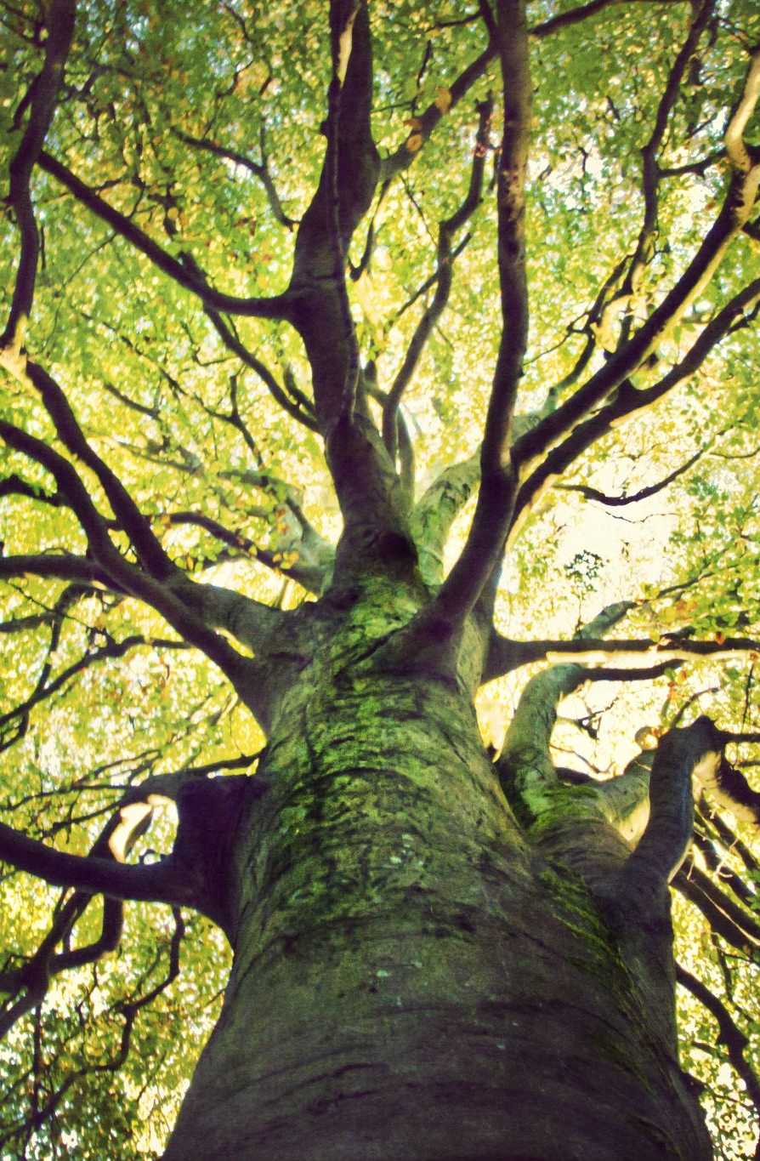
The Ideal Tree: Thinking Critically and Dreaming
Martin Stone, PhD, ISA Certified Arborist
Western Kentucky University

Slide 2
What is the IDEAL TREE?
What is your favorite band?
What is your favorite color?
What is your Favorite dessert?
Does it even exist?
Are we already too philosophical? I thought this was horticulture!!

Slide 3
What are the characteristics of an IDEAL TREE?
Now that is more like it.
More critical thinking less dreaming!
We can do both!

Slide 4
Ornamental Trees
ALL trees are ornamental…

Slide 5

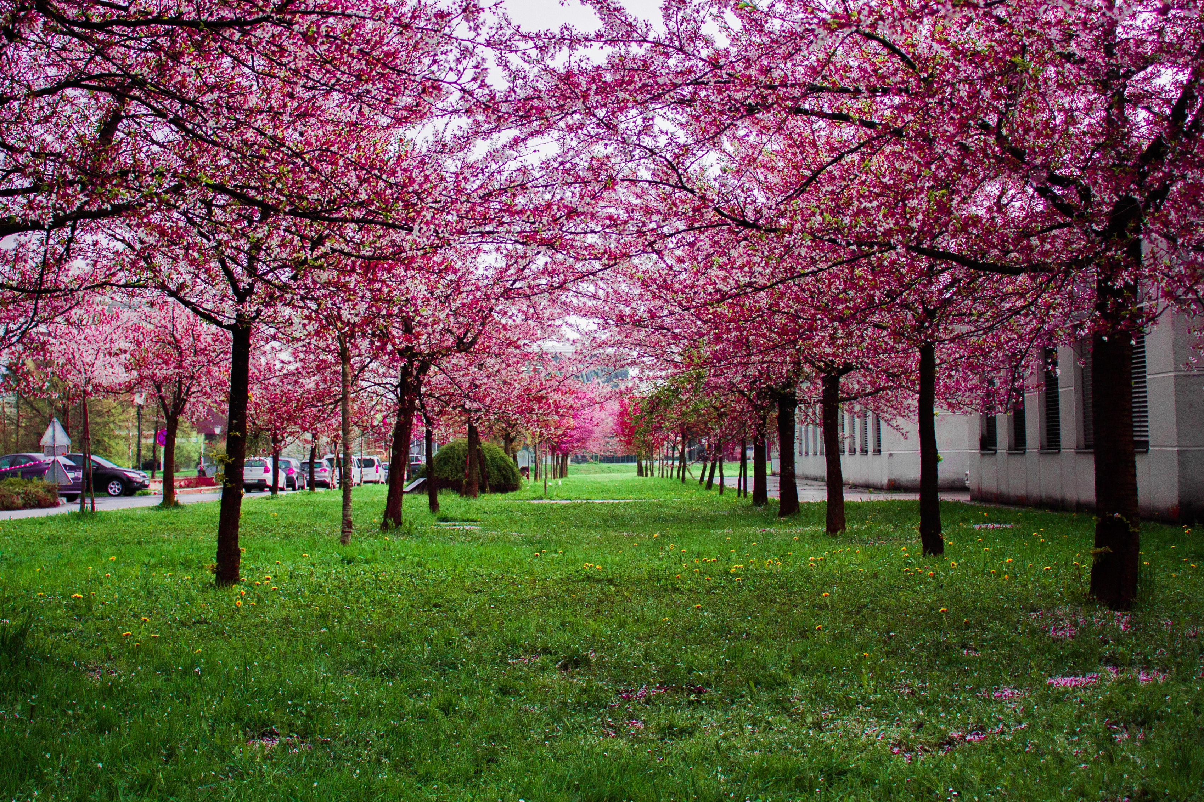
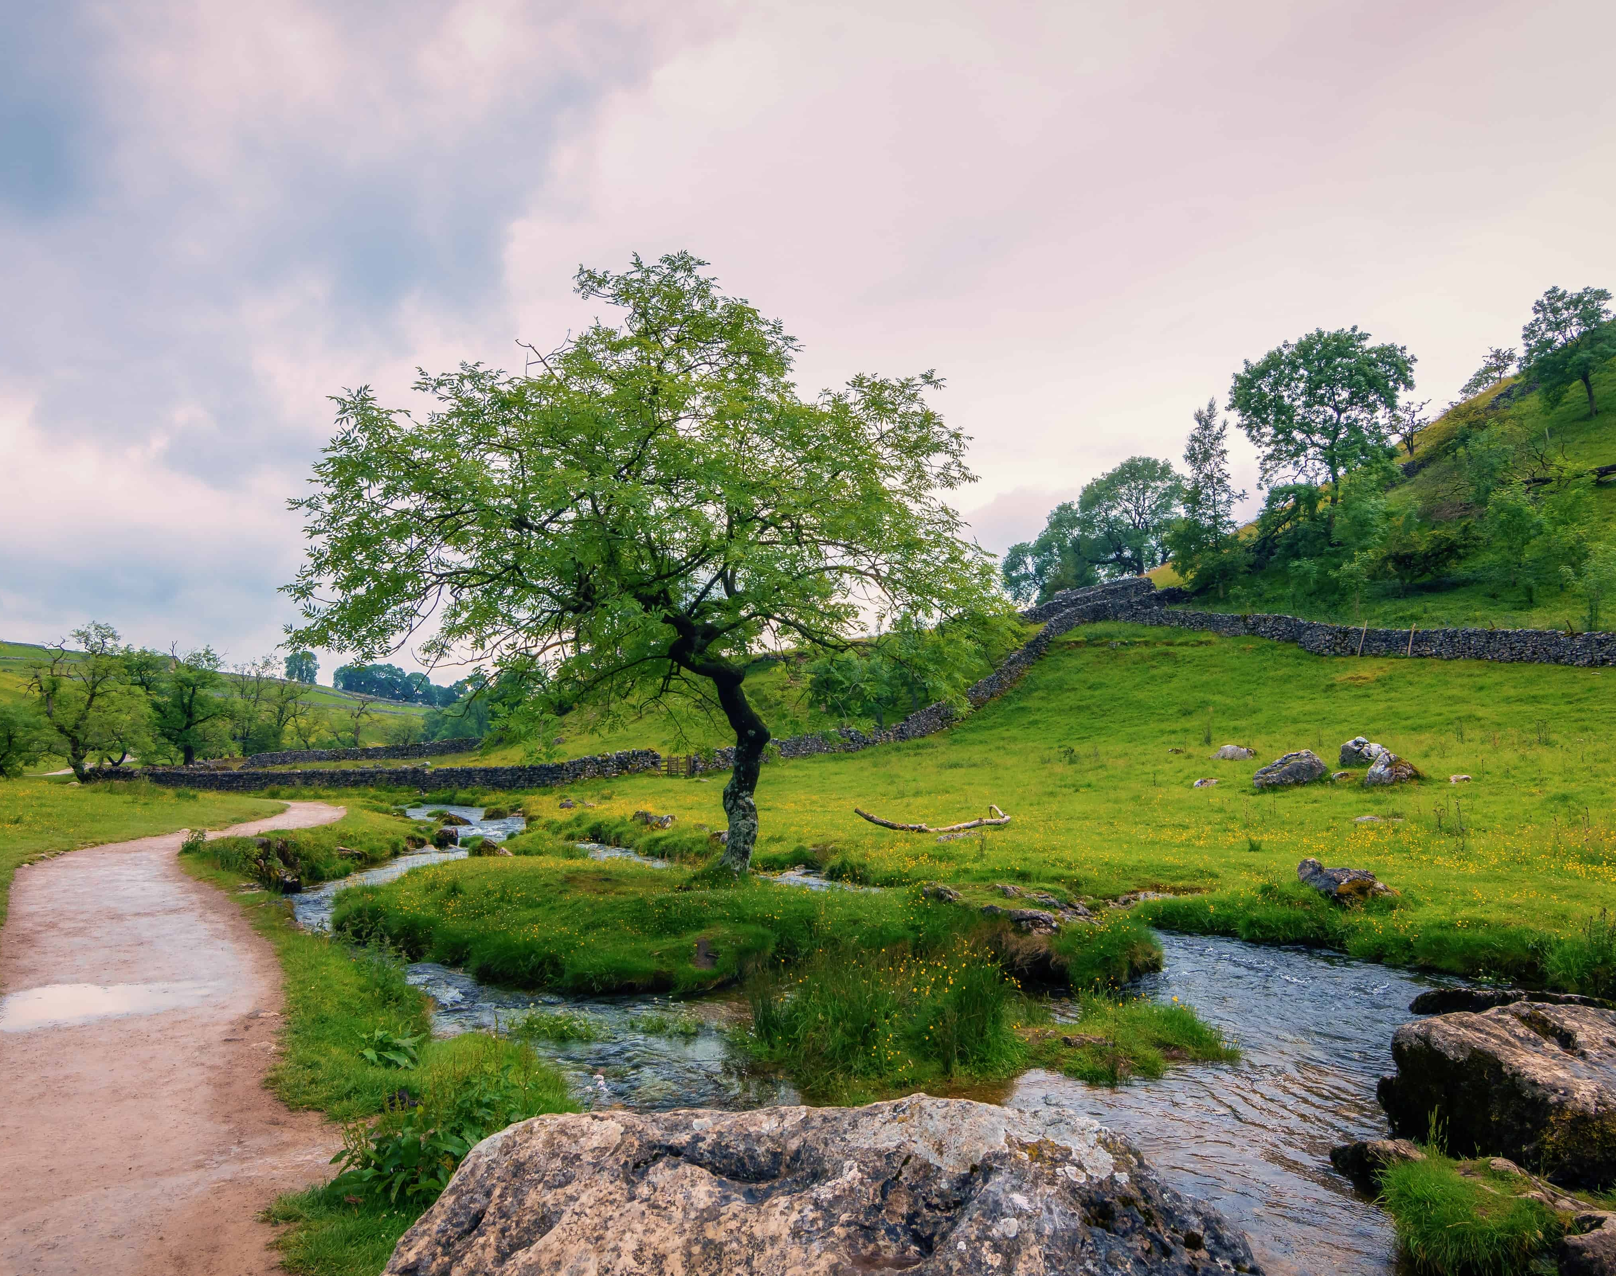




Slide 6
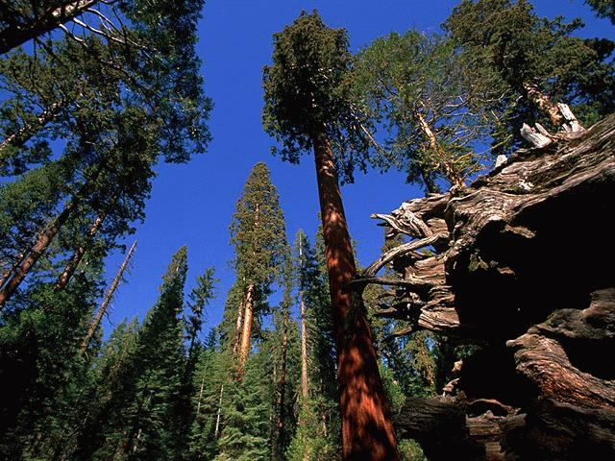

Slide 7
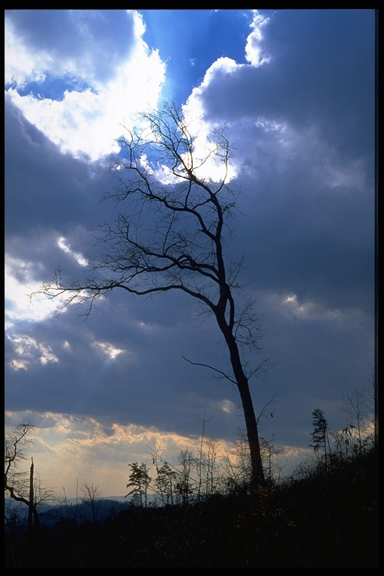
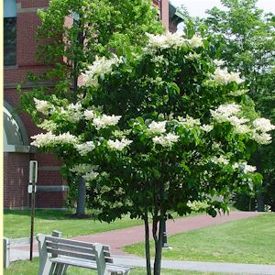
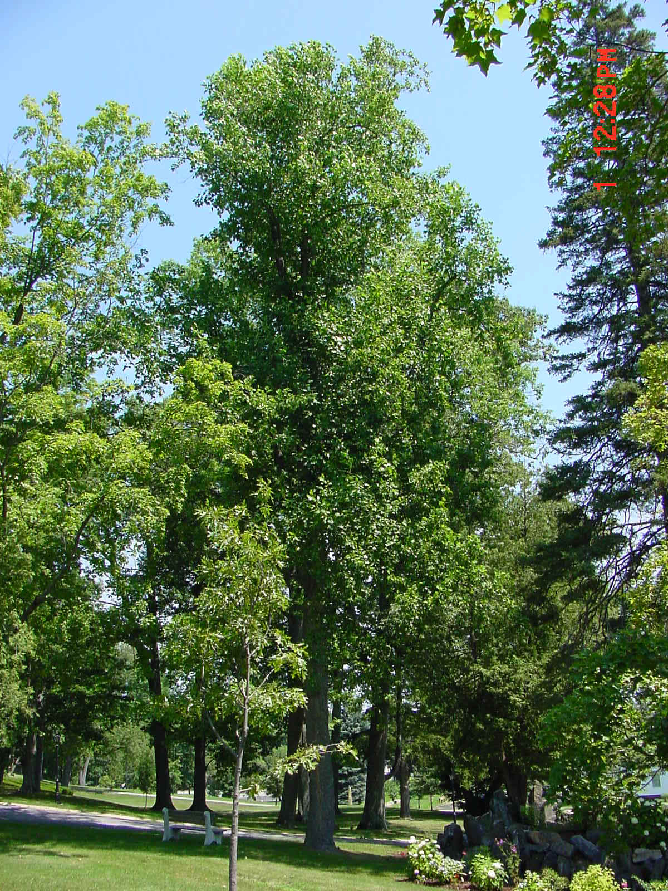

Slide 8
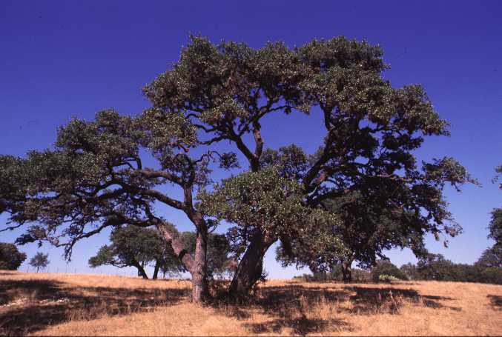

Slide 9
Demographics…
Most people live in town
Even if you live on a huge property…
Typically want smaller trees 30’ or less
Typically want ornamental trees
Smaller trees in front
Larger shade trees in backyard

Slide 10
Demographics…
Houses have gotten larger
Property sizes have shrunk
Window to window…12’ b/w houses
HOA & towns mandate landscaping minimums
What to do?

Slide 11
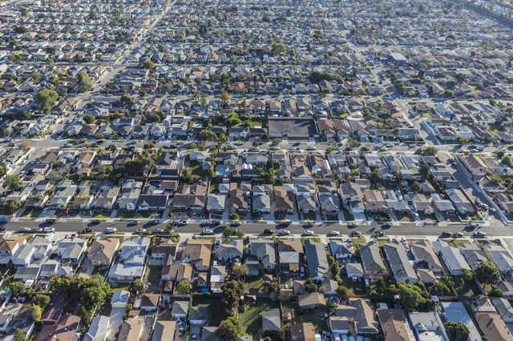

Slide 12
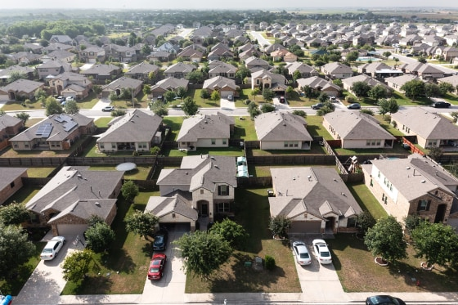

Slide 13



Slide 14
Let’s Focus
Small(ish) trees 25’or less
Fit beneath power line
Easy culture
Readily available
Transplant easily
Fastigiate? Part of the solution
READY? Let’s become critical tree-thinkers

Slide 15
Fastigiate or fastigiata
Describes plants that are at least 10X taller than wide
Rocket Shaped
Fit into small spaces but violate the 25’ tall rule

Slide 16
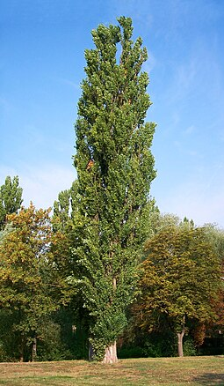
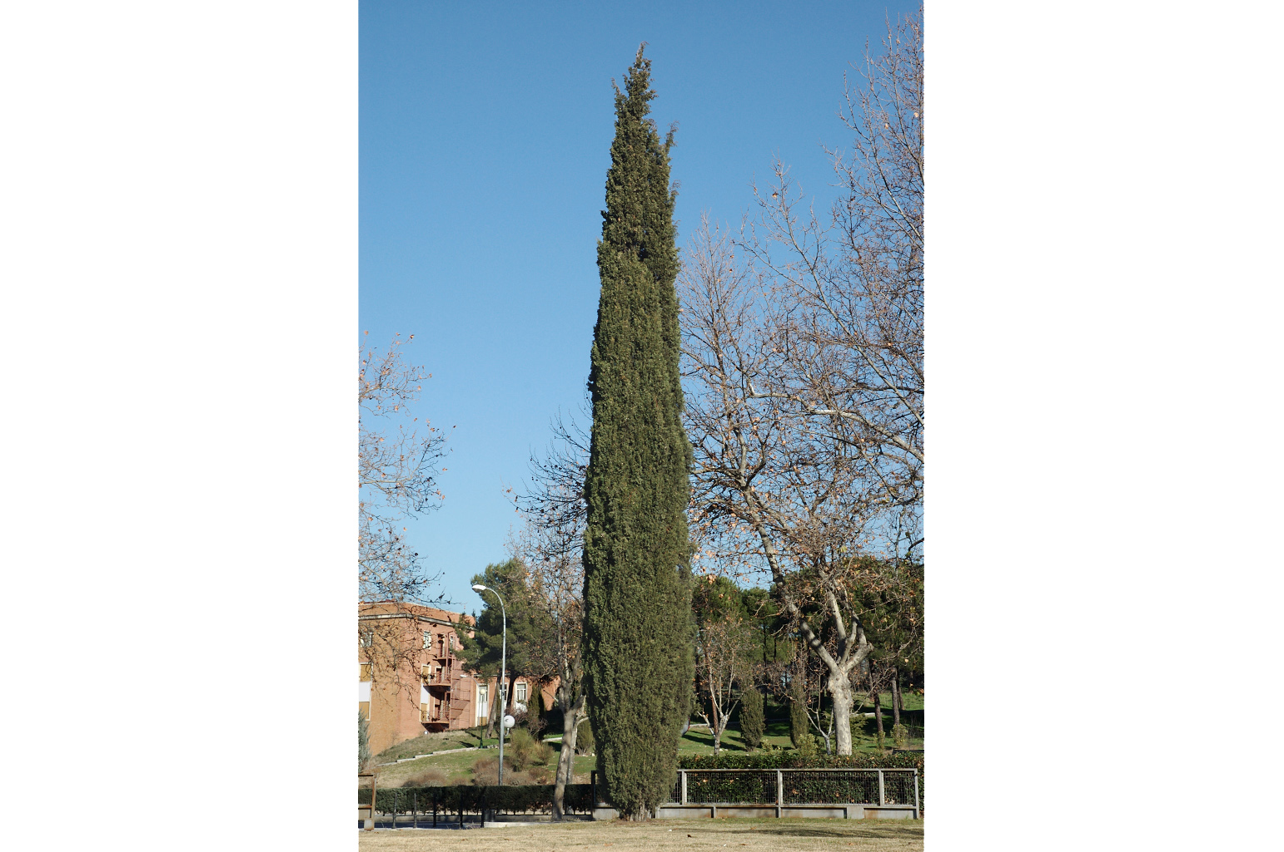
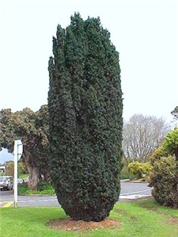

Slide 17
Ideal Small Tree
More than one season of interest
Leaves, Flowers, Fruits
Contribute to the beauty of landscape
But not overwhelm it
Contribute to functionality of landscape
Energy conservation
Resistance to insects and diseases
Tolerance of abused, compacted, polluted urban soils
No plants are native to an urban landscape

Slide 18
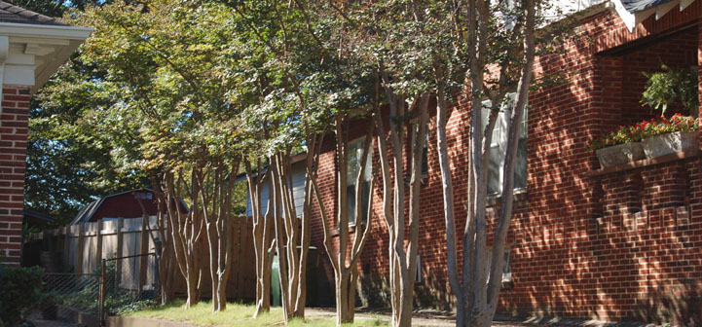

Slide 19
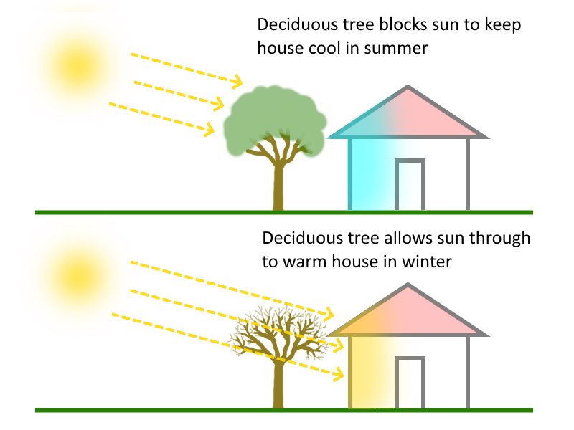

Slide 20
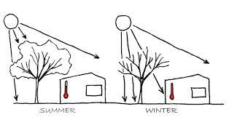
Incoming solar radiation
Summer
Winter
Evaporative cooling

Slide 21
Ideal Small Tree
May Also Include
Wildlife habitat
Evergreens provide winter cover
Winter food supply

Slide 22
Ideal Small Tree
Should NOT Include
Messy habits
Dropping seeds, acorns, fruits, stinking flowers
Surface roots

Slide 23
Small, Ornamental Trees
Street Trees
Fit beneath power lines
Designed to grow between sidewalk and street (hell strip)
Pedestrian-friendly branches
Low maintenance

Slide 24
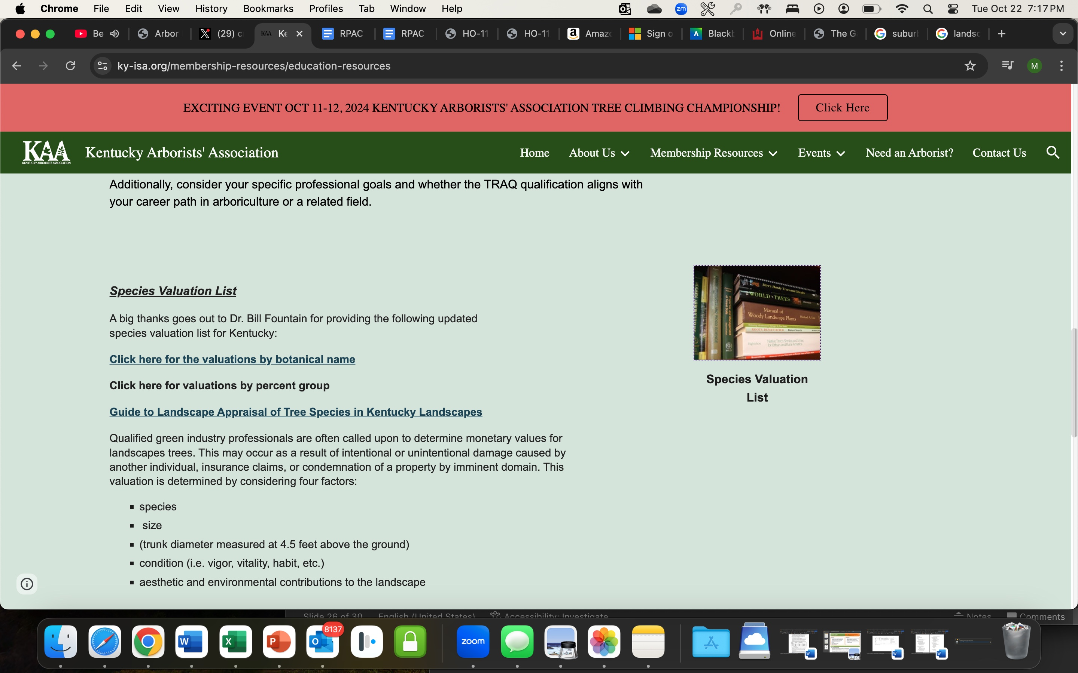
https://docs.google.com/document/d/1jrsJY47dBSfh7LdJpcC6Px0KjkL1RNr_/edit

Slide 25
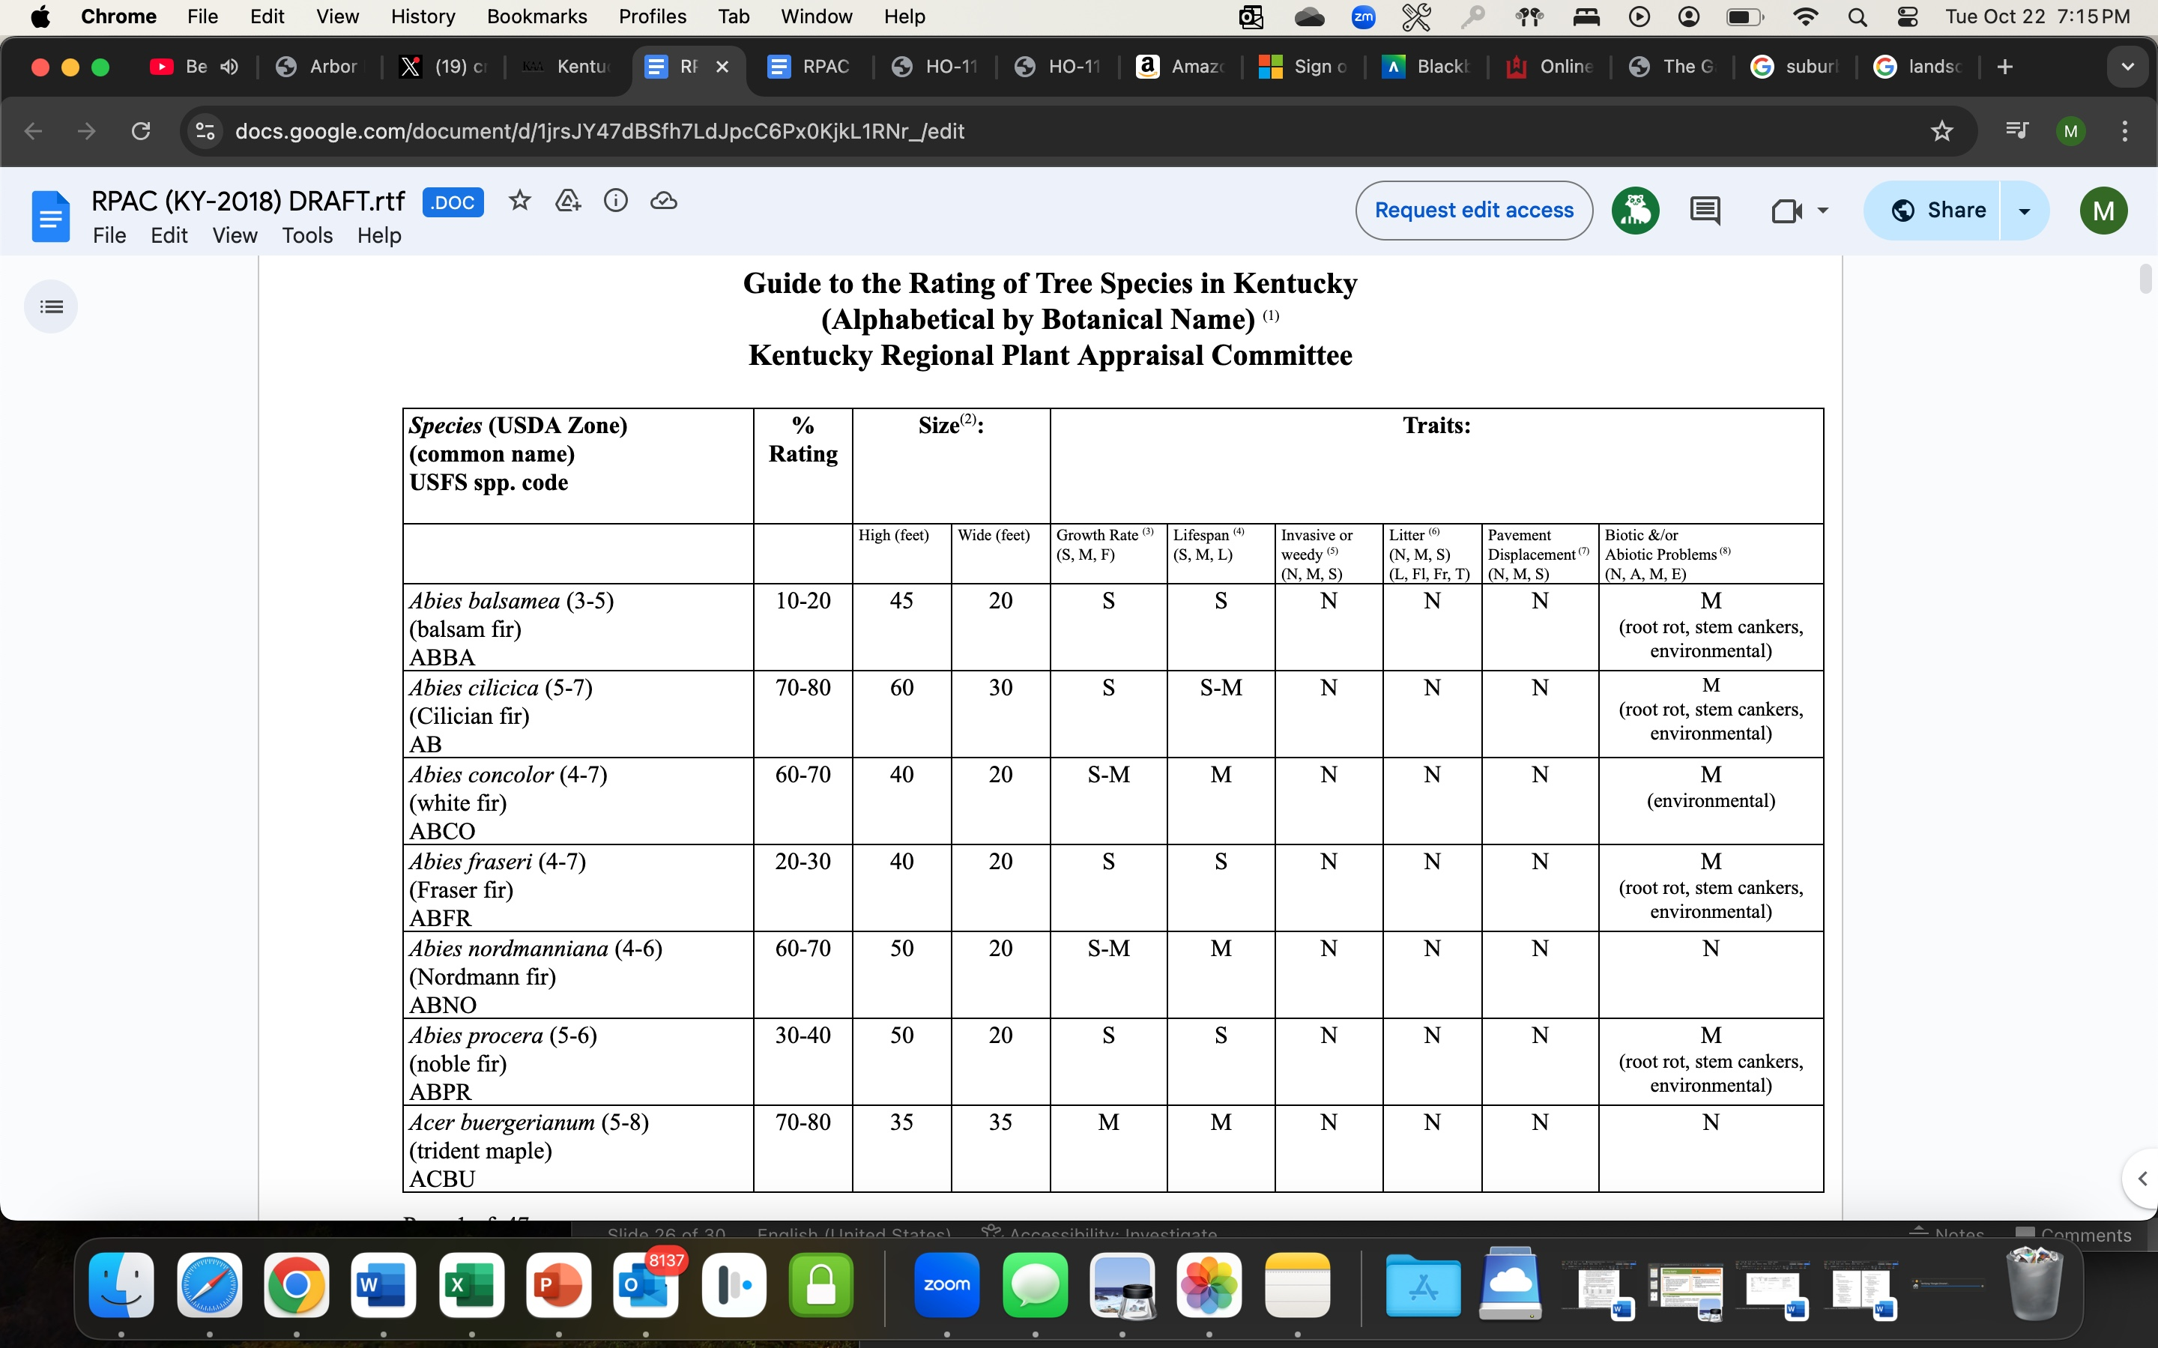

Slide 26
10-20% - Species of trees that should be avoided in home landscapes
Abies balsamea (balsam fir)
Ailanthus altissima (tree of heaven)
Albizia julibrissin (mimosa)
Caragana arborescens (Siberian peashrub)
xCupressocyparis leylandii (Leyland cypress)
Elaeagnus angustifolia (Russian olive)
Fraxinus americana (white ash, untreated for EAB)
Fraxinus excelsior (European ash, untreated for EAB)
Fraxinus nigra (black ash, untreated for EAB)
Fraxinus pennsylvanica (green ash, untreated for EAB)
Lonicera maackii (Amur bush honeysuckle)
Lonicera tatarica (Tatarian bush honeysuckle)
Morus alba (white mulberry, female)
Populus nigra ‘Italica’ (Lombardy poplar)
Pyrus calleryana (Callery pear)
Sorbus aucuparia (European mountainash)
Ulmus pumila (Siberian elm)

Slide 27
90-100%
Ginkgo biloba (ginkgo, male)
Gymnocladus dioica (Kentucky coffeetree, male)
Maclura pomifera (Osage orange, male)
Nyssa sylvatica (blackgum)
Quercus alba (white oak)
Quercus bicolor (swamp white oak)
Quercus macrocarpa (bur oak)
Zelkova serrata (Japanese zelkova)

Slide 28
80-90%
Acer campestre (hedge maple)
Acer griseum (paperbark maple)
Acer miyabei (miyabe maple)
Acer truncatum (shantung maple)
Aesculus parviflora (bottlebrush buckeye)
Cercidiphyllum japonicum (katsuratree)
Cornus mas (cornelian cherry dogwood)
Cornus officinalis (Japanese cornelian cherry dogwood)
Eucommia ulmoides (hardy rubbertree)
Fagus grandifolia (American beech)
Fagus sylvatica (European beech)
Gymnocladus dioica (Kentucky coffeetree, female)
Ilex decidua (possumhaw)
Juniperus chinensis (Chinese juniper)
Juniperus virginiana (eastern redcedar)
Maackia amurensis (Amur maackia)
Magnolia xloebneri (Loebner magnolia)
Magnolia virginiana (sweetbay magnolia)
Magnolia virginiana australis (sweetbay magnolia, southern form)
Metasequoia glyptostroboides (dawn redwood)
Nyssa aquatica (water blackgum)
Ostrya virginiana (hophornbeam)

Slide 29
80-90% continued
Picea abies (Norway spruce)
Picea orientalis (oriental spruce)
Pinus bungeana (lacebark pine)
Quercus acutissima (sawtooth oak)
Quercus coccinea (scarlet oak)
Quercus falcata (southern red oak)
Quercus imbricaria (shingle oak)
Quercus laurifolia (laurel oak)
Quercus lyrata (overcup oak)
Quercus muehlenbergii (chinkapin oak)
Quercus pagodifolia (cherrybark oak)
Quercus phellos (willow oak)
Quercus prinus (chestnut oak)
Quercus rubra (red oak)
Quercus shumardii (Shumard oak)
Quercus velutina (black oak)
Taxodium ascendens (pondcypress)
Taxodium distichum (baldcypress)
Thuja plicata (western arborvitae)
Tilia cordata (European littleleaf linden)
Tilia xeuchlora (Crimean linden)
Tilia tomentosa (silver linden)

Slide 30
On to the TREES

Slide 31
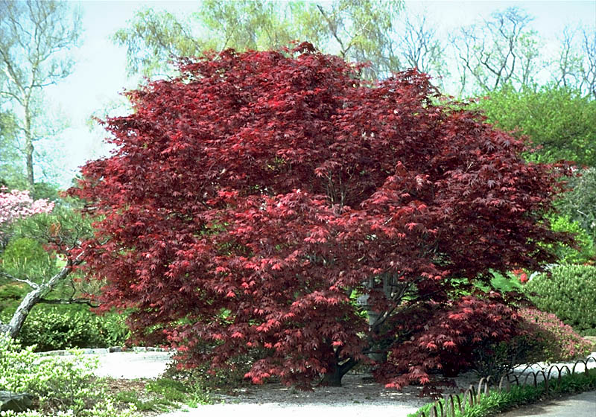
Japanese Maple (Acer palmatum)
60-70%
Many cultivars
Prefers afternoon protection
Evenly moist conditions
DO NOT plant deeply
Sunlight gives color

Slide 32
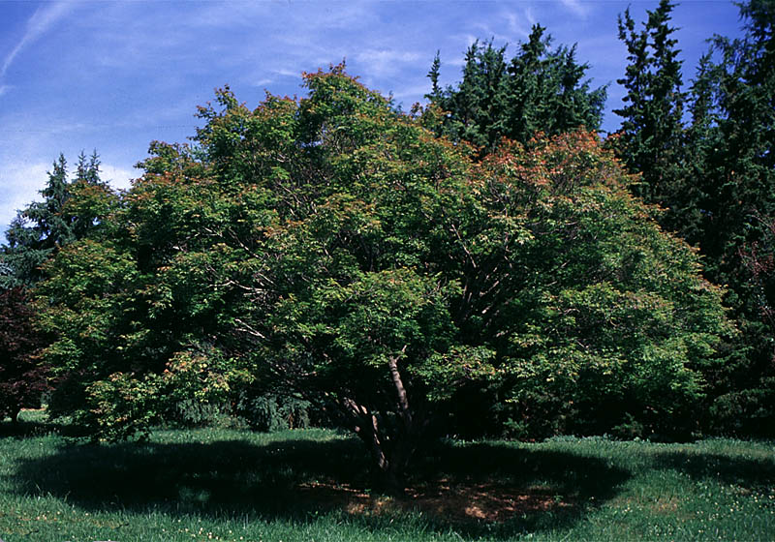
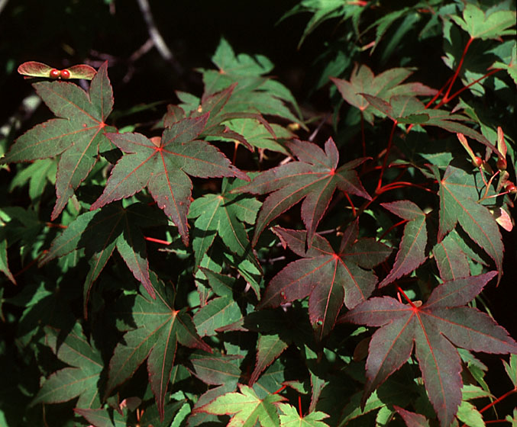

Slide 33
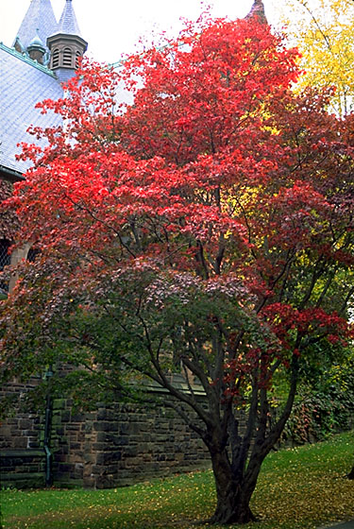
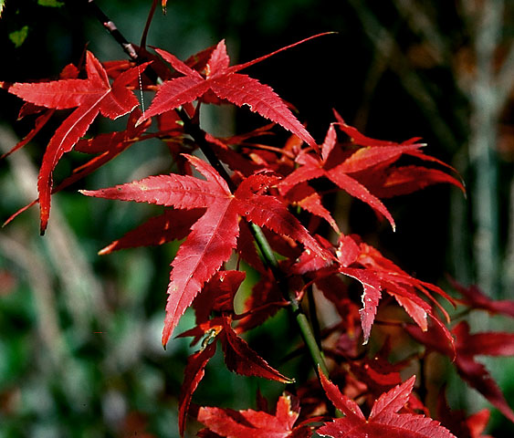

Slide 34
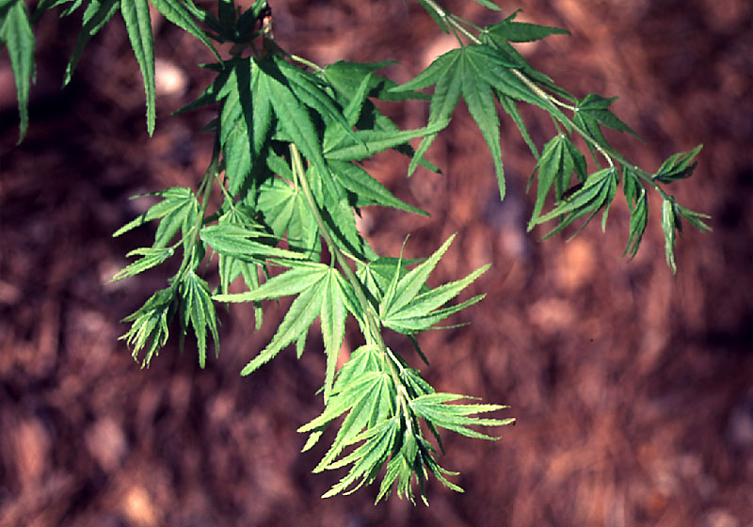
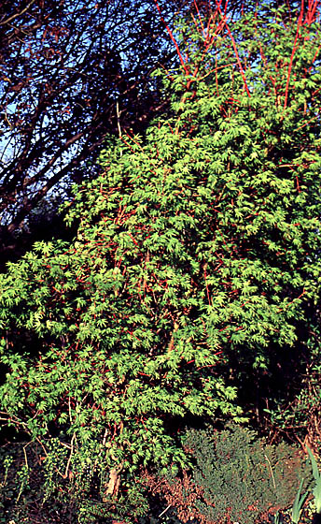
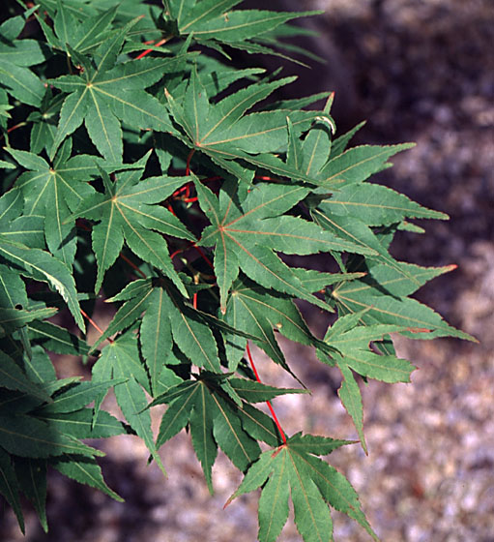

Slide 35
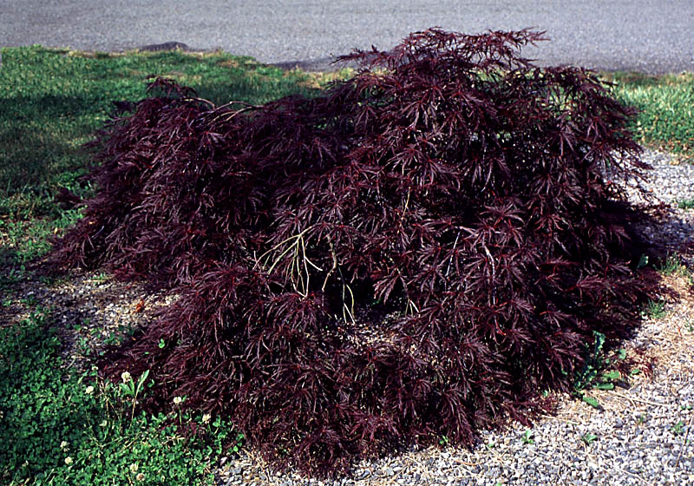
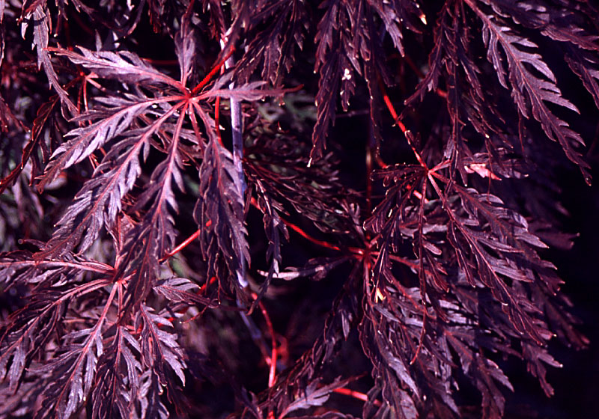

Slide 36
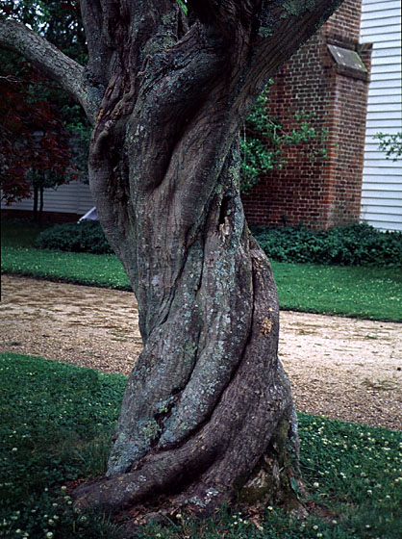
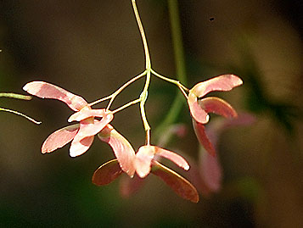

Slide 37
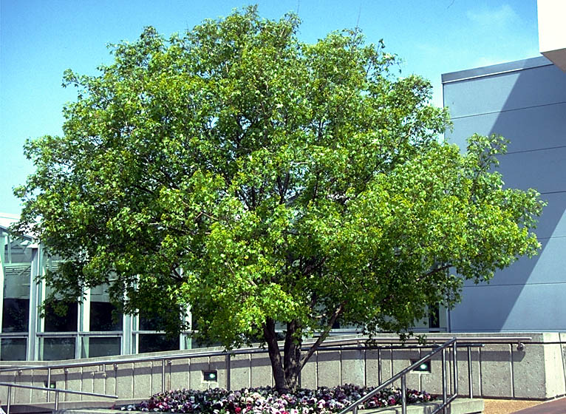
Shangtung Maple (Acer truncatum)
80-90%
Evenly moist soil
Beautiful fall foliage orange to red to yellow
Trained as a single trunk but multiple trunk is more attractive

Slide 38
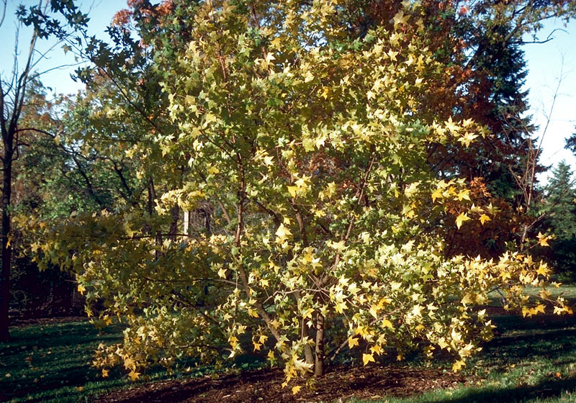
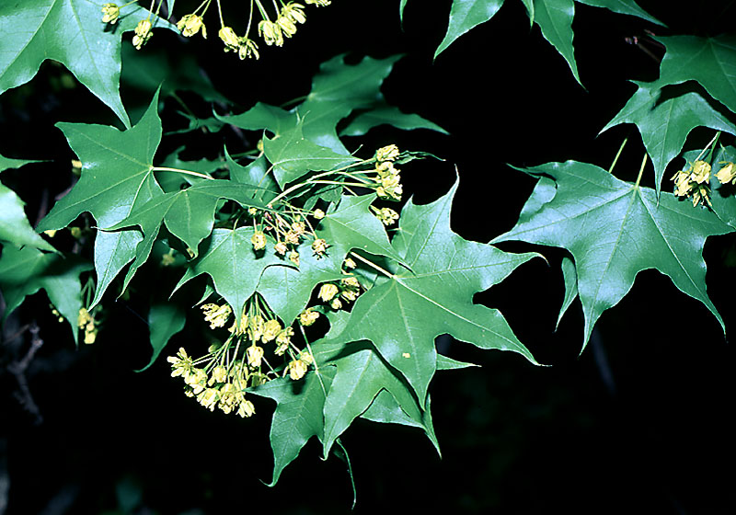
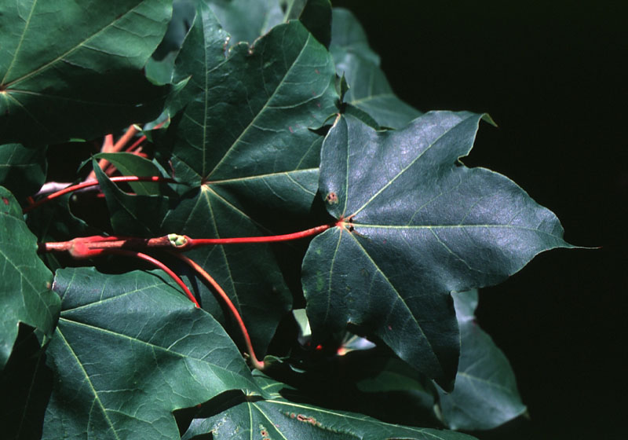

Slide 39
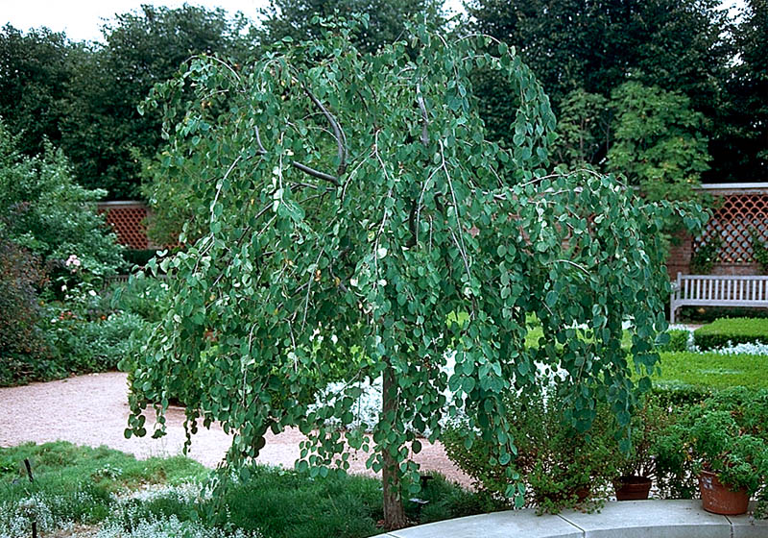
Weeping Katsura Tree (Cercidiphyllum japonicum)
80-90%
Part shade to full sun
Great specimen or accent
Yellow fall color
Somewhat drought tolerant

Slide 40
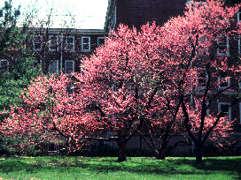
Redbud (Cercis canadensis)
60-70%
Great spring flowers
Widely tolerant of conditions
Yellow fall color
Bean pods
Cultivar selection important

Slide 41
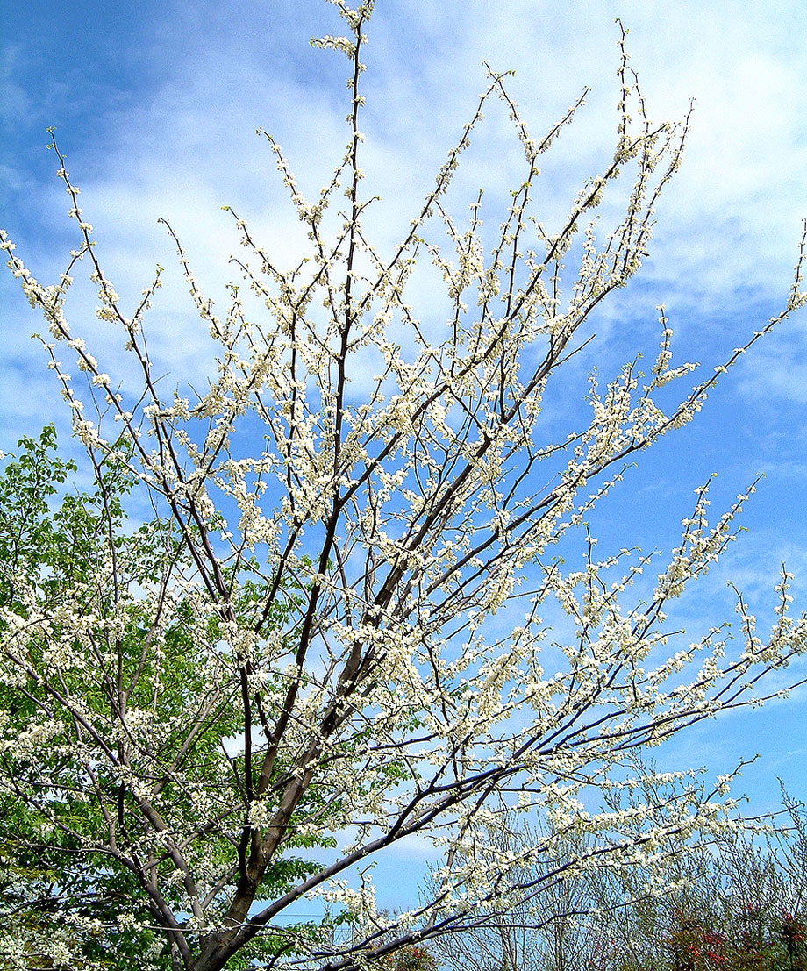
Whitebud

Slide 42
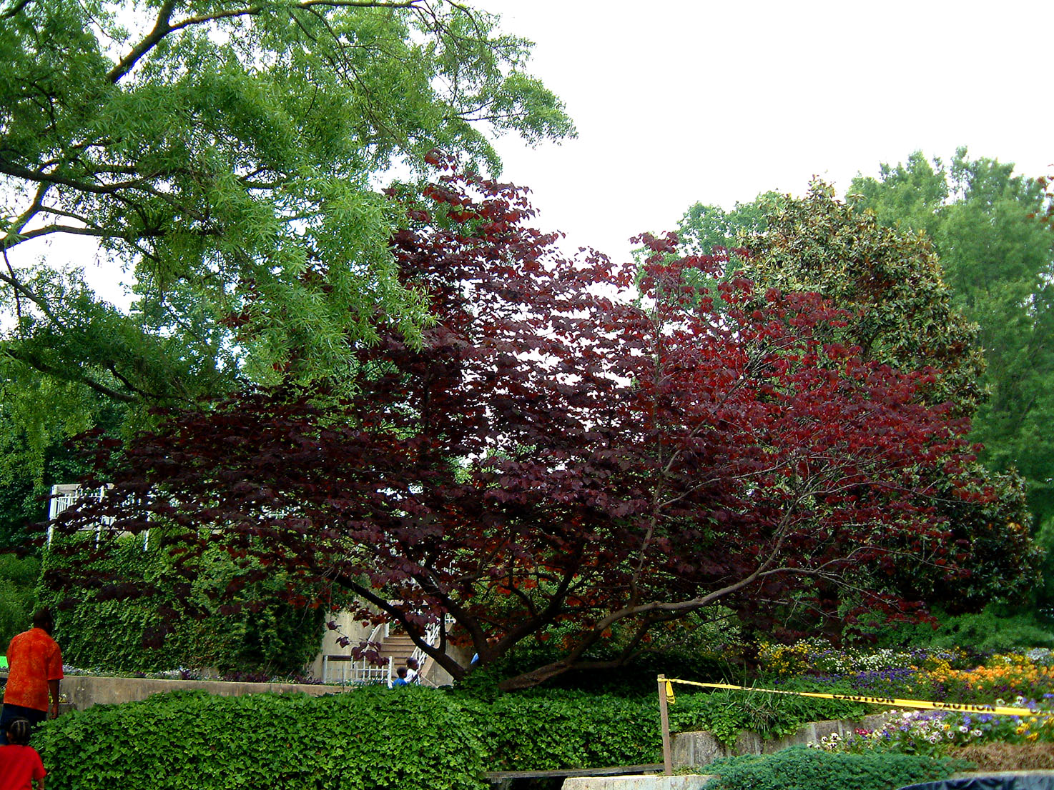
‘Forest Pansy’

Slide 43
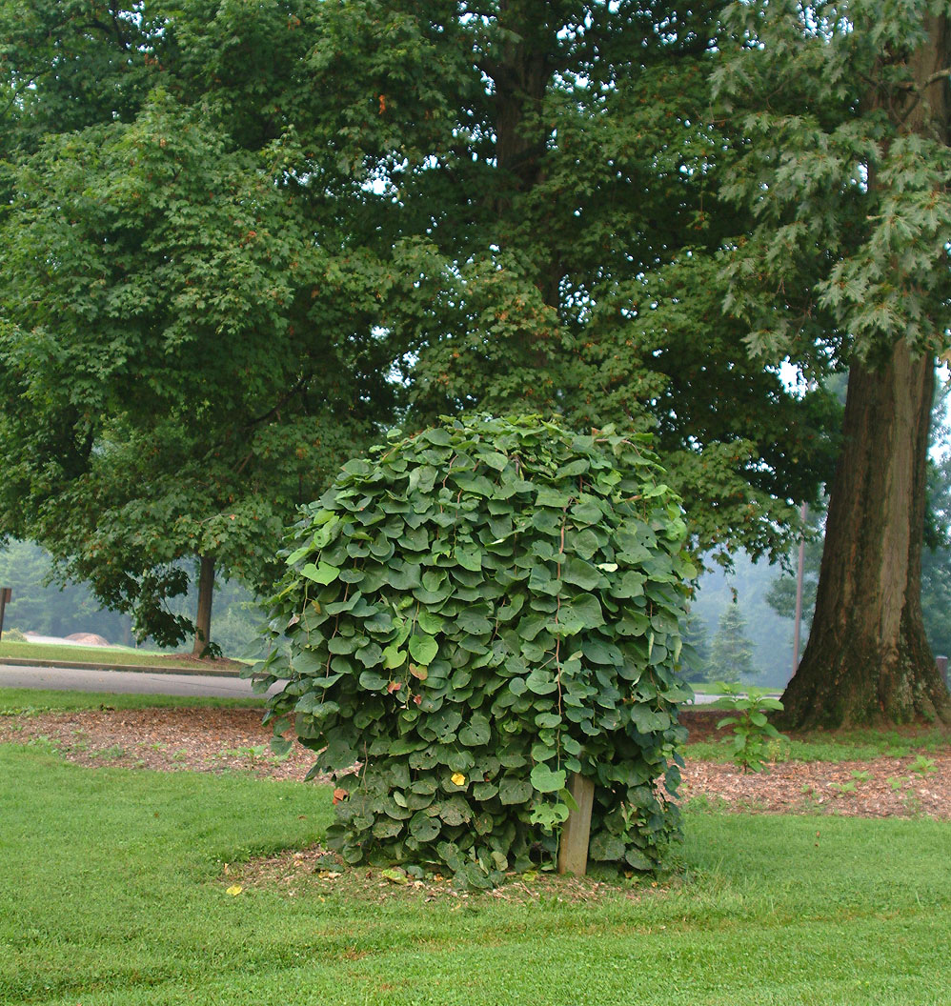
‘Covey’

Slide 44
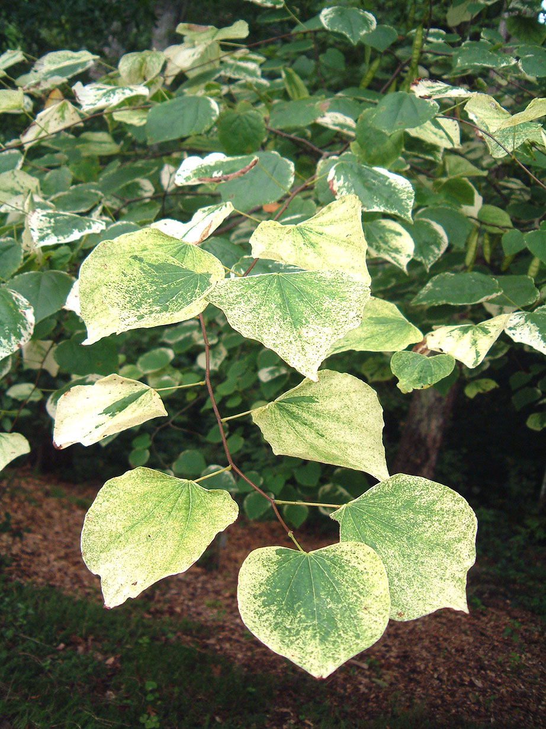
‘Silver Cloud’

Slide 45
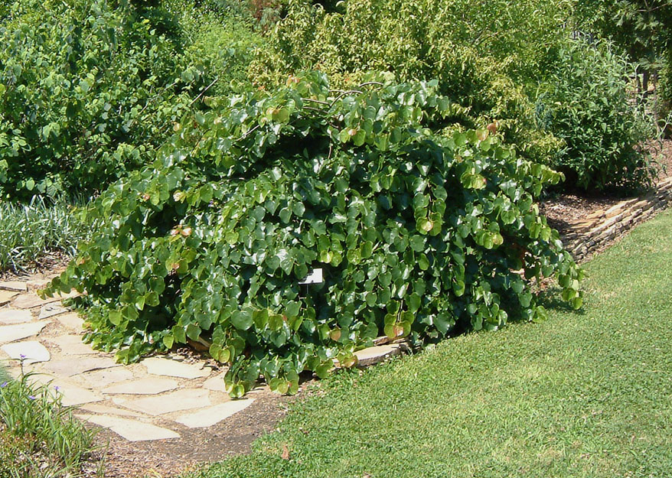
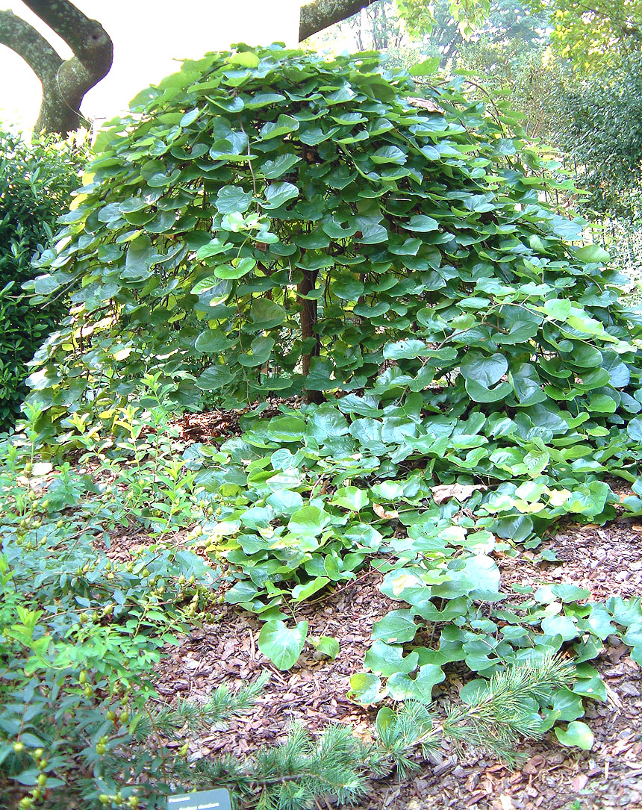
‘Traveller’

Slide 46
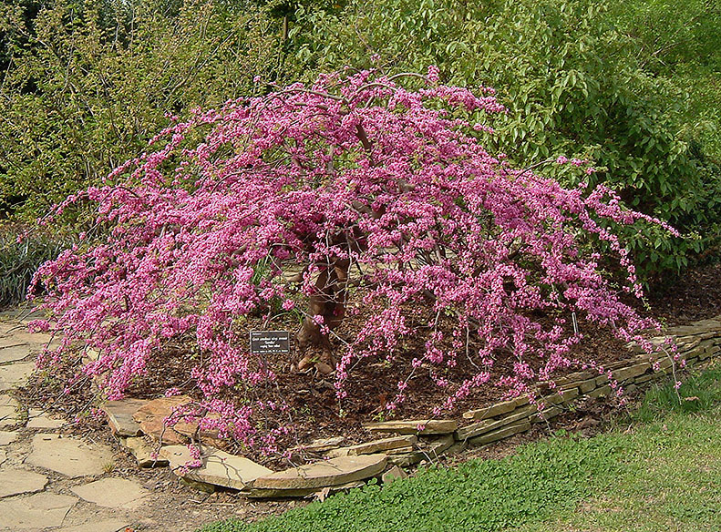

Slide 47
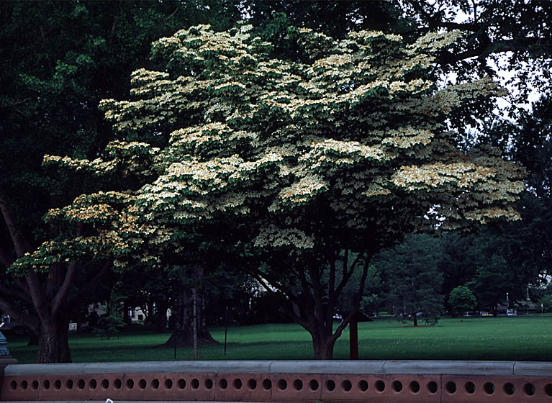
Kousa, Korean Dogwood
60-70%
Analog of native
Resistance to anthracnose
Leaves and flowers emerge at same time
More sun tolerant than native

Slide 48
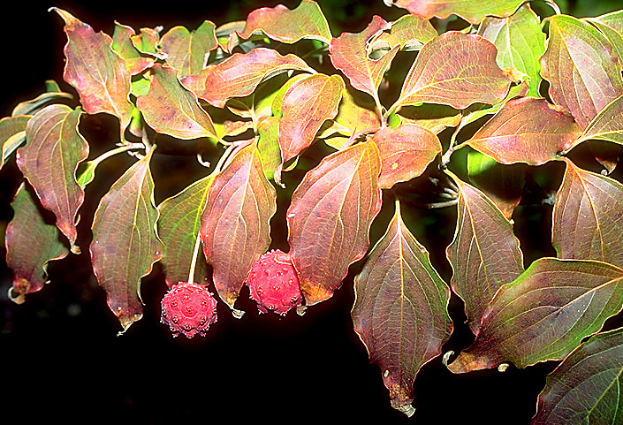
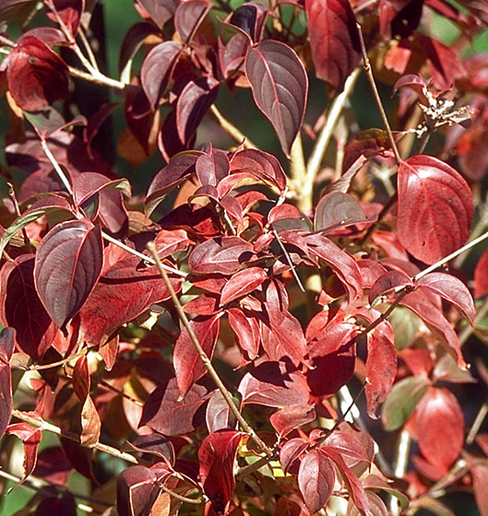

Slide 49
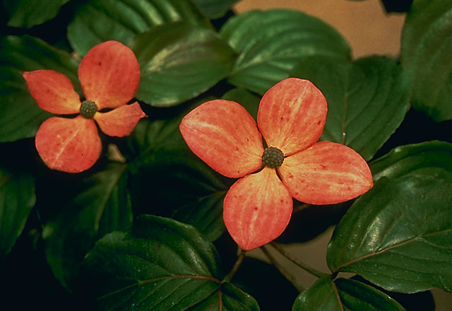
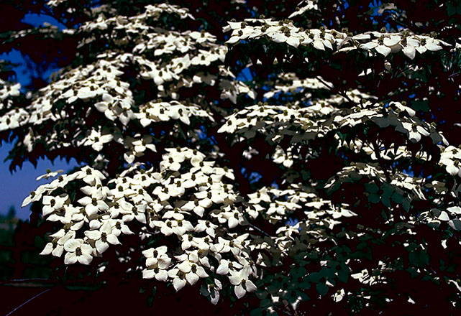

Slide 50
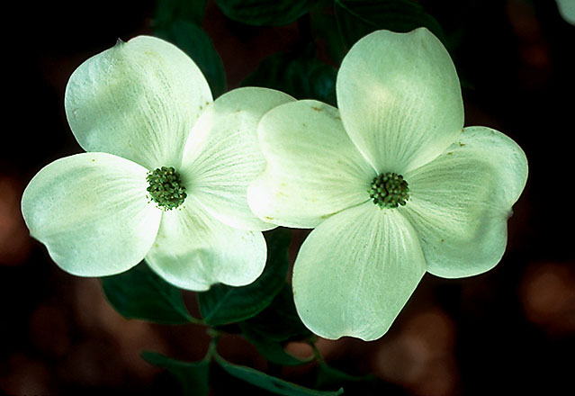
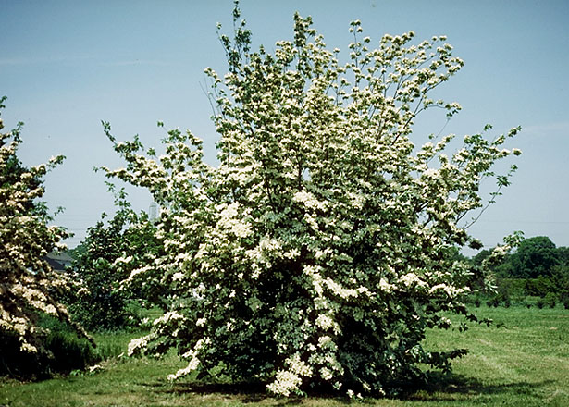

Slide 51

Hawthorn (Crataegus spp.)
50-70%
Flowers profusely in spring
Often confused as a crabapple
Beautiful wide shape
Some species have thorns!

Slide 52



Slide 53



Slide 54



Slide 55

Possum Haw Holly (Ilex decidua)
80-90%
Native
Winter fruits relished by birds
Multiple seasons of interest

Slide 56



Slide 57



Slide 58

Magnolias
80-90%
Too many to cover
Small to large trees
Deciduous species smaller
Size greatly varies by cultivar, choose carefully

Slide 59




Slide 60




Slide 61

Crabapples (Malus sp.)
70-80%
The most spectacular flowering tree
Very tolerant of soil conditions
Multiple seasons of interest
New cultivars no longer drop fruits and are disease resistant!

Slide 62



Slide 63



Slide 64



Slide 65

Japanese Snowbell (Styrax japonicus)
50-60%
Underused species
Great accent tree by entry or patio
Often grown with multiple trunks
Slow grower
Prefers afternoon shade

Slide 66



Slide 67

Foster Holly (Ilex attenuata)
Not rated
Evergreen
Wildlife interest with berries and cover
Great accent plant or screen
Can be shaped to be formal
Winner except pH/foundations
Dioecious - male and female
70-80%
American holly is a parent and has a good rating

Slide 68



Slide 69



Slide 70


