Slide 1

Skills Mapping
Kentucky Graduate Profile 10 Essential Skills
Introduce
Reinforce
Mastery

Slide 2

Agenda
Overview of KGP
CPE Expectations
Skill Map Development
Review Process
Submission

Slide 3
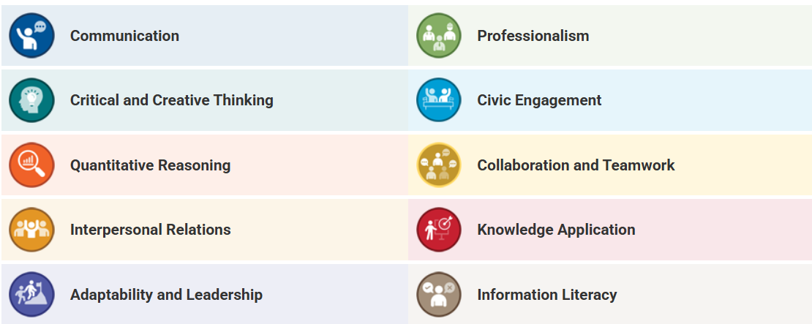
Overview
What is the Kentucky Graduate Profile?
10 Essential Skills needed for Kentucky’s workforce
Validated by stakeholders who hire Kentucky undergraduates

Slide 4
CPE Expectations
Mandated implementation of skills into general education, academic programs, and campus experience by Fall 2028
Skill Maps for all currently offered undergraduate programs and all future program proposals
Assessment plan for general education and academic programs that incorporates skills

Slide 5
Development
Skills Maps
2023-2024 Curriculum Maps
Program Learning Outcomes
Core Course Descriptions
Levels of Mastery for Each Skill
(see AA ASL Templates & Resources Page)
Consider these as conversation starters and first drafts!

Slide 6
Considerations
CORE COURSES: Map only the constant courses that all students take as part of your program (Core).
MAJOR CATEGORICAL REQUIREMENTS: Some majors have multiple course options for all students to complete a categorical requirement. For example, take an “Ethics” course from the following options. “Ethics” can simply be listed on the map with the intended skill/level marked for that category.
CONCENTRATIONS: Since students have the choice to pick different concentrations in some majors, programs can simply list the concentration title and mark the skills.
ASSESSMENT: Mastery (or Capstone) Skills must be assessed within the program.
Example Skills Map – Political Science

Slide 7
Review Process
Watch for a link to maps.
Ensure the skill maps include the correct courses for each program; update as needed.
Review the level indicators (I, R, and M), and make sure you agree with their alignment to the program’s courses/skills; update as needed.
Update the highlighted mastery skills based on your updated level indicators.
Add skill statements to the course syllabi within the program.
Begin discussions on how skills are being assessed within the program.

Slide 8
Unavailable Skills Maps
Learning outcomes are missing in CourseLeaf.
CourseLeaf is the repository for learning outcomes. If your program does not have learning outcomes listed, contact me (Rheanna.Plemons@wku.edu) for additional steps to get them added ASAP.
The program is too fluid.
We were unable to determine a core group of courses for the program. We did not make assumptions about categorical requirements within programs (Ethics example).
Curriculum Maps were not submitted as part of the AY 2023-2024 ASL Report.

Slide 9
Submission Process
Final map is due to AA on May 15.
Update your curriculum map as well.
Department Heads/Directors will receive instructions on how to upload information into a central repository.

Slide 10
Questions?

