Slide 1

Creating Measurable Learning Outcomes:
Setting Up Effective Program Assessment

Slide 2
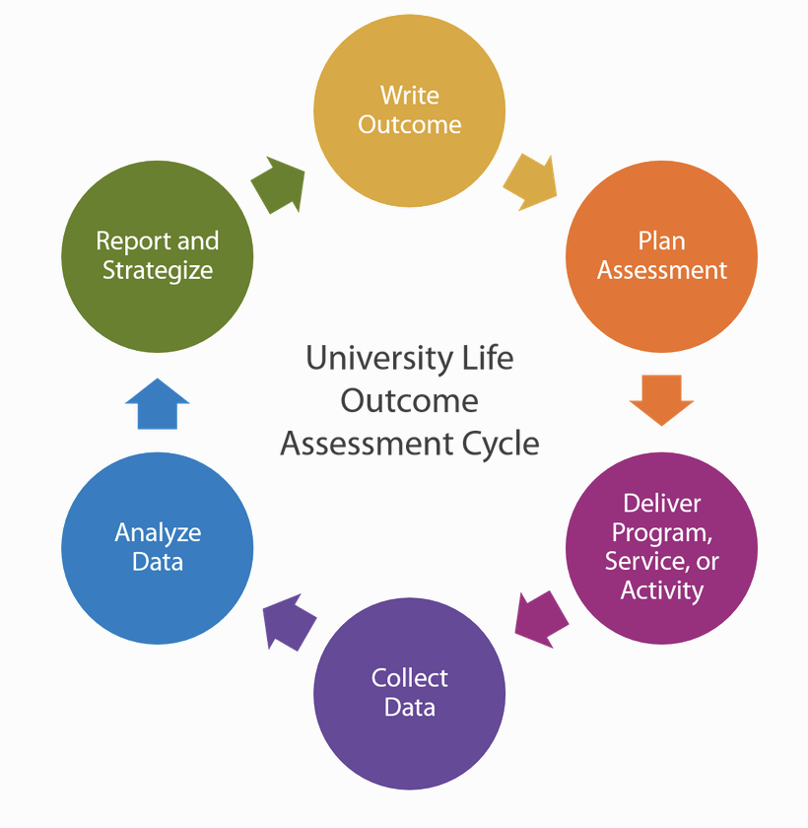
The first part of the cycle…SLOs/PLOs
This takes a lot of thoughtfulness,
collaboration, & work up front!
What do you want students to know upon completion of your program?
What do you want students to be able to do? What do employers expect? If it’s an undergraduate program, what do graduate schools expect? COMPENTENCIES!
When do you want them to be able to know it or do it? And, is it scaffolded?
Are the outcomes observable, measurable, and reasonable (can they be performed by students)?

Slide 3
The Basics
Use simple language and be specific, clear, and concise.
Ensure that the learning outcome is measurable
Use Bloom's Taxonomy

Slide 4
Option 1: Students will be given opportunities to learn effective communication skills | Verdict: Not an outcome. Describes content rather than outcome.
Option 2: Students will have a deeper appreciation for good communication practices | Verdict: Vague. No measurable action verb or level of learning. No context.
Option 3: Understand principles of effective communication | Verdict: Less vague, but not a measurable action verb
Option 4: Students will demonstrate effective communication skills in a professional environment through technical reports | Verdict: Specific, clear, and concise
Use simple language and be specific, clear, and concise.

Slide 5
Ensure that the learning outcome is measurable
If your goal is to make sure students can demonstrate mastery of quantitative and qualitative research methods appropriate to applied research, what would an SLO, or SLOs, to measure this look like?
Students will be able to…
Apply the appropriate method to address research questions…OR
Develop a research study that applies quantitative research methods processes to address an applied research question…OR
Develop a research study that applies qualitative research methods processes to address an applied research question…OR
Evaluate appropriate methodologies used in applied research.
Note: The Bloom’s level of measurement would depend on the goal, major, purpose, etc.

Slide 6

Beware of double-barreled outcomes!
Triple-double-double-barreled example:
Describe, analyze, and synthesize qualitative and quantitative research methods processes to address an applied research questions and theoretical concepts.

Slide 7
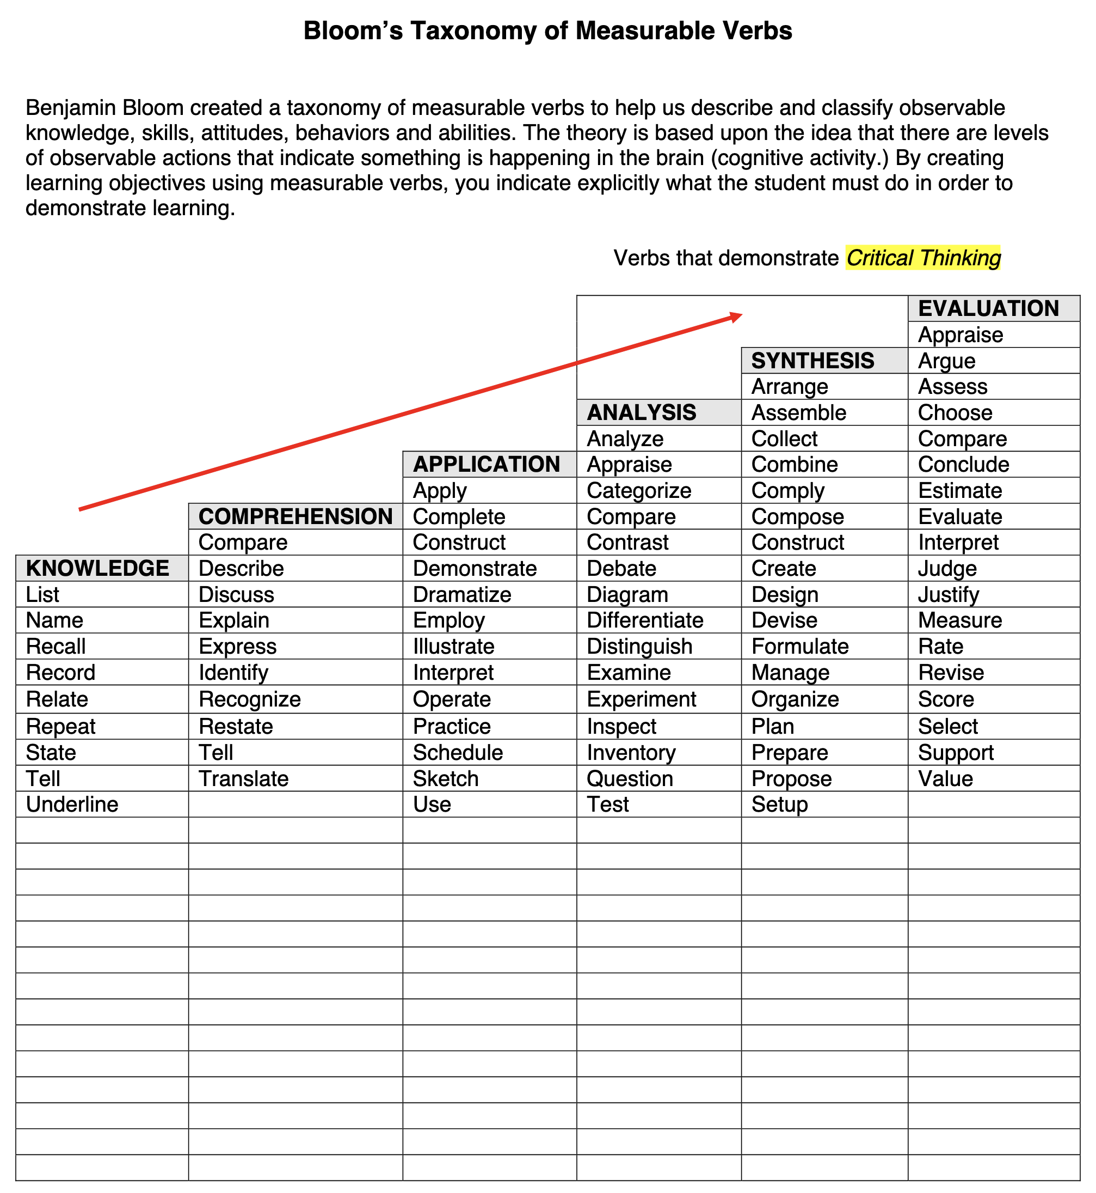
Use Bloom's Taxonomy
Check the chat for this document!

Slide 8
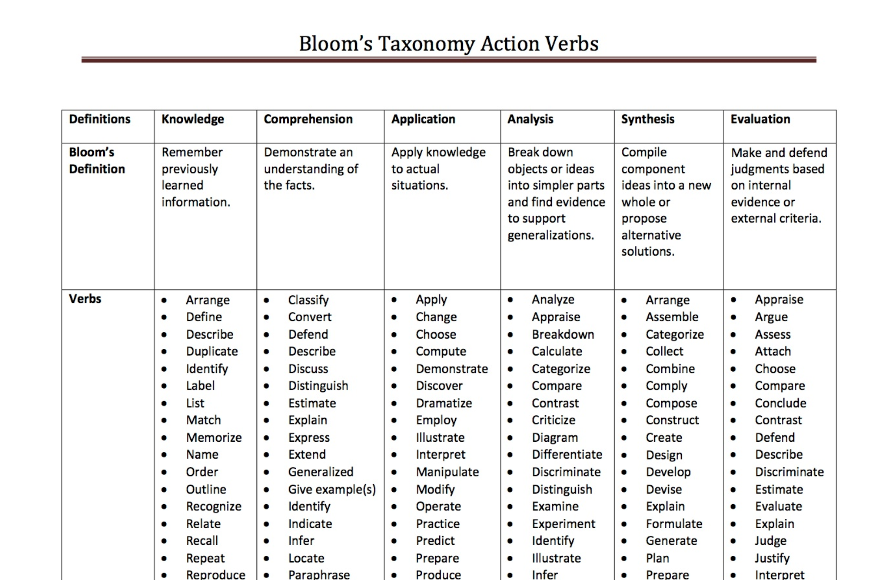
Use Bloom's Taxonomy
Check the chat for this document!

Slide 9

SLO Final Thought
Learning outcomes should align with departmental/program missions, the mission/vision of the university, and the WKU strategic plan.

