Slide 2
Peaklet Analysis: Software for Spectrum Analysis
Kentucky Innovation and Entrepreneurship Conference
August 29, 2013

Slide 3
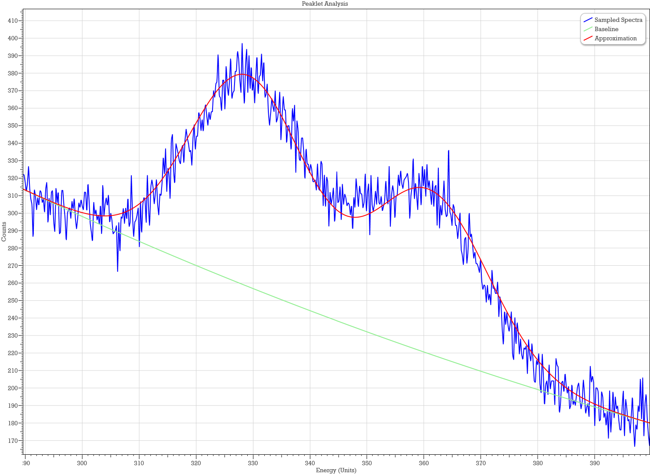
Peaklet Analysis is…
Software for the analysis of spectrum data (counts at different channels representing time, energy, etc.) that finds peaks (high counts) through background noise and distortions.

Slide 4
Peaklet Analysis is…
A tool for identifying elements/substances and their ratios from a spectrum where a peak or collection of peaks is indicative of a particular element or substance.

Slide 5
Peaklet Analysis is…
Particularly useful in situations where
an automated response is needed, and/or
an objective, non-biased analysis is required.

Slide 6
How It Started
It all started with a question from a physicist, they were using neutron interrogation to examine unexploded ordnance, and had issues with small peaks and overlapping peaks.
I had to learn to speak their language and understand their issues. We (WKU and I) eventually realized that the algorithm had larger potential applications than just theirs.
We applied for a patent on the analysis algorithm in 2010, and received the patent on April 2, 2013. We entered into a joint venture with Hitcents, who wrote the software code, and provides technical support and integration services.

Slide 7
www.peakletanalysis.com

Slide 8
Where we are now
The US patent on the core analysis idea has been issued, although the software uses some techniques not covered in the patent.
We have had one significant sale, but are still struggling to commercialize the software. We are working with the WKU Applied Physics Institute to build a demonstrator.
We are always open to collaborations with others who could benefit from the use of the analysis software, including those who encounter less peak-like structures in their gathered spectra.

Slide 9
Thanks to KSTC for inviting me,
and for the grants that have supported this work:
KSEF-324-RDE-003, KSEF-1653-RDE-011, and COMMFUND-1280-RFP-011.
Thank you for your kind attention!
Bruce Kessler
www.peakletanalysis.com
info@peakletanalysis.com
bruce.kessler@wku.edu
(270) 792-9790

