Slide 1
Board of Regents Special Budget
Approval Meeting
June 10, 2022

Slide 2
Agenda
FB-1 – 2022-23 Operating Budget
FB-2 – Design and construction of the new Gordon Ford College of Business building
FB-3 – Cherry Hall renovations using State Asset Preservation Funds
FB-4 – Refinancing of existing Athletic Debt to upgrade facilities
FB-5 – Refinancing of bonds for Phase III of DSU renovation
FB-6 – Asset Preservation of campus wide infrastructure

Slide 3
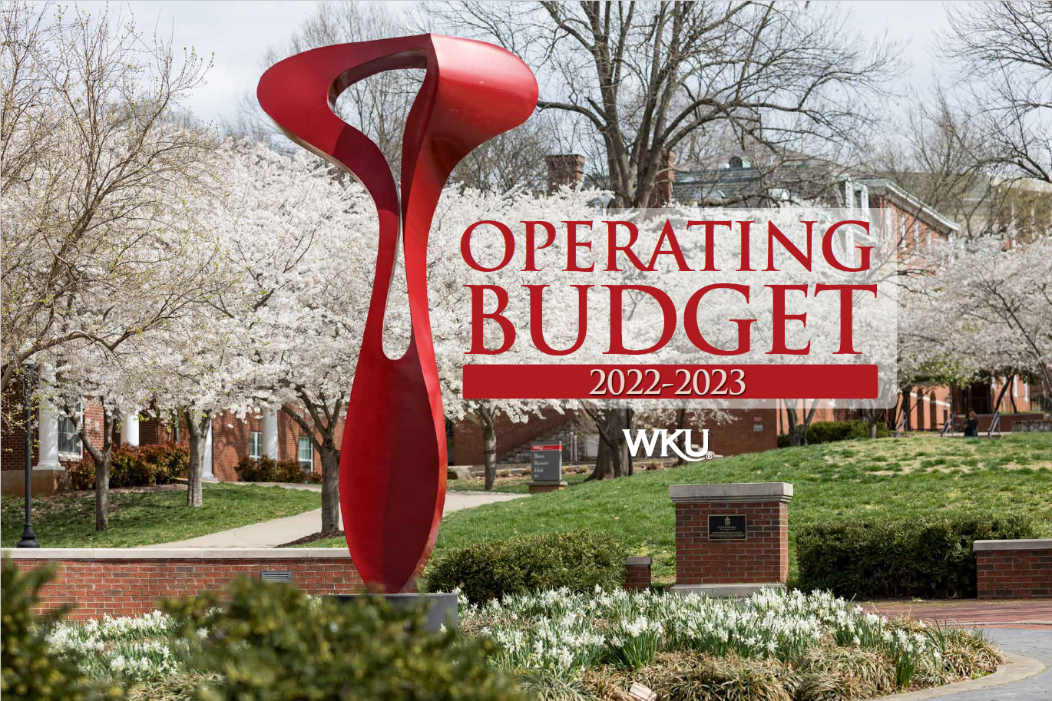

Slide 4
Adjustments since Presentation at May Meeting
Bottom line remains the same
No change to the total budget of $383,447,700
Minor adjustment to fringe benefits
Fringe benefits increased by $15,000 after final calculations
Balancing adjustments to other expenditure categories

Slide 5
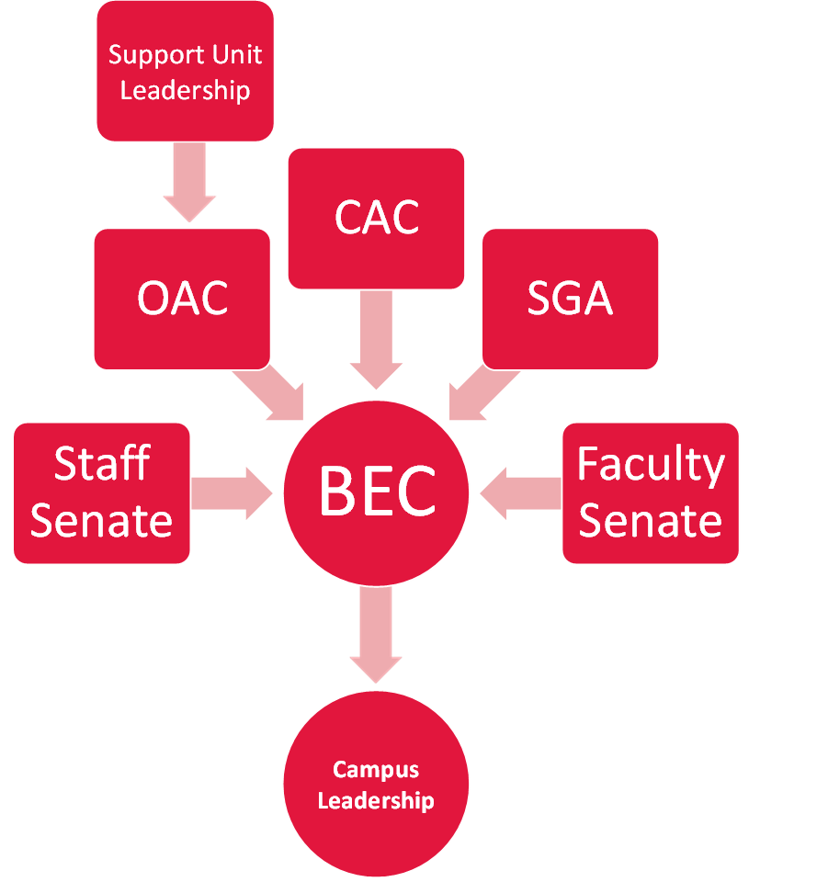
Budget Governance Structure
WKU’s budget governance structure promotes full campus transparency

Slide 6
Budget Recommendations and Approvals
Evaluate fixed cost increase in real time over the budget year – monitor excess in expenses to pay with one-time funds
2% Salary Pool to be distributed in January 2023 at the guidance of the BEC/OAC and senior leadership
Commitment to consider funding BEC High Priority List with Strategic Initiative Fund

Slide 7
FY23 Budget Summary
No change to the total budget since the May Board of Regents meeting

Slide 8
Revenue

Slide 9
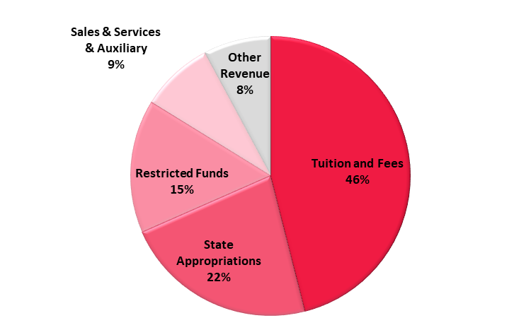
Revenue Highlights
Tuition and Fees - $176.5M
State Appropriation - $85.7M
Restricted Funds - $59.1M
Sales & Services & Auxiliary - $32.3M
Other Revenue - $29.8M

Slide 10
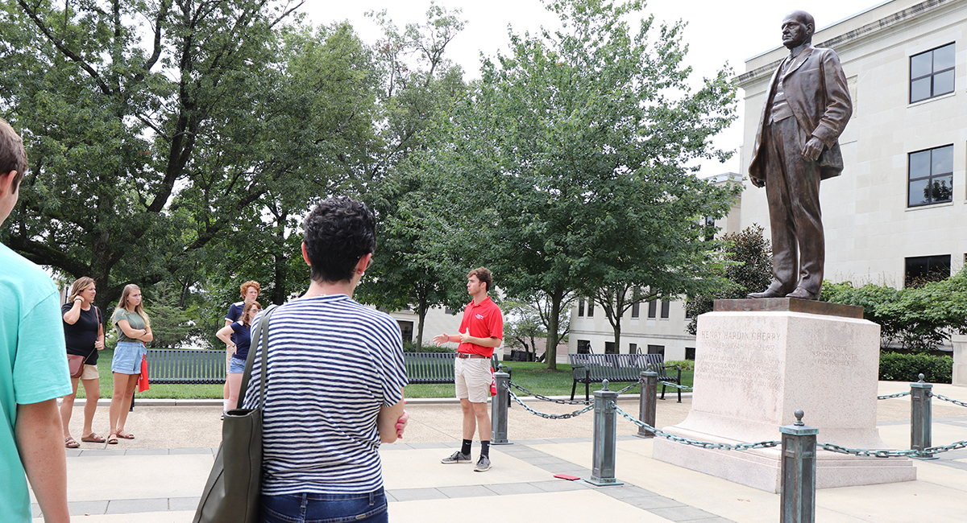
Tuition and Fees
Total headcount – 16,492
Full-time equivalent – 13,909
First time, first year – 2,908
  76 students more than fall 2021
  Smaller classes working their way through the pipeline
1.19% tuition increase for FY23

Slide 11
Tuition and Fee Schedule
* Does not include mandatory student fees

Slide 12
Tuition and Fee Schedule

Slide 13
Tuition and Fee Schedule

Slide 14
State Appropriation
Performance funding pool increase of $80M – WKU’s portion increased $6.4M
$1.0M increase to KY Mesonet
LifeWorks at WKU received a one-time allocation of $2.8M

Slide 15
Expenditures

Slide 16
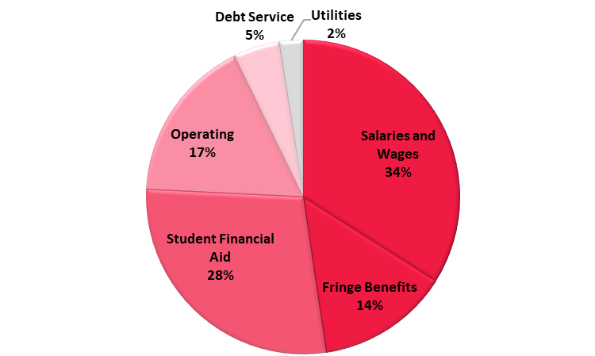
Expenditure Highlights
48%
Salaries and Wages - $130.3M
Fringe Benefits - $52.5M
Student Financial Aid - $107.8M
Operating - $65.2M
Debt Service - $18.4M
Utilities - $9.4M

Slide 17
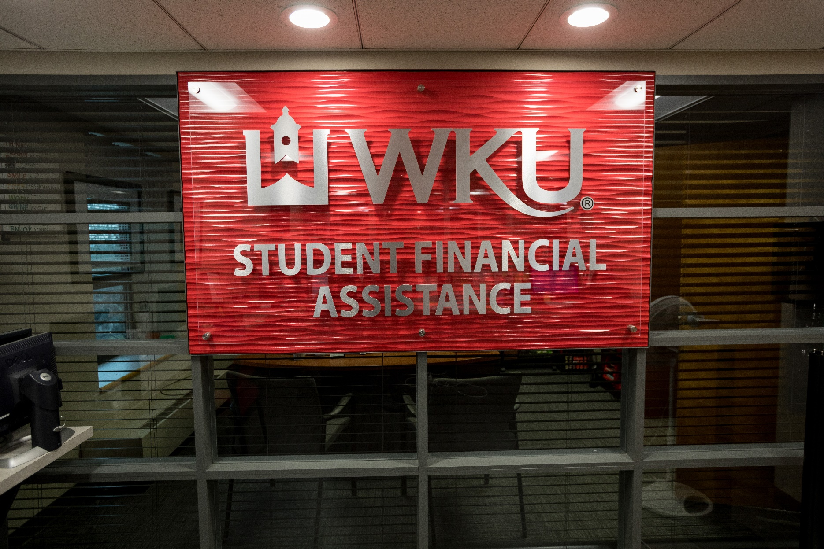
Expenditure Assumptions
Personnel
  2% salary pool – distribution methodology to be determined over the next few months
Financial aid
  FY23 is the third class to be eligible for the expanded scholarship model
  $7 million increase fund the new scholarship programs

Slide 18
Next Steps
Load Axiom budget data into Banner general ledger
BOR approves final budget
CPE tuition rate approval on June 15

Slide 19
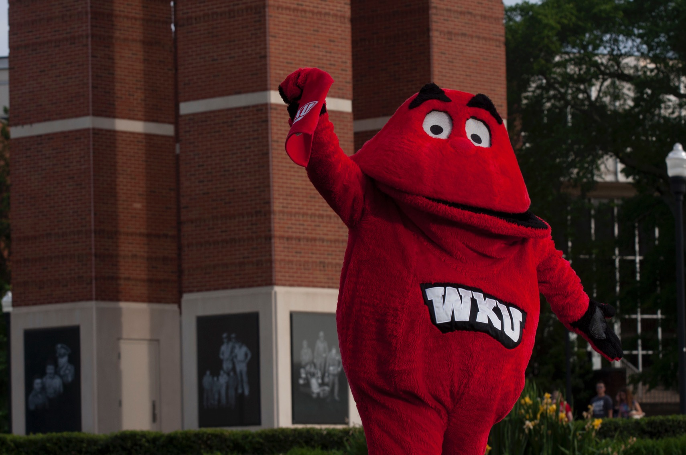
Questions

Slide 20
Design and construction of the new Gordon Ford College of Business building

Slide 21
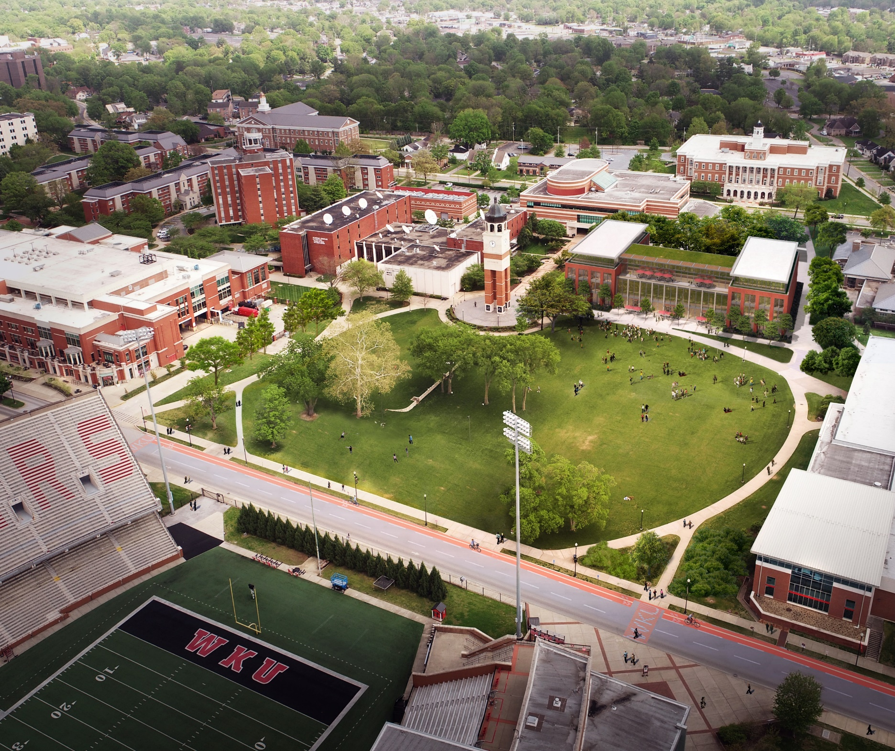
Construct New Gordon Ford College of Business
Included in WKU 2021-2031 Campus Master Plan
Included as WKU’s #1 Priority Project in our submitted 2022-2028 Six Year Capital Plan to the Commonwealth
Included in House Bill 1, executive branch biennial budget funding of $74.4M for the construction of the New GFCB
WKU’s goal is to complete the design and award construction July 1, 2023
Goal is to Open Facility 2025 Fall Semester

Slide 22
Questions

Slide 23
Cherry Hall renovations using state asset preservation funds

Slide 24
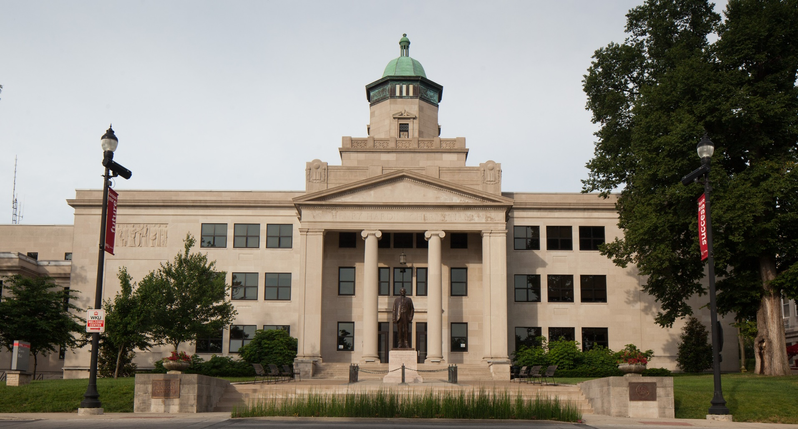
Henry Hardin Cherry Asset Preservation
2021-2031 WKU Campus Master Plan
  Space utilization analysis identified Cherry Hall as having the 2nd most utilized classroom learning minutes (616,240) on campus
  Moreover, facility condition analysis identified Cherry Hall in Poor Condition in 2017
  Strategic investments in learning infrastructure focusing on buildings with the poorest conditions and the most scheduled classroom minutes
Goal to fully evaluate the building and customer needs to develop a plan for improvements needed to support our strategic plan for student success
Henry Hardin Cherry Hall
Brinton B. Davis, Architect
Originally Built in 1937; 85 years
Three (3) floors and 105,268 gross square feet

Slide 25
Questions

Slide 26
Refinancing of existing Athletic debt to upgrade facilities

Slide 27
Important Considerations
Total bond issue of $50M payable over 20 years
No increase to student athletic fee
No significant increase in annual debt service over the life of the project
While the debt restructure proposal is for $50M, WKU will only take on an additional $39M in debt
WKU’s debt burden on operations will decrease even with the new debt

Slide 28
Diddle Arena Bond Refunding
Approximately $11M needed to refund the Diddle Arena bonds
Date of maturity remains the same
Estimated savings of $400K

Slide 29
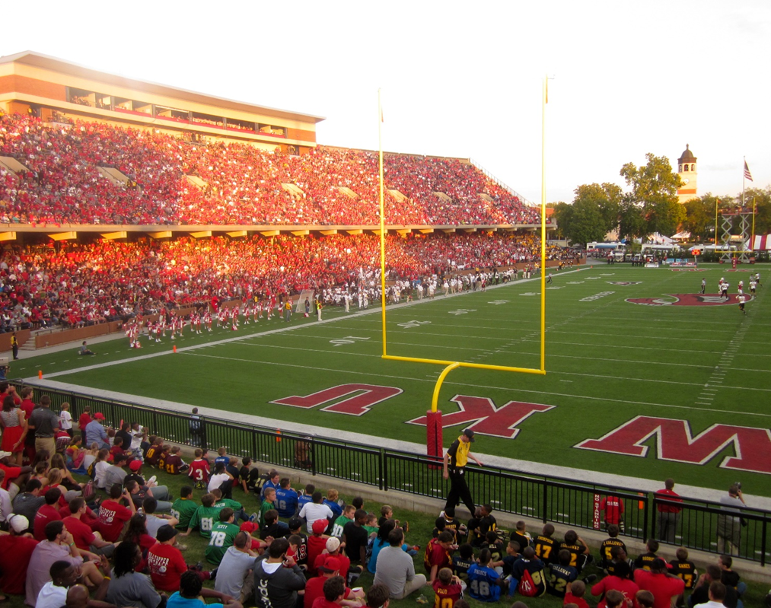
Press Box Renovation
Originally constructed in 1968
Estimated $4-6M needed for renovation
The current structure is not ADA compliant
  No elevator to the facility
  Only one restroom in the facility
  No air conditioning or heat
  Requires coaching staff from both teams to walk through crowd in the bleacher seating, which creates safety concerns

Slide 30
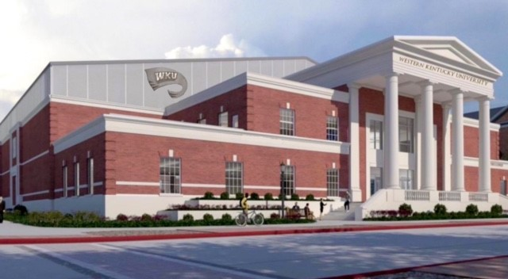
Hilltopper Fieldhouse
Estimated cost of $32-35M
Positions WKU favorably for the future
Provides a first-class indoor training area for 16 WKU sports
Provides a permanent indoor practice facility for the Big Red Marching Band
Baseball clubhouse and hitting facility will exist within the fieldhouse
To be utilized by other campus groups such as band, intramural sports, EA Sports, and Forensics

Slide 31
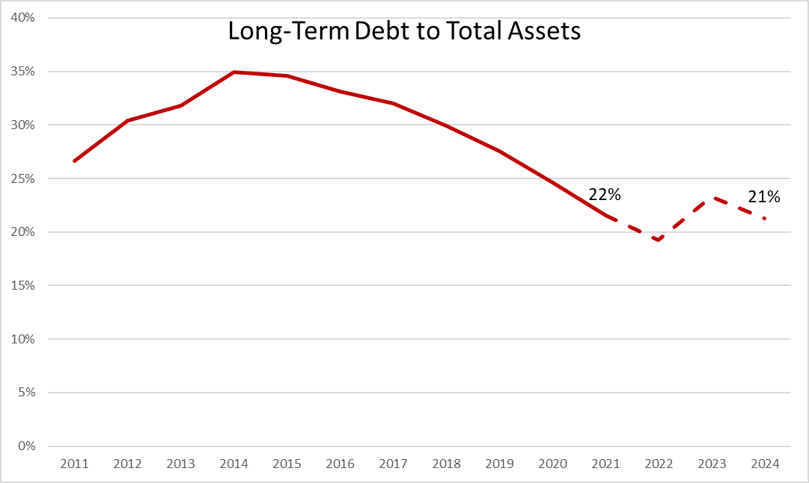
Long-Term Debt
Long-term debt to total assets measures the extent of an institution’s leverage
Long-term obligations have decreased by more than $80M since FY14, resulting in a decline in long-term debt to total assets from 35% to 22% over the same period
Suggests that WKU currently has a relatively low degree of risk

Slide 32

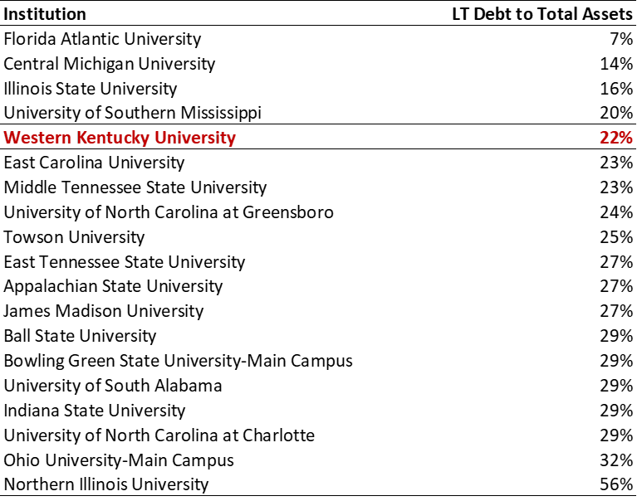
Long-Term Debt to Total Assets

Slide 33
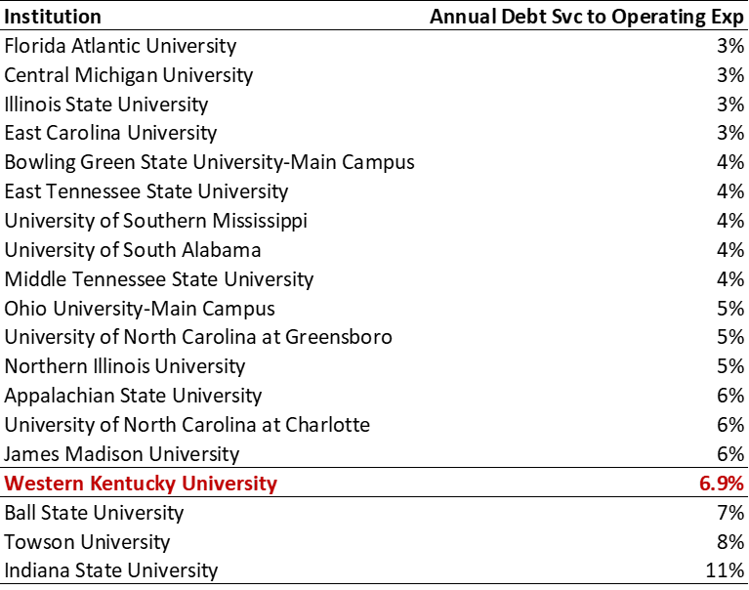
Debt Burden on Campus Operations
Public median debt threshold per NACUBO advisory – 7%

Slide 34
Questions

Slide 35
Refinancing of bonds for Phase III of DSU renovation

Slide 36
DSU Bonds Refinancing
WKU General Receipts Bonds, Series 2012A were originally issued June 6, 2012 for $35,860,000. The proceeds were used in the Downing Student Union -- Phase III renovation
Refunding the remaining $20,300,000 principal balance will result in interest savings of approximately $1.4 million ($140,000 annually) over the remaining ten years of the loan
The date of maturity will not change. These bonds will be paid off in FY 2032

Slide 37
Questions

Slide 38
Asset preservation of campus wide infrastructure

Slide 39
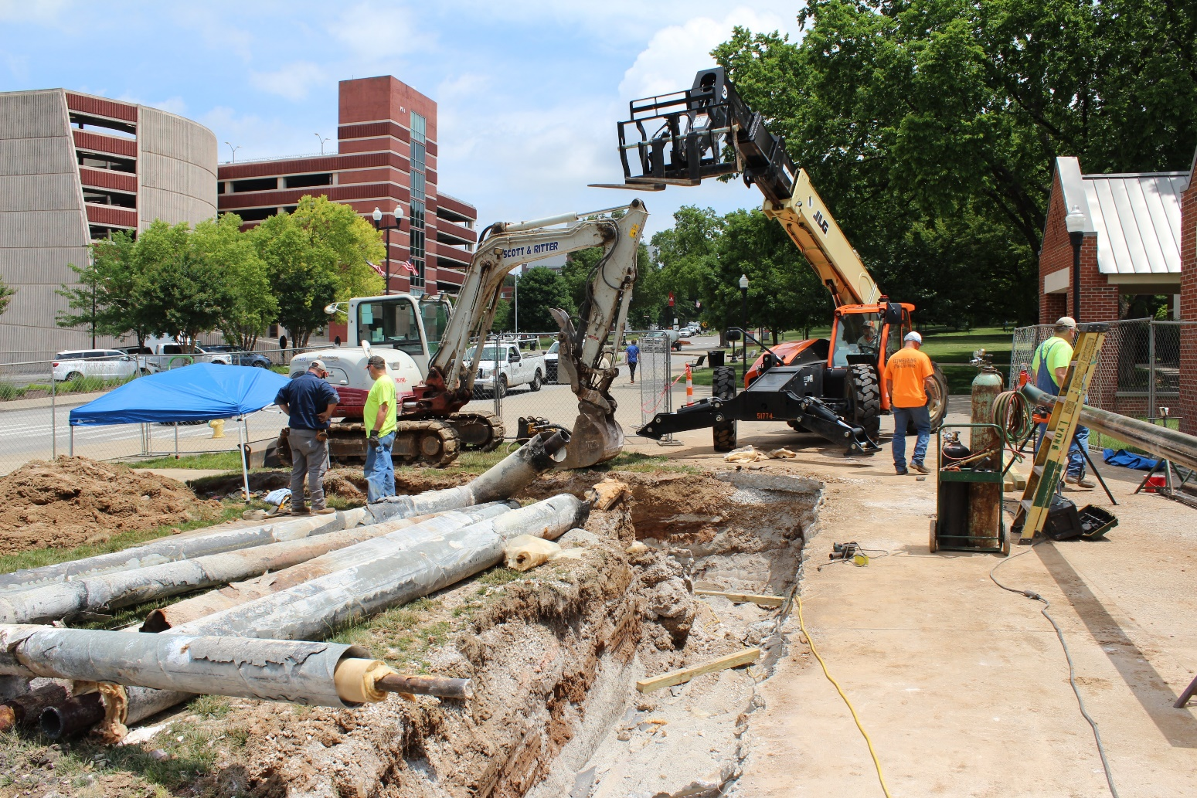
Asset Preservation of Campus Wide Infrastructure
In the 2022-2024 Budget of the Commonwealth (22 RS, HB 1), the Kentucky General Assembly authorized for Postsecondary Education an Asset Preservation Pool providing funding for individual asset preservation, renovation, and maintenance projects.
Western Kentucky University asset preservation pool allocation each year is $34,040,000 for a total of $68,080,000. Required matching funding by WKU is $5,106,000 annually for a total of $10,212,000.
Individual Authorization Amounts
Steam Distribution System: Up to $3,000,000 Fiber Optic Cabling System: Up to $2,000,000
Exterior Lighting: Up to $1,500,000 High Voltage Distribution System: Up to $6,000,000
Sanitary Sewer System: Up to $1,500,000 Domestic Water Systems: Up to $600,000
Natural Gas Systems: Up to 500,000 Storm Water System: Up to 1,000,000
Building Automation System Upgrades: Up to $2,000,000

Slide 40
Questions

