Slide 1

Teaching History As Mystery: An Inquiry Strategy That Works!
Jana Kirchner, Ph.D.
Asst. Professor, Teacher Education
Western Kentucky University
(Jana.kirchner@wku.edu)
NCSS Conference
November 21, 2014

Slide 2


What is it that fascinates us about mysteries?
Asking questions
Finding evidence
Guessing the answer
Were we correct?

Slide 3

Proficient readers/thinkers…
Use background knowledge
Use prediction and inference
Ask questions
Use sensory images
Determine importance
Synthesize

Slide 4
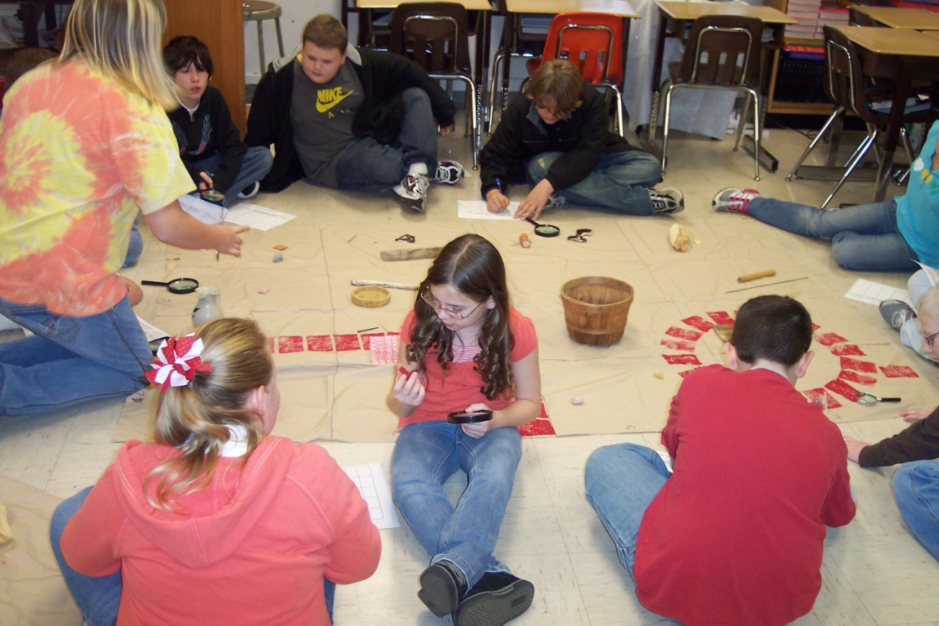
What if there was a way to teach social studies using a mystery/inquiry approach?

Slide 5
History as Mystery Strategy: Connections to C3
How does it work?
1. Teacher provides or students generate an interesting mystery question. (Dimension 1)
2. Students examine clues using analysis skills. (Dimensions 2 & 3)
3. Students present hypotheses and evidence to the class. (Dimension 4)
4. Students evaluate their results and complete a self-evaluation.

Slide 6

Using the Mystery
Strategy
Components:
Mystery question
Encountering the problem/lesson hook
Examining and interpreting clues
Establishing the hypothesis (collecting the data)
Explaining the hypothesis (product/rubric)
Evaluating the hypothesis (reflection on content/process)

Slide 7
Setting it up…
Identify a question to be answered.
Determine some solutions you want students to discover.
Gather the clues.
Decide how students will work: groups, roles, etc.
Determine how to present the clues.
Design a graphic organizer.
Select a format for the product.
Decide assessment criteria.
Design the student self-reflection piece.
Source: Silver, Strong & Associates (2001). Mystery. Ho-ho-kus, NJ: Thoughtful Education Press.

Slide 8
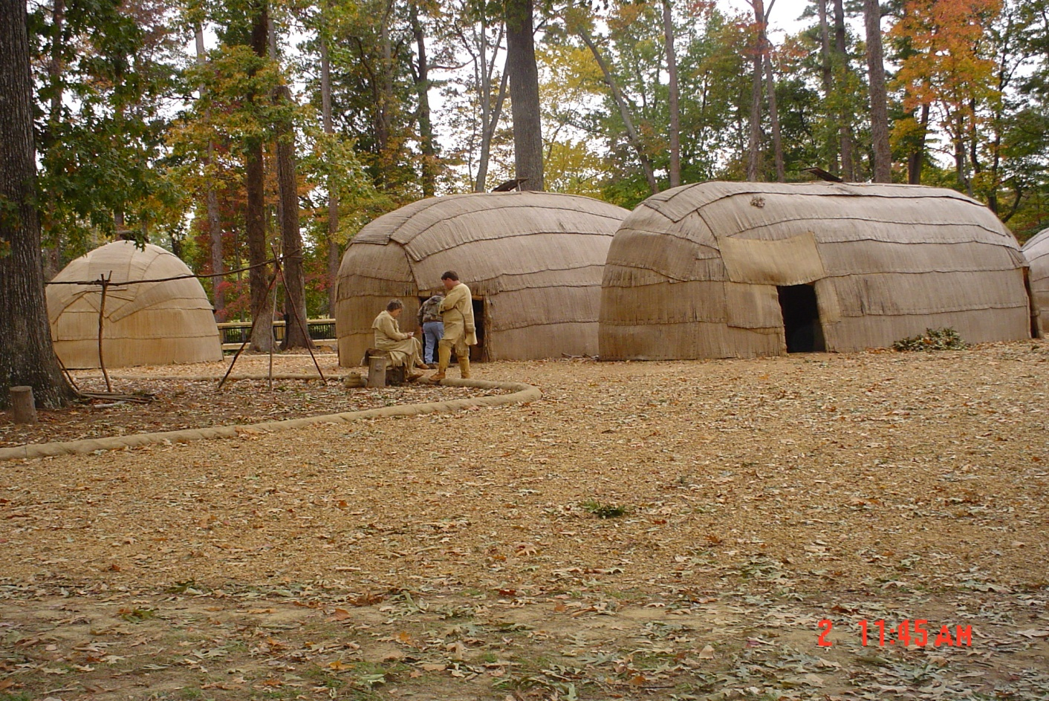
What was life like in a 17th century Powhatan village?
The
Mystery
Question

Slide 9
Lesson Hook - Scenario
Lesson hook – The Association for the Preservation of Virginia Antiquities (APVA) has decided to hire the most skillful archaeologists in the world to determine the answer to our question. (Encountering the Problem)
You will work within your team to discover and analyze clues. Upon completion of your research, you will report your findings to the APVA. Ready? Let’s get digging!

Slide 10
Now What Do We Do?
In your group, examine the following clues. Develop a hypothesis that will answer the mystery question. (Examining the Clues)
Group Roles:
Chief Archaeologist
Recorder
Reporter
Sketch Artist
Project Manager

Slide 11
Collecting and Analyzing Data
Your task: (Examining and interpreting the clues)
  As your team examines the clues, use your handout to record evidence. Then categorize your data into broader themes:
  Government -Roles of women
  Roles of men -Family structure
  Religious beliefs -Trade
  Food -Warfare

Slide 12
Presentation of Findings:
What was life like in a 17th century Powhatan village?
Your archaeological team will present your findings about Powhatan village life to the Association for the Preservation of Virginia Antiquities. (Establishing a hypothesis)
Use your chart paper to provide a 1-page overview of Powhatan village life. Use bulleted phrases to describe all areas of Powhatan life. Include sketches to illustrate scenes of village life. (could be a museum exhibit, a written paper, a Moviemaker project, etc.) (Explaining the hypothesis)

Slide 13
Assessment
Scoring Rubric for Presentation
  (Evaluating the hypothesis)
  Will include the following categories:
    Accurate content
    Thorough presentation of findings from clues
    A reasonable hypothesis based on clues from sources
    Effective and efficient work in teams

Slide 14
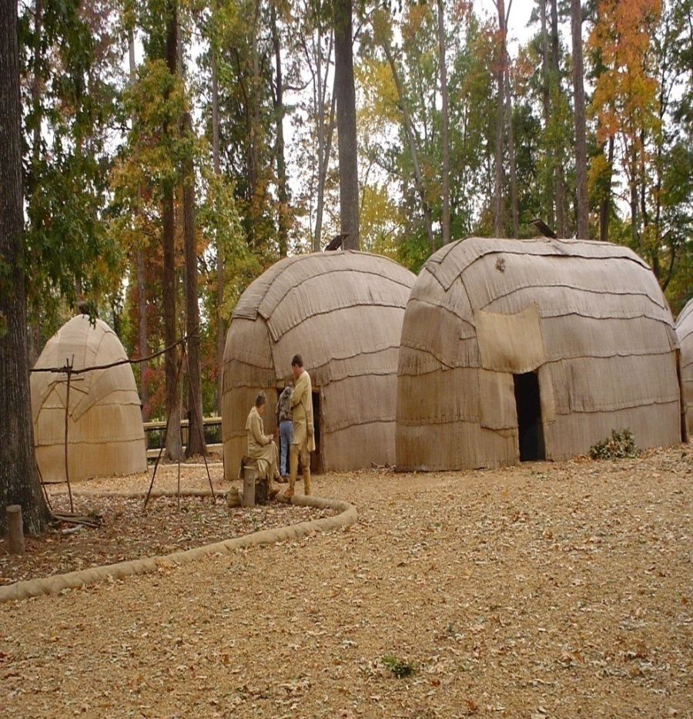
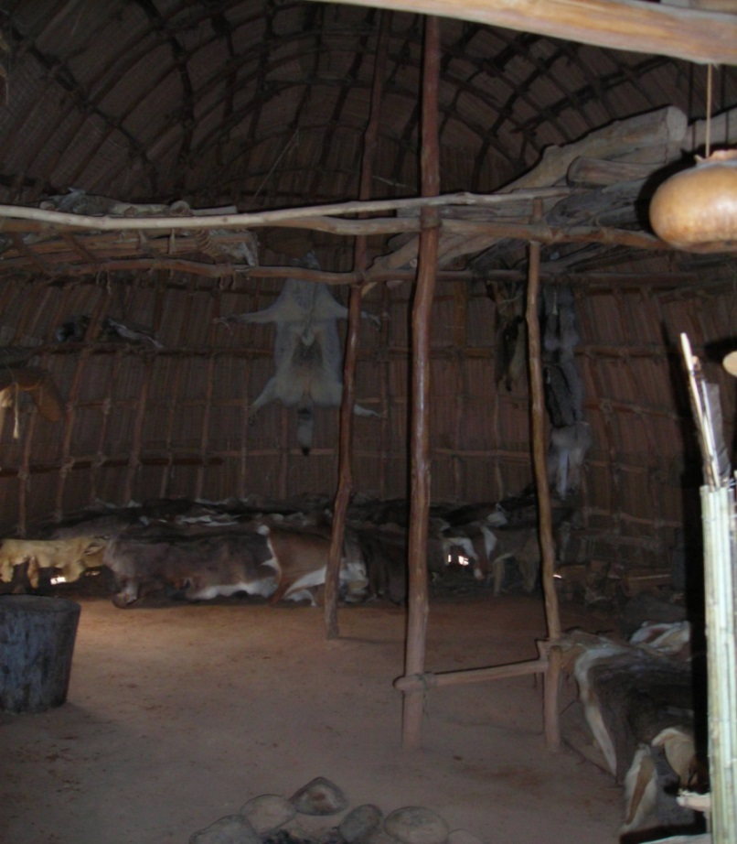
Examine the following pictures.
What was life like in a Powhatan village?
Clue # 1 Clue # 2

Slide 15
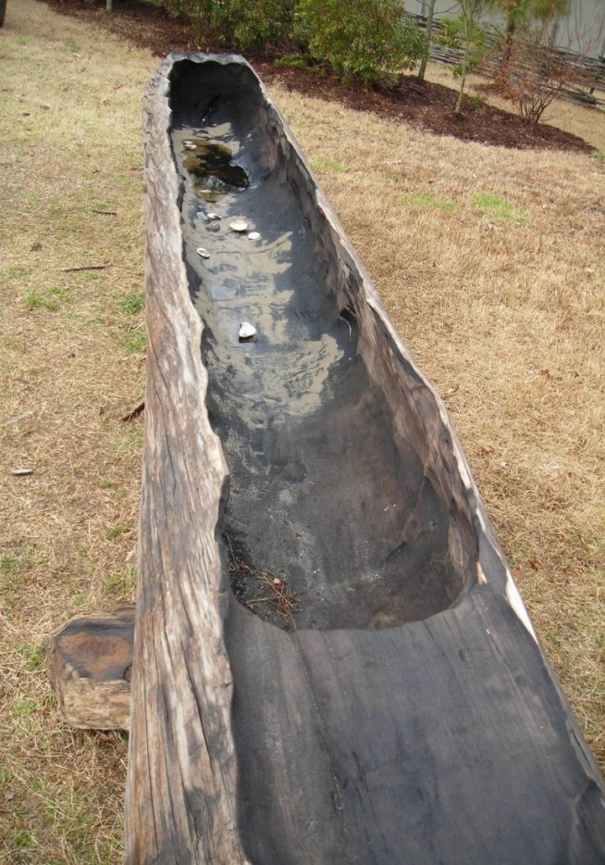
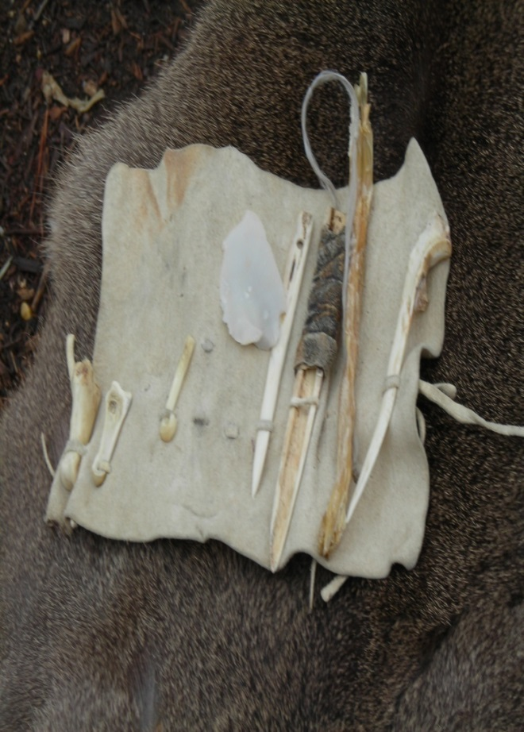
Examine the following pictures for clues.
What are these
artifacts?
How might they
have been used?
Clue # 3 Clue # 4

Slide 16
Examine the following picture. What can you learn about Powhatan culture?
(Clue #5)

Slide 17
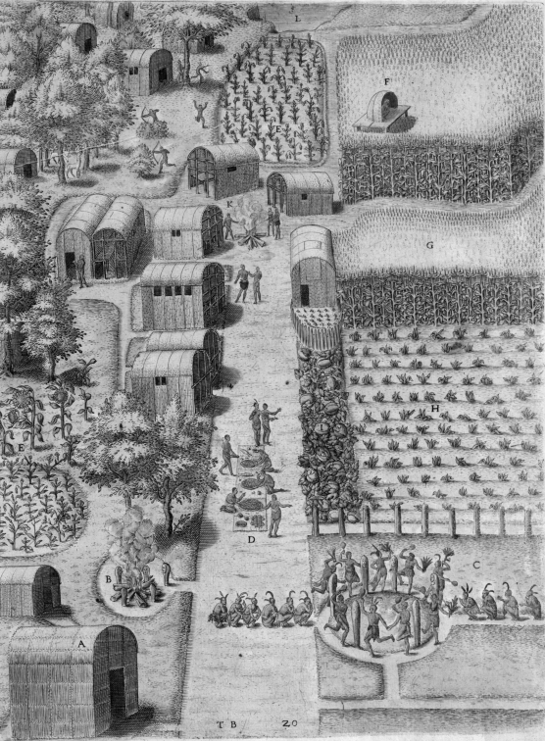
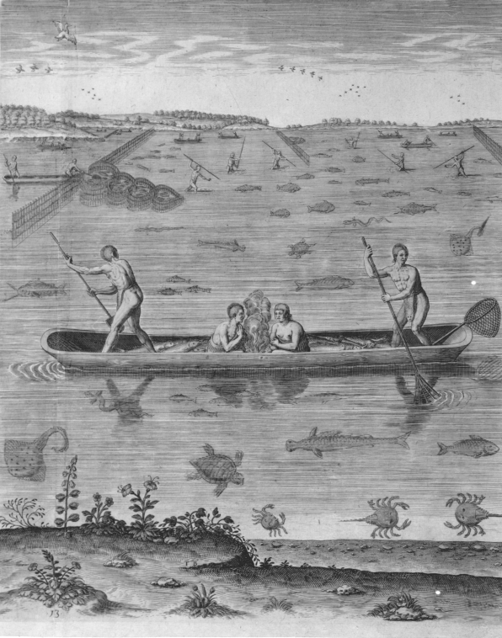
Examine the following pictures. What can you learn about Powhatan culture?
(Clue #6)
(Clue #7)

Slide 18
Clues from Maps and Texts:
“When Cultures Collided” by National Geographic (Clue #8)
Gabriel Archer’s “A Brief Description of the People” (Clue # 9)
  What clues can you discover about Powhatan culture from Archer’s description?

Slide 19
Self-Reflection
Answer the following questions on your own paper.
  What are 4 details about Powhatan culture that you learned from this archaeology project?
  Was your hypothesis supported by the evidence (clues)?
  How well did each group member perform the role they were assigned?
  Does your final presentation reflect your best work?
  (Evaluating the hypothesis)

Slide 20
Planning a Mystery/Inquiry Unit or Lesson
What unit do you teach next? What might be an effective mystery question for that unit? (C3 – compelling and supporting questions)
Is there a mystery/inquiry question that could work for a lesson you are teaching soon?
  What texts will you use?
Locating quality sources…

