Slide 1
International Projects without Leaving Home
Marge Maxwell

Slide 2
Project Choice 1
Penpals
Select a country and make contact with a teacher (your class can communicate and partner with the class) or an organization in that country (collaborate on some issue about that country).

Slide 3
Project Choice 2
Global Issue
Select a global issue (such as world hunger, poverty, health, environmental, arms control, fair trade, endangered animals, etc.) and partner with an international organization promoting that issue. Most of the international organizations provide ways to partner with them and get involved.

Slide 4
Project Requirements
Develop mashup website
3 technology products (one must be higher-level thinking)
Demonstrate collaboration with international organization

Slide 5
Education Around the World
Drew Fulkerson

Slide 6
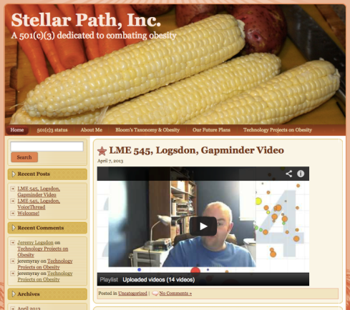
Obesity
Jeremy Logsdon

Slide 7
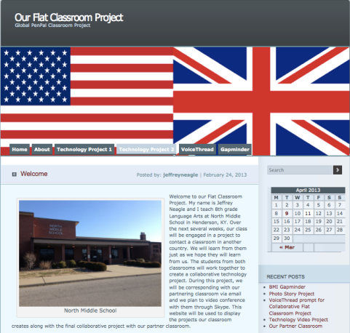
English Penpals
Jeff Neagle

Slide 8
Cyberbullying
Shante Galloway

Slide 9
Slavery, Today?
Rachel Rosales

Slide 10
How are you internationalizing your class? I love sharing ideas!
Come to see me to share techy ideas or international inspirations.

