Slide 1
Robots, Right Triangles, and Romance, Oh My!
Hannah Keith and Ariel Wren
Logan County High School

Slide 2
Standards & Objectives
G-SRT.2 Given two figures, use the definition of similarity in terms of similarity transformations to decide if they are similar; explain using similarity transformations the meaning of similarity for triangles as the equality of all corresponding pairs of angles and the proportionality of all corresponding pairs of sides.
G-SRT.6 Understand that by similarity, side ratios in right triangles are properties of the angles in the triangle, leading to definitions of trigonometric ratios for acute angles.
I can decide whether or not two triangles are similar.
I can construct a special right triangle.

Slide 3
Math, Science, & Engineering Practices
Science and Engineering Practices:
Planning and carrying out investigations
Obtaining, evaluating, and communicating information
Cross-cutting Concepts:
Scale, proportion, and quantity
Standards for Mathematical Practice:
Make sense of problems and persevere in solving them.
Reason abstractly and quantitatively.
Use appropriate tools strategically.
Attend to precision.
Look for and make use of structure.

Slide 4
Engagement
Movie Trailer for “Passengers”
https://www.youtube.com/watch?v=yVXQq2u6OP0
In this clip, we see that the ship uses little robots to help with things like maintenance, cleaning, and personal errands. We are going to use the Ozobots to model these robots on the ship.

Slide 5
Engagement
What if every single room on the ship was designed in the shape of a right triangle? What would you know about these rooms?
If you were the engineer on this ship and you were asked to design two rooms that were “similar,” what would you be doing?

Slide 6
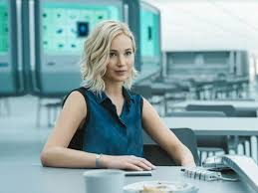
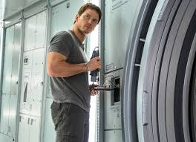
Passengers: The Movie
He’s acute when he’s mad...
...and she’s always right.

Slide 7
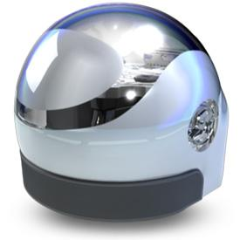
Exploration
Chris Pratt is in the mechanical room and is needing to deliver a message to Jennifer Lawrence, who down the hall in the observation deck, to ask her out on a date. He uses an “Ozobot” to make this happen.
Your task is to deliver the message before it is time for dinner. After leaving Chris, the robot must travel to the garden to pick up a rose and then must travel to Jennifer to give her the dinner invitation. After Jennifer accepts the invite (hopefully), the robot must take the invite back to Chris.

Slide 8
Your Mission
Chris
The path from Chris, to the garden, to Jennifer, and then back to Chris forms a triangle!
Make Chris’ Ozobot complete the special right triangle path from Chris, to the Garden, to Jennifer, and finally back to Chris.
Along the way, your Ozobot must perform two “special” moves.
Garden
Jennifer

Slide 9
Exploration
You have 15 minutes to construct your special right triangle and program the Ozobot for its “special” moves.
Materials provided:
Ozobots
Large paper
Rulers
Markers
OzoCodes
Once you are finished, raise your hand and I will come see if your Ozobot has successfully completed its path.
Go!

Slide 10
Explanation
Display student work
Use SeeSaw Chrome Extension for student commentary during discussion

Slide 11
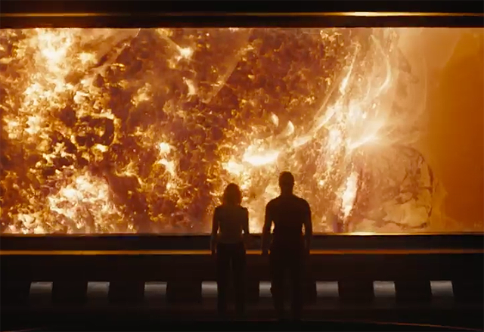
Elaboration
Chris and Jennifer have survived the fiery trials of deception and the ship explosion!
Their love will last forever!
However, the ship will not...

Slide 12
Your Mission!
*Send your Ozobot into the heat-damaged rooms and determine which one must be fixed first to save the ship.
*Rooms with angles 45-45-90 are food service rooms, and rooms with angles 30-60-90 angles are mechanical rooms.
*No rulers will be used as the rooms are currently too hot to enter- only your Ozobot may be sent into the room to measure the walls.

Slide 13
Your Mission
*Once you have determined the 30-60-90 triangle, draw out a similar triangle that is scaled down. On this similar triangle, you should write in a different code on each of the three sides to make the Ozobot repair the walls.
*You must now create a video to send to the captain of the ship. The video must include:
-Your reasoning about which triangle is 30-60-90
-Your Ozobot performing repairs on your scaled model of the room.

Slide 14
Evaluation: Exit Ticket
On the paper, make sure you have your name, class period, and the date.
Answer the following questions (please label):
A) Are these triangles similar? How do you know?
B) Construct a 45-45-90 triangle where no side equal 1. Label all side lengths (show work).
C) What was your favorite part about the using the robots on the spaceship?
Please give this to me on your way out the door.
15
10
4
6

