Slide 1
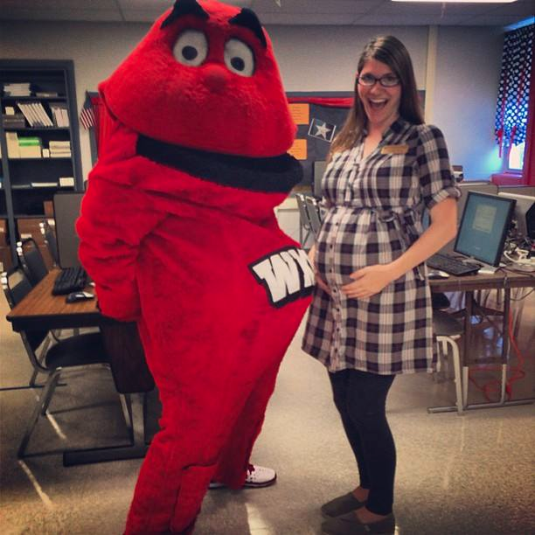
mORGANTOWN eLEMENTARY
sARA AND BIG RED GO TO RIBBON CUTTING FOR COMPUTER LAB DEDICATION!

Slide 2
Wku sURPLUS dONATES 30 coMPUTERS AND LAB FURNITURE
On September 26, Sara and Big Red went to Morgantown Elementary for a ribbon cutting of the Big Red Computer Lab. The computer lab is made up of 30 complete computers and peripherals as well as furniture donated by WKU Surplus to Butler County Schools. The assistant principal, Chad Flener, said that these computers were so important because being a Title 1 school they have limited funding and over 70% of students are on free or reduced lunch. Since all schools are mandated to test frequently, adding a whole new computer lab to the school will make testing go much easier for the students and staff. Once the school got the computers, they put their own Windows Operating System image on them, increased the RAM, and had their IT department set them up. We were able to donate these computers because they are no longer under warranty with WKU and IT does not want to service computers that are not cost effective to repair. Morgantown Elementary will have local media present but we will keep the PR on the WKU end to a minimum because of the agreement with surplus and WKU IT. IT agreed to OK the donations if we did not overly advertise it so not to appear that we were donating usable WKU computers and purchasing new ones that were unneeded.

Slide 3
wHEN WE ARRIVED
A GROUP OF STUDENTS WERE CHOSEN (FOR GOOD BEHAVIOR) TO ESCORT BIG RED UP AND DOWN THE HALLS FOR A PARADE

Slide 4
Then we were paraded up and down the halls. big red just hated this ;)
Click Play! ☺

Slide 5
wE THEN MADE IT THE ‘BIG RED’ COMPUTER LAB FOR A RIBBON CUTTING.
thE bUTLER cO. suPERINTINDENT sCOTT hOWARDwas also present
thE ASSISTANT PRINCIPAL, CHAD FLENER, ALSO WAS THERE.

Slide 6
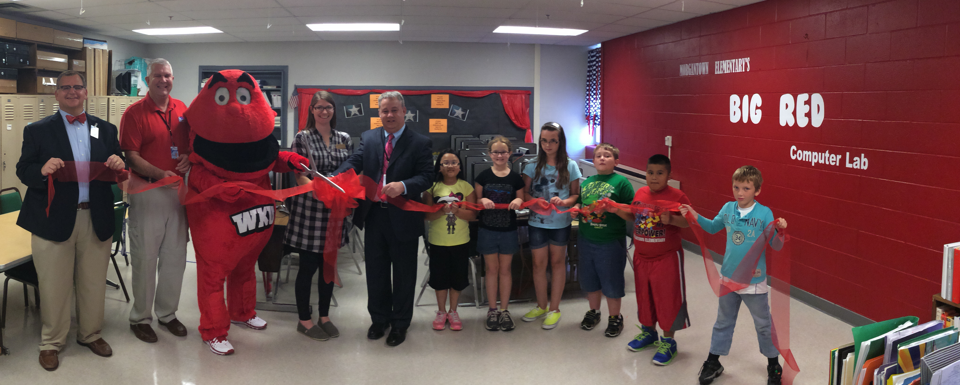

Slide 7
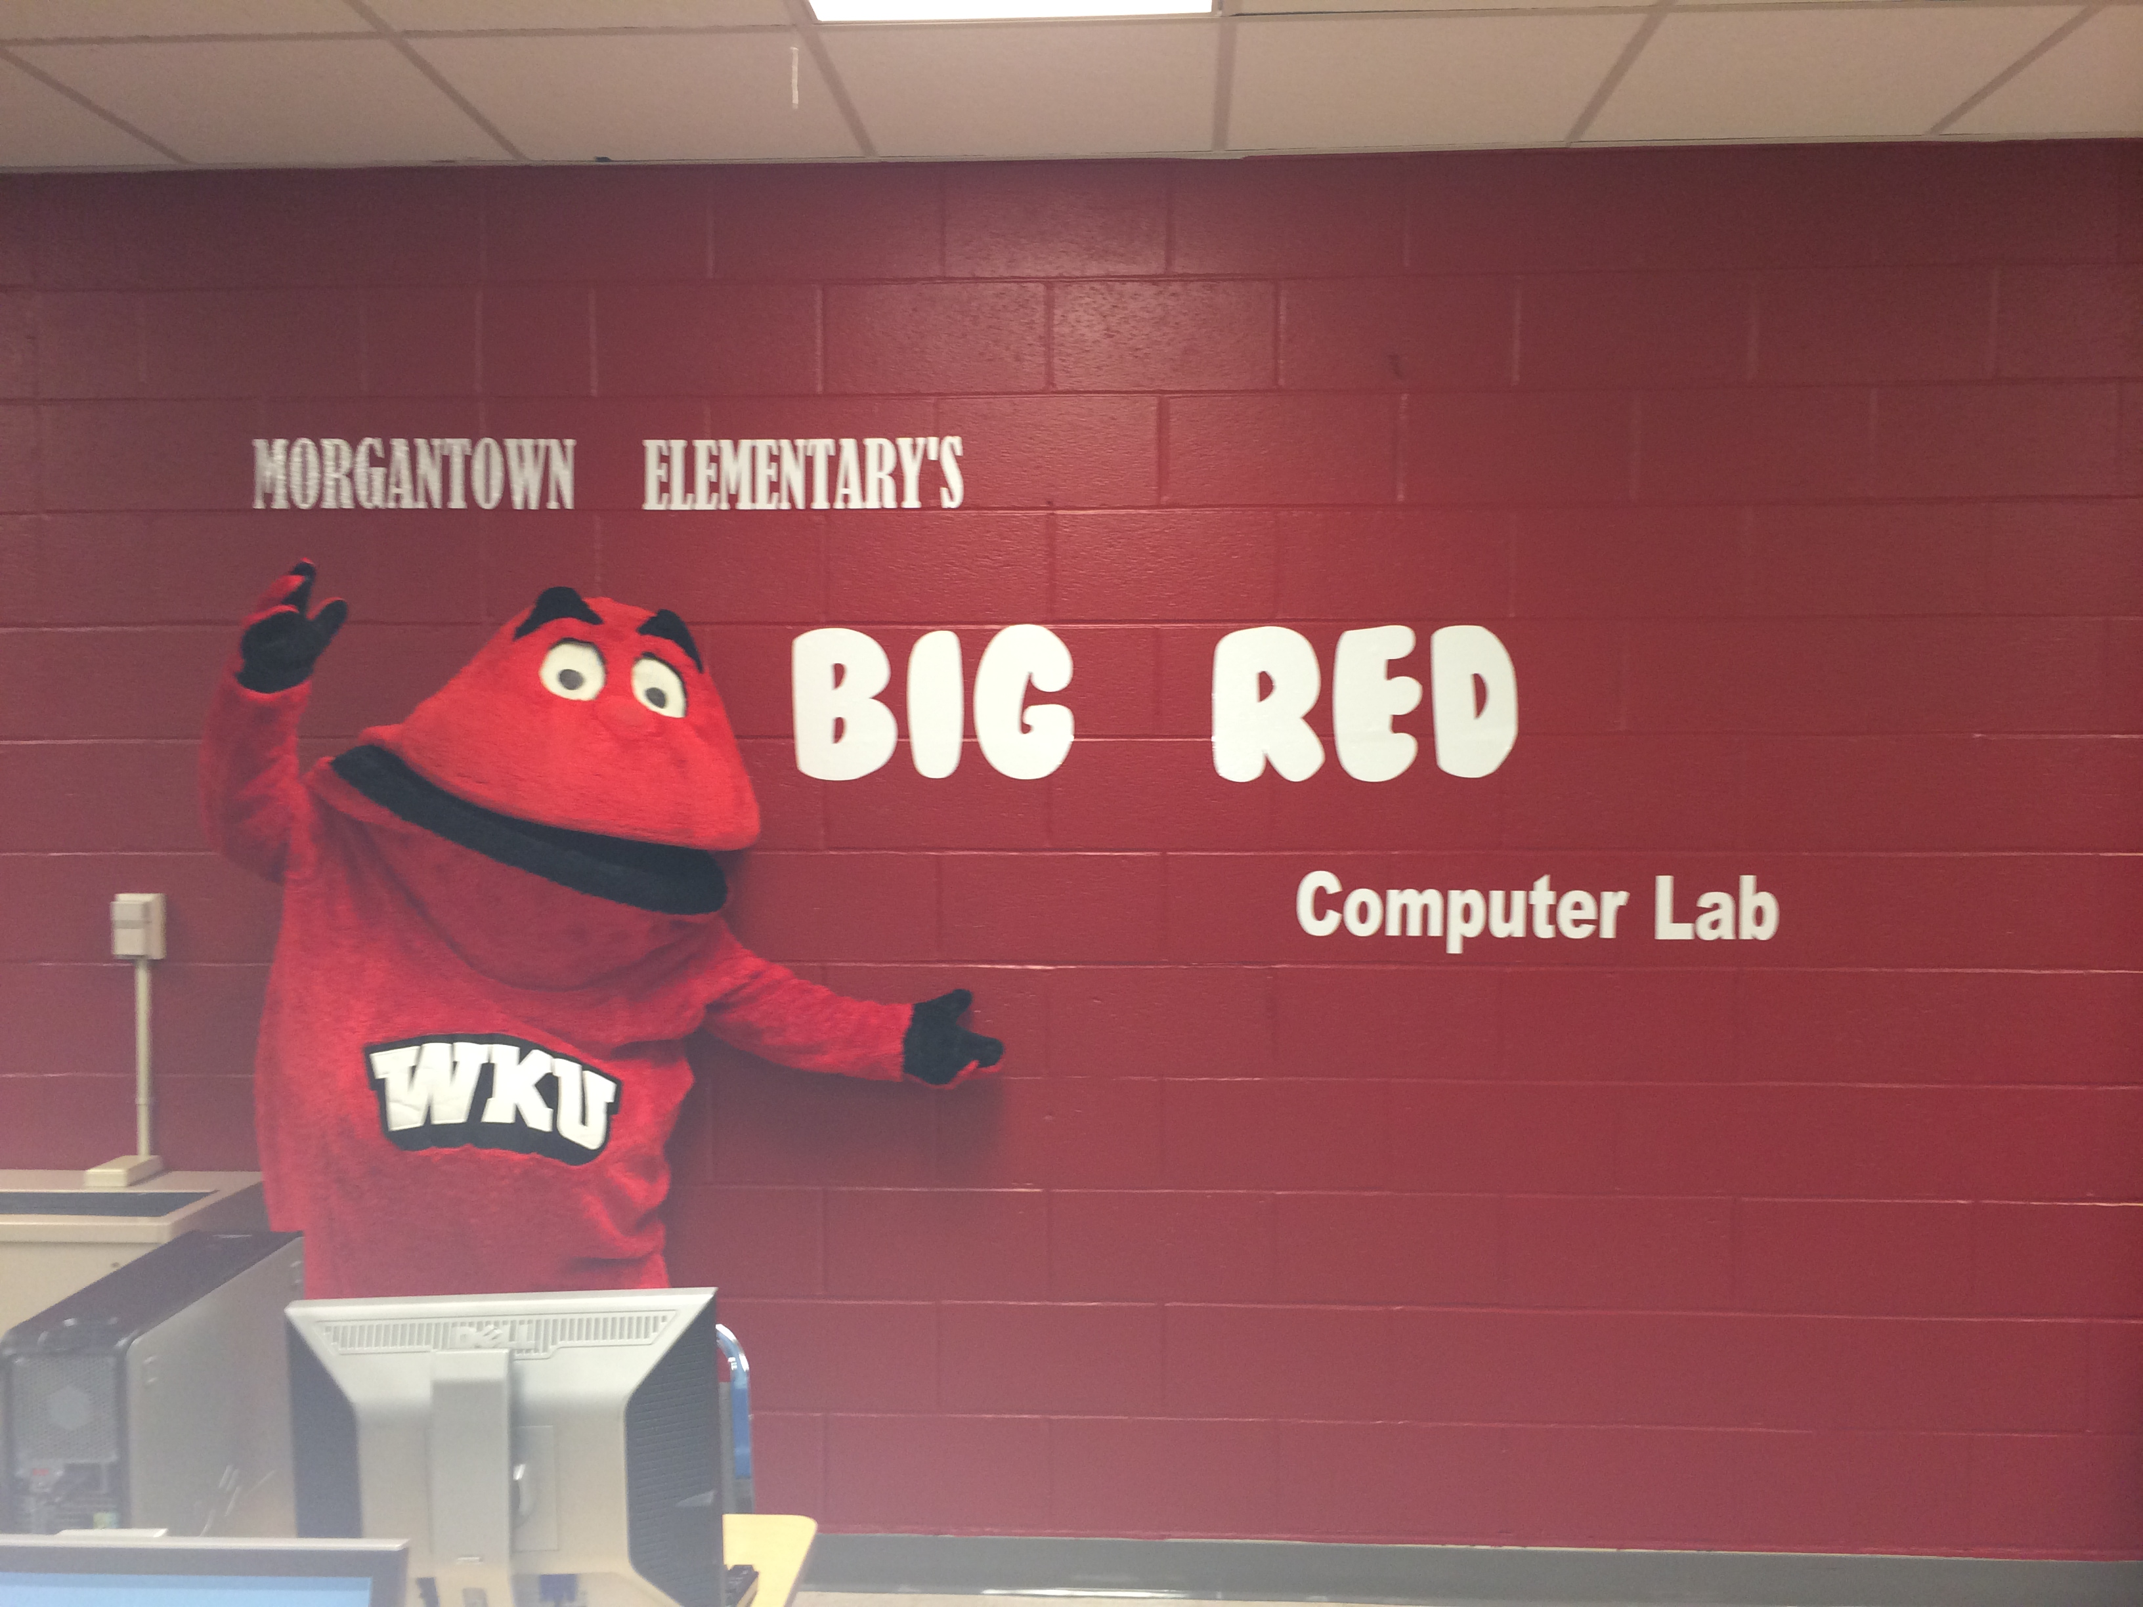
The Big Red Computer lab

Slide 8
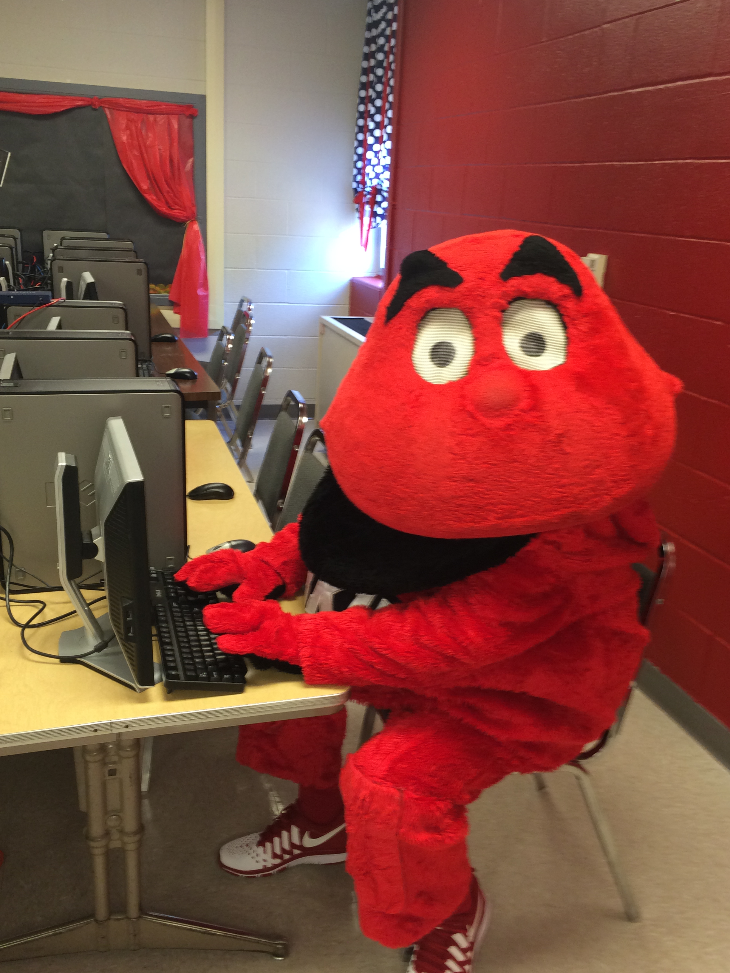
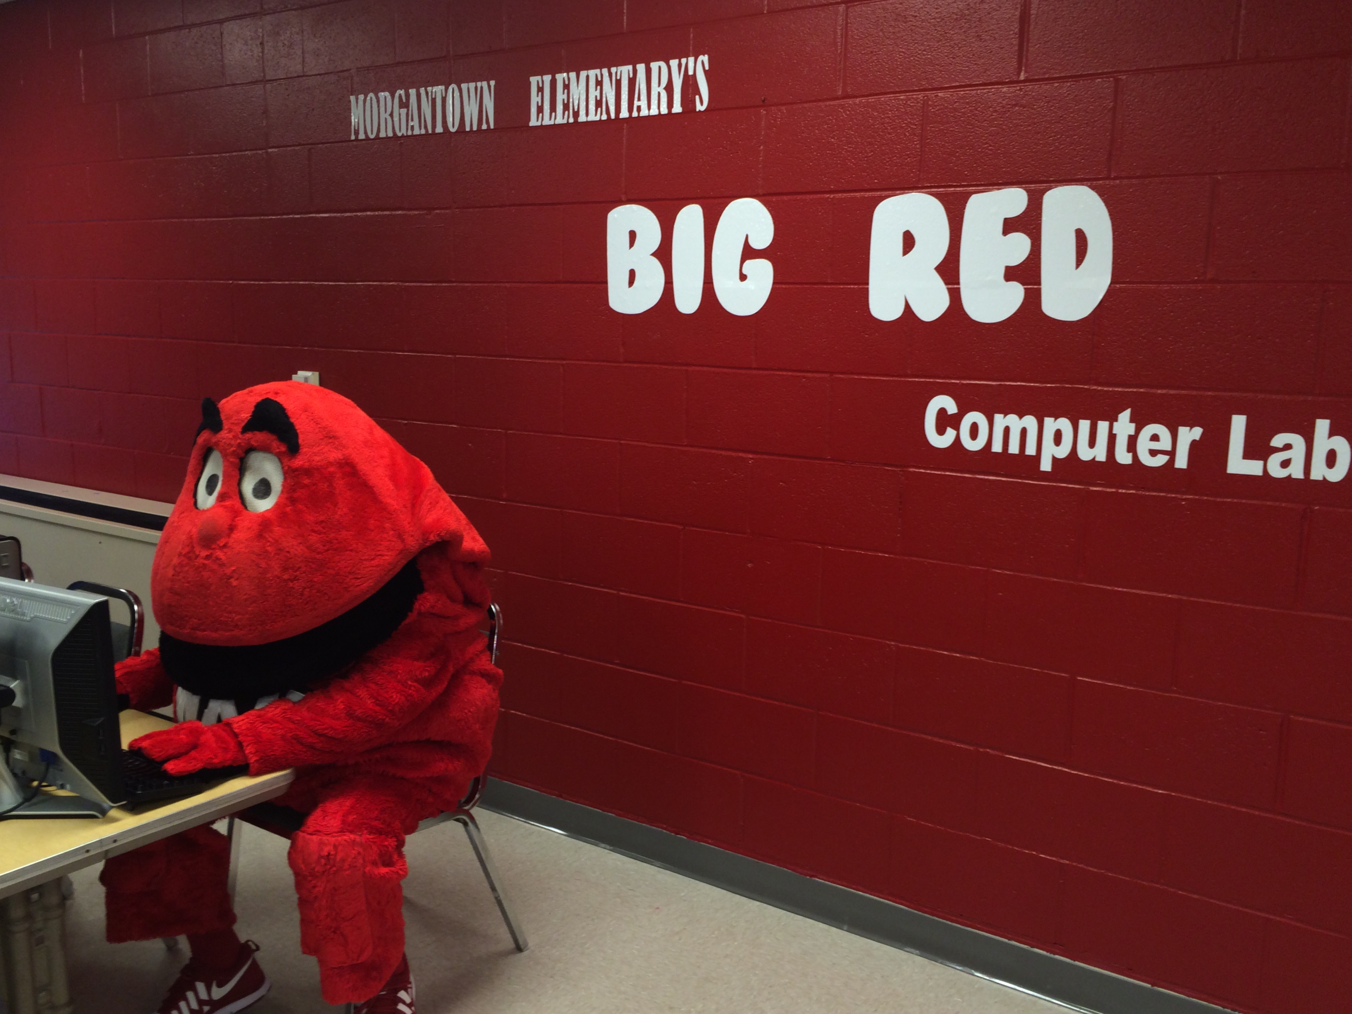
The Big Red Computer lab

