Slide 1
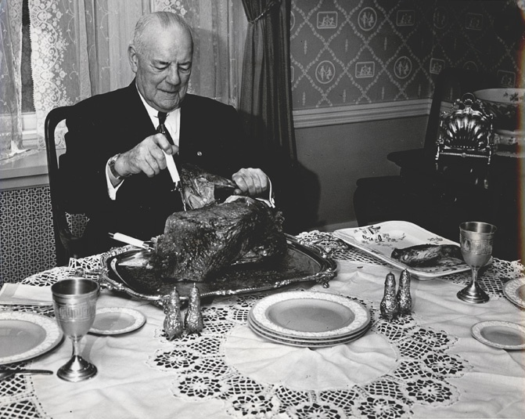
Recommended by
Duncan Hines
by Donna Parker
and Jonathan Jeffrey

Slide 2
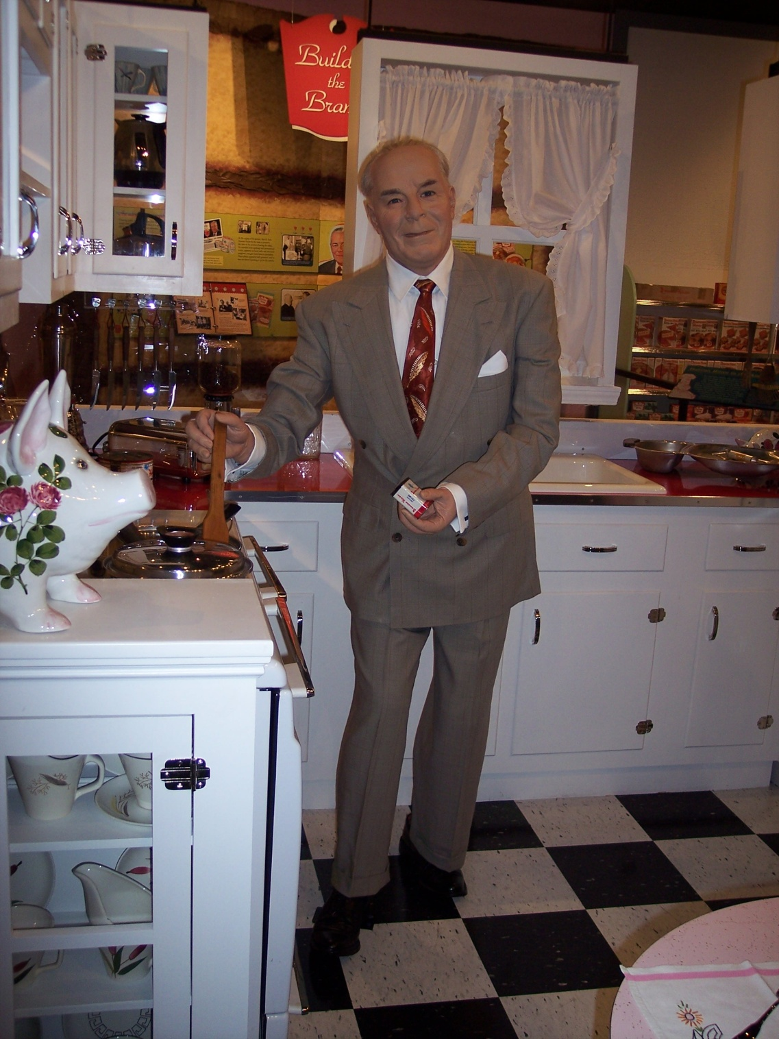
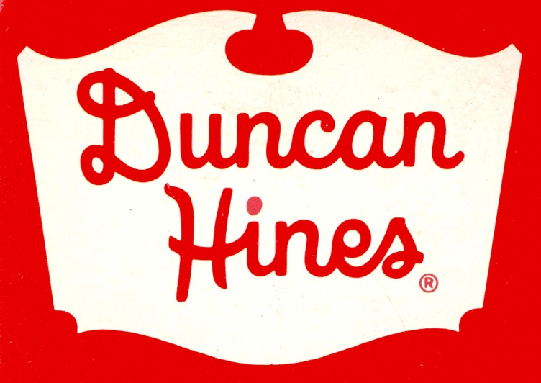
Businessman, salesman, kitchen inspector, lover of comfortable lodgings, and connoisseur of good food - - this was the man Duncan Hines.
The Kentucky Library and Museum at Western Kentucky University celebrates his life with the exhibit “Recommended by Duncan Hines.”

Slide 3

Born March 26, 1880 in Bowling Green, Duncan was the youngest of Edward and Cornelia Hines’ six children. After his mother died of pneumonia when he was four years old, he and his older brother went to live with grandparents Joseph and Jane Duncan on their Warren County farm.

Slide 4
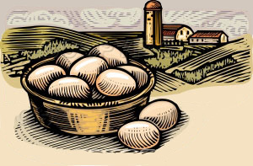
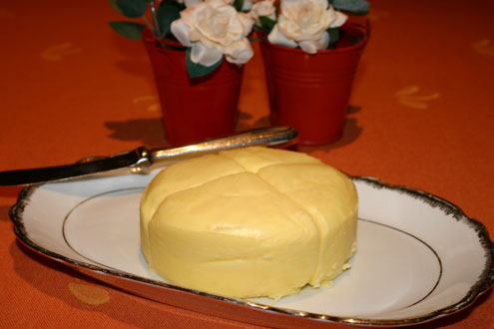
According to Hines, his appreciation of fine foods was due to eating his grandmother’s delicious homemade cooking – food made good by the use of fresh eggs and butter.

Slide 5
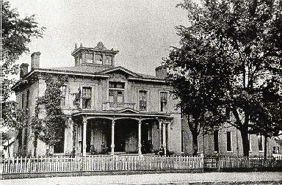
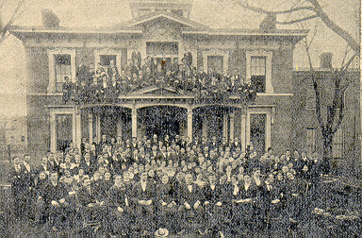
Hines attended St. Columba’s School on Center Street in Bowling Green - then Bowling Green Business University. After two years there, Hines took a position with Wells-Fargo. While working in New Mexico and Wyoming, he met Florence Chaffin who became his wife in 1905.

Slide 6
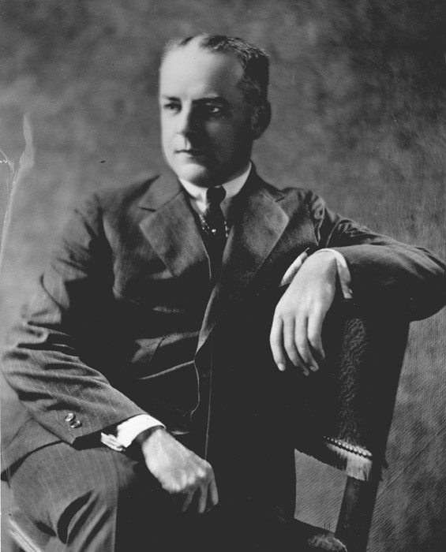
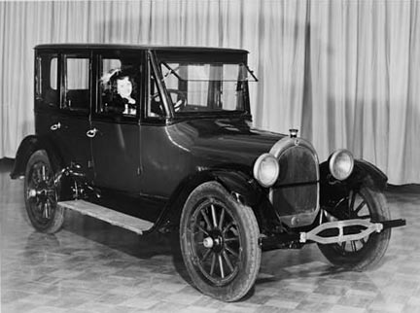
Duncan and Florence moved to Chicago soon after their marriage where Hines worked as a salesman for several printing companies. In 1919, he made a purchase that would set him upon a course not yet imagined. Unlike the train, Duncan’s new automobile gave him the freedom to go when and where he wished.

Slide 7
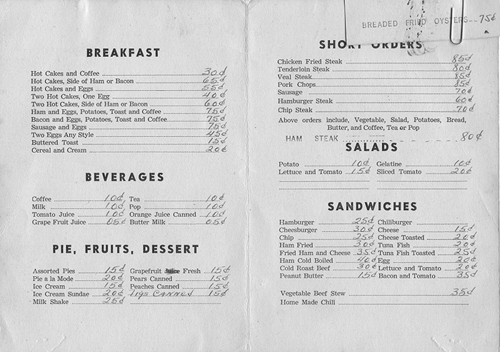
Like most salesmen, Hines spent the week on the road making business calls. He frequented local restaurants and soon began to record his experiences in a small notebook. On weekends, he and Florence toured the countryside, a relaxing and companionable pursuit for the young couple.

Slide 8
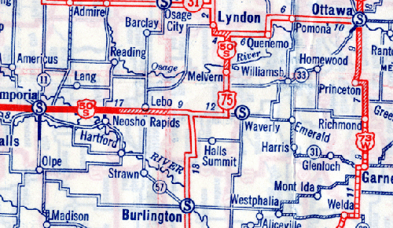
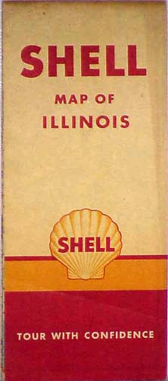
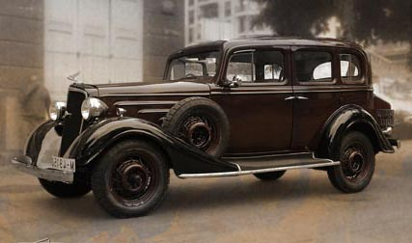
Florence and Duncan joined the many Americans who took to the road for recreation. From the early 20s to the late 30s, they traveled 40–60 thousand miles a year frequenting inns and restaurants across the United States. All the while jotting down notes in Duncan’s little book.

Slide 9
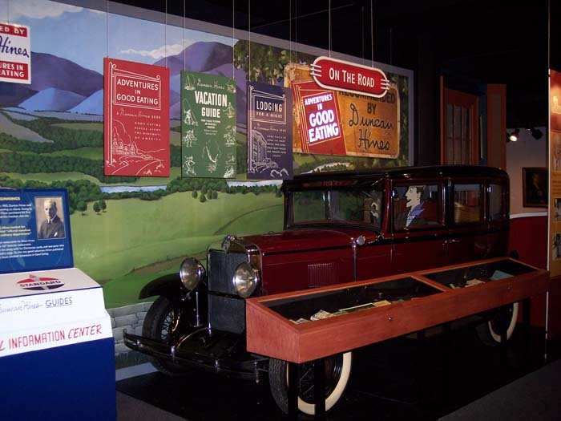

Slide 10
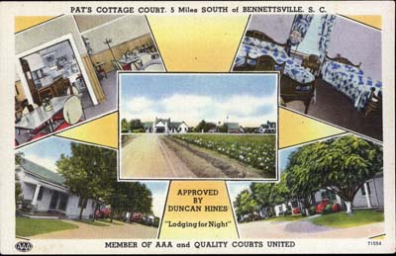
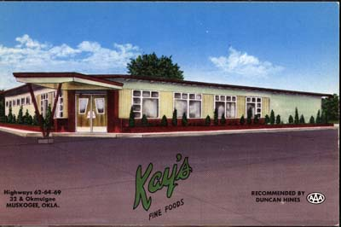
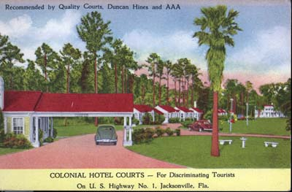
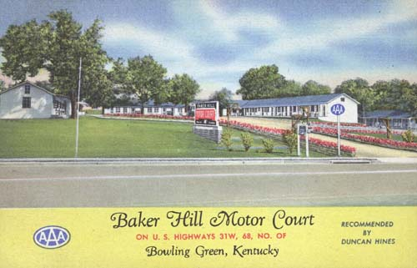
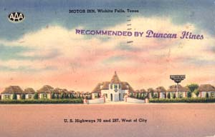
In certain circles – particularly that of the traveling businessmen - he was soon known as an expert on where to find clean and comfortable lodgings and healthy, well-cooked meals. In 1934, when a Chicago newspaper wrote an article on Duncan’s hobby, he began to receive calls.

Slide 11
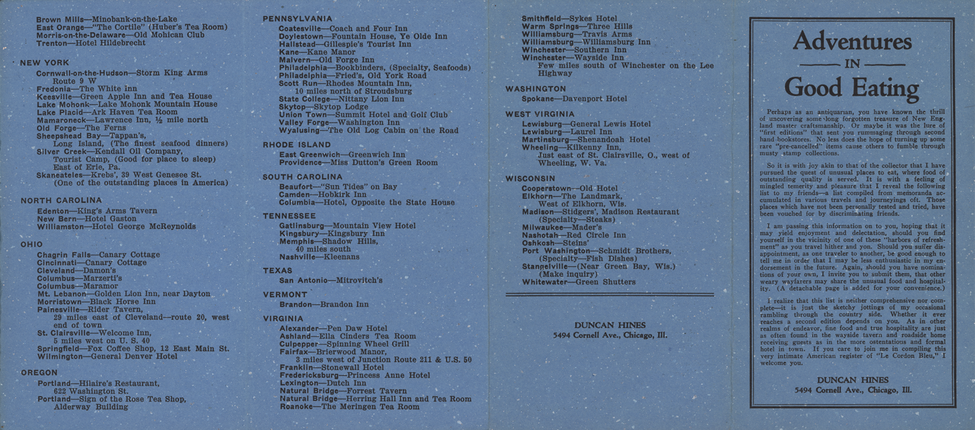
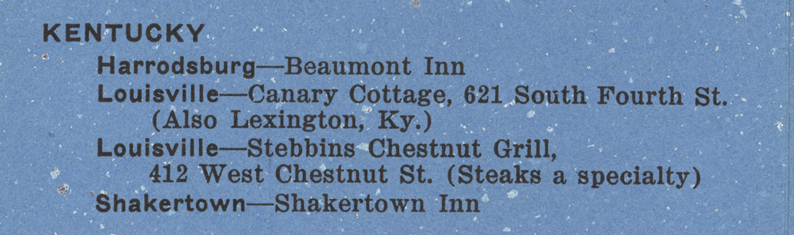
This newfound popularity prompted he and Florence to select 167 of their favorite restaurants to use in a small publication which was to become the first “Adventures in Good Eating.” Hines printed 1000 of these blue tri-fold guides to include in their Christmas card.

Slide 12
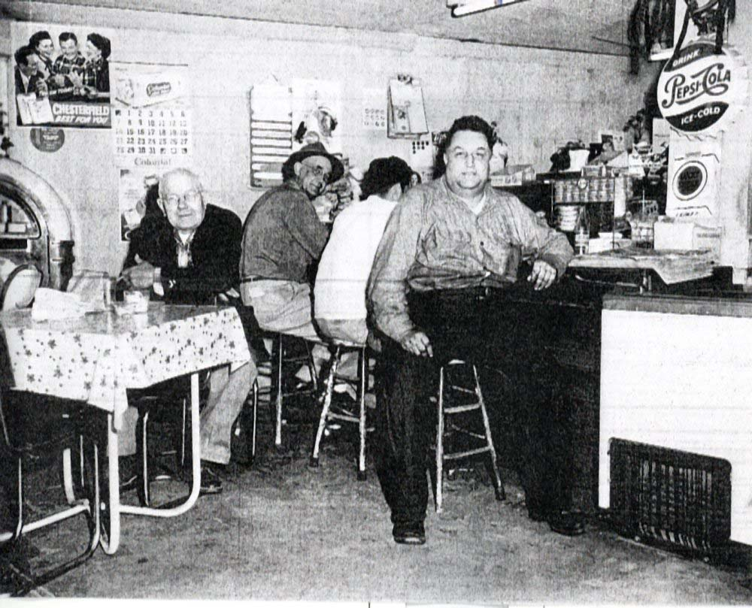
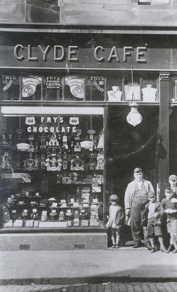
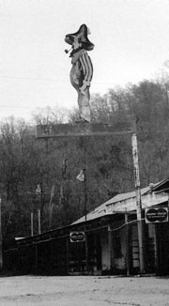
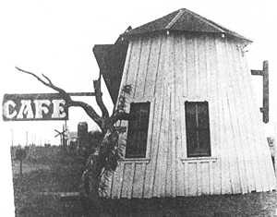
Before the 1950s, eating out could be an adventure - - - but not necessarily a good one. Hines realized he had done something rather new - - given good, solid advice to the average person. So many people wanted his “Christmas Card” that he began to charge. Could he have enough material and interest to for a book?

Slide 13

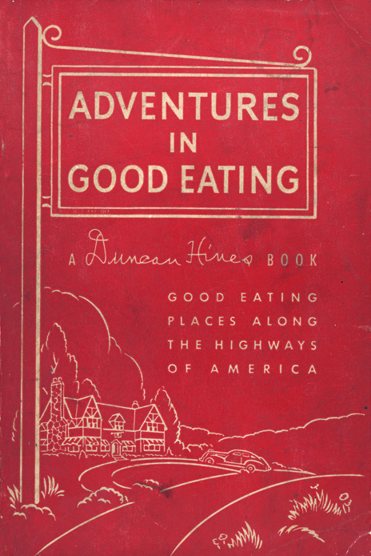
In June 1936, Hines published the first edition of “Adventures in Good Eating for the Discriminating Motorist.” He printed 5000 copies of the 96-page guide and sold them for $1.00 each. Though he lost $1,500 on this first edition, he persisted until his book found a market. With entries listed by state and city alphabetically, the guidebook included the average price of a meal and tidbits about the establishment.

Slide 14
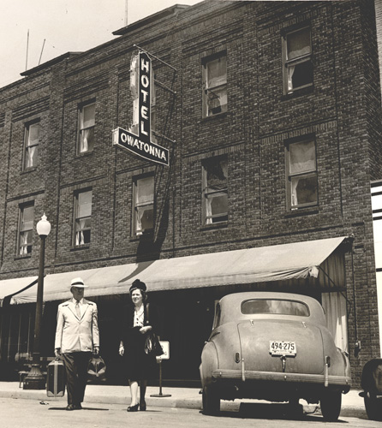
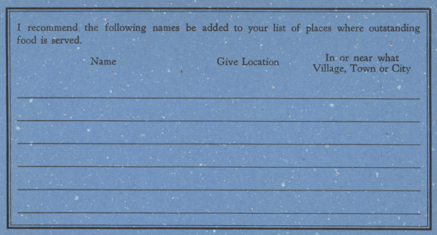
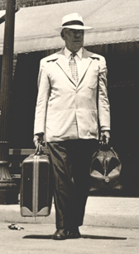
“Adventures in Good Eating” also contained three postcards readers could send to Hines suggesting restaurants they thought might be included in his book. Hines, aided by his group of “dinner detectives”, traveled 50,000 miles a year to inspect recommended restaurants. Hines was on his way to becoming known as the authority on the subject.

Slide 15

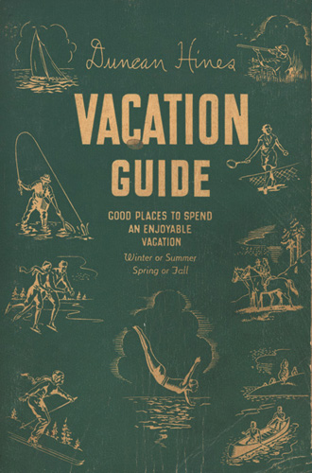
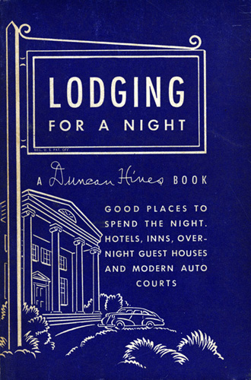
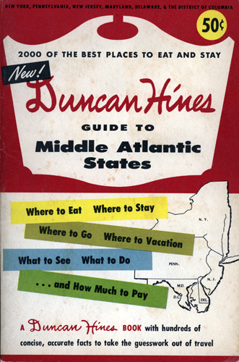
Spin offs of the first guidebook, Lodging for a Night, Vacation Guide, and Adventures in Good Cooking, became popular sellers filled with Hines’s thoughts and observations.

Slide 16
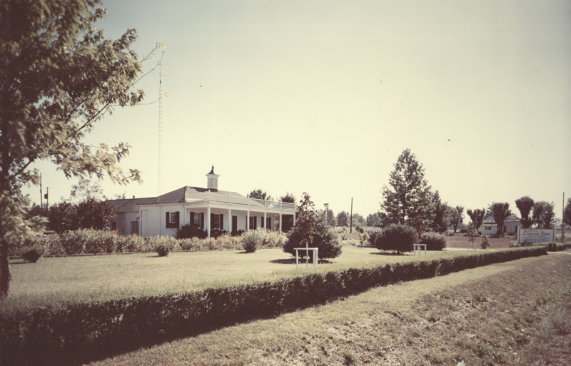
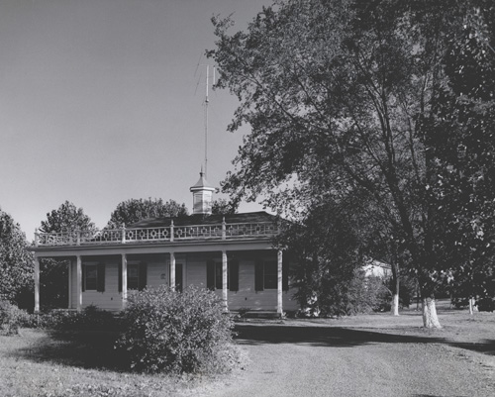
In Fall of 1938 Florence passed away from cancer. While spending the holiday season in Bowling Green, Duncan’s sister persuaded him to come back to Kentucky. The following March, he moved to the Bluegrass State and purchased 4 acres of land on the Dixie Highway (31-W). There he built his house and office - soon receiving a steady flow of visitors and mail - typically 600 letters a day from fans.

Slide 17
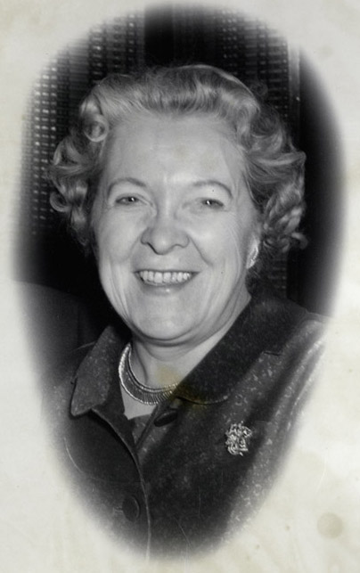
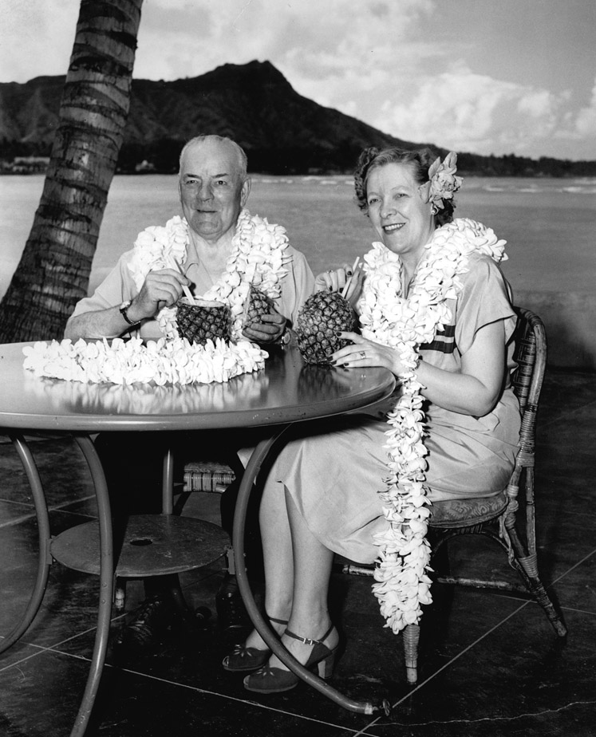
In the mid 1940s, Hines married family friend Clara Wright Nahm who enjoyed traveling with Duncan. It was very important to Hines that his name was associated with quality food and he was adamant about maintaining his reputation. To keep his objectivity, Hines routinely refused gifts and avoided endorsements.

Slide 18
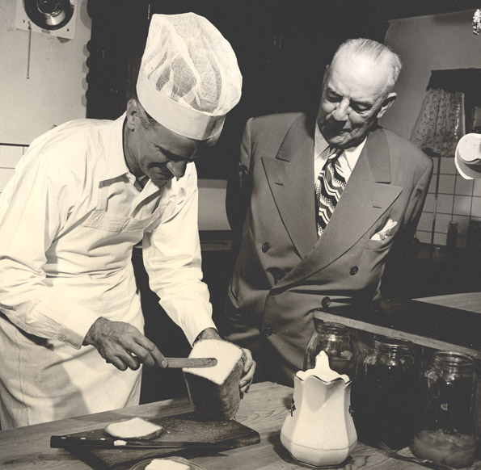
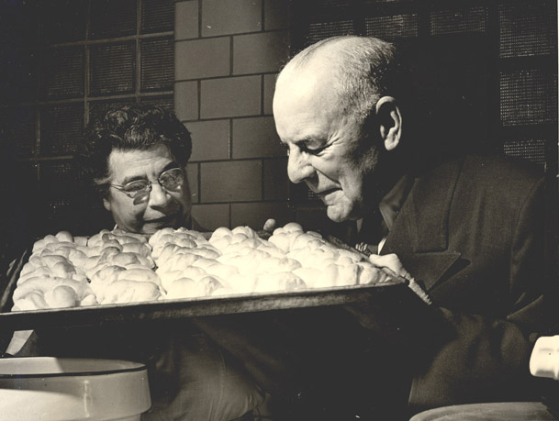
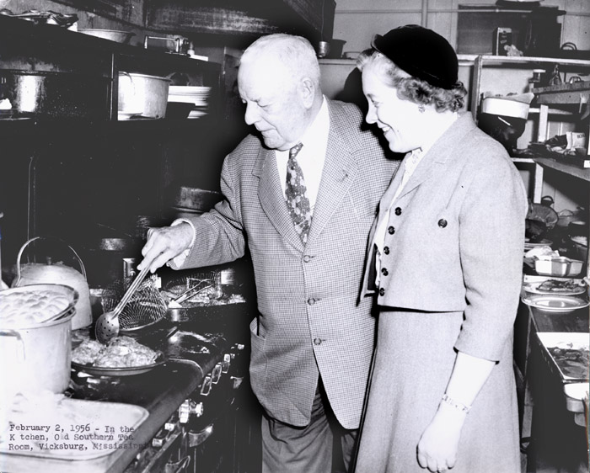
He felt strongly that good food and good health were linked – that cleanliness in food preparation was paramount. A kitchen tour to inspect the sanitation of the food preparation area was a routine part of Hines’s assessment.

Slide 19

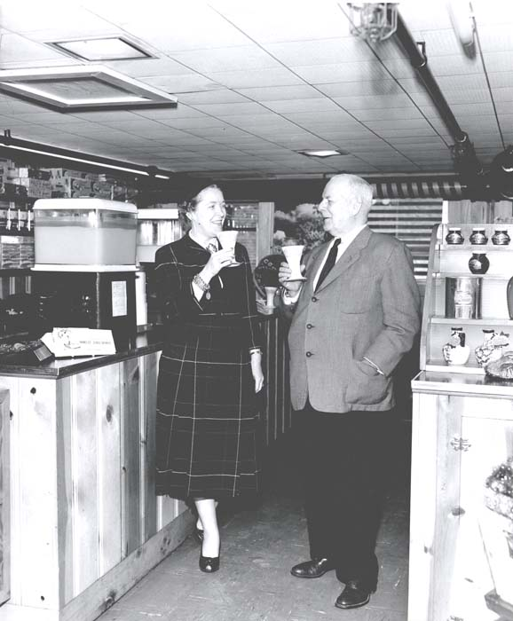
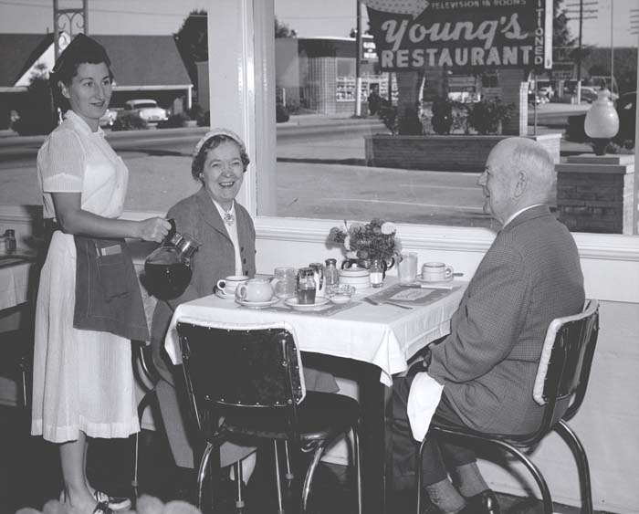
When visiting restaurants, Hines preferred to keep a low profile, arrive unannounced and remain anonymous until the end of his visit. As his guidebooks gained in popularity, and restaurants and inns desired to be included in his publications, this became more and more difficult.

Slide 20
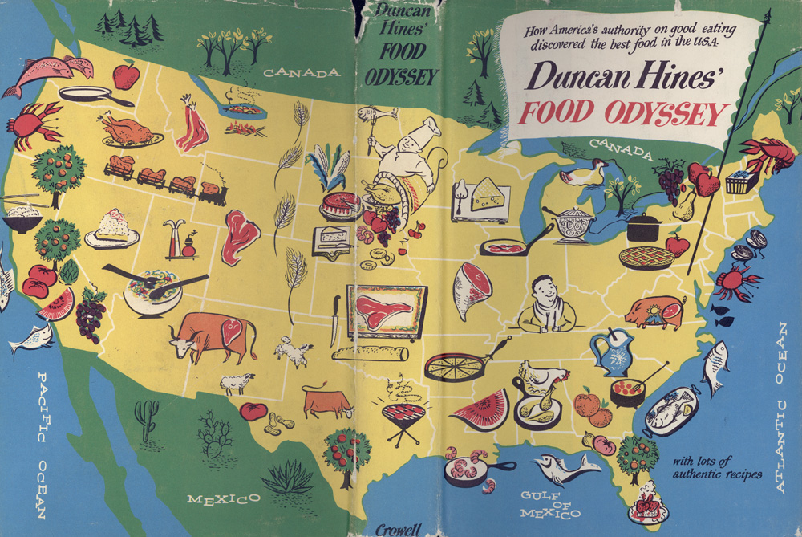
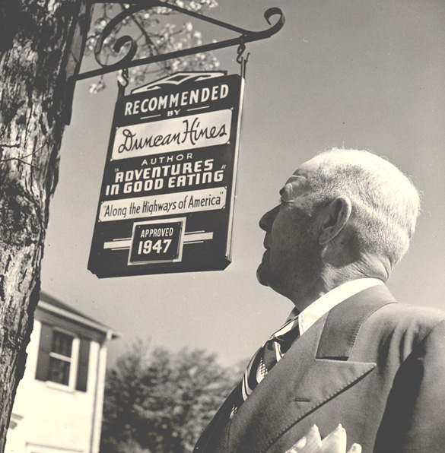
Hines began to rent signs to lodging and dining establishments that appeared in his guidebooks. He maintained strict control over who was to post these signs that read “Recommended by Duncan Hines.”

Slide 21
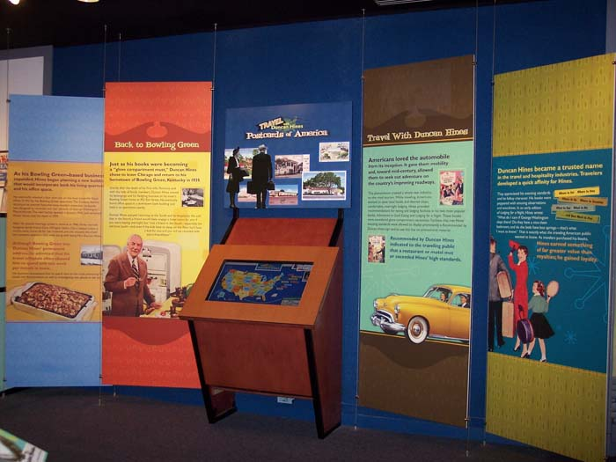
The exhibit features a computer kiosk the visitor can search to find postcards of establishments recommended by Duncan Hines.

Slide 22
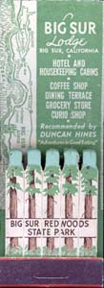
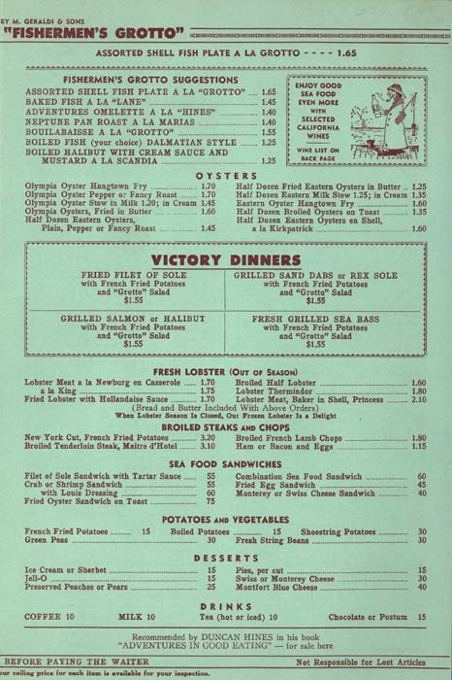
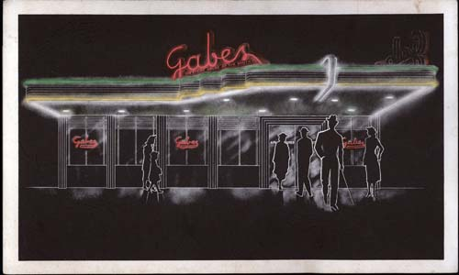
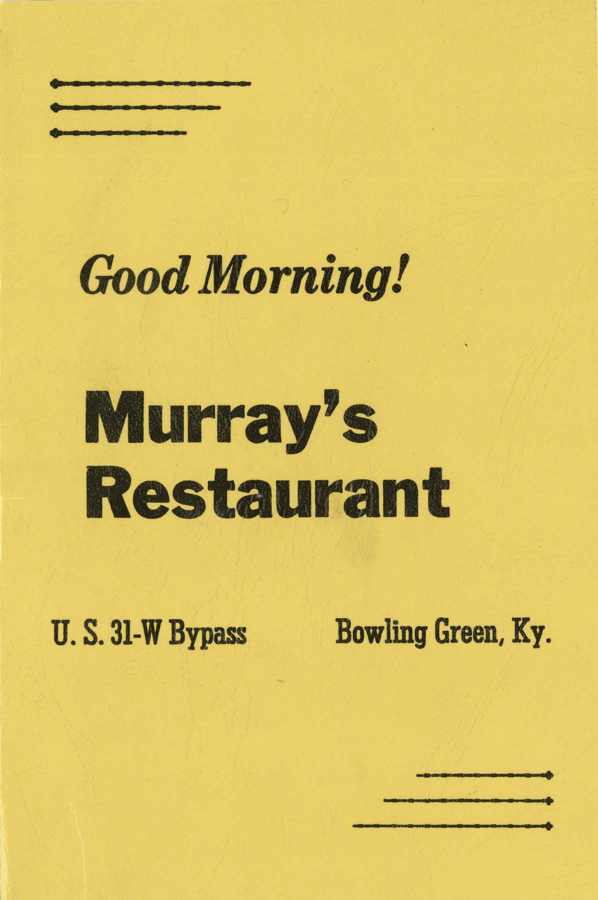
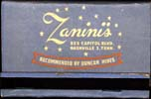
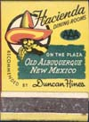


Hines also allowed use of his name on printed materials which including menus, postcards, advertisements and even matchbooks.

Slide 23

By the late 40s the modern supermarket began to replace the corner store. Hines was repeatedly approached by companies desiring his endorsement of their food products. All of which he turned down.

Slide 24

Though Hines felt strongly about selling his name and protecting his reputation, a meeting with Roy Park in 1948 changed his mind. Park owned an advertising agency whose client, Grange League Federation Exchange, wanted to develop a line of packaged food products that the housewife would link with superior quality. They found that to the average housewife superior quality meant Duncan Hines.

Slide 25



Park suggested to Hines the development of a line of food products that would have the Hines name. Park convinced Hines that the foods would be of such a high quality the link to
his name would serve to help upgrade American’s eating
habits. So, Hines-Park Foods
was formed in 1949. Ice cream was the first product and an instant success.

Slide 26




Hines loaned his name to a variety of foodstuffs including condiments, salad dressings, cottage cheese, and butter. At the height, Duncan endorsed 157 food products.

Slide 27


The company grew and expanded to include non-food product endorsements. As the idea of eating outside emerged in the 1950s, one of Duncan’s endorsed products was a bar-b-que grill with utensil sets, and sauces.

Slide 28





Slide 29

Hines endorsed cookware, coffee pots, steak knives, playing cards, soap, and food preparation utensils such as food grinders.

Slide 30








Slide 31




Hines endorsed several styles of dinnerware produced by the Stetson Company.

Slide 32


Forever the salesman, Hines again began to travel to promote Hines-Park Foods.

Slide 33





Hines is best known today for his cake mixes introduced in 1951. Within three years, Duncan Hines white, yellow and devil’s food cake captured 10% of the national market.

Slide 34


Hines explained that the popularity of his cake mixes was due to the use of fresh eggs rather than dehydrated eggs - like those used in other products.

Slide 35

With the use of a magnet board, visitors can build and decorate their own cake in the
exhibit.

Slide 36





Soon the company began to market a variety of new mixes including brownies, pancakes, pizza dough, muffins, coffee cake and rolls.

Slide 37

After Hines’s retirement at the age 73, Hines-Park Foods and “Adventures in Good Eating, Inc. (Hines’s publishing company) merged in 1953 putting Roy Park at its helm.

Slide 38

Park moved the company
to Ithaca New York where it
merged with Proctor Gamble
in 1956. Pinnacle Foods now
produces Hines cake mixes which continue to do extremely well.

Slide 39





In 1959 Duncan Hines died of lung cancer in Bowling Green. Clara sold the house on 31W and moved to town. In his lifetime, Hines made a major impact on the restaurant and hotel business. He promoted healthy foods and became a household word. Duncan Hines may be gone but his legacy lives on.

Slide 40



Exhibition
“Recommended by Duncan Hines”
The Kentucky Library and Museum
Western Kentucky University
Bowling Green Kentucky
270-745-2592
http://www.wku.edu/Library/museum/

Slide 41




Slide 42


All Contents Copyright © 2009
Western Kentucky University
http://digitalcommons.wku.edu/dlsc_fac_pub/17

