Slide 1
The Future of KATAC
Tammy Duddy
University of Louisville
March 13, 2013

Slide 2

“The Official” KATAC LOGO

Slide 3
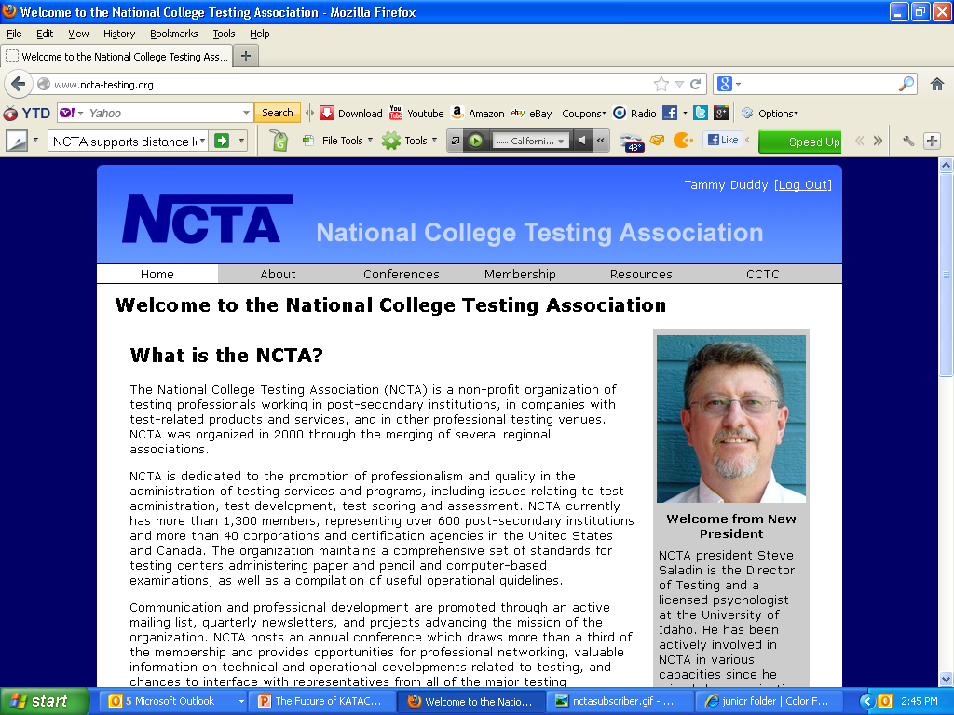

Slide 4

NCTA Professional Standards and Guidelines
NCTA has established standards and guidelines for testing centers and testing personnel. A list of test administrators who have endorsed these standards may be found on this website.

Slide 5

NCTA Consortium of College Testing Centers (CCTC)
NCTA supports distance learning by providing this free web-based referral service. The CCTC web page contains a listing of testing centers across the country and abroad that are willing to provide proctoring services to students away from their campuses.

Slide 6
Establishing an Effective State or Regional Testing Organization
Get Support – Ask your supervisor & your institution’s leadership for permission or approval to participate.
Determine the Purpose of the Organization
  Improving communication about testing practices & issues in the state or region.
  Working with testing companies to provide professional testing services.
  Promoting membership in the National College Testing Association.

Slide 7
Informal & Formal Organizations
In the past 3 years, we were INFORMAL
But the future of KATAC will be FORMAL
Leadership – Cindy, Tammy & Shara (along with help of many others) put together each conference.
Membership - has been attained through word of mouth & just on a spreadsheet
Meetings/Conferences – Annual mini-conferences have been held and have included workshops & training
A Mission Statement – will clarify the purpose of an organization.
By-Laws – are the internal rules of an organization. They define the operation of the organization & outline the procedures for election of officers & other details of the processes & procedures.
Dues/Other Funding – Some funding will be necessary and we will need to decide the type and amount.
Business status – Does this organization want to register as a not-for-profit organization.

Slide 8
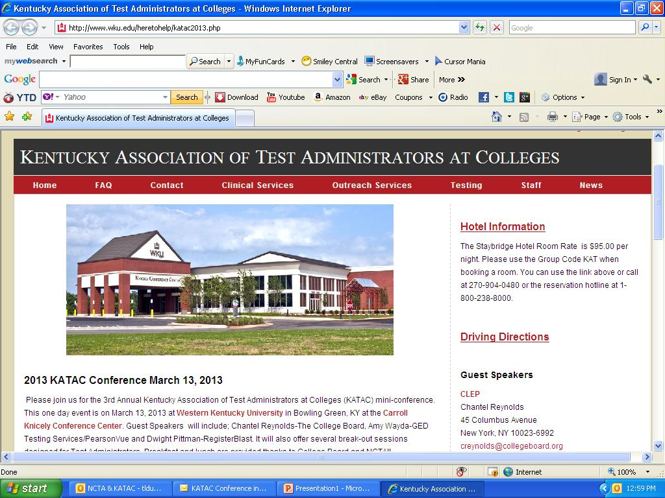
Set up Communication Channels
The website has been created, thanks to Julia Johnson from WKU, and will remain on this site until it is moved to the NCTA site.
The link is http://www.wku.edu/heretohelp/katac2013.php

Slide 9
Other Channels of Communication Include:
LISTSERV for KATAC
File Sharing System
A listserv is an electronic mailing list that allows a sender to send one email message which will be sent transparently to other subscribers on the list.
File Sharing is the practice of distributing or providing access to digitally stored information.
Do we NEED or NOT???
THOUGHTS???

Slide 10

VISION STATEMENT: KATAC will be a formal, cohesive organization of Kentucky regional test administrators which is national recognized for membership growth, sharing best practices, and providing professional development to its members in at least one annual conference.
MISSION STATEMENT: KATAC is bringing together a wide range of testing professionals who meet, interact, communicate and learn from each other.

Slide 11

CORE VALUES
Strive for/promote professional recognition
Bringing together/networking test administrators
Forming relationships with vendors and other test administrators
Adhering to NCTA standards
Receive/provide current information
Identify/Share best practices
Identify/promote professional development
Continuity/sustainability of the association

Slide 12
Responsibilities
NCTA State Liaison (appointed position): Currently held by Tammy Duddy, University of Louisville. This position has the shared responsibility with the other key roles to coordinate the logistics of the annual KATAC conference, generally held in the spring at a mutually agreed upon location. This role will serve as the recorder/reporter to NCTA and other organizations and will send out “minutes” electronically within a week of each KATAC conference.
Conference HOST Committee (appointed/voluntarily)– This committee will assist in the logistics of the mini-conference each year. The host committee will be members who volunteer to help from the location selected for the following year’s conference.

Slide 13
2013 Elected Positions
The Conference Committee Chairperson – This position has the shared responsibility with the other key roles to coordinate the logistics of the annual KATAC conference, generally held in the spring at a mutually agreed upon location. This role serves the purpose of also generating ideas and securing funding or deciding how the annual conference will be funded (conferences fees, vendor sponsorship, etc.)
**Since Cindy Sproehnle is an active NCTA Board member, she will serve as mentor/assistant to the person in this position for next two years.
The Facilitator – This position has the shared responsibility with the other key roles to coordinate the logistics of the annual KATAC conference, generally held in the spring at a mutually agreed upon location. This role serves the purpose of maintaining data of membership information, finalizing agenda, sending “Save the Date” & invitation emails, and any miscellaneous ideas that may need addressing.
Each position will serve a two year term with eligibility for one additional, consecutive appointment if so elected.

Slide 14
Now…It’s Time
Think about if you would like to be more involved with KATAC and run for a position
Please see me during the afternoon break between 1:30 – 2ish
Be prepared to give an introduction before the elections
We will vote & results will be announced during CLOSING today!!!

