Slide 1
Light Imprint for Sustainability & Community Design
Andrew Stoeckinger
Bluegrass PRIDE
3/21/2001

Slide 2
Light Imprint Handbook: Integrating Sustainability & Community Design
Website: www.LightImprint.org
Utilizes 60 techniques for:
Paving streets and sidewalks
Channeling and storing water
Filtering surface runoff
Mitigates environmental impacts
Makes communities more beautiful and livable
Pedestrian-friendly design
Economical results

Slide 3
Light Imprint Approach
Compact and connected design
Respects nature and existing site terrain
Emphasizes importance of public civic spaces
Addresses stormwater runoff through:
Natural drainage
Innovative infiltration practices
Incorporated with conventional engineering, as needed
Breakdown of site into transects
Four LID categories: Paving, Channelizing, Storage, & Filtration
Urban to Rural

Slide 4
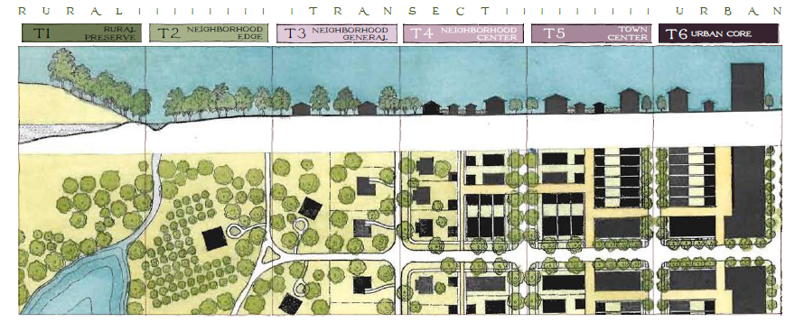
Light Imprint Transects
Provides information on:
Appropriateness of BMPs
Initial Costs
Long-term maintenance factors
Soil: Poor Drainage (Rock /Clay); Medium Drainage (Silt/Loam); Good Drainage (Loam/Sand)
Slope conditions: Flat (0 – 8 %); Moderate (8 – 15 %); Steep (>15 %)
Climate: Cold; Temperate; Hot; Dry; Moderately Wet; Wet

Slide 5
Light Imprint Matrix: Paving

Slide 6
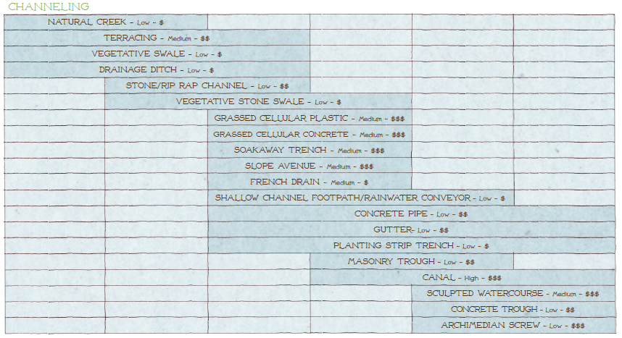
Light Imprint Matrix: Channelizing

Slide 7
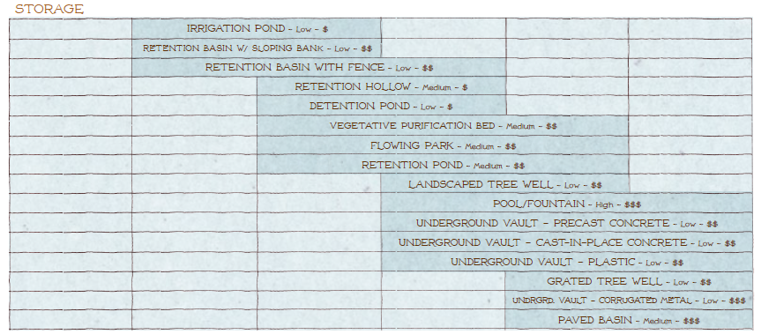
Light Imprint Matrix: Storage

Slide 8
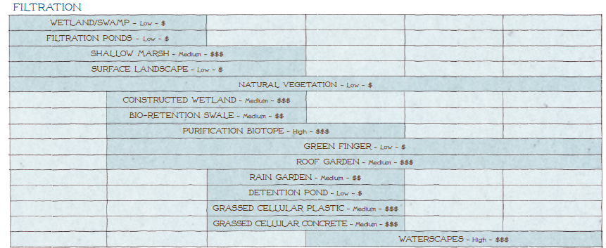
Light Imprint Matrix: Filtration

Slide 9
BMP Menu According to Low Imprint Matrix
Paving | Channelizing | Storage | Filtration
Geotextile Mat | Natural Creek | Irrigation Pond | Filtration Pond
Crushed Stone | Drainage Ditch | Retention Basin | Natural Vegetation
Pavers | Stone Channel | Detention Pond | Surface Landscape
Stamped Asphalt | Soakaway Trench | Flowing Park | Constructed Wetland
Stamped Concrete | French Drain | Pool/Fountain | Bio-Retention Swale
Pea Gravel/Washed Stone | Sculpted Watercourse | Underground Vault | Purification Biotope
--- | --- | Grated Tree Well | Green Finger
--- | --- | --- | Waterscapes

Slide 10
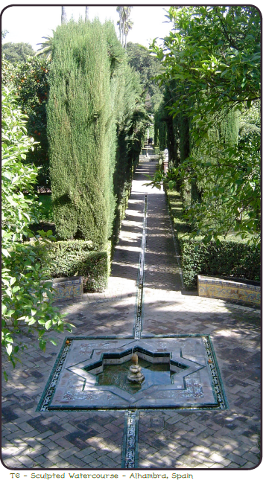
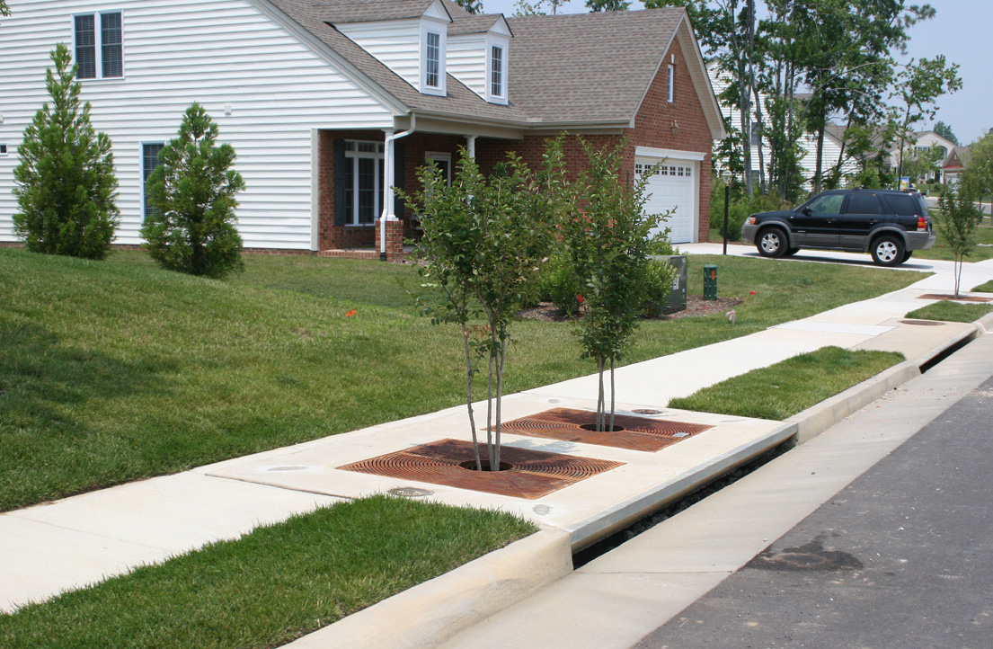
Stormwater Fountain/Pool
Grated Tree Well

Slide 11
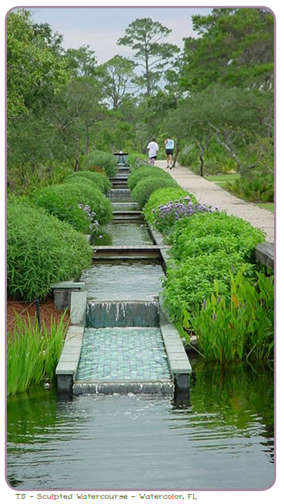
Sculpted Watercourse
Purification Biotope

Slide 12
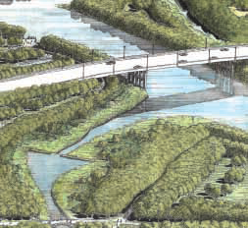
Flowing Park
Green Finger

Slide 13
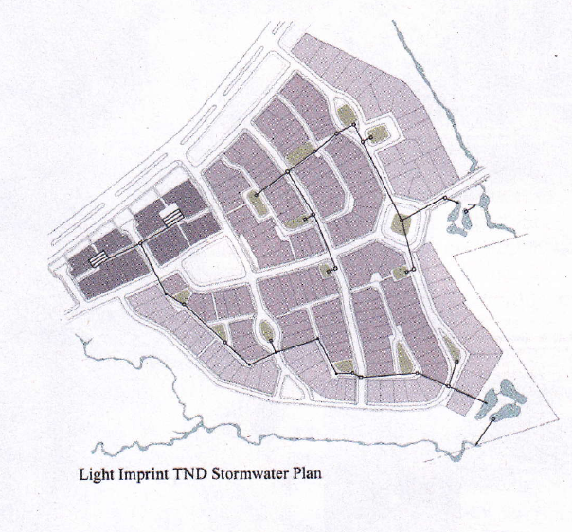
Light Imprint/Conventional Comparison
Source: “Choosing a Green Infrastructure Framework? Consider Light Imprint.” Stormwater: The Journal for Surface Water Quality Professionals. March/April 2011. www.stormh2o.com

Slide 14
Light Imprint/Conventional Comparison
Source: “Choosing a Green Infrastructure Framework? Consider Light Imprint.” Stormwater: The Journal for Surface Water Quality Professionals. March/April 2011. www.stormh2o.com

