Slide 1
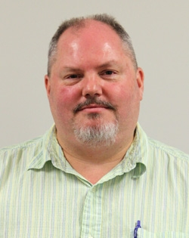
Lawrence Alice, Ph.D.
University of Maine
Associate Professor
Courses
BIOL 122 - Biological Concepts: Evolution, Diversity & Ecology
BIOL 222/223 Plant Biology and Diversity
BIOL 348 Plant Taxonomy
Research
My research interests include the systematics of the economically important plant genera Rubus (Rosaceae), which includes blackberries and raspberries, and Mentha (Lamiaceae), including spearmint and peppermint. These groups have long been considered taxonomically difficult due in part to polyploidy (more than two sets of chromosomes), agamospermy (asexual seed production) in Rubus, and hybridization. I primarily use molecular techniques, in particular DNA sequencing, to address evolutionary biology questions. These data can be used, for example, to infer evolutionary relationships (phylogeny reconstruction), test hypotheses of hybridization, examine biogeographic patterns, and consider modes of speciation especially in polyploid taxa.
Bio
Ph.D. - Plant Science, University of Maine 1997
M.A. - Botany, Southern Illinois University at Carbondale 1989
B.A. - Botany, Southern Illinois University at Carbondale 1986

Slide 2
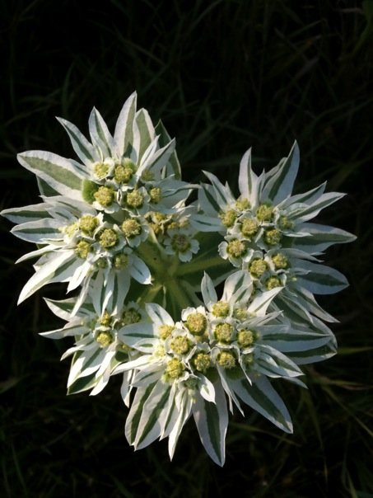
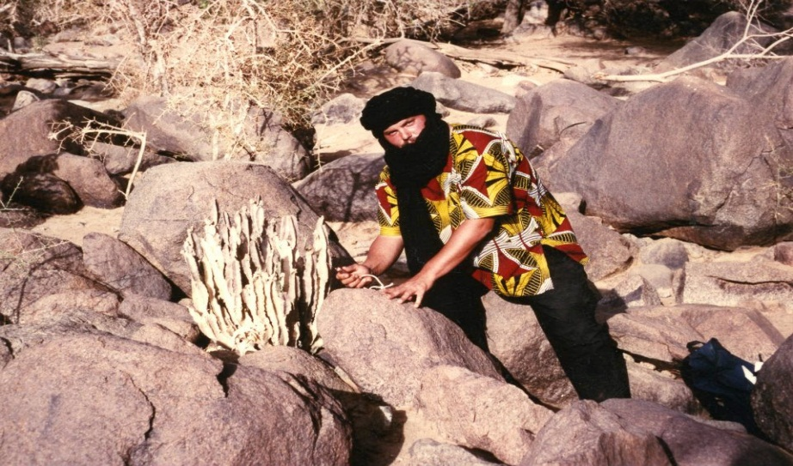
Research by Dr. Alice
I primarily use molecular techniques, in particular DNA sequencing, to address evolutionary biology questions. These data can be used, for example, to infer evolutionary relationships (phylogeny reconstruction), test hypotheses of hybridization, examine biogeographic patterns, and consider modes of speciation especially in polyploid taxa. I am also interested in systematics of subfamily Rosoideae and the Rose family (Rosaceae), tribe Mentheae of the mint family (Lamiaceae), and subfamily Chloridoideae of the grass family (Poaceae).
  Current Research Projects:
Plant ProtectionResearch Institute –"Taxonomic Status and Phylogenetic Affinity of an Invasive Blackberry in South Africa"
Flora of North America & Jepson Flora - Rubus
National Science Foundation – "RUI: Molecular Phylogenetics and Allopolyploidization in Rubus (Rosaceae)“

Slide 3
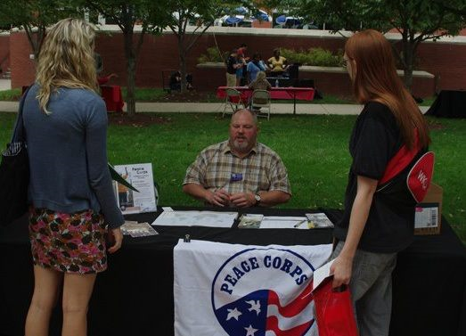
Graduate Research with Dr. Alice
Lauren Ebbeck
Tim Ferguson
David Kem
Jessie Lyne
Taryn Shelton

Slide 4
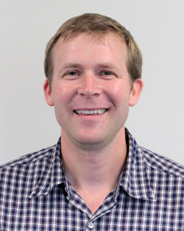
Noah Ashley, Ph.D.
University of Washington
Assistant Professor
Courses
BIOL 131: Human Anatomy & Physiology I
BIOL 464: Endocrinology
BIOL 326: Ornithology
Research
Endocrine-Immune Interactions in Vertebrates
Hormonal Regulation of Inflammation during Sleep Loss
Comparative Evolution of Sickness Behavior and Inflammation
Ecological Immunology
Sleep/Wake Cycles and Chronobiology
Non-Invasive Measures of Stress Hormones
Regulation of Immune Function by Androgens
Bio
Ph.D. Zoology, University of Washington, Seattle.WA
B.A. Biology, Colby College, Waterville, ME

Slide 5
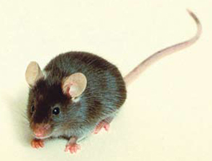
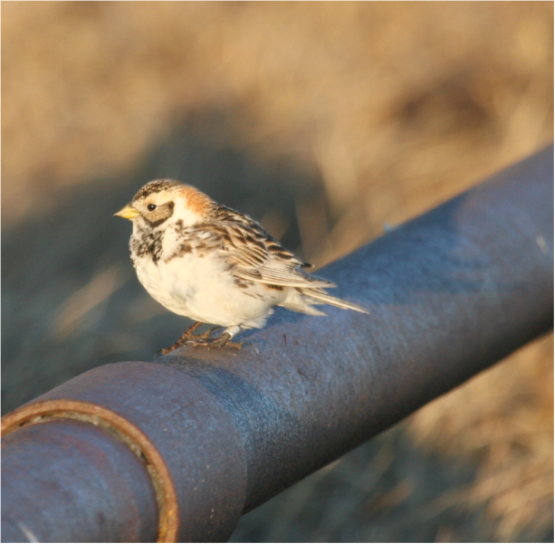
Current Research in Ashley Lab
Sleep-immune interactions in rodents
  Inflammation/Immune function & microglial activation
  Stress hormones
  Anxiety/memory
Comparative biology of sleep and circadian rhythms
  Latitudinal studies (arctic vs. temperate comparisons)
  Determining responses to sleep deprivation
  Assessing seasonal and hormonal effects
  This project involves field work in Alaska!!
C57BL/6 mouse
Female Lapland Longspur (Calcarius laponnicus)

Slide 6
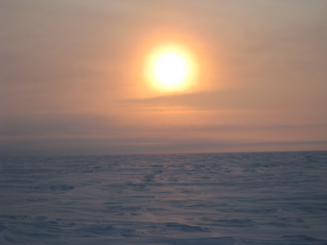
Graduate Students
Jennie Dumaine
  B.S. Hanover College
  Starting in Fall 2013
Laken Cooper
  B. S. Radford University
  Started in Fall 2014
I am currently recruiting a student (Master’s level) who is interested in examining the comparative biology of sleep in songbirds. Please let me know if you are interested! Contact me at noah.ashley@wku.edu
Land of the Midnight Sun, Barrow, Alaska
(Where we conduct field work!)

Slide 7
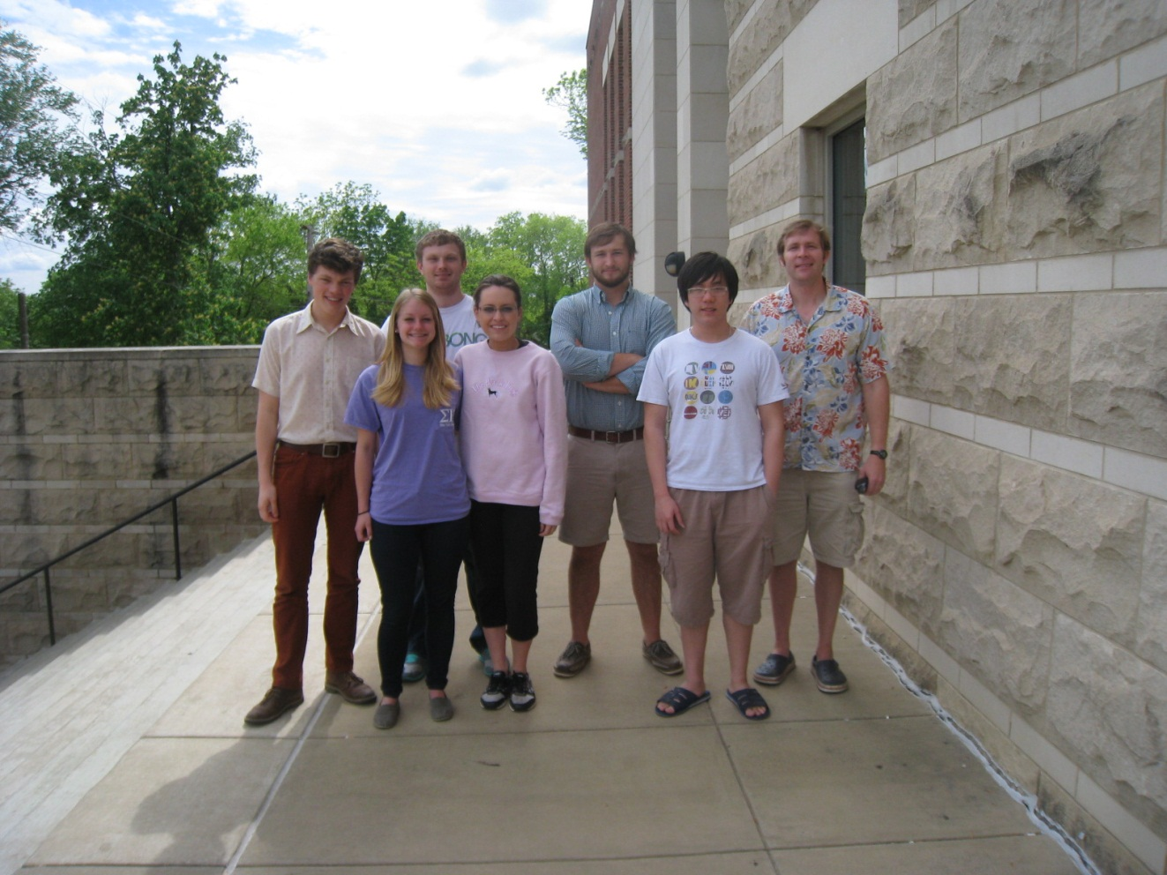
Undergraduate Students
Involvement of undergraduate students is an essential part of my research philosophy!
2014 Lab members
  Jamie Doctrow
  Johnny England
  David Sams
  Audrey Brown
  Dai Le Hieu Vo
  Chase Knibbe
  Kaley Coffey
  Nakeya Owens
  Callie Allison
Interested in gaining laboratory experience for professional or graduate school?
Please contact me (Noah.Ashley@wku.edu) if you are interested!

Slide 8
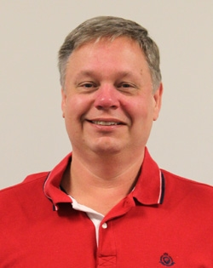
Kenneth M. Crawford, Ph.D.
University of Michigan
Associate Dean, Ogden College
Director Pre-Health Professions Advising Office
Education
B.A. 1978 : SUNY College at Buffalo
M.A. 1980 : SUNY College at Buffalo
Ph.D. 1988 : University of Michigan
Courses
BIOL 330: Animal Physiology
BIOL 324: Histology
Research
Wound healing, cell proliferation and cell migration in corneal endothelial cells.
Activity of Endothelin-1 in corneal endothelial cells.

Slide 9
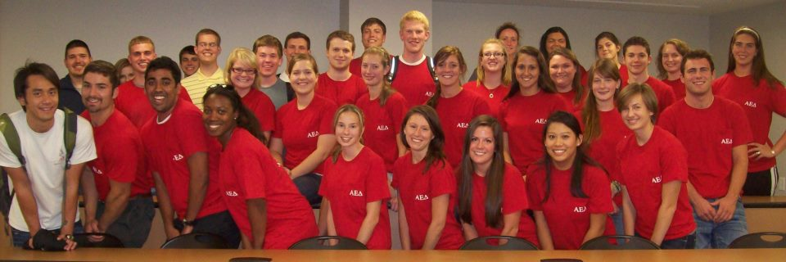

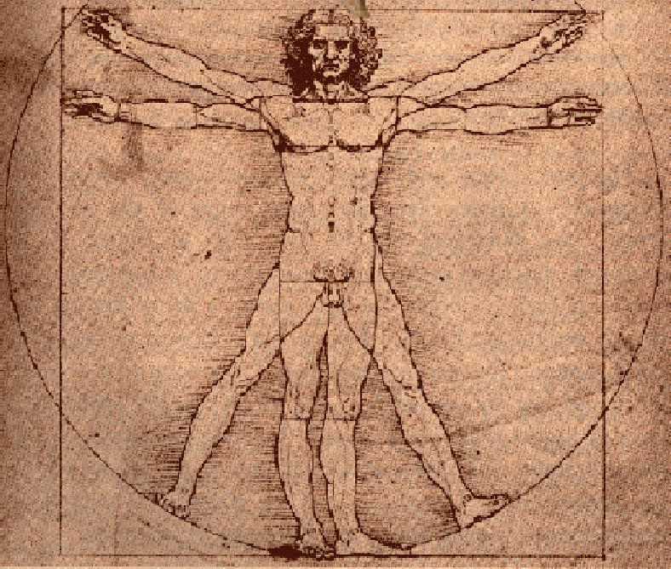

Chief Pre-Health Professions Advisor
Faculty Advisor – Alpha Epsilon Delta

Slide 10
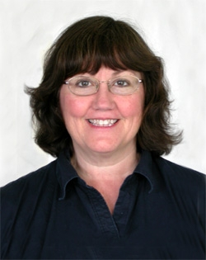
Cheryl Davis, Ph.D.
Wake Forest University
Professor
Courses
BIOL 121 Biological Concepts Laboratory
BIOL 328 Immunology
BIOL 460 Parasitology
BIOL 570 Adv. Immunology
BIOL 561 Human Parasitology
Research
Immunobiology of Parasite-Host Interactions
Tick-borne and parasitic disease surveillance
Bio
Ph.D. - Biology (1988). Wake Forest University, Winston-Salem, NC.
M.S. - Zoology (1983). The University of Oklahoma, Norman, OK.
B.S. - Zoology (1979). The University of Oklahoma, Norman, OK.

Slide 11
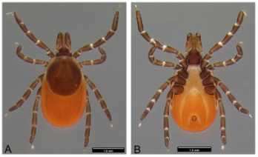
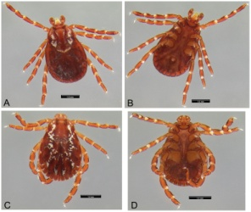
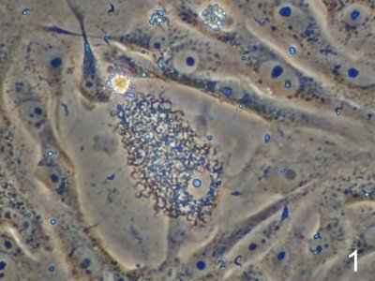
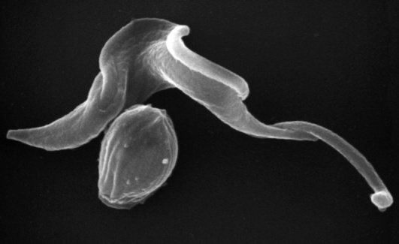
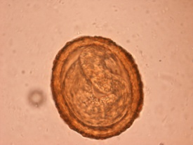
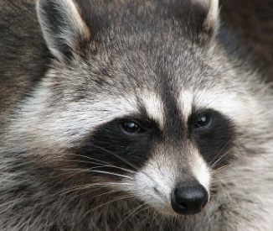
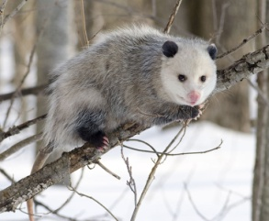
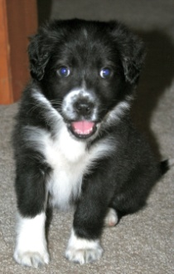
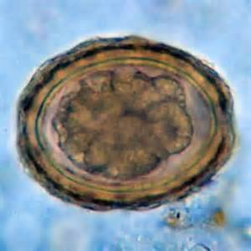
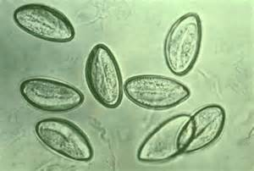
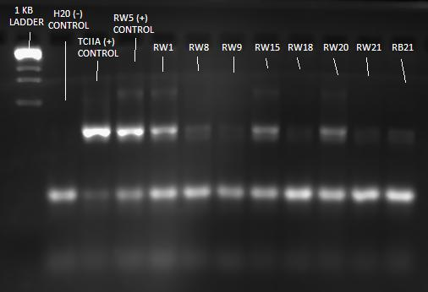
Research by Dr. Davis
Tick-borne and parasitic disease surveillance
Immunobiology of Parasite-Host Interactions
Trypanosoma cruzi (causative agent of Chagas’ disease)
Trypomastigotes in cell culture
Ixodes scapularis
Dermacentor variabilis
Trypomastigote and Amastigote
Human Soil Parasitic Helminth Surveillance
Baylisascaris procyonis
PCR detection

Slide 12
Research Students
M.S. Students
Pittman, Kayla
Melchert, Valerie
Undergraduate Students
Bosse, Luke
Cox, Katelyn
Smith, Ashley
Research Projects:
Canine Chagas’ Disease in Kentucky
Baylisascaris procyonis (Raccoon Roundworm) in Warren County, KY
Human Parasitic Helminth Disease Surveillance in KY

Slide 13
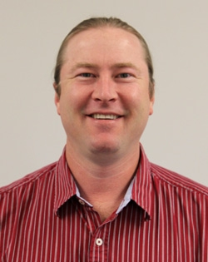
Bio
PhD - Zoology (2005), Texas Tech
University
MS - Biology (1998), University of
Central Arkansas
BA - Biology/Env. Science (1992),
Tabor College
Courses
BIOL 122 Introductory Biology
BIOL 316 Evolution
BIOL 523 Evolution of Symbioses
BIOL 598 Graduate Seminar
Research
Evolution and ecology of parasite-host associations; taxonomy and systematics of bat flies; biodiversity and faunal surveys
Carl W, Dick, Ph.D.
Texas Tech University
Assistant Professor

Slide 14
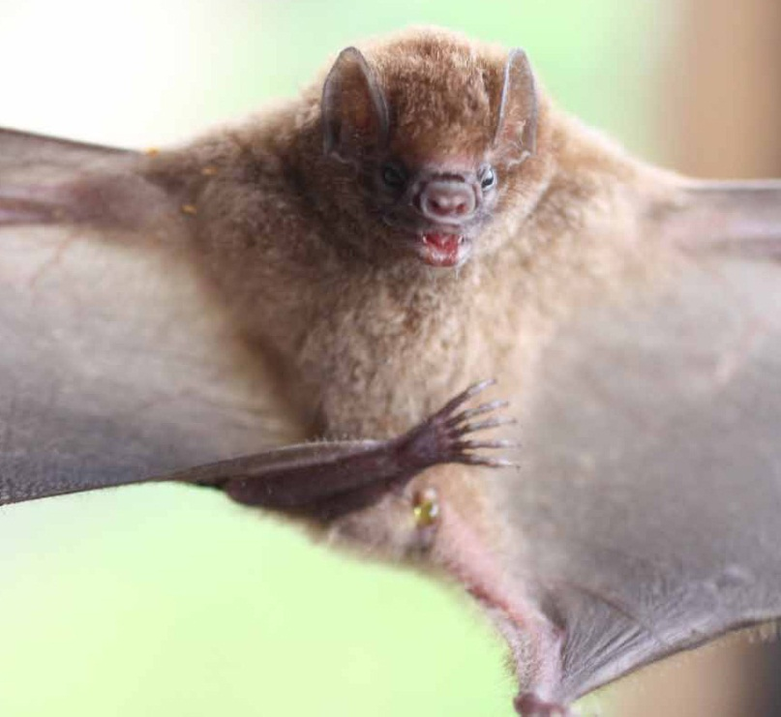
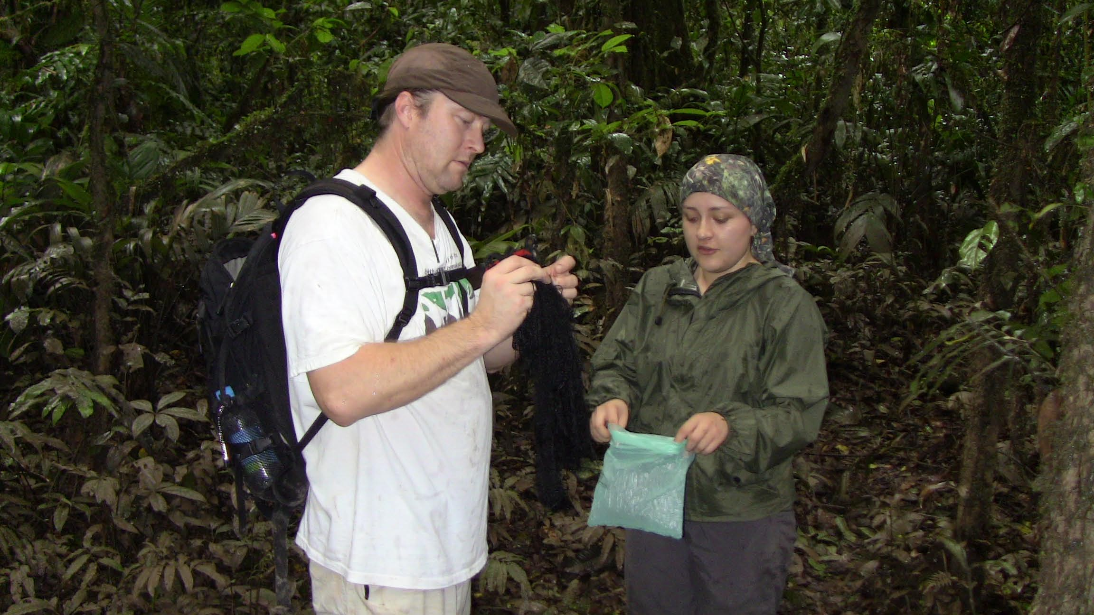
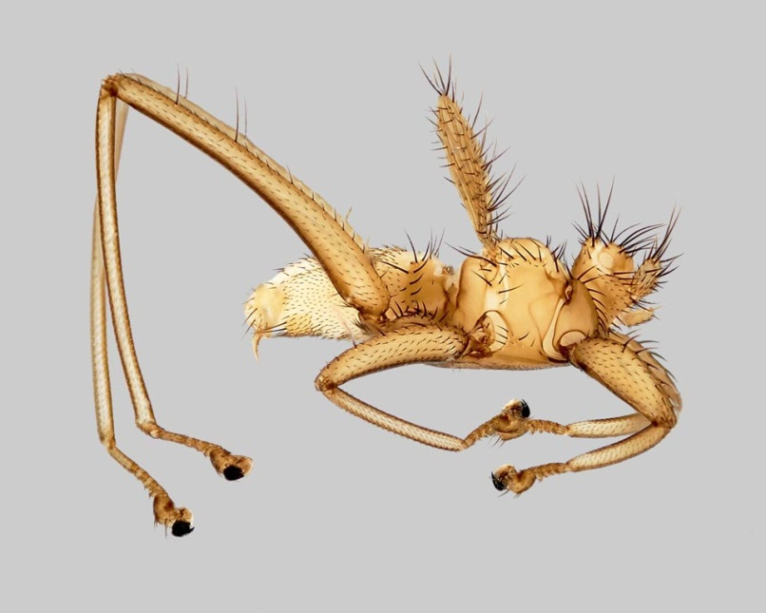
Research by Dr. Dick
How and why do parasites specialize on host
species?
How do multiple parasite species coexist?
What host characteristics influence parasite
distribution and abundance?
How do parasites and hosts interact with viruses
and other pathogens?
Have parasites evolved in concert with their
hosts?

Slide 15
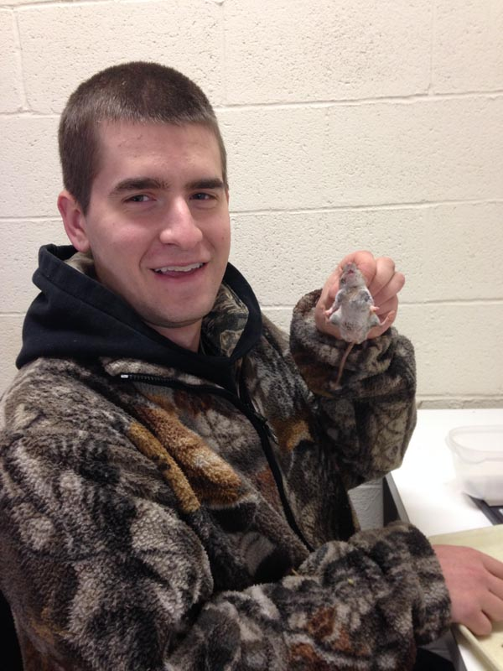
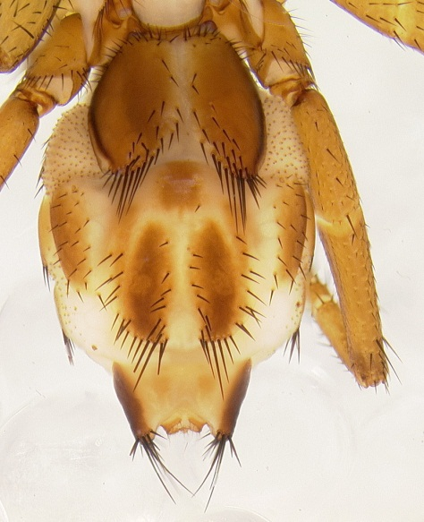
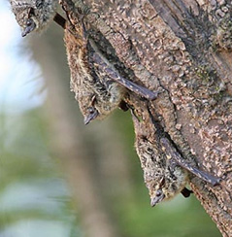
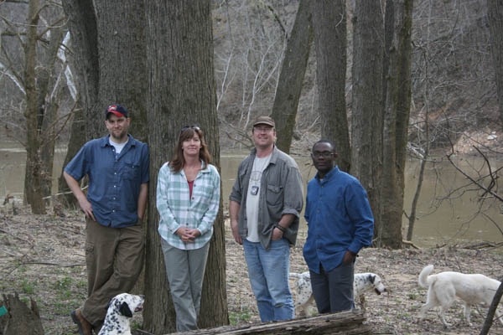
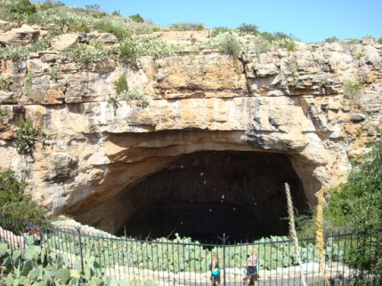
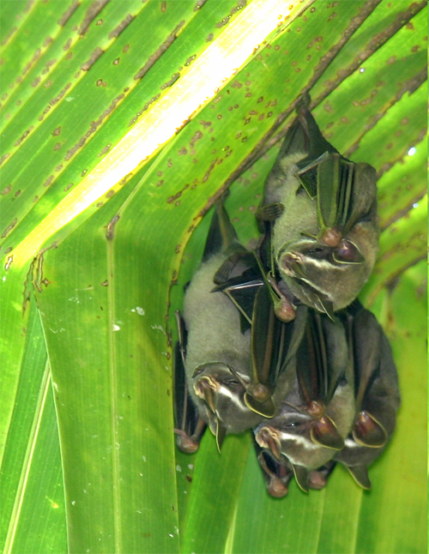
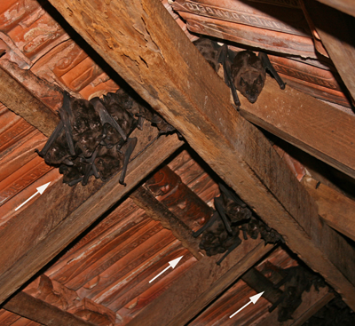
Graduate Research with Dr. Dick contact me if you are interested in research
Mr. Matthew Buchholz with a deer mouse (Peromyscus maniculatus). Matt is working to understand relations between rodents, ectoparasites, and symbiotic bacteria
Abdomen of a newly discovered species of nycteribiid bat fly from Madagascar
Installing experimental bat houses at WKU’s Upper Green River Biological Preserve, Hart county, Kentucky
Our research shows that the type of roosts used by bats strongly influences the quality and quantity of their parasites. Such research also takes us to interesting places like Kenya, Ecuador, Borneo, and Puerto Rico!

Slide 16
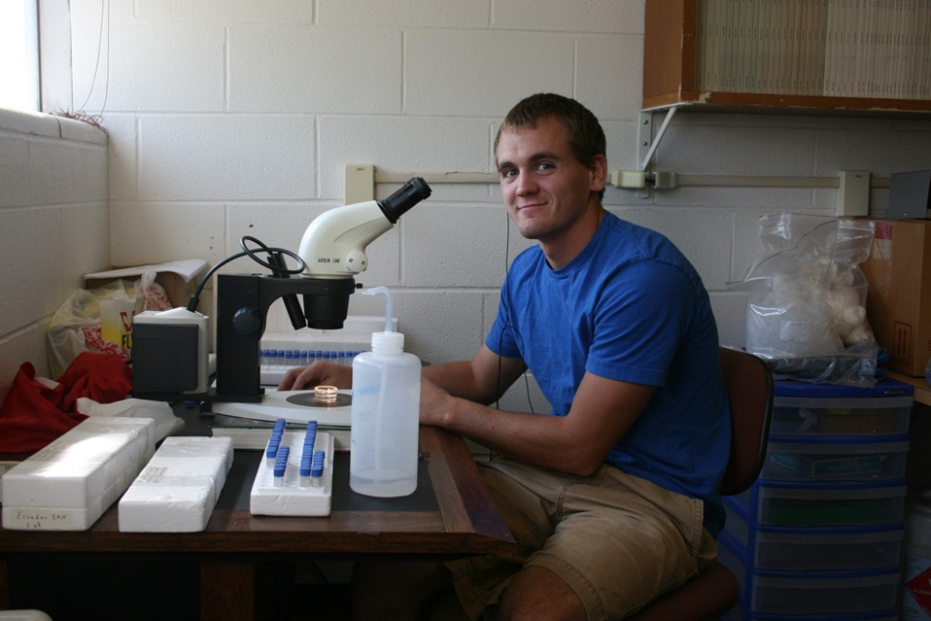
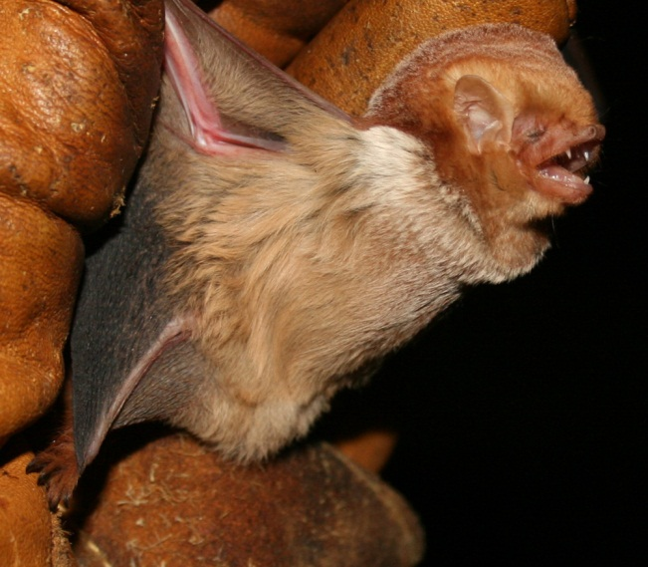
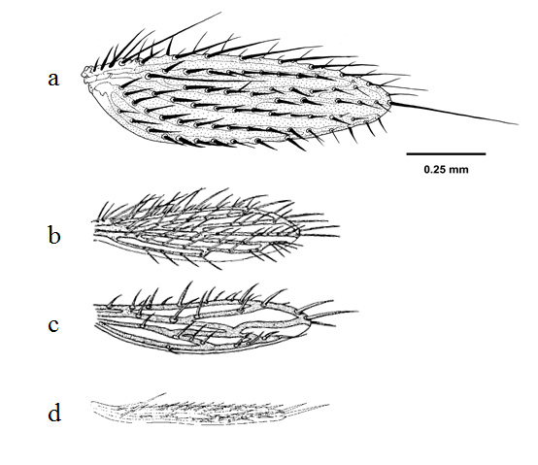
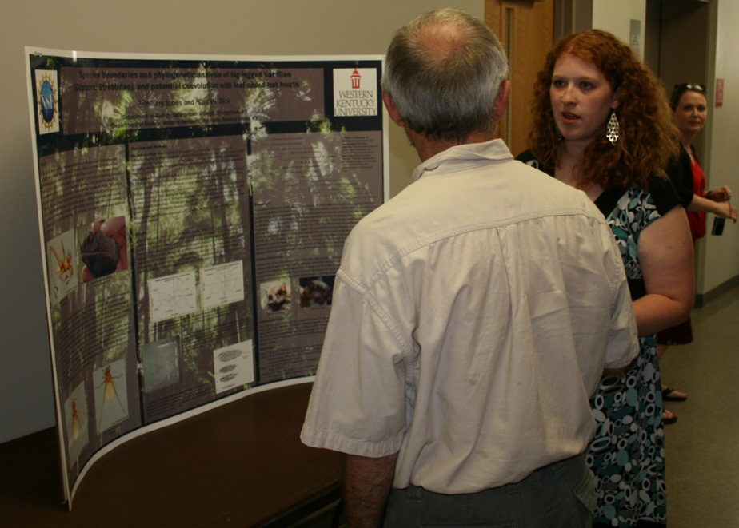
Undergraduate Research with Dr. Dick contact me if you are interested in research
Mr. Eric Stamper working on samples of parasites from bats of Ecuador
An insectivorous red bat (Lasiurus borealis) captured at WKU’s Green River Preserve
Bat flies are highly specialized parasites, with many interesting adaptations for living on bats. Shorter and narrower - an evolutionary trend in vestigial bat fly wings
Ms. Hillary Jones presenting results of her NSF-REU research project at Western Kentucky University

Slide 17
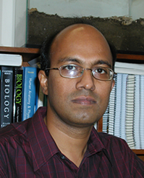
Chandrakanth Emani, Ph.D.
Associate Professor
Bio
B.Sc. - Genetics, Zoology, Chemistry, Nizam College, India, 1989
M.Sc. - Biochemistry, University of Pune, India 1991
Ph.D. - Plant Molecular Genetics, Osmania University, India, 1997
Courses
Bio 312 – Bioinformatics
Bio 327 - Genetics
Bio 350 – Introduction to Recombinant Gene Technology
Bio 399 – Research Methods in Biology
Bio 412 – Laboratory Cell Biology
Bio 447 – Laboratory Biochemistry
Bio 450 – Recombinant Gene Technology
Bio 495 – Molecular Genetics
Bio 496 – Plant Biotechnology
Research
Plant Genetic Engineering: Engineering sorghum and Indian beech for biofuel usage.
Plant Molecular Biology: Molecular basis of non-neuronal acetylcholine expression in bamboo
Molecular Evolution: Tracing the evolution of seed proteins and ribosomal domains in silico
Biology Education: Using episodic science history to educate the general public on scientific process and scientific thinking

Slide 18
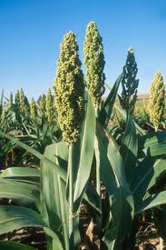
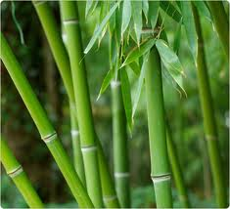
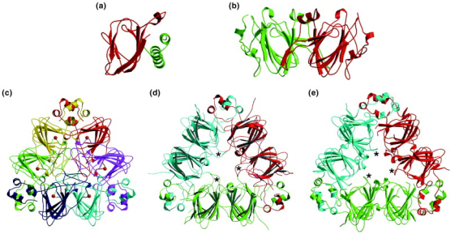
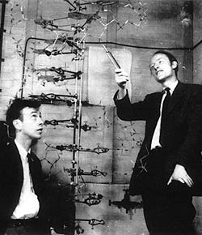
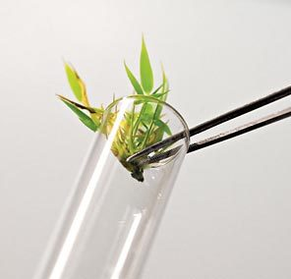
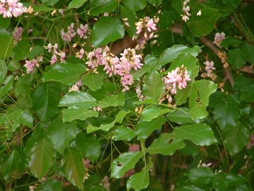
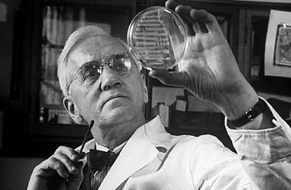
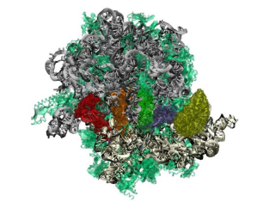
Research by Dr. Emani
Plant Genetic Engineering
Engineering sorghum with a cellulase gene from Acidothermus cellulyticus for biofuel usage
Plant Molecular Biology
Developing a genetic transformation system in bamboo to understand the molecular basis of non-neuronal acetylcholine expression
Molecular Evolution
Tracing the evolution of seed proteins for the cupin domains in silico to examine structural and functional features for nutritional improvement
Biology Education
Using episodic history in science to instill the scientific thought process in classroom and educating the general public about scientific method and scientific thinking
Engineering Indian Beech to manipulate oil content for biofuel and medicinal usage
Tracing the evolution of ribosomal domains in silico to understand the fundamental processes of the origin of RNA and Life

Slide 19

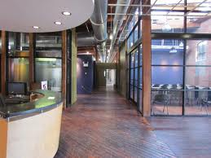
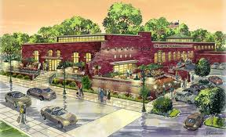
Graduate Research with Dr. Emani
Opportunities exist for graduate students to work in a research incubator setting at the Center for Business Research at Owensboro where Dr. Emani’s lab is housed
Students will have real-world experiences with biotechnology companies and labs within the research incubator
Research projects with Dr. Emani will be in the areas of plant genetic engineering in sorghum, bamboo and Indian beech, and plant molecular evolution involving bioinformatic analysis of seed proteins and ribosomal domains

Slide 20
Undergraduate Research with Dr. Emani
Angela Shouse (graduated, Spring 2011) – Molecular and epistemological basis of polycystic kidney disease by in silico analysis of the PKD-1 gene
Michael Alstott (graduated, Fall 2011) – The molecular evolution of plant cellulase genes
Joey Guinto (Senior, currently working in lab as a student researcher with the RCAP grant) – Assessing the genetics of asthma through in silico analysis of a cow and human G protein-coupled receptor for asthma susceptibility
Andrew Burkhalter (Senior) – Molecular evolution of a protein related to HIV
Joseph Early (Senior) – Genetic engineering of a GFP gene in soybean and examining the efficacy of dicot and monocot promoters
Kendall Wedding (Senior) – In silico analysis of a protein related to rheumotoid disease common to horses and humans
Chelsea Zingg (Senior) – A literature review on culturally significant botanicals and their biotechnological applications

Slide 21


Bio
Ph.D. – 1998, Biological Sciences, University of Pittsburgh
B.S. – 1990, Biology, Central Michigan University
Courses
BIOL 122 - Biological Concepts: Evolution, Diversity & Ecology
BIOL 224 - Animal Biology & Diversity
BIOL 316 - Evolution
BIOL 405 - Aquatic Insect Diversity
BIOL 497 - Aquatic Field Ecology
BIOL 505 - Aquatic Insect Ecology
Research
Biogeography, Conservation, Diversity & Systematics of Stonefly (Plecoptera)
Scott Grubbs, Ph.D.
University of Pittsburgh
Professor
Director, Center for Biodiversity Studies

Slide 22


Research in the Grubbs Lab
Stonefly biogeography, conservation, & diversity
example - Ohio stoneflies
Several species of stoneflies are now extirpated (= no longer present) from Ohio

Slide 23





Research in the Grubbs Lab
Current projects – updated October 2016
Stoneflies of the Appalachian Mountains, including projects in…
  Talladega Mountain region in Alabama
  Kentucky, Maryland, and West Virginia
  High peaks of North Carolina
Stoneflies of the Great Lakes region, including projects in…
    Michigan, Ohio, and Ontario
Big South Fork Cumberland River in eastern Kentucky
Black Mountains of North Carolina
Hurricane River in Michigan’s Upper Peninsula (view from Lake Superior)

Slide 24
Research in the Grubbs Lab
Stonefly systematics
I emphasize the use of scanning electron microscopy as a tool to study fine scale morphology
Example - important identification structure of six related species of Leuctra
Example - eggs of Perlesta teaysia from five eastern U.S. states

Slide 25




Research in the Grubbs Lab
Current projects – updated October 2016
Several systematic revisions, focusing mainly in eastern North America, including…
  Family Nemouridae
  Family Leuctridae
  Family Perlidae
SEM images showing variability in egg features of one widespread species of Acroneuria
SEM images comparing two closely-related species of Appalachian Leuctra
SEM images of a recently described species from the high Appalachian Mountains

Slide 26


Bio
Post-doctoral 2003 - UC Davis
Ph.D. 2003 - Florida Tech
B.S. 1996 - Western Michigan University
Courses
BIOL 122H Introductory Biology
BIOL 377 Animal Form and Function
BIOL 477 Marine Biology
Research
Functional Morphology, Skeletal Design and Performance, Predator/Prey Interactions, and Animal Behavior
My research examines the link between functional design and ecological utility in vertebrates. I use examinations of dissected carcasses, fully articulated skeletons, and animal behavior to better understand how evolution has shaped organismal design and performance. In my laboratory, we employ EMG's, high-speed video cameras, and pressure transducers to better understand the feeding mechanisms of fishes. In the field, we use SCUBA, rebreathers, portable high-speed video systems, and still-cameras to tease out the intricacies of specialized feeding performance by everything from pelagic species to reef species. My students and I have also worked on the biomechanics of mammal locomotion, tooth development and phenotypic plasticity in fishes, and communication in lizards. We use biomechanics, gross dissection, dermestid beetles, and behavioral observations to draw conclusions about what makes predators successful at doing what they do best -- catching and killing prey.
Steve Huskey, Ph.D.
Florida Tech
Associate Professor

Slide 27









Research by Dr. Huskey
Feeding Performance
in Fishes
Vertebrate Functional Morphology
Underwater High-Speed Cinematography
Barracuda
SCUBA & Rebreathers
Bull Shark
Grouper
Phenotypic Plasticity
in Fish Teeth

Slide 28



Graduate Research with Dr. Huskey
Sam Tegge
Nate Zbasnik
Biotremology in chameleons
Feeding competition in scorpionfishes

Slide 29




Undergraduate Research with Dr. Huskey
Chameleon Communication &
Behavior with Sydnie Gordon
Stingray Envenomation Behavior
with Ruth Hughes

Slide 30

Sigrid Jacobshagen, Ph.D.
Free University of Berlin
Professor
Courses
BIOL 400(G) Plant Physiology
BIOL/CHEM 446(G) Biochemistry I
BIOL/CHEM 446(G) on-line Biochemistry I
BIOL/CHEM 447(G) Biochemistry Laboratory
BIOL/CHEM 467(G) Biochemistry II
BIOL/CHEM 562 Advanced Biochemistry
Research
Research in my lab is concerned with the circadian clock. We are using the unicellular green alga Chlamydomonas as a model organism to study the circadian clock, because we can measure its daily rhythm of swimming towards light in an automated fashion. The rhythm is very similar to the daily sleep/wake cycle in humans. Projects in the lab center on the photoreceptor proteins that are able to reset the circadian clock using physiological, molecular, biochemical and cell biological techniques. We are also interested in understanding how the circadian clock regulates genes so that they show a circadian rhythm in their expression. A third interest is the use of mathematical equations to model the circadian clock.
Bio
Ph.D. - 1988 Plant Biochemistry, Free University of Berlin, Germany
M.S. - 1985 Biology, Justus-Liebig-University of Giessen, Germany

Slide 31

Research by Dr. Jacobshagen
How is the circadian clock reset after travel to a different time zone?
How does the circadian clock cause genes to be rhythmically expressed?
Can the circadian clock be modeled using mathematical equations?

Slide 32



Graduate Research with
Dr. Jacobshagen
Howton, Jonathan
Chittaloori, Madhu
Unicellular green alga Chlamydomonas
Swimming into light beam
Jonathan and Madhu handling
strains with manipulated genes
Time in constant conditions [h]

Slide 33


Undergraduate Research with Dr. Jacobshagen
Noelle Spooner
Strain 1
wild-type
Strain 2
Strains with
less of this
protein
Also less able
to reset their
clock?
Noelle testing whether the expression
of a gene was successfully manipulated

Slide 34

Courses
BIOL 122 Introductory Biology
BIOL 327 Genetics
BIOL 457 Herpetology
BIOL 524 Ecological Genetics
Research
Evolutionary Ecology, Population Genetics, and Conservation of Amphibians.
Research in my lab uses field and laboratory experimentation in conjunction with molecular genetic tools to understand local adaptation, speciation, and gene flow using amphibian species as models.
Our goal is to provide empirical data that are relevant to the conservation and management of amphibian populations while simultaneously improving our understanding of evolution and ecology in general.
Jarrett Johnson, Ph.D.
Associate Professor
Bio
Ph.D. - 2005 Evolution and Ecology, University of Missouri
B.S. - 1999 Ecology, Ethology, and Evolution, University of Illinois

Slide 35



Research by Dr. Johnson
California Tiger Salamander
Hellbender
Red Salamander
Notes:
I use field and laboratory experimentation in conjunction with molecular genetic tools to understand local adaptation, speciation, and gene flow using amphibian species as models. My goal is to provide empirical data that are relevant to the conservation and management of amphibian populations while simultaneously improving our understanding of evolutionary mechanisms in general.

Slide 36




Graduate Research with Dr. Johnson
Landscape Genetics = Understanding patterns of gene flow
Salamander hunting
Marbled Salamander (Ambystoma opacum)
Notes:
Current graduate research in the Johnson lab involves landscape genetics of the marbled salamander at Mammoth Cave Natl. Park. Landscape genetics identifies patterns of gene flow (red arrows) among breeding sites (blue dots), and correlates genetic structure with landscape attributes such as habitat composition and migratory barriers such as roads and rivers. These data are important for improving our understanding of appropriate methods for integrating human activities with the needs of forest-associated, pond-breeding amphibians.

Slide 37




Undergraduate Research with Dr. Johnson
Live Animal Lab Work
Molecular Lab Work
Field Work
Presenting Research
Notes:
Undergraduate opportunities in the Johnson Lab include laboratory experiments in evolutionary biology and molecular genetics and field experiences in Kentucky and beyond. Top left: Rearing of hundreds of salamander larvae in individual deli cups to understand the effects of hybridization on phenotypic evolution and viability; top right: Isolation of DNA from salamander tissues for amplification via PCR and genotyping in the Biotechnology Center; bottom left: seining for salamander larvae in ephemeral ponds for excision of tail tips for genetic analysis; bottom right: Student research presentation (Biotech REU).

Slide 38

Rodney King, Ph.D.
Medical College of VA,
VA Commonwealth Univ.,
Professor
Bio
Ph.D. Med. Coll. of VA, VCU
B.S. Virginia Tech
Courses
BIOL 212 Genome Discovery & Exploration
BIOL 226/227 Microbial Biology & Diversity
BIOL 407 Virology
BIOL 470 Pathogenic Microbiology
BIOL 568 Advanced Microbiology
Research
Bacteriophage Biology
Regulation of Transcription

Slide 39




Research by Dr. King
Research Interests:
Bacterial and Bacteriophage genetics
Bacteriophage biology
Control of transcription elongation and termination
Current Projects:
Identification and characterization of RNA based transcription antiterminators
Genomic analysis of Bacteriophages
Phage-host interactions

Slide 40



Graduate Research with Dr. King
Current Graduate Student:
Amanda Staples
Discovery, isolation and characterization of bacteriophages that infect Paenibacillus larvae, the causative agent of American Foulbrood Disease
Previous Graduate Students:
Amanda Seaton
Ali Wright
Chandrika Kunapuli
Maduri Janalagadda
Amanda Staples
Sequencing and annotation of bacteriophage genomes
Dr. King and Ali Wright

Slide 41



Undergraduate Research with Dr. King
Millie Ronkainen*
Olivia Urso
Amber Carroll
Courtney Hamilton*
Kimberly Baugh*
Sarah Schrader*#
Charles Coomer*#
*Honors Thesis
#Goldwater winners
Genome Discovery and Exploration

Slide 42


Bio
Ph.D. in Zoology – University of Oklahoma
M.S. in Biology – James Madison University
B.S. Biology – Towson State University
Courses
BIOL 122 Biological Concepts –
Evolution, Diversity & Ecology
BIOL 224 Animal Biology & Diversity
BIOL 456 Ichthyology
BIOL 458 Fisheries Management
Research
My research interests range from basic aquatic ecology to more applied fisheries management.
Recent projects:
Fish population management in reclaimed strip mines.
Effects of dams on stream fishes distributions.
Life history of introduced species.
Use of cave habitats by river fishes.
Trophic structure of springs and caves.
Population genetics of darters.
Catfish foraging.
Philip Lienesch, Ph.D.
University of Oklahoma
Associate Professor

Slide 43





Research in the Lienesch Lab
Aquatic Ecology
Fisheries Management

Slide 44



Graduate Research with Dr. Lienesch
Recent Students:
Fose, Jacob – reproduction in white bass.
Rupert, Derek –
Sportfish management in reclaimed strip mines.

Slide 45



Undergraduate research assistants get hands on experience with field and laboratory techniques.

Slide 46




Kerrie McDaniel, Ph.D
Assistant Professor
Education:
Ph.D-1997 Southern Illinois University
M.S. 1990 Western Kentucky University
B.S. 1988 Western Kentucky University
Courses Frequently Taught/Developed:
BIOL 113/114 General Biology for nonmajors
BIOL 131 Human Anatomy and Physiology
BIOL 231 Advanced Human Anatomy and Physiology
BIOL 303 Life Science for Middle School Teachers
BIOL 420 Introduction to Toxicology
BIOL 579 Mechanistic Toxicology
BIOL 493 Internship in Medical Technology

Slide 47












Research Interests (Undergraduate and Graduate):
Assessing Efficacy of pedagogical change in university classroom.
Evaluating e-text effectiveness.
Improvement of STEM education.
Promote experiences in Clinical Laboratory Science.
Outreach:
Making science fun, interesting, accessible and accurate for ALL learners!

Slide 48

Albert Meier, Ph.D.
University of Georgia
Professor
Bio
Ph.D. – University of Georgia
Courses
BIOL 315 Ecology
Research
Ecology, Biodiversity, and Conservation Biology.
Eastern Old Growth
Response of forest herbs to disturbance
Upper Green River Research
Systems Ecology and Network Analysis

Slide 49



Research by Dr. Meier
Ecology, Biodiversity, and Conservation Biology.
Eastern Old Growth
Response of forest herbs to disturbance
Upper Green River Research
Systems Ecology and Network Analysis

Slide 50

Keith Philips, Ph.D.
Professor
Courses
BIOL 122 Introductory Biology
BIOL 325 Insect Biodiversity
BIOL 285 Costa Rican Biodiversity
BIOL 522 Systematics + Evolution
BIOL 675 Coleoptera Evolution
BIOL 675 Insect Evolution
Research
Evolution and Diversity of the Insects, especially on beetles.
Bio
Ph.D. – Ohio State University

Slide 51


Insects – the most diverse and fascinating group on Earth
Sampling in threatened habitats
New species discovery
Phylogenetic analyses (molecular + morph. data)
Ecological studies of dung beetles

Slide 52





Current Projects
The Ghana and West Africa Insect Project
Evolution of cave beetles
Diversity + ecological studies of african dung beetles
Global diversity of spider beetles

Slide 53




Nancy Rice, Ph.D.
University of Tennessee, Health Science Center
Professor
Bio
Ph.D. – Biochemistry; University of Tennessee, Memphis
B.S. – Recombinant Genetics, Western Kentucky University
Courses
BIOL 120 Introductory Biology
BIOL 403 Molecular Basis of Cancer
BIOL 411 Cell Biology
BIOL 475 Medicine in Kenya
BIOL 560 Advanced Cell Biology
Research Interests
Mammalian cell signaling, transcriptional regulation of metabolic genes, and molecular epidemiology of chronic disease in developing countries

Slide 54


















Research by Dr. Rice
Genetic epidemiology of essential hypertension in Kasigau, Kenya
The role of nitric oxide signaling in pulmonary myofibroblasts
Transcriptional regulation of phosphorylase kinase genes

Slide 55







Opportunities to Study or Research Abroad with Dr. Rice
Partners in Caring: Medicine in Kenya
Opportunities to participate in service learning and /or independent research on the genetic epidemiology of hypertension in rural Kenya
Harlaxton, England
Biology in Harlaxton
  In 2016, the WKU Biology Department will begin offering courses at Harlaxton College in order to provide students with an opportunity to study abroad AND take courses in the biology MAJOR. Contact Dr. Rice for more information.

Slide 56

Claire Rinehart, Ph.D.
University of Georgia
Professor
Bio
Ph.D. - Botany/Biochemistry, University of Georgia, Athens, GA, 1984
M.S. - Botany/Plant Physiology, Brigham Young University, Provo, UT, 1979
B.S. - Microbiology, Brigham Young University, Provo, UT, 1977
Courses
BIOL 312 Bioinformatics
BIOL 350 Introduction to Recombinant Genetics
BIOL 450 Recombinant Gene Technology
BIOL 495 Molecular Genetics
BIOL 566 Advanced Molecular Genetics
BIOL 275 co-teach Genome Discovery and Exploration with Rodney King
Research
Bioinformatics
Application of genome analysis to discover genes that are differentially expressed and the metabolic and regulatory pathways to which they belong.
Genome sequencing and annotation.
Comparison of bacteriophage families to discover the functional design of their genomes.
In silico prediction of protein structure as an aid in discovering the protein's function.

Slide 57

Research by Dr. Rinehart
Assembly and annotation of functions on newly sequenced viral and bacterial genomes.
Developing and applying bioinformatics tools.
Correlating protein structure and amino acid properties with protein function.

Slide 58



Graduate Research with
Dr. Rinehart
Shrikant Pawar
Jitesh Tiwari
Microarray analysis of gene expression
Genome assembly is done at the WKU
High Performance Computing Center
Past students.

Slide 59





Undergraduate Research with
Dr. Rinehart
HHMI Genome Discovery &
Exploration
Spring 2010 phage explorers annotated
Wizard007and Backyardigan phages
Spring 2011 phage explorers annotated
BarrelRoll and Gemini mycobacteriophages
Clostridium scatologenes annotation teams took top honors at 2009 KAS

Slide 60

Shivendra Sahi, Ph.D.
Professor
Education
Ph.D. - North Carolina State University, Raleigh, NC
Teaching
BIOL 319/322 Molecular and Cellular Biology
Research
Plant Biotechnology and Plant Molecular Biology.
BIOL 496/496G Plant Biotechnology
M.S. - Laurentian University, Sudbury, Canada
B.S. - Gorakhpur University, India

Slide 61

Research
Plant Biotechnology and Plant Molecular Biology
Plant based synthesis of nanoparticles
Phytoremediation of heavy metals
Mass production of Algae for biofuel
Gene expression in plants in response to excess phosphorus & remediation
Biomedical application of plants

Slide 62
Tyler Gillenwaters: Using the UV Spectrophotometer to measure the presence of green synthesis silver nanoparticles
Undergraduate researchers use Electron Microscopy (TEM) to examine nanoparticle shapes and sizes.
Andi Esterle: Using the TEM to view and capture images of gold nanoparticles.
Andi Esterle: Presenting her research on Green Synthesis of Gold Nanoparticles in Nanotechnology Symposium.
Plant Based Synthesis of Nanoparticles

Slide 63
Gene Expression in Plants in Response to Excess Phosphorus and Remediation
Real Time PCR analysis of Zinc concentrations
Dr Sinilal Bhaskaran, Post Doc: Phosphorous nutrition and it’s application in phytoremediation
Real Time PCR
Gel
Genetic transformation of Medicago

Slide 64
Phytoremediation of Heavy Metals
TEM of Sesbania roots containing lead in the cells
Sahi et al. EST 36, 4676-4680, 2002
Monodisperse spherical gold particles in Sesbania roots. Sharma et al. 2007

Slide 65





Bruce A. Schulte, Ph.D.
Professor
Department Head of Biology
Bio
Doctorate of Philosophy - Biology (1993). State University of New York, College of Environmental Science and Forestry, Syracuse, NY.
M.S. - Biology. University of Southern California, Los Angeles, CA.
B.S. - Biology. College of William and Mary, Williamsburg, VA.
Courses
BIOL 113 General Biology
BIOL 315 Ecology
BIOL 334 Animal Behavior
BIOL 380 Challenges of a Changing Biosphere (Colonnade)
BIOL 532 Behavioral Ecology
BIOL 534 Chemical Ecology
BIOL 543 Environmental Science Concepts
Research
Communication and social behavior of herbivorous mammals, such as elephants, manatees, beavers and horses
Our research group examines the development of social and reproductive behaviors as well as the mechanisms, especially chemical that mediate these interactions. In recent years, we have taken more of a conservation behavior approach, as we work to reduce human-wildlife conflict by studying the behavioral ecology of these species, specifically their modes of communication, reproductive patterns and social systems. Thus, applications of our research hope to use an understanding of behavior to facilitate positive human-animal interactions.
CV and list of recent publications at website:
www.wku.edu/biology/

Slide 66









Research by Dr. Schulte
Human-wildlife interaction
Alaska
Kenya, South Africa, Zambia
Horse & Elephant & Beaver Behavior

Slide 67









Schulte Graduate Students
We have a real good time:
WKU MS Thesis Students
  Carly Sinderbrand, 2011. Examining dominance and stress relationship in a non-cooperative breeder, the domestic horse (Equus caballus).
  Maggie Wisniewska, 2011. Dominance hierarchy, leadership, behavioral traits, and reproductive states in female African savanna elephants (Loxodonta africana africana.
  Margaret Rose Hook, 2012. Effect of predation and competition risk on African elephant behavior based on age, sex, personality, reproductive status, and dominance rank
  Kelly Derham, 2014. Effectiveness of wire netting in reducing damage by african elephants (loxodonta africana) to marula (sclerocarya birrea), knobthorn (acacia nigrescens), and false marula (lannea schweinfurti) in the Associated Private Nature Reserves, South Africa.
  Sarah Goodyear 2015. Habituation to auditory stimuli by captive African elephants (Loxodonta africana).
  Charlotte Hacker, 2015. Examination of enrichment using space and food for African elephants (Loxodonta africana) at the San Diego Zoo Safari Park.
  Chase LaDue, 2016. Chemical signaling in Asian elephants (Elephas maximus): concentration effects with applications for management and conservation
  Emily McIntre, 2010-present. Elephant leadership and personality in response to conspecific cues.
  Rebecca Lynn von Hagen, 2016—present. A Comparison of Mitigation Techniques Utilized to Alleviate Human Elephant Conflict (HEC) in the Kasigau Corridor, Kenya.
Carly and horse friend
Bowling Green, KY
Charlotte at SD Zoo Safari Park
Maggie and Maggie at World Cup, South Africa
Kelly in South Africa
Chase doing a bioassay
Sarah at Nashville Zoo
Emily in South Africa
Lynn in Kenya

Slide 68




Undergraduate Research with Dr. Schulte
Opportunities exist for undergraduates to work with graduate students locally and abroad
Research also can be conducted independently under tutelage of Dr. Schulte
Adam Edge in South Africa
Clouded Leopard
Nashville Zoo
Study by Meghan Ryckeley

Slide 69

Nilesh Sharma, Ph.D.
University of Bihar
Instructor
Bio
Ph.D. – University of Bihar
MS - Patna University
BS Honors - Patna University
Courses
BIOL 113 Gen Biology
BIOL 207/208 Gen Microbiology
BIOL 490 Plant Therapeutics
Biol 516
Research
Plant biotechnology
Nanotoxicology

Slide 70


Research by Dr. Sharma
My research interests include biosynthesis of nanomaterials such as gold/silver nanoparticles using plants and bacteria
Wide applications of nanomaterials cause concern for toxicity in living organisms. We investigate the effect of titanium and gold nanoparticles on the inflammatory response in mice model. The effect of Ti-nanoparticles on the growth and physiology of crop plants is also under investigation.
Au

Slide 71
Undergraduate/Graduate Research with Dr. Sharma
Pranav, Chandra: Completed his MS thesis “Efficacy of coconut oil on ulcerative colitis in mice” (2013)
Justin Pile completed his Honors Thesis “ Interventional effect of plumbagin on ulcerative colitis in mice model” - Published in J of Natural Products, 76, 1001-6, 2013
Cyrus Sadrinia (Honors college junior): working on “Does exposure of TiO₂ nanoparticles induce inflammatory cytokines and toxicity in mice?”
Paul Fleischmann (Honors Thesis): working on “Assessing phytotoxicity in selected food crops exposed to TiO₂ nanoparticles”
Ronald Strecker (Honors) presented “Inflammatory responses in mice exposed to nanotitania” in Annual Meeting of American Association of Immunologists, Hawaii, May 2013

Slide 72
Graduate non-thesis research with Dr. Sharma
Charity A. Jackson
Nanosilver in the Prevention and Treatment of Influenza
Mary Beth Ping
Food and Phytochemicals in Inflammatory Bowel Disease
Justin Pile (completed)
Inflammatory Colitis: Conventional & Plant therapeutics

Slide 73

Michael Smith, Ph.D.
University of Texas
Professor
Bio
Ph.D. 2001 Marine Science, The University of Texas at Austin
B.S., M.S. 1994, 1996 Zoology, Brigham Young University
Courses
BIOL 120 Introductory Biology
BIOL 335 Neurobiology
BIOL 545 Animal Communication
Research
Auditory Neurobiology and Bioacoustics of Fishes
Research in my lab uses electrophysiological, behavioral, molecular, and morphological analysis to understand processes related to hearing in teleost fishes.

Slide 74






Research in the Smith Lab
Auditory hair cell regeneration in zebrafish
Tonotopic organization of the fish ear
Electrophysiology to examine fish hearing loss
Sound production and hearing in suckermouth catfishes

Slide 75





Graduate Research with Dr. Smith
Julie Schuck examining hair cells under a fluorescent microscope and at a scientific conference in Denver.
Gopinath Rajadinakaran presenting his research on gene expression during auditory hair cell regeneration at a scientific conference in New Orleans.

Slide 76





Undergraduate Research with Dr. Smith
Dissection of the inner ear
Auditory brainstem response hearing tests
Brian Rogers examining the inner ear of a South American catfish.
Reagan Gilley performed hearing tests by measuring brain wave activity.
Mannie Webb in Hawaii at an Acoustical Society of America meeting.

Slide 77

Ajay Srivastava, Ph.D.
Associate Professor
Bio
Postdoctoral: HHMI, Department of Genetics, Yale University
Ph.D.: University of Alberta
Courses
BIOL 120 Introductory Biology
BIOL 327 Genetics
BIOL411 Cell Biology
BIOL 440 Developmental Genetics
Research
We use genetic tools available in the model organism Drosophila to better understand and dissect the underlying mechanisms of normal development and disease.
We are particularly interested in understanding the contributions of Extracellular Matrix to normal development and tumorigenesis.
Development of Drosophila wing is another area of my labs’ interest as this is an excellent model for organogenesis where various events that give rise to an adult structure can be studied.
Several projects spanning the domain of our interest are available for motivated students. I welcome enquiries!

Slide 78


RESEARCH IN THE SRIVASTAVA LAB
A novel protein (green) being expressed by invasive tumor (red) cells
Srivastava and Xu (Unpublished)
We use Drosophila to address problems in development and disease

Slide 79



Graduate/Honors Thesis Research in the Srivastava Lab
I currently have one Graduate Student and I am looking for motivated students to work on challenging biological problems.
The projects in the lab utilize molecular and genetic techniques to understand the mechanisms of development and disease.
We are specially interested in the contributions that the Extra Cellular Matrix (ECM) makes to normal development and tumor progression.
We have recently demonstrated the role of a protease in invasive behavior during the movement of Air Sac Primordium (ASP), an organ analogous to the human lung.

Slide 80


Graduate/Honors Thesis Research in the Srivastava Lab
Graduate Theses Completed:
Gillian Jones, Christopher Fields, Qian Dong, Mayank Kapadia
Graduate Theses in Progress:
Dane Flinchum, Sayo Aromiwura (JUMP), Nathan Powers (JUMP), Aref Ranjbar (JUMP)
Honors Theses Completed:
Jordan Olberding, Christopher Fields
Honors Thesis in Progress:
Enes Atici

Slide 81

Courses I currently teach
BIOL122 Honors Intro Biology—Evolution, Biodiversity and Ecology
BIOL131 Intro to Human A&P
BIOL232 Principles of Wildlife Ecology and Management
BIOL459 Mammalogy
BIOL 485 Field Biology: Conservation and Management of African Wildlife (in South Africa, see http://bioweb.wku.edu/Africa/)
BIOL518 Population Ecology
BIOL519 International Wildlife Management and Policy (online only)
Research questions
What role do rodents play in structuring their habitats in African savannas?
Can we develop nonlethal means of reducing crop predation by large, wild mammals on African farms? (funded by NSF)
http://txchnologist.com/post/75792553109/can-ipod-powered-scarecrows-protect-africas-farms
Can existing social-psychological models be applied to developing effective indigenous wildlife conservation efforts?
http://www.ecologyandsociety.org/vol18/iss4/art40/ES-2013-5837.pdf
Michael Stokes, Ph.D.
Professor
Bio
Ph.D. – Systematics and Ecology (1994). University of Kansas
M.A. – Systematics and Ecology (1990). University of Kansas
B.S. – Biology (1986). University of Missouri Kansas City

Slide 82


My life is fun, Part I--Student Research
Recent Honors Thesis Students at WKU
  Rachel Beyke studied influences of traffic patterns and human dwellings on black rhino movements
  Brooke Barber and Whitney Walker examined potential roles of South African rodents as predators on trees of conservation concern. We work on Balule Nature Reserve in the Greater Kruger Park
APNR

Slide 83


My life is fun, Part II – advancing internationalization
  Western Kentucky University is …a leading American university with international reach.
  We are preparing for the campus International Year of South Africa in 2015, during which I’ll lead a group of 11 faculty on an academic exploration of South Africa.
  http://www.wku.edu/zseifs/programinfo_southafrica.php

Slide 84



My life is fun, Biology 485
If you’re lucky, you get to teach about the sorts of things you’d do for fun anyway. I’m lucky.
Biology 459 is all about the most excellent of all organisms, mammals.
Biology 485 is where my students get to do stuff you see on TV. Catch big animals, chase stuff from a helicopter, wrestle buffalo.
My Biol485 class retrieving an errant lioness
My classroom, South Africa

Slide 85

Deborah Weisberger
Associate Professor, Biology
Education
Bachelor of Science in Zoology
  University of Louisville, Louisville, Kentucky
Master of Science in Biology
  Western Kentucky University, Bowling Green, Kentucky
Courses Taught
BIOL 113-General Biology
BIOL 114-General Biology Lab
BIOL 131-Anatomy and Physiology
BIOL 121-Biological Concepts 1 Lab
BIOL 207-General Microbiology
BIOL 208-General Microbiology Lab

Slide 86

Robert Wyatt, Ph.D.
University of Georgia
Associate Professor
Courses
BIOL 120 - Biological Concepts: Cells Metabolism & Genetics
BIOL 319/322 Intro to Cell & Molecular Biology
Research
My research interests revolve around genome-wide studies of gene expression and its relationship to specific plant traits and environmental adaptations.
I use Next-Gen Sequencing techniques and bioinformatics to investigate transcription profiles of plants under various conditions in order see which genes are being utilized and connect this back to the biology of the plant.
I also have an interest in the availability of culturally specific fruits and vegetables in retail food stores
And a basic interest in tropical plants
Bio
Ph.D. - Plant Science, University of Georgia 1992
B.S. With honors – Biology, Indiana University 1986

Slide 87




Research with Dr. Wyatt
Current projects:
1. Use Next-Gen Sequencing to examine gene expression in four different types of Bromeliads. The Bromeliaceae family is ideal for studying drought-adaptations in plants particularly because of the large variation in adaptations found between species. Results from this study should provide knowledge on mechanisms for survival in dry environments and provide a framework for future biotechnology projects.

Slide 88




Research with Dr. Wyatt
Current projects:
2. Although the importance of culture in shaping individual dietary behaviors is well-documented, cultural food preferences have received limited attention in research in the food environment. This study will assess the availability of culturally specific fruits and vegetables in retail food stores located in Bowling Green KY.

